Slide 1
SC Overview 2013
White & Rouge
The Codes in Comparison
The Noise Issue
Convergence Test
Some latest Results
  PSB
  PS
  SPS

Slide 2
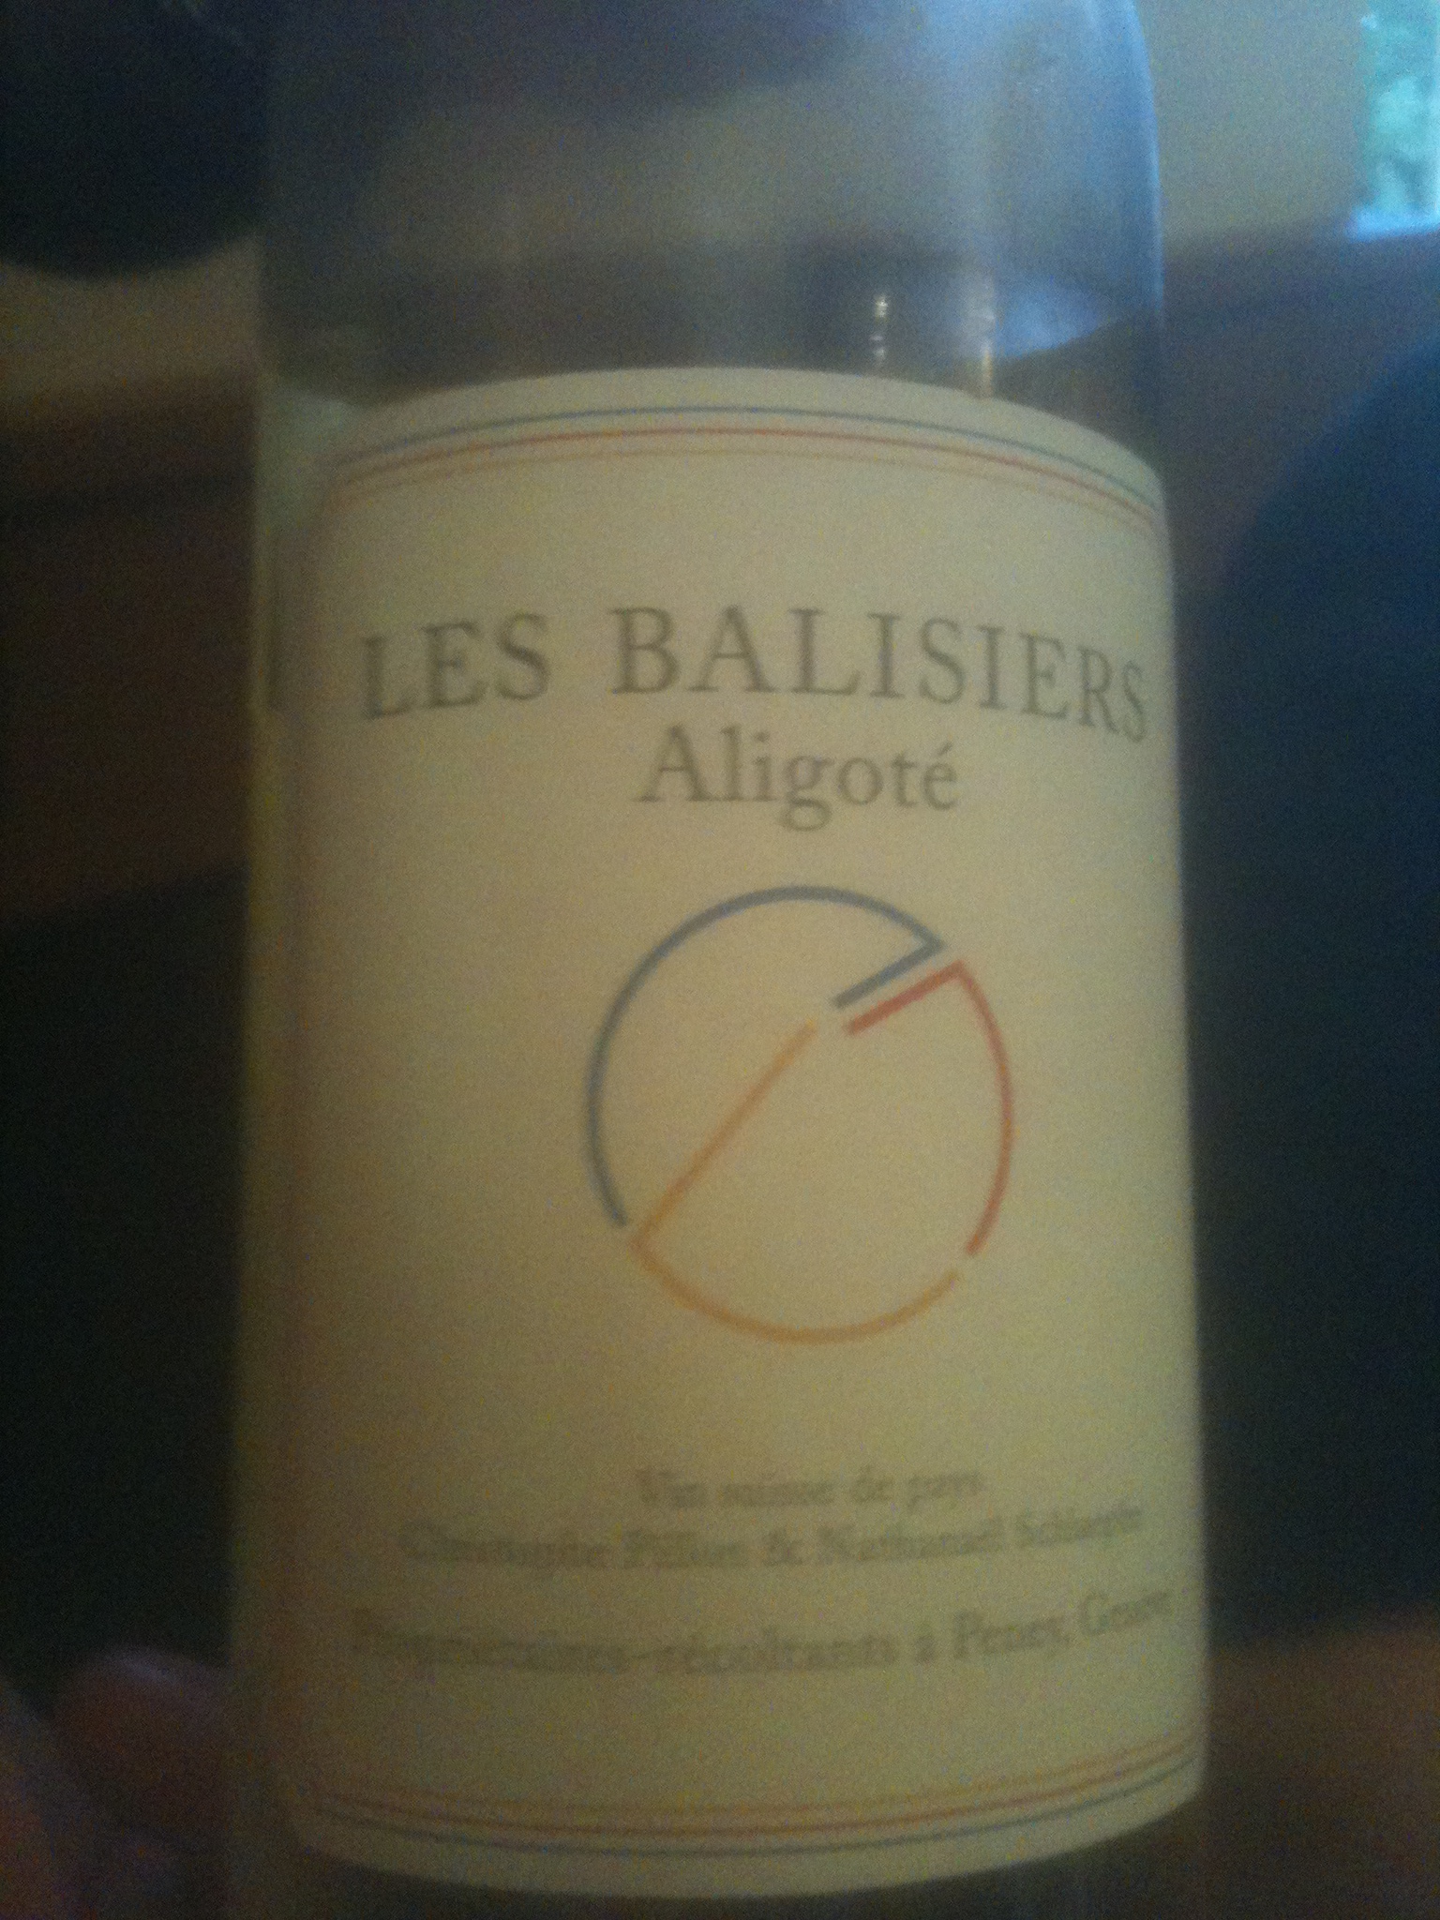

Slide 3
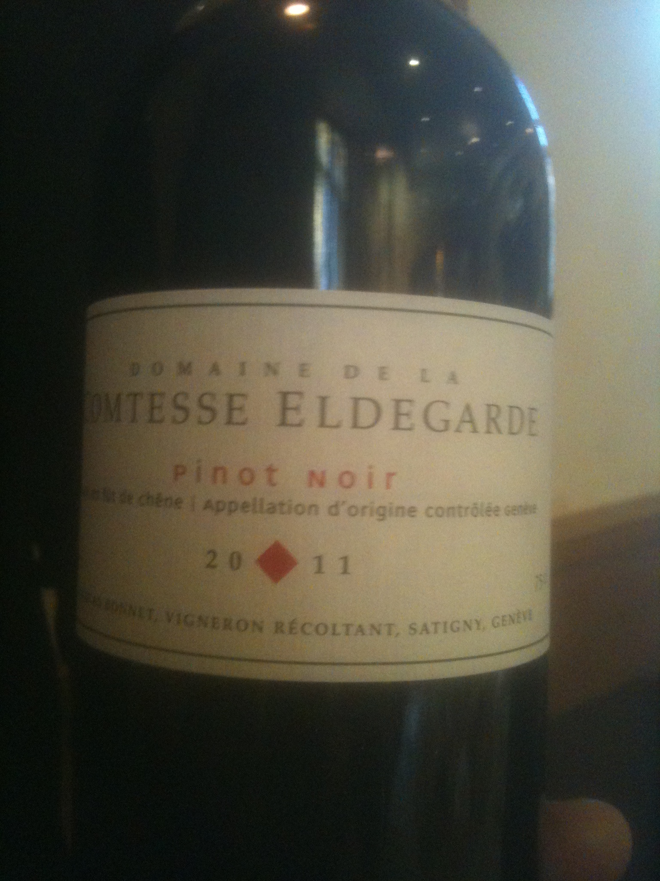

Slide 4
SC Codes in Comparison I
PIC codes
Selfconsistent Treatment
2D, 2.5D and full 3D, boundary
Inherently slow because many macro-particles to be tracked
Noisy, but “badness” effect still unclear
Sensitive to skewed particle distributions ➔ avalanche effects & with sudden loss
Best at injection with various short-term beam adjustments at injection
Frozen Model
Frozen “adaptive” at best
2D with some coupling via dispersion
fast
No noise
No un-physical avalanche effects
Good for long-term simulation after the initial injection complications

Slide 5
SC Codes in Comparison II
PIC codes
PTC-ORBIT (SNS), SYNERGIA (FERMILAB), IMPACT (LBL)
Frozen Model
MICROMAP (GSI), MADX-SC (CERN)
In both cases we have now to take into account advanced symplectic nonlinear dynamics codes that faithfully describe the linear lattice of our machines together with a good nonlinear model of the individual magnets. The codes uses well tested codes like MADX (CERN), PTC (KEK) and CHEF (FERMILAB). This is needed to evaluate the nonlinear resonances in conjunction with SC.
Detailed benchmarking in progress (example below)

Slide 6

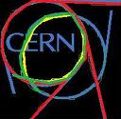
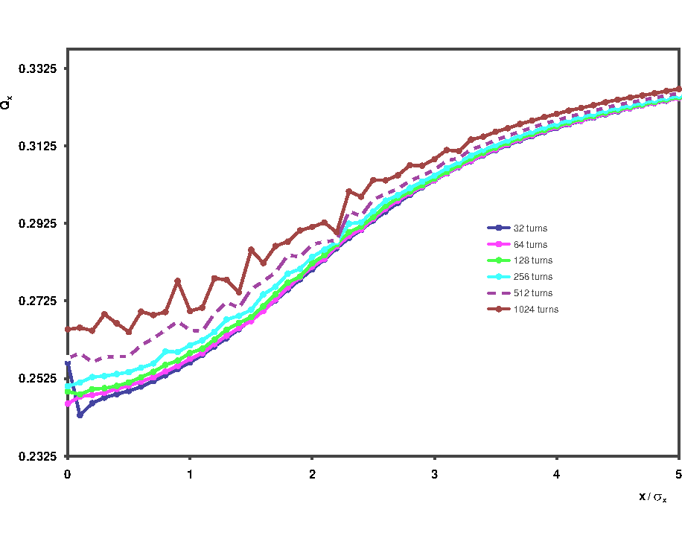
H-DETUNING PTC-ORBIT
NOISE 1/3

Slide 7
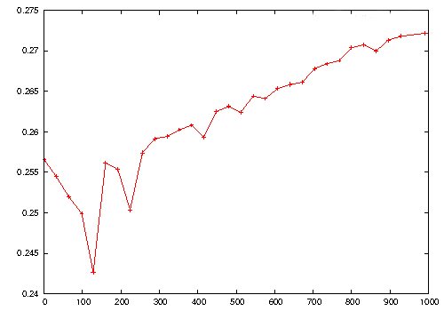
Tune Evolution PTC-ORBIT
NOISE 2/3
Qx
Turns

Slide 8
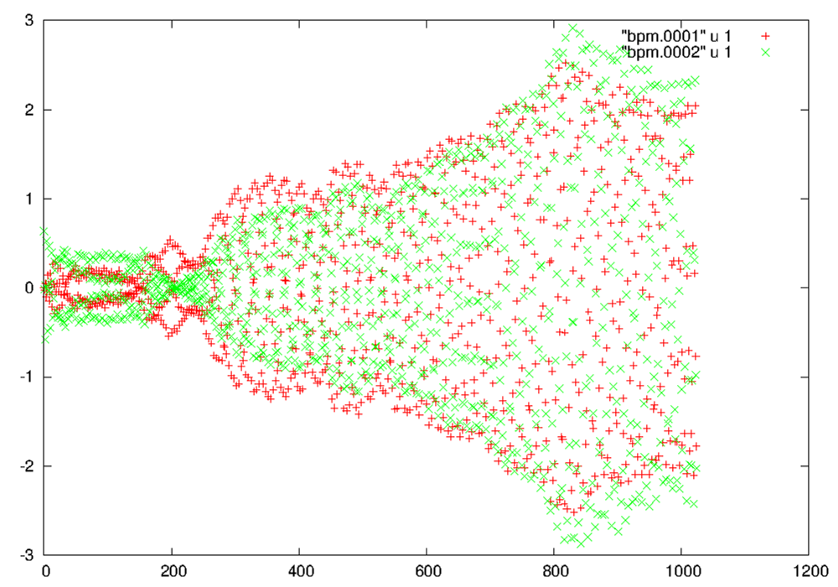
Amplitude blow-up PTC-ORBIT
NOISE 3/3
RED: zero Amplitude
GREEN: 0.1 sigma Amplitude
X [0.13σ]
Turns

Slide 9
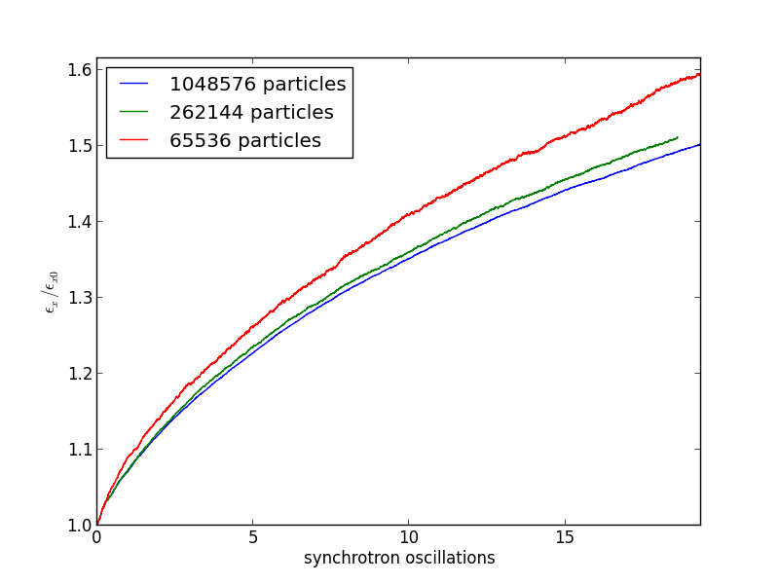
Convergence Test 1/3
Long-term Simulation
SYNERGIA
Preliminary

Slide 10
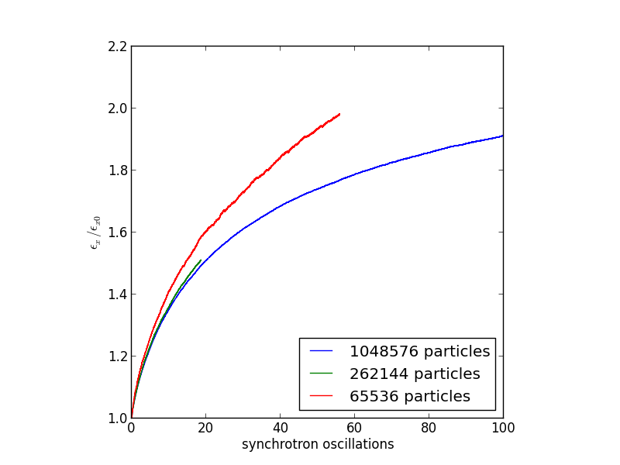
Convergence Test 2/3
Long-term Simulation
SYNERGIA
Preliminary
100’000
Turns

Slide 11
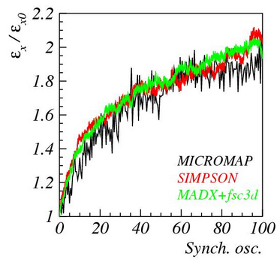
Convergence Test 3/3
SYNERGIA

Slide 12
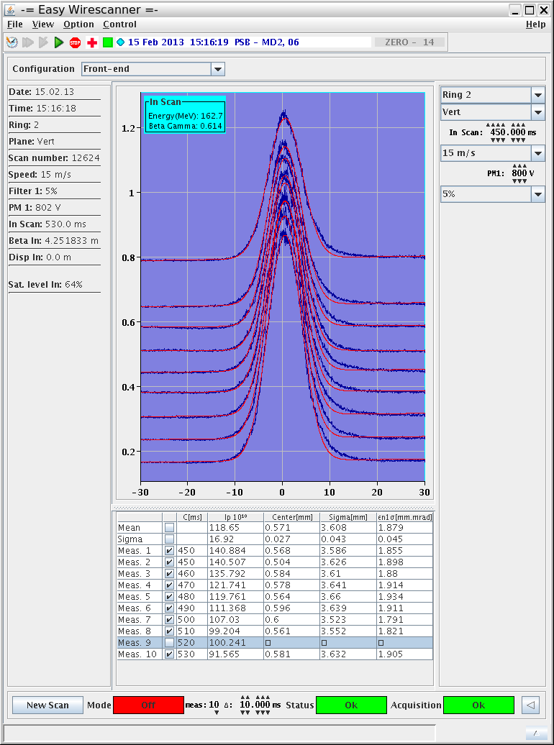
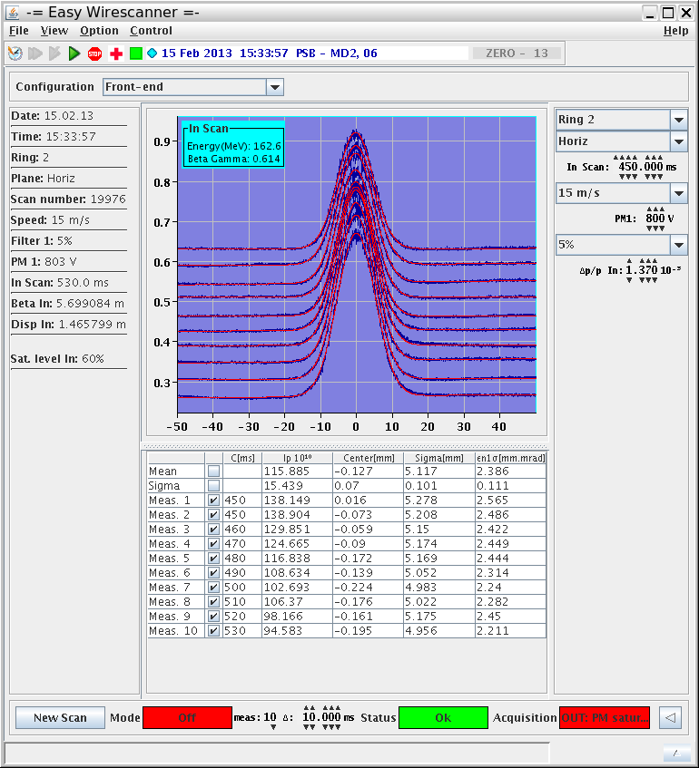
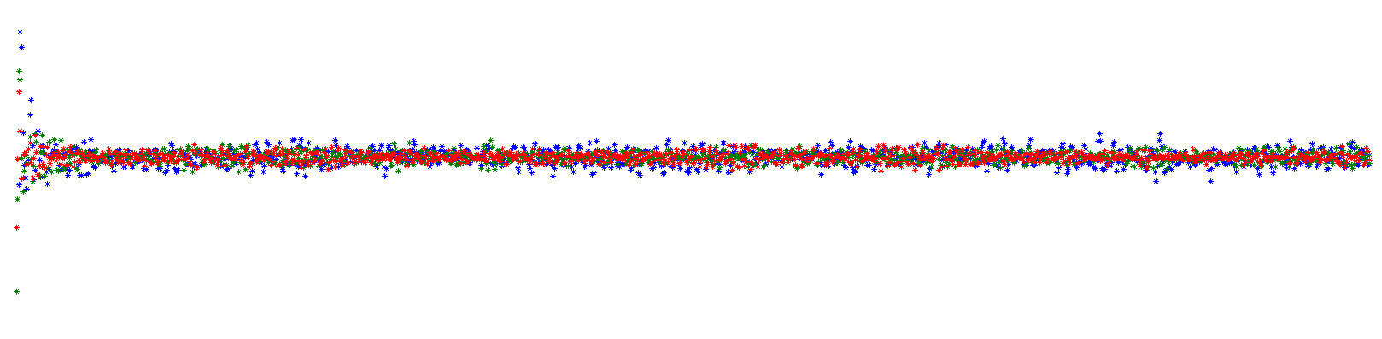


Measurements: half integer resonance crossing… (static w. point above 2Qy=9)
Transverse emittances constant
@ C450
(switching off
QNO correctors)
Nice case for code benchmarking (simulations are on-going)
Status of the space charge studies and measurements in the CERN PSB
Vincenzo Forte – Space charge workshop – CERN - 16/04/2012

Slide 13
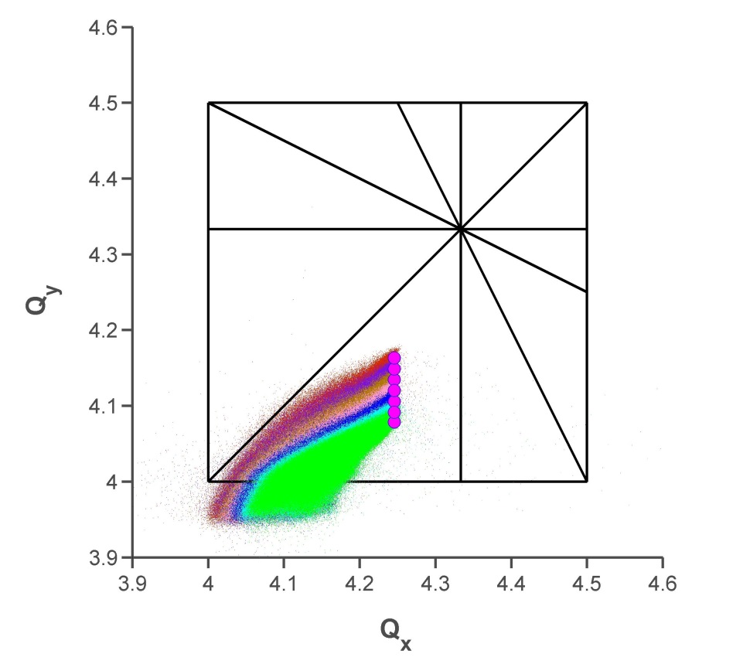
Space Charge studies in the PSB
Dynamic tune variation approaching the integer @ 160MeV
RMS emittances and losses evolution for:
  code benchmarking
  prediction of machine performances when Space Charge necktie crosses the integer (i.e large tune spread and/or low working point)
Simulations
Measurements
2Q_{y}=9
Q_{x}+2Q_{y}=13
Q_{x}-Q_{y}=0
3Q_{y}=13
Q_{x}=4
2Q_{x}+Q_{y}=13
3Q_{x}=13
Q_{y}=4

Slide 14
4th order Resonance
Maximum detuning due to space charge:
Beam 1 : (-.22 ; -.4)
Beam 2 : (-.18 ; -.37)
Beam 3 : (-.08 ; -.24)
Beam 4 : (-.01 ; -.01)
➔ The 4th order resonance seems to be excited by space charge
8
Raymond WASEF, Space Charge Workshop, 16/04/13, CERN

Slide 15
Resonance compensation
Horizontal tune scan
2Qx+Qy compensation
3Qy compensation

Slide 16
Resonance compensation
Vertical tune scan
2Qx+Qy compensation
3Qy compensation

Slide 17
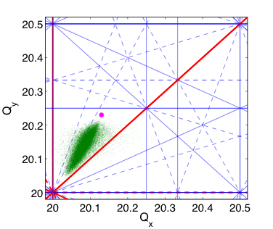
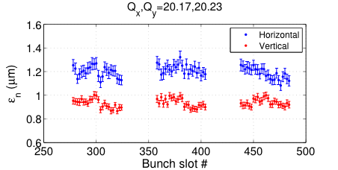
SPS space charge studies
Optimized working point for high brightness beam
  Incoherent tune spread from PTC-ORBIT simulation
  No emittance blow-up in measurements – same emittance for batches with different storage times
PTC-ORBIT simulation
Transverse emittance measurements
ΔQ_{x}≈0.10
ΔQ_{y}≈0.18
~11s
~7.5s
~4s
storage time at injection energy

Slide 18
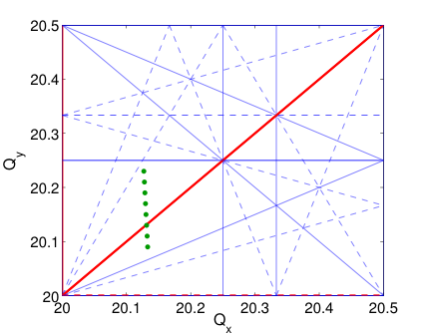
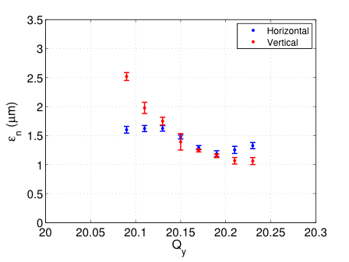
SPS space charge studies
Optimized working point for high brightness beam
  Incoherent tune spread from PTC-ORBIT simulation
  No emittance blow-up in measurements – same emittance for batches with different storage times
Experimental study: working point scan
  Emittance blow-up due to integer resonance for Q_{y}<20.20
Vertical tune scan
Emittance measurements
No blow-up

Slide 19
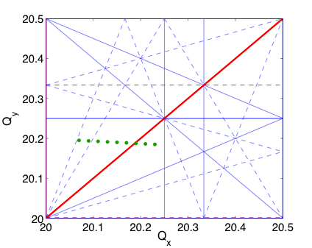
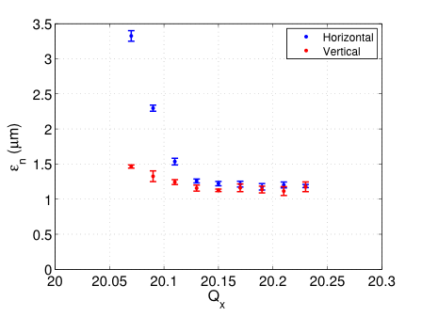
SPS space charge studies
Optimized working point for high brightness beam
  Incoherent tune spread from PTC-ORBIT simulation
  No emittance blow-up in measurements – same emittance for batches with different storage times
Experimental study: working point scan
  Emittance blow-up due to integer resonance for Q_{y}<20.20
  Emittance blow-up due to integer resonance for Q_{x}<20.12
Consistent with tune shift in simulations
Horizontal tune scan
Emittance measurements
No blow-up

