Slide 1
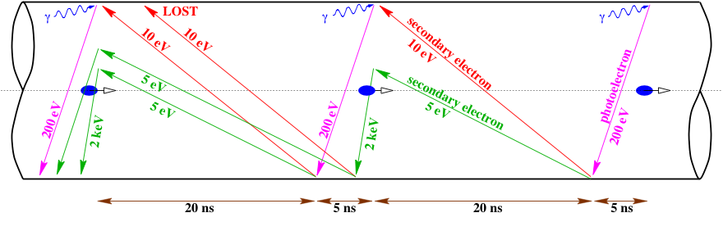
Physics of electron cloud build up
Principle of the multi-bunch multipacting.
No need to be on resonance, wide ranges of parameters allow for the electron cloud formation

Slide 2
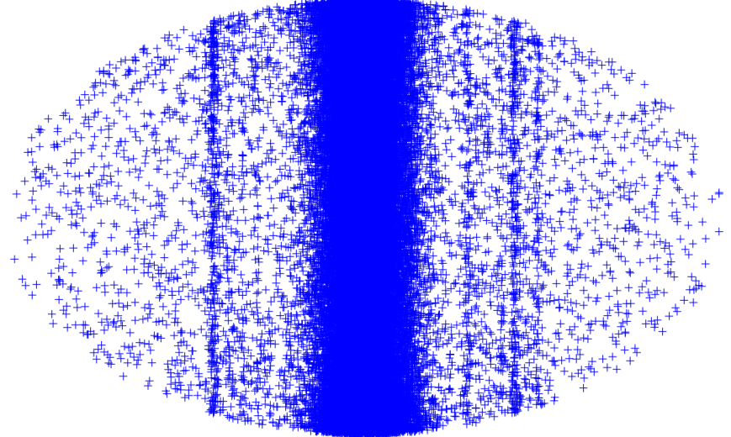
Electron cloud simulations
Multi-bunch beam
s
Noise
Equations of motion of the beam particles
Primary and secondary electron production, chamber properties
E-cloud build up
x
y

Slide 3
Electron cloud simulations: splitting the problem
Multi-bunch beam
One turn
s
Single bunch
Several turns
Noise
Equations of motion of the beam particles
Primary and secondary electron production, chamber properties
E-cloud build up
x
The instability problem
The build up problem
y

Slide 4

Electron cloud build up simulation (PyECLOUD)
t=t+Δt
Generate seed e⁻
  PyECLOUD is a 2D macroparticle (MP) code for the simulation of the electron cloud build-up with:
  Arbitrary shaped chamber
  Ultra-relativistic beam
  Externally applied (uniform) magnetic field
Evaluate the electric field of beam at each MP location
Evaluate the e⁻ space charge
electric field
Compute MP motion (t->t+Δt)
Detect impacts and generate secondaries

Slide 5
Electron cloud build up simulation
t=t+Δt
Generate seed e⁻
Evaluate the electric field of beam at each MP location
  Evaluate the number of seed e⁻ generated during the current time step and generate the corresponding MP:
  Residual gas ionization and photoemission are implemented
Evaluate the e⁻ space charge
electric field
Compute MP motion (t->t+Δt)
Detect impacts and generate secondaries

Slide 6
Electron cloud build up simulation
t=t+Δt
Generate seed e⁻
Evaluate the electric field of beam at each MP location
  The field map for the relevant chamber geometry and beam shape is pre-computed on a suitable rectangular grid and loaded from file in the initialization stage
  When the field at a certain location is needed a linear (4 points) interpolation algorithm is employed
Evaluate the e⁻ space charge
electric field
Compute MP motion (t->t+Δt)
Detect impacts and generate secondaries

Slide 7
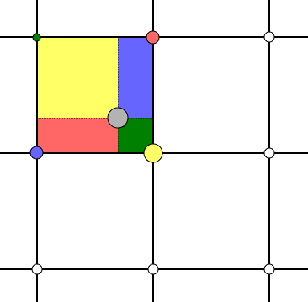
Electron cloud build up simulation
t=t+Δt
Generate seed e⁻
Evaluate the electric field of beam at each MP location
  Classical Particle In Cell (PIC) algorithm:
  Electron charge density distribution ρ(x,y) computed on a rectangular grid
  Poisson equation solved using finite difference method
  Field at MP location evaluated through linear (4 points) interpolation
Evaluate the e⁻ space charge
electric field
Compute MP motion (t->t+Δt)
Detect impacts and generate secondaries

Slide 8

Electron cloud build up simulation
t=t+Δt
Generate seed e⁻
Evaluate the electric field of beam at each MP location
  The dynamics equation is integrated in order to update MP position and momentum:
Evaluate the e⁻ space charge
electric field
Compute MP motion (t->t+Δt)
  When possible, “strong B condition” is exploited in order to speed-up the computation
Detect impacts and generate secondaries

Slide 9
Electron cloud build up simulation
t=t+Δt
Generate seed e⁻
Evaluate the electric field of beam at each MP location
  When a MP hits the wall theoretical/empirical models are employed to generate charge, energy and angle of the emitted charge
  According to the number of emitted electrons, MPs can be simply rescaled or new MP can be generated
Evaluate the e⁻ space charge
electric field
Compute MP motion (t->t+Δt)
Detect impacts and generate secondaries

Slide 10
Simulation of e-cloud build up: a sample result (LHC arc dipole)
Saturation
x 10⁹
Exponential rise
Decay
Several orders of magnitude covered during simulation, need to regenerate and redistribute macroparticles!

Slide 11
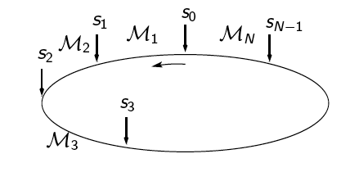
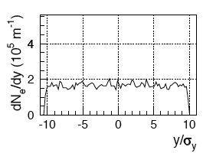
Beam instability simulation
(HEADTAIL)

Slide 12
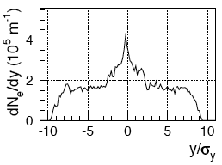
Beam instability simulation

Slide 13
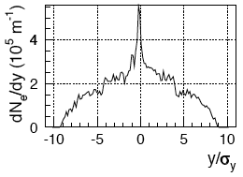
Beam instability simulation
The effect of the electron cloud on the beam becomes visible only after many turns
The electron cloud is refreshed at every interaction point
Slicing is renewed at every turn

Slide 14

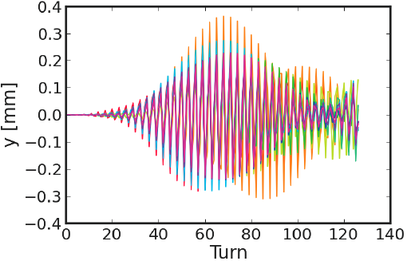
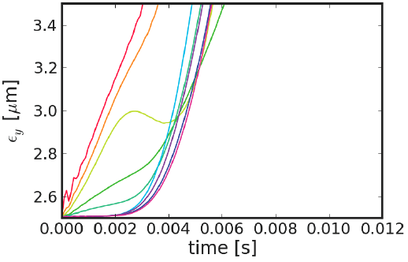
A sample result
Coherent instability of an LHC bunch under the effect of an electron cloud
Number of kicks per turn can be used
  for ‘lumping’ in a certain number of locations the action of a continuous electron cloud, or
  kicks represent real localized electron clouds in the accelerator
In case 1., if number of kicks per turn is too low, coherent motion may be turned into incoherent

Slide 15
Observables
The electron flux to the chamber wall Φ_{e} is revealed through
1) Pressure rise
Beam chamber
2) Heat load

Slide 16
Observables
The presence of electrons with density ρ_{e} around the beam causes
1) Beam coherent instabilities, single or coupled-bunch type, for the last bunches of a bunch train
Beam
2) Incoherent emittance growth, degrading lifetime, slow losses
Obviously, both Φ_{e} and ρ_{e} depend on the beam structure and on the surface properties, e.g. δ_{max}
→ From the evolution of the observables during scrubbing, we can infer the decrease of δ_{max} !

