Slide 1

Status of the PSB impedance model
C. Zannini and G. Rumolo
Thanks to: E. Benedetto, N. Biancacci, E. Métral, N. Mounet, T. Rijoff, B. Salvant

Slide 2
Overview
PSB impedance model
  Contributions
    Indirect space charge
    Resistive wall
    PSB extraction kicker including cables
    Transitions
  Summary
Other devices studied
  Vacuum chamber of the new H- region
  Finemet cavities
Future plans

Slide 3
Impedance calculations for β < 1
Analytical calculation (applies only to simple structures)
3D EM simulation (CST Particle Studio: never used for β < 1)
In the LHC, SPS, PS CST EM simulation are performed in the ultra-relativistic approximation (β = 1)
The use of 3D EM simulations for β < 1 has been investigated

Slide 4
3D CST EM simulation for β < 1
Depend only on the source
contribution due to the interaction of beam and external surroundings
  To single out the impedance contribution the direct space charge must be removed

Slide 5
Overview
PSB impedance model
  Contributions
    Indirect space charge
    Resistive wall
    PSB extraction kicker including cables
    Transitions
  Summary
Other devices studied
  Vacuum chamber of the new H- region
  Finemet cavities
Future plans

Slide 6
Indirect space charge
Analytical calculation based on the PSB aperture model (provided by O. Berrig)
[a, b, L, β_{x} , β_{y} , Apertype]_{i}
Rectangular pipe
Circular pipe
K. Y. Ng, Space charge impedances of beams with non-uniform transverse distributions
Elliptic pipe

Slide 7
Overview
PSB impedance model
  Contributions
    Indirect space charge
    Resistive wall
    PSB extraction kicker including cables
    Transitions
  Summary
Other devices studied
  Vacuum chamber of the new H- region
  Finemet cavities
Future plans

Slide 8
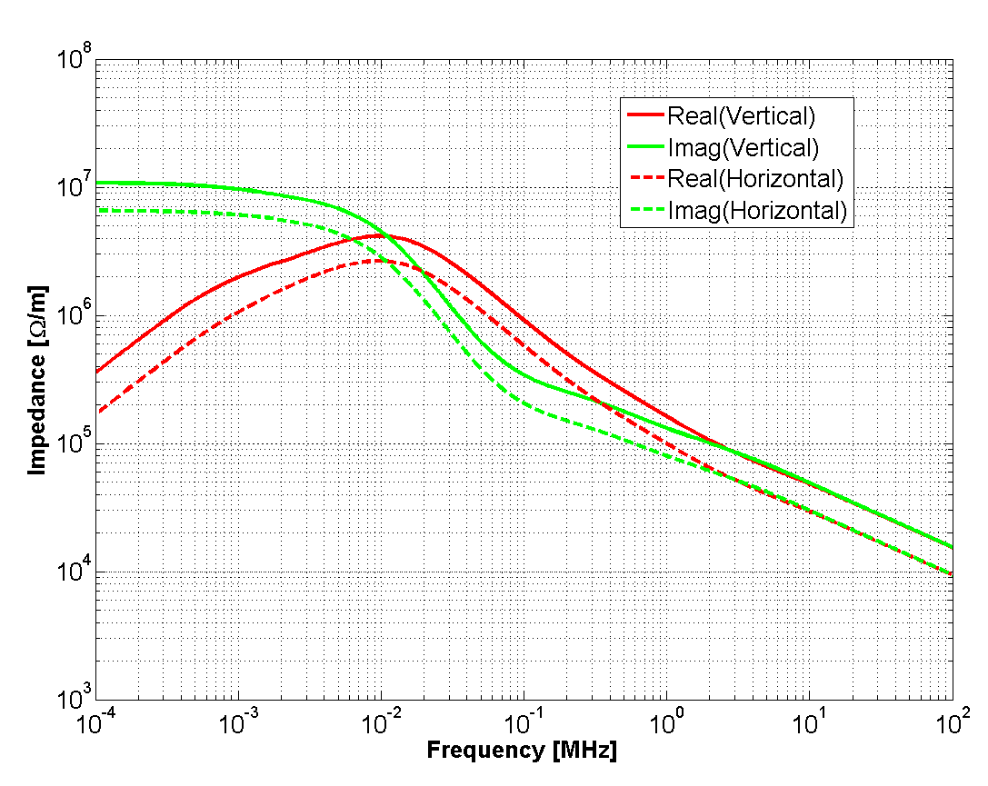
Resistive wall impedance
 | Wall thickness | Wall (σ_{el}) | Background material
Dipoles | 0.4 mm | 7.7 10⁵ S/m | Iron (silicon steel)
Quadrupoles | 1.5 mm | 1.3 10⁶ S/m | Iron (silicon steel)
Straight sections | 1 mm | 1.3 10⁶ S/m | Vacuum
Analytical calculation based on the PSB aperture model (provided by O. Berrig)
[a, b, L, β_{x} , β_{y} , Apertype]_{i}
Calculation performed with the TLwall code

Slide 9
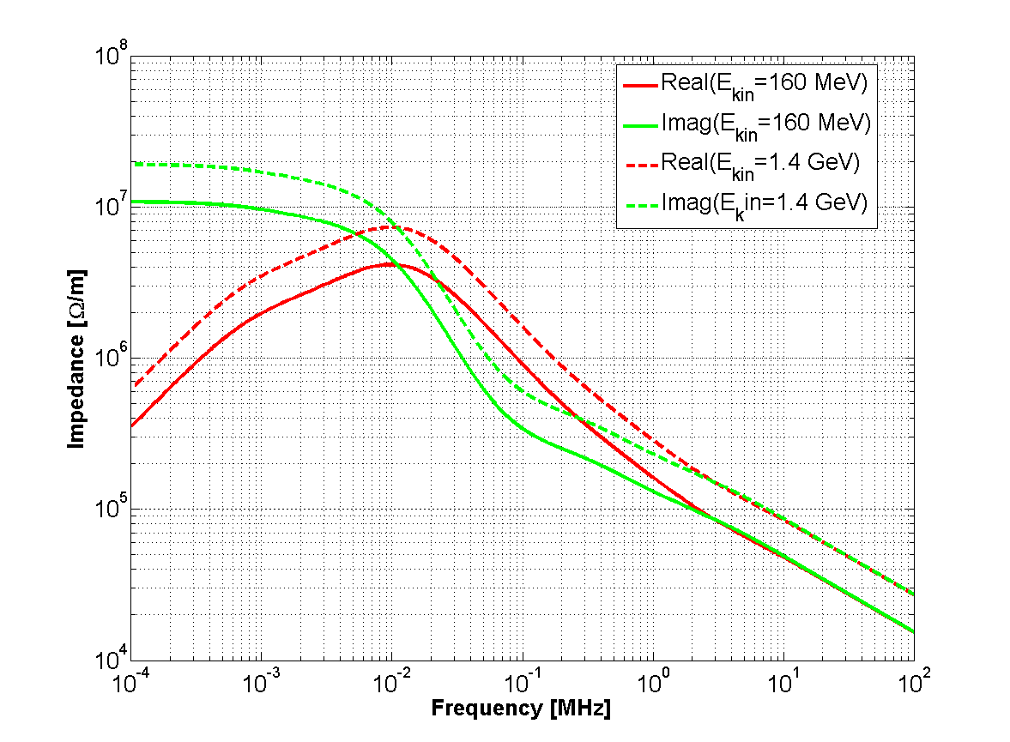
Resistive wall impedance
 | Wall thickness | Wall (σ_{el}) | Background material
Dipoles | 0.4 mm | 7.7 10⁵ S/m | Iron (silicon steel)
Quadrupoles | 1.5 mm | 1.3 10⁶ S/m | Iron (silicon steel)
Straight sections | 1 mm | 1.3 10⁶ S/m | Vacuum
Analytical calculation based on the PSB aperture model (provided by O. Berrig)
[a, b, L, β_{x} , β_{y} , Apertype]_{i}
Vertical
Calculation performed with the TLwall code

Slide 10
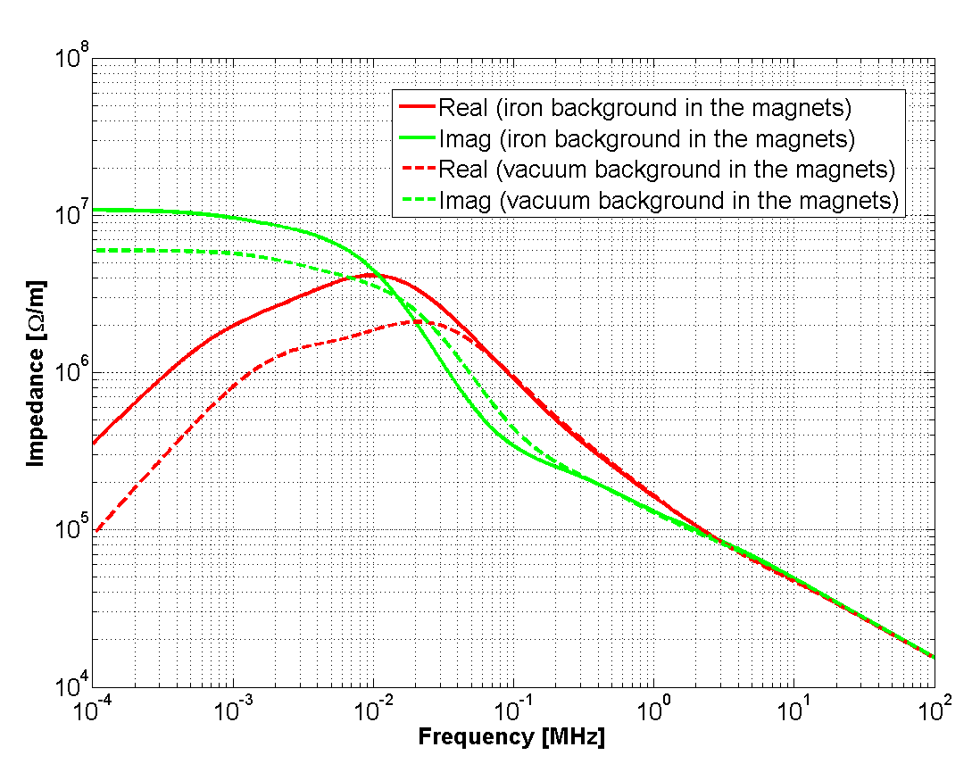
Resistive wall impedance: impact of the iron
Resistive wall vertical generalized impedance of the PSB

Slide 11
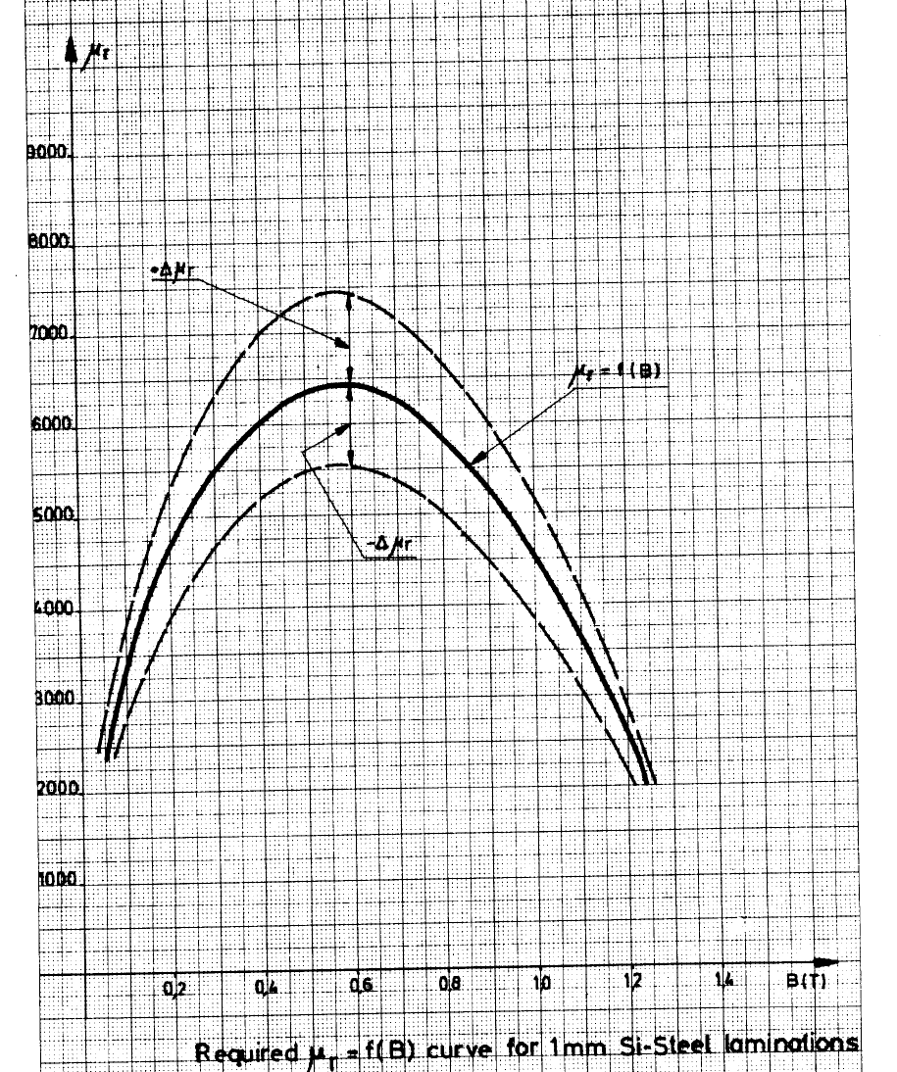
Resistive wall impedance
A. Asner et al., The PSB main bending magnets and quadrupole lenses, Geneva, April 1970.
f_{rel} = 10 kHz
K. G. Nilanga et al., Determination of complex permeability of silicon-steel for use in high frequency modelling of power transformers, IEEE TRANS. ON MAGNETICS, VOL. 44, NO. 4, APRIL 2008.

Slide 12
Overview
PSB impedance model
  Contributions
    Indirect space charge
    Resistive wall
    PSB extraction kicker including cables
    Transitions
  Summary
Other devices studied
  Vacuum chamber of the new H- region
  Finemet cavities
Future plans

Slide 13

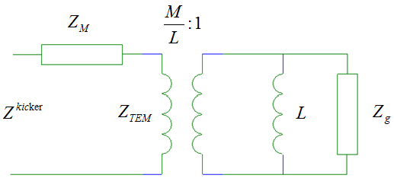
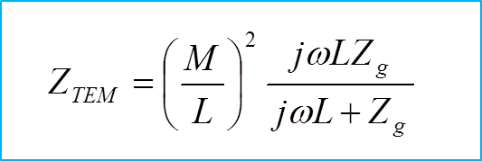
A theoretical calculation for the C-Magnet model
is the impedance calculated using the Tsutsui formalism
N. Wang, Coupling Impedance and Collective Effects in the RCS ring of the China Spallation Neutron Source, PhD Thesis, 2010.
N. Biancacci et al., Impedance calculations for simple models of kickers in the non-ultrarelativistic regime, IPAC11.
Constant horizontal impedance

Slide 14
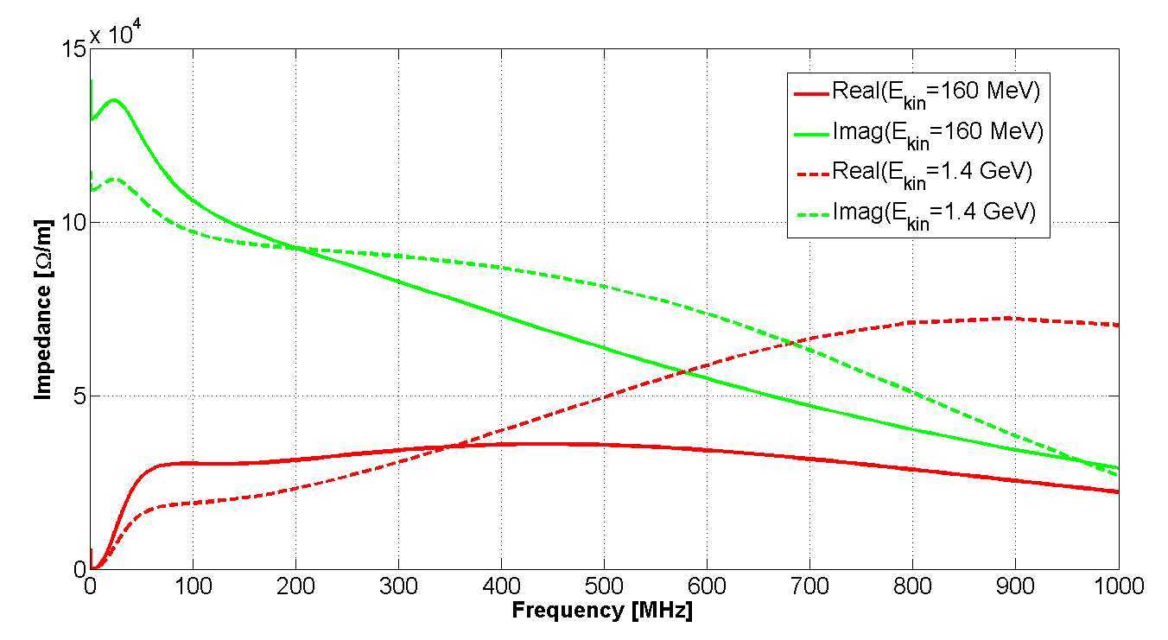
PSB extraction kicker: impedance due to the ferrite loaded structure Z_{M}
Vertical

Slide 15
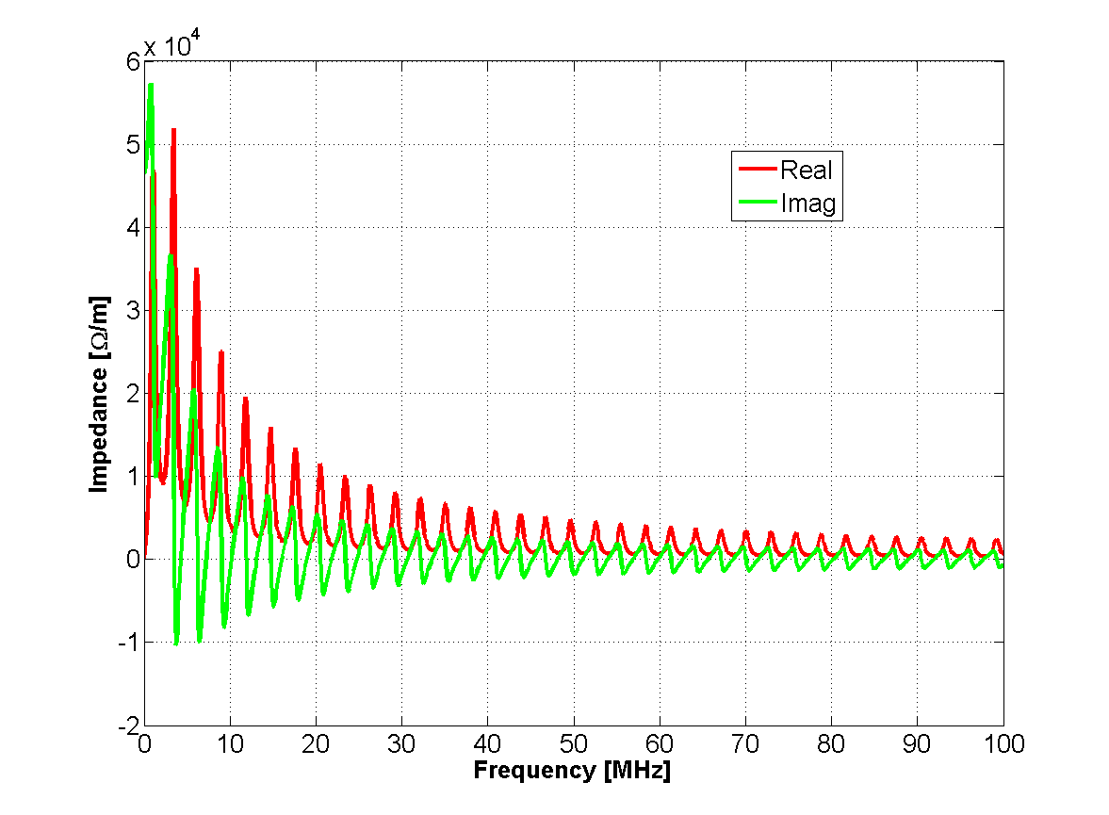
PSB extraction kicker: impedance due to the coupling to the external circuits Z_{TEM}
Horizontal
Cables in the open-short configuration

Slide 16
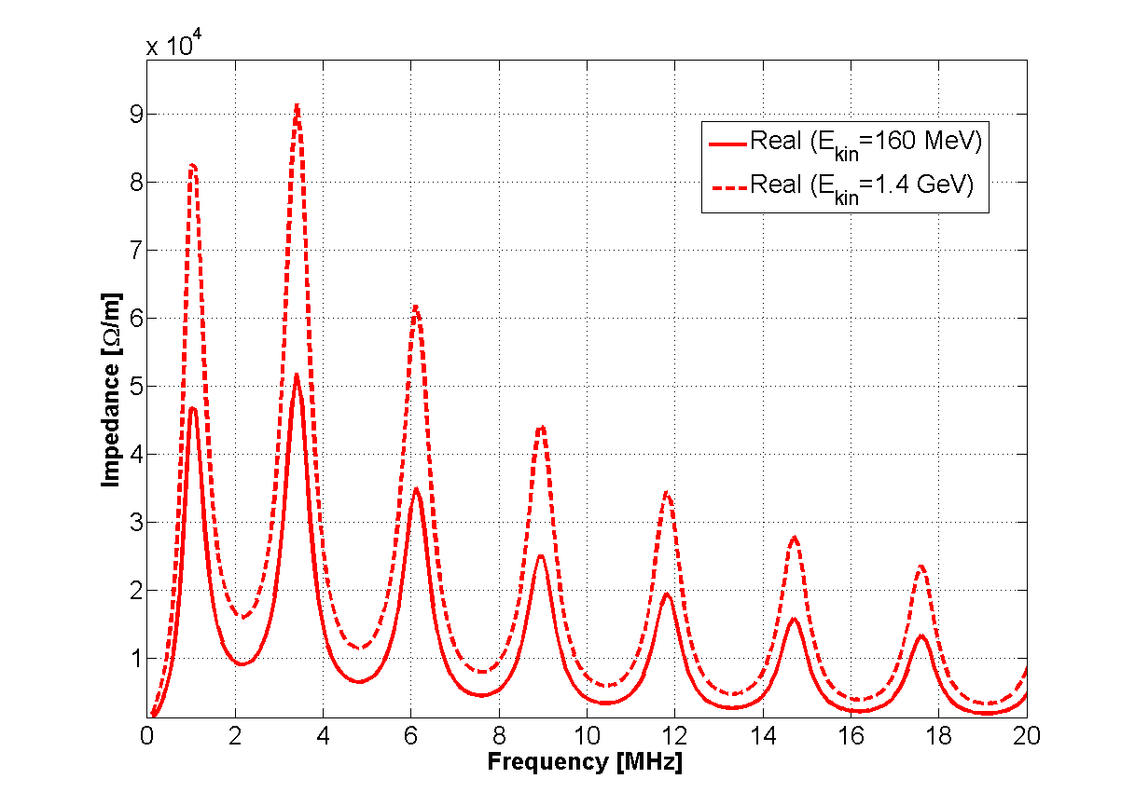
PSB extraction kicker: impedance due to the coupling to the external circuits Z_{TEM}
Horizontal
Cables in the open-short configuration

Slide 17
Overview
PSB impedance model
  Contributions
    Indirect space charge
    Resistive wall
    PSB extraction kicker including cables
    Transitions
  Summary
Other devices studied
  Vacuum chamber of the new H- region
  Finemet cavities
Future plans

Slide 18
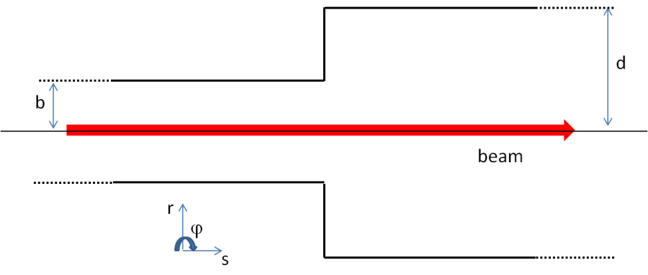
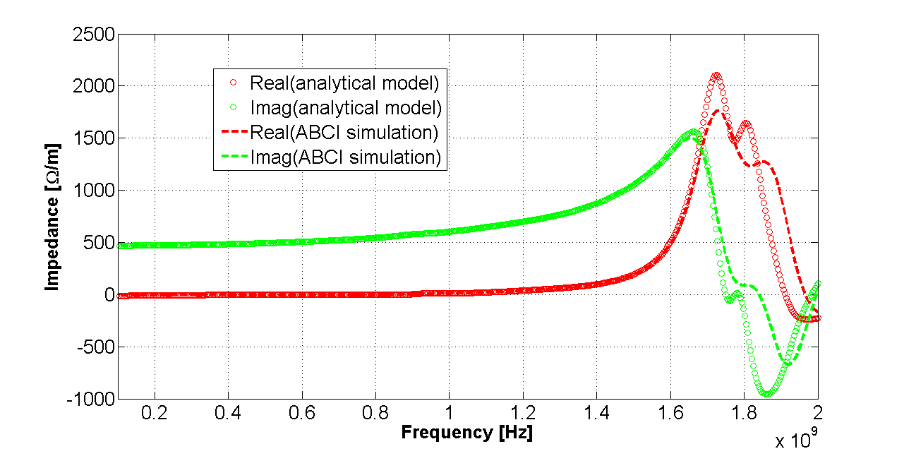
Broadband impedance of a step transition
Based on the results of 3D EM simulations, the broadband impedance contribution due to an abrupt transition is independent of the relativistic beta. Therefore, based on the aperture model, the generalized broadband impedance of the PSB transitions has been calculated as:
C. Zannini, Electromagnetic simulations of CERN accelerator components and experimental applications. PhD thesis, Lausanne, EPFL, 2013. CERN-THESIS-2013-076.

Slide 19
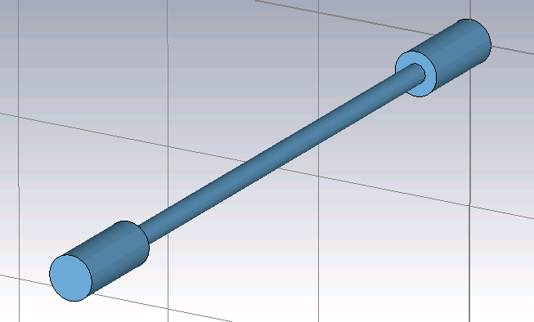
Broadband impedance of step transitions
L
Weak dependence on the relativistic beta and L

Slide 20
Overview
PSB impedance model
  Contributions
    Indirect space charge
    Resistive wall
    PSB extraction kicker including cables
    Transitions
  Summary
Other devices studied
  Vacuum chamber of the new H- region
  Finemet cavities
Future plans

Slide 21
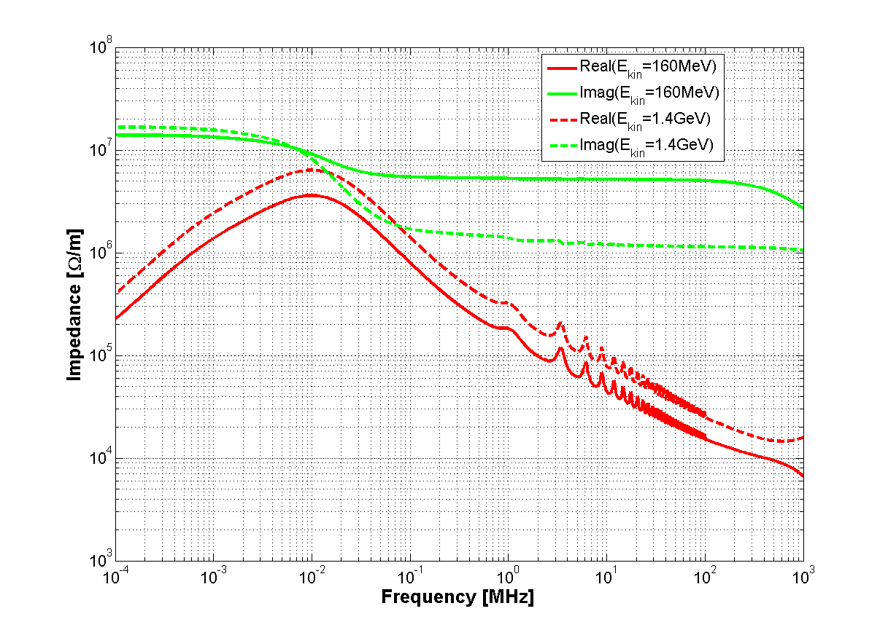
Total horizontal driving impedance of the PSB
E
E
Contributions of the extraction kicker due to the coupling with external circuits

Slide 22
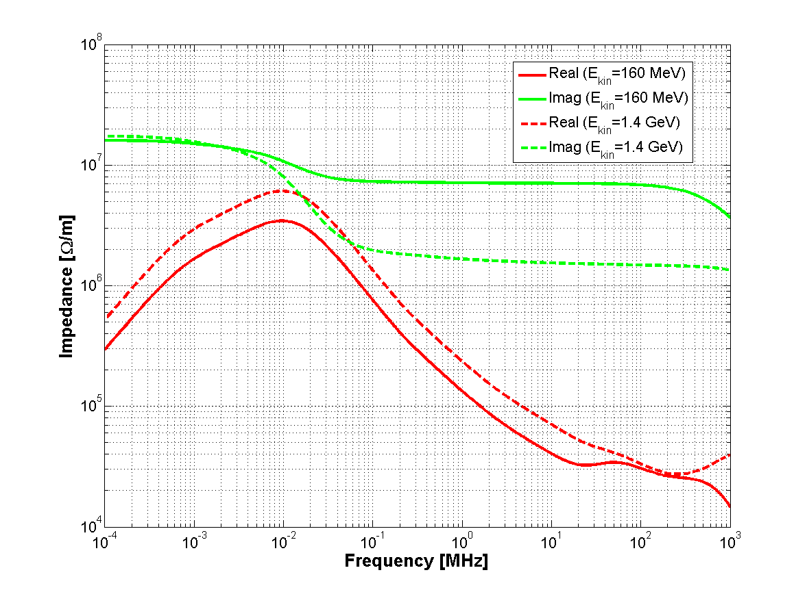
Total vertical driving impedance of the PSB
E
E

Slide 23
Effective impedance of the PSB
Z_{effx,y}[MΩ/m] | E_{kin}=160 MeV | E_{kin}=1.0 GeV | E_{kin}=1.4 GeV
Indirect space charge | 1.50/8.80 | 0.29/1.68 | 0.19/1.10
Kicker cables | 0.0084/0 | 0.012/0 | 0.0105/0
Kicker ferrite | -0.044/0.13 | -0.04/0.11 | -0.04/0.11
Steps | 0.53/0.63 | 0.53/0.63 | 0.53/0.63
Resistive wall | 0.03/0.05 | 0.04/0.07 | 0.04/0.07
Total (expected) | 2.03/9.62 | 0.83/2.49 | 0.73/1.91

Slide 24
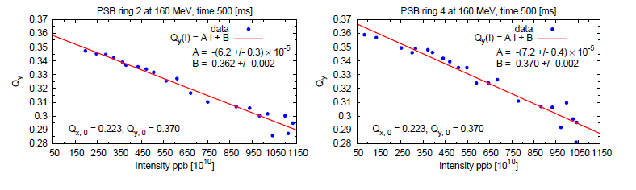
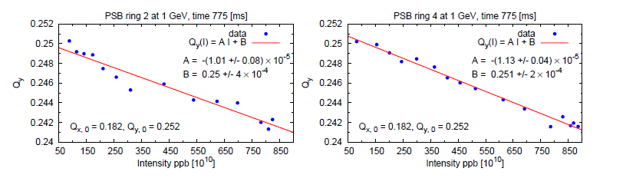
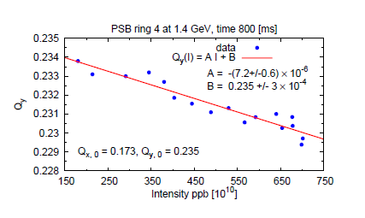
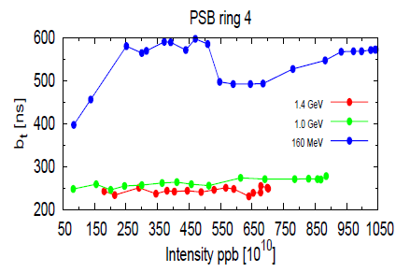
Measurement data
D. Quatraro, Collective effects for the LHC injectors: non-ultrarelativistic approaches. PhD thesis, Bologna, University of Bologna, 2011. CERN-THESIS-2011-103.

Slide 25
Effective impedance of the PSB
Z_{effx,y}[MΩ/m] | E_{kin}=160 MeV | E_{kin}=1.0 GeV | E_{kin}=1.4 GeV
Indirect space charge | 1.50/8.80 | 0.29/1.68 | 0.19/1.10
Kicker cables | 0.0084/0 | 0.012/0 | 0.0105/0
Kicker ferrite | -0.044/0.13 | -0.04/0.11 | -0.04/0.11
Steps | 0.53/0.63 | 0.53/0.63 | 0.53/0.63
Resistive wall | 0.03/0.05 | 0.04/0.07 | 0.04/0.07
Total (expected) | 2.03/9.62 | 0.83/2.49 | 0.73/1.91
Total (measured ) | ?/13.4 | ?/4.6 | ?/3.8
D. Quatraro, Collective effects for the LHC injectors: non-ultrarelativistic approaches. PhD thesis, Bologna, University of Bologna, 2011. CERN-THESIS-2011-103.

Slide 26
Effective impedance of the PSB
 | E_{kin}=160 MeV [MΩ/m](x/y) | E_{kin}=1.0 GeV [MΩ/m](x/y) | E_{kin}=1.4 GeV [MΩ/m](x/y)
Indirect space charge | 1.50/8.80 | 0.29/1.68 | 0.19/1.10
Kicker cables | 0.0084/0 | 0.012/0 | 0.0105/0
Kicker ferrite | -0.044/0.13 | -0.04/0.11 | -0.04/0.11
Steps | 0.53/0.63 | 0.53/0.63 | 0.53/0.63
Resistive wall | 0.03/0.05 | 0.04/0.07 | 0.04/0.07
Total (expected) | 2.03/9.62 | 0.83/2.49 | 0.73/1.91
Total (measured ) | ?/13.4 | ?/4.6 | ?/3.8
Measurements at 1.0 GeV and 1.4 GeV are consistent with a missing ~2 MΩ/m
Measurement at 160 MeV seems to suggest a discrepancy by ~ 4 MΩ/m
A 20% error in the estimation of the indirect space charge impedance could explain the discrepancy on the missing impedance

Slide 27
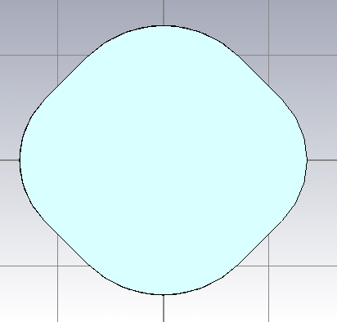
Indirect space charge: refinement of the calculation
Using numerical form factors

Slide 28
Overview
PSB impedance model
  Contributions
    Indirect space charge
    Resistive wall
    PSB extraction kicker including cables
    Transitions
  Summary
Other devices studied
  Vacuum chamber of the new H- region
  Finemet cavities
Future plans

Slide 29
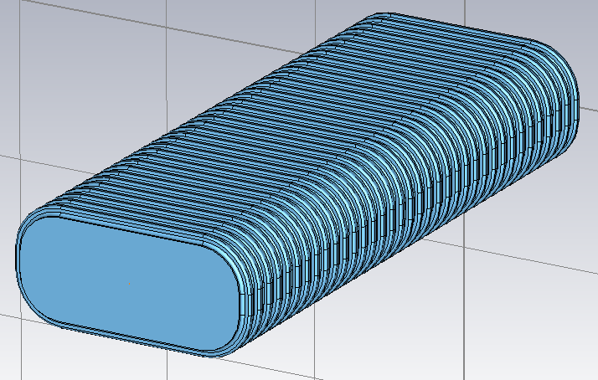
Inconel undulated chamber
Inconel undulated chamber
Alternative solution
Titanium coated Ceramic (Al2O3) chamber (no corrugation)
Vertical full aperture: 63 mm
Titanium thickness: 100 μm
Inconel thickness: 0.45-0.50 mm
Vertical full aperture: 63 mm
Inconel conductivity = 7.89 10⁵

Slide 30
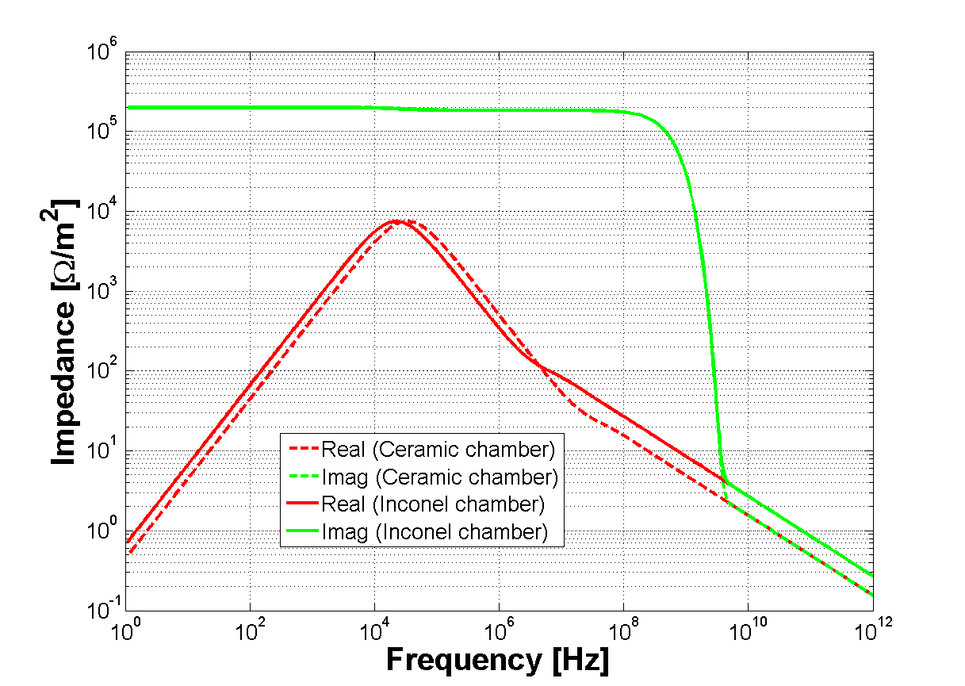
Analytical calculation (no corrugation): comparison between Inconel and Ceramic chamber
Theoretical calculation made with the TLwall code

Slide 31
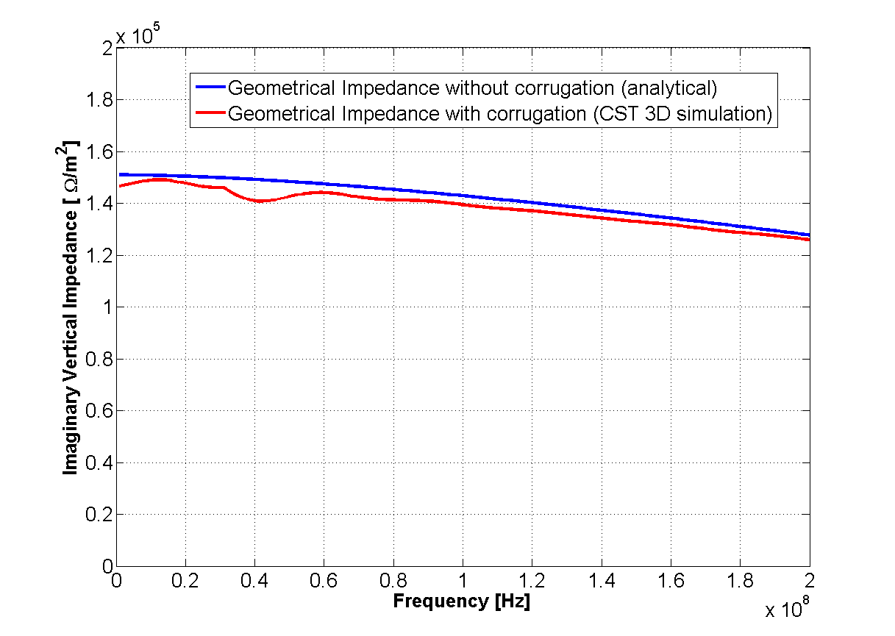
Inconel undulated chamber:
CST Particle Studio simulation
The impedance contribution of the corrugation seems to be negligible

Slide 32
Overview
PSB impedance model
  Contributions
    Indirect space charge
    Resistive wall
    PSB extraction kicker including cables
    Transitions
  Summary
Other devices studied
  Vacuum chamber of the new H- region
  Finemet cavities
Future plans

Slide 33
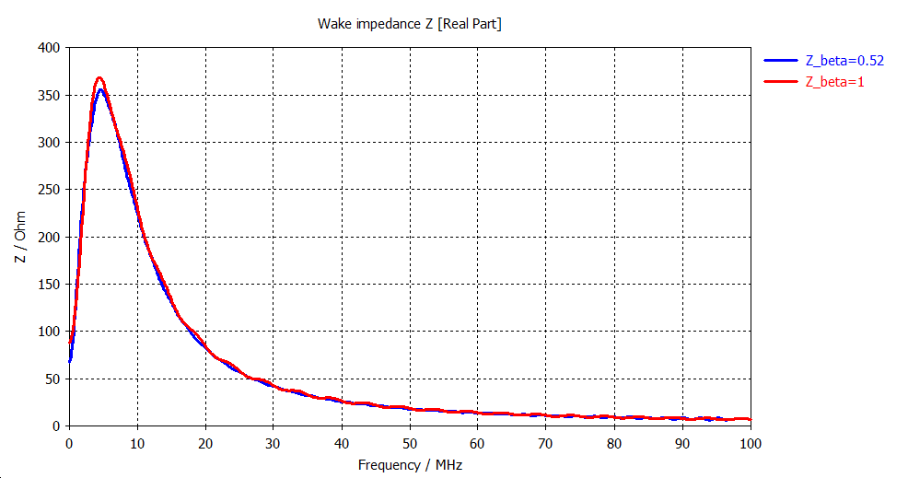
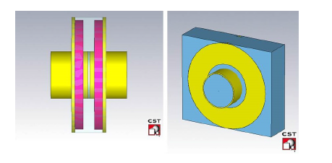
Finemet cavities
Ps and PSB cell cavity
The impedance does not depend on the relativistic beta
S. Persichelli et al., Finemet cavities impedance studies, CERN-ACC-NOTE-2013-0033, 2013.

Slide 34
Overview
PSB impedance model
  Contributions
    Indirect space charge
    Resistive wall
    PSB extraction kicker including cables
    Transitions
  Summary
Other devices studied
  Vacuum chamber of the new H- region
  Finemet cavities
Future plans

Slide 35
Future plans
CST 3D EM simulations will be used to continue characterizing the PSB devices in terms of impedance
Refinement of the calculation of the indirect space charge impedance
Longitudinal impedance model

Slide 36
Thank you for your attention

Slide 37
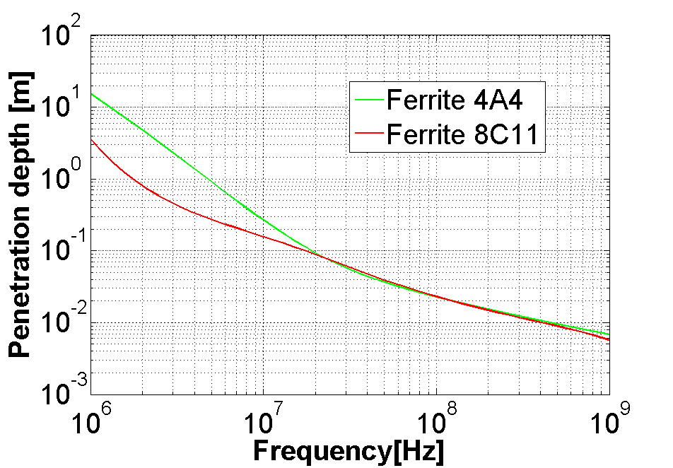
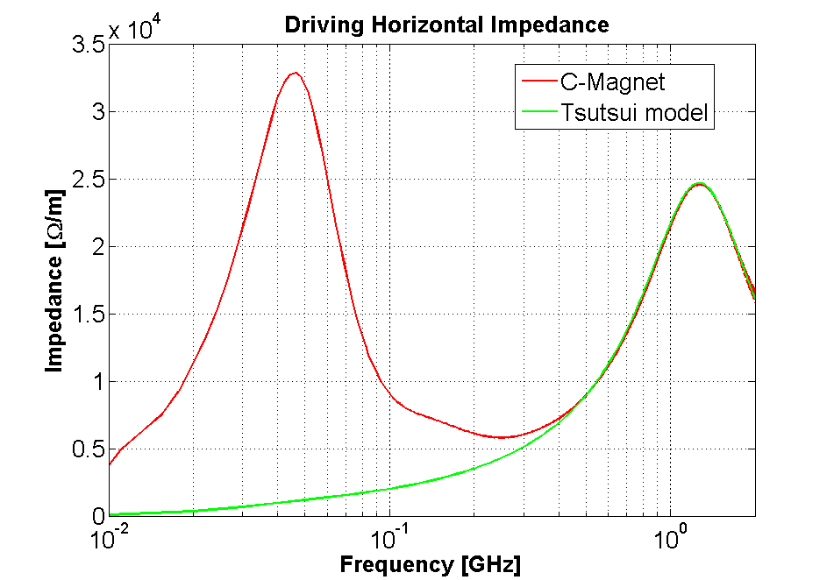
C-magnet: driving horizontal impedance
The C-Magnet model can support a TEM propagation
Expectation
The TEM mode plays a role when the penetration depth in the ferrite becomes comparable to the magnetic circuit length (below few hundred MHz).
Theoretical estimation
CST Particle Studio simulations
Peak due to the TEM propagation
Notes:
Invertire animazioni

Slide 38


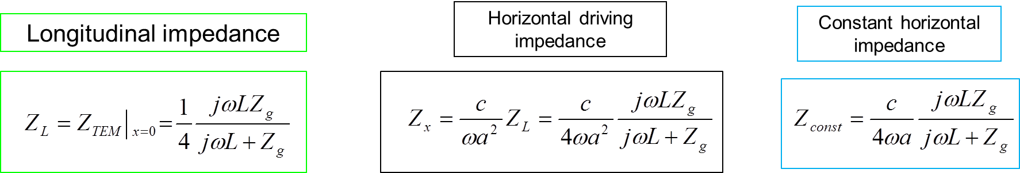
A theoretical calculation for the C-Magnet model
is the impedance calculated using the Tsutsui formalism
Constant horizontal impedance

Slide 39
C-Magnet: Comparing theoretical model and 3-D simulations
The theoretical predictions and simulations show a very good agreement
CST Particle Studio is found to be a reliable tool to simulate the impedance of ferrite loaded components
Confirmation of the new theory

Slide 40

Indirect space charge
Analytical calculation based on the PSB aperture model (provided by O. Berrig)
Rectangular pipe
Circular pipe
K. Y. Ng, Space charge impedances of beams with non-uniform transverse distributions
Elliptic pipe

Slide 41

Definition of impedance
Longitudinal component of the electric field in (x, y) induced by a source charge placed in (x₀, y₀)
Depend only on the source
EM simulator uses the total fields
contribution due to the interaction of beam and accelerator components

