Slide 1
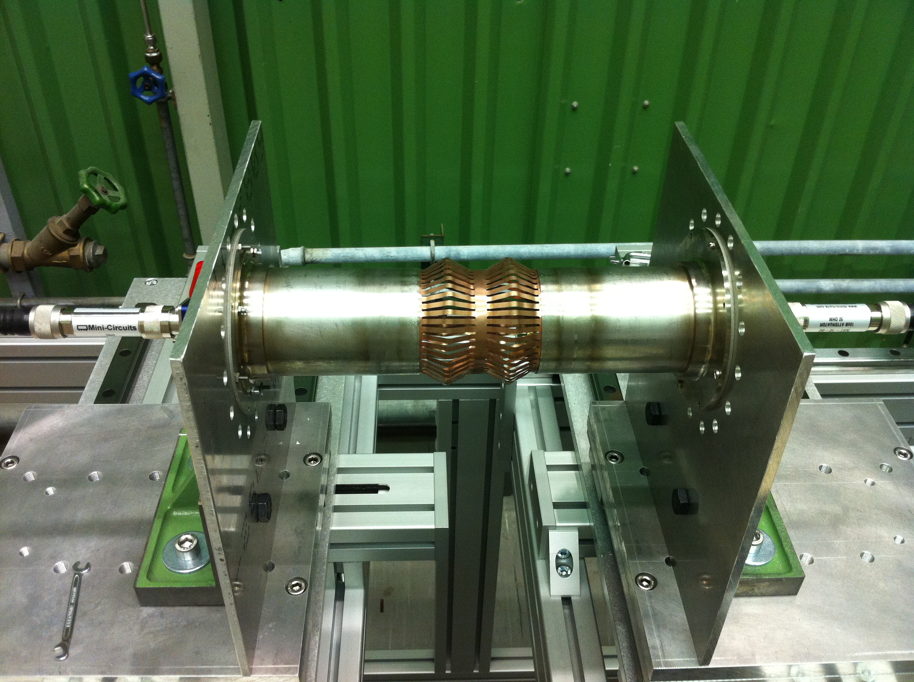
Tools and instruments used for beam impedance measurements
O.Berrig & J.Kuczerowski

Slide 2
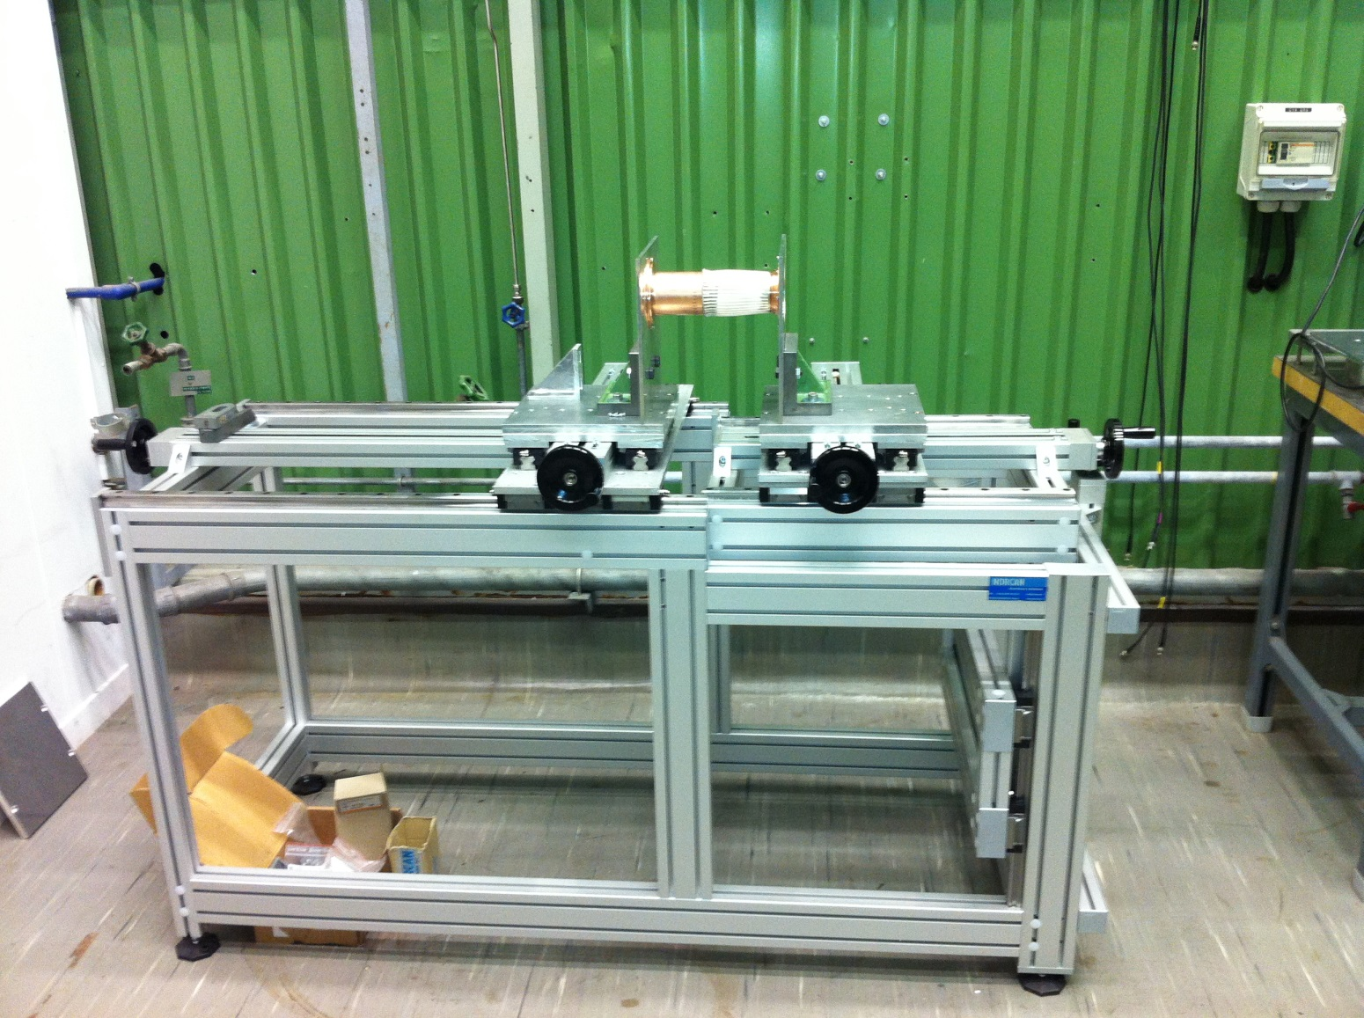
When measuring on equipment that changes length or equipment with horizontal or vertical offset;
we use a measuring bench
This bench is in building 113. It belongs to V.Baglin and A.Vidal. They kindly allow us to use it.

Slide 3
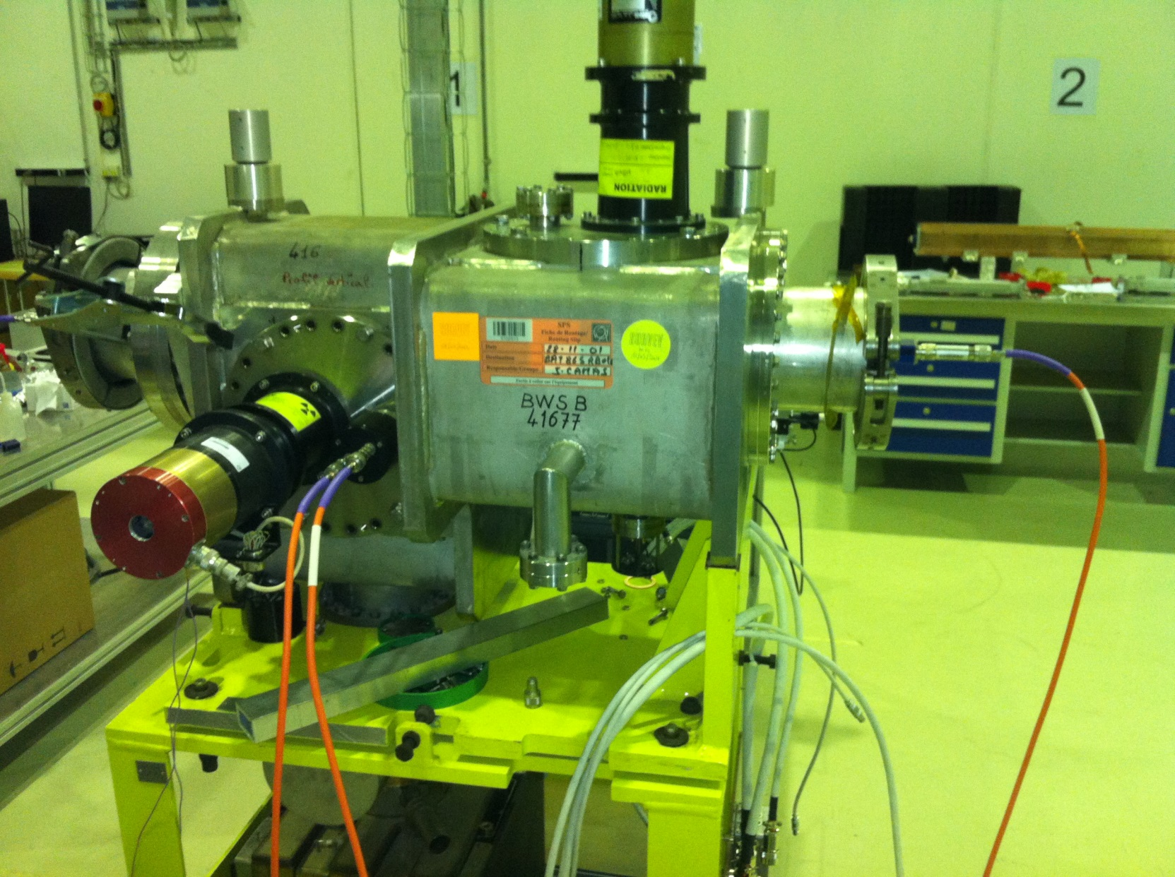
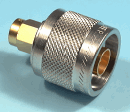
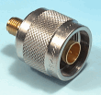
When measuring on equipment with several inputs/outputs, we need to borrow a 4 port network analyzer (e.g. F.Caspers, M.Ehret/M.Wendt, M.Barnes )
Please Note also, that we need connectors, which converts from N-Type to SMA
A 4 port network analyzer needs an automatic calibration unit, otherwise the calibration will take too long time (16 combinations for the channels)

Slide 4
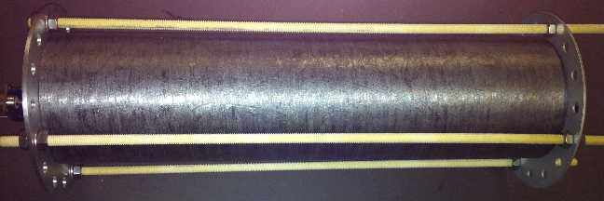
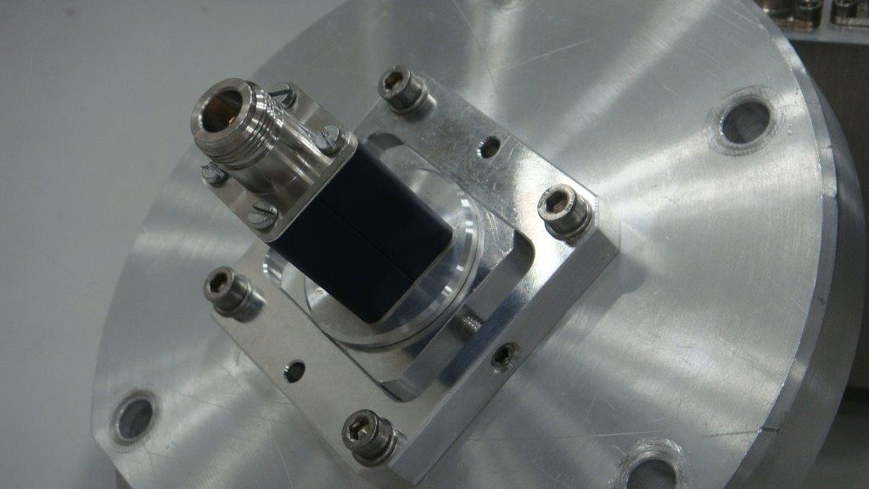
We need to buy SUCO boxes and in general we need a budget for the mechanical workshop: Flanges, etc.
Screws made of plastic (non conducting)
Flange with moving SUCO box. Used for measuring transverse impedance

Slide 5
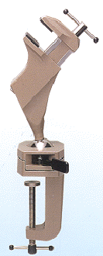
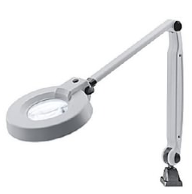
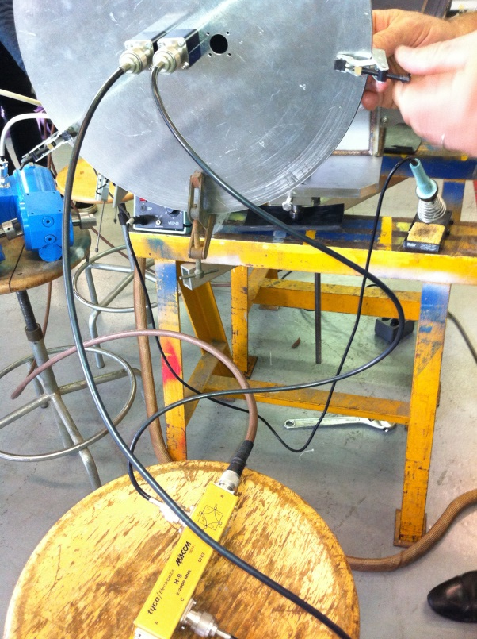
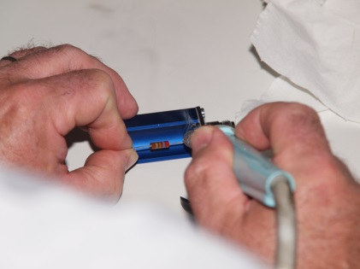
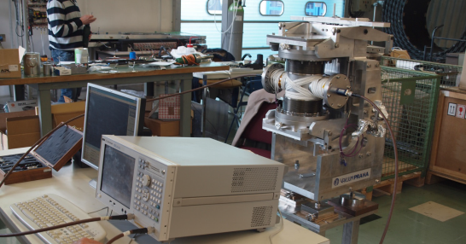
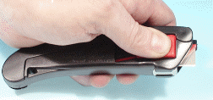
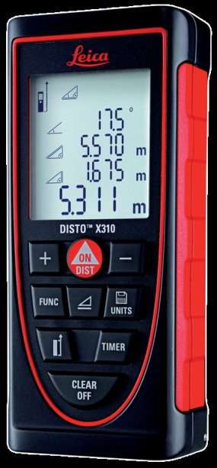
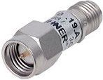
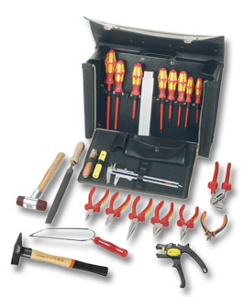
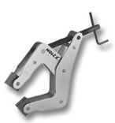
Tools, matching resistors (carbon), wires, coax cables (good ones), hybrids for transverse beam impedance measurements, Network Analyzer, etc.
Clamp
Soldering iron
Hybrid
Attenuator
Probe for precise measure of the Q-value
The laser is used to measure the length of the equipment, so that the wire can be cut in the right length

Slide 6
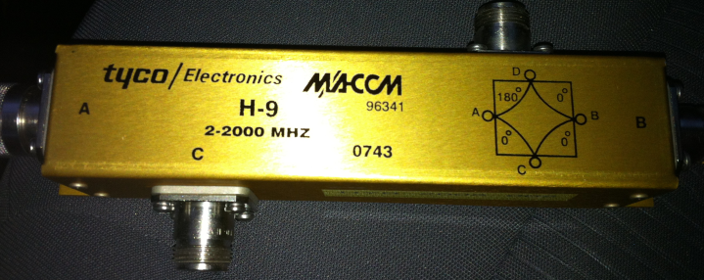
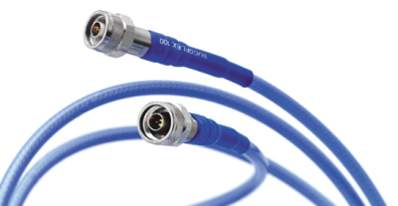
Foreseen purchases for 2014
De-block of present commands: ~ 1000 CHF
Hybrid: ~ 3000 CHF
(We really need to buy two hybrids
– one at each end of the DUT –
but it was agreed with Oliver that
we buy one in 2014 and another in 2015)
Cables: ~ 2000 CHF
Mechanical workshop: ~ 5000 CHF (flanges)

