Slide 1
Impedance working group update
Benoit, Carlo, Nicolas for the impedance team
26 Nov 2013

Slide 2
General
Nicolo will join as fellow from February 1st
End of internship for Johannes
→ Interesting studies on matching for impedance measurements with Olav, in particular on the impact of the Sucobox used to connect the vector network analyzer to the device. Presentation planned through Vidyo.
Need to find short term and long term solutions for impedance measurements and EDMS approval
Impedance models:
  3 distinct codes for PS (Matlab on Linux), SPS (Matlab on Windows), LHC (python)
  Should we continue like this?
Bench measurements:
  Many bench measurements on-going
  Proposition by UA9/LAL to buy a testbench for impedance measurements. Need to check that it would be useful
  Requests to buy supplies by Joseph and Olav to be discussed at a forthcoming impedance meeting

Slide 3
Machines
PSB
  Deadline for ICE meeting on Dec 11th for PSB impedance model and related beam dynamics (very tight, as other priorities took precedence until now)
  Contribution for TDR (deadline not clear, to be discussed, probably end of year)
  Contributions includes steps, resistive-wall and indirect space charge, kicker (+ cables)
  Model is being put together now
PS
  Impedance model presented at PS-LIU
  Recommendation for PS dummy septum did not change following the bench measurements (agreement between simulations and measurements for the low frequency mode)

Slide 4
Machines
SPS
  Broadband contribution from transition and flanges could explain the missing SPS vertical tune shift (~4 MOhm/m). Very promising, to be further investigated.
  Contribution from pumping ports shielding in 2001 could also be explained this way (10.5 to 12 MOhm/m reduction expected for 12 MOhm/m measured). Very promising, to be continued.
  Wire scanner measurements on-going. Set up and measurements not trivial → wires broken, proposal to remove ferrites.
  LIU/LAGUNA collimation review: 5 to 10% increase of effective transverse impedance expected, but need for this system is not clear

Slide 5
Machines
LHC
  Upgraded impedance model of LHC implemented
  Action on power loss for TCTP collimators: bugs still present in CST, new version not yet available.
  TDI: cooling will be removed (!), as simulated to be inefficient. However this does not go in the right direction.
  BGV: fine-tuning the final geometry and trade-offs to be found between manufacturing and impedance. ECR rejected, will be resubmitted.
  Checking MKD as small beam induced temperature rise measured
  Beam spectrum and power loss estimations for two-beam-regions.
  Studies of beam spectrum and power loss estimation for various fill patterns, bunch distribution, realistic bunch intensities and length
  → important to disentangle heat load contributions from electron cloud and impedance

Slide 6
Machines
HL-LHC
  First impedance model
  Beam induced heating of selected equipment was predicted for HL-LHC parameters (new idea of 200 MHz system and longer bunch lengths would help a lot for heating, but we should be careful of instabilities)
  Presentation at crab cavity workshop, need to implement a more realistic model of crab cavities
VHE-LHC:
  First look at Wall impedance

Slide 7
EDMS approvals
BGV was rejected, need to write an updated statement from impedance team
UA9 goniometer for LHC (studied by Andrea and Alessandro)
Replacement of beam stoppers after PS extraction to East Area → seems rejected
Suppression of VVFA 11899 in LSS1 of SPS → replaced by vacuum chamber: however, connection to large pump with shielding? To be checked.
Replacement of pumps in 3 tanks MKP in LSS1 of the SPS → no apparent impact
Infrastructure Installation for Physics Debris Absorbers (TCL) on both sides of IP1 and IP5 in front of Q6 Quadrupole → as mentioned by Olav in his comment, no impact as only infrastructure installation.

Slide 8
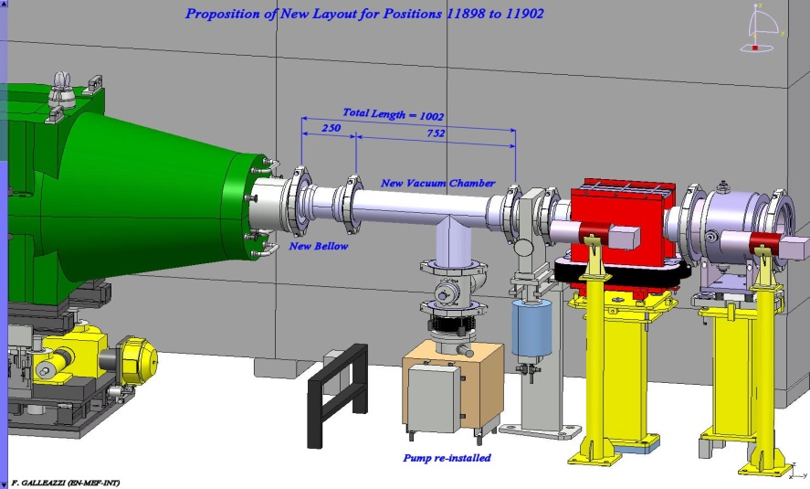
Suppression of VVFA 11899 in LSS1 of SPS

