Slide 1
Several presentations on e-cloud status in LHC
  LMC 18/09/2013: overview, present status of understanding
  LBOC 08/10/2013: heat loads in cold magnets and extrapolation to future operation (post-LS1): encouraged effort to make heat load and bunch-by-bunch stable phase monitoring on line for 25 ns run
  RLIUP Preparation meeting 15/10/2013: overview and extrapolation of heat load values to future operation (post-LS1, PICs, US1, US2) for different scenarios
  In general, strong endorsement to plan using doublets in LHC after LS1 to try suppressing the e-cloud in the dipoles (will be followed up within the LBOC, already scheduled on 5 November 2013)
HL-LHC Triplets
  WP2 meeting 18/10/2013
    Summary of understanding of the present triplets
    Results for the new triplets → need to include in design electron cloud suppression measures (a-C coating and/or clearing electrodes)
E-cloud meeting #5
  Octavio’s rehearsal of PhD defense (mainly LHC results from SS, scrubbing optimization studies with maps, future accelerators)
  Discussion on sensitivity of build up simulation on model parameters (when defining thresholds for different filling patterns)

Slide 2
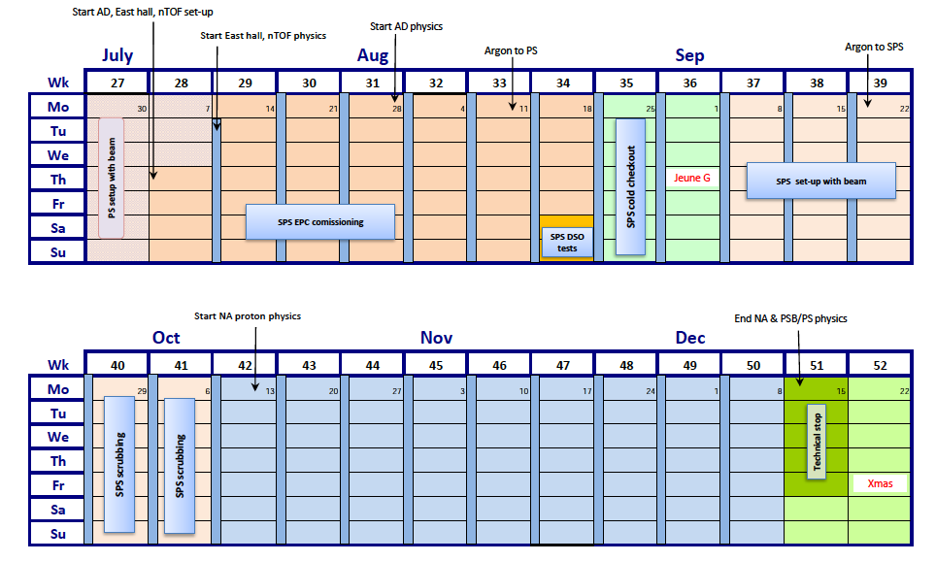
SPS
  Scrubbing strategy for 2014: Scrubbing run tentatively fixed on weeks 40 – 41. Decision for coating vs. scrubbing to be made by mid 2015 (detailed strategy will be discussed by Hannes in RLIUP)
  Coating planning for LS2: logistics sorted out (building for coating lab, transportation from the tunnel, production rate, etc.), it should be possible to coat 90% of the SPS within 12 months

