Slide 1
Summary of parameters for upgrade scenarios (PIC/US1/US2)
G. Arduini, O. Brüning, R. De Maria with input from: H. Bartosik, R. Bruce, S. Fartoukh, M. Fitterer, S. Gilardoni, M. Giovanozzi, M. Lamont, A. MacPherson, S. Redaelli, G. Rumolo and LIU/HL-LHC teams

Slide 2
Hardware changes: PIC
  PIC
  Experiment compatible with 140 pileup-ev crossing
  New TAS, 60 mm, IT, D1, 150 mm, correctors, beam pipes and Y chamber between D1 and TAN
  New collimators with buttons, material for robustness and impedance, new TCTs in IR1-5 for D2-Q5 for cleaning and protection
  Arc sextupoles (MS) at 600A
  SC links in IR15, QRL
  New powering with SC links at P7 (RR)
  New Cryoplant P4 for SCRF
  Cryoplants in P1,5?

Slide 3
Hardware changes US1, US2
  US1
  All what it is in PIC
  BBLR in IR1 and IR5 located where effective
  For 40/10 optics
    new TAN (movable jaws designed for both US1 and US2?)
    Stronger Q5 IR6,
    MS in Q10
    beam screen rotations
    Are the mactching section magnet apertures still protected?
  US2
  All what it is in US1 for 40/10 optics
  Crab cavities, new D2, Q4, Q5 in IR1-5 with line shielding, 800MHz?, e-lens?

Slide 4
Scenarios for consideration with 140 pile-up limit
 | N_{b inj} [10¹¹] | ε*_{inj} [μm] | N_{b coll} [10¹¹] | ε*_{coll} [μm] | B-B Sep [σ] | Min β* (xing/sep) [cm] | Xing angle [μrad] | L_{peak} [10³⁴ cm⁻²s⁻¹] | L_{lev} [10³⁴ cm⁻²s⁻¹] | τ_{lumi} [h] | Lev. time [h] | Machine eff. 6 h fills [%] | Machine eff. opt. fill length [%] | Opt. Fill length [h] | Avg. Peak-pile-up density [ev./mm] | Target int. Lumi [fb⁻¹/year]
PIC | 1.3 | 1.28 | 1.24 | 1.54¹⁾ | 12 | 40/20 | 285 | 3.6 | - | 5.8 | - | 33.9 | 33.6 | 5.1 | 1.24 | 70
PIC | 1.3 | 1.65 | 1.24 | 1.98²⁾ | 12 | 40/20 | 323 | 3.1 |  | 8.1 |  | 35.0 | 35.0 | 6.1 | 0.97 | 70
US1 | 1.45 | 1.37 | 1.38 | 1.8²⁾ | 10⁴⁾ | 40/10 | 256 | 6.2 | 5.1 | 5.6 | 1.1 | 49.6 | 49.3 | 5.1 | 1.53 | 170
US1 | 2.0 | 2.18 | 1.9 | 2.62¹⁾ | 10⁴⁾ | 40/10 | 320 | 7.4 | 4.6 | 8 | 3.7 | 41.8 | 41.4 | 7.2 | 1.45 | 170
US1 | 2.0 | 2.18 | 1.9 | 2.62¹⁾ | 10⁴⁾ | 40/20 | 310 | 5.4 | 4.6 | 8 | 1.2 | 49.4 | 49.4 | 6.2 | 1.45 | 170
US2 | 2.32 | 2.08 | 2.2 | 2.5²⁾ | 12 | 15/15 | 590³⁾ | 20 | 5.1 | 8.2 | 11.2 | 57.3 | 47.3 | 13.0 | 1.16 | 270
US2 | 2.32 | 2.08 | 2.2 | 2.5¹⁾ | 10⁴⁾ | 30/7.5 | 420 | 19 | 5.1 | 8.2 | 10.7 | 57.3 | 48.0 | 12.6 | <1.24⁵⁾ | 270
Using total bunch length of 1 ns and 2760 bunches where not specified differently.
Average pile-up density calculated but not included in the optimization.
BCMS scheme (2508 colliding pairs in IP1/5)
Standard PS production scheme (2760 colliding pairs in IP1/5)
Crab cavities used
BBLR used (parameters to be matched)
Crab kissing scheme can be used to reduce and the average pile-up density (S. Fartoukh)

Slide 5
IBS (Rogelio, Octavio)
IBS at injection and during the ramp/squeeze (Rogelio, Octavio):
  Check longitudinal/RF parameters with Elena, Philippe
    Longitudinal parameters after capture
    Longitudinal blow-up at injection/during ramp
    RF voltage during the ramp. Can we limit the voltage to 10 MV?
  Provide table with emittances in collision with IBS only

Slide 6
Aperture, Optics (Riccardo, Roderik)
Are the assumed parameters compatible with protection at 12 sigma? If not by how much we have to re-scale apertures?
Are the proposed optics compatible with the assumed upgrades? If not what are the modifications required?
Strengths compatible with 7 TeV operation (e.g 40/10)?
See in particular optics 40/10 for US1. Is it compatible with no modification of the matching section except for TAN?
When do we need to install an additional MS in Q10?
Wen do we need a stronger Q5 in point 6?

Slide 7
Energy deposition and radiation (Helmut, Luigi, Francesco)
Are the considered scenarios compatible with energy deposition and radiation limits in the various stages?
E.g.: can we run with larger triplets and no modifications to the matching section for Pic?
Do we need to modify the TAN for US1? Is a movable TAN a possible solution for US1 and US2?

Slide 8
Transverse beam stability and heating (Elias, Benoit, Nicolas)
Are the above schemes compatible with transverse stability taking into account the collimator settings (assuming present jaw materials) presented by Roderik at the WP2 meeting on 13/9?
At which stage do we need to have Molybdenum-Graphite jaws with Molybdenum coating for impedance reduction?
Is the octupole strength sufficient for all cases up to 7 TeV?
When heating is becoming an issue for the present hardware?

Slide 9
Beam-beam (Sasha, Tatiana)
Is there any scheme among those proposed for BCMS (see next slide) that could pose problems for beam-beam effects?
What is the required beam-beam separation for flat optics and no BBLR? What is the dependence on intensity?
BBLR position vs emittance, flat beam crossing angle with BBLR. Is it compatible with collimation?

Slide 10
Filling patterns with BCMS and max of 5 PS train per SPS extraction
 | K_{B1/B2} | k_{IP1/IP5} | k_{IP2} | k_{IP8}
Filling 1 | 2508 | 2508 | 2108 | 2204
Filling 2 | 2508 | 2472 | 2087 | 2240
Filling 3 | 2508 | 2428 | 2061 | 2284
Filling 4 | 2508 | 2384 | 2035 | 2328
Filling 5 | 2652 | 2652 | 1839 | 1859
Selected for the rest of the presentation
B. Gorini
Abort Gap Keeper at 276 bunches
Max. 5 PS train/SPS extraction (=240 bunches)
No isolated bunches to ATLAS and CMS
12 bunches intermediate injection
Over injection over pilot
Any preference from beam dynamics point of view ➔ Beam-beam team
Any counter proposal?

Slide 11
Electron cloud effects (Elias, Giovanni²)
What are the heat loads that we can expect after scrubbing for the considered scenarios? And during scrubbing?
What is the required SEY to achieve in the triplets to avoid electron cloud build-up?
What are the electron cloud effects that we can expect after scrubbing during the various phases?
Countermeasures?

Slide 12
Longitudinal parameters (Elena)
Are the above parameters consistent with longitudinal stability
What are the possible RF and longitudinal parameters at injection, after capture, during the ramp and at flat-top?
In which phases are we going to have controlled longitudinal blow-up? To which values?

Slide 13
Reserve

Slide 14
Beam/Machine parameters
Momentum [TeV/c] | 6.5
Max. Number of bunches/colliding pairs IP1/5 | 2508 or 2760
Total RF Voltage | 16
ε_{L}*[eV.s] at start of fill | 2.5
Bunch length (4 σ)[ns]/ (r.m.s.) [cm] | 1/7.5
“Visible” cross-section IP1-5-8 [mb] for pile-up estimation | 85¹⁾
Pile-up limit IP1 | 140
Pile-up limit IP5 | 140
Pile-up limit IP8 | 6²⁾
Luminosity limit IP2 [10³⁴ cm⁻² s⁻¹] | 0.002³⁾
Pile-up Density can be an issue here
Need limits from experiments!
Likely 70-75 for LHCb at 6.5 TeV (R. Jacobsson)
Likely 4.5 for LHCb assuming the visible cross section above (R. Jacobsson)
Feasible?

Slide 15
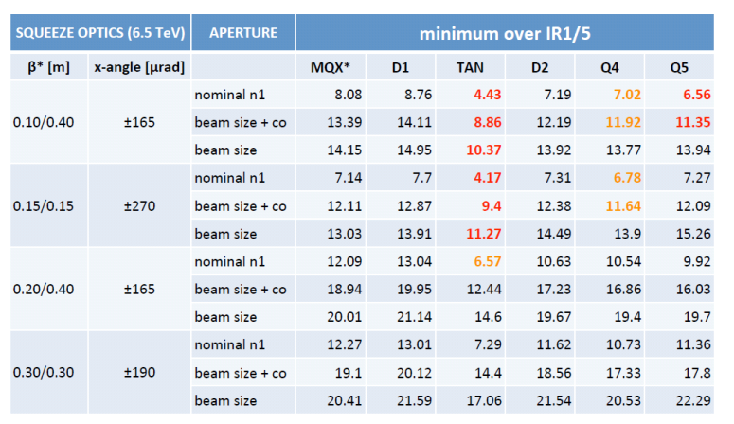
Aperture estimates for PIC layouts
Beta*<20cm needs MS in Q10 and new Q5 IR6
M. Fitterer

Slide 16
Integrated luminosity targets
Assumptions:
  Luminosity in 2015=30 fb⁻¹
  310 fb⁻¹ by the end of 2021. See M. Lamont 6th HL-LHC Coordination Group meeting 26.07.13.
 | No PIC Only gain in reduced SD | PIC | US1 | US2
Integrated luminosity by end 2021/ end 2035 | 300 | 300/1000 | 300/2000 | 300/3000
Number of years of operation after 2021 | >10 (shorter SD) | >10 (shorter SD?) | 10 | 10
Goal luminosity/year | 30-50 | 70 | 170 | 270

