Slide 1
Impedance working group update 21st August 2013
General
Systematic studies to understand our simulation tools:
using symmetries in CST (Andrea), to be presented at the next impedance meeting.
using eigenmode and wakefield simulations (Berengere), to be presented at this meeting.
Simulations with ferrites in GdfidL are not in agreement with what we expect (Gianni and Carlo, also confirmed by M. Zobov), Gianni in touch with W. Bruns to see if something can be done.
HL-LHC
Chapter in HL-LHC book written (Elias et al)
Deadline: Beam induced heating with HL-LHC parameters for end of Summer
Deadline: impedance model for November

Slide 2
LHC
Wire measurements on ALFA completed (Olav, Joseph, Fritz and Sune) → good agreement, but one peak seen in simulations and not in measurements. Recommendation given by the team to use filler with ring ferrites.
Non-conformities in RF contacts: no news from TE/VSC.
Andrea started simulations for UA9 (design provided by Andrea Danisi).
First geometrical wake for collimators produced by M. Zobov (5mm half-gap).
TDI: ECR for the copper coating in preparation.
TCTP measurements: new flanges for 2-wire-measurements are being designed and manufactured (Joseph, Patrice and EN/MME)
SPS
Wirescanner: studies on-going to understand the mode dependence with the fork movement, and checks with transmission line model → type of boundary condition could be critical for the harmful mode (for MSWG next week).
High bandwidth feedback: recommendation to be given → slide of Carlo at this meeting
ZS pumping ports: more realistic geometry leads to smaller shunt impedance.
Continuing effort of LIU-SPS to look for resonant modes in SPS that would be responsible for microwave instabilities: extensive survey of all cavities in short straight sections maybe Jose and Fritz found one of the culprits
→ the bellow next to the BPMs (narrow band frequency domain simulations with HFSS)
PS
Deadline: corrected TDR chapter to be given to Simone.
PSB
No news.
CLIC
No news
ELENA:
Many pickup simulations by the Zanninis.
TLEP:
impedance of RF cavities was evaluated by a collaborator.

Slide 3
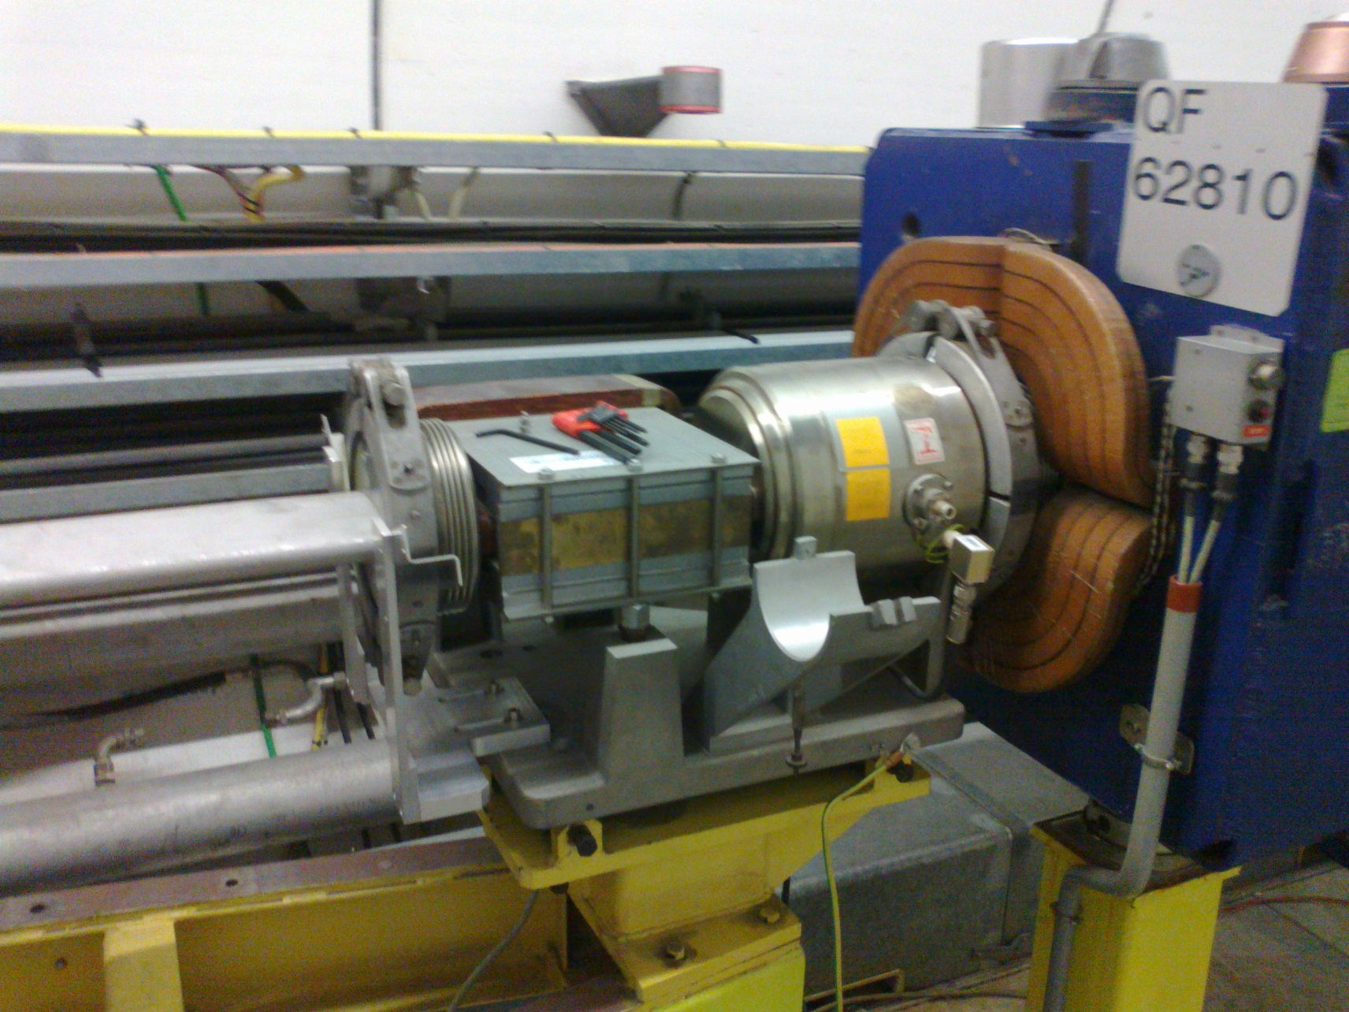
Example of unshielded bellow

