Slide 1
High Bandwidth Damper System: kicker impedance
Some slides on kicker impedance calculation from the High bandwidth damper system review of July 30th 2013

Slide 2
Beam Impedance calculation for slotted kicker
A. Gallo on behalf of the INFN Frascati Hi-Lumi LHC Broadband FBK Team*
(*) D. Alesini, A. Drago, A. Gallo,
F. Marcellini, M. Zobov

Slide 3
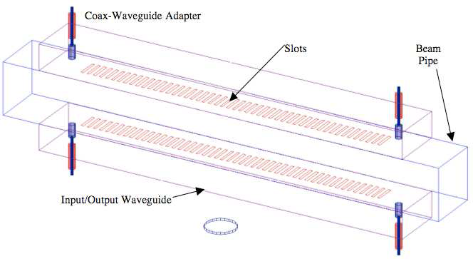
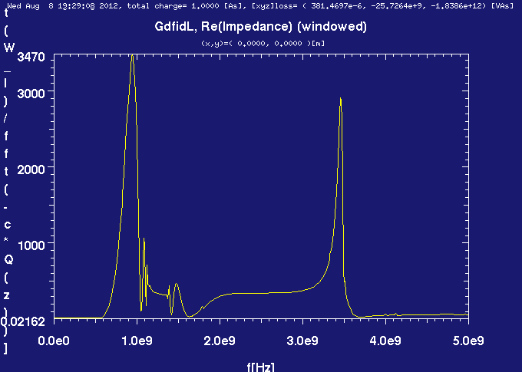
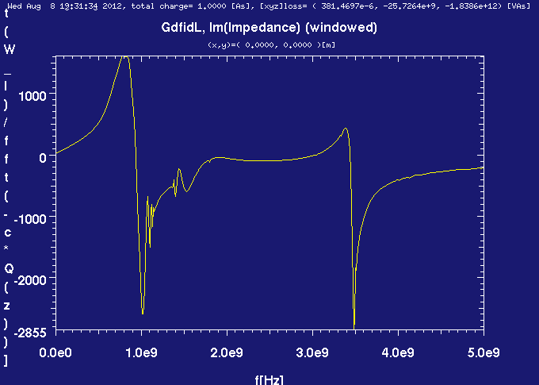
Initial impedance calculations for slotted kicker
D. Alesini, A. Drago, A. Gallo,
F. Marcellini, M. Zobov.
D. Mc. Ginnis
Impedance simulations with GdfidL started on a simple slotted structure made by 2 rectangular waveguides on both top and bottom sides of the beam pipe.
Real
Imaginary

Slide 4
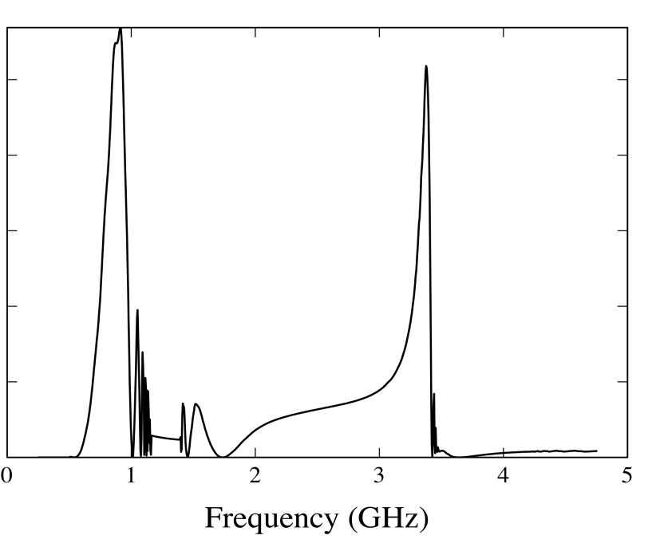
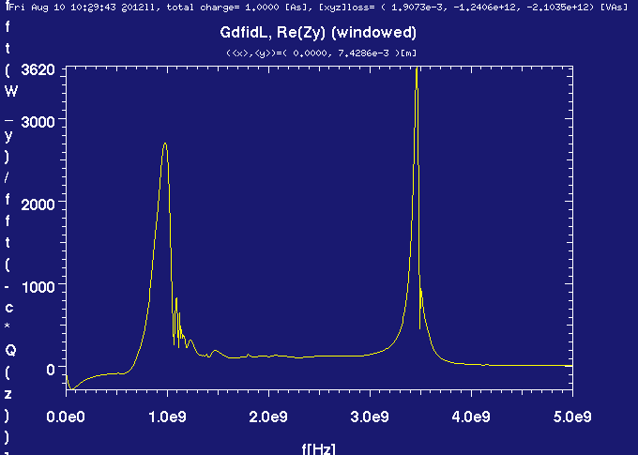
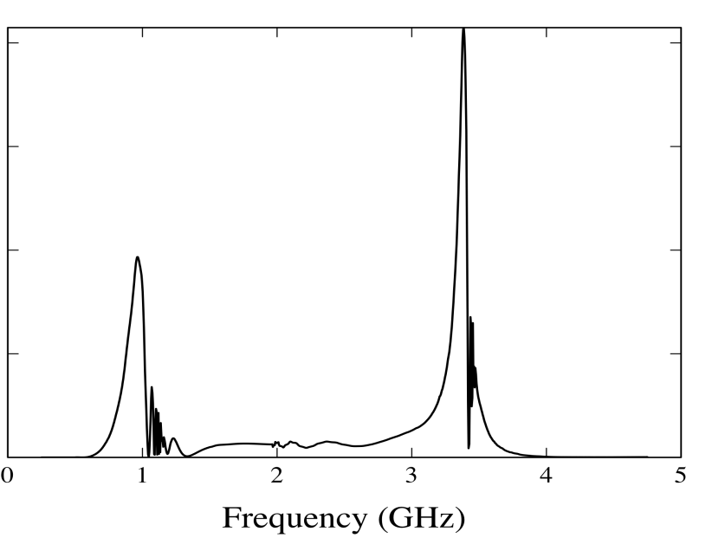
Slotted Kicker Impedance Calculations Comparison
ReZ_{L}
Longitudinal
ReZ_{T}
Transverse
GdfidL (M.Zobov, LNF INFN)
Moment method (J.Cesaratto, SLAC)

Slide 5
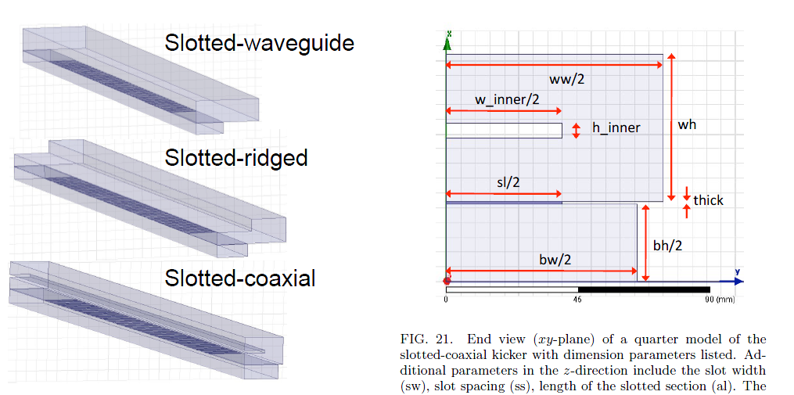
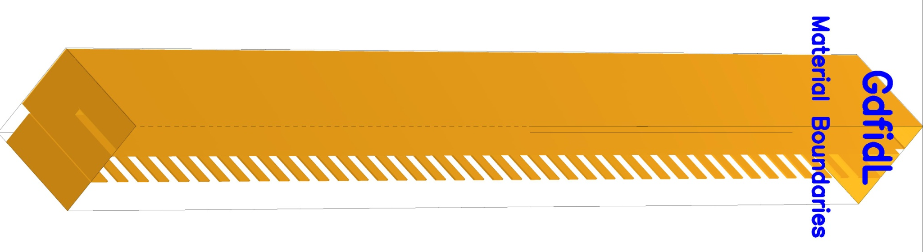
Slotted-coaxial kicker Impedance calculation
Design evolution

Slide 6
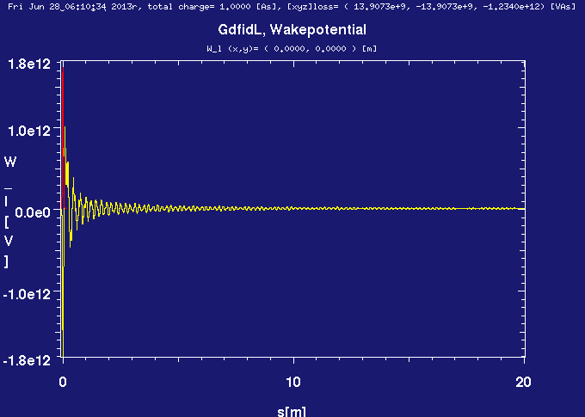
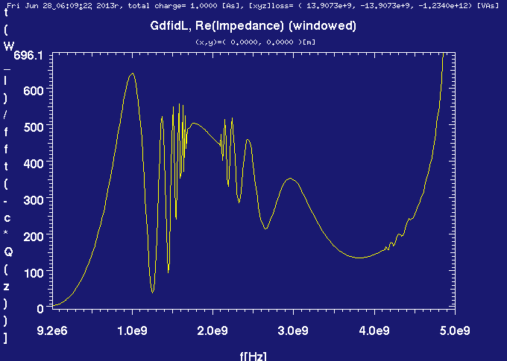
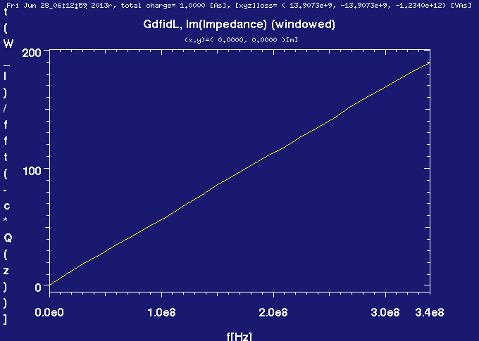
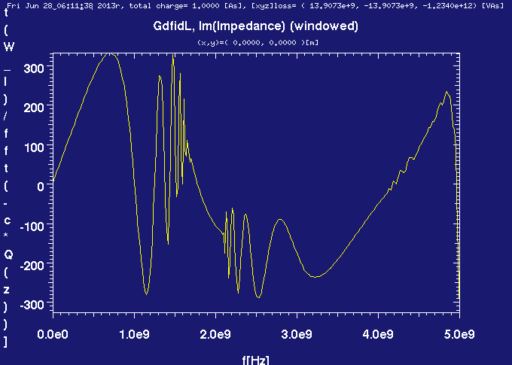
Longitudinal Impedance
Gaussian bunch, σ_{z} = 2 cm
25 ns

Slide 7
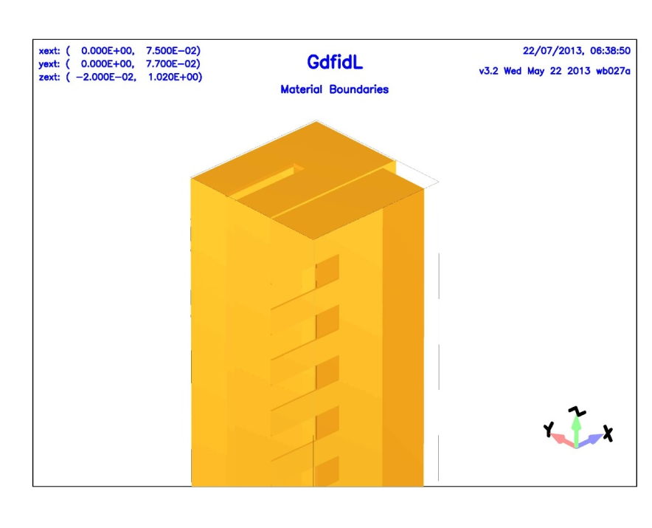
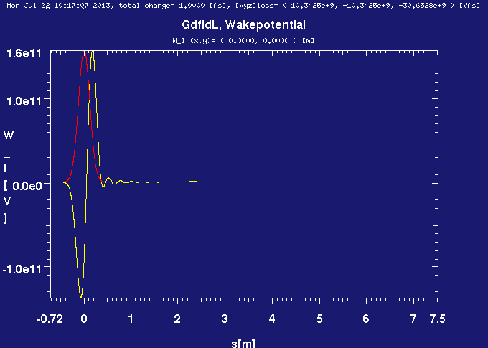
Total Power Loss
25 ns
σ_{z} = 12 cm
P = 820 W for 12 cm bunch length, N_{b} = 144, N = 4.09x10¹¹
Because of the device directionality, most of the power is expected to be dissipated into the dummy loads connected to the downstream ports.
A precise evaluation of the delivered power partition among ports and structure walls is needed.

Slide 8
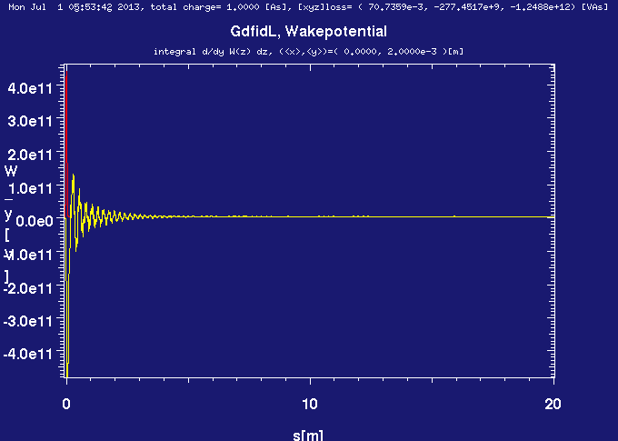
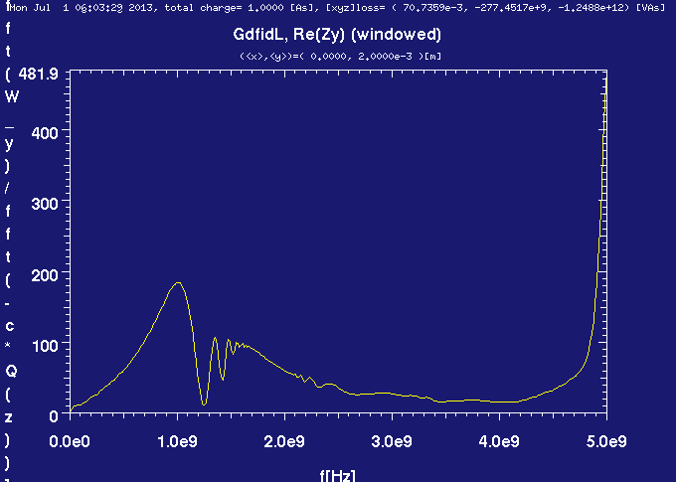
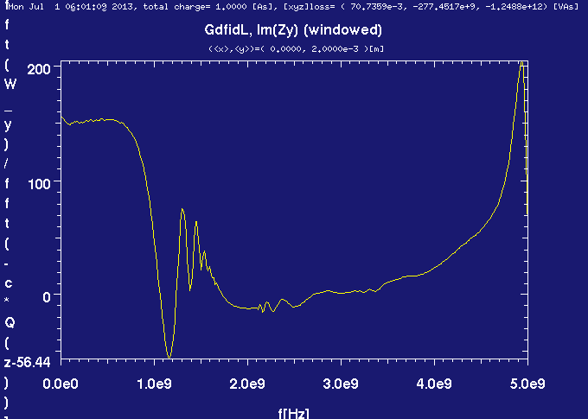
Transverse Wakes and Impedance
(2 cm bunch length, 2 mm offset)
Gaussian bunch, σ_{z} = 2 cm
25 ns

Slide 9

CONCLUSIONS #1
We should not expect any additional harmful multibunch effects due to the slotted kicker since both longitudinal and transverse wakes decay in time shorter than the minimum bunch spacing of 25 ns
The low frequency longitudinal impedance of 0.024 Ω is very small in comparison with the overall SPS longitudinal impedance budget (10 Ω )
The longitudinal loss factor for the shortest bunch length in SPS of 12 cm is estimated to be k_{l} = 3.06x10¹⁰ V/C . This corresponds to the total lost power of 820 W for the worst scenario (Np =4.09x10¹¹, Nb = 144), mainly flowing out through the device downstream ports.
The real and imaginary parts of the total transverse impedance do not exceed 100 kΩ/m - to be compared with ≈ 7 MΩ/m contributed by the other SPS kickers.

Slide 10
Array of Stripline Kickers
S. De Santis and H. Qian
Lawrence Berkeley National Laboratory

Slide 11
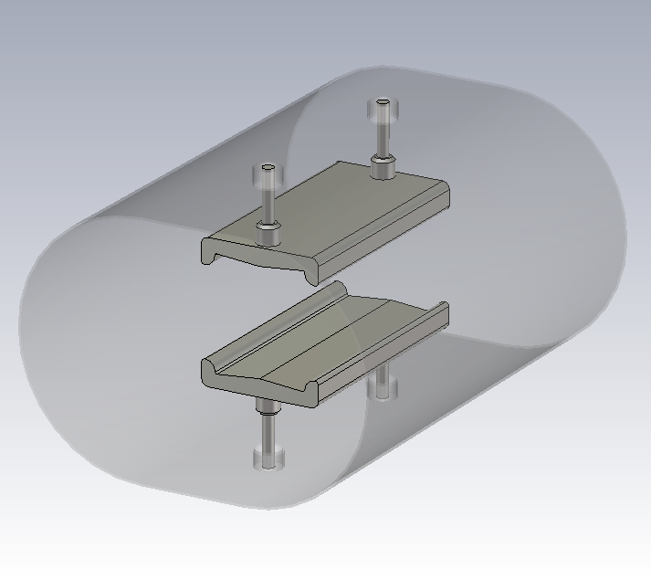
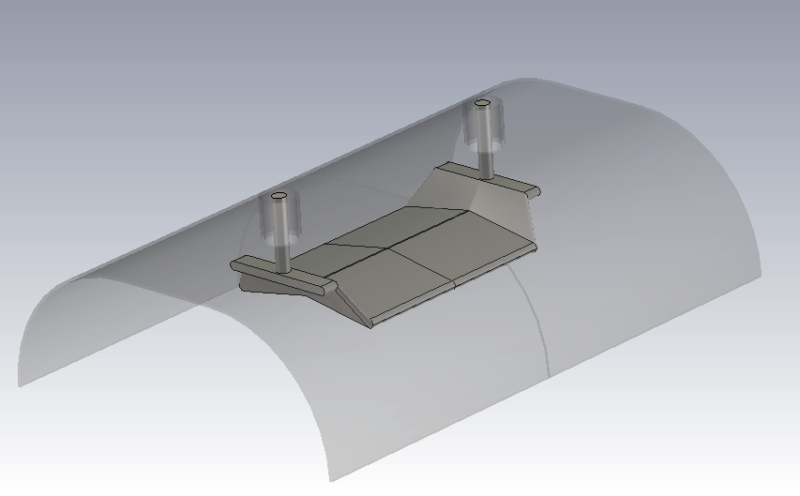
6
Old vs. New Design
No taper
Taper
100 mm
100 mm
150 mm
130 mm
TE₀₁ cutoff: 1.08 GHz
TE₀₁ cutoff: 1.3 GHz
S. De Santis – July 30th, 2013

Slide 12
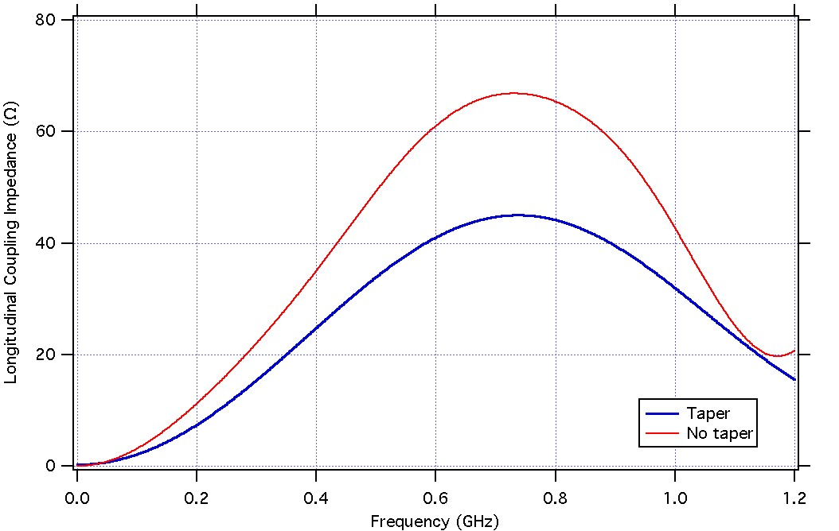
10
Beam Coupling Impedance
Shaded area coincides with most of the SPS beam power spectrum (98% reduction @ 800 MHz), with σ_{z}=12 cm.
Even assuming uniform spectrum and uniform 40 Ω impedance over 800 MHz, the loss factor is around 0.03 V/pC. To be multiplied by N_{mod}.
- Loss per bunch: <18 μJ -> ΔE/E < 750 eV/26 GeV ≈ 0
- Power absorbed by load: 750 W (@ 40 MHz rep rate, ~1kW @ 20 MHz)
S. De Santis – July 30th, 2013

Slide 13
High Bandwidth Damper System: kicker impedance
Recommendation on the SPS transverse impedance budget

Slide 14
SPS transverse impedance budget
The effective impedance of the new wideband kicker should be compared with the effective impedance of installed devices.
The total measured effective vertical impedance of SPS is around 18MΩ/m. Based on 3D simulations, coaxial wire measurements, beam induced heating measurements and history of the measured effective vertical impedance the kickers are the most important contributors (around 7MΩ/m).
Presently there are 19 kickers installed in the machine, an average contribution per kicker of ≈ 0.37 MΩ/m.
The beam coupling impedance of the new wideband kicker should not exhibit narrow resonances and must contribute by less than the average contribution per kicker, i.e. ≈ 0.37 MΩ/m. Preferably the beam coupling impedance should not exceed about 1% of the total SPS impedance, i.e. ≈ 0.18 MΩ/m.

