Slide 1
Benchmarking CST impedance simulations and application to the BGV project
August 21st 2013
BE-ABP
Bérengère Lüthi – Summer Student 2013
Supervisors : Benoît Salvant and Carlo Zannini
Many thanks to Serena Persichelli, Elias Metral, Massimiliano Ferro-Luzzi, Plamen Hopchev, Ray Veness, Alexej Grudiev, Elena Shaposhnikova.

Slide 2
Context
CST is used a lot at CERN
Can we trust the code ?
Just the start of a long process to understand the tools ans their limits
Two solvers :
Eigenmode solver : no beam, calculates the eigenmodes of the cavity (frequency domain method), can use tetrahedral or cartesian mesh, no open boudaries conditions
Wakefield solver : with a beam, calculates the wakepotential (time domain method),only cartesian mesh, open boundaries conditions possible

Slide 3
Agenda
Longitudinal Impedance Benchmarks
Transverse Impedance Benchmarks
Application to BGV studies

Slide 4
Longitudinal Impedance
Plan of studies
Simple cavity
Comparison betwen two solvers : Eigenmode and Wakefield.
      Changing length and radius of the cavity
      Changing conductivity
      Studies on both magnitude and Q
      First mode only
      First check with ferrite materials

Slide 5
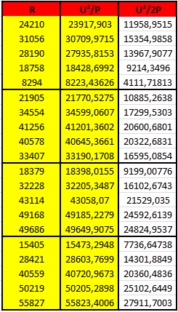

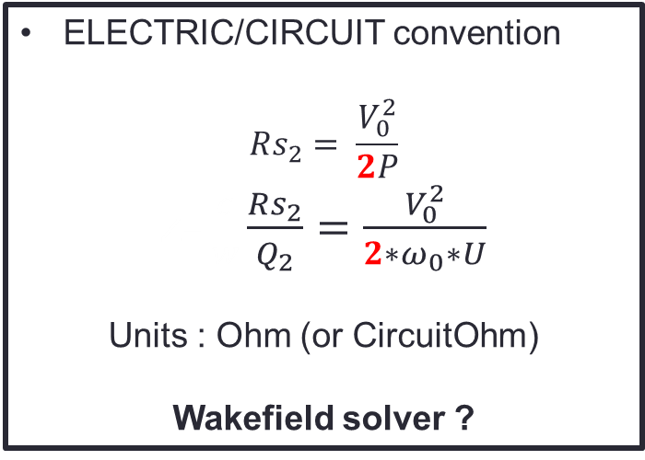
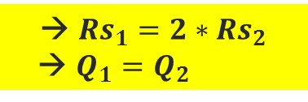
Longitudinal Impedance
Two conventions (from Serena)
LINAC convention
$$Rs_{1}= \frac{V_{0}^{2}}{P}$$
$\frac{Rs_{1}}{Q_{1}}=$ $\frac{V_{0}^{2}}{ω_{0}∗U}$
Units : LinacOhm
Eigenmode Solver
ELECTRIC/CIRCUIT convention
$$Rs_{2}= \frac{V_{0}^{2}}{2P}$$
Z= $\frac{c}{w}\frac{Rs_{2}}{Q_{2}}=$ $\frac{V_{0}^{2}}{{2∗ω}_{0}∗U}$
Units : Ohm (or CircuitOhm)
Wakefield solver ?
Calculations from simulation results with the Eigenmode solver
→ $Rs_{1}=2∗Rs_{2}$
→ $Q_{1}=Q_{2}$

Slide 6
Longitudinal Impedance
Strategy suggested
Already mentionned for instance in two studies:
Calculation of Wakefields and Higher Order Modes for the New Design of the Vacuum Chamber of the CMS Experiment for the HL-LHC
by R. Wanzenberg and O. Zagorodnova
Simulation of Longitudinal and Transverse Impedances of Trapped Modes in LHC Secondary Collimator
by A. Grudiev
Wakefield values should be used as references when the unit Omh is used.
With the Eigenmode solver it is better to talk about LinacOhm or adapt the value to obtain Ohm.

Slide 7
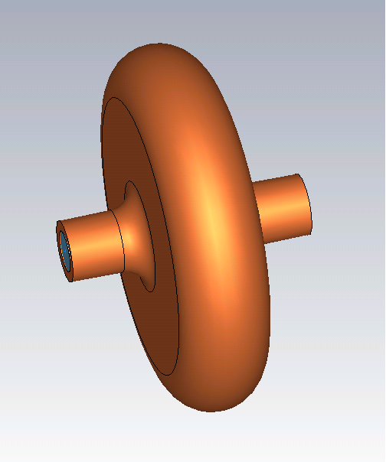
Longitudinal Impedance
Cavity used
Conductivity = 1e3 S/m
(in order to get reasonnable
simulation time)
Lossy Metal with both solvers
Double parameter sweep :
Radius from 30 to 60 cm
Length from 20 to 60 cm
radius
length

Slide 8
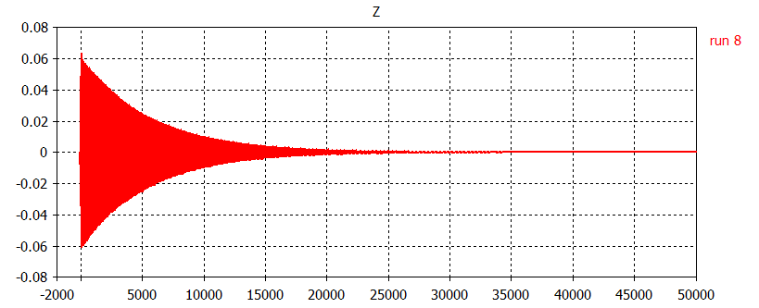
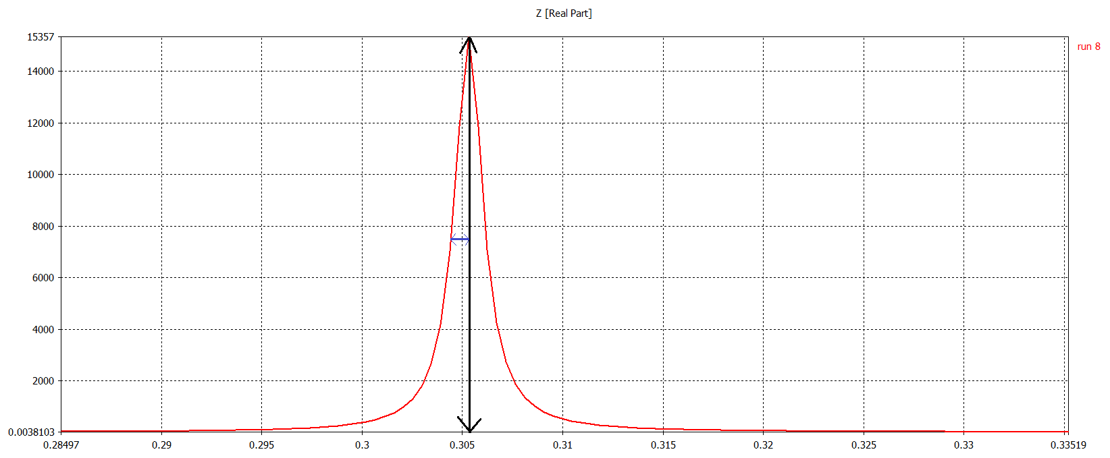
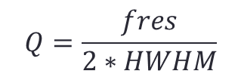
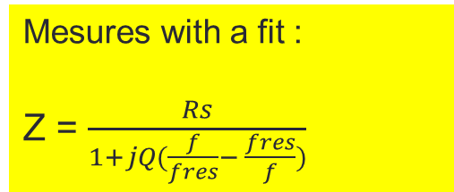
Longitudinal Impedance
Wakepotential
Example : length = 30cm
and radius = 40cm
Wakefield solver
Wakelength (in cm)
Impedance in Ohm
Mesures with a fit :
Z = $\frac{Rs}{1+jQ(\frac{f}{fres}− \frac{fres}{f})}$
Rs
HWHM
$$Q=\frac{fres}{2∗HWHM}$$
Frequency in Ghz
Notes:
Half width half maximum

Slide 9
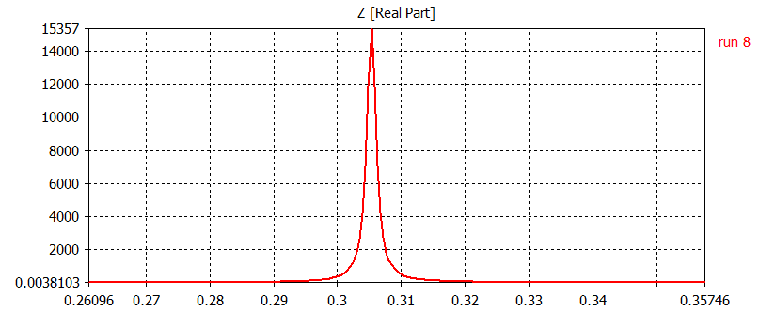
Longitudinal Impedance
One point : ratio of the shunt impedance with Eigenmode with a particular geometry to the shunt impedance with wakefield with the same geometry
Results : magnitude
Example (wakefield) : length = 30cm and radius = 40cm
Wakelength in cm
Z in Ohm
It seems to be converging to a ratio close to 2
~10% error even though the wake decayed by factor 100
Frequency in Ghz
Notes:
12 000 : ~5
20 000 : ~10
50 000 : ~100

Slide 10
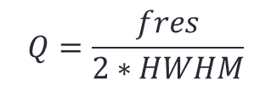

Longitudinal Impedance
Longitudinal impedance with CST PS
Results : Q factor (perturbation)
Impedance in Ohm
Rs
HWHM
Frequency in Ghz
Mesures with a fit :
Z = $\frac{Rs}{1+jQ(\frac{f}{fres}− \frac{fres}{f})}$
$$Q=\frac{fres}{2∗HWHM}$$
10% to 20% error

Slide 11
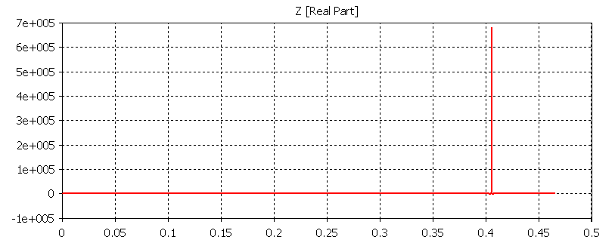
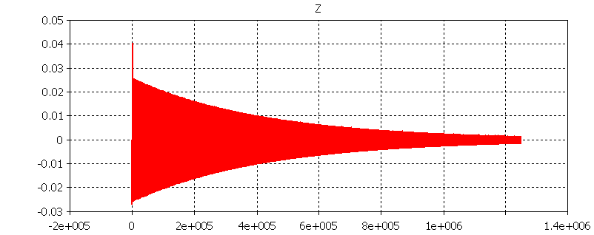
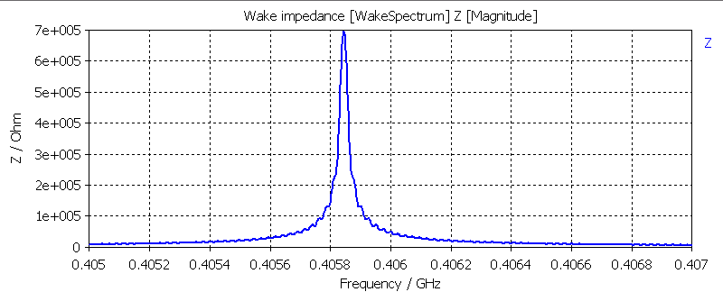
Longitudinal Impedance
What if we change the conductivity from ${10}^{3}$S/m to ${10}^{7}$S/m ?
Longitudinal impedance with CST PS
→ Ratio more ~2.5
Longitudinal wake potential with CST PS
Longitudinal impedance after a post processing on CST PS
Note : issue when changing
the conductivity in Eigenmode
CST support contacted
No parameter sweep possible
Notes:
Walength ~20

Slide 12
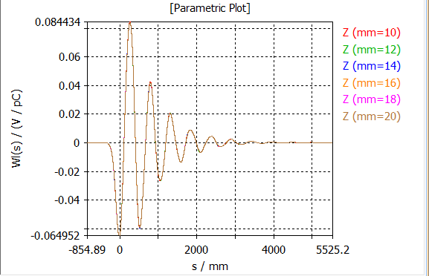
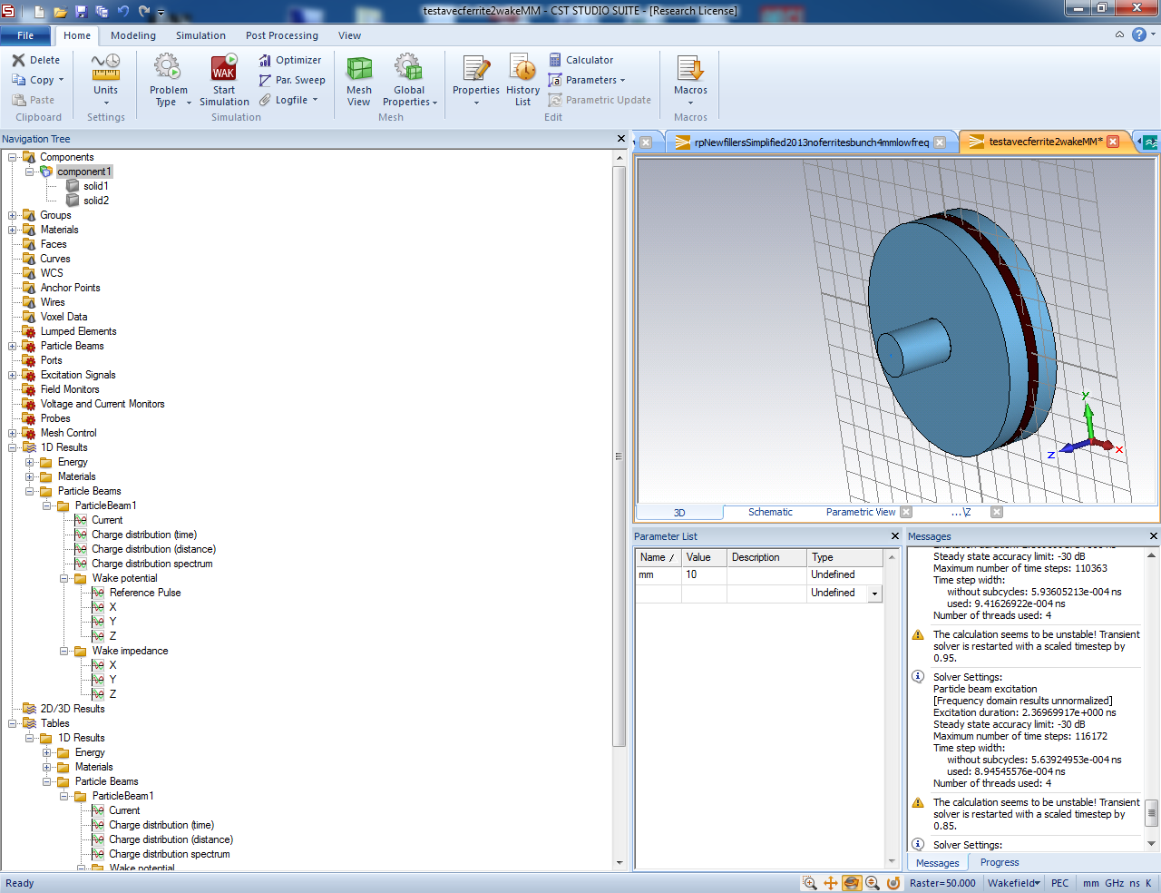
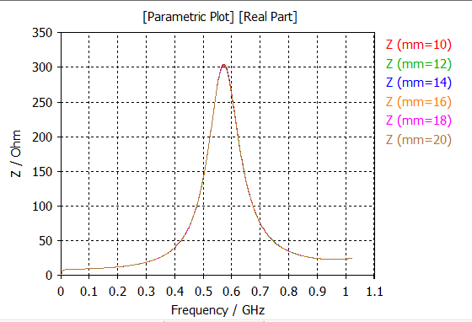
First checks with ferrite materials
Wakefield simulations for a
ferrite loaded cavity:
Longitudinal wake potential from CST PS
with increasing number of mesh cells from 256k to 2M
Ferrite
material
Longitudinal impedance from CST PS
with increasing number of mesh cells from 256k to 2M
→ Computed parameters
Q=fres/(2*HWHM)=4.34
fres=570 MHz
R=303 Ohm
R/Q=70 Ohm
→ Seems to have converged with number of mesh cells

Slide 13
First checks with ferrite materials
Eigenmode simulations for the same ferrite loaded cavity:
Note: many problems, even after the new release and the hotfix (following the email of Serena)
Note: perturbation values (shunt impedance and Q factors) should be used with lossy materials
Ferrite
material
Computed parameters from eigenmode (CST EM):
1st mode
Q(lossy eigenmode)=3.05
fres=566 MHz
R(from lossy eigenmode)=346 LinacOhm
R/Q= 114 LinacOhm
→ Eigenmode solver converged
→ Computed parameters from wakefield (CST PS)
Q=fres/(2*HWHM)=4.34
fres=572 MHz
R=303 Ohm
R/Q=70 Ohm
→ Seems to have converged with number of mesh cells
Orders of magnitude between the
two solvers are the same, but
significant difference in the Q (50%)
R/Q looks reasonable
But which code should we believe?
We should also check with HFSS.

Slide 14
Agenda
Longitudinal Impedance Benchmarks
Transverse Impedance Benchmarks
Application to BGV studies

Slide 15
Transverse Impedance
Plan of studies
Simple cavity
Comparison between two solvers : Eigenmode and Wakefield
      Studies on both magnitude and Q
      First mode only

Slide 16
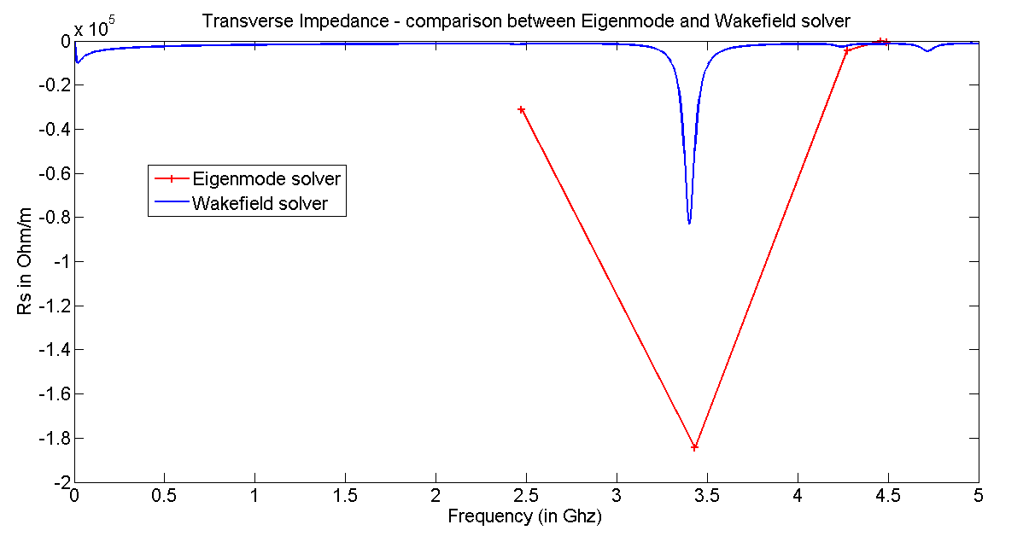
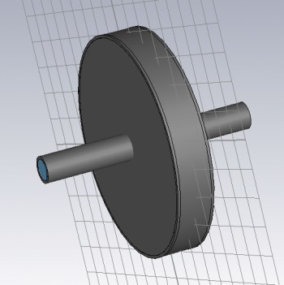
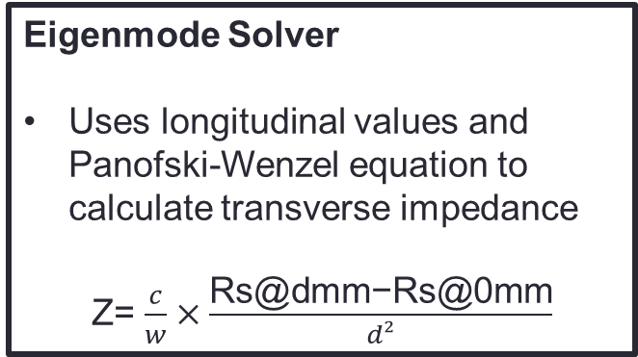
Transverse Impedance
Eigenmode Solver
Uses longitudinal values and Panofski-Wenzel equation to calculate transverse impedance
Z= $\frac{c}{w}×\frac{\text{Rs}\text{@}\text{dmm}\text{−}\text{Rs}\text{@0}\text{mm}}{d²}$
Wakefield Solver
Direct values in results
radius
length
Simulation and calculation of the transverse modes.
Radius = 50 mm and length = 20 mm
→ Conclusion : need a way to know which modes really are transverse modes

Slide 17
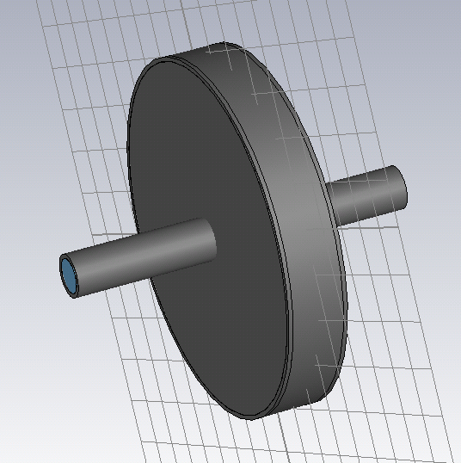
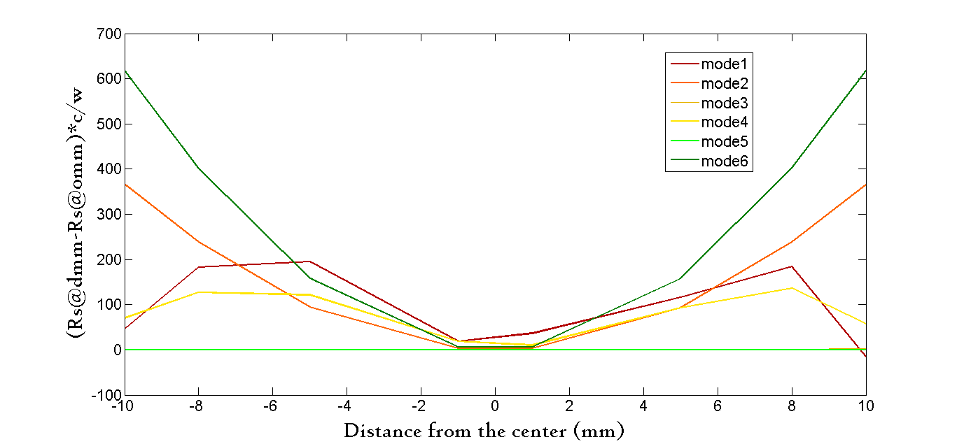
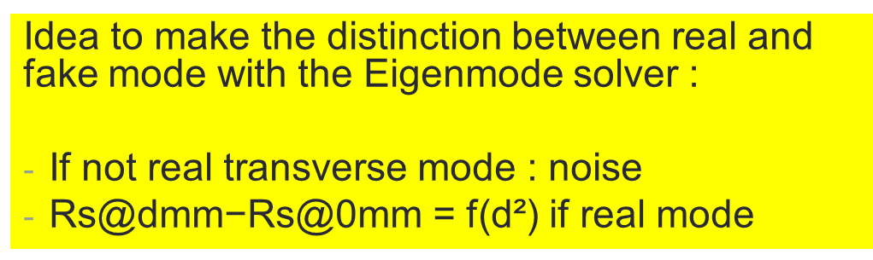
Transverse Impedance
Idea to make the distinction between real and fake mode with the Eigenmode solver :
If not real transverse mode : noise
$\text{Rs}\text{@}\text{dmm}\text{−}\text{Rs}\text{@0}\text{mm}$ = f(d²) if real mode

Slide 18
Transverse Impedance
Cavity used
Conductivity = 1e3 S/m
(in order to get reasonnable
simulation time)
Lossy Metal with both
Solvers
Double parameter sweep :
Radius from 40 to 60 mm
Length from 30 to 60 mm
radius
length

Slide 19
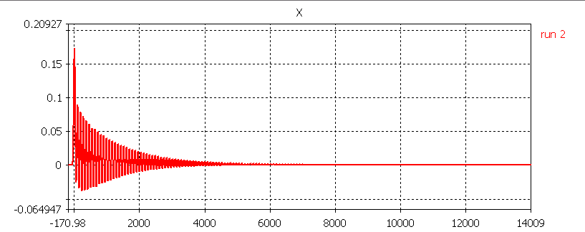
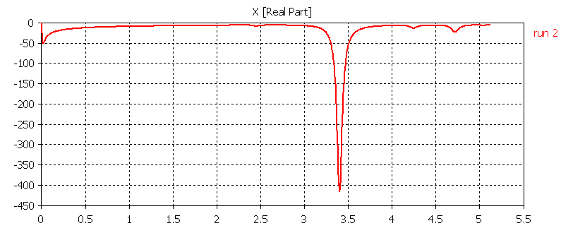
Transverse Impedance
Results : magnitude
Wakepotential with CST PS
Transverse Impedance (x direction) with CST PS
Z in Ohm/5mm
Rs
→ ~10% error

Slide 20
Transverse Impedance
Results : Q factor
Wakepotential with CST PS
Transverse Impedance (x direction) with CST PS
→ ~20% error → no fit

Slide 21
Longitudinal and Transverse Impedance
Conclusions
In general it seems like we can trust the code but
Eigenmode solver is certainly preferable when using high conductivity
One should be careful when using ferrite materials : not sure yet which one to believe
One should be careful to the convention used (Ohm VS LinacOhm)
Wakefield solver uses the circuit convention
Safer to fit a parabola to identify transverse modes

Slide 22
Agenda
Longitudinal Impedance Benchmarks
Transverse Impedance Benchmarks
Application to BGV studies

Slide 23
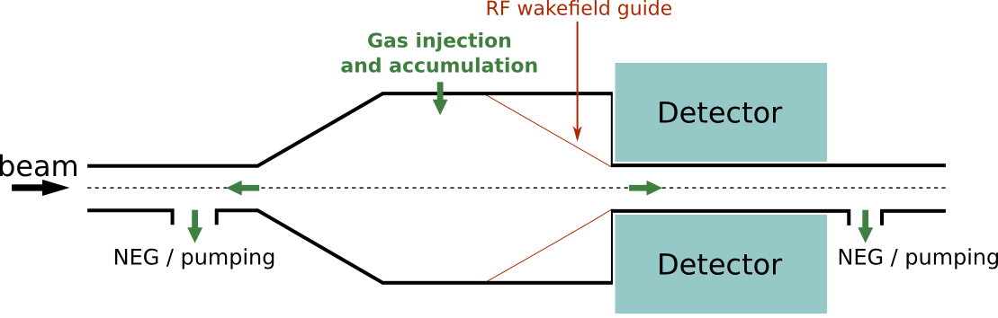
BGV Studies
What is a BGV ?
BGV stands for Beam Gas Vertexing
studies for a beam shape imaging detector, based on vertex reconstruction of beam-gas interactions.
The goal is also to provide transverse emittance measurements at the LHC.

Slide 24
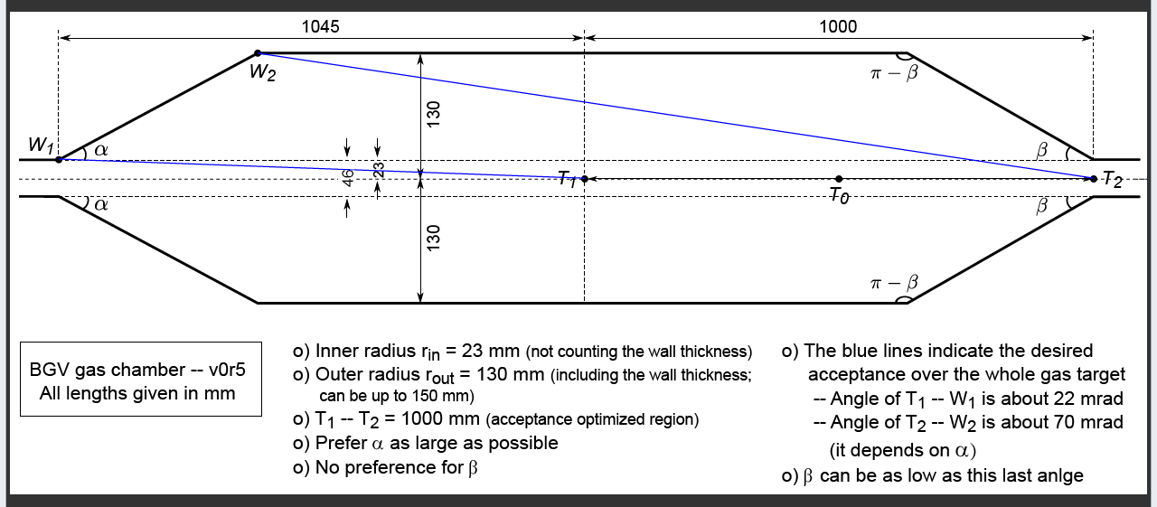
BGV Studies
What is a BGV ?
Structure

Slide 25
BGV Studies
Plan of study
Radius of 147mm
Radius of 106mm
    Influence of the length
    Influence of the taper
    Influence of the angle of the taper

Slide 26
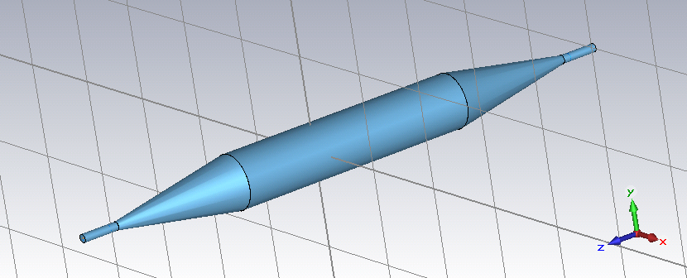
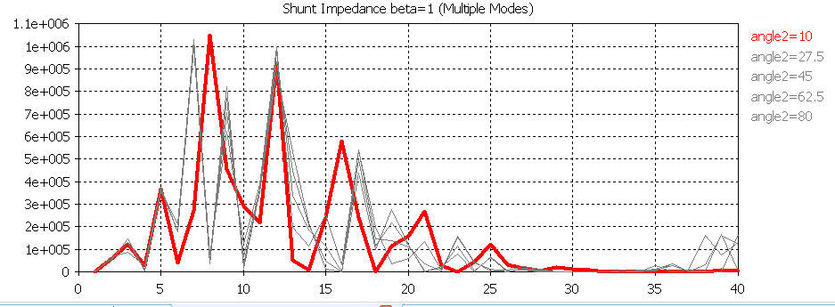
BGV Studies
Scan over Angle 2
147mm radius
Eigenmode simulations
Angle 1=10 degrees
Longitudinal impedance in LinacOhm
Frequency in GHz
→ Tapers don’t kill all the modes
→ Many longitudinal resonances whatever the angle from 800 MHz onwards.

Slide 27
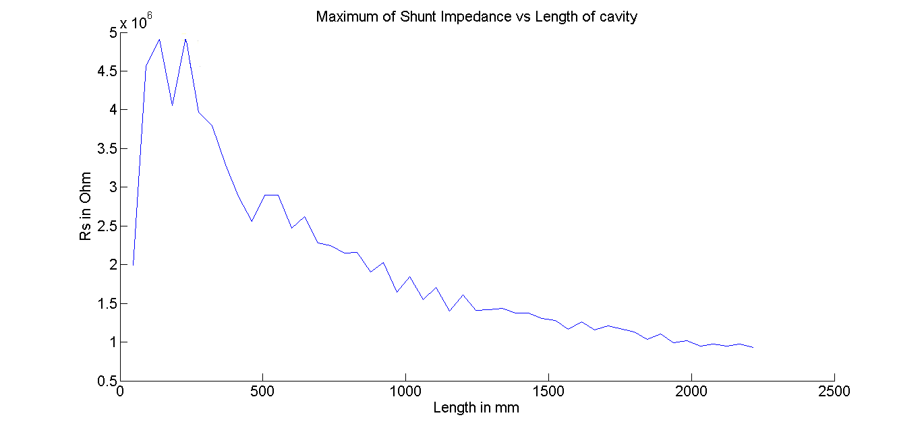
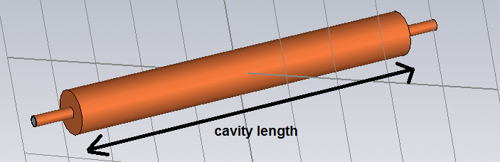
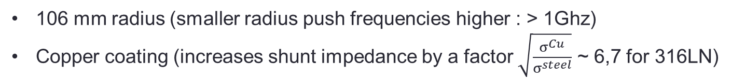
BGV Studies
106 mm radius (smaller radius push frequencies higher : > 1Ghz)
Copper coating (increases shunt impedance by a factor $\sqrt{\frac{σ^{Cu}}{σ^{steel}}}$ ~ 6,7 for 316LN)
Rs in LinacOhm
Not monotonic
The length of the cavity should not be too small
Frequency of the modes is not plotted, but is also important to assess their effects

Slide 28
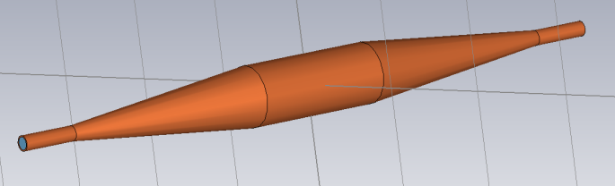
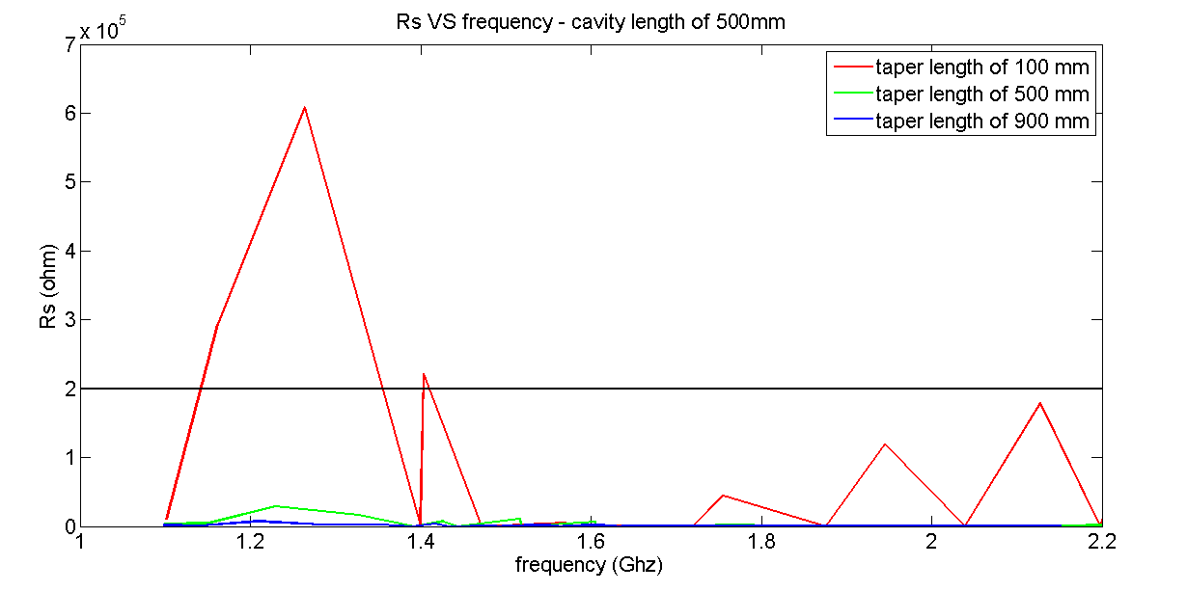
BGV Studies
L
l
Influence of the taper – L = 0.5m
l
Rs in LinacOhm
→ The longer taper, the better

Slide 29
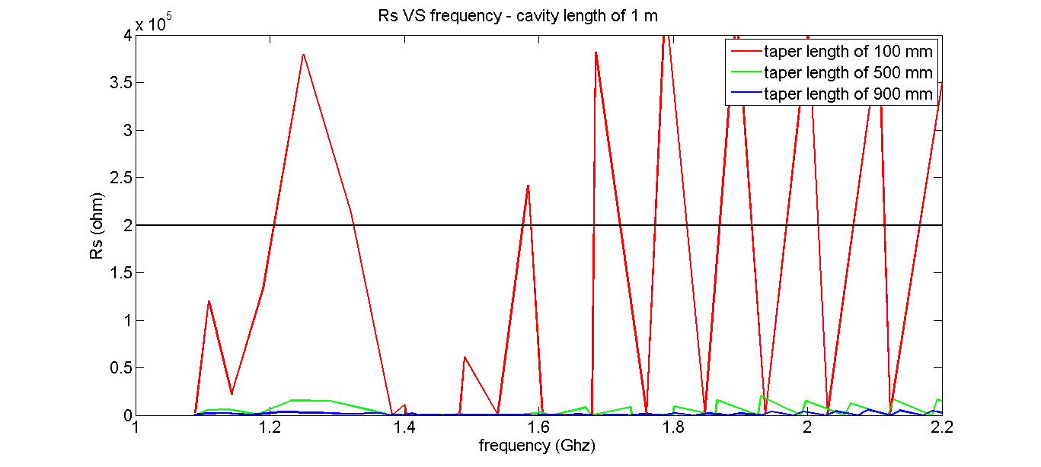
BGV Studies
L
l
Influence of the taper – L = 1m
l
Rs in LinacOhm
→ The longer taper, the better

Slide 30
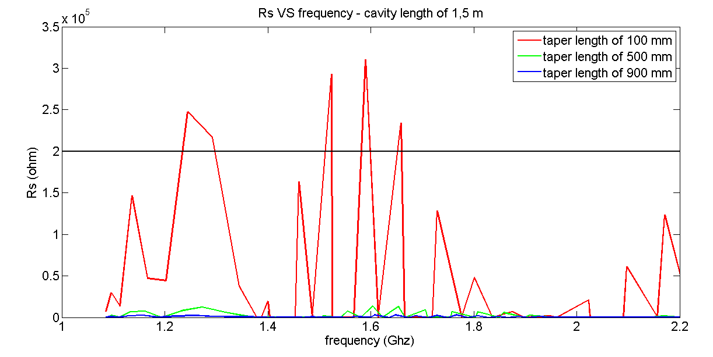
BGV Studies
L
l
Influence of the taper – L = 1.5m
l
Rs in LinacOhm
→ The longer taper, the better

Slide 31
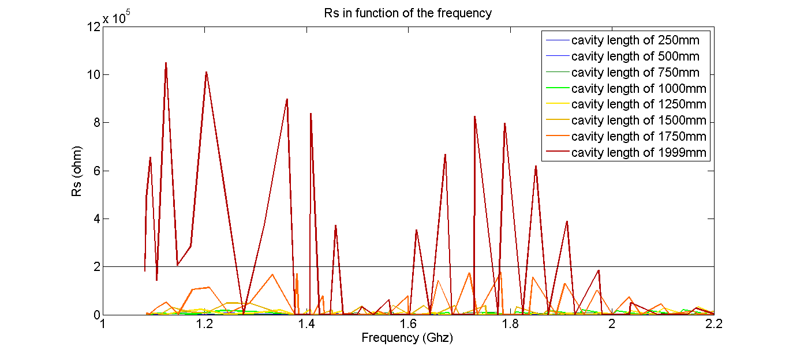

BGV Studies
106 mm radius (smaller radius push frequencies higher)
Copper coating (increases shunt impedance by a factor $\sqrt{\frac{σ^{Cu}}{σ^{steel}}}$ ~ 6,7 for 316LN)
Full length of about 2 m (taper included)
L+2l = 2 m
l
L
l
Cavity length increases
→ Taper length decreases

Slide 32
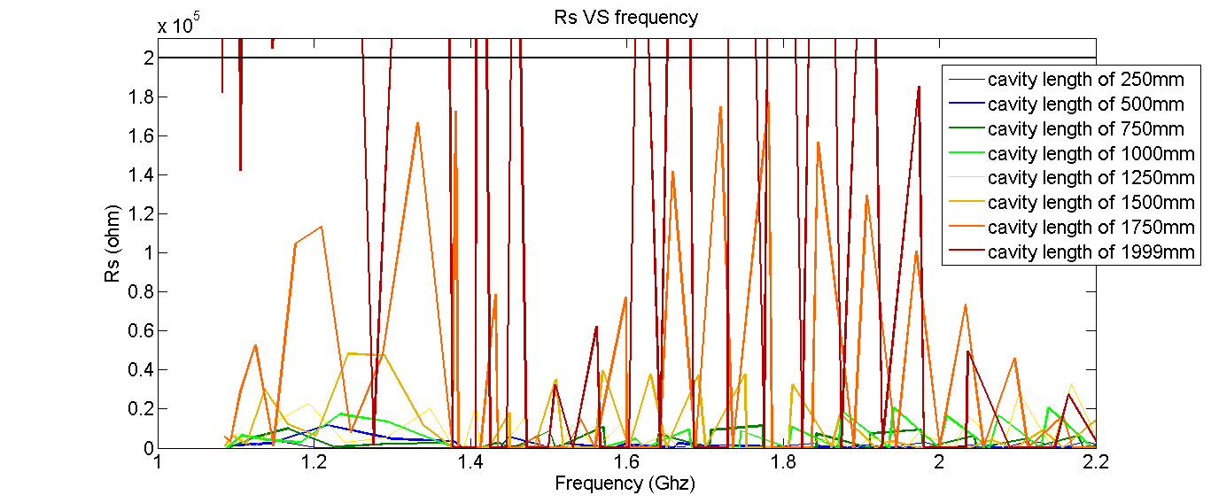
BGV Studies
L+2l = 2 m
l
L
l
Zoom below the limit
Rs in LinacOhm
The longer the taper, the better (for the symmetric case)
Even with copper coating, well below the limit below 1.5 m of flat length

Slide 33
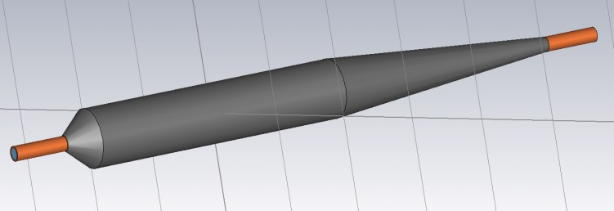
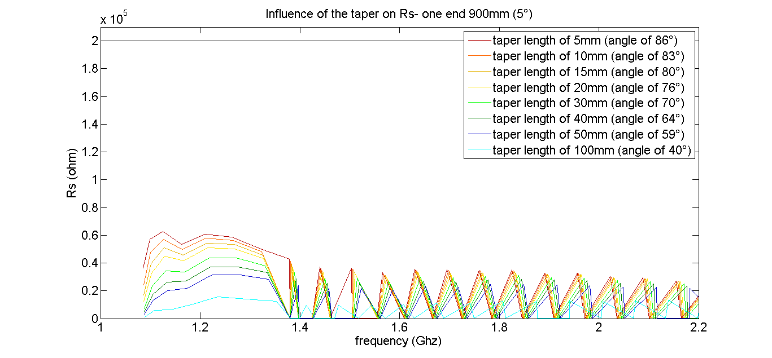
BGV Studies
Angle 2=5 degrees
Scan over Angle 1
Total length: 2 m
More realistic : Copper and Steel structure
Longitudinal studies
Copper
Copper
Stainless Steel 316LN
Rs in LinacOhm
The lower the tapering angle, the better
Under the limit even with angle close to 90°

Slide 34
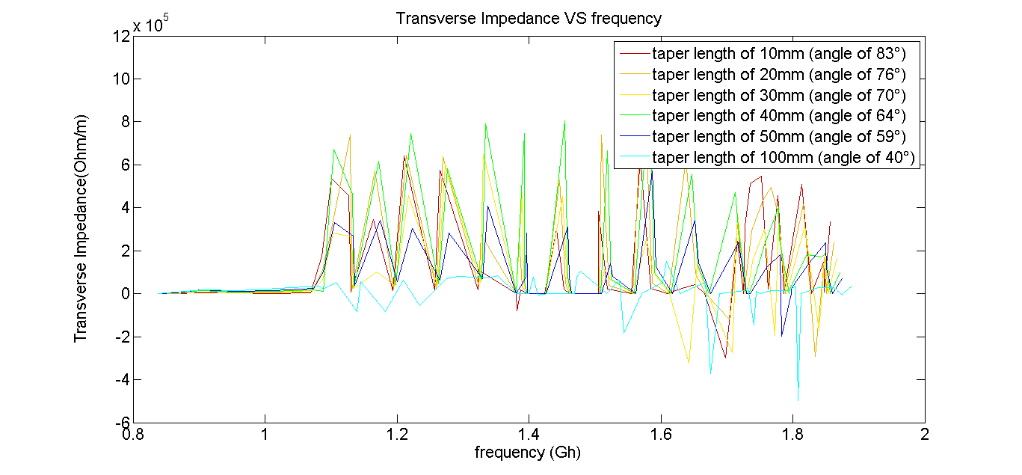
BGV Studies
Angle 2=5 degrees
Scan over Angle 1
Total length: 2 m
Transverse studies
Copper
Copper
Stainless Steel 316LN
Transverse Impedance in LinacOhm/m
Seems ok but still need some precision
Waiting fot the final structure to do more accurate simulations

Slide 35
BGV Project
Conclusions
106 mm radius helped a lot
With the Steel/Copper structure, longitudinal and transverse modes seem to be under the acceptable limit
We are still waiting for the final structure to confirm these first studies

Slide 39
radius
length

Slide 40
Transverse Impedance
Cavity used
Conductivity = 1e3 S/m
Double parameter sweep :
Radius from 30 to 60 mm
Length from 20 to 60 mm
radius
length

Slide 41

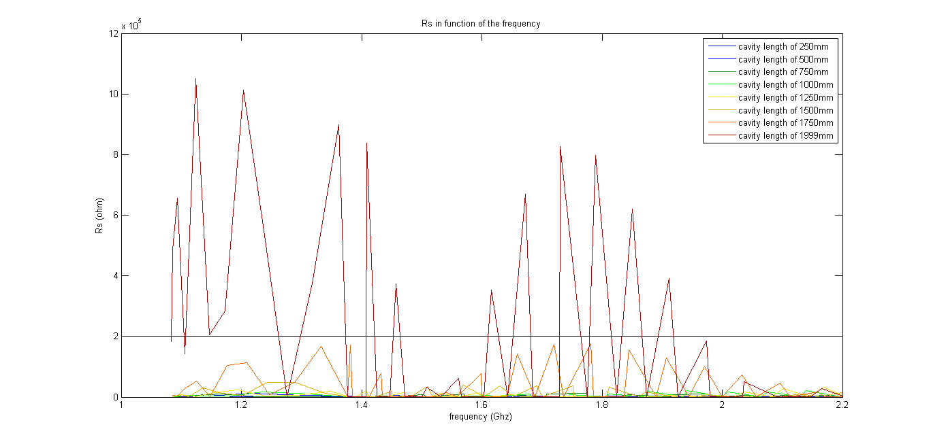

A more realistic geometry
106 mm radius (smaller radius push frequencies higher)
Copper coating (increases shunt impedance by a factor $\sqrt{\frac{ρ^{Cu}}{ρ^{steel}}}$ ~ 6 for 316LN)
Full length of about 2 m (taper included)
l
L
l
L+2l = 2 m
Cavity length increases
→ Taper length decreases

Slide 42
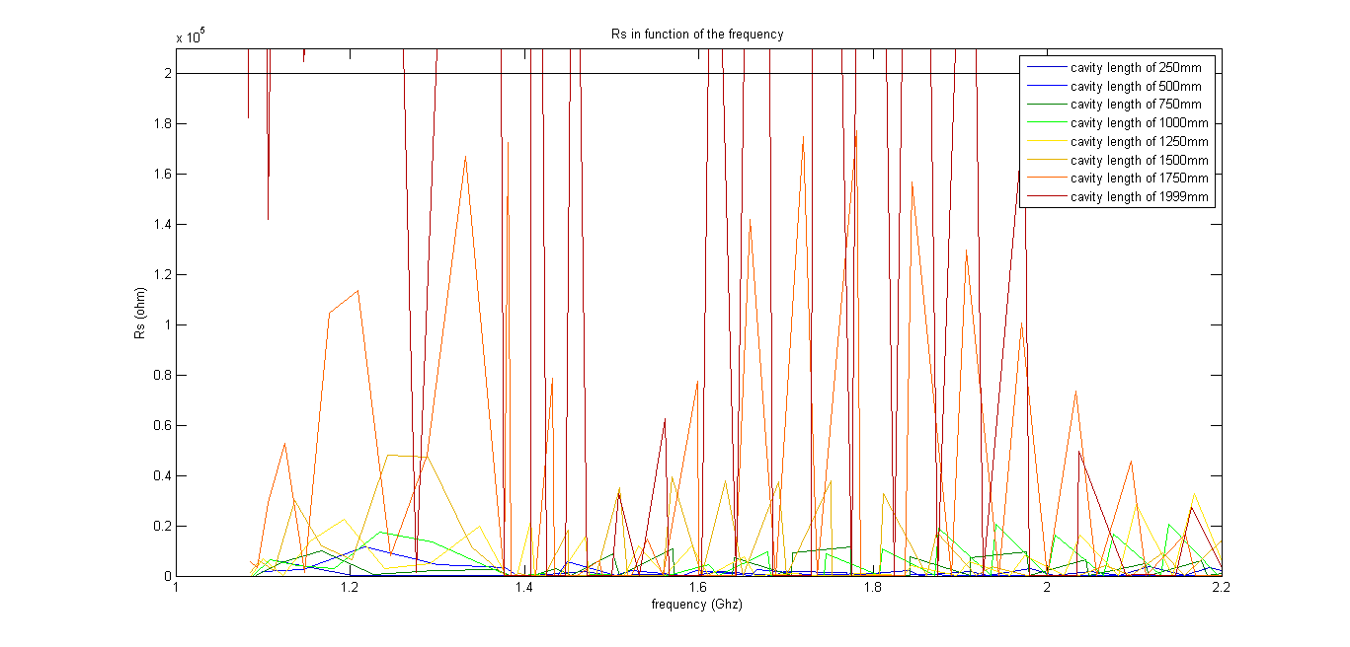
Zoom below the limit
The longer the taper, the better (for the symmetric case)
Even with copper coating, well below the limit below 1.5 m of flat length
(with Ploss of 40 W → is it acceptable from mechanical point of view?).

Slide 43
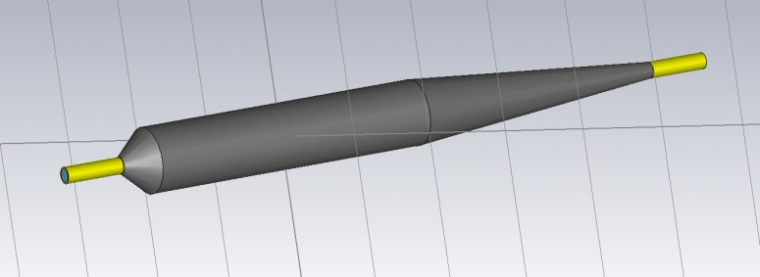
Longitudinal impedance at high frequency
Angle 2=5 degrees
Total length: 2 m
Copper and Steel structure
Scan over Angle 1
Copper
Copper
Stainless Steel 316LN
The lower the tapering angle, the better
Under the limit even with angle close to 90°

Slide 44
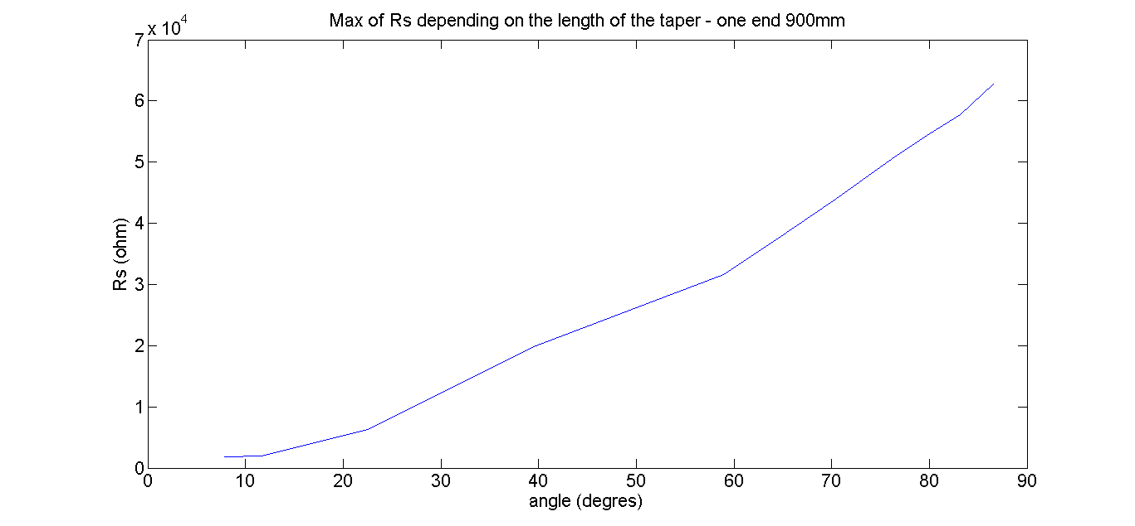
Longitudinal impedance at high frequency
Angle 2=5 degrees
Total length: 2 m
Scan over Angle 1
Copper
Copper
Stainless Steel 316LN

Slide 45
Transverse impedance at high frequency
Total length: 2 m
Angle 2=5 degrees
Scan over Angle 1
Copper
Copper
Stainless Steel 316LN

