Slide 1

https://ab-mgt-md-users.web.cern.ch/ab-mgt-md-users/2012/index.html
Overview on the collective effects studied in 2013 MDs in the LHC injectors
Giovanni Rumolo
on behalf of all MD users
Giovanni Rumolo, ICE meeting, 26 June 2013, CERN

Slide 2
Introduction
Prolongation of the MD run into 2012 agreed by LMC on 17/10/2012, as a result of the Beam Studies Review (28/08/2012)
Originally four additional weeks for studies
  The final run extension allowed for an extra week of MDs during the LHC run with protons at intermediate energy
PSB and PS had parallel MDs ongoing all the time with several MD users (no limitations as there were no physics users). PS MDs only stopped during LHC filling
SPS had at least one parallel cycle all the time MD users requested for it – in addition to the NA ion physics cycle
  No MD including ramps to 450 GeV/c to limit the energy consumption (only exception was for orbit measurements at top energy with Q26)
  Possibly only single bunch MDs in order not to increase the activation level of the dump before LS1 (few exceptions with 25ns beams)

Slide 3
Disclaimer
Some studies already reported in detail in previous ICE meetings will not be reviewed again here. For ex.
  Space charge
  Impedance localization
Huge amount of data acquired and stored in these five weeks …..
For most of the MDs, the data analysis will probably require quite a long time to be completed (also including all the simulation work needed for the interpretation)
Most of the results/plots shown in this presentation are PRELIMINARY

Slide 4
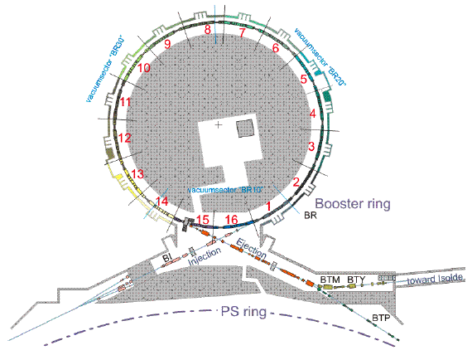
Transverse instabilities
PSB
Detailed study of the instability at c370
  Scan intensities in single and double RF (determine thresholds)
  Scan C04 voltage
  Scan chromaticity by means of the harmonic sextupoles. This was found to affect the instability threshold (the beam was stable throughout the cycle with horizontal chromaticity close to 2)
  Scan damper gain
  Record instability data with Q-meter and with TFB pick-up
Few scans for the “second” instability at c480
  Determine thresholds in double RF
  Record instability data with Q-meter and with TFB pick-up
K. Li & N. Mounet, et al.

Slide 5
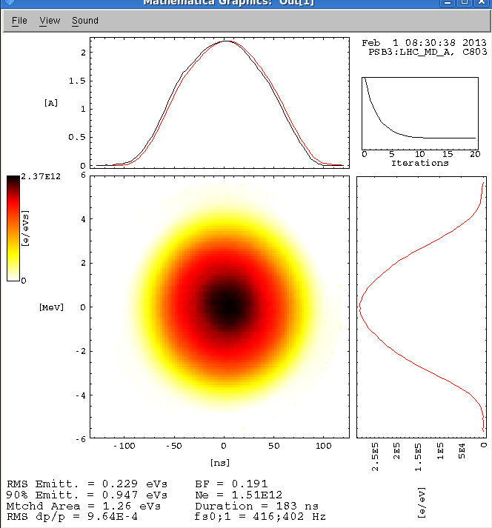
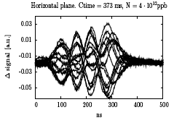
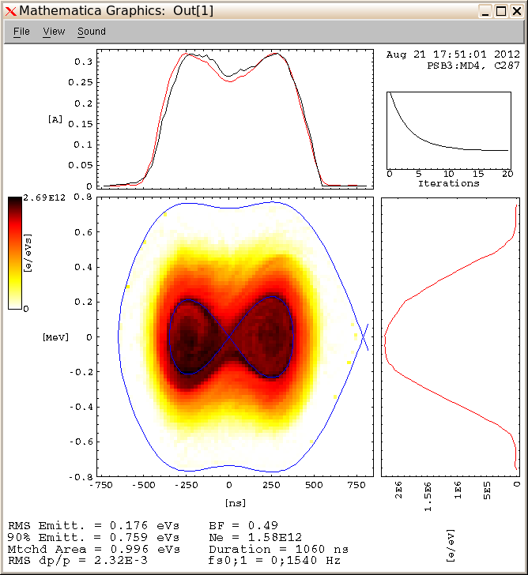
PSB
β
PSB acceleration cycle
Extraction@c805
Feedback on, beam stable
Feedback off, beam unstable @c370 and @c480
Injection@c275
K. Li & N. Mounet, et al.

Slide 6
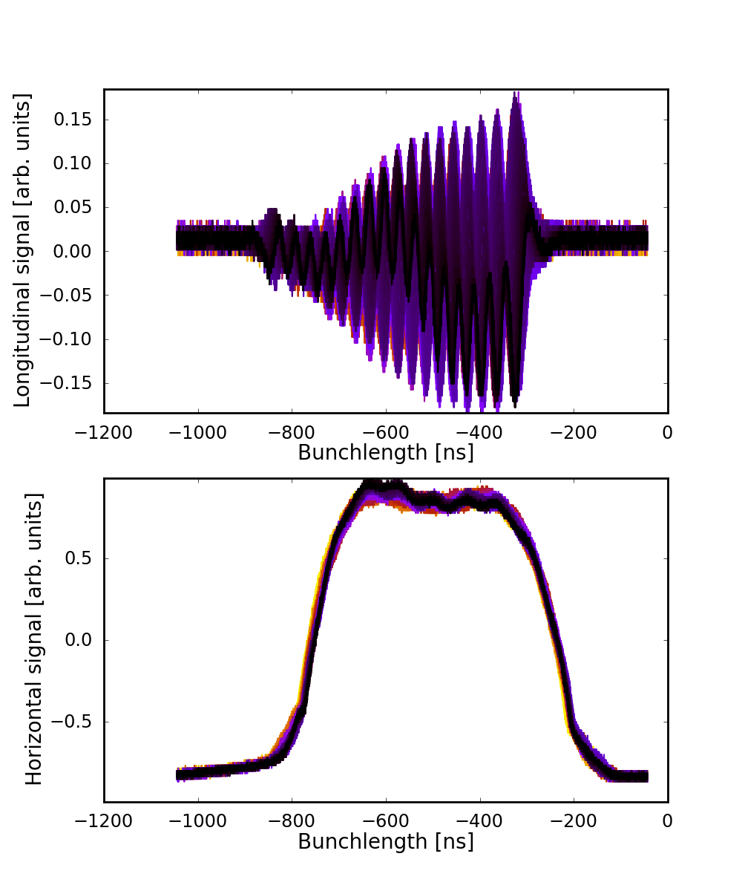
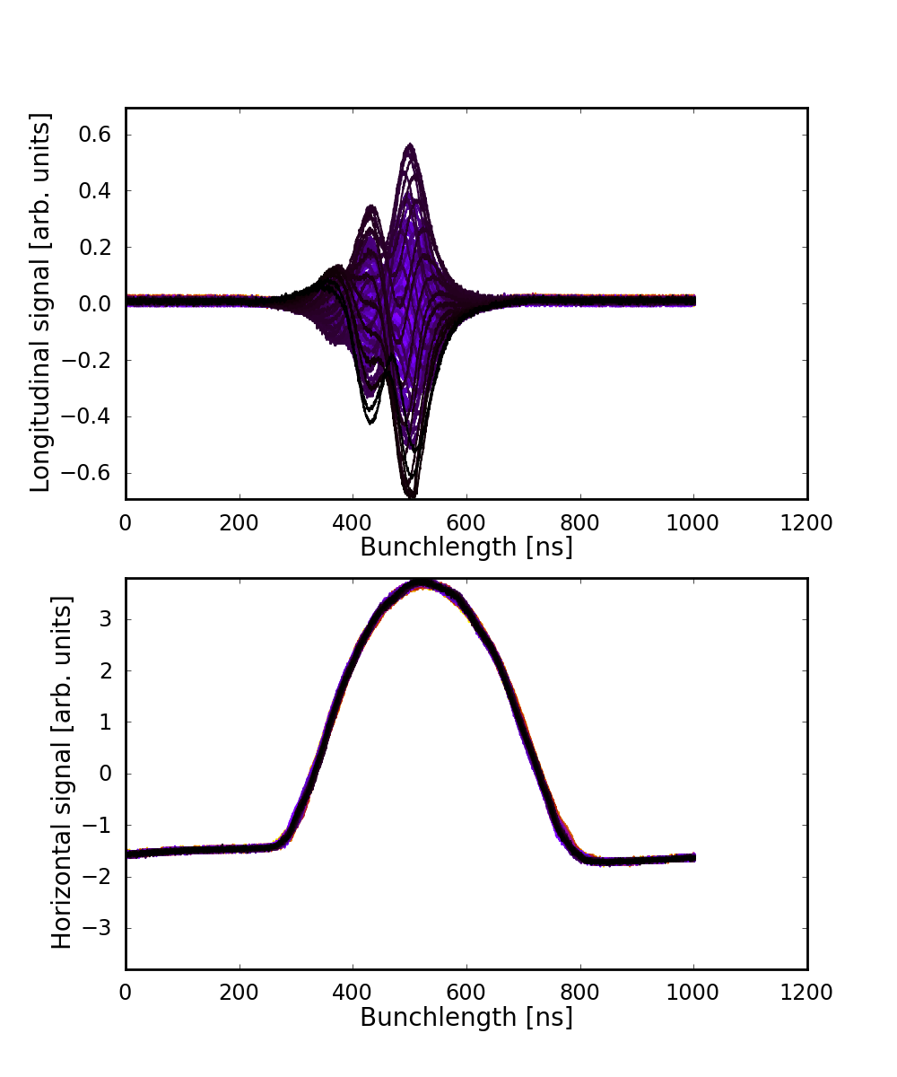
Transverse instabilities
PSB
ξ_{x} = 2.5
ξ_{x} = 0.9
K. Li & N. Mounet, et al.

Slide 7
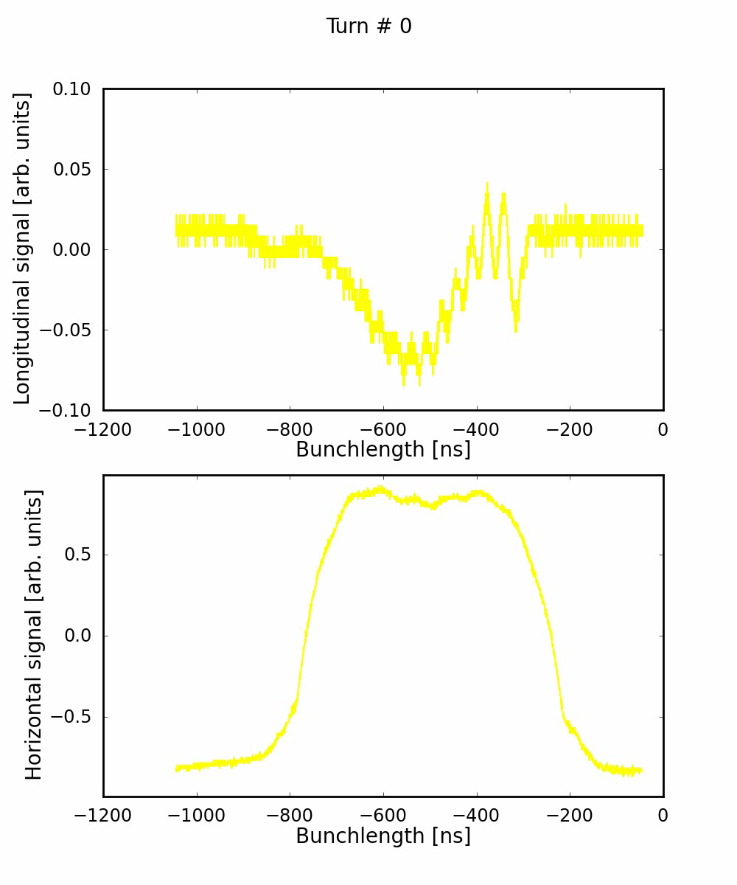
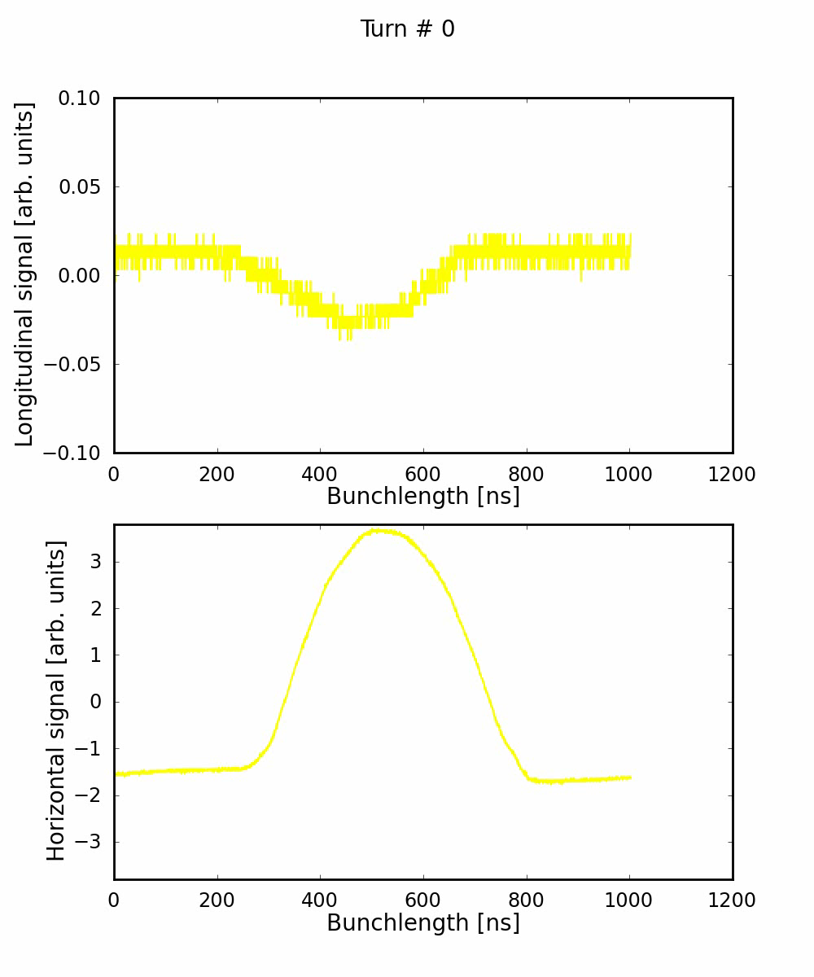
Transverse instabilities
PSB
K. Li & N. Mounet, et al.

Slide 8
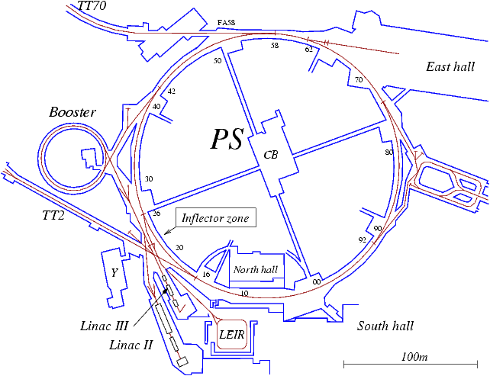
Transverse feedback system
PS
Excite and cure with the transverse feedback the head-tail instabilities of the uncoupled machine at injection energy
  Correct coupling (excite)
  Scan chromaticity to change the mode number (change intra-bunch pattern)
  Switch on transverse damper
Other studies
  Damping of injection oscillations
  Try to suppress H instability at 26 GeV (electron cloud?), clear beneficial effect observed but not full suppression
  Not effective against TMCI at transition on high intensity LHCINDIV (instability frequency beyond TFB bandwidth)
G. Sterbini, N. Mounet, A. Blas, D. Perrelet

Slide 9
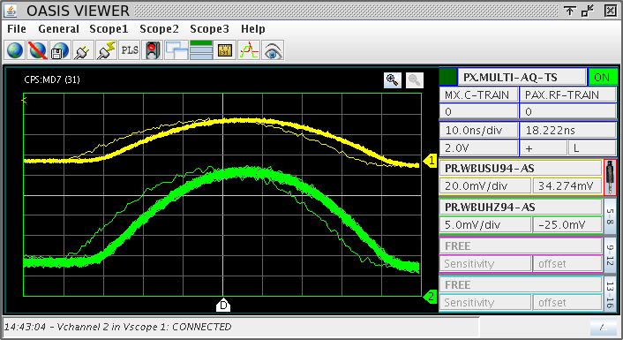
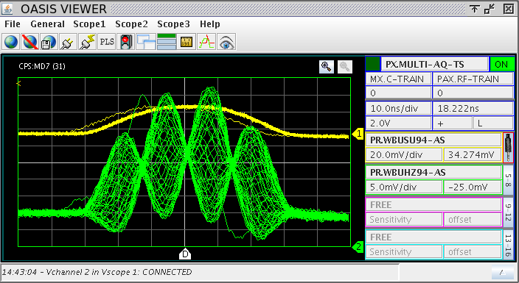
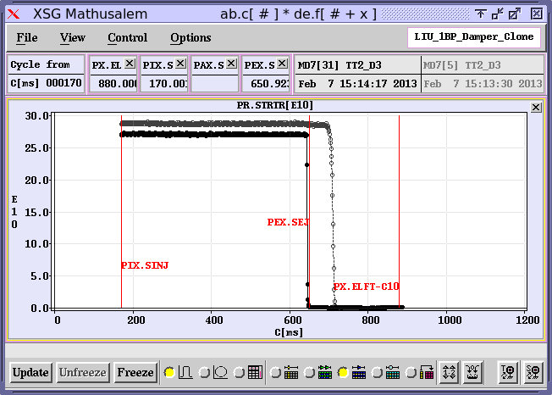
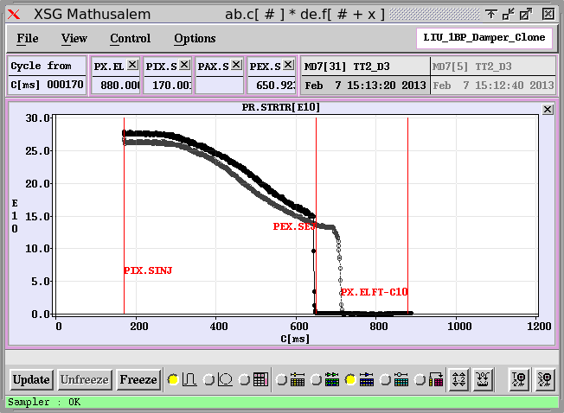
Transverse feedback system
(headtail instability @1.4 GeV)
PS
TFB off
TFB on
G. Sterbini, N. Mounet, A. Blas, D. Perrelet

Slide 10
Transverse feedback system
(electron cloud instability at 26 GeV/c)
PS
10 ms
G. Sterbini, A. Blas, G. Iadarola, et al.

Slide 11
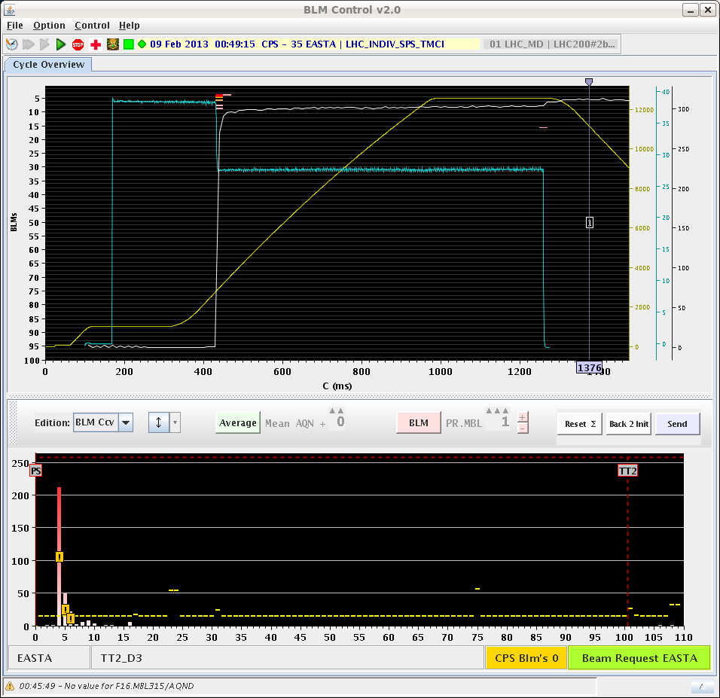
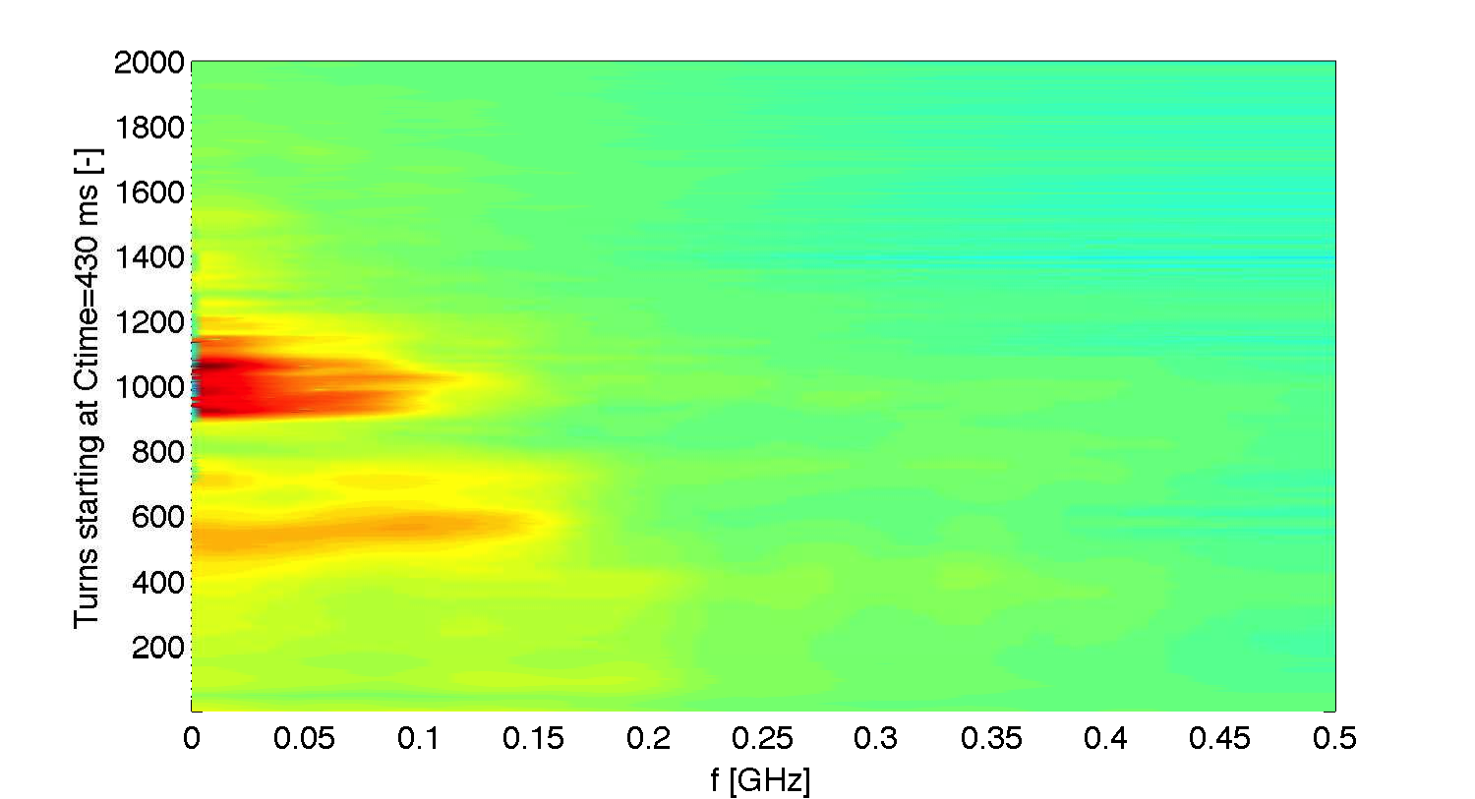
Transverse feedback system
(transition instability)
PS
While doing SPS MDs with single bunch, a very fast single bunch transition instability for intensity above 45e10 ppb and 0.25-0.3 eVs was observed.
It was attempted to set up the TFB to cure the instability.
The TFB did not have any effect.
From the spectrogram it is possible to see that this instability is beyond the BW of the system.
G. Sterbini, A. Blas, et al.

Slide 12
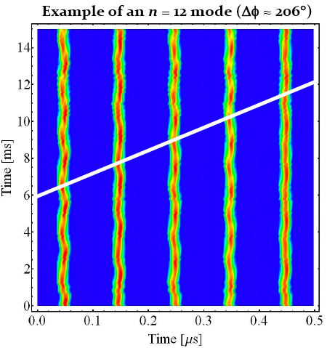
Longitudinal coupled bunch instabilities and feedback
PS
Excitation and damping of coupled-bunch modes
  Spare 10 MHz cavity C10-11 could be used as kicker cavity for the feedback (no high intensity beams to LHC in 2013), tuned to the mode to be damped
  Mode scans (excite modes individually and measure spectra)
  Damping time vs. kicker (voltage) strength
  Damping times versus longitudinal emittance, intensity and feedback gain
  Damping times for modes around h = 19 and 20 along the cycle
Goal was to extract relevant voltage requirement and estimate performance of new longitudinal damper with wide-band kicker cavity (installed during LS1)
H. Damerau

Slide 13
E-cloud measurements
PS
Study on e-cloud formation BEFORE bunch rotation (last splitting + adiabatic shortening):
  Found to be the main contribution to the measured pressure rise in drift section
Tested possible mitigation strategies (for different intensities):
  Lower RF voltage during splitting
  Double bunch rotation
  Shorter trains (60b. or 48.b)
No e-cloud before bunch rotation observed with 50 ns beams
H. Damerau, G. Iadarola

Slide 14
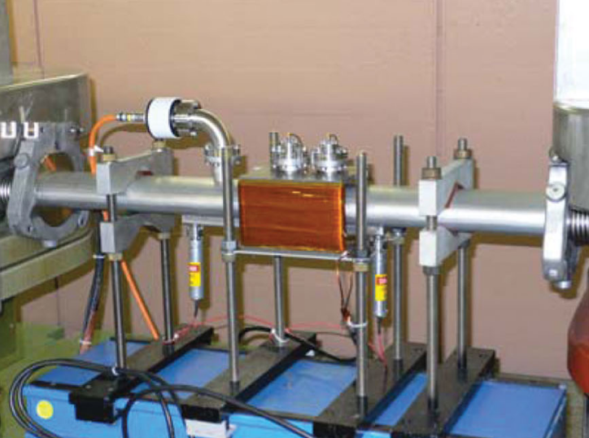
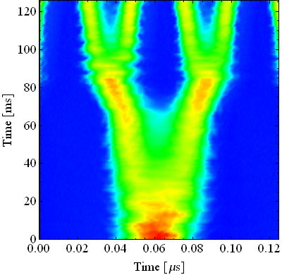
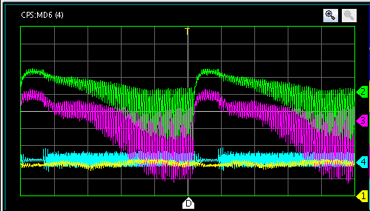
E-cloud measurements
PS
h=42
b.sp. = 50 ns (36 b.)
h=84
b.sp. = 25 ns (72 b.)
300
4 ns
Double splitting
250
200
40 MHz RF Voltage [kV]
Bunch rotation
150
100
11 ns
50
b.l.≈14 ns
40 kV
0
10
20
30
40
50
60
Time [ms]
Adiabatic shortening
H. Damerau, G. Iadarola

Slide 15
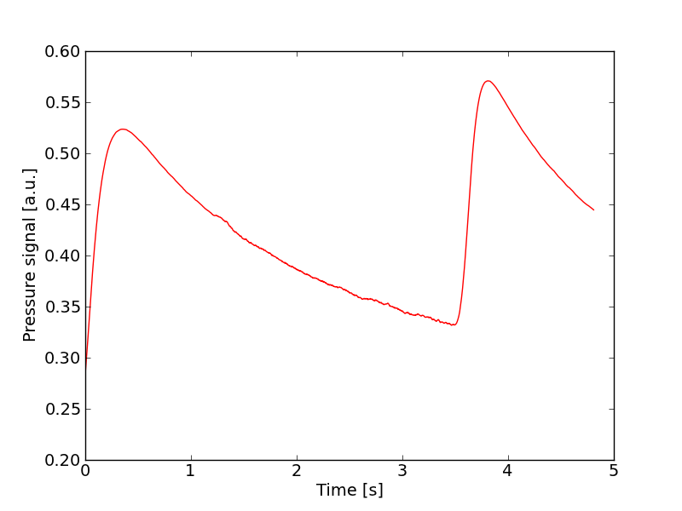
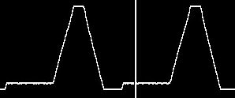
E-cloud measurements
PS
  The signal from the pressure gauge at SS98, can be used as an “time integrated” e-cloud indicator along the cycle (actually along the last ~60ms before extraction)
H. Damerau, G. Iadarola

Slide 16
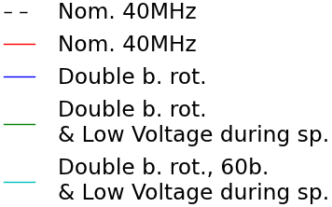
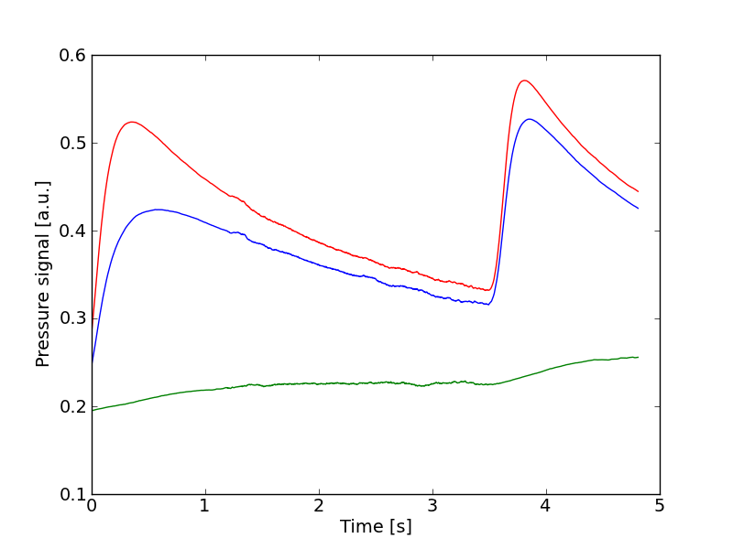
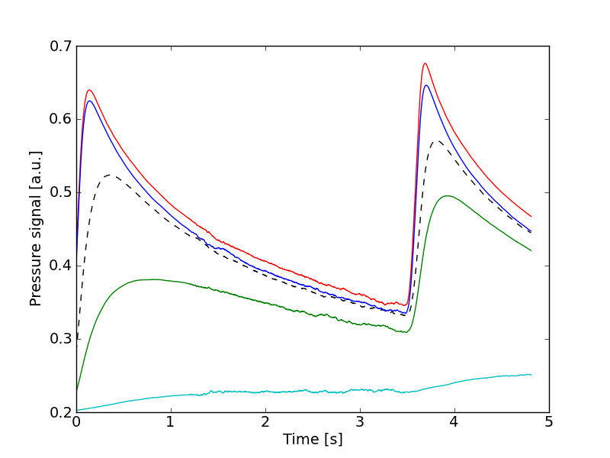
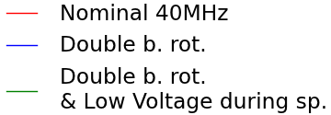
E-cloud measurements
PS
1.25e11 ppb
1.45e11 ppb
H. Damerau, G. Iadarola

Slide 17
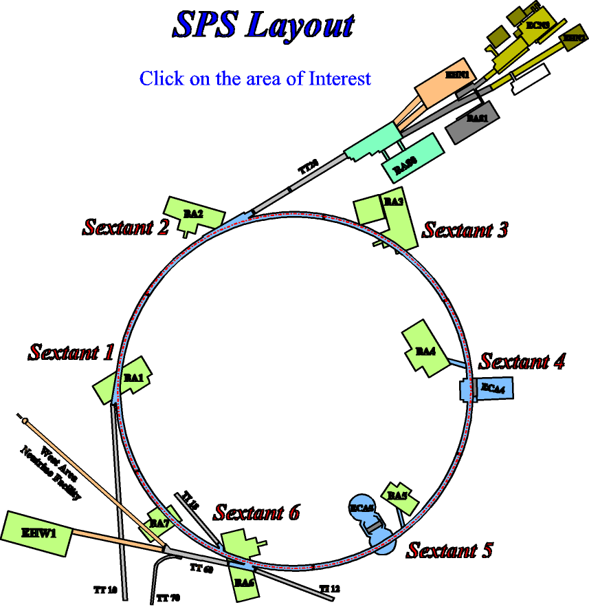
RF MDs
SPS
Synchrotron frequency shift with intensity - reference impedance measurements (single bunches in Q26)
  to see effect of impedance reduction (MKEs)
  to compare with simulations (test the impedance model)
Spectra of long unstable bunches with RF off in Q20
  to compare with measurements in Q26 (from 2012)
  to identify high impedances (resonant frequencies)
Single bunch stability in a single and a double RF systems (in Q26 and Q20)
  to compare with simulations
  to see effect of phase-space distribution (after rotation in PS)
  to compare with measured multi-bunch instability thresholds
E. Shaposhnikova, T. Argyropulos, T. Bohl, J. Esteban-Müller, H. Timkó

Slide 18
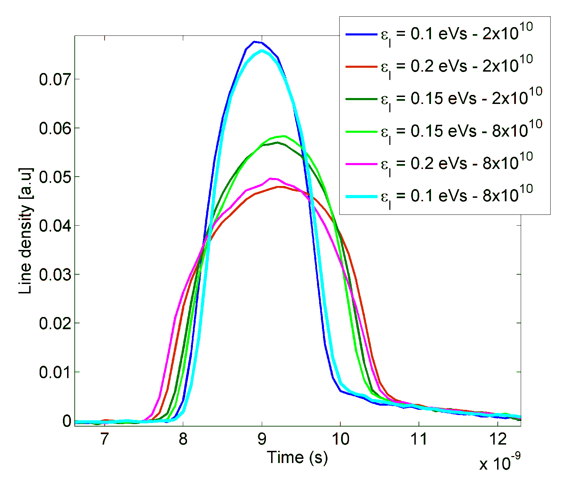
RF MDs
SPS
Intensity/longitudinal emittance defined at the PSB with new C16 knob (S. Hancock)
E. Shaposhnikova, T. Argyropulos, T. Bohl, J. Esteban-Müller, H. Timkó

Slide 19
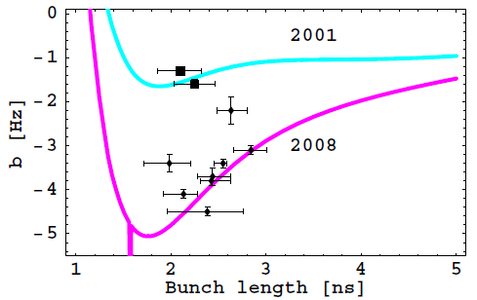
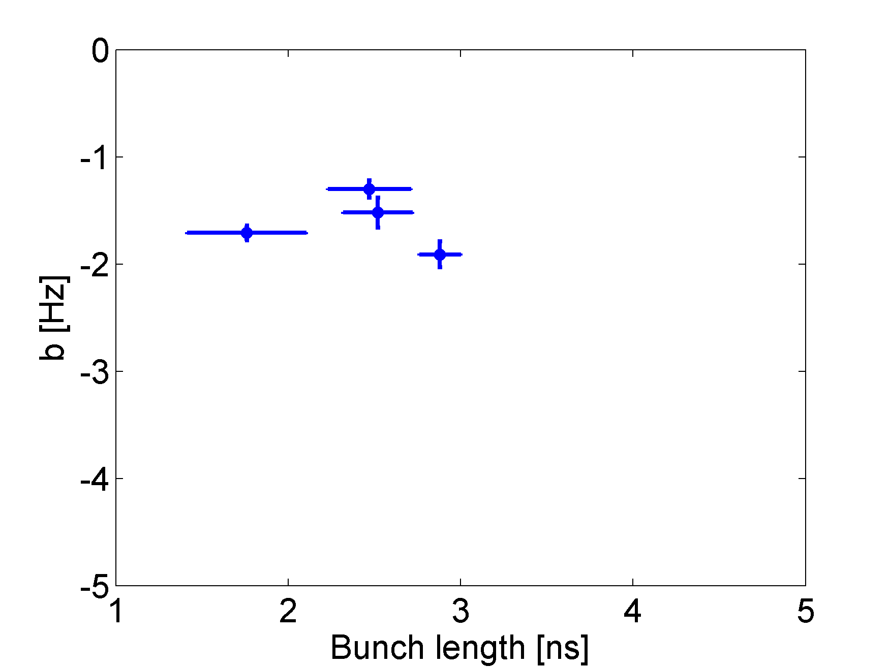
RF MDs
SPS
  Slope of synchrotron frequency shift
  as a function of bunch length
  Comparison with 2008 shows that longitudinal impedance is reduced (serigraphy of MKEs)
  More studies ongoing on the identification of the 1.4 GHz impedance source
E. Shaposhnikova, T. Argyropulos, T. Bohl, J. Esteban-Müller, H. Timkó

Slide 20
Transverse MDs
SPS
TMCI threshold
  Detailed studies done for Q20 and Q26 in parallel in same supercycle
  Broad region of longitudinal emittance vs. intensity space covered
    Low chromaticity for TMCI scans
    Negative chromaticity scanned in both optics
  Different voltages, always in double RF with voltage of 800MHz at 10% of that of 200 MHz
  Recorded all data from Qmeter, BBQ, BCT, WCM, Wirescanner, Headtail monitor, εl (PS), PS BCT → to be analyzed in detail and compared with simulations!
Doublet 25ns beam
  First tests: injection of two bunches with voltage dip
  Short test of injection of two batches
  Voltage program optimized to efficiently split the bunches in both batches (however, TFB still to be set up for this beam!)
H. Bartosik & G. Iadarola, et al.

Slide 21
Transverse MDs (TMCI)
SPS
Q26 optics
Border between stable and unstable region is a line
No stability found for intensities larger than 2 x 10¹¹ ppb
H. Bartosik & G. Iadarola, et al.

Slide 22
Transverse MDs (TMCI)
SPS
“Island’ of slow instability observed for intermediate intensity and small ε_{l}
Different behavior than Q26
Q20 optics
H. Bartosik & G. Iadarola, et al.

Slide 23
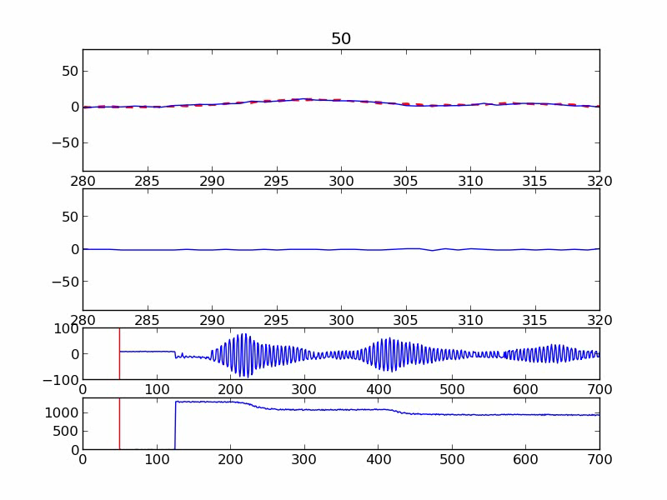
Transverse MDs (TMCI)
SPS
H. Bartosik & G. Iadarola, et al.

Slide 24
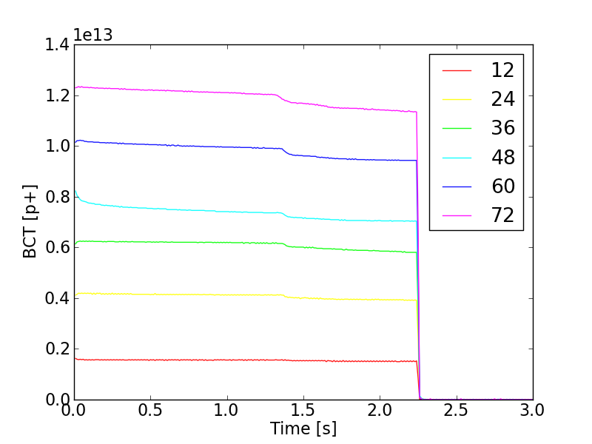
Transverse MDs (doublet beam)
SPS
Low injection losses
Higher chroma needed for trains longer than 48 bunches
Good capture, as visible from the low losses at the beginning of ramp
H. Bartosik & G. Iadarola, et al.

Slide 25
Transverse MDs (doublet beam)
SPS
  Beam profile along the cycle
H. Bartosik & G. Iadarola, et al.

Slide 26
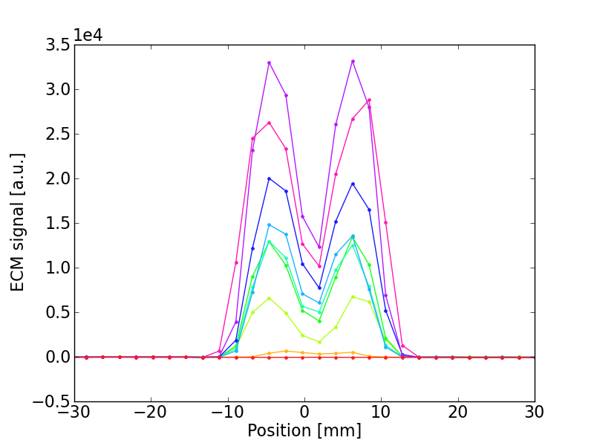
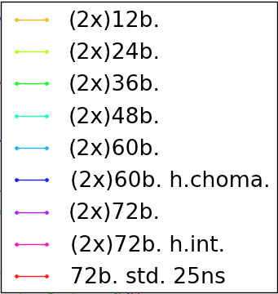
Transverse MDs (doublet beam)
SPS
  MBA-like Stainless Steel liner
25ns “doublet” (1.7e11p/doublet)
25ns standard
(1.6e11p/bunch)
H. Bartosik & G. Iadarola, et al.

Slide 27
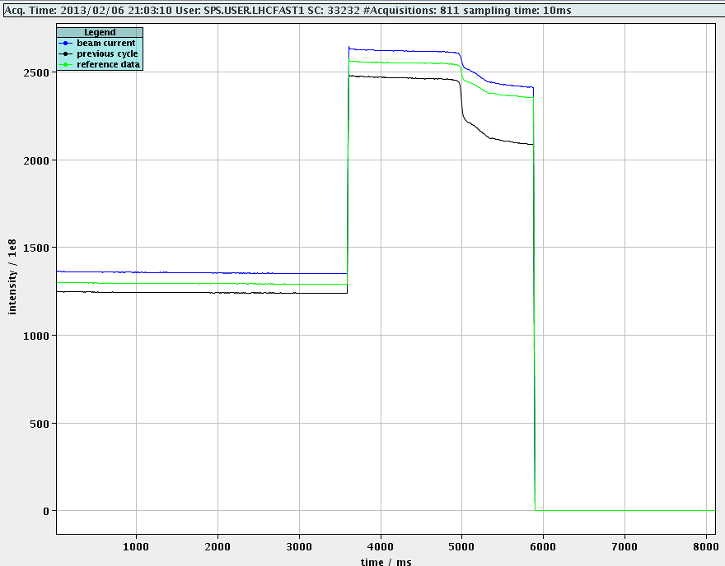
Transverse MDs (doublet beam)
SPS
Two batches injected and split
Low losses along the flat bottom
Improved capture with optimization of the voltage program around 2nd injection
H. Bartosik & G. Iadarola, et al.

Slide 28
High bandwidth transverse damper
SPS
Driven motion studies
  Excite the beam through tailored excitation
  Control on selected modes by sweeping frequency
  Characterization of the response of the combined beam-feedback system
Feedback studies of naturally unstable or marginally stable beams
  Make the beam unstable with negative chromaticity (mode zero excited)
  Find feedback settings to suppress the instability and show that beam becomes unstable with FB off
  Feedback control needed to make more studies
W. Höfle, J. Cesaratto, J. Dusatko, J. Fox, G. Kotzian, C. Rivetta, U. Wehrle, H. Bartosik, K. Li

Slide 29
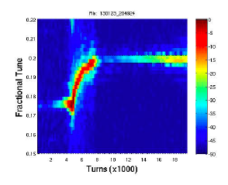
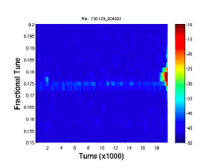
High bandwidth transverse damper
SPS
Instability
Beam loss
Instability
Feedback off
Feedback on
Chroma ramped down
Chroma ramped down
Feedback switch off
W. Höfle, J. Cesaratto, J. Dusatko, J. Fox, G. Kotzian, C. Rivetta, U. Wehrle, H. Bartosik, K. Li

