Slide 1
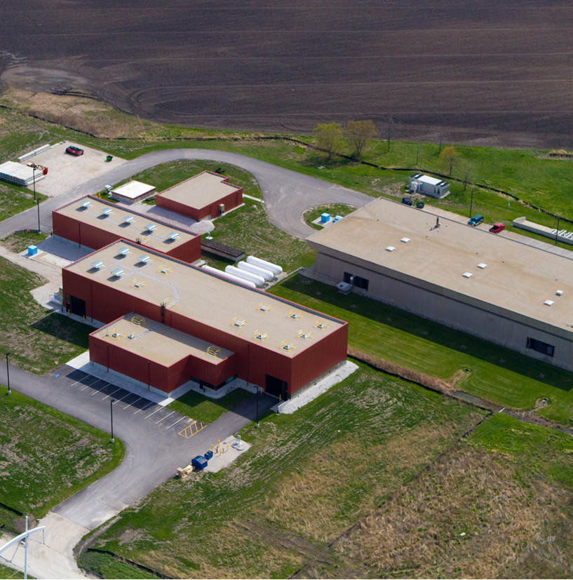
Project X Overview
L. Prost
(for the Project X team)
FNAL
Accelerator Physics forum
CERN
June 17, 2013
Many slides taken from
V. Lebedev, S. Nagaitsev,
S. Holmes and A. Shemyakin former presentations

Slide 2
Outline
Project X Facility Goals
Reference Design
Staging Strategy
R&D Program
  Project X Injector Experiment
Our websites:
http://projectx.fnal.gov
http://projectx-docdb.fnal.gov

Slide 3
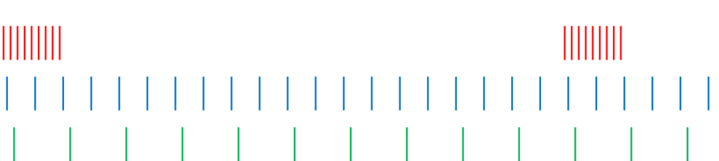
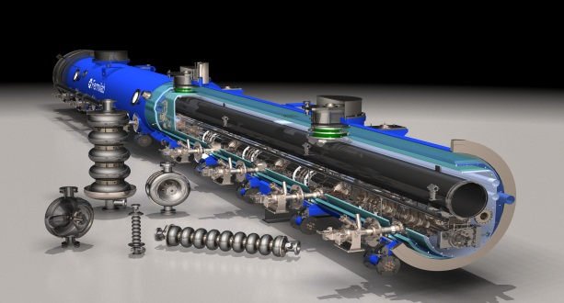
What is Project X?
The opportunity to construct and operate the foremost Intensity Frontier facility in the world: multi-MW proton beams available at energies ranging from 1 – 120 GeV
Unique ability to provide high beam power, high duty factor, independent beam formats to multiple experiments simultaneously
Capitalizing on the rapid development
of superconducting rf technology
Undertaken by an international
collaboration

Slide 4
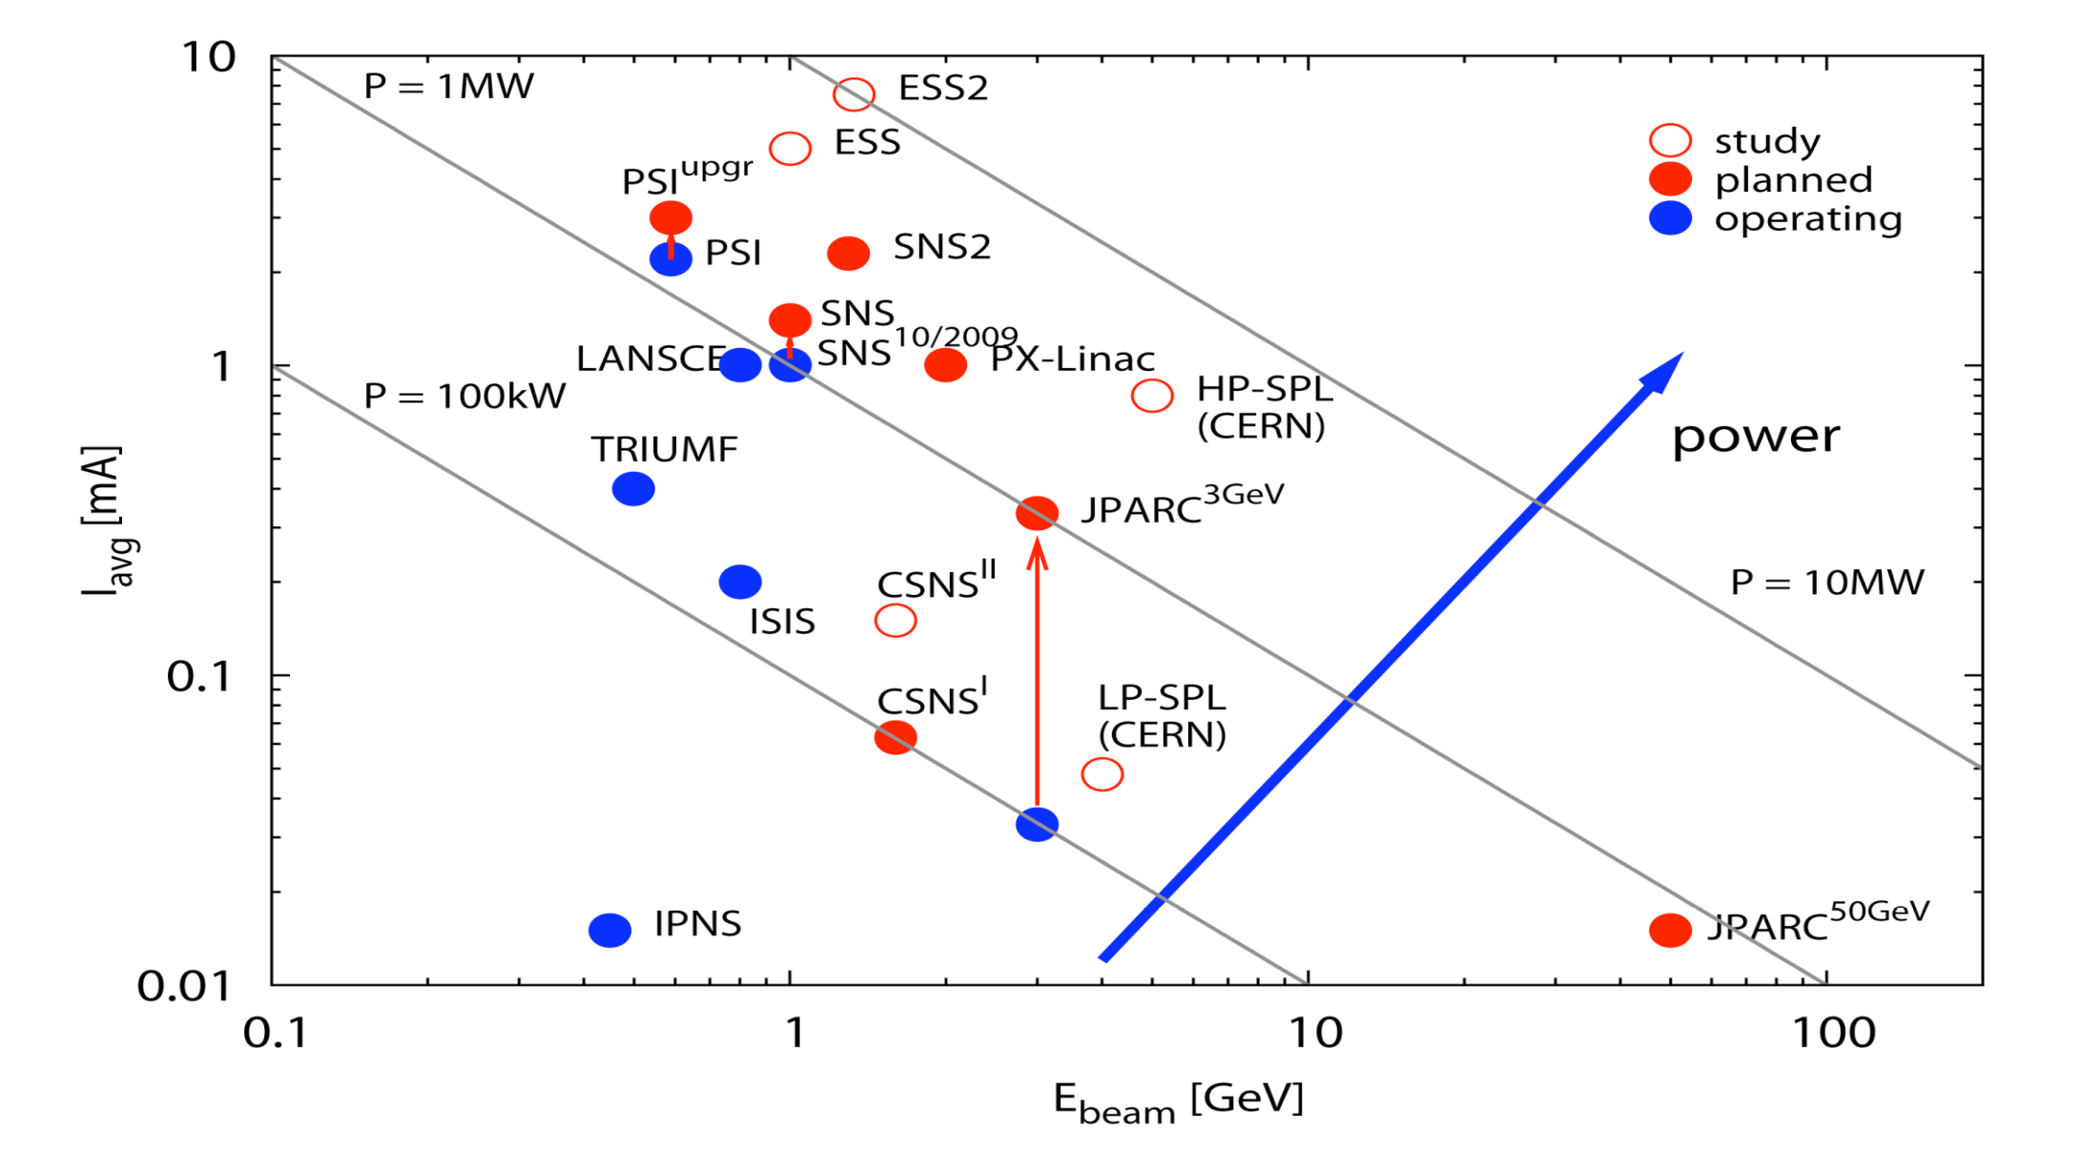
The Landscape
Project-X
M Seidel, PSI

Slide 5
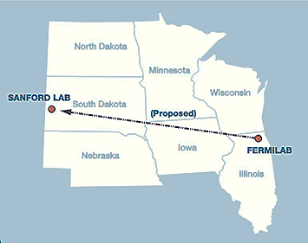
Facility Goals
A neutrino beam for long baseline neutrino oscillation experiments
  2 MW proton source at 60-120 GeV
MW-class low energy proton beams for kaon, muon, neutrino, and nuclei/ nucleon based precision
experiments
  Operations simultaneous with the
  neutrino program
A path toward a muon source for
possible future Neutrino Factory
and/or a Muon Collider
Possible missions beyond particle
physics
  Energy and materials applications

Slide 6
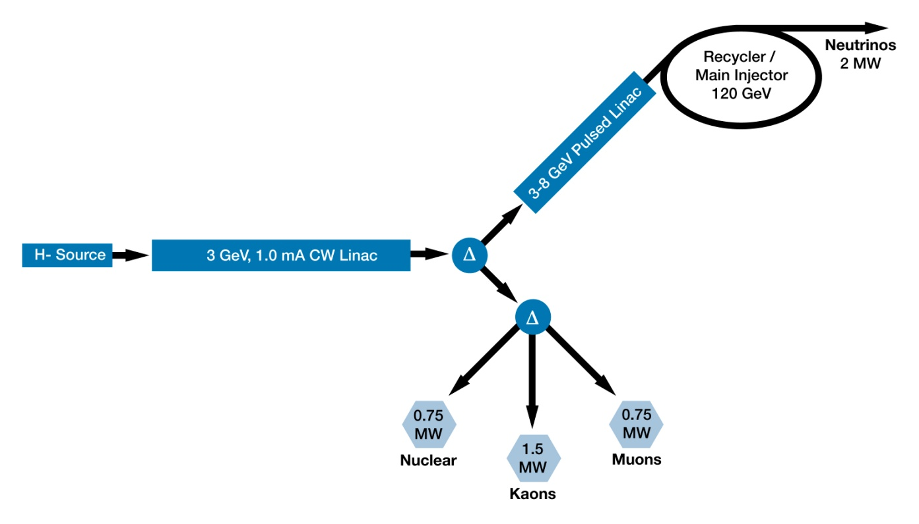
Project X Schematic
~5 % duty cycle
1.0
MW
1 GeV

Slide 7
Performance Goals

Slide 8
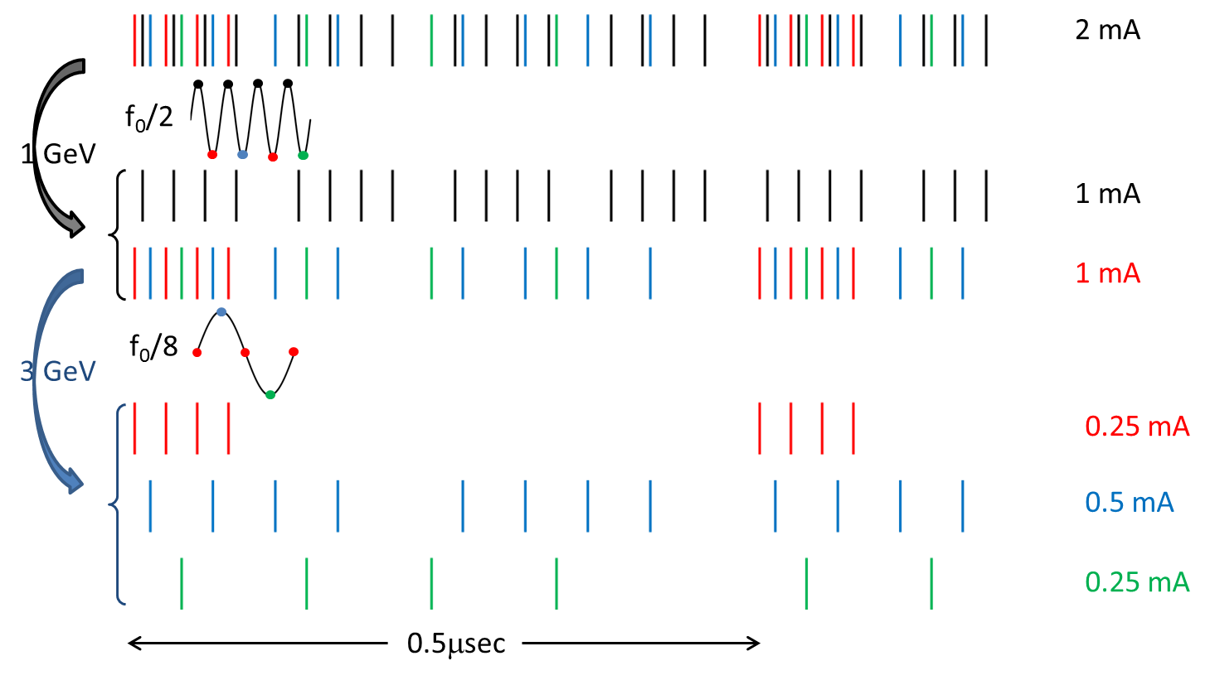
Beam(s) Structure
Bunch-by-bunch beam chopping and RF separation after acceleration are two corner stones of the project
  Each experiment can receive its desired bunch structure

Slide 9
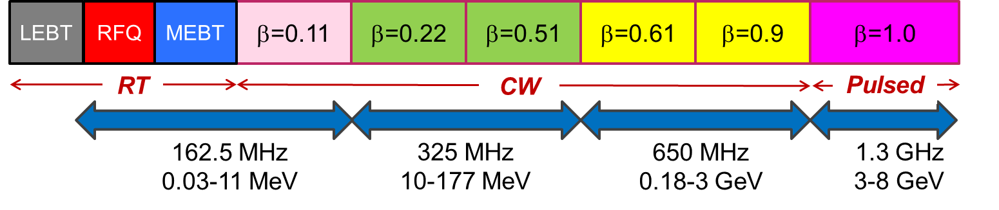
Linac technology map
“Standard” scheme for beam acceleration is used
  Except for acceleration in SRF from low energies
Section | Freq | Energy (MeV) | Cav/mag/CM | Type
RFQ | 162.5 | 0.03-2.1
HWR (β_{G}=0.1) | 162.5 | 2.1-11 | 8/8/1 | HWR, solenoid
SSR1 (β_{G}=0.22) | 325 | 11-38 | 16/8/ 2 | SSR, solenoid
SSR2 (β_{G}=0.51) | 325 | 38-177 | 35/21/7 | SSR, solenoid
LB 650 (β_{G}=0.61) | 650 | 177-467 | 30/20/5 | 5-cell elliptical, doublet
HB 650 (β_{G}=0.9) | 650 | 467-1000 | 42/16/7 | 5-cell elliptical, doublet
HB 650 (β_{G}=0.9) | 650 | 1000-3000 | 120/30/15 | 5-cell elliptical, doublet
ILC 1.3 (β_{G}=1.0) | 1300 | 3000-8000 | 224 /28 /28 | 9-cell elliptical, quad

Slide 10
Choice of Main Parameters
Bunch repetition rate of 162.5 MHz is set by RFQ
  Sub-harmonic of the ILC frequency
  The fastest rate compatible with bunch-by-bunch chopping
Beam energies are determined by experimental program
  1 GeV – nuclear physics, nuclear energy and μ-to-e
  3 GeV – kaon and muon experiments
Beam current
  5 mA from the ion source
    Bunch-by-bunch chopping allows to create desired bunch patterns and powers for all experiments
  2 mA in 1 GeV linac
    Then the current is equally split between 1 & 3 GeV experiments
  1 mA in 3 GeV linac delivers 3 MW to 3 GeV

Slide 11
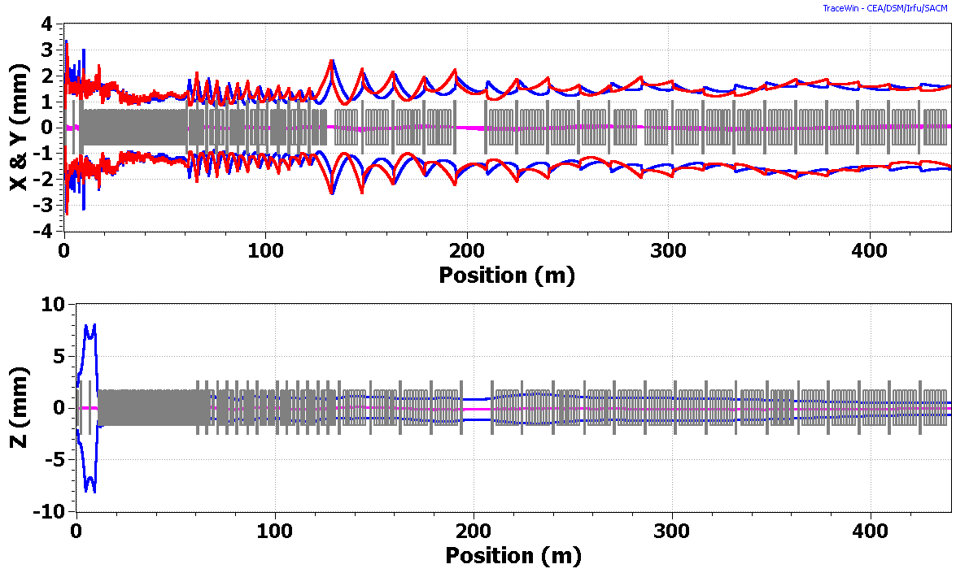
CW Linac – Beam Dynamics
Lattice design & beam dynamics optimization are made utilizing the TRACK, TraceWin and GenLinWin codes.
Transverse x- and y– rms envelopes
1 GeV arc is presented as a short drift.
Rms bunch length

Slide 12
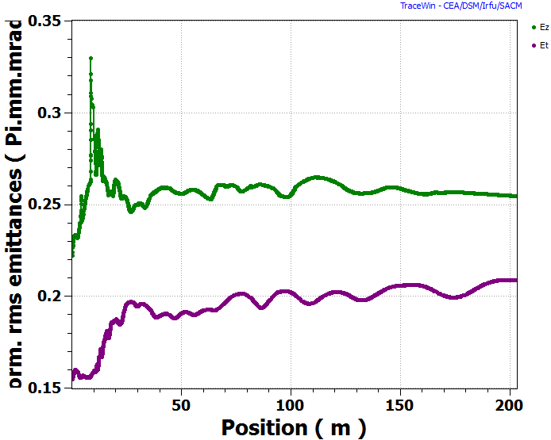
Emittance growth in CW Linac
Emittance growth is within Project X specifications
ε_{n⊥}(magenta) and ε_{nL} (green) rms emittances along the linac
Only the 1 GeV part of CW linac is shown
Initial longitudinal emittance corresponds to 1.6 keV*nsec

Slide 13
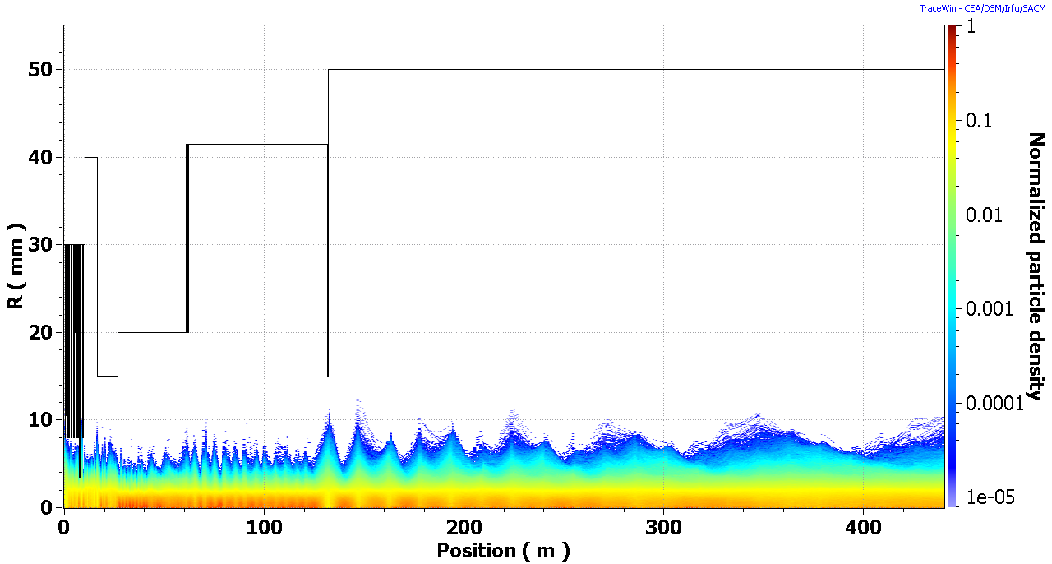
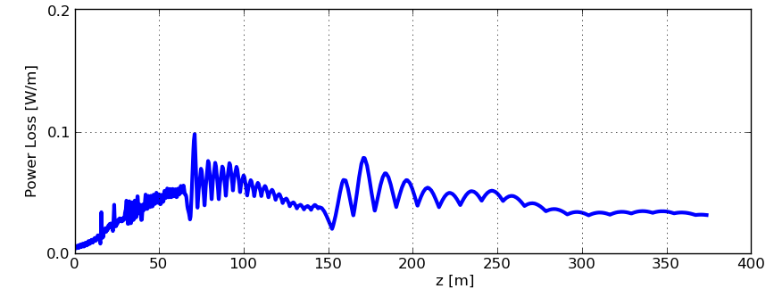
Particle Loss in SC linac
Aperture and Particle density distribution along the linac
100,000 particles tracked in PARTRAN
Beam power losses per unit length
Intrabeam stripping is the major mechanism resulting in the beam loss

Slide 14
Staging
Fiscal considerations/constraints have motivated development of a staging plan
Staging principles:
  Compelling physics opportunities at each stage
  Cost of each stage substantially <$1B
  Utilize existing infrastructure to the extent possible at each stage
  Minimize interruptions to the ongoing program at each stage
  Achieve full Reference Design capabilities at end of final stage
Three stage plan developed and presented to DOE/OHEP
Reference Design siting plan developed consistent with staging
Notes:
Test
14

Slide 15
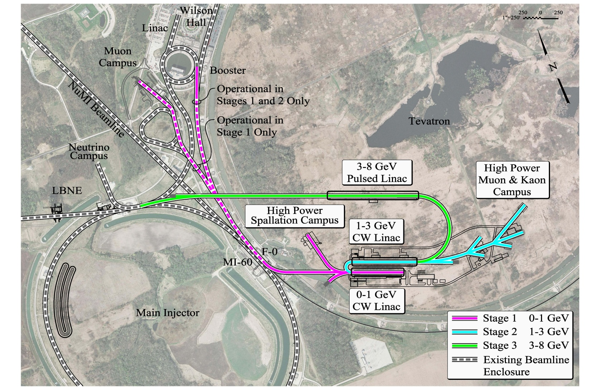
Staging
Site Plan

Slide 16
Linac Beam
(Stage 1)
ON
Pulsed
dipole
OFF
To Booster
To 1-GeV program
1
Linac beam
current, mA
0
->66.7 ms
Time, ms
In Stage 1: the Booster injection is 1-ms long (flattop) at 15 Hz

Slide 17
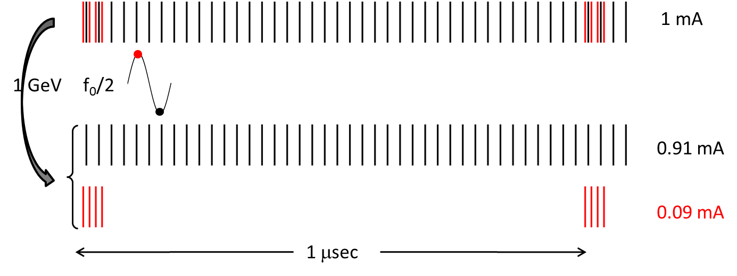
1-GeV CW linac in Stage 1
Ion source operates at ~3.6 mA
Chopper removes unwanted bunches to make ave. beam current 1 mA
Bunches are rf-split between the muon and “nuclear” programs

Slide 18
Linac Beam
(Stage 2)
ON
Pulsed
dipole
OFF
To 1-GeV program (1 mA)
and 3-GeV program (1 mA)
To Booster
2
MEBT beam
current, mA
0
Time, ms
->66.7 ms
In Stage 2: The 1-GeV linac rf power is upgraded to 2-mA
The Booster injection: ~0.5-ms long (flattop) at 15 Hz

Slide 19
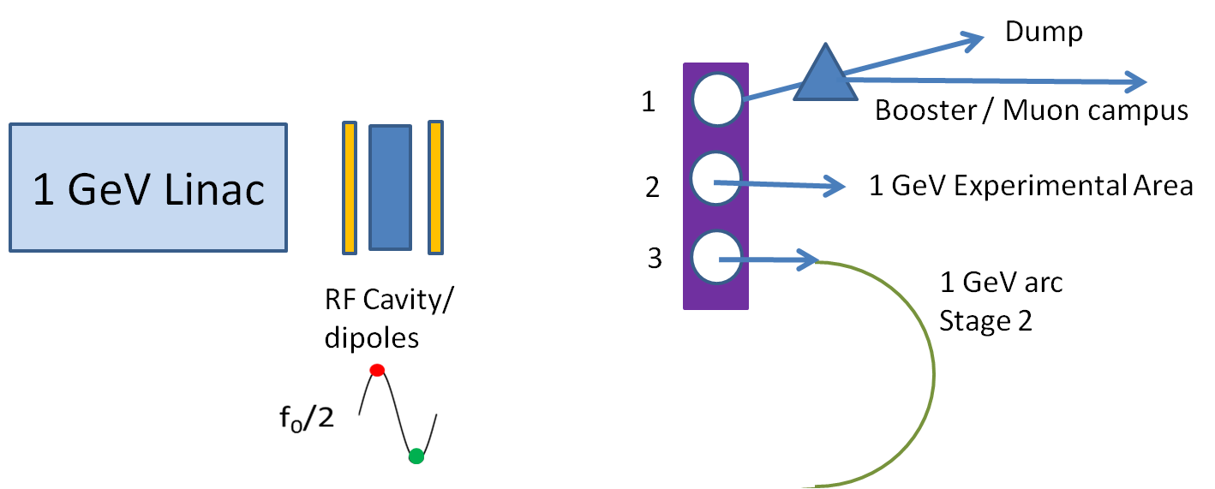
Stage-2 CW linac
To 1-GeV Experimental Area
To 1-GeV Arc and 3-GeV linac
Ion source at 5 mA
2-mA beam up to 1 GeV
RF bunch splitter at 1 GeV

Slide 20
Linac Beam
(Stage 3)
ON
Pulsed
dipole
OFF
To 1-GeV program (1 mA)
and 3-GeV program (1 mA)
2
MEBT beam
current, mA
To Pulsed Linac
0
Time, ms
->100 ms
In Stage 3: The 3-8 GeV linac is added to inject into the Recycler
The Recycler injection is ~4.4-ms long (flattop) at 10 Hz

Slide 21
R&D Program
Goal is to be prepared for a construction start in Q1FY18
  Most likely, Stage 1
Goal of the R&D Program is to mitigate risk: technical/cost/schedule
      The unique capabilities of Project X depend (almost) entirely on the front end, in particular the wideband chopper.
Technical Risks
  Front End
    CW ion source through SSR1
  H⁻ injection system
    Booster in Stage 1, 2; Recycler in Stage 3
  High Intensity Recycler/Main Injector operations
  High Power targets
Cost Risks
  Superconducting rf
    Cavities, cryomodules, rf sources – CW to long-pulse
Project X Injector Experiment (PXIE)

Slide 22
Front-End R&D Program
(as proposed in Oct 2011)
We are building an integrated systems test of the first ~30 MeV of Project X.
  Validate the concept for the Project X front end
  Demonstrate wideband chopper; low-β acceleration
  Operate at full design parameters
Integrated systems test goals:
  1 mA average current with 80% chopping of beam delivered from RFQ
  Efficient acceleration with minimal emittance dilution through ~30 MeV
Beam through β=0.1 , 0.2 CM at ~30 MeV with nearly final parameters (1 mA cw, 5 mA peak, arbitrary bunch chopping)

Slide 23
PXIE structure
Standard scheme for proton (H⁻) acceleration
  Ion source and LEBT (30 keV, 5 mA nominal/ 10 mA max DC)
    Beam pre-chopping for machine tuning
  162.5 MHz RFQ (2.1 MeV, 5/10 mA CW)
  MEBT (chopping, 5mA CW->1mA Repetitive Structure )
  2 SC cryomodules accelerating the beam to 20-30 MeV
  HEBT (beam diagnostics)
  50 kW beam dump
Total length ~ 40 m
Collaboration between Fermilab, ANL, LBNL, SNS, SLAC, and Indian institutions

Slide 24
PXIE Goals
The main specific goals
  Demonstrate the bunch-by-bunch chopping
    Kicker and absorber
  Efficient acceleration of 1mA beam in SRF to at least 15 MeV
    Emittance dilution; halo generation and management
Also, address
  Emittance issues and pre-chopping in LEBT
  Reliable CW RFQ
  MEBT/SRF interface (vacuum, microparticle migration)
  Diagnostics for testing the extinction of the removed bunches to ~10⁻⁹
  Gain experience in design and operation of SC cryomodules
    SSR1 cryomodule will be designed and built by Fermilab

Slide 25
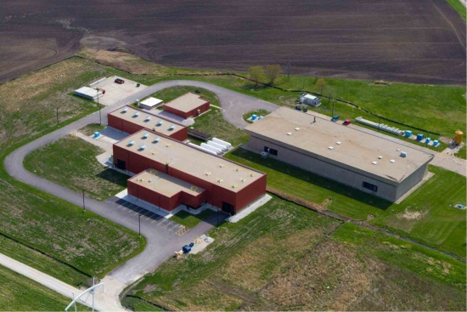
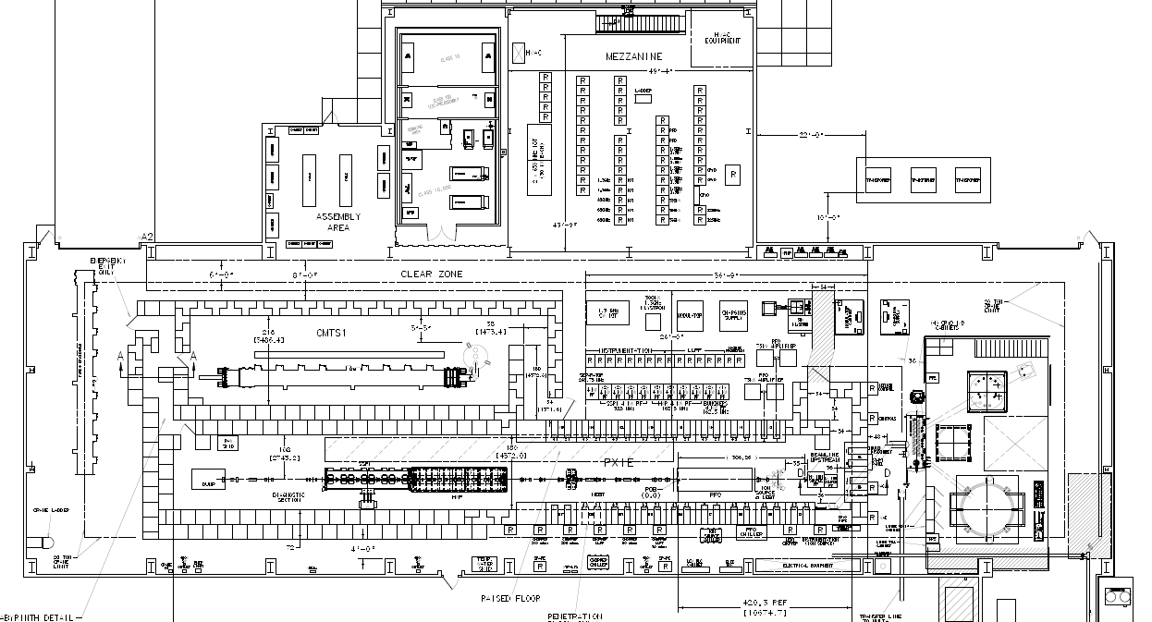
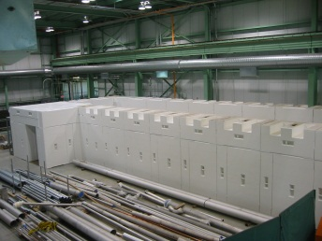
PXIE layout
PXIE will be assembled in the existing Cryo Module Test Facility building
Cryomodule test stand
Cryoplant
PXIE
41 m

Slide 26
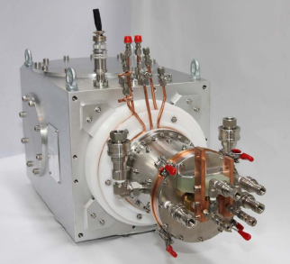
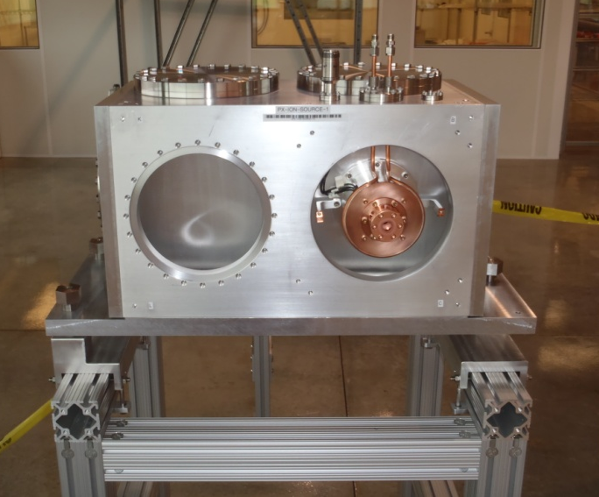
Ion source
H⁻ ion source
  Purchased from D-Pace Inc.
  Was tested and used at LBNL for a year
    Now at Fermilab
Port for turbo pump
30 kV, 15 mA DC, ε_{rms,n_x} ≈ 0.12µm
Life time 300 hrs
Ground electrode

Slide 27
LEBT
LEBT
  3 solenoids
  Dipole to accommodate two IS for PX
    Only one at PXIE
3D model of the first, straight stage of LEBT
  Chopper
    Pre-chopping,
    MPS, pulse mode
  Possibility of partially
  un-neutralized transport
  Beam halo scraping

Slide 28
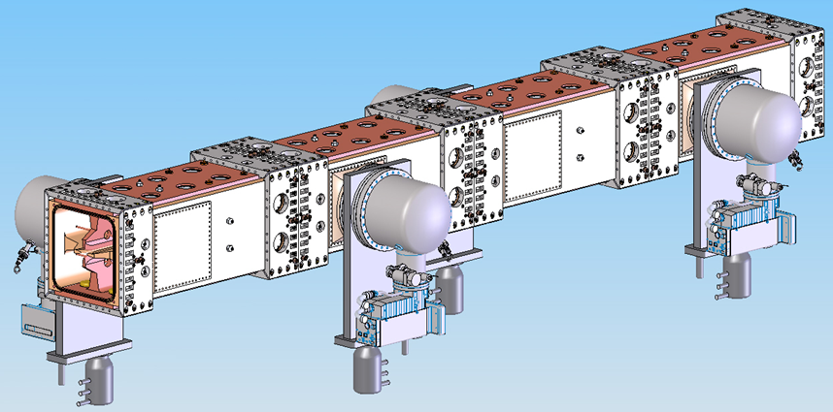
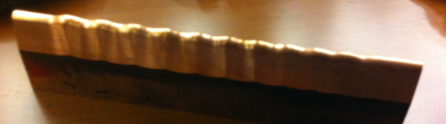
RFQ
Design (LBNL): 4 vanes CW RFQ
  162.5 MHz frequency to make bunch-by-bunch chopping possible
  2.1 MeV energy to exclude residual radiation in the MEBT
Beam current: 1 – 10 mA; ε_{⊥n,rms} < 0.25 µm ε_{||n,rms} ≤1.0 keV-ns Length: ~4.4 m
  Simulations completed
    RF, beam, thermal, stress
  Finalizing the production drawings
  Manufacturing tests
RF coupler has been designed

Slide 29
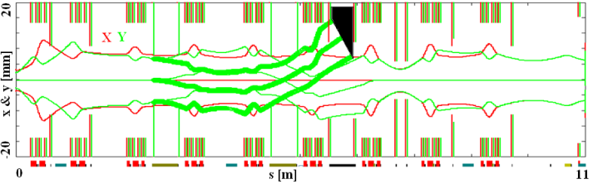
MEBT
MEBT sections and optics. 3σ envelopes of passing bunches – thin lines, removed bunches- thick lines.
Red squares- quads, blue – bunching cavities.
Transverse focusing – 9 quadrupole doublets/triplets
  Small β-function variation
  Quads/dipole correctors are being designed by BARC, India
Longitudinal focusing – 3 bunching cavities
  Production drawings preparation
Design: I. Terechkine et al.
Frequency 162.5 MHz
Max voltage 100 kV
Gap 2x23 mm
Max power loss 1.5 kW

Slide 30
Chopping system
Two kickers separated by 180º
Absorber
Differential pumping
Undesired bunches are removed by the MEBT chopper
  Two kickers separated by 180º and working in sync (next slide)
  Removed and passing bunches are separated at the absorber by 6σ_{y}
  Large gas load from absorber, ~1 mTorr·l/s
    2500 l/s turbo pumping at the absorber and differential pumping
Developed a concept of a 21 kW absorber
(x2 full nominal power)
  29 mrad incident angle
  Mo alloy TZM
  Testing ¼ size
  prototype
  with e-beam

Slide 31
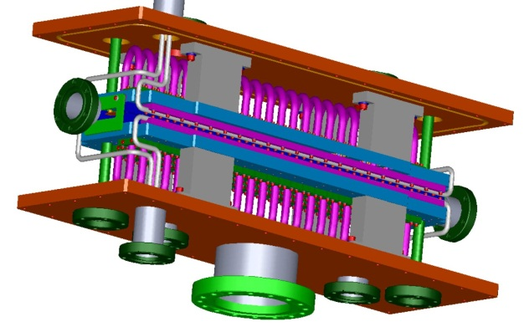
Kicker
Travelling – wave, broadband kickers: 50 and 200 Ohm versions
  0.5m, ±250V on each plate, 16mm gap; 6σ beam length is 1.3 ns
50 Ohm
  25 electrodes per plate connected in vacuum by cables
    Finalizing the production drawings
  Commercial linear amplifier and pre-distortion
    Lower power driver successfully tested
200 Ohm
  Helix as travelling-wave structure
    RF simulations, modeling, concept development
  Driver: broadband, DC coupled switches in push-pull configuration
    Fermilab development
    Single switch: tested to 0-500V
    Complete driver: tested to 0-100 V
3D model A.Chen, D.Sun
RF model G. Saewert

Slide 32
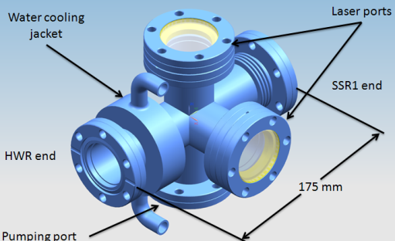
SRF cryomodules
Two cryomodules operating at 2K, HWR and SSR1
  Half Wave Resonators (HWR) and Single Spoke Resonators (SSR1)
  Warm gap between cryomodules; fast vacuum valves on both sides
In both cryomodules
  Solenoidal focusing
    No magnetic steel; backing coil to reduce fringe field
  BPM and dipole correctors in each solenoid
Structure of HWR cryomodule
  8 cavities, 8 solenoids arranged as 8x ( S C )
  Starts with a solenoid to mitigate H₂ influx from MEBT
Structure of SSR1 cryomodule
  8 cavities, 4 solenoids arranged as 4x ( C S C )
  Separated coils of dipole correctors allow creating of skew-quads
  The first upstream element is a cavity to improve longitudinal dynamics
Warm transition box between CMs

Slide 33
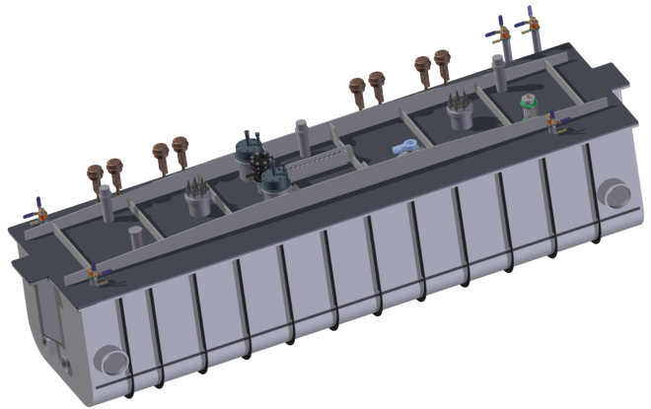
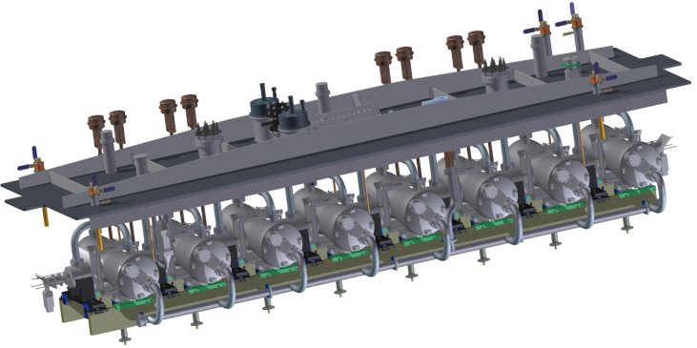
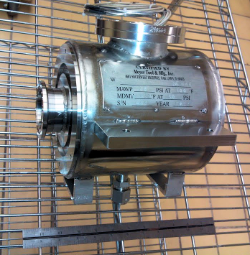
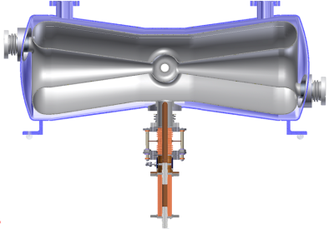
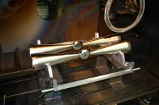
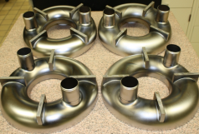
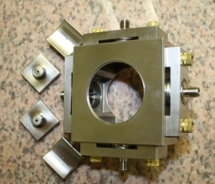
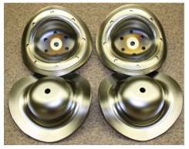
HWR
Beam energy: 2.1-11MeV
Frequency 162.5 MHz
CM length (flange-to-flange): 5.9 m
β_{g} 0.11
Cavity voltage 1.7 MV
Design and production by Argonne National Lab
  Cavity and cryomodule design is complete
  Prototypes of 10-kW RF coupler and SC solenoid with steering coils have been built and successfully tested
  BPM prototype has been built and will be tested with beam in FY13
  Nb parts for all cavities will be fabricated in FY13
  Two prototype SC cavities will be tested in FY14
Cavity with coupler
Solenoid installed in He vessel
Cavity parts
BPM parts

Slide 34
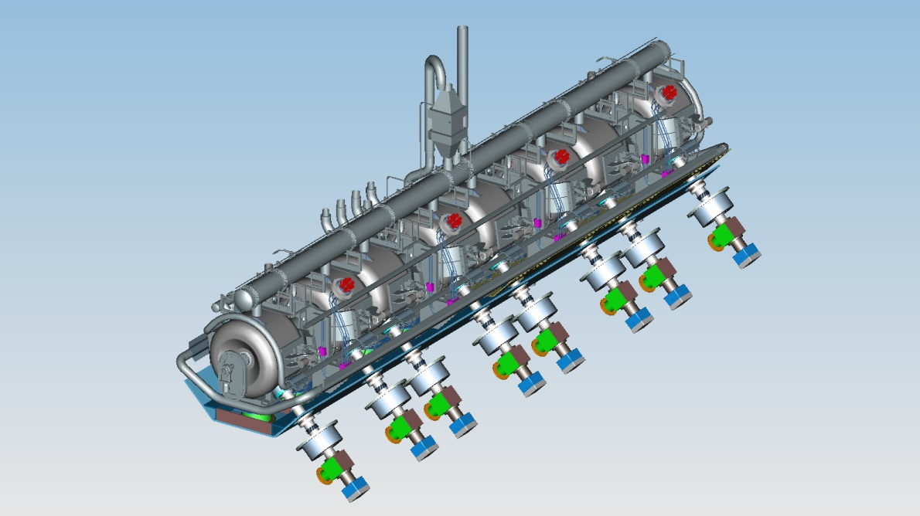
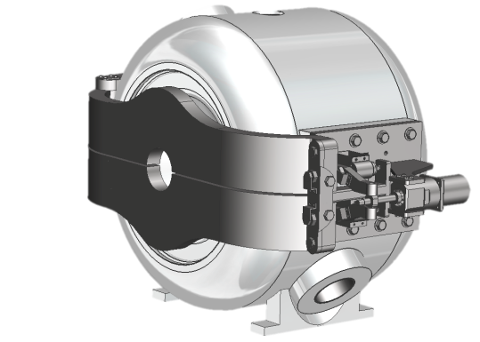
SSR1
Beam energy: 11-25 MeV
Frequency 325 MHz
CM length (flange-to-flange): 5.4 m
β_{g} 0.22
Cavity voltage 2 MV
3D model of cavity with tuners
  Design of major components is complete
    Cavity, tuner, coupler, solenoid, current leads, helium vessel, support
  Design of cryomodule to be complete in Fall 2013
  First production batch of 10 cavities is complete
    Tests proceed well
    Prototypes of coupler, solenoid, and helium vessel are close to production

Slide 35
HEBT
D. Johnson
Functions:
  Primary 50 kW beam dump
  Instrumentation to characterize beam parameters and measure efficiency of MEBT bunch-by-bunch chopper
Status:
  Preliminary design of optics, absorber, and shielding complete
  deflecting cavity is being designed
  Instrumentation specifications in progress

Slide 36
Plans
FY2013 – beam from ion source (at Fermilab)
FY2015 – beam from RFQ
FY2017 – Stage 1
  Ion source, LEBT, RFQ at full power
  Full MEBT with prototype kickers, prototype absorber, temporary dump, bunchers, some diagnostics
  Cryo system
  SSR1 CM – cold and RF powered, no beam
Aug 2017- Stage 2
  HWR CM – cold and RF powered, no beam
Aug 2018- Stage 3
  HEBT, final MEBT kickers, final 50 kW beam dump, 1-mA beam with required structure delivered to the dump

Slide 37
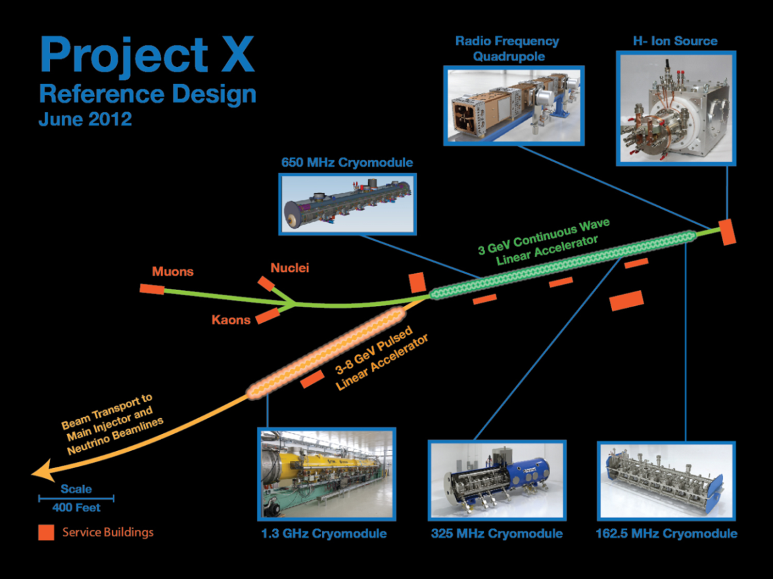
Backup Slides

Slide 38
Reference Design
A complete design concept exists (Reference Design Report)
3 GeV CW superconducting H⁻ linac with 1 mA average beam current.
  Enhanced performance of the existing proton complex
  Spallation-based program (nucleon/energy applications) at 1 GeV (1 MW)
  Rare processes programs at 3 GeV (3 MW)
  Flexible provision for variable beam structures to multiple users
3-8 GeV pulsed linac capable of delivering 340 kW at 8 GeV
  Enhanced performance for short and long-baseline neutrino programs
  Establishes a path toward a muon-based facility
Upgrades to the Recycler and Main Injector to provide ≥ 2 MW to the neutrino production target at 60-120 GeV.
Utilization of a CW linac creates a facility that is unique in the world, with performance that cannot be matched in a circular accelerator based facility.
Notes:
ADS Development with Nuclear Energy Applications

Slide 39
Reference Design Performance Goals
Linac
Particle Type H⁻
Beam Kinetic Energy 3.0 GeV
Average Beam Current 1 mA
Linac pulse rate CW
Beam Power to 1 GeV program 1000 kW
Beam Power to 3 GeV program 2870 kW
Pulsed Linac
Particle Type H⁻
Beam Kinetic Energy 8.0 GeV
Pulse rate 10 Hz
Pulse Width 4.3 msec
Cycles to Recycler/MI 6
Particles per cycle to Recycler/MI 2.7×10¹³
Beam Power 340 kW
Beam Power to 8 GeV program 170 kW
Main Injector/Recycler
Beam Kinetic Energy (maximum) 120 GeV
Cycle time 1.2 sec
Particles per cycle 1.5×10¹⁴
Beam Power at 120 GeV 2400 kW
simultaneous

Slide 40
Choice of Main Parameters
Bunch repletion rate of 162.5 MHz is set by RFQ
  Sub-harmonic of the ILC frequency
  The fastest rate compatible with bunch-by-bunch chopping
Beam current
  0-10 mA from the ion source
    Bunch-by-bunch chopping allows to create desired bunch patterns and beam powers for all experiments
  2 mA up to 1 GeV
    Then the current is equally split between 1 & 3 GeV experiments
  1 mA in 1 to 3 GeV linac (delivers 3 MW to 3 GeV)

Slide 41
Project X and PXIE
Project X is an Intensity Frontier accelerator providing MW-scale proton beam to many users quasi- simultaneously
  Acceleration in SRF from low energies
  Constant power in time scale >µs; adjustable structure of the bunch train
  Accomplished by bunch-by-bunch chopping in MEBT and RF separation after acceleration to the required energy
Addressed by the Project X Injector Experiment, PXIE

