Slide 1


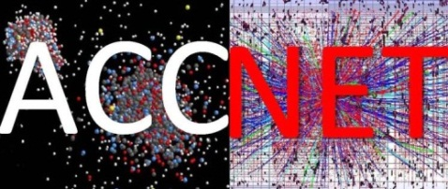





e-cloud activities – 2012 achievements & plans for 2013
Frank Zimmermann
ICE Meeting 13 February 2013
Hannes Bartosik (CERN), Chandra Bhat (CERN/FNAL), Alexey Burov (CERN/FNAL), Roberto Cimino (INFN-Frascati), Guillermo Contreras (CINVESTAV & TU Prague), Octavio Dominguez (CERN/EPFL), Giovanni Iadarola (CERN/U. Napoli), Kevin Li (SLAC/CERN), Humberto Maury Cuna (CINVESTAV & CONACYT), Sergio Rioja (CERN), Giovanni Rumolo (CERN), Vittorio Vaccaro (U. Napoli), Frank Zimmermann (CERN)

Slide 2
e-cloud activities in 2012
“regular” team meetings; ECLOUD’12 workshop at La Biodola; strong presence at ICAP’12, IPAC’12
preparation for, participation in, and analysis of 2012 scrubbing run
analysis & benchmarking of 2011 & 2012 surface conditioning (heat load, vacuum, phase shift)
PS studies: effect of bunch shape & bunch length
numerous ECLOUD-PyECLOUD comparisons
simulations for various LHC upgrade scenarios
journal publications

Slide 3
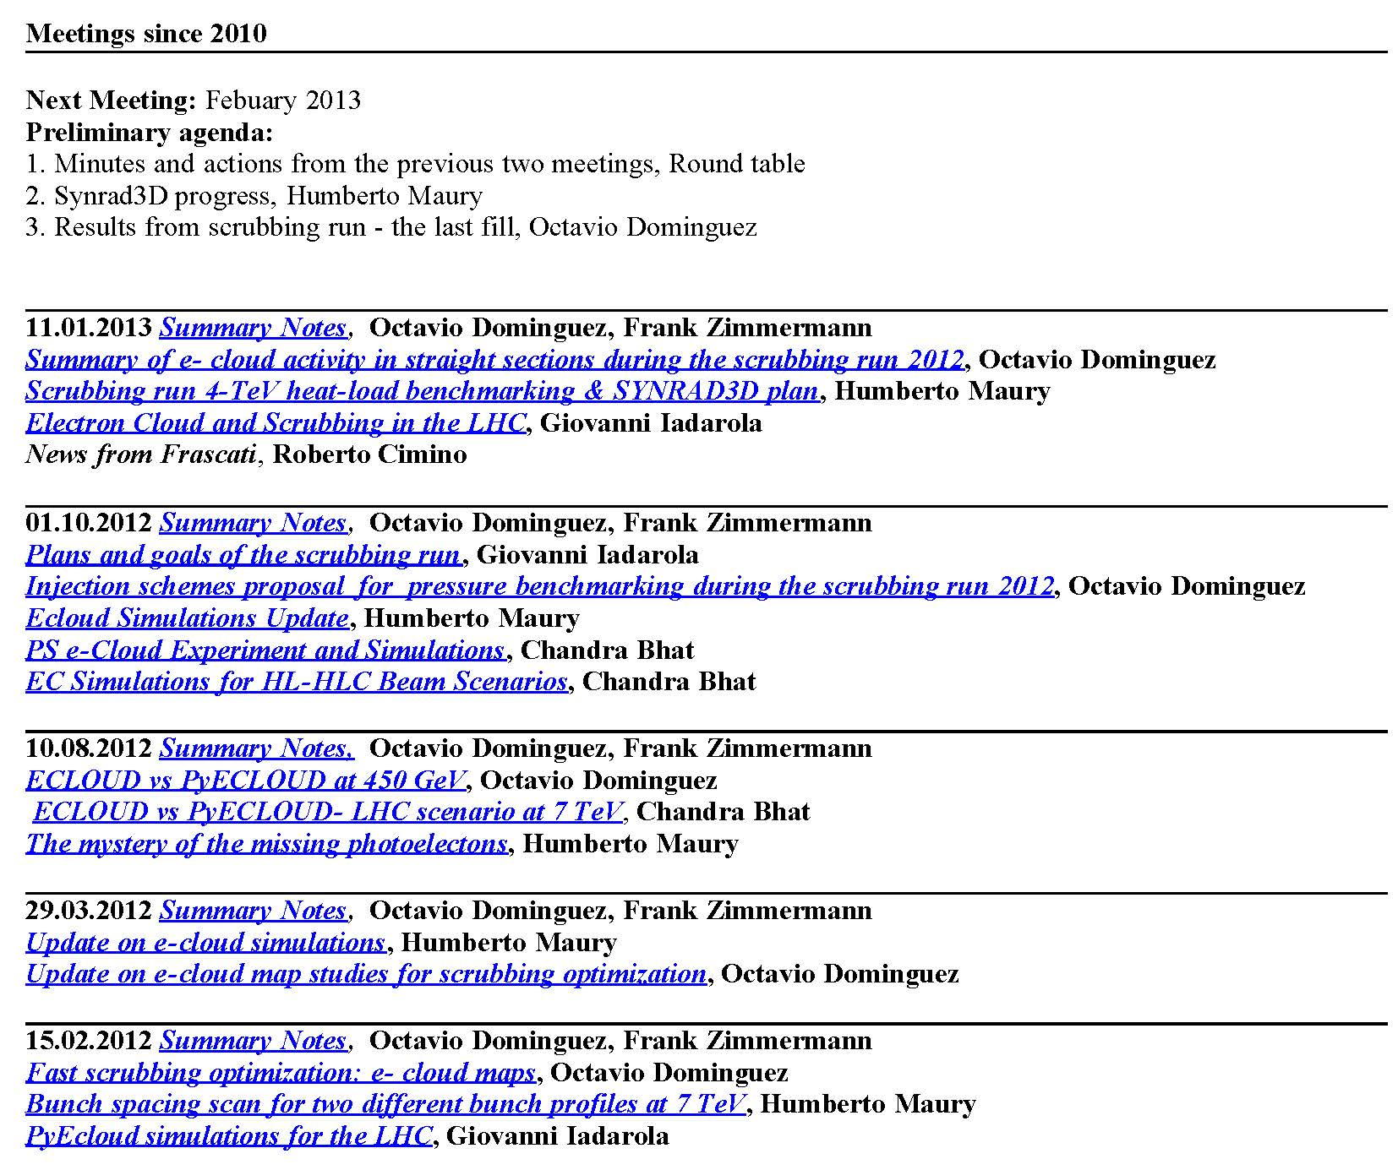
Meetings in 2012
regular team meetings accessible
from LHC e-cloud web site
http://cern.ch/ab-abp-rlc-ecloud/

Slide 4
G. Iadarola
reproducing measured 2011 heat load by PyECLOUD simulations→scrubbing in the arcs
Heat load
29/06
07/10
14/10
24-25/10
50ns
2011 scrubbing history of LHC arcs
δ_{max} has decreased from the initial 2.1 to 1.52 in the arcs !

Slide 5
G. Iadarola
comparing simulated and measured energy loss (from stable phase shift)
Bunch energy loss
Simulations → δ_{max} fixed to 1.6
Measurements → the energy loss per bunch is obtained from the stable phase shift
ZOOM
Beam 1

Slide 6
G. Iadarola
comparing simulated and measured energy loss (from stable phase shift)
bunch energy loss
build up phase of the electron cloud less well reproduced (possible reasons: R₀, primary e⁻, uncaptured beam?)

Slide 7
H. Maury Cuna
February 2012
arc heat load versus bunch spacing
dramatic increase for spacing <10 ns

Slide 8
H. Maury Cuna
ECLOUD heat load less for small δ_{max} & for N_{b}~5x10¹⁰
dipole

Slide 9
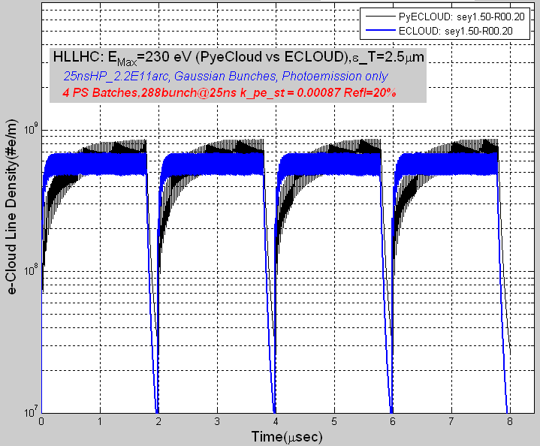
Comparison between
ECLOUD and PyECLOUD simulations
C. Bhat
ECLOUD: faster build up and earlier saturation
field-free region

Slide 10
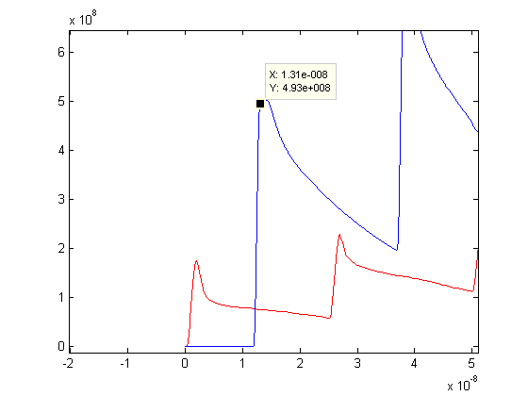
inconsistency of photo-electrons in dipole field between ECLOUD and PyECLOUD
ECLOUD sees only ~40% of the photoelectrons
C. Bhat
H. Maury Cuna
PyECLOUD
Electron linear density (e-/m)
ECLOUD
Time (s)

Slide 11
arc heat load in 2012 scrubbing
δ_{max} = 1.58
δ_{max} = 1.54
δ_{max} = 1.51
H. Maury Cuna

Slide 12
arc SEY evolution during 25-ns scrubbing:
H. Maury Cuna
~4-5%

Slide 13
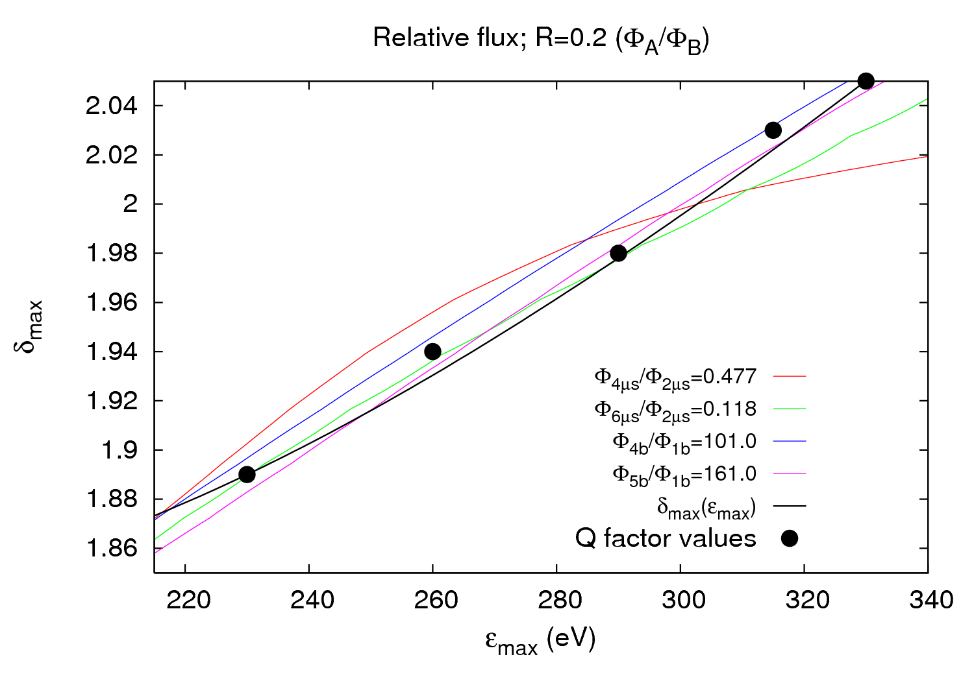
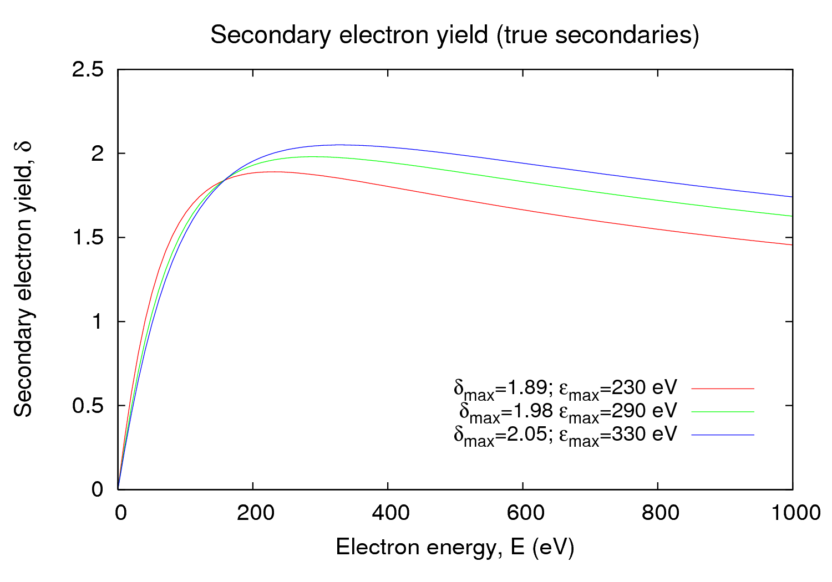
O. Dominguez
Benchmarking 1/3
SEY in straight sections - pressure benchmarking
Quality factor
minimum Q factor helps pinning down [δ_{max}, R]
does not rely on 3D surface fits
less sensitive to grid parameters/statistical noise
N has to be big enough (>3 would be ideal)
Experimental δ_{max}(ε_{max}) relation
a=exp(1/2*(1-cos(theta)))
b=(1+0.7*(1-cos(theta)))
we can pin down δ_{max} & R for fixed ε_{max} , and extrapolate to other ε_{max} values

Slide 14
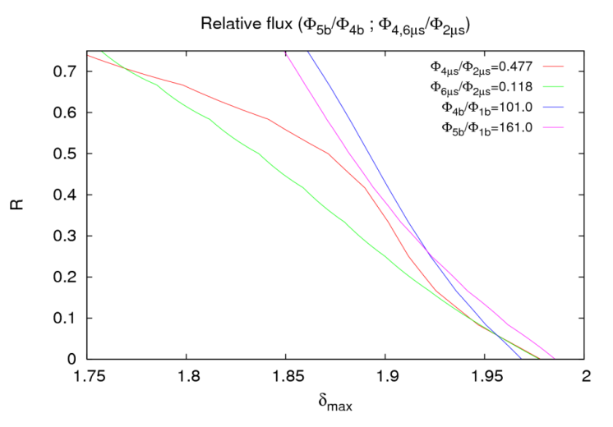
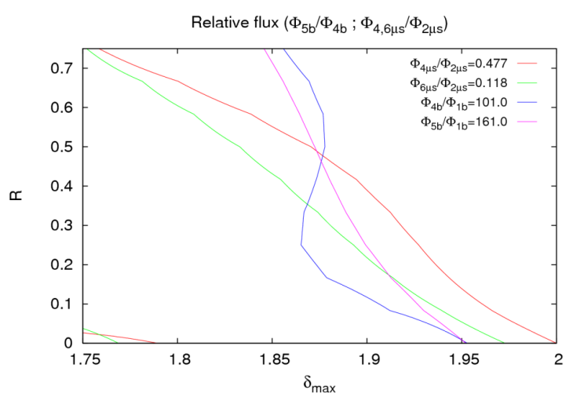
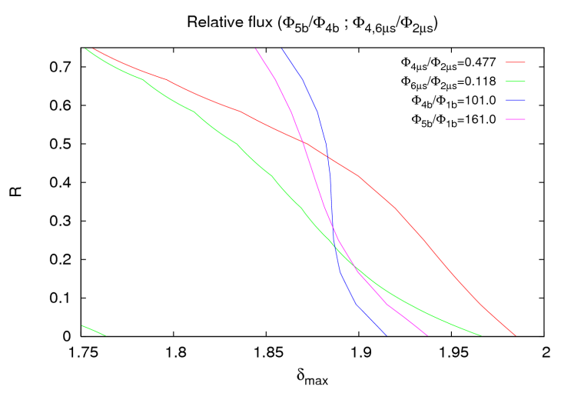
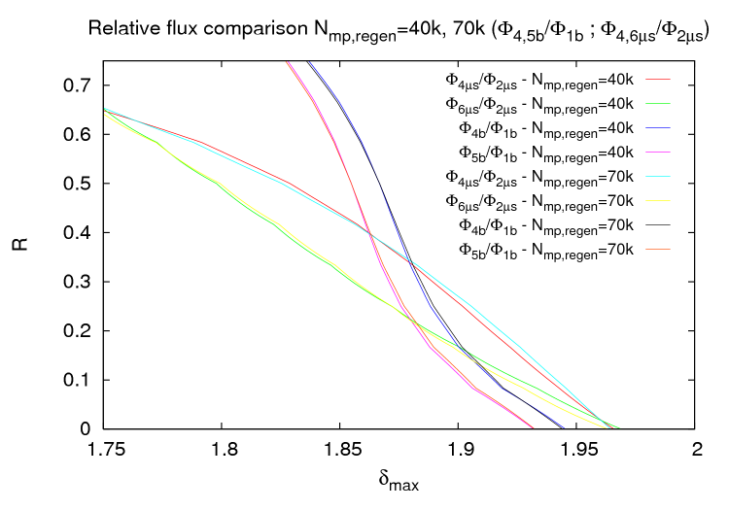
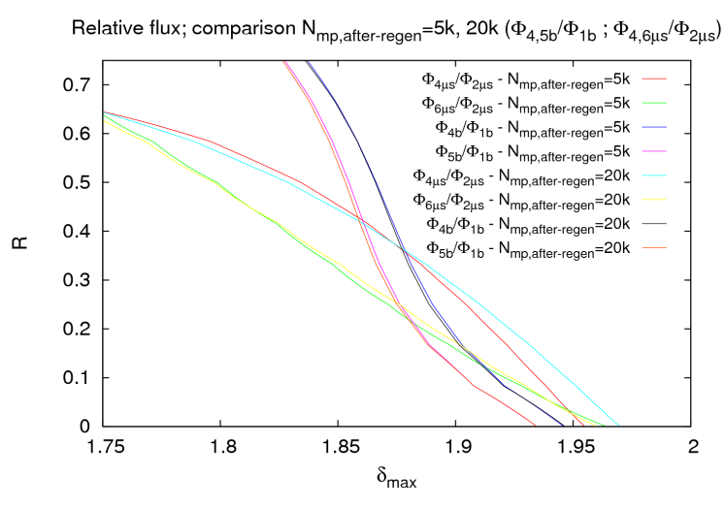
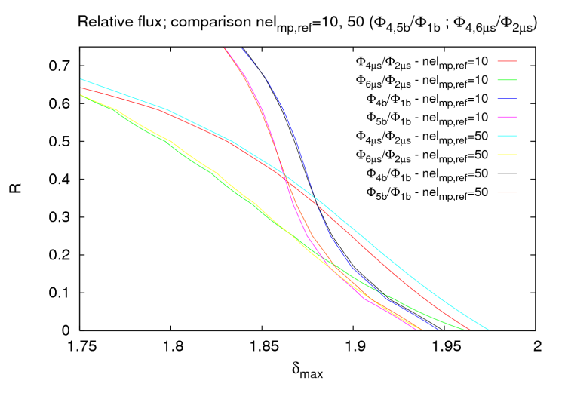
O. Dominguez
Benchmarking 2/3
PyECLOUD vs. ECLOUD for benchmarking studies
(tests of sensitivity to number of macroparticles)
ECLOUD
Npepb=1000
Npepb=2000
Npepb=3000
PyECLOUD
N_mp_max=100000, 130000
#Regen parameters
N_mp_regen=40000, 70000;
N_mp_regen_low=5000;
N_mp_after_regen=10000;
nel_mp_ref_0=10.
N_mp_max=100000
#Regen parameters
N_mp_regen=50000;
N_mp_regen_low=2500, 10000;
N_mp_after_regen=5000, 20000;
nel_mp_ref_0=10.
N_mp_max=100000;
#Regen parameters
N_mp_regen=50000;
N_mp_regen_low=5000;
N_mp_after_regen=10000;
nel_mp_ref_0=10., 50.
PyECLOUD seems to be more robust w.r.t. number of macroparticles and other parameters explored such as grid size

Slide 15
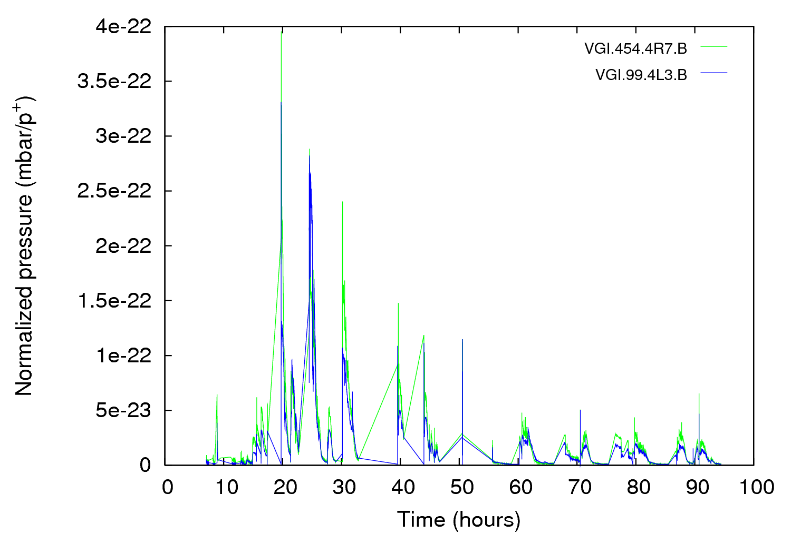
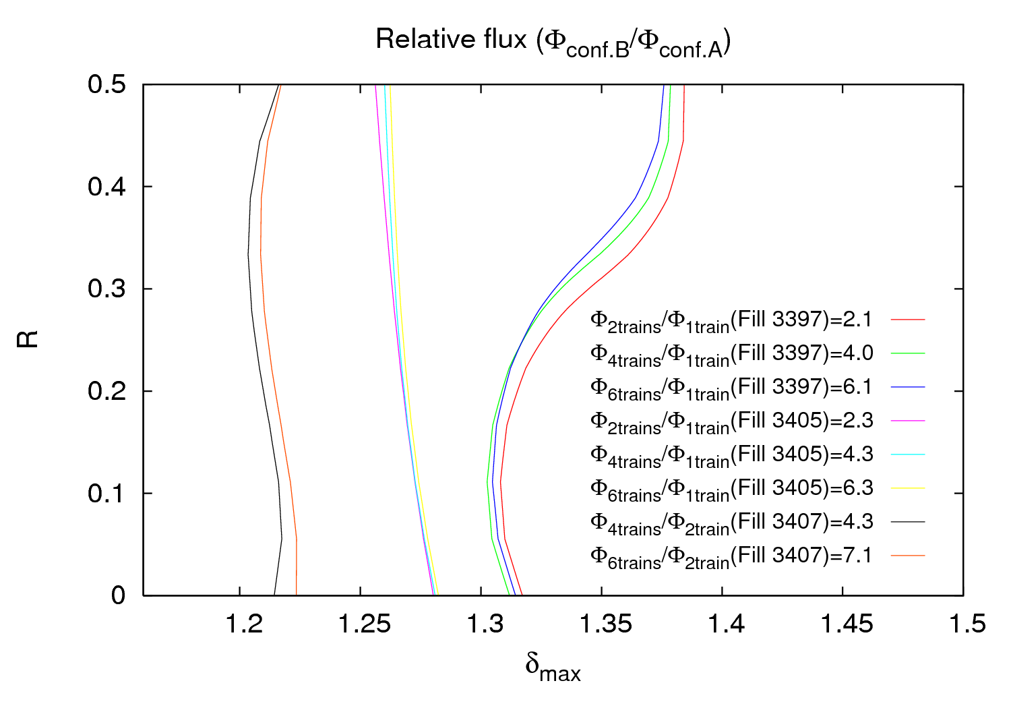
O. Dominguez
Scrubbing run 2012 – Straight Section
Benchmarking 3/3
reduction of pressure rise and of δ_{max} during the scrubbing run
clear reduction of δ_{max} according to observations and other criteria
for R=0.2 “threshold” at 450 GeV is δ_{max} ≈ 1.16.
δ_{max}

Slide 16
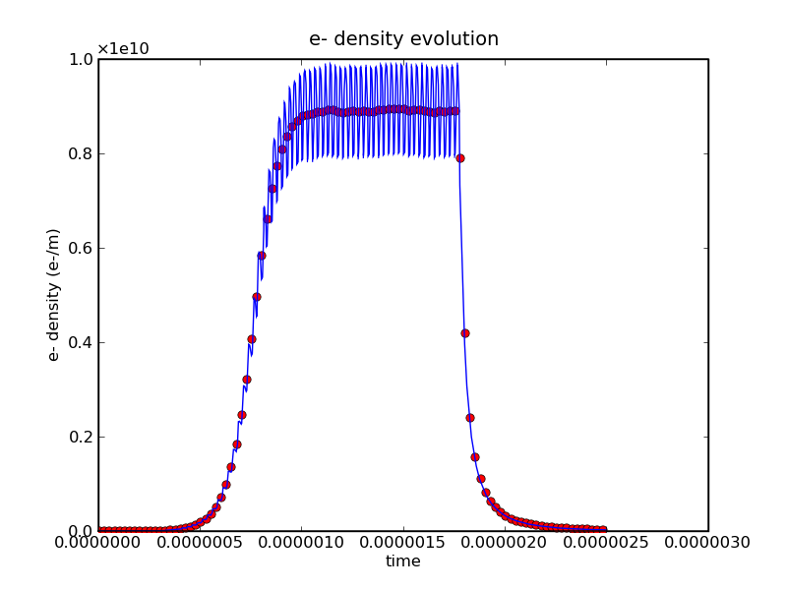
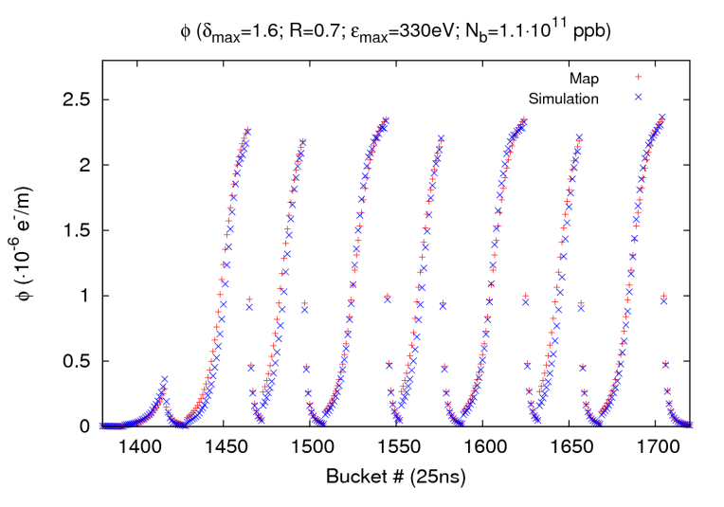
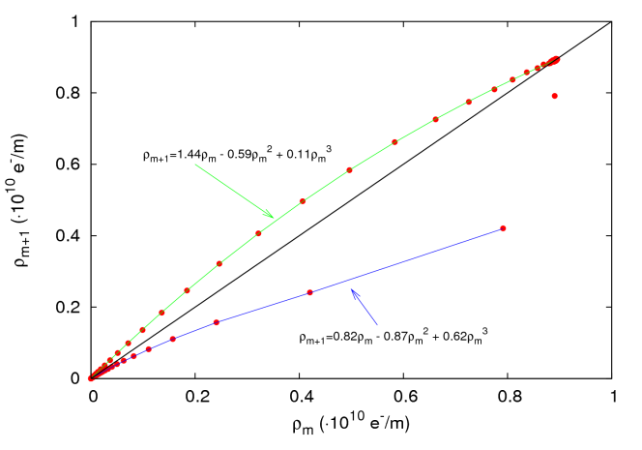
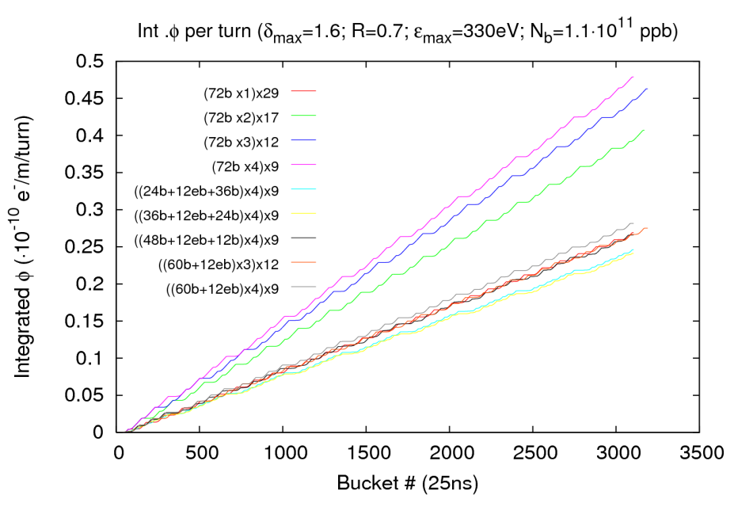
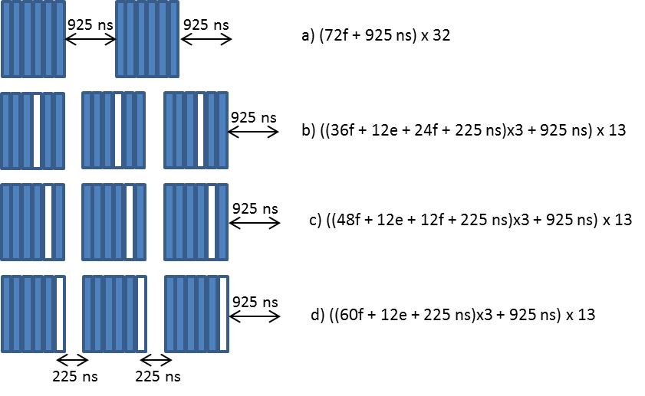
O. Dominguez
e-cloud maps
maps treat⁻ cloud evolution in an abstract way:
this reduces computing time by about 7 orders of magnitude.
suggested filling schemes for scrubbing
Idea: In theory, for the initial scrubbing we obtain an equivalent dose but with lower central e- density
one can easily skip an injection from one ring of the PS Booster (12 LHC bunches)

Slide 17
Landau cavity & e-cloud @ PE ejection
Data versus Simulations
C. Bhat
Experiment
After steady-state is reached
Using measured bunch profiles
Simulations

Slide 18
Simulated cumulative electrons during the entire e-cloud activity in PS
C. Bhat
ε_{max} = 287 eV
_{max} = 1.57
R₀ = 0.55
*
*
  Comparison between experiment data and simulations sets tight range on the SEY parameters: ε_{Max}= 287 eV (±3%), δ_{Max} =1.57 (±1%) and R₀=0.55 (±3%) in region of PS e-cloud monitor. BSM50 mode gives 2x smaller e-cloud.
Data@ Ejection show that
BSM50/BLM50≈2.7 and SH/BLM50≈2.3

Slide 19
average heatload for HL-LHC w Landau RF
C. Bhat
Landau cavity will not suppress e-cloud build up in the LHC , but will not make it worse either
PyECLOUD
ECLOUD and PyECLOUD results agree quite well
ECLOUD
&
PyECLOUD

Slide 20
LHC heat load versus bunch length
C. Bhat
no dependence on bunch length for L(4σ) <1.3ns & L(4σ) >2.75ns
bunch shortening (or bunch lengthening) needed during high bunch intensity operation for the HL-LHC using a Landau cavity has no impact on e-cloud growth.

Slide 21
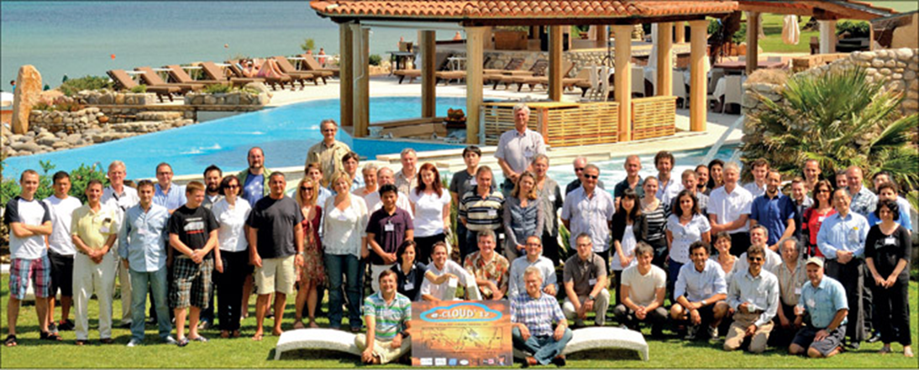
ECLOUD’12, La Biodola, Elba, 5-9 June 2012 jointly organized by INFN-Pisa, INFN-Frascati, EuCARD-AccNet and CERN Low-ε Ring
reviewed recent e-cloud observations at LHC, DAFNE, PETRA-III, Cesr-TA, J-PARC,.. & e-cloud predictions for SuperKEKB, SuperB, Project-X, ISIS upgrade, RHIC upgrade, HL-LHC, HE-LHC, ILC,…
established & strengthened links with space community (ESA, Val Space consortium, ONERA, ICMM, Princeton SPL, EPFL LEMA, …)
discussed new powerful simulation tools (SYNRAD3D/Cornell, OSMOSEE/ONERA, PyECLOUD/CERN, WARP-POSINST/LBNL, BI-RME-ECLOUD/EPFL, FEST3D/Aurora, …)
62
participants

Slide 22
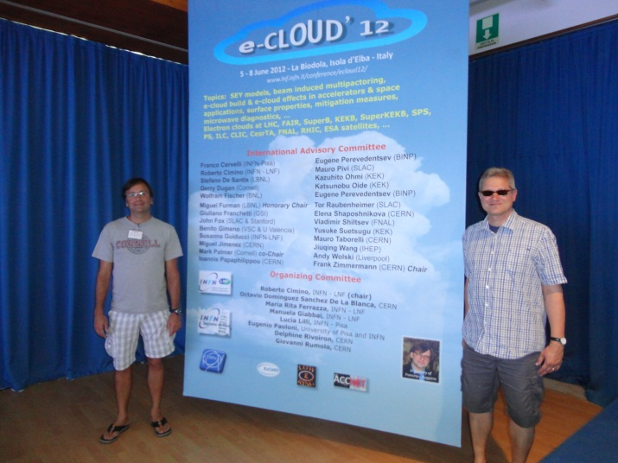
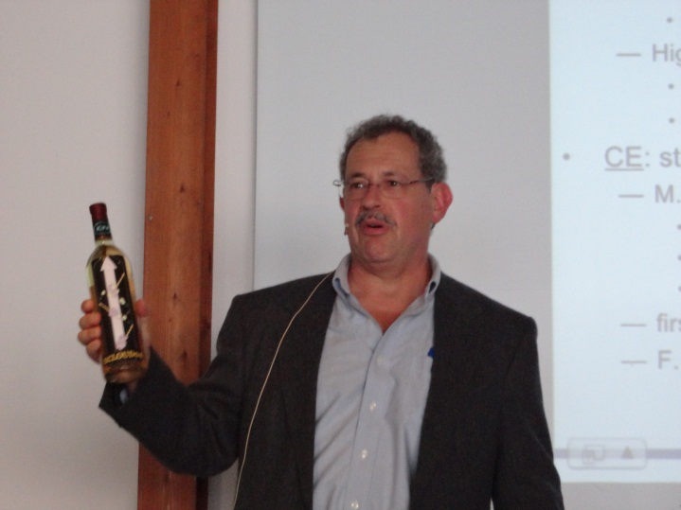
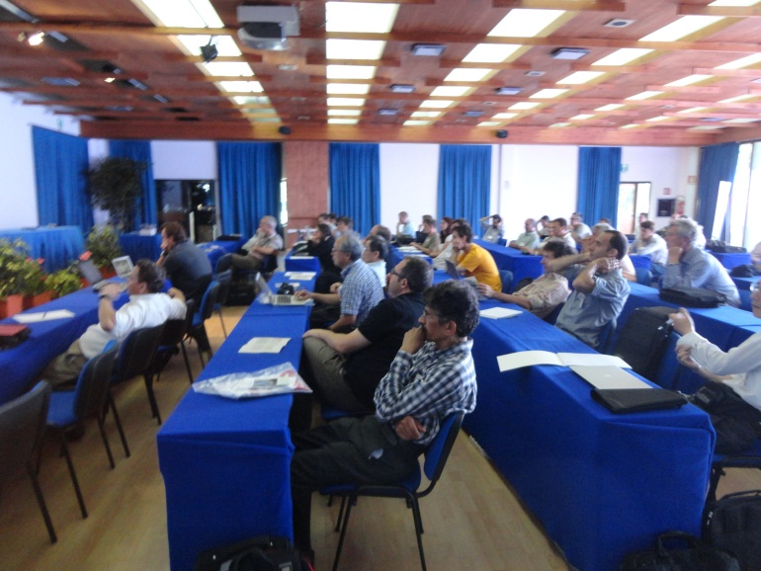
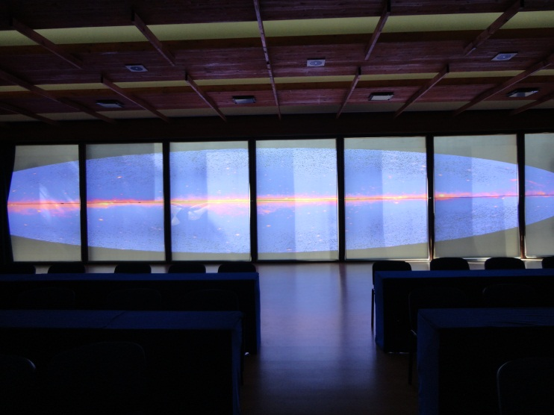
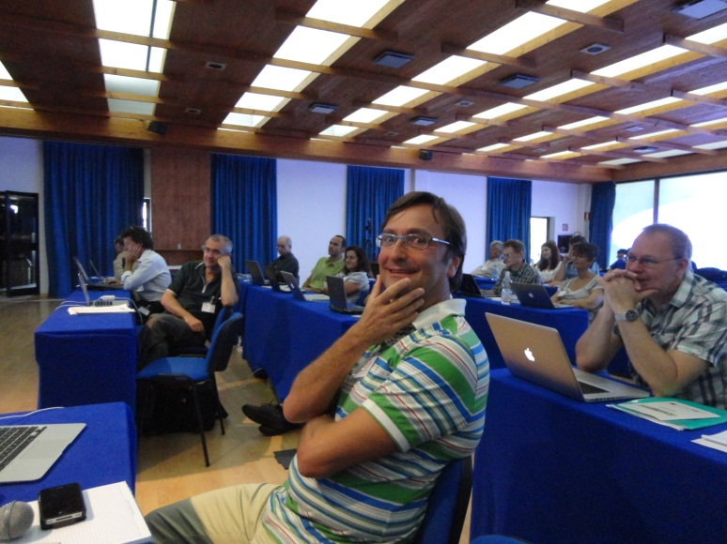
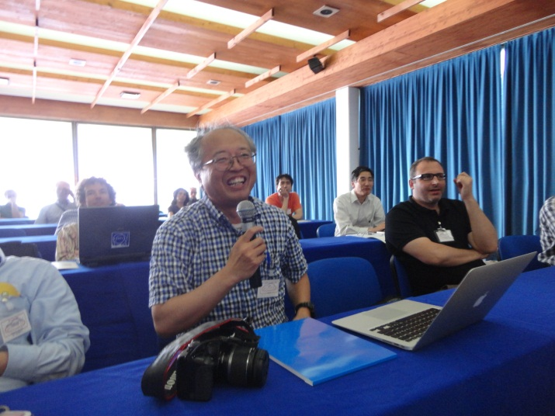
ECLOUD’12 photos
EuCARD workshop proceedings ready for publication (eds. R. Cimino,
G. Rumolo, F. Zimmermann), papers posted at http://cern.ch/ecloud12 ;
in addition PRST-AB special edition ECLOUD’12

Slide 23
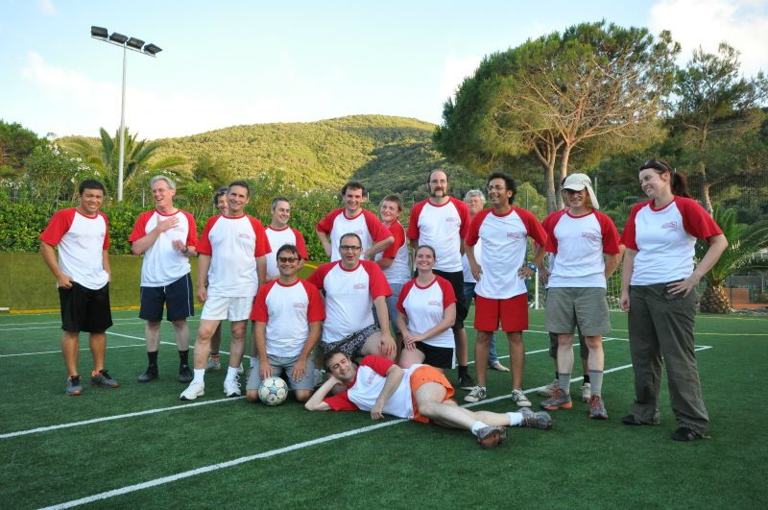
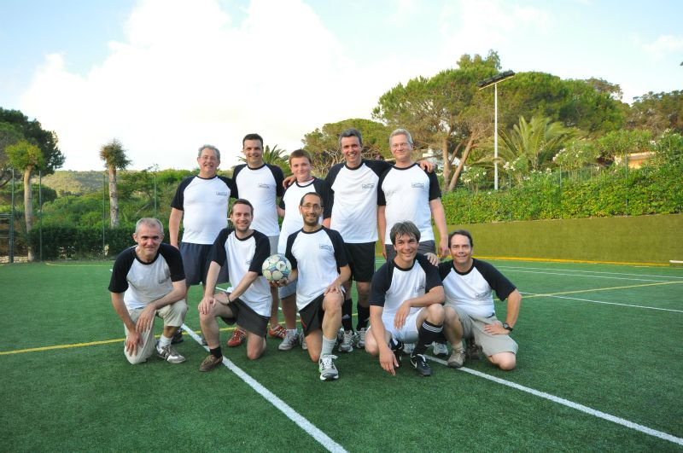
more ECLOUD’12 photos
ECLOUD experiment
first ECLOUD soccer match
ECLOUD theory

Slide 24

e-cloud at ICAP’12 AccNet sessions
Wednesday 22 August
LHC & FAIR (EuCARD-AccNet)
Chair Giovanni Rumolo
09:00-09:25 (invited)
Ralph Assmann, CERN, Switzerland: Advanced modeling and measurements of LHC beam halo and collimation
09:25-09:45
Giuliano Franchetti, GSI, Germany: Space charge and electron cloud simulations
09:45-10:05
Tatiana Rijoff, U. Milano: Beam-beam long range compensation studies for the LHC
10:05-10:30
Giovanni Iadarola, Università degli Studi di Napoli Federico II, Italy: Electron cloud simulations with PyECLOUD
RF & Impedance (EuCARD-AccNet)
Chair: Jean-Marie De Conto
14:00-14:25
Carlo Zannini, EPFL, Switzerland: EM simulations in beam coupling impedance studies: some examples of application
14:25-14:50
Uwe Niedermayer, TU Darmstadt, Germany: Kicker modeling
14:50-15:15
Eirini Koukovini-Platia, EPFL, Switzerland: A method of EM characterization of coating materials for beam chambers

Slide 25
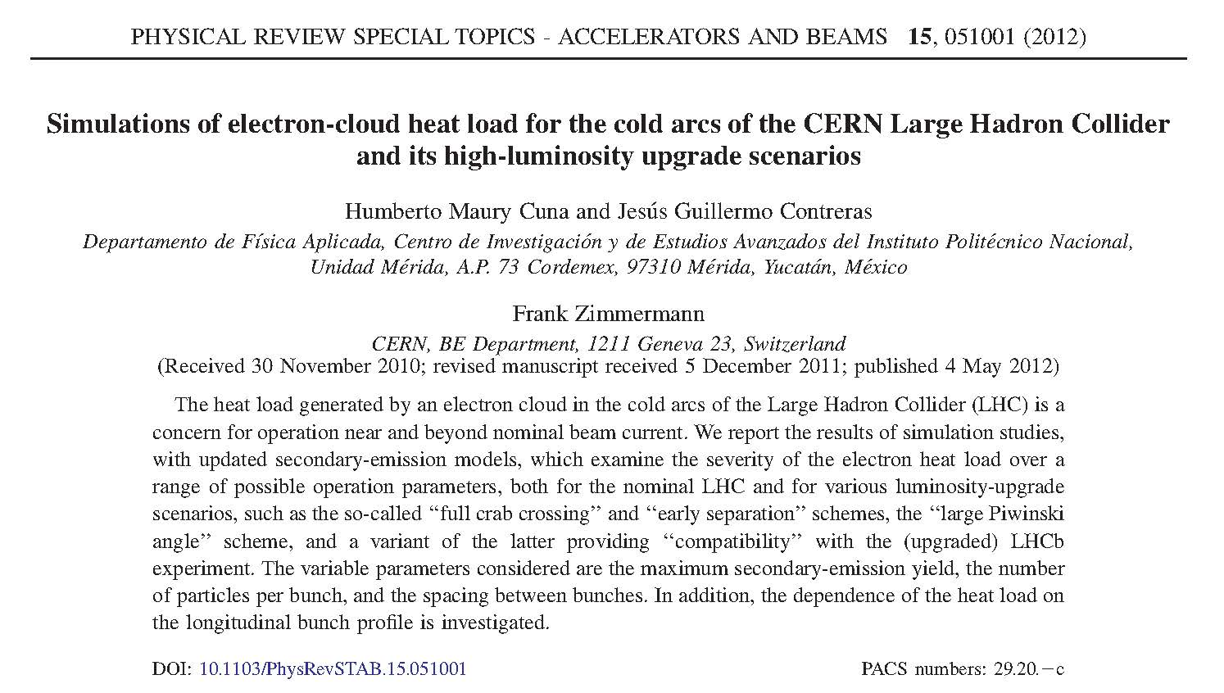
PRST-AB May 2012
simulations of arc heat load for LHC & LHC luminosity upgrade with 25 & 50 ns bunch spacing, different bunch lengths & profiles

Slide 26
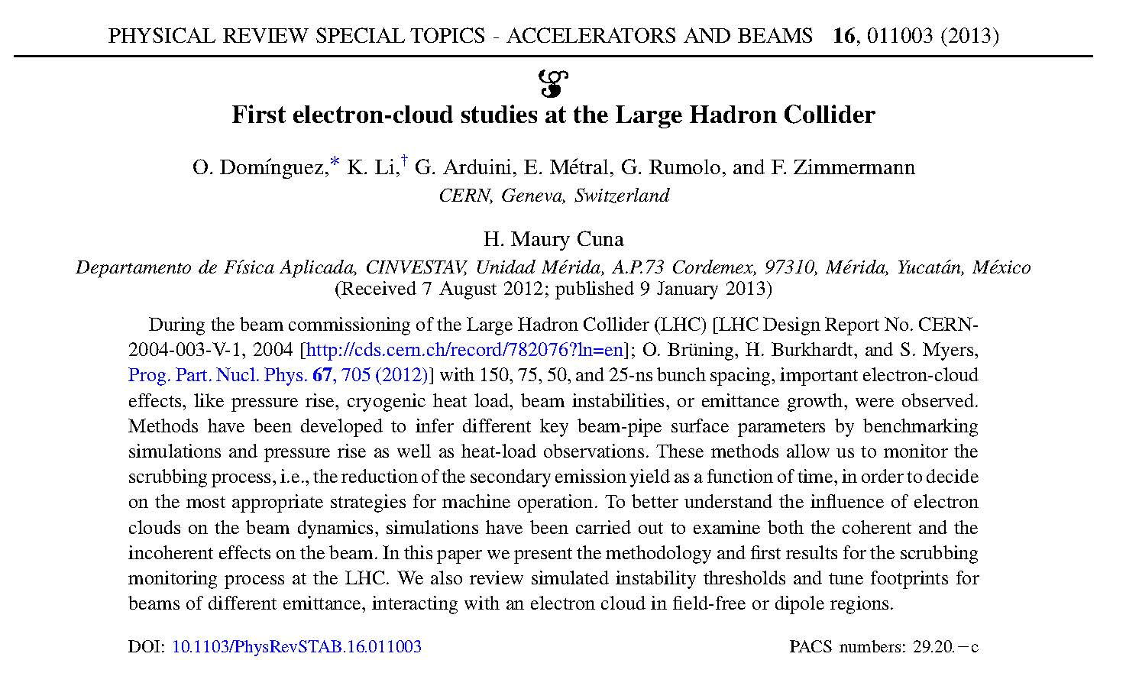
PRST-AB January 2013
first e-cloud observations at LHC – surface conditioning from vacuum in the straights and heat load in arcs, instabilities
Editor’s
suggestion

Slide 27
ongoing effort & plans for 2013
e-cloud simulations for extremely short bunch spacings in HL-LHC (proposal by S. Fartoukh): 5 ns, 2.5 ns, 1.25 ns (O. Dominguez)
e-cloud for HE-LHC and VHE-LHC (O.Dominguez)
3D photon simulations for LHC, HL-LHC, (V)HE-LHC (H. Maury Cuna, visit to Cornell last week)

Slide 28
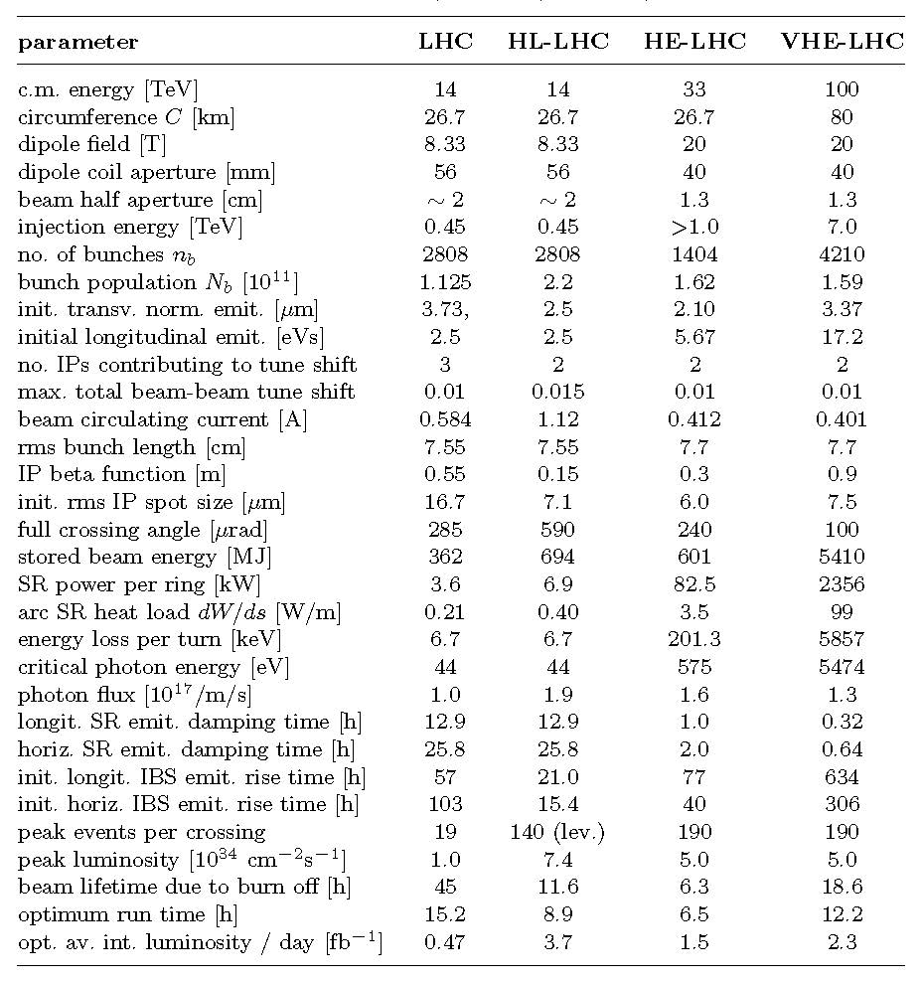

Slide 29
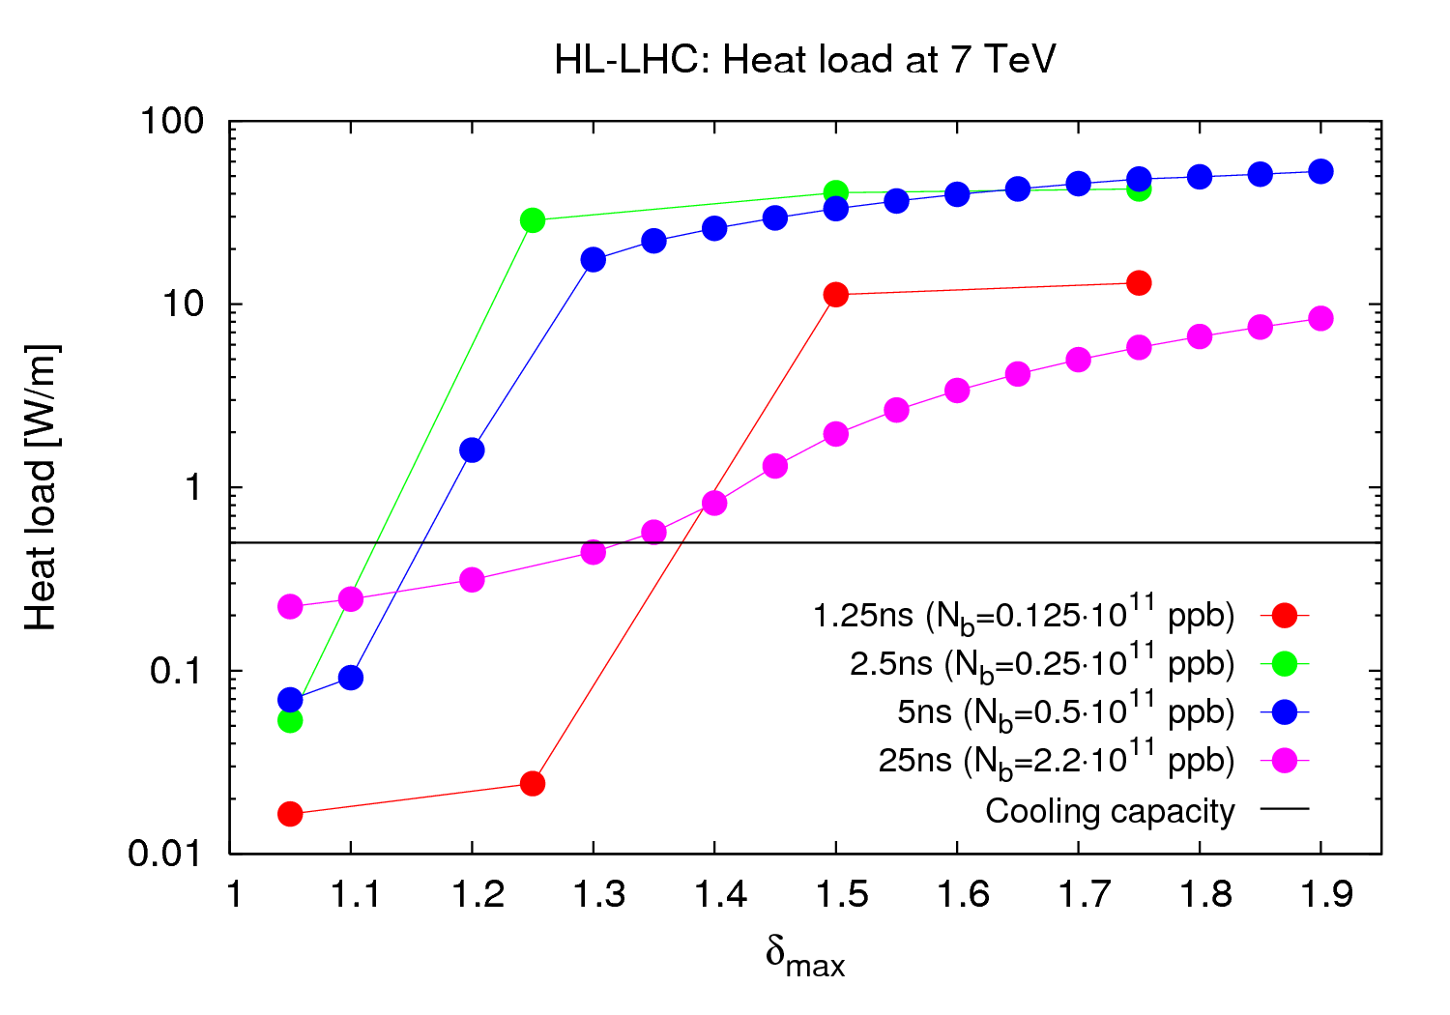
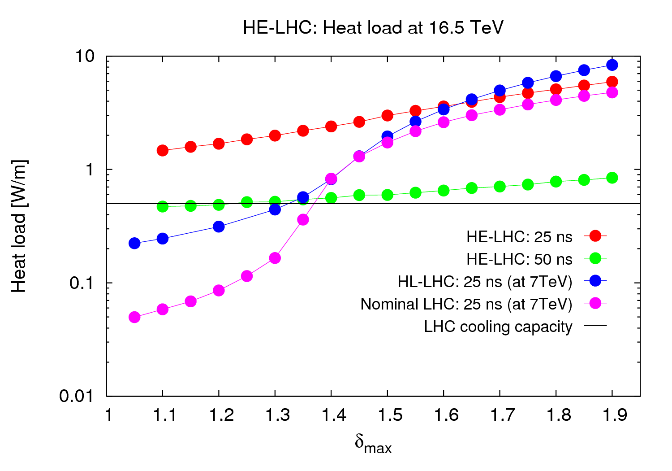
O. Dominguez
future/ongoing work - LHC upgrades
HL-LHC
investigation of shorter bunch spacings
next: 25 ns/1.25ns pairs ? (suggested by S. Fartoukh)
HE-LHC
almost all heat from photoelectrons
multipacting thresholds
25 ns: δ_{max}≈1.65
50 ns: δ_{max}≈2.45
50-ns heat load from e-cloud is small compared with SR heat load (beam screen at 50 K) – OK!
25 ns may not be possible
Soon: VHE-LHC: a 50 ns beam at 50 TeV!

Slide 30
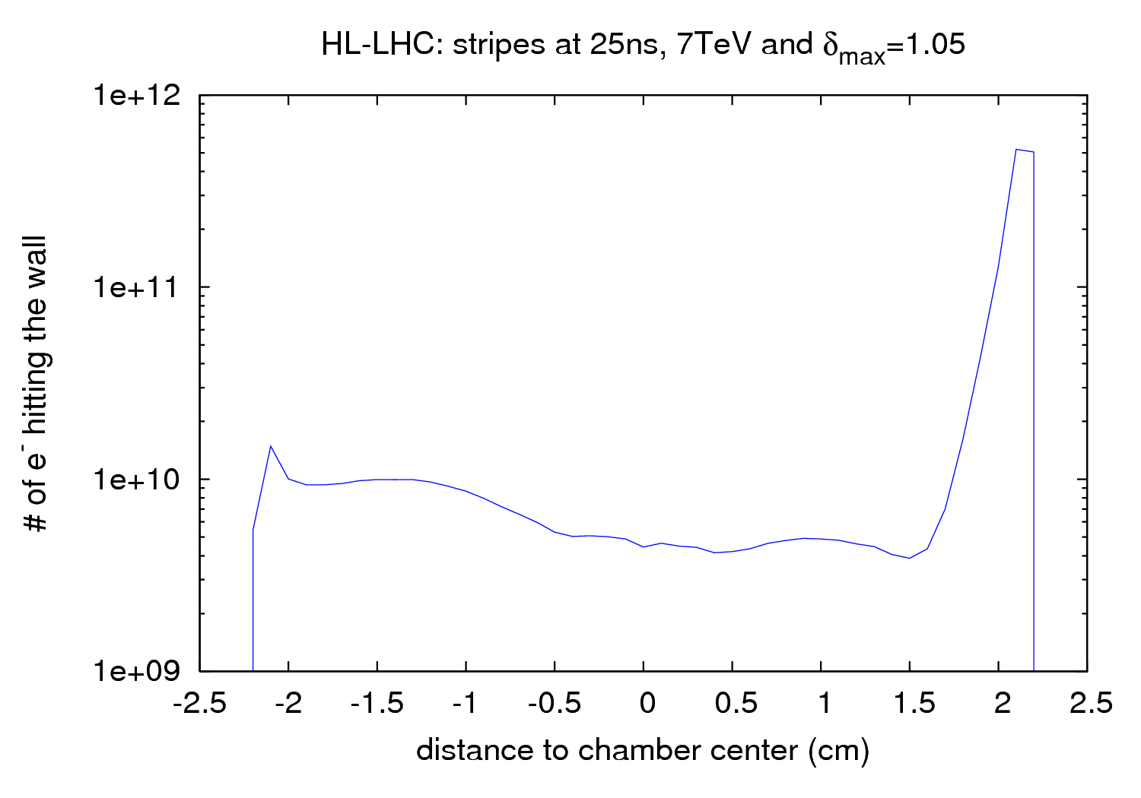
O. Dominguez

Slide 31
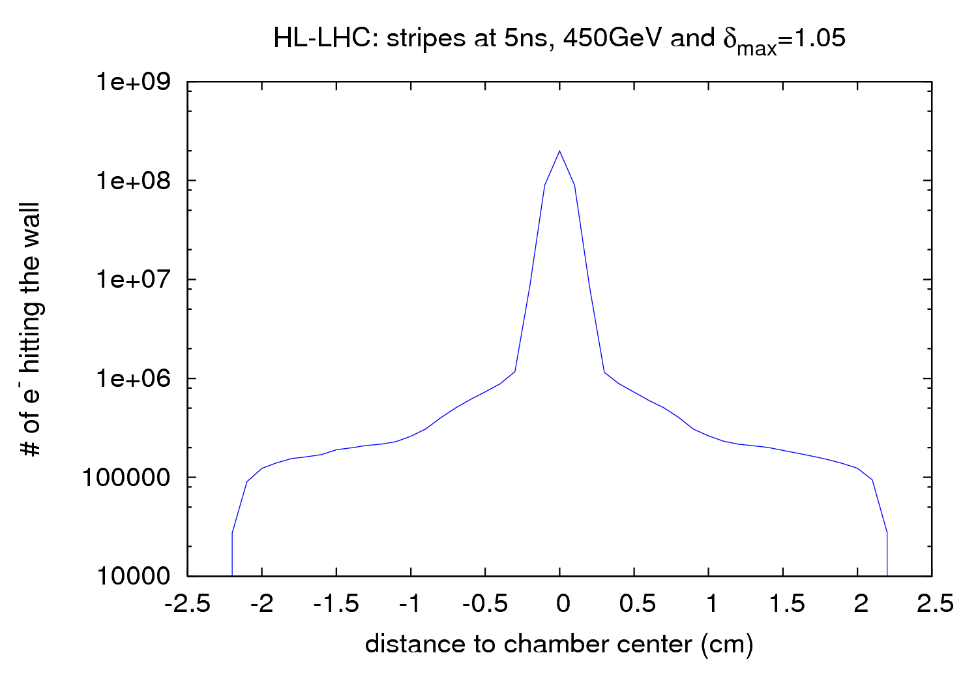
O. Dominguez

Slide 32
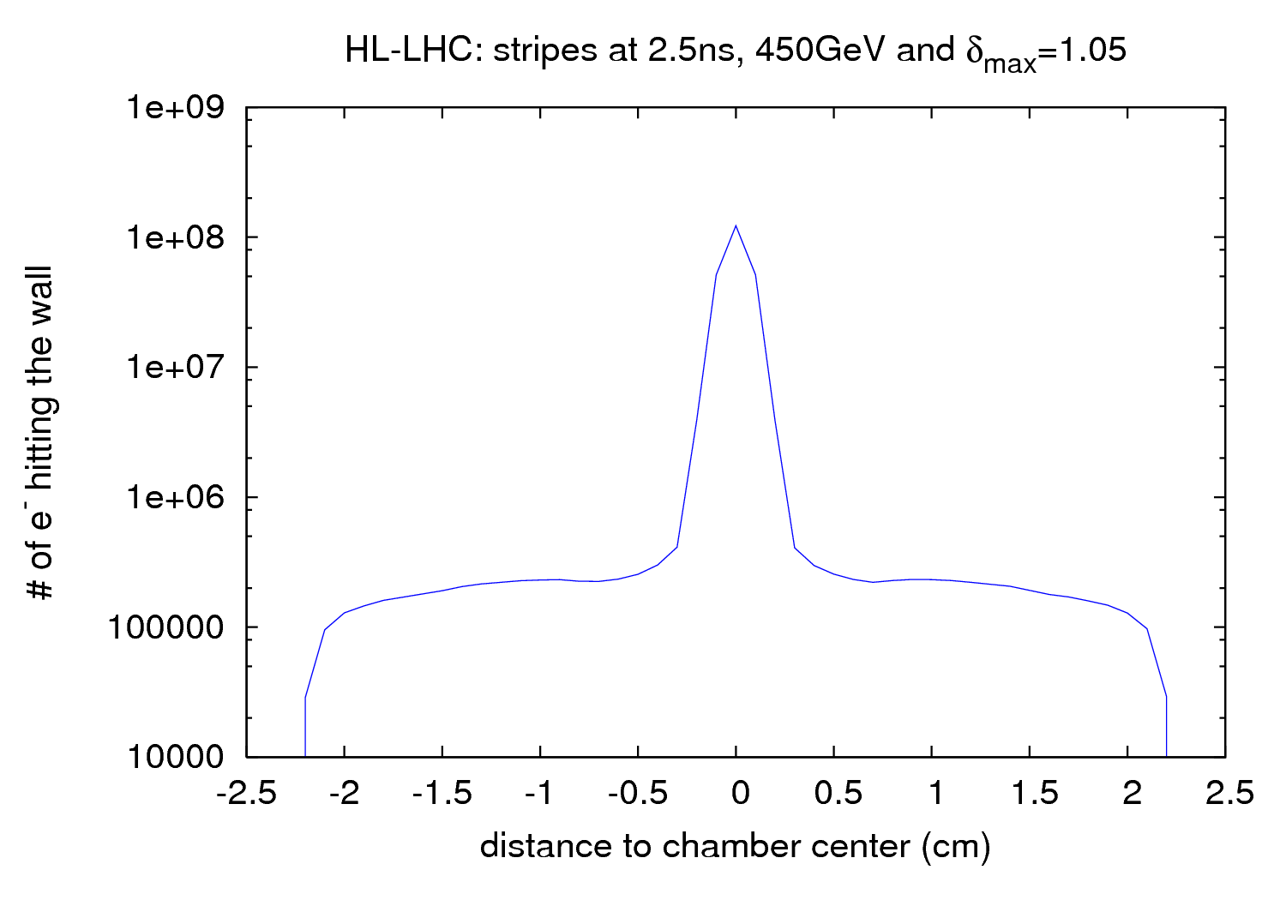
O. Dominguez

Slide 33
Future Work: LHC photon map
H. Maury Cuna
past simulations for LHC assumed
  80% of photoelectrons are emitted at the primary impact point
  20% are diffusively reflected following a cos² distribution.
  In the past, simulations using code PHOTON (F. Zimmermann, LHC-PROJECT-NOTE-237, 2000) showed SR photons >10 times fewer photons absorbed in the straights than in the arcs
are our assumptions correct?

Slide 34
Synrad3D
H. Maury Cuna
developed at Cornell by David Sagan and Gerry Dugan.
simulating production and scattering of synchrotron radiation generated by electron (or proton) beam in high energy accelerator
any planar lattice and wide variety of vacuum chambers
Monte Carlo techniques to generate photons based on the standard synchrotron radiation formulas for dipoles, quadrupoles and wigglers – similar to PHOTON
photon tracking inside the vacuum chamber; at the wall probability of being scattered is determined by the angle of incidence, the energy of the photon, and wall surface properties [similar to PHOTON but better surface model]

Slide 35
Synrad3D modifications for LHC
H. Maury Cuna
LHC-specific aspects:
  different beam pipe coatings at different locations
  varying beam pipe geometries
  sawtooth pattern in the arcs
recently, David Sagan has implemented these characteristics into Synrad3d and the code is now able to simulate LHC-like machines

Slide 36
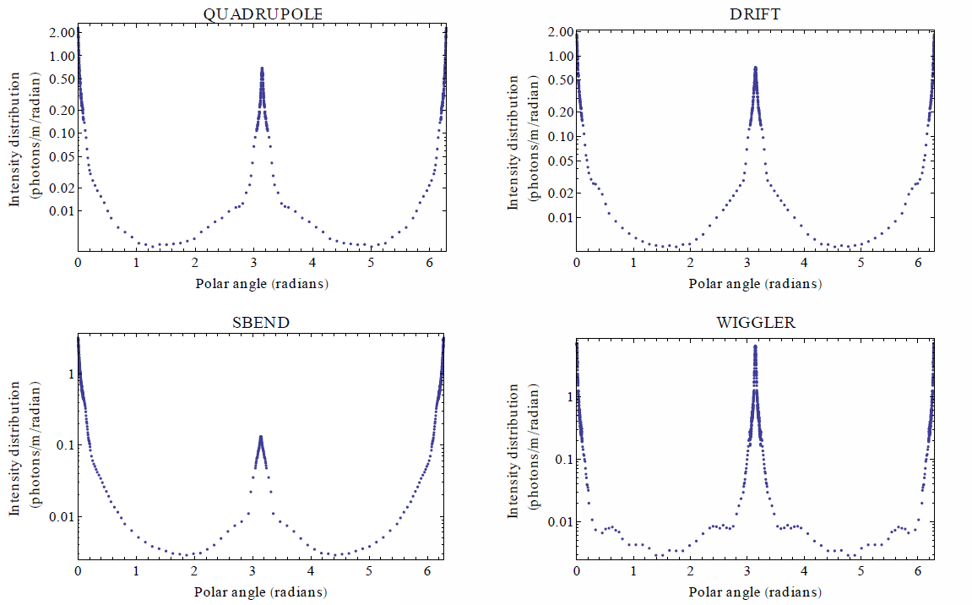
SYNRAD3D example predictions of photon absorption sites
Photon emission throughout the ring, averaged over different magnetic environments.
Actual Cesr vacuum chamber, specular reflection only,
beam energy 2.1 GeV
polar angle
chamber wall
Thanks to G. Dugan
H. Maury Cuna

Slide 37
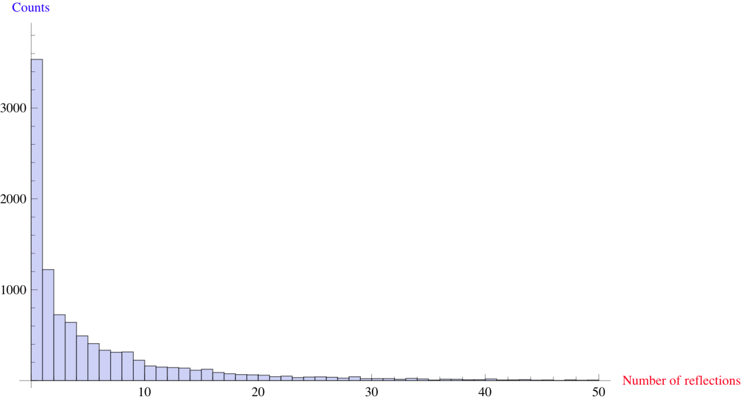
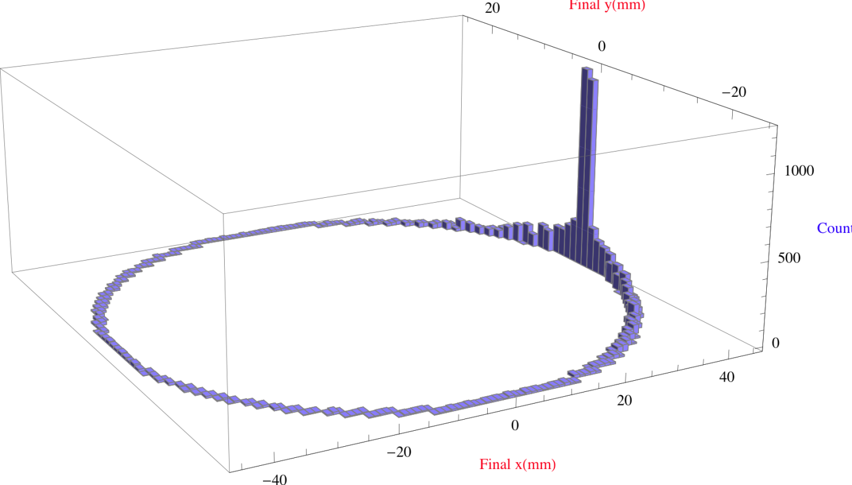
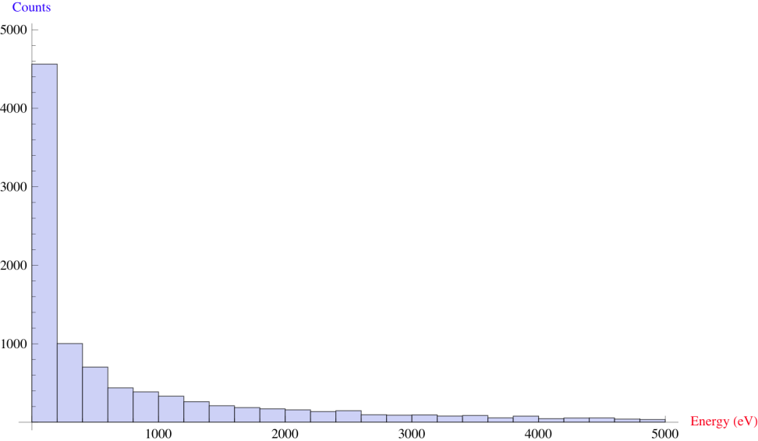
H. Maury Cuna
SYNRAD3D example results
Photon reflection number distribution
Avg. number of
reflections=5.4
Distribution of photon absorption sites around the vacuum chamber perimeter
Photon energy distribution

Slide 38
most importantly
Octavio and Humberto
to finish their PhD theses by late summer 2013
– good luck!

Slide 39

thank you!
CERN-CINVESTAV-TU Prague e-cloud collaboration dinner this Monday (thanks to G. Contreras & H. Maury)

