Slide 1


The HEADTAIL Development Working Group (HDWG) in 2012
G. Rumolo
Wednesday 23.01.2013, in ABP-ICE Meeting
HDWG: T. Argyropoulos, S. Aumon, H. Bartosik, N. Biancacci, H. Day, C. Hansen, G. Iadarola, E. Koukovini-Platia, K. Li*, E. Métral, N. Mounet, B. Salvant, H. Timkó, R. Wasef, C. Zannini
* @SLAC until November 2012
Special guests: A. Burov, M. Migliorati, V. Vaccaro

Slide 2
Background
Over the years HEADTAIL has been used on a broad variety of machines and problems (single bunch)
  Electron cloud
    PS, SPS (Q26 & Q20), LHC (protons), SIS18, SIS100 (ions)
    KEKB LER, DaΦne (positrons)
    CLIC/ILC Damping Rings (positrons)
    Studies of high-bandwidth transverse feedback system
  Impedance (transverse plane)
    SPS (TMCI at injection, headtail instabilities)
    PS (headtail instabilities at injection, TMCI at transition)
    ALBA, CLIC Damping Rings (impedance budget)
  Impedance (longitudinal plane)
    Potential well distortion (synchronous phase shift, bunch lengthening/shortening)
    Microwave instability threshold (above and below transition)
    Space charge vs. impedance effects over transition crossing
The extension to multi-bunch comes from Nicolas’ PhD thesis and it was applied to SPS and LHC

Slide 3
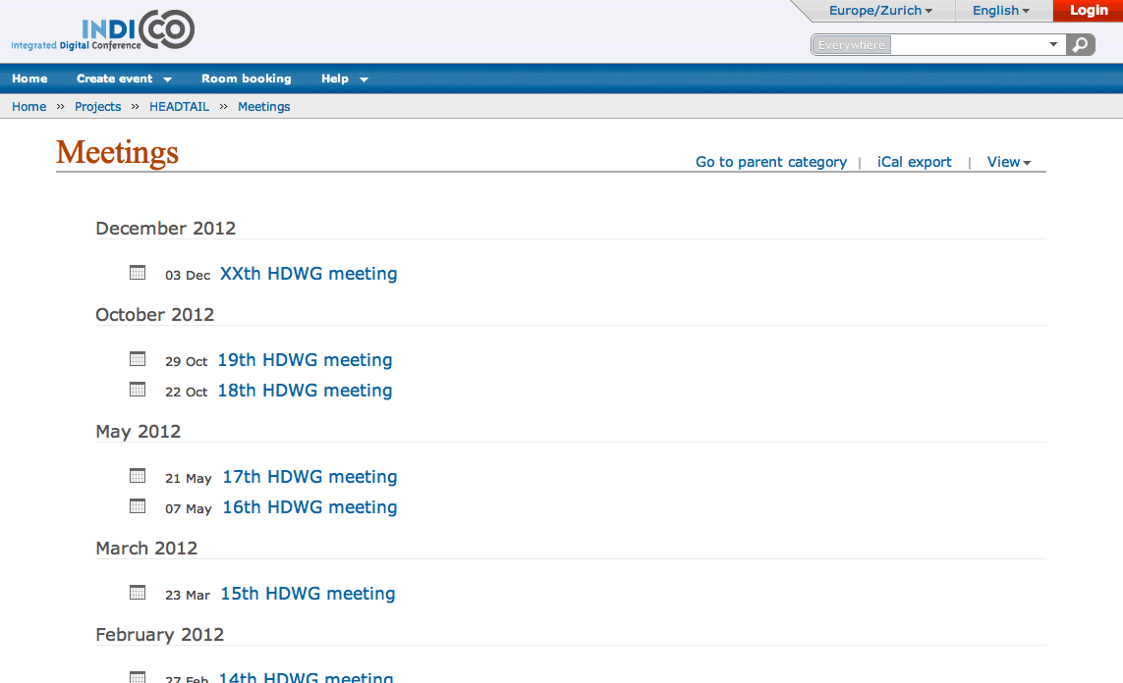
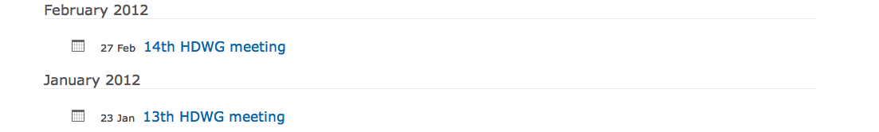
INDICO site under Projects → HEADTAIL
So far 20 meetings, 8 of which took place in 2012
Slides of the presentations & minutes are posted on the specific meeting Indico pages

Slide 4
HEADTAIL
HEADTAIL_ecloud
HEADTAIL_impedance
Kevin Li
Nicolas Mounet
Single bunch
Multi-kick with different beta-function transport
Different electron cloud density at different kick points
Different magnetic field option at different kick points
Can import electron cloud distribution file from ECLOUD or PyECLOUD
New structure of input file(s)
New structure of output files (HDF5)
Two slicing options (constant slice length or slice charge)
Presently includes high bandwidth damper
Post-processing tools (footprint, 3D rendering of beam and cloud dynamics, Sussix mode analyses, ..)
Option for multi-bunch tracking
Parallelized on the bunch loop
Multi-kick with different beta-function transport
Use the cumulated wake from several turns
Different analytical impedances in different kick points (resonators, resistive wall)
Wake functions can be imported from Z-base (constant, dipolar, quadrupolar, coupling)
Multi-turn tracking to speed calculations for slow processes
Bunch/slice grouping options

Slide 5
Subjects of the
2012 meetings
Past meetings (I):
  Effects of octupoles on Electron Cloud Instability (Kevin → IPAC paper)
  Mode analysis for electron cloud instabilities (Hannes)
    Detailed study of the mode shift as a function of electron cloud density or bunch intensity
    Not clear whether ECI is TMCI-type
  Longitudinal single bunch instability (Hugo)
    Effect of space charge and broad band resonator
    Microwave instability threshold
  HEADTAIL with tracking between impedance/observation points (Nicolo)
    Code upgrade to allow tracking through a lattice
    Impedance localization MDs
    Application to CLIC damping rings (Eirini)

Slide 6
Subjects of the
2012 meetings
Past meetings (II):
  Effect of Q’’ on single bunch stability (Nicolas)
    Octupoles + Q’’ contribution in theory and simulations
    Effect of positive and negative chromaticities
  E-cloud instabilities with inputs from PyECLOUD (Hannes + Gianni)
    Reproduce bunch-by-bunch interaction of an LHC bunch with an electron cloud
    Direct benchmark with LHC data from 25ns injection test from 2011
  Potential well distortion studies in the PS (Mauro Migliorati)
    Benchmark with theory and other longitudinal tracking code
  HEADTAIL simulations in the longitudinal plane (Helga)
    Can HEADTAIL be used also for simulations of collective effects in the longitudinal plane?
  Explore the possibility to code a simplified beam-beam module in HEADTAIL ? (Nicolas, Simon, Xavier)
    How much effort does it take? Does it pay off?
  Update on wide-band feedback system and HEADTAIL library (Kevin)

Slide 7
Subjects of the
2012 meetings
Activities/studies in stand-by, planned or ongoing
  TMCI with double harmonic in BS and BL mode
    Kevin and Nicolas are now also in the process of taking data in the PSB in these two modes of operation (see last point)
  Study of the efficiency of the high bandwidth transverse feedback against TMCI
    The feedback module, as was built for HEADTAIL_ecloud, needs to be ported into HEADTAIL_impedance
  Loss of Landau damping in the longitudinal/transverse plane
    Test/review of simplified space charge models and possible artifacts
  Radiation damping + space charge for CLIC damping ring studies
  Single bunch excitation [using the transverse feedback toolbox]
    Benchmark with SPS experiments
  Investigation on LHC instabilities with 25ns on first batch – observed during the scrubbing run and cured by octupoles
  Understanding of PSB instability

Slide 8
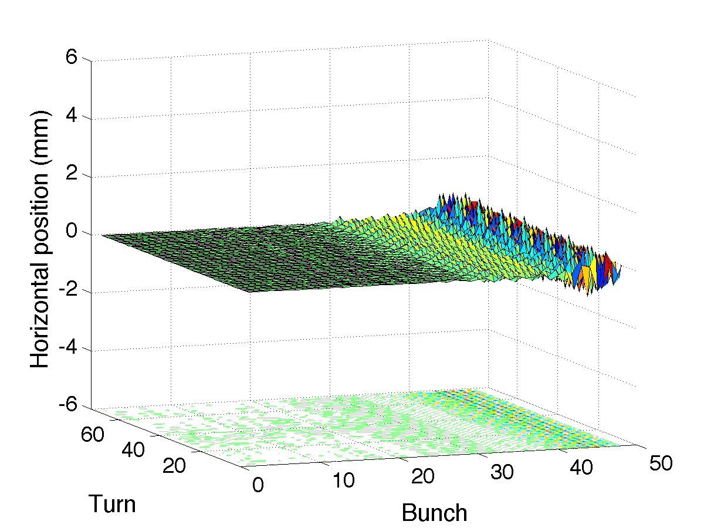
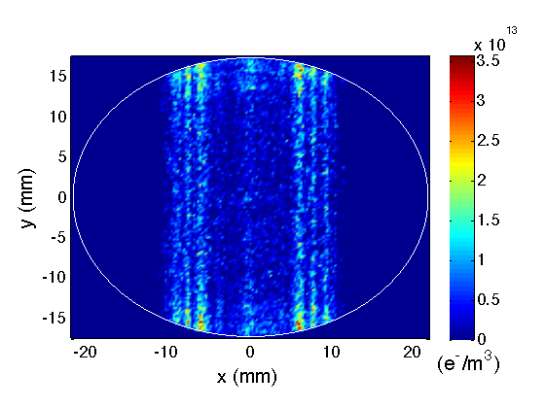
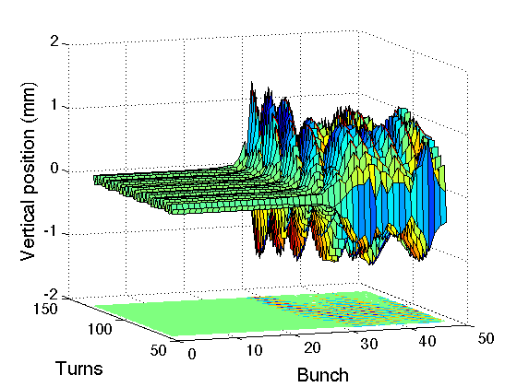
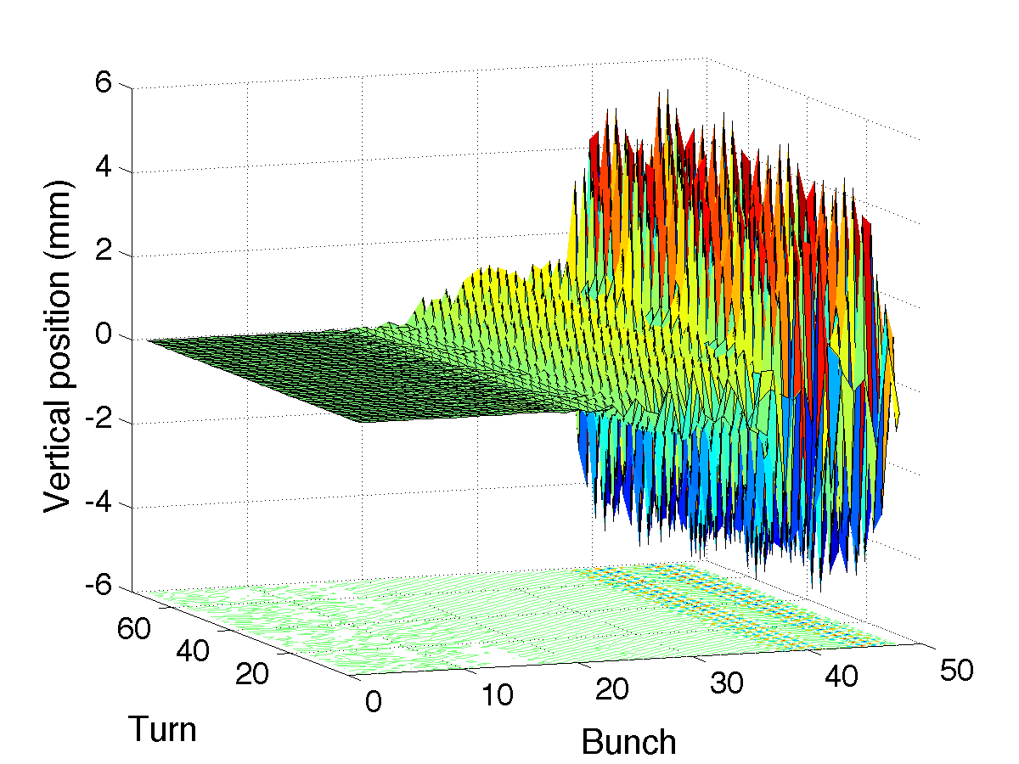
Some samples:
LHC application (I) → e-cloud instability
48b injection test (26/08/11)
Headtail simulation 1
48x
Headtail simulation 1
PyECLOUD e⁻ distribution (δ_{max}=2.1)
Some motion only
for last bunches …
bunch 48
48x HEADTAIL simulations reveal the onset of instability
~ bunch 25 is the first unstable
up to ±5mm
H. Bartosik et al.

Slide 9
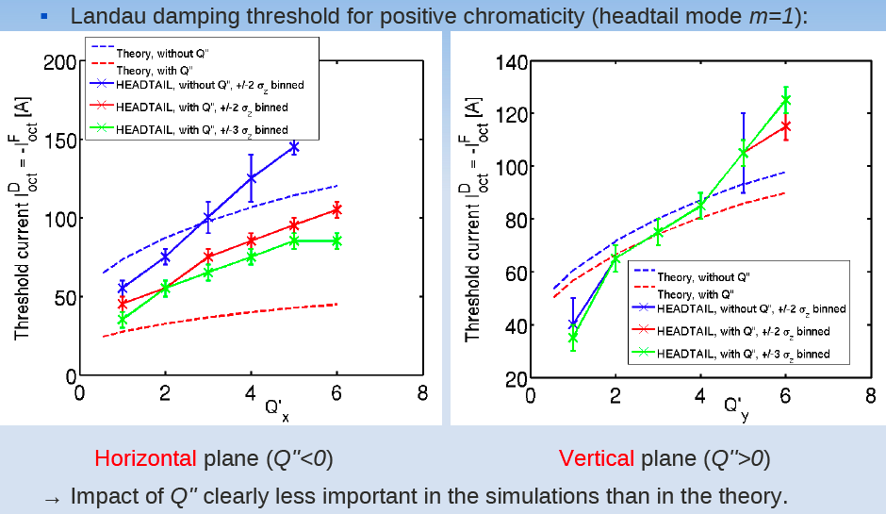
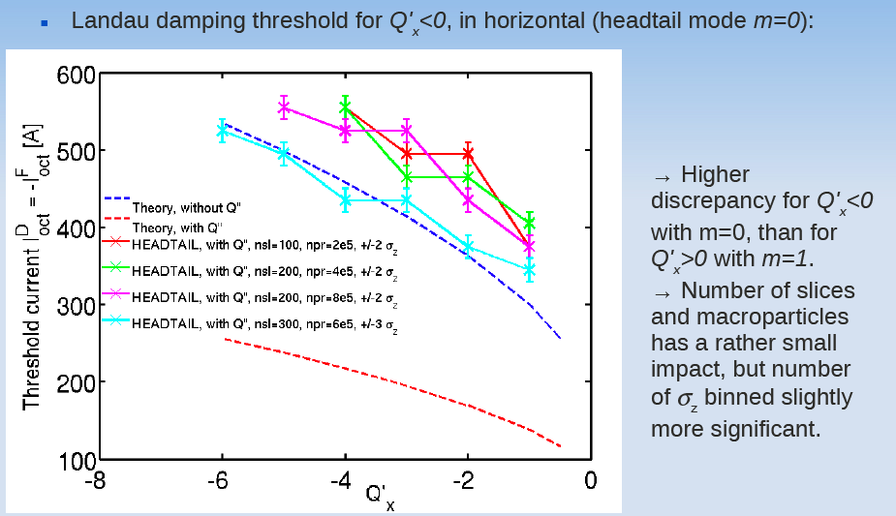
Some samples:
LHC application (II) → Q’’ and octupoles
Stability study for an LHC single bunch @4 TeV, ε_{z}=2.5 eVs, ε_{x,y}=2μm, N_{b}=1.7e11 p
Octupole current threshold needed to stabilize bunch against impedance for different Q’ values
N. Mounet et al.

Slide 10
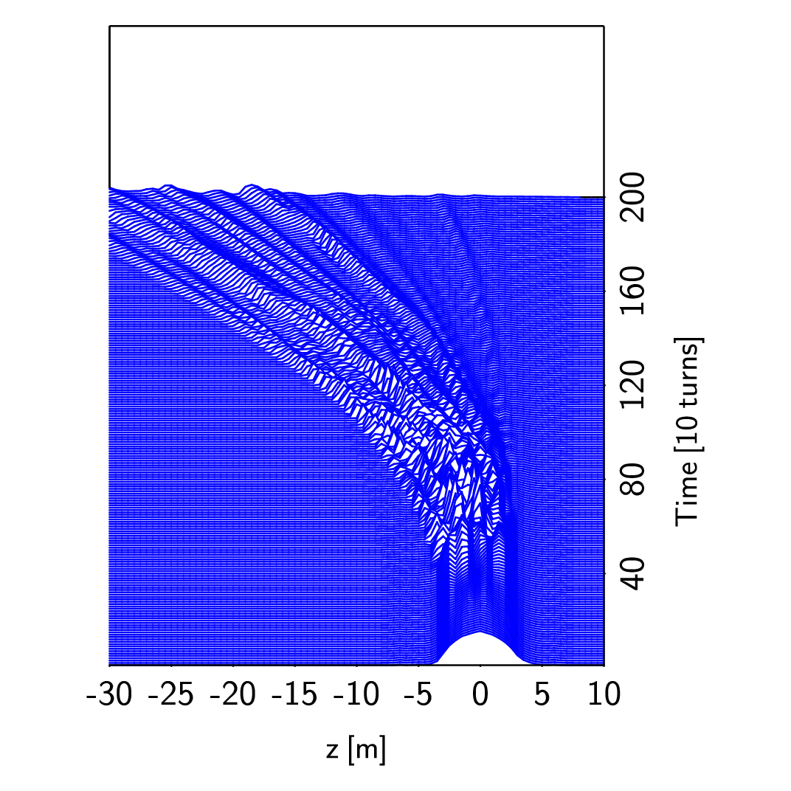
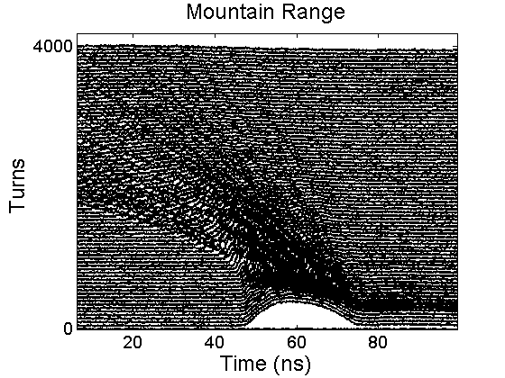
Some samples:
HEADTAIL for simulations in the longitudinal plane?
Application to a de-bunching bunch experiment in the SPS
28ns long single bunch injected into the SPS with RF off for impedance measurements
Reproduce evolution with the SPS longitudinal impedance model (ongoing)
EXPERIMENT
SIMULATION
H. Timkó et al.

Slide 11
Some samples:
HEADTAIL for simulations in the longitudinal plane?
Clear path for this application not set yet
  Different codes could be used as starting point
    HEADTAIL, ESME, Theodoros Argyropoulos’ code can all simulate the beam longitudinal evolution in presence of collective interactions
    “Possibility of using Rama Calaga’s python code to test modules and couple with c++ or Fortran subroutines” (H. Timko)
  HEADTAIL strengths and weaknesses
    A few options for the longitudinal motion are already implemented and to some extent tested
      Debunching, linear bucket, sinusoidal single and double RF (with harmonic numbers, voltages and relative phase from input file)
      Variable voltage (rebucketing)
      Accelerating bucket
      Longitudinal space charge (analytical approach, smoothing)
      Broad-band impedance, but also long range wake fields possible
    Code built for simulations in the transverse plane and performs 6D tracking, which is an overkill when emphasis is only in longitudinal
    Bunch manipulations including batch compression and bunch splitting cannot be handled at the present stage (slicing?)
    Matched distributions unavailable

Slide 12
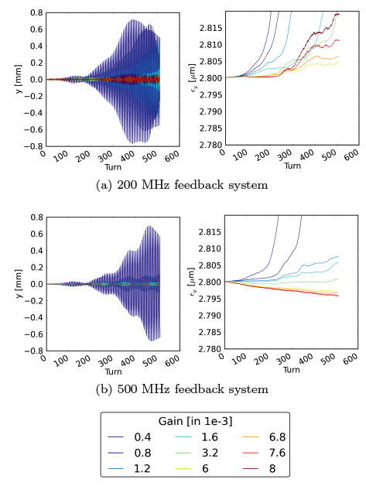
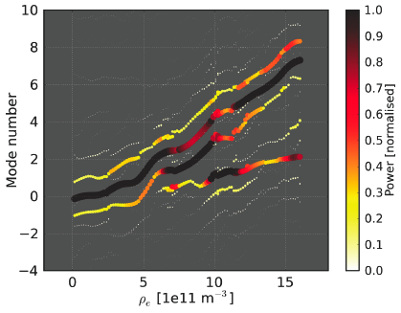
Some samples:
High bandwidth feedback system
A realistic feedback system (with all transfer functions and noise sources) has been implemented
Its efficiency was tested both to damp injection oscillations and against ECI
Bandwidth and gain must be large enough to efficiently suppress ECI
Instability region, where the dominant lines move from m=0 → -1 → -2
K. Li et al.

Slide 13

Ongoing activities development
HEADTAIL_ecloud
HEADTAIL_impedance
Testing additional Poisson solver(s) with adaptive mesh capability
Collaboration with Seneca College - Toronto, Canada for GPU/parallelization (just started, promising in terms of potential)
HEADTAIL
Library
MAD-X lattice support; smooth approximation → full Courant-Snyder parametrization
Interpolation of wake functions
Integration of MAD-X lattice support and multi-bunch tracking
Python interfaced library to study collective effects in circular accelerators
Written in C++ and Python
Highly modularized
Foundation for simple addition of any type of collective effect
One goal is to prepare for the final unification of HeadTail_impedance – HeadTail_ecloud – PyEcloud

Slide 14
Few words to conclude …
Plenty of work done and underway:
  Transverse and longitudinal plane
  Electron cloud and impedance (dipolar, quadrupolar)
  Single and multi-bunch
  Can optionally include chromaticity, octupoles, Q’’, damper, …
  Parallelization, GPU perspectives, Python library
  Several machines, several benchmarks → multiple occasions for applications & further development
Main showstopper (2012, future?) is lack of dedicated manpower to pursue the code development
  Need for resources with clear “HEADTAIL Development” objectives
  Little space for large scale testing, which is as important as developing
  No systematic check that all code capabilities are systematically transported through the upgrades
  In spite of the multiple occasions for applications, study cases should not be limited to one or few simulations, but systematic and complete scans should be always carried out (including the sensitivity to numerical parameters)

