Slide 1
The Two-beam impedance MD
P. Baudrenghien, A. Burov, S. Fartoukh, E. Métral,
G. Papotti, B. Salvant, F. Zimmermann
Acknowledgments: M. Pojer, L. Ponce, M. Solfaroli, J. Wenninger, ...

Slide 2
Machine conditions
78 bunches (6+2×36), 1.5E11, 1.5-2 microns (from SPS)
4 TeV, end of squeeze (0.6/3/0.6/3), all settings nominal
Moving Beam2 clockwise with the RF (-12Hz → δ_{p} ∼ 10⁻⁴) by step of one quarter of turn (∼ 15 min.):
“0 turn” or IR15 configuration : beam overlap in IR1 and IR5
“1/4 turn” or IR2 configuration : beam overlap in IR2 only
“1/2 turn” or IR0 configuration : no overlap in any experimental IR
“3/4 turn” or IR8 configuration : beam overlap in IR8 only
“1 turn” = “0 turn”, “1.5 turn” = “1/2 turn”, ...
For each configuration, MO scan performed, sometimes with tune split (always moving down along the diagonal the tunes of the most stable beam)

Slide 3
Overview
B2H
B2V
IR15 configuration:
→ 400A w/o Q-split (tested twice)
→ 300 A with Q-split (-0.005 on B1V/H)
→ No way to stabilize B2H
→ Cogging stabilizes
IR15 and then IR0 again
→ No threshold, both MO polarities!
→ IR15: Q’H +4 at 0 A to stabilize a bit
→ IR0: ΔQ’=+10 (H/V) at 0A, beam still stable
IR2
→ 150-180A
→ Q-split does not help
IR0
→ 150A
IR8
→ 100A

Slide 4
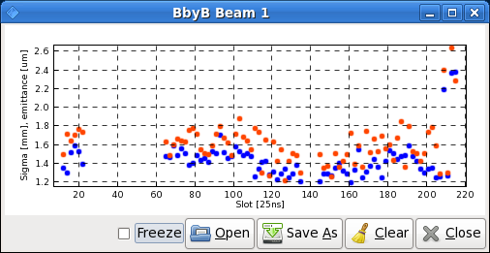
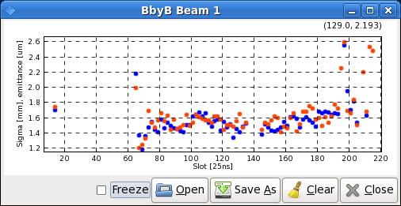
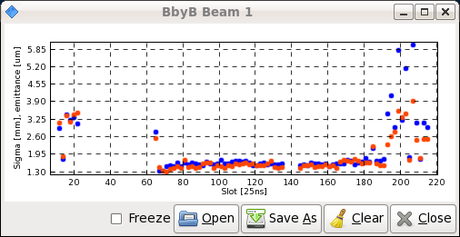
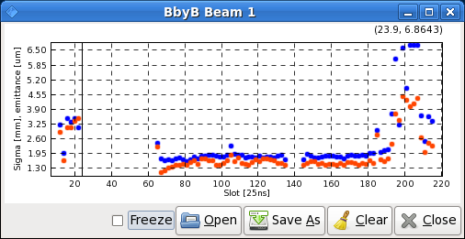
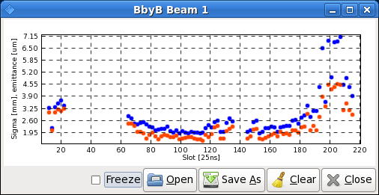
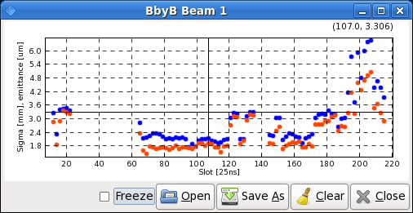
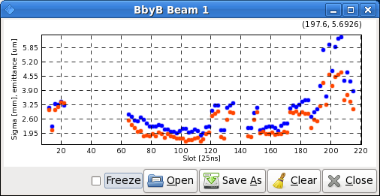
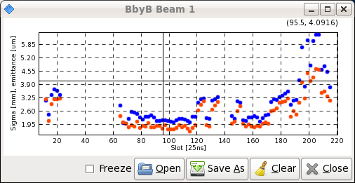
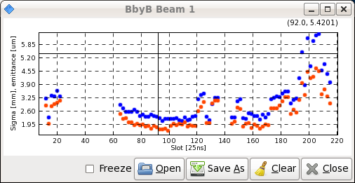
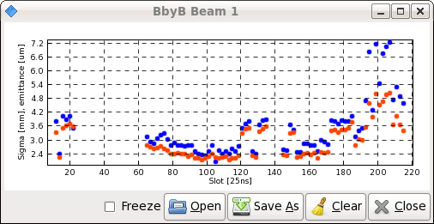
Emittance (B1 only)
7h21: IR15 start (1.2→2.6)
7h50: IR15, 400 A, dQb2=-0.003 (1.2→2.6)
7h53: IR15, 400 A, dQb2=-0.005 (1.3→5.8)
8h18: IR15, 300 A, dQb1=-0.005 (1.3→6.5)
8h46: IR15 end(1.3→7.2)
9h11: IR2 start (1.4→6.5)
9h35: IR2 end (1.4→6.5)
10h06: IR0 end (1.4→6.5)
10h28: IR8 start (1.4→6.5)
11h16: IR15 again, 0A, (1.8→7.2)
→ Only in the IR15 configuration, the instabilities blowed up
the emittance (end of 2d batch, then start/end of both batches)
→ The cogging with or w/o moving LR encounters does not
seem to impact at all on the beam emittance

Slide 5
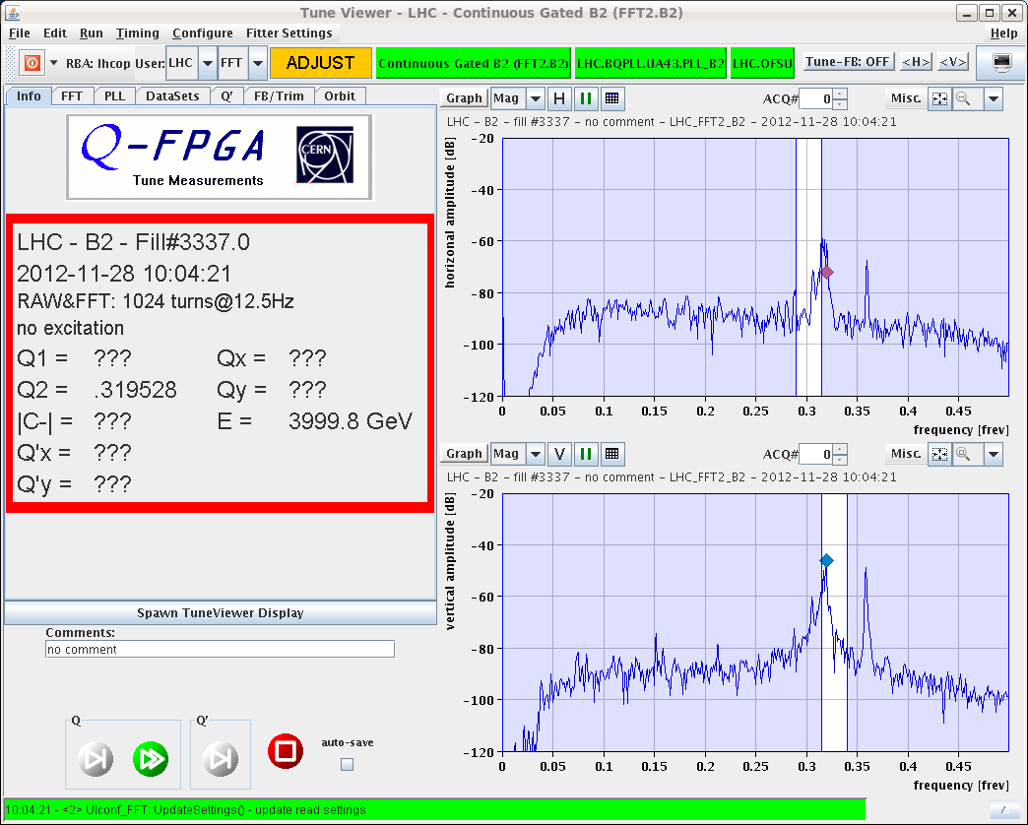
The 2Qy-line
→ Always occur with the instability in ALL cogging configuration (possibly BBQ saturation, analysis on-going)
IR0 configuration, 150A, instability B2V (no tune-split)

Slide 6
“(Kind of) conclusions”
→ Why no threshold any longer after one turn?
We do not know.
...There were still bunches with reasonably high charge (1.3-1.4E11) and small emittance (<2.5 microns) at the center of the trains. The B2 bunch length only increased a bit (≤ 0.05ns), and that of B1 was strictly constant.
→ Why as soon as an instability occurs, it is extremely difficult to damp it, even stepping back with the octupoles?

