Slide 1
RF MD observations
T. Pieloni and N. Mounet

Slide 2
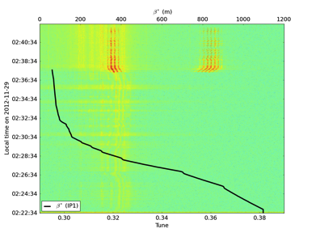
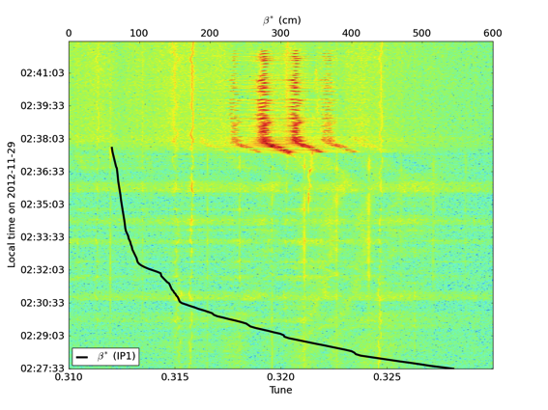
Spectrograms:
Tune split
Usual picture
Settings: Tune split at the end of squeeze in 3e-3 on B1V down. Tune for B1 (0.31, 0.317)
Instability arrives around 0.7 m beta* as in normal operation with tune split
Stops alone without collisions, could also be the case for normal fills but we normally go into collision fast

Slide 3
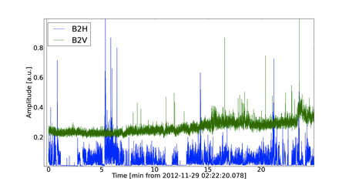
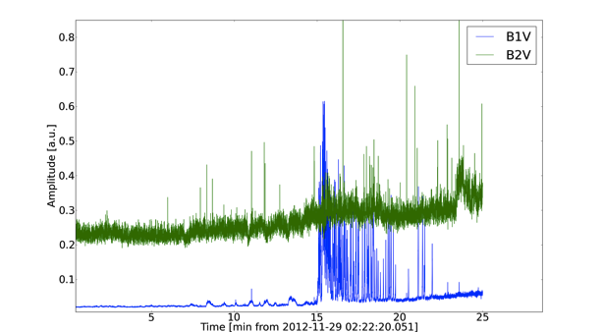
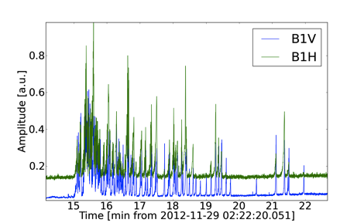
Beam oscillation
B2 is also oscillating but no instability,
Just slightly increase of oscillation amplitudes
Zoom to notice the HV coupling for B1
Nothing special to be noticed
Instability arrives from B1 V plane.
Couples strongly to B1 H plane due to the tunes which are very close

Slide 4
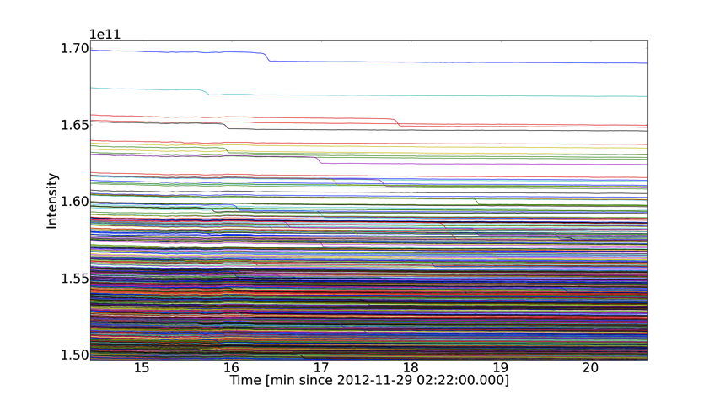
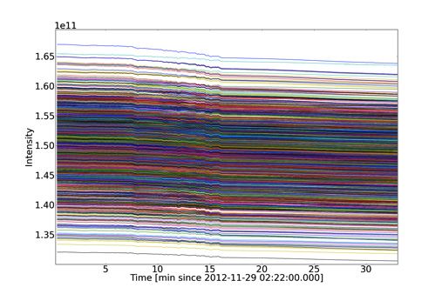
Bbb Intensities fill 3340 MD
B1 losses looks like normal fills
Losses on few bunches of less than 1%
We had fills also in same conditions

Slide 5
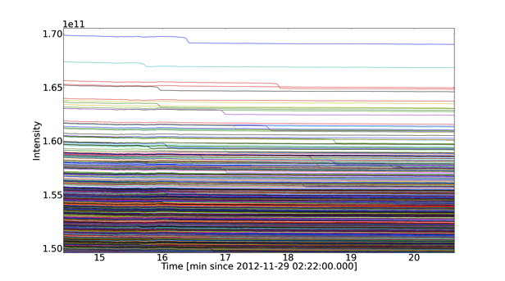
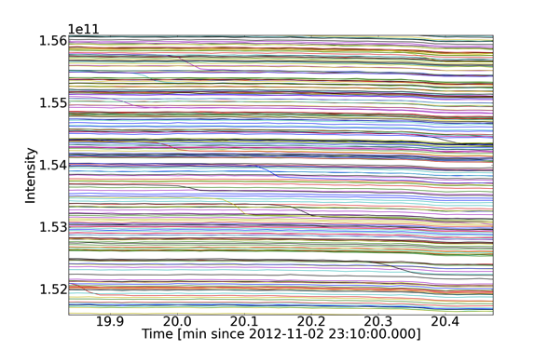
Intensity comparison with 3259
Fill 3340 MD
Fill 3259
Fill 3259
Very similar in amplitude of losses and “shape”.

Slide 6
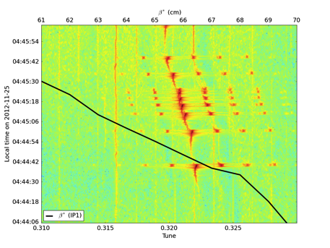
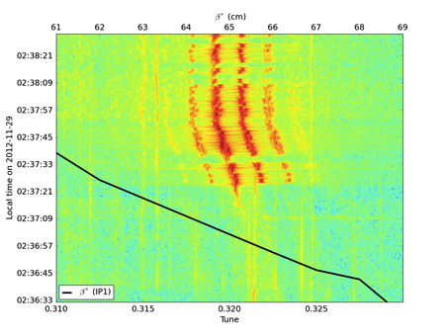
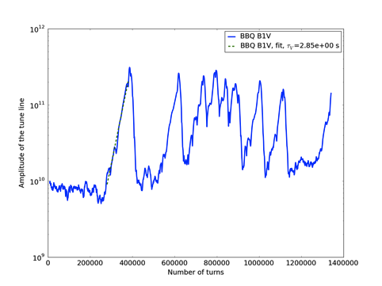
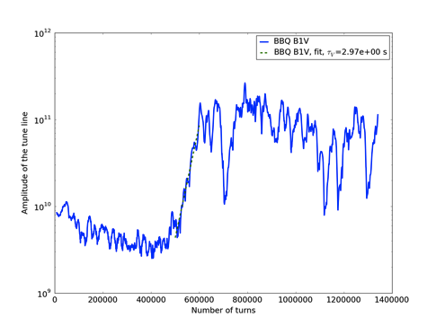
Comparing with 3322
Fill 3322
Fill 3340 MD
Instability rise time

Slide 7
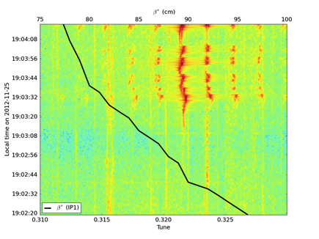
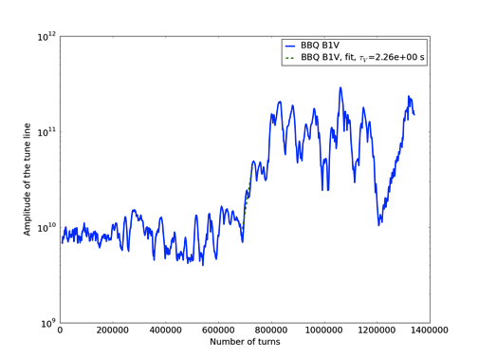
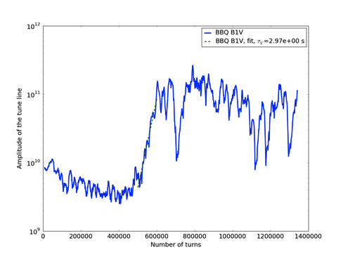
Comparing with 3323
Fill 3323
Fill 3340 MD
Instability rise time

Slide 8
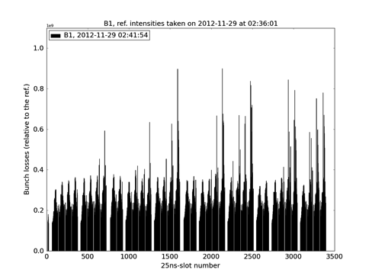
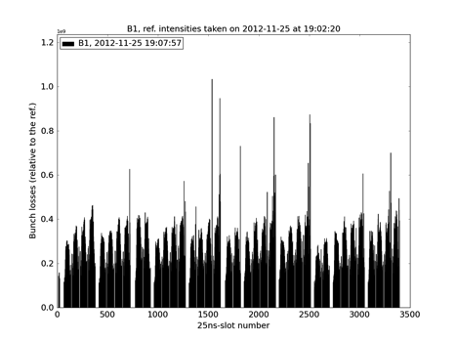
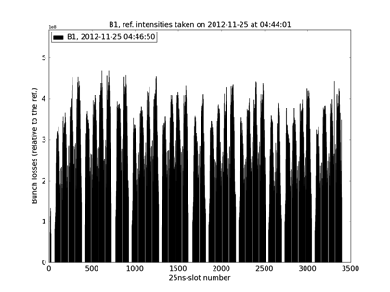
Losses comparison Fills 3340, 3322 and 3323
Fill 3323
MD
Fill 3322
Losses look a bit more “homogeneous” respect to the two fills 3323 and 3322
Level of losses comparable to other fills so no improvement

Slide 9
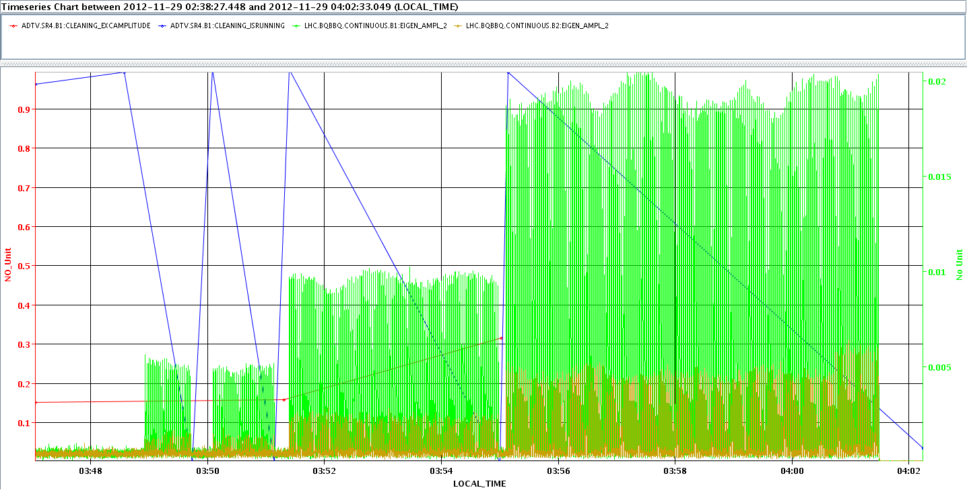
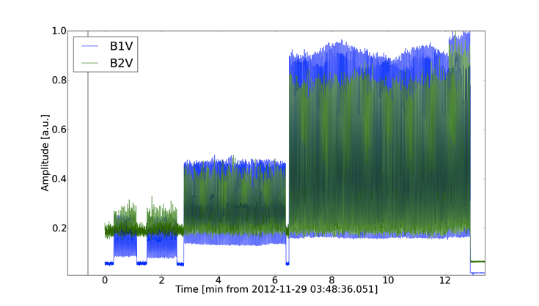
Dump due to Abort Gap Cleaning
Dump due to AGC active on B1 only!
B1 oscillates when AGC turned on following increase of level (low the intermediate level)
B2 follows oscillations of B1
Dump due to losses in IP5, one collimator protecting the Triplet
Detailed analysis of losses during this fill on-going with collimation team (seems more losses in IP3 and IP7 wrt “nominal fills”)
Transvers damper on?? Wolfgang will let us know…

Slide 10
Losses from collimation during MD
Where are we losing? Are we losing more wrt physics?
Waiting for collimation people (maybe tomorrow some plots) but seems we were losing more than usual in IP7 and IP3…and also in the Irs.

Slide 11
Still to de done/understood:
ADT post-mortem data
Collimation data to check general losses over the fill wrt to standard physics fill
Check with few more fills with tune split on
Need to understand how AGC works and do some simulations on this effect which caused the dump (read Wolfgang suggested paper and discuss with him)
Was the transverse damper on? Then why the two beams oscillates together when AGC active only on B1?
Strange no effect been seen to mitigate the instability, maybe beam parameters not at optimum further test for reproducibility should be useful

