Slide 1
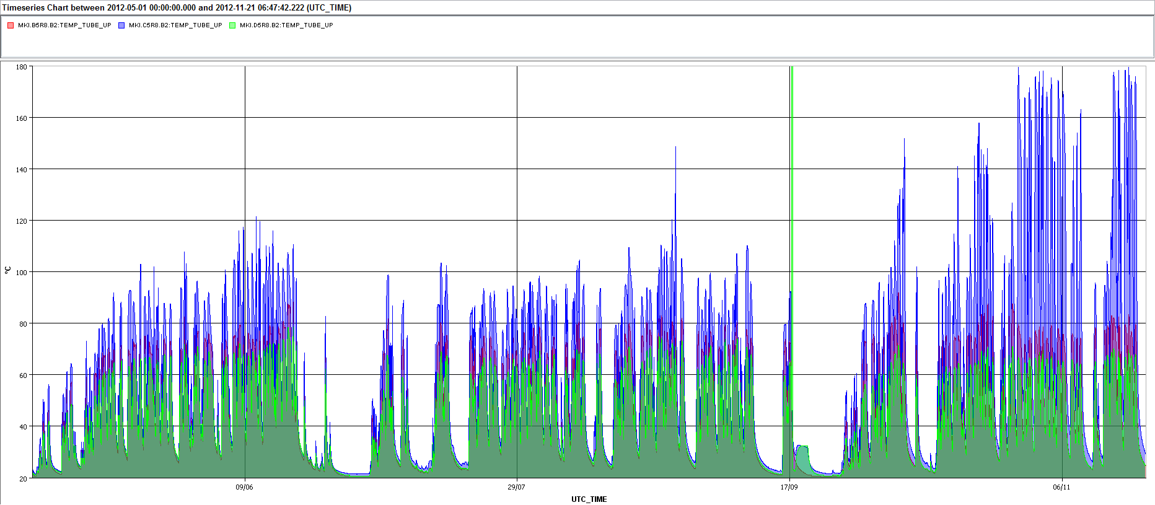
MKI8BCD: Temp_Tube_Up. May 1, 2012 to 21 Nov. 2012
TS#3
MKI8B_TEMP_TUBE_UP
MKI8D_TEMP_TUBE_UP
MKI8C_TEMP_TUBE_UP
Maximum value of Temp_Tube_Up of MKI8B, since May 1st, has been fairly consistent;
Maximum value of Temp_Tube_Up of MKI8D, since May 1st, has been fairly consistent, but is slightly lower for the new MKI8D (changed TS#3);
Maximum value of Temp_Tube_Up of MKI8C, until TS#3, was generally < 120˚C, with one excursion to ~150˚C on 27/08. Since TS#3 the temperature has approached 180˚C at times (but not always).

Slide 2
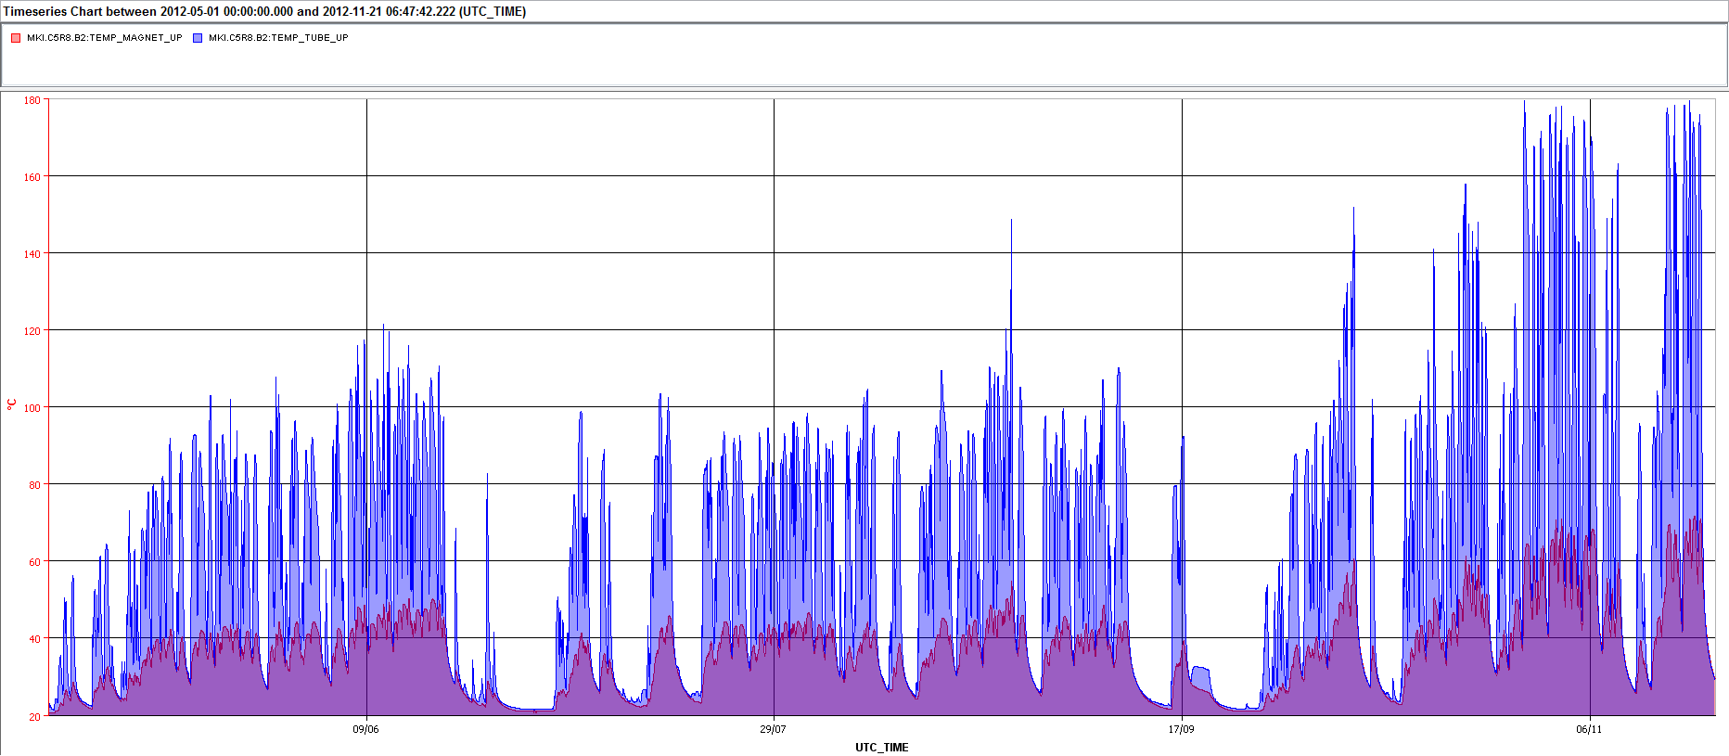
MKI8C: Temp_Tube/Magnet_Up. May 1, 2012 to 21 Nov. 2012
MKI8C_TEMP_MAGNET_UP
MKI8C_TEMP_TUBE_UP
TS#3
Before TS#3 maximum value of Temp_Tube_Up of MKI8C was generally < 120˚C, and Temp_Magnet_Up approached 50˚C.
Since TS#3 increased heating of maximum value of MKI8C Temp_Tube_Up has increased temperature of MKI8C Temp_Magnet_Up (by thermal radiation).

Slide 3
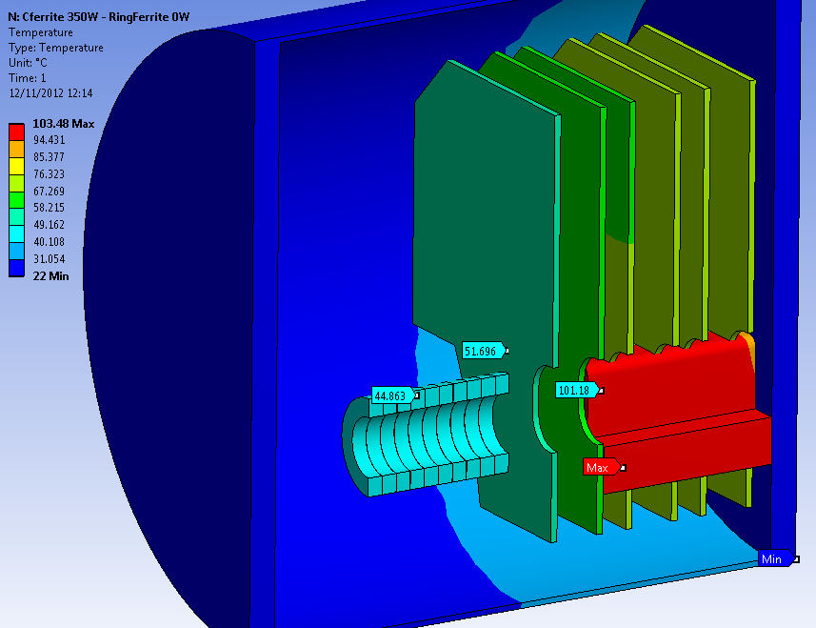
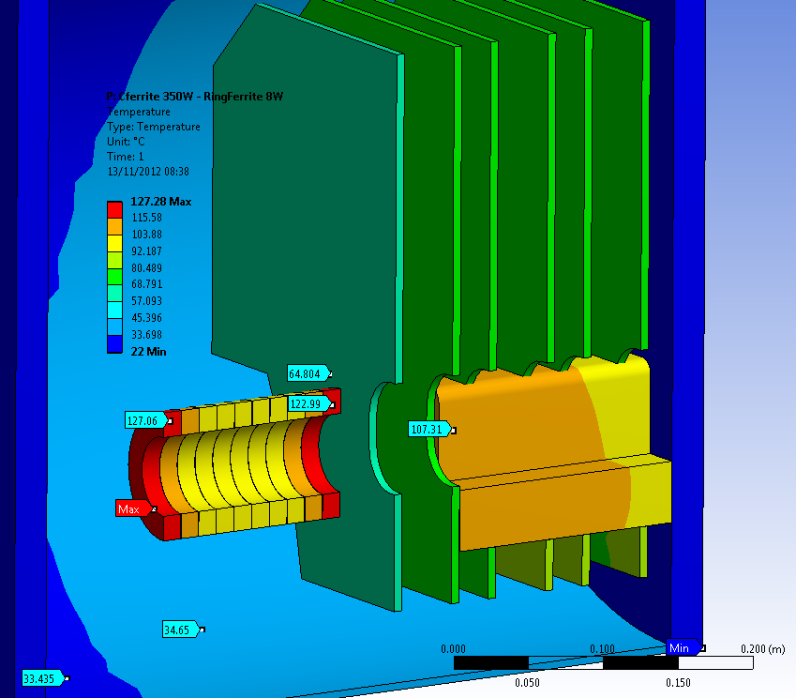
Results:
Initial condition for analyses: P_{Cshape_EQ}=350W , P_{Rings}=0
First plate reaches 52°C
Given P_{Rings} such that T_{Rings} is met, does the model predict well the first plate temperature?
T_{Rings} [°C] experimental | T [°C] meas. experimental | P_{Rings} FEM | T_{Rings} [°C] FEM | T [°C] plate FEM | T [°C] yoke FEM
130 | 55 | 8 | 127 | 64 | 109.2
160 | 60 | 12 | 155 | 71 | 111.9
Case P_{Rings}=8W
ΔT=5˚C
ΔT=7˚C
T_{plate} overestimated, but increase due to ferrite rings is possible
Corresponding predicted ΔT of ferrite: ~3˚C
Slide courtesy of Marco Garlasche

Slide 4
MKI8C: Magnet Delay and Rise-Time Since TS#3
TS#3
When the magnet yoke temperature is below the Curie temperature the slope of the above curves are defined by the temperature dependence of the MKI capacitors.
Abrupt changes of above slopes are most likely due to radiated power from MKI8C_Tube_Up, due to an increase of the measured temperature of MKI8C_Magnet_Up, increasing the temperature of ~10% (guestimate) of the ferrite yoke.

