Slide 1
15th MKI Strategy Meeting:
MKI8C Temperature
Mike Barnes

Slide 2
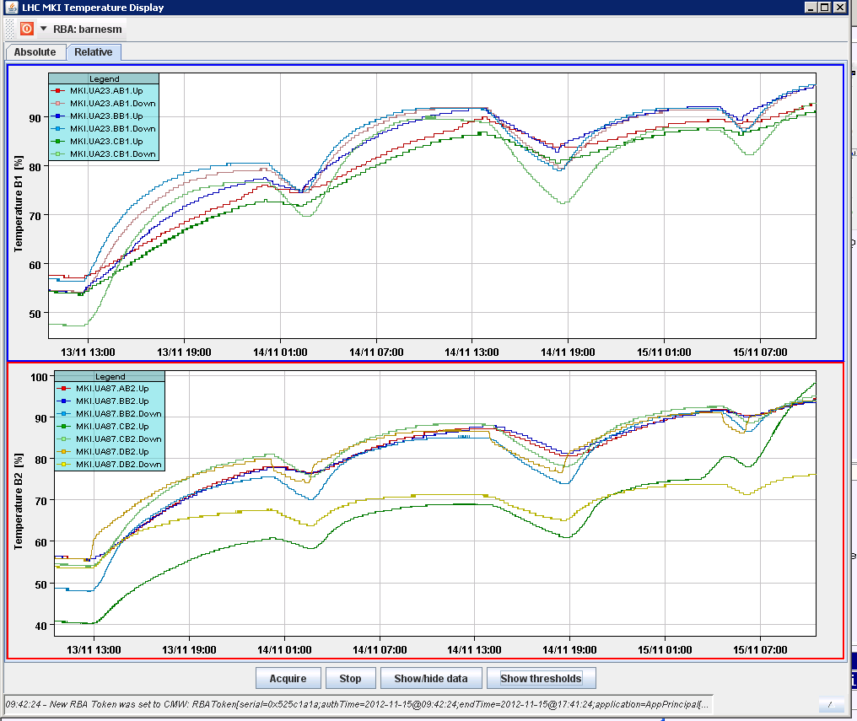
Recent Heating at Points 2 & 8
Early this week Point 2 was heating at a similar or slightly high rate, relative to the SIS thresholds, than Point 8.

Slide 3
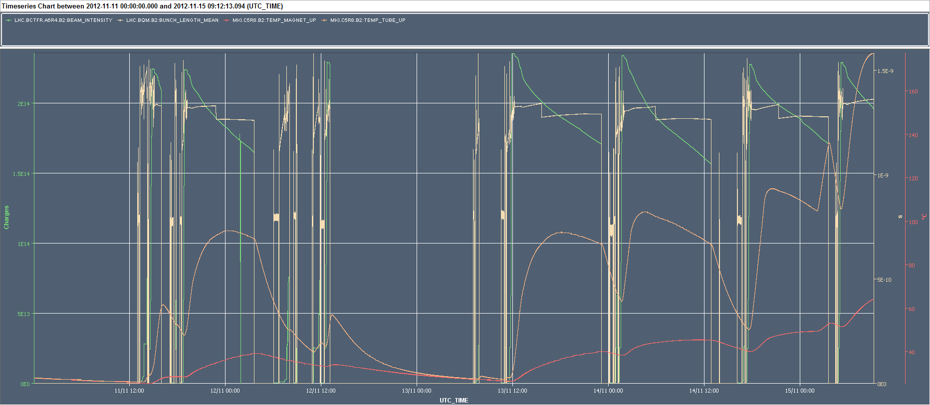
Recent Heating in MKI8C
Temperature of MKI8C_Tube_up was, before this morning, back to pre-October 2012 levels – what has changed again this morning?

