Slide 1
HiRadMat Tests on Collimator Materials: Preliminary Results and RF Implications
BE-ABP-ICE Section Meeting
07.11.2012
A. Bertarelli on behalf of the LCMAT Design Team
(A. Bertarelli, E. Berthome, F. Carra, A. Dallocchio, M. Garlaschè, M. Guinchard, N. Mariani, S. dos Santos, …)

Slide 2
Outlook
    Context
    HRMT-14 LCMAT experiment
    Irradiation History
    Preliminary Results (Medium Intensity)
    Preliminary Results (High Intensity)
    First Post-irradiation Images
    RF impedance Questions

Slide 3
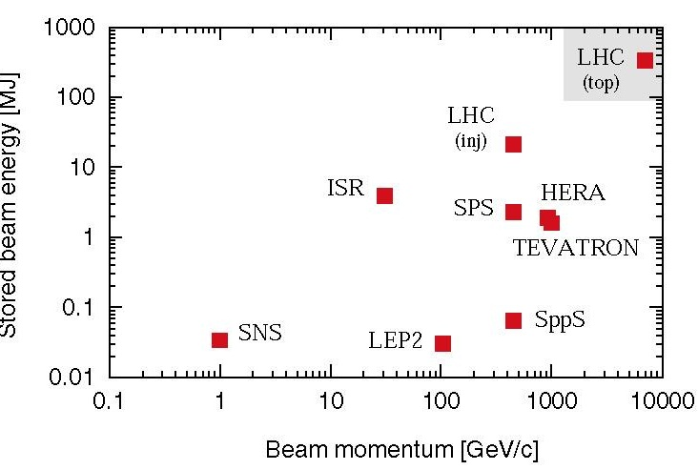
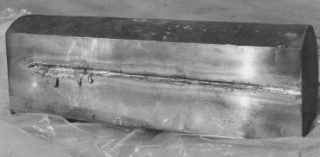
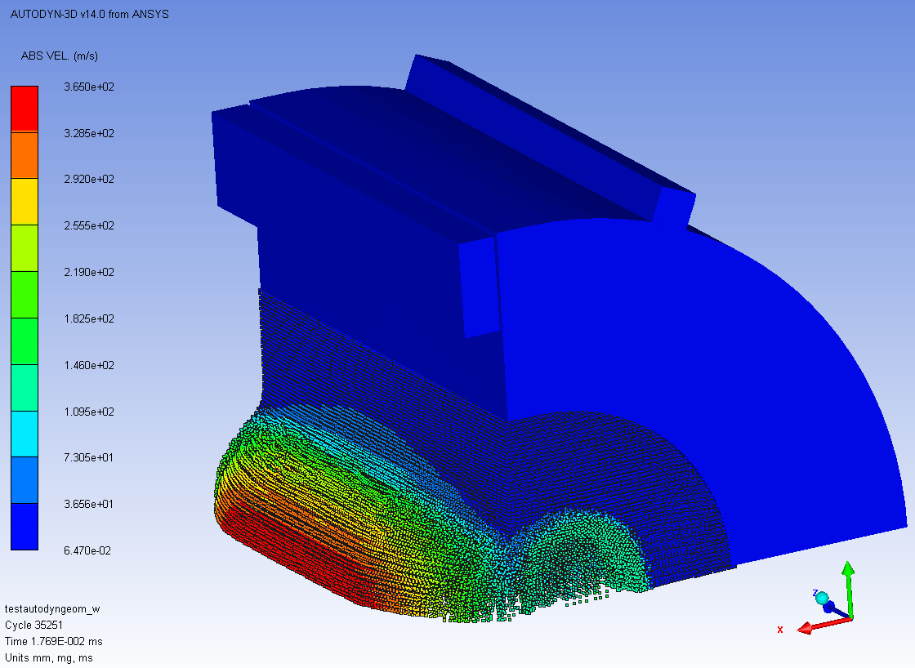
Context
LHC beam energy is 2 orders of magnitude above previous machines. Stored energy density is 3 orders of magnitude higher.
Beam-induced accidents represent one of the most dangerous and though less explored events for the LHC.
Novel, yet-to-characterize, composite materials are under development to meet these challenges.
New sophisticated and powerful numerical tools (Hydrocodes) are being used to simulate accidental events.

Slide 4
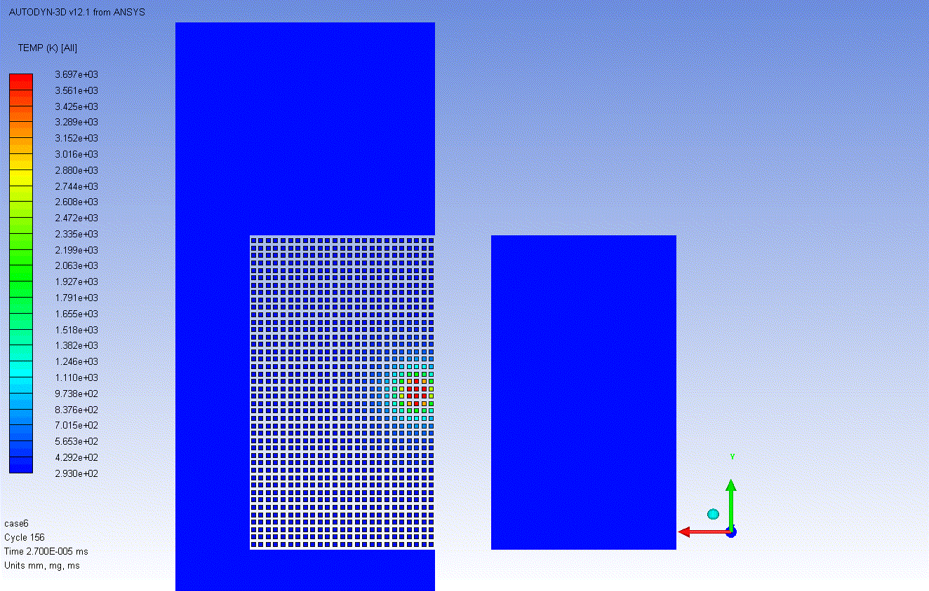
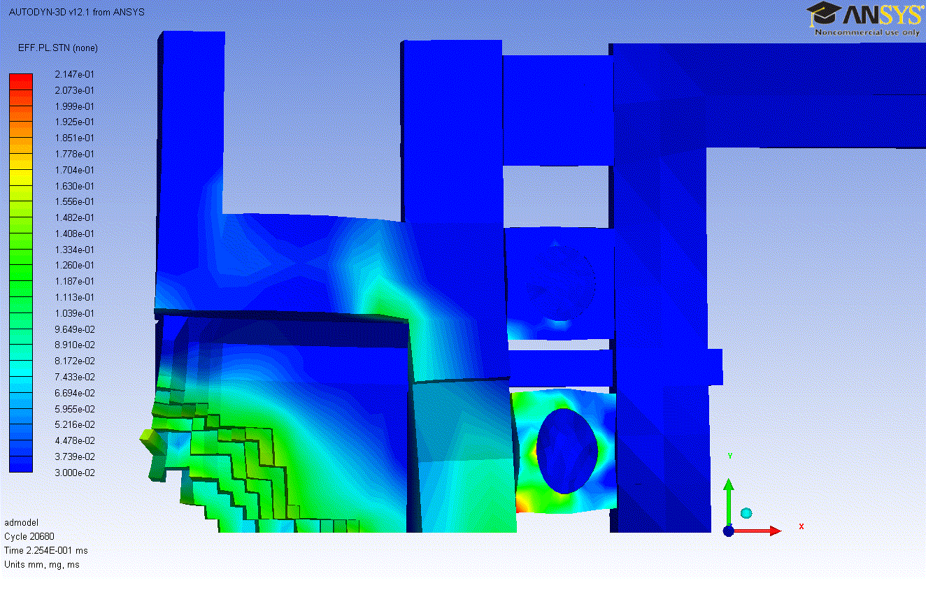
Accident Simulations on TCTA
Simulation of direct impact of 8 LHC bunches at 5 TeV on Tungsten Jaw
Probability of water leakage due to very severe plastic deformations on pipes.
Impressive jaw damage:
  Extended eroded and deformed zones.
  Projections of hot and fast solid tungsten bullets (T≈2000K, Vmax ≈ 1 km/s) towards opposite jaw. Slower particles hit tank covers (at velocities just below ballistic limit).
  Risk of “bonding” the two jaws due to the projected resolidified material.
Real Scale Deformations !!

Slide 5
Novel Materials for Phase II
C-C Collimators are affected by intrinsic limitations which may ultimately limit LHC performances:
Low-Z material (Limited Cleaning Efficiency)
Poor electrical conductivity (High RF impedance)
Limited Radiation Hardness (Reduced Lifetime)
Beam propagation
Core
Unavoidable losses
To overcome this, additional advanced collimators (Phase II) are to complement Phase I
Primary
halo (p)
p
Innovative Materials for Phase II Jaws are the key element for next-generation Collimators
Primary Collimator
p
Impact
parameter
≤ 1 mm
Secondary Collimator
p
e
Shower
Phase II Collimator
Absorber
Absorber
Super-conducting magnets
SC magnets and particle physics exp.
Courtesy:
R. Assmann
C-C
C-C
W
W

Slide 6
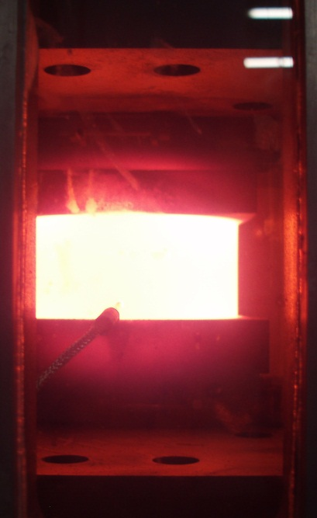
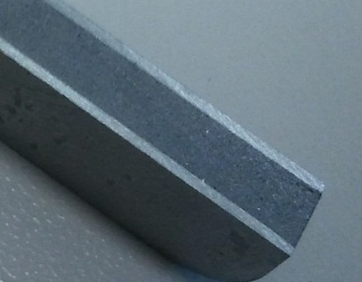
Novel Materials for Phase II
Metal Matrix Composites (MMC) for advanced thermal management materials combine properties of Diamond or Graphite (high k, low ρ and low CTE) with those of Metals (strength, γ , etc.).
Candidate materials include Copper-diamond (Cu-CD), Molybdenum-diamond (Mo-CD), Silver-diamond (Ag-CD), Molybdenum Graphite (Mo-Gr)

Slide 7
Material Ranking
Material | C-C | Mo | Glidcop ® | Cu-CD | Mo-CD | Ag-CD | Mo-Gr
Density [g/cm³] | 1.65 | 10.22 | 8.90 | ~5.4 | ~6.9 | ~6.10 | 3.9 ÷ 5.6
Atomic Number (Z) | 6 | 42 | 29 | ~11.4 | ~17.3 | ~13.9 | 10.9 ÷16.5
T_{m} [°C] | 3650 | 2623 | 1083 | ~1083 | ~2623 | ~840 | ~2520
SSNI [kWm²/kg] | 24 | 2.6 | 2.5 | 13.1 ÷ 15.3 | 6.9 ÷ 10.9 | 11.4 ÷ 15.4 | 7.4 *
TSNI [kJ/kg] | 793 | 55 | 35 | 44 ÷ 51 | 72 ÷ 96 | 60 ÷ 92 | 115 *
Electrical Conductivity [MS/m] | 0.14 | 19.2 | 53.8 | ~12.6 | ~9.9 | ~11.8 | 1 ÷ 18 **
worse
better
* Estimated values
** with Mo coating
C-C stands out as to thermo-mechanical performances. Adversely outweighed by poor electrical conductivity, low Z, expected degradation under irradiation.
High-Z metals (Cu, Mo) possess very good electrical properties. High density adversely affects their thermal stability and accident robustness.
Metal-diamond composites exhibit a balanced compromise between TSNI, SSNI, electrical conductivity , density, atomic number.
Molybdenum-graphite, currently under development and characterization, shows overall very promising figures of merit.

Slide 8
Why HiRadMat Tests?
To test materials for BID components under the extreme conditions they may encounter in case of accidental beam impacts.
To qualify collimator materials for series production and installation in the LHC, specifically high-Z Tertiary Collimators (TCTA and TCTP).
To quantify collimator damage for LHC Operating Scenarios.
To characterize novel materials currently under development for Phase II Collimators.
To benchmark advanced numerical simulations, extensive but based on limited and scarce literature data on material constitutive models.
To collect, mostly in real time, experimental data on Constitutive Models of BID Materials (Equations Of State, Strength models, Failure Models).

Slide 9
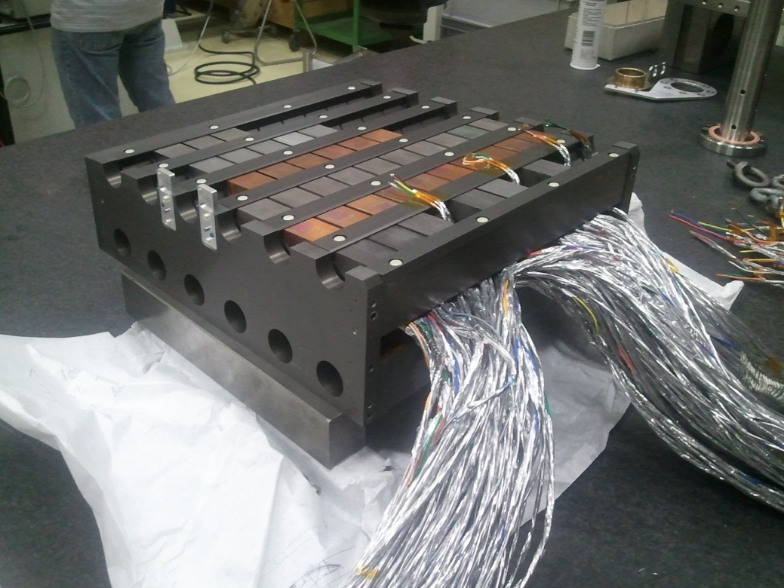
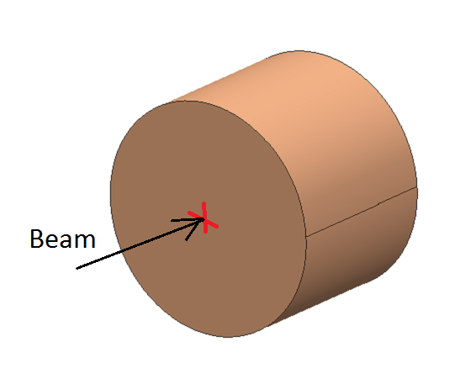
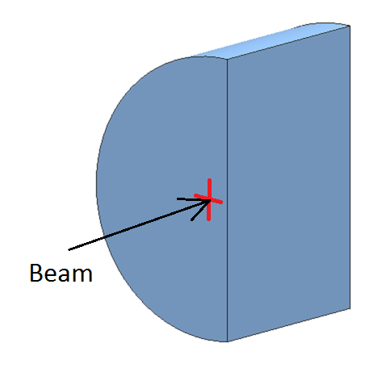
LCMAT Experiment: Specifications
6 different materials (Inermet 180, Glidcop, Molybdenum, Copper-Diamond, Molybdenum-Diamond, Molybdenum-Graphite)
12 Target Stations (Medium intensity and High intensity), with different material samples for each material (Type 1, Type2)
Up to 10 specimens per target station
Extensive Data Acquisition System
Post-irradiation analysis
Type 2 Sample
(Ø 40 mm, L30 mm,
Surf. Offset 2 mm)
Type 1 Sample
(Ø 40 mm L30 mm)

Slide 10
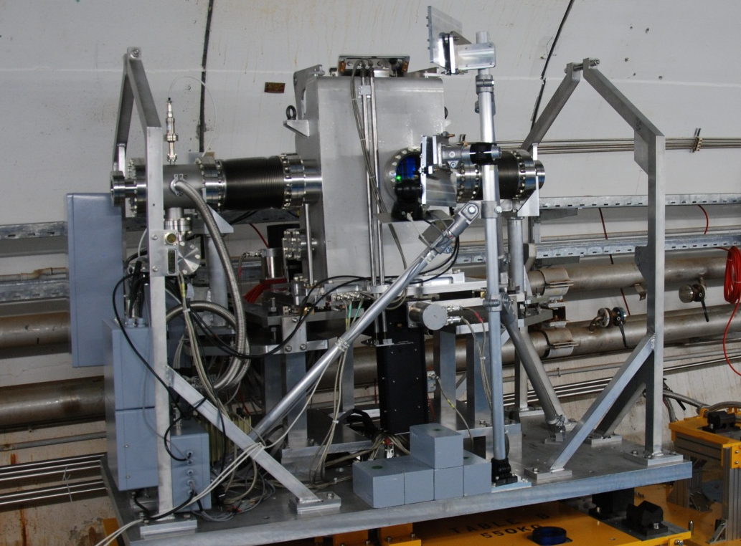
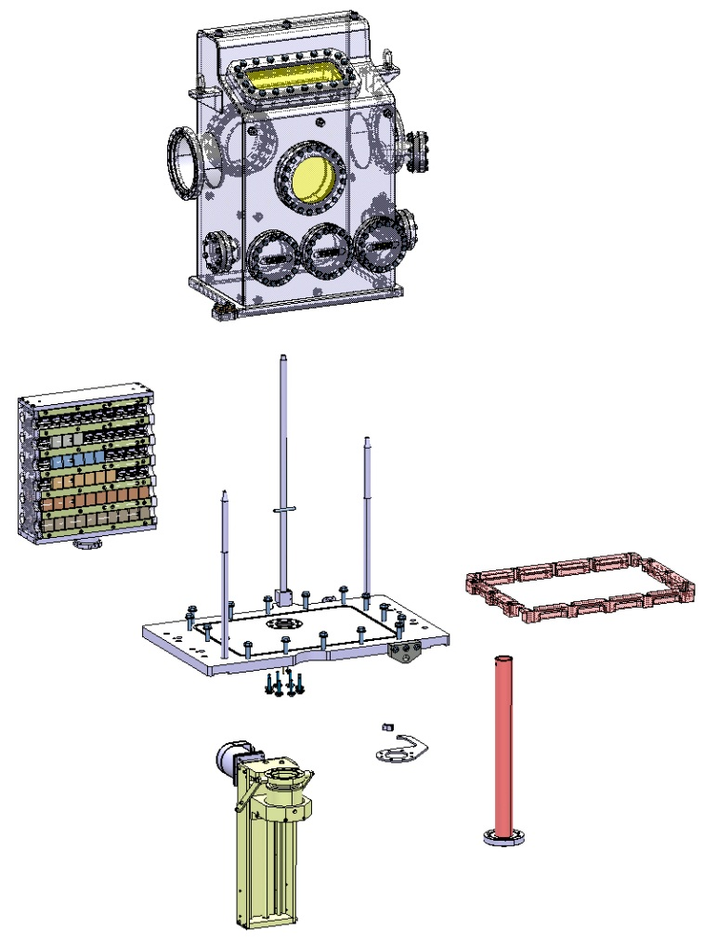
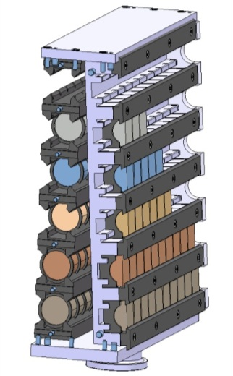
Technical Description: Design Overview
Data Acquisition Hardware
Transport structure
Beam
Vacuum Tank
Data Acquisition Windows
Quick Dismounting clamp
Specimen holder
2 axes-movement
Compact experiment Setup

Slide 11
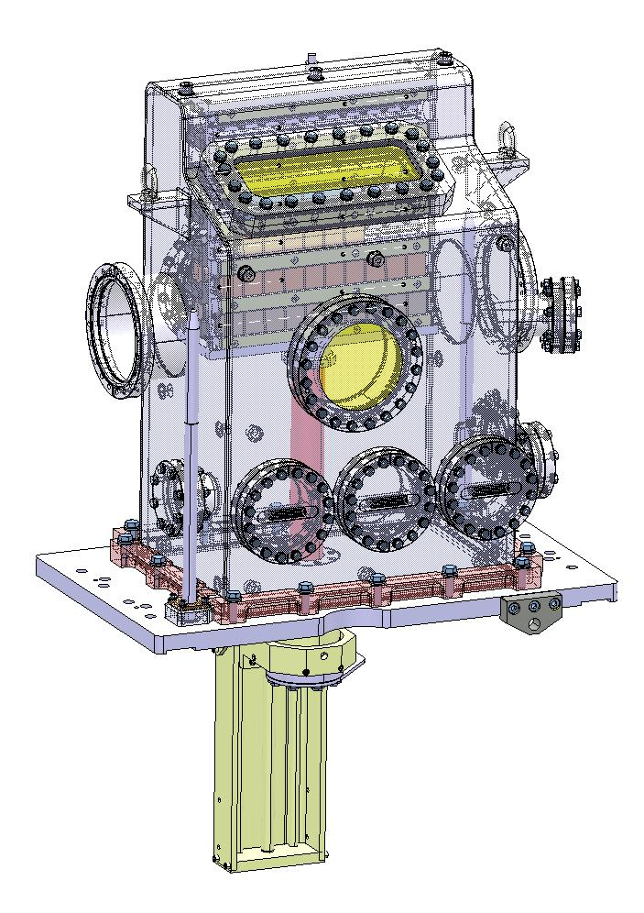
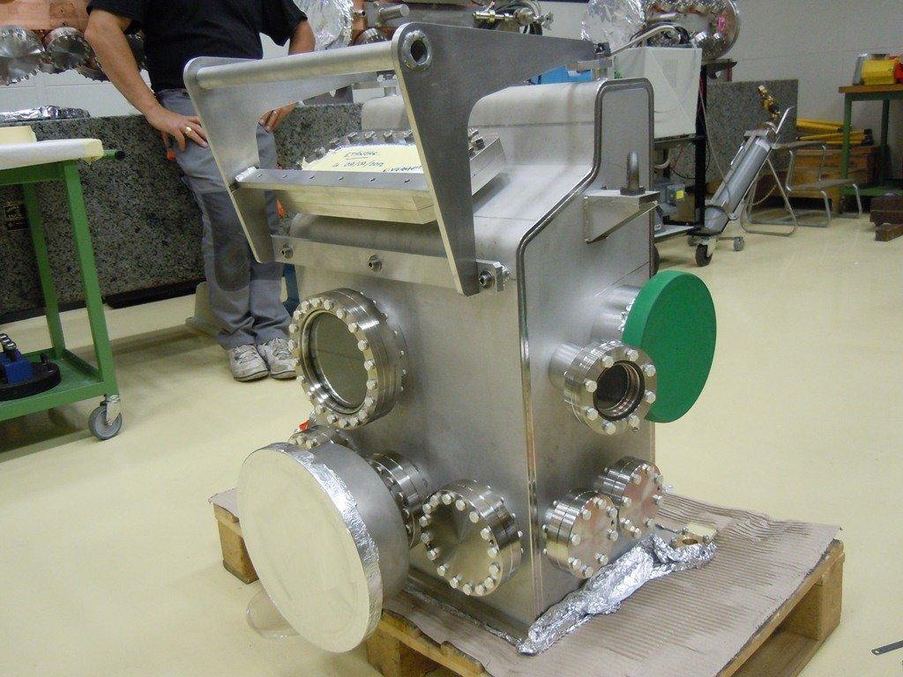
Technical Description: Design Overview
Fast dismounting system studied to ease tank opening, decreasing exposure time for operators
Vacuum: standard mobile turbo group will allow for pressure below 1mbar
Static structural and buckling analyses performed for tank, glass windows and Be windows. Safety is ok.
Debris generated by beam impacts on samples do not have enough kinetic energy to plastically deform or drill the tank
Stainless Steel vacuum tank: 304L, 10 mm wall thickness

Slide 12
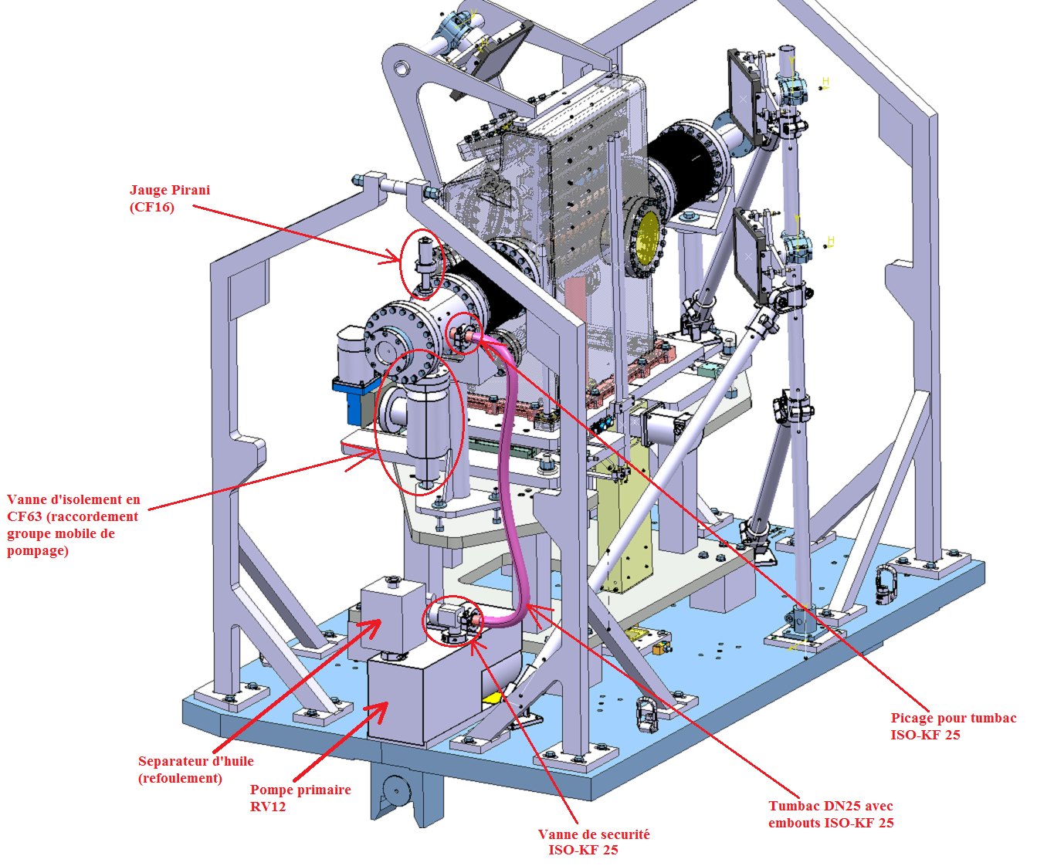
Technical Description: Vacuum System
Beam line windows in Beryllium, with C/C reinforcements (dimensioning: M. Delonca, C. Maglioni – EN/STI)
Structural and radiation hard, highly transparent optical windows and portholes: fused silica and UHV specific glass adopted
Leak tightness test performed on the assembly
Thermal treatment (vacuum firing) performed on highly outgassing graphite components.

Slide 13
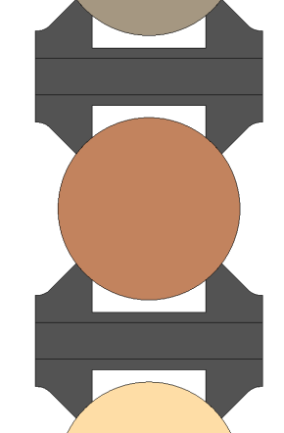
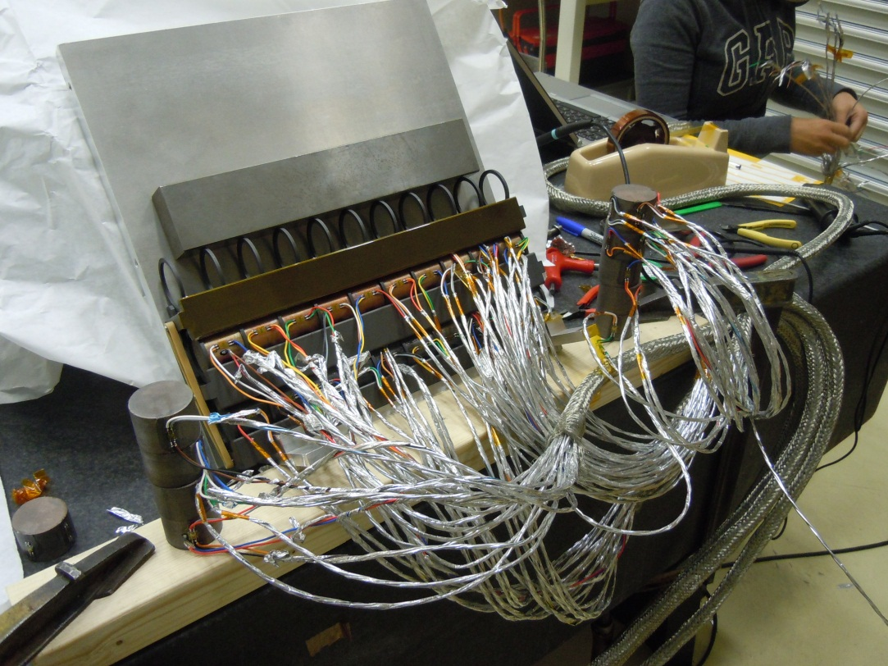
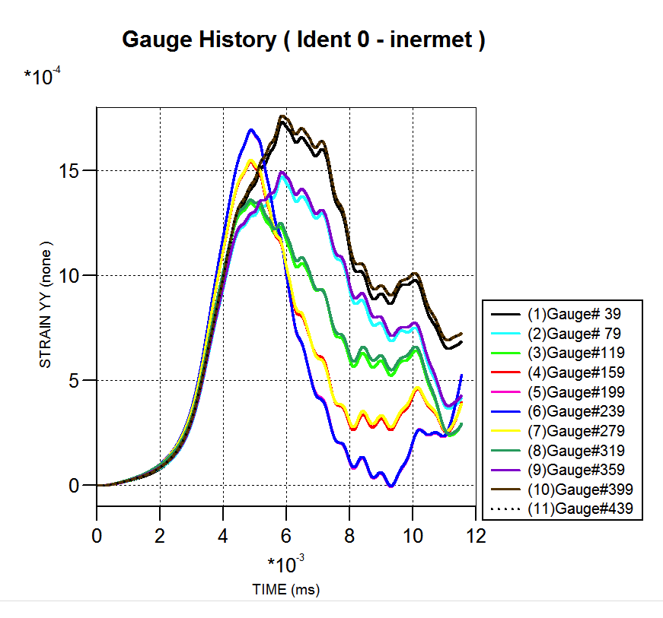
HRMT-14: Embarked Instrumentation
38 Temperature probes and 1 Vacuum sensor, Microphones (D. Deboy).
244 Resistive Strain Gauges: measuring circumferential and axial strains generated on outer surface (type 1 and 2).
  Amplitude : 1500 up to 20’000 μm/m
  Sampling Frequency: 2 MHz
  Compliant with high radiation levels
Expected circumferential strain on Inermet180, 20 bunches

Slide 14
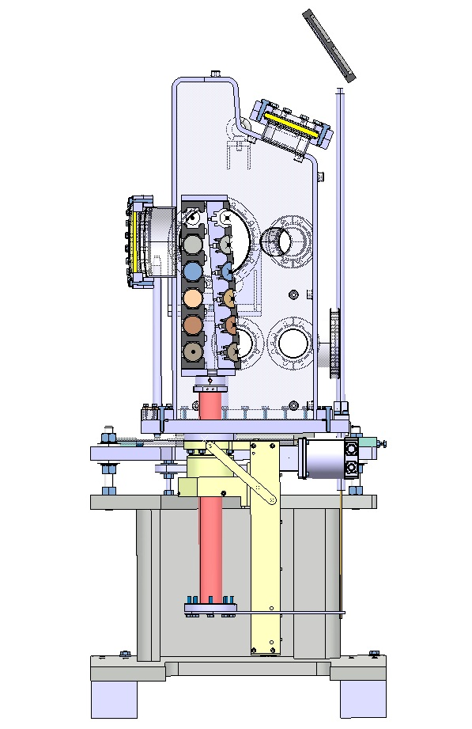
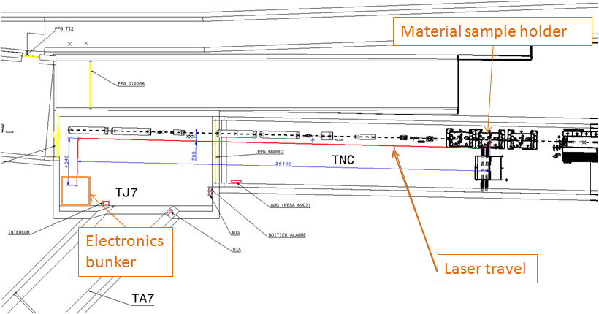
HRMT14: Remote Instrumentation
To Camera
Mirror
LDV: measuring radial velocity (up to 24 m/s) of outer cylindrical surface (type 1 samples). Sampling rate: 2.5 MHz
High Speed Camera: acquiring live images of impacted type 2 samples. Capture rate 20 kfps. Exposure time 5 μs.
Placed in a bunker 42 m upstream of the experiment.
Laser Doppler Vibrometer
Restricted Access
No or Very limited Access
Table B

Slide 15
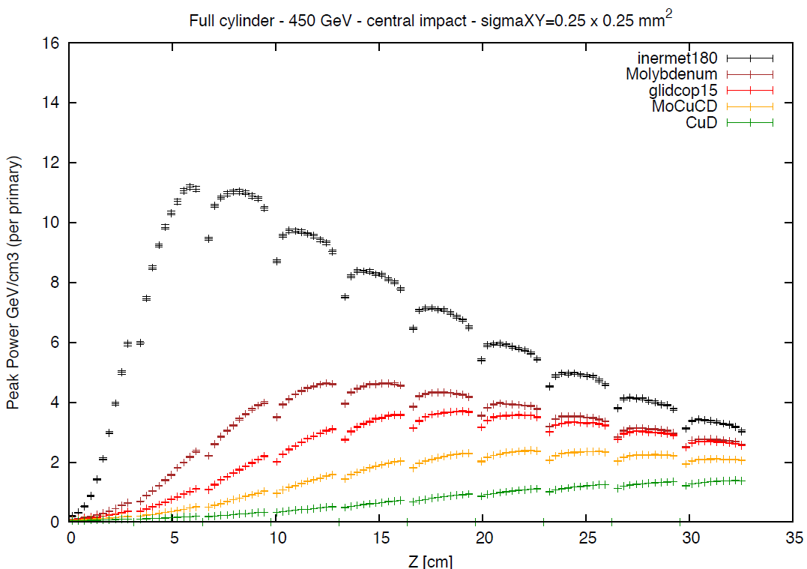
Energy Deposition
V. Boccone
EN-STI

Slide 16
Irradiation History
Irradiation Summary
Beam energy: 440 GeV
Bunch spacing: 25 ns
Protons/bunch: ~1.1E11 (lower when scraped)
Beam Pulses: 1 to 24 b/pls on Type 1;
72 or 144 b/pls on Type 2
Beam size: ~1.5x1.5 mm² (unscraped) on Type 1; ~2x2 mm² on Type 2
1 to 144 bunches per pulse
Total # bunches: 1558 (excluding alignment)
Total # pulses: 52 (excluding alignment)
Total # protons ~ 1.7E14
Test Runs: 27-28/Sept, 2-4/Oct

Slide 17
Medium intensity tests on Glidcop
  Simulations versus Reality
  Glidcop, 72 bunches (scraped), total beam intensity: 4.66e12 p (equivalent to ~42 b)
  σ ≅ 1.3x1.3 mm²
  Hoop Strain and Radial velocity on outer surface of Sample 8

Slide 18

High Intensity Tests on Inermet180

Slide 19
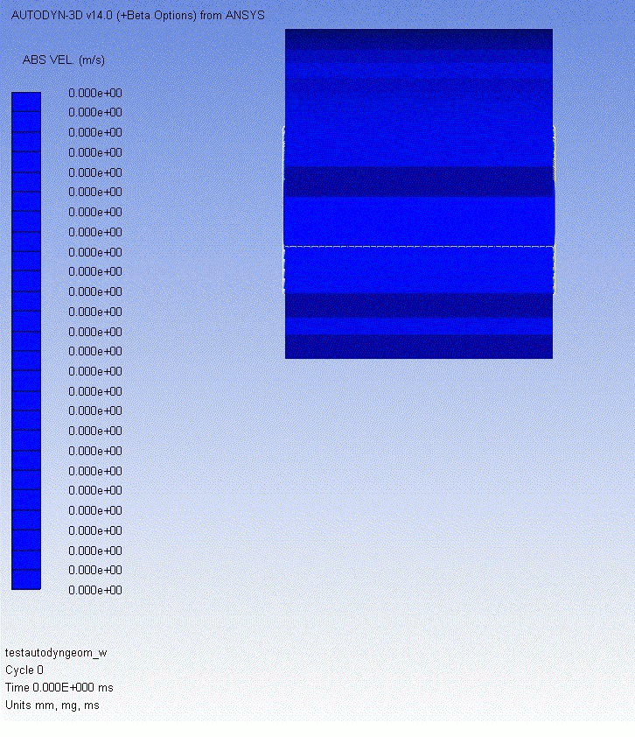
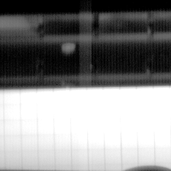
High Intensity Tests on Inermet180
  Simulations versus Reality
Beam
Case | Material | Bunches | p/bunch | Total Intensity | Observed Sample | Velocity
Simulation | Inermet 180 (W,Ni,Cu) | 60 | 1.5e11 | 9.0e12 p | 3rd sample (+Energy) | 316 m/s
Experiment | Inermet (W,Ni,Cu) | 72 | 1.26e11 | 9.05e11 | 2nd sample (-Energy) | ~275 m/s

Slide 20

High Intensity on Glidcop/1
  Delay Beam – T0 = 22 µs (errors in measurements and in CCC pre-trigger settings).
  Configuration: Simultaneous shot of Flash 3 + 4 at t=3 ms.
  ➔ Images acquired between 2.9 and 4 ms after the beam impact!!!!
  Need for higher pre-trigger from CCC!!!
#80 – 4000 µs
#62 – 3100 µs
T0 (trigger CCC)
#58 – 2900 µs
Delay Beam – T0
T0 + 1850 µs
1150 µs
Total Lighted time 1.1 ms
Flash 4
T0 + 2350 µs
650 µs
Flash 3
0
1
2
3
4
5
6
t (ms)

Slide 21

High Intensity on Glidcop/2
  Delay Beam – T0 = 2022 µs (after asking for 4 ms pre-trigger…)
  Configuration: Simultaneous shot of Flash 3 + 4 at t=2 ms.
  ➔ Images acquired between -0.1 ms and 1 ms after the beam impact!!!!
  Successful synchronization between Beam, Video-camera and Flashes!!!
#61 – 3050 µs
T0 (trigger CCC)
#41 – 2050 µs
Delay Beam – T0
T0 + 850 µs
1150 µs
Total Lighted time 1.1 ms
Flash 4
Flash 3
T0 + 1350 µs
650 µs
0
1
2
3
4
5
t (ms)

Slide 22
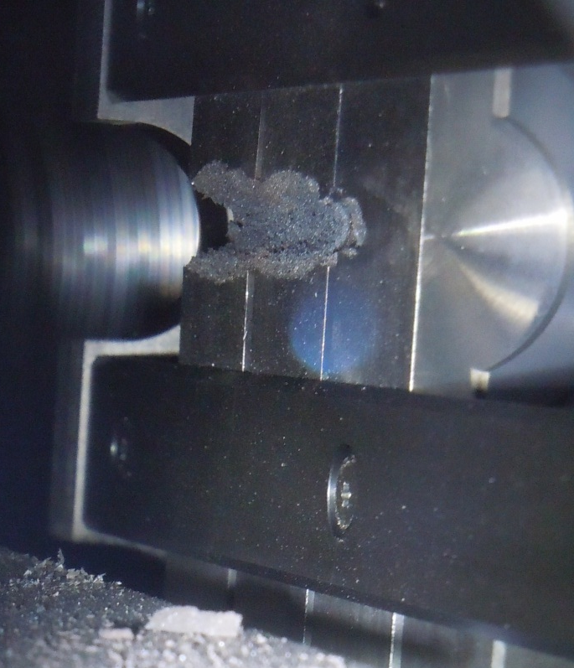

Post-irradiation (Type 2 samples)
  72 bunches on Inermet
  72 (center) and 144 bunches (offset) on Molybdenum

Slide 23
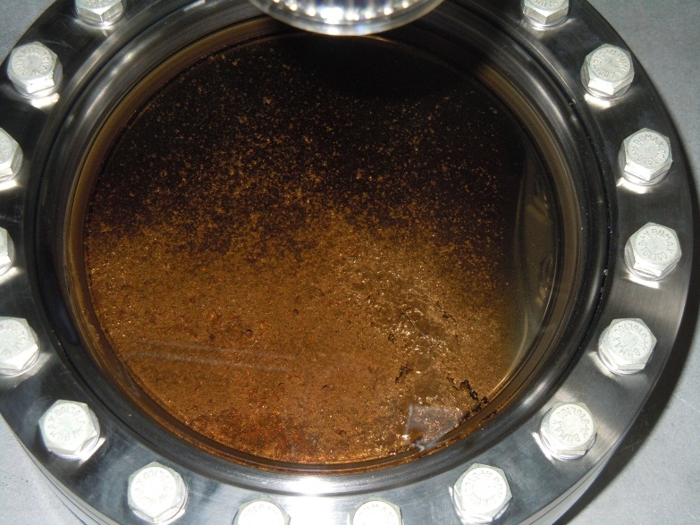
Window covering
Tungsten vapour cloud generated during the beam impact expanded inside the vacuum tank and condensed on the video camera window, covering the window itself preventing further video acquisition.
Tungsten debris
Picture of the front window after impacts
Window
29 October 2012

Slide 24
Some RF-related questions …
Performance of Molybdenum is significantly better that Inermet180 (Tungsten) and marginally better than Glidcop (Copper) for the same accident scenario (72 SPS bunches)
Molybdenum may be a candidate for Phase II Secondary collimators … what are the consequences on RF-impedance (e.g. as opposed to Copper)?
To further reduce damage exposure, we may envisage to apply a thin Mo coating on a lighter bulk material:
  What is pure Mo minimum required thickness?
  What is the effect of bulk material (e.g. graphite vs. Moly/Graphite)?
What if we do not use any pure Mo coating?

Slide 25
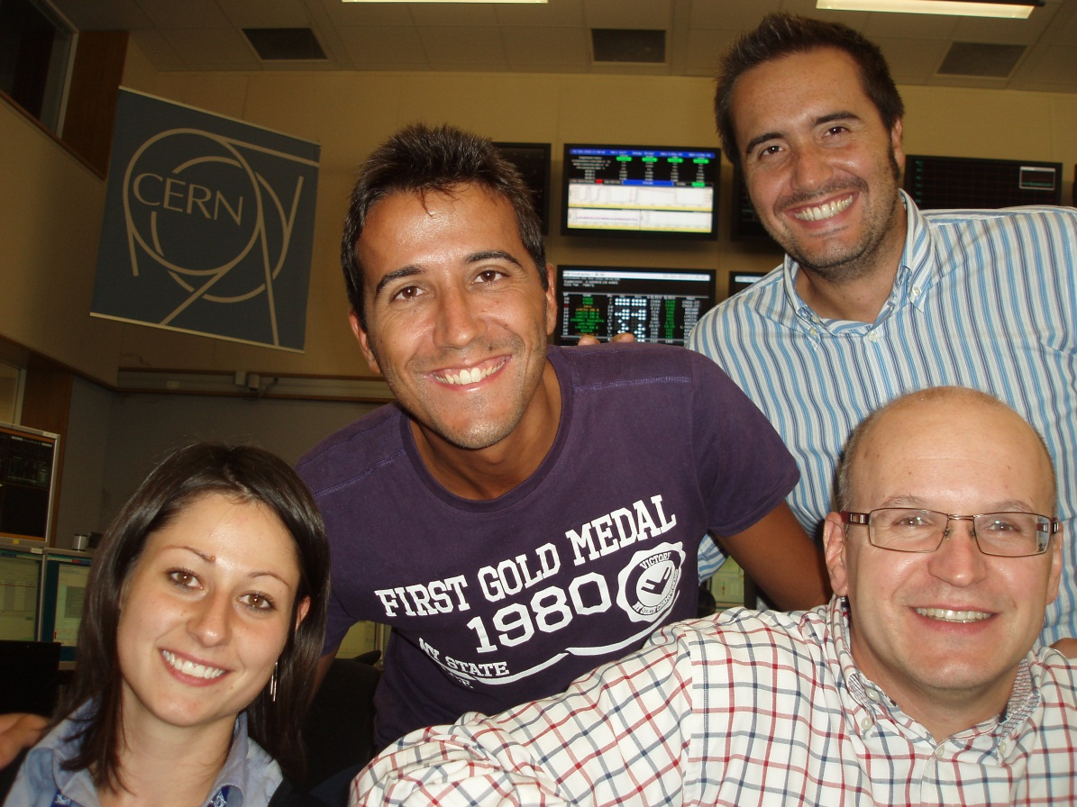
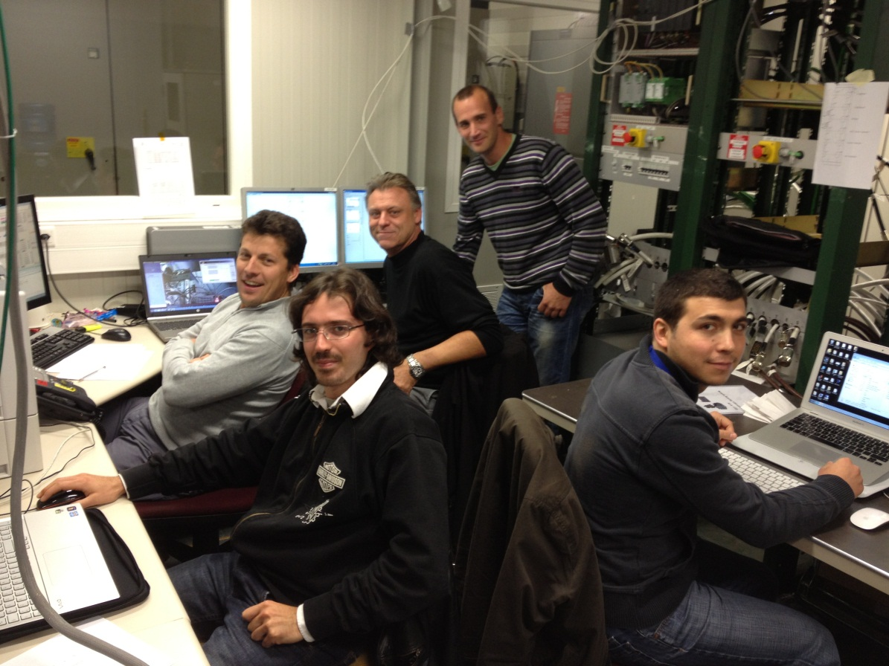
“Houston” (CCC)
Greetings from….
Not shown in Houston picture:
Marco Garlaschè
“Baikonur” (BA7)

Slide 26
  Backup slides

Slide 27
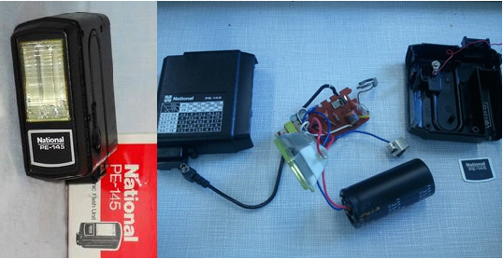
Technical Description: Xenon Flash Lightening System
Modified National/Panasonic PE-145 circuit:
Robust and rad-hard
Excellent luminous output using modified condensers (400V, 3300 µF), lightening time ~ 3.5 ms
Low power requirement (3V to charge condensers)
Flash triggered by high speed relays, measured delay ~650 µs (MSS7 type) and ~1200 µs (SAR90505 type)
System components:
  Xenon lamps on windows sides
  Flash box on tank: condensers and relays board
  Pulse generator & power supply in CCC
Safety issues: potential hazards from condensers
RelayMSS7 (650 µs)
Timing diagram
RelaySAR90505 (1200 µs)
Flash3
Flash4
Flash1
Flash2
Test apparatus examined and approved by safety experts (visit 3/7/12 of C. Bernard and J. Pedersen)
-3
-2
-1
t₀
1
2
3
t (ms)
Trigger from CCC

Slide 28
Conclusions
Flash System:
The use of 2 simultaneous flashes gives rise to a certain overexposure, but permits to see small debris on the dark background between the sample holder and the plate.
The error in the CCC trigger signal has been corrected after the first acquisition permitting a very good synchronization between flashes and beam arrival (~100 µs).
Final Tests & Comparison with Numerical Simulations:
The acquired videos, especially the H6_center on Inermet180, have an acceptable quality and permit to see the particles escaping from the samples.
In addition, the video of the impact on Inermet180 showed a clear agreement with Autodyn SPH simulations, confirming the validity of the proposed models in predicting the damage on the TCT Collimators Jaws.
Final remarks:
The Tungsten hot vapour released during the H6_center impact covered significantly the window, not permitting to acquire further videos at high speed...

Slide 29
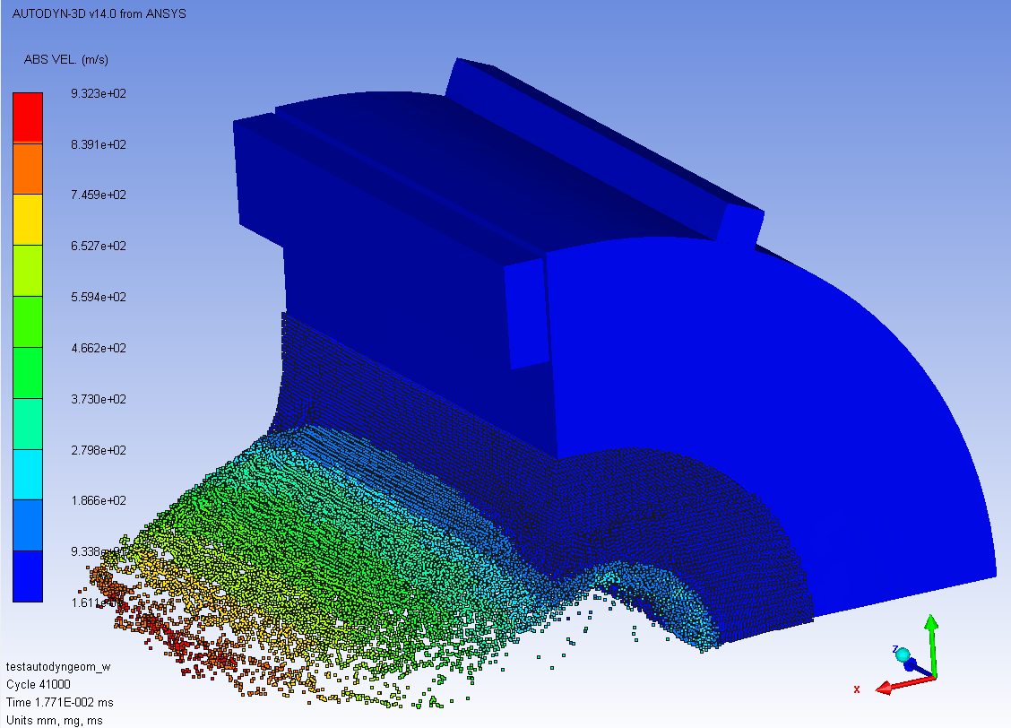
Autodyn: Type 2 Sample
70 bunches 2.5mm
T=17µs
  PROS sigma 2.5 mm:
  Less vaporized material (window covering)
  Lower density change
  Lower load on Be window
70 bunches 0.25 mm
t=17µs
  PROS sigma 0.25 mm:
  Representative of high energetic beam impacts
  (~ LHC Scenario)
  Higher particles speeds

Slide 30
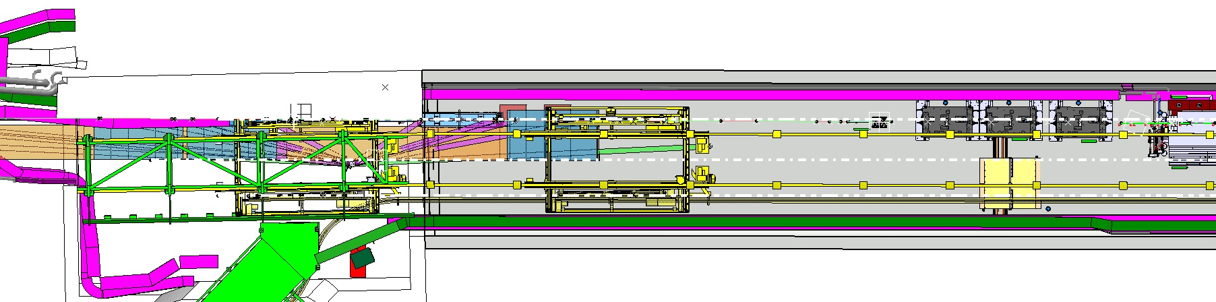
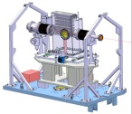
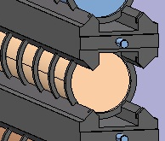
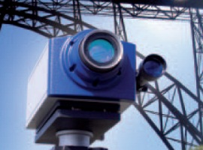
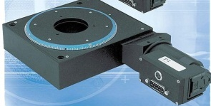
Remote measurements
  Difficulties for the integration…
Restricted Access
No or Very limited Access
Bunker
For DAQ
40m
  Vacuum Tank
  Window
  Mirror
40m
  Mirror
  Active control of the mirror position ?

Slide 31

Inermet 72b center σ=1.8 mm
  Delay Beam – T0 = 2022 µs
  Configuration: Simultaneous shot of Flash 3 + 4 at t=2 ms.
#44 – 2200 µs
#42 – 2100 µs
T0 (trigger CCC)
#41 – 2050 µs
Delay Beam – T0
T0 + 850 µs
1150 µs
Total Lighted time 1.1 ms
Flash 4
Flash 3
T0 + 1350 µs
650 µs
0
1
2
3
4
5
t (ms)

