Slide 1
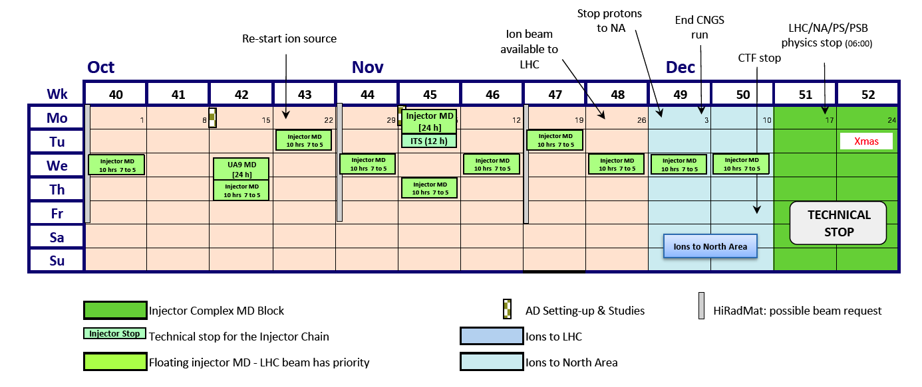
SPS MDs
LHC scrubbing run + MDs + 25ns
(3)
(1)
(2)
(*)
(4)
Collimators + UA9
Ion MD or SU
Priorities
  Study longitudinal beam quality/e-cloud for higher intensity 25ns beams on Q20/Q26
  Test preservation of low emittances for 25ns beams using the h9 beams from the PS
  More e-cloud studies (conditioning, full characterization of Cu liner, HBW damper)
  Test of new 800 MHz LLRF (available as from December 2012)

Slide 2
SPS MDs
LHC scrubbing run + MDs + 25ns
(3)
(1)
(2)
(*)
(4)
Collimators + UA9
Ion MD or SU
4x 10h + 1x 24h blocks (main users)
  (1) Stepwise higher intensity 25ns beams (e-cloud, long) + conditioning studies → 2x 10h
  (2) 25ns h9 beams in the SPS (preservation of low emittances) → 1x 10h
  (3) 24h → EC & longitudinal studies with 25ns beam (Mauro, Elena) + Space charge studies on Q20 with high intensity single bunches and scan of working points
  (4) Coasting of 25ns beam @26GeV/c to see possible residual EC effects with nominal intensity → 1x 10h

