Slide 1
BSRT UPDATE LMC 02-OCT-2012 F.Roncarolo on behalf of the BSRT team W.Andreazza, E.Bravin, A.Boccardi, J-J.Gras, A.Goldblatt, M.Hamani, T.Lefevre, R.Jones, A.Nosych, G.Trad, R.Veness, M.Wendt A.Fisher EN-MME – S.Sgobba and team, Main Workshop, Design Office E.Metral, B.Salvant, F.Caspers, A.Grudiev, C.Vollinger G.Lanza and Team

Slide 2
Recap - TS#3 Actions
BSRT mirrors before TS#3: silicon bulk + dielectric coating
After B2 mirror removal end of August (coating blistered) and suspect of same damage on B1 mirror, three options for TS#3:
Spare mirror: Silicon bulk + dielectric coating
Option dropped, good choice after B1 mirror removal (coating blistered)
Spare mirror after coating removal and polishing → pure silicon mirror
Installed on B2
New mirror: glass bulk + metallic (Al) coating
Installed on B1
On both B1 and B2:
Failsafe mirror supports
Inconel mirror clamps
Ferrites with higher Curie temperature – increase ferrite volume
See LMC 14 Sep 2012

Slide 3
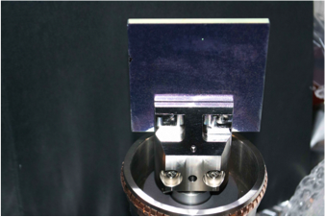
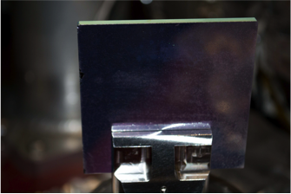
B1 Mirror removal
Evidence of blistering
Decided not to install an identical mirror
Mirror out of place

Slide 4
B1 refurbishment during TS#3
Mirror: glass bulk+ metallic (Al) coating
Imaging optics changed from focusing mirrors to focusing lenses
Change already scheduled in advance, independently from August’s systems failure
Alignment with calibration laser as done with old optics
OLD: 2 focusing + 8 folding mirrors
NEW: 2 focusing lenses + 2 folding mirrors
A.Goldblatt, A.Fisher

Slide 5
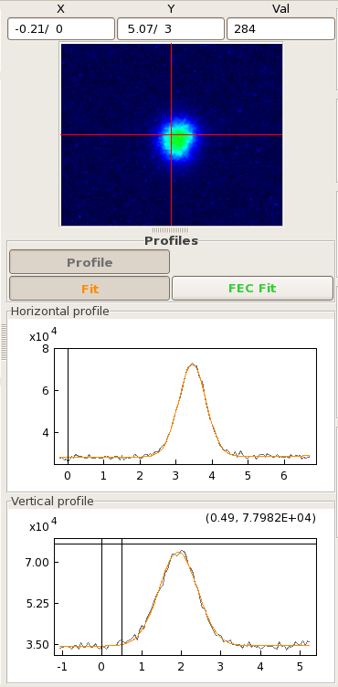
B1 performance @ re-start
Steering to find light spot very similar to what expected after laser alignment
Amount of light ~ as expected, ~ = dielectric coating (maybe even better, to be characterized)
Preliminary calibration w.r.t. WS (next slides)

Slide 6
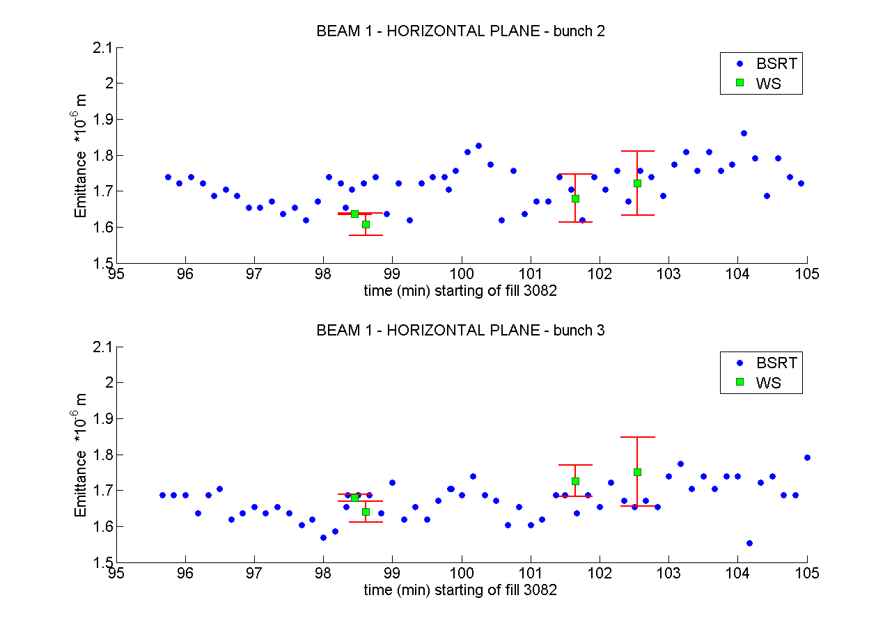
BSRT vs WS B1 HOR 4 TeV
BSRT Correction in quadrature: 0.21 mm (was 0.38 mm)
G.Trad

Slide 7
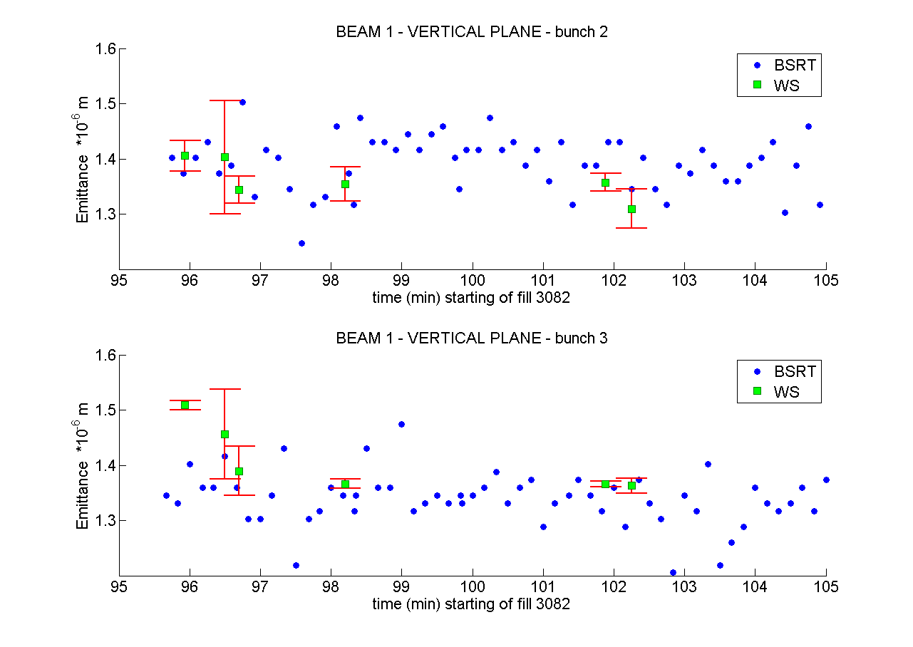
BSRT vs WS B1 VER 4TeV
BSRT Correction in quadrature: 0.23 mm (was 0.35 mm)
G.Trad

Slide 8
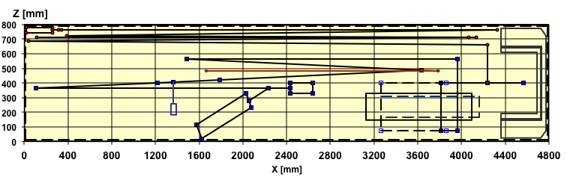
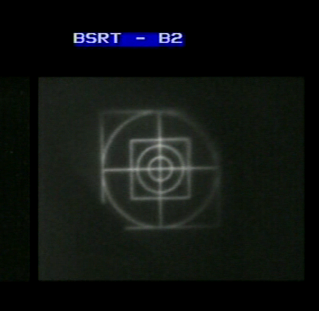
B2 refurbishment during TS#3
Mirror: polished Silicon bulk, no coating
Imaging optics (focusing mirrors) unchanged
Re-alignment with calibration laser
Imaging of calibration target
Target calibration line
Illuminated target
Optical table top view
BSRT Camera
Extraction mirror (vacuum) + steering mirror (air, first mirror on the table)
Imaging calibration target as before TS#3
→ no evidence of image distortion on all mirrors apart from Extraction + Steering mirrors

Slide 9
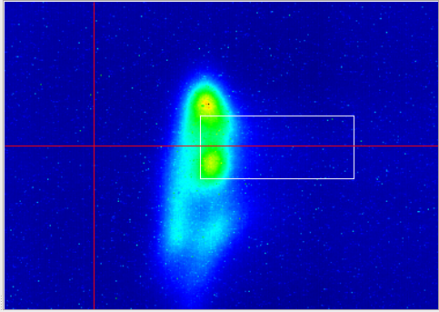
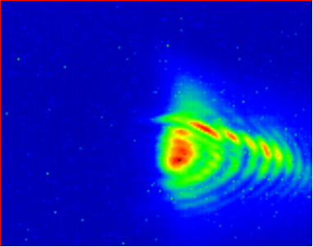
B2 observations @ re-start
Steering to find light spot very similar to what expected after laser alignment
Amount of light ~ as expected after removing coating (~ factor 2 less w.r.t. coated mirror)
Bad surprise looking at image quality
450 GeV
4 TeV

Slide 10
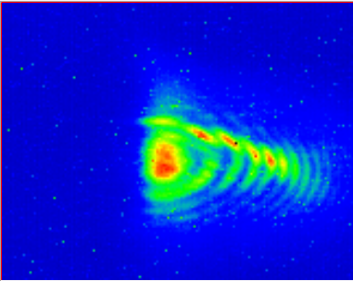
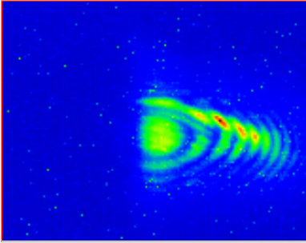
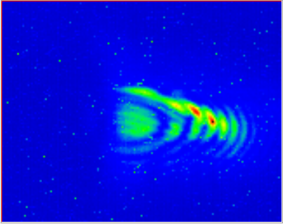
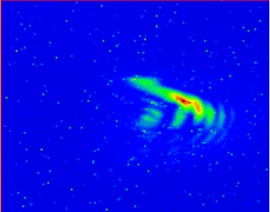
B2 Scan mirror IN → OUT
4 TeV
Proton beam
BSRT mirror
Proton beam
BSRT mirror
Sync. Light
Sync. Light
MIRROR IN
MIRROR OUT
1
2
0
1
3
4
Conclusion: Moving mirror out
→ loose image ‘core’, ‘fringes’ remain
N.B.: tried same exercise on B1 → no evidence of distorted images…

Slide 11
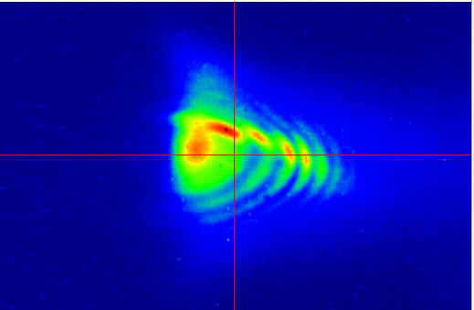
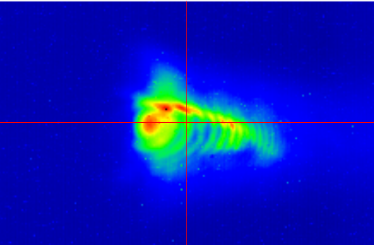
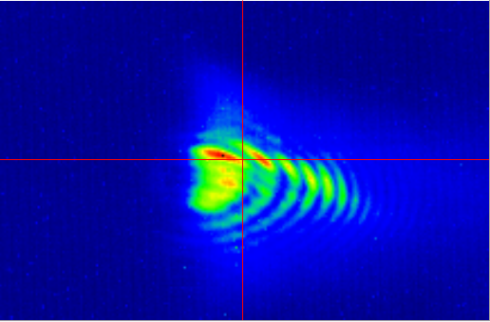
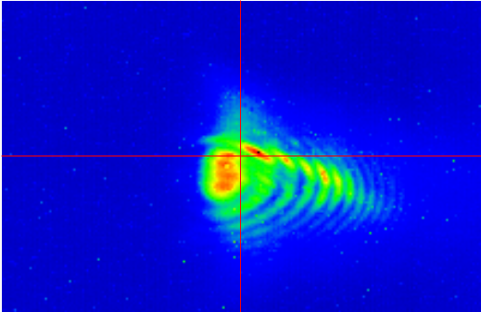
B2 Selecting different wavelengths
4 TeV
All wavelengths
Blue
Red
Green
Red
Larger radiation wavelength → larger ‘fringes’ distance → compatible with diffraction

Slide 12
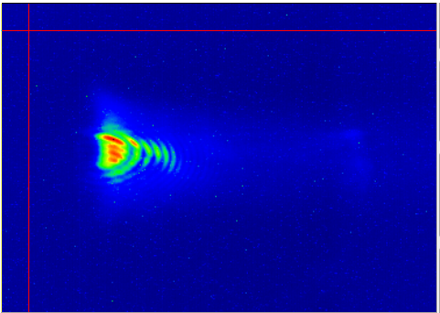
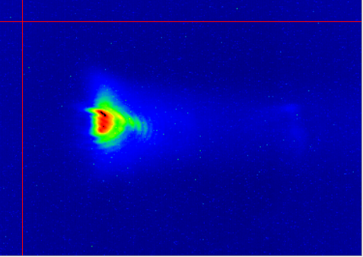
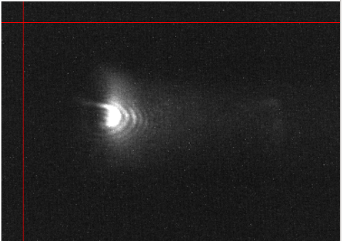
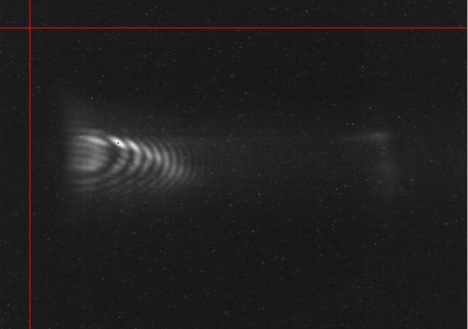
B2 Horizontal Closed Orbit Bumps
4 TeV
Proton beam
Bump -
BSRT mirror
Sync. Light
Bump +
70 mm
0
NO bump
+2mm Bump
In all these cases: camera gain to have maximum ‘fringes’ visibility
Bump + → weight of ‘fringes’ w.r.t. ‘core’ decreases
+4mm Bump
-4mm Bump

Slide 13
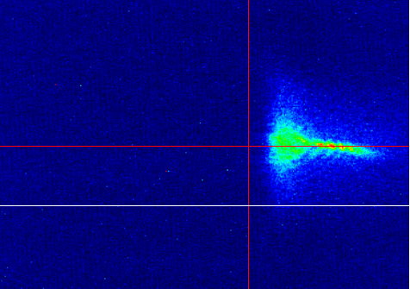
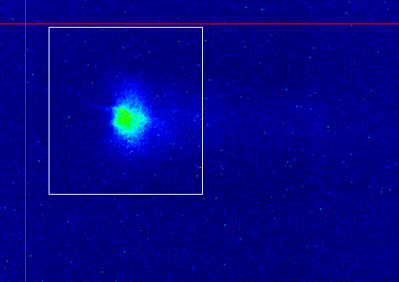
B2 Horizontal Closed Orbit Bumps
4 TeV
Setting camera gain as in operational mode (no saturation)
NO bump, low gain
+4mm bump, low gain
Anyway: emittances from Gaussian fits give unphysical large emittance
N.B. :
absolute position on screen depends on steering (not the same for these two acq.)
Verified that steering (→ different path inside telescope) doesn’t change ‘fringes’ shape and weight

Slide 14
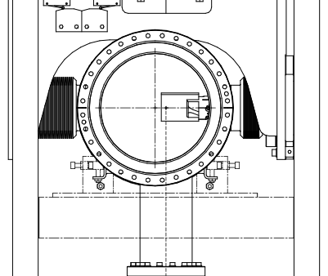
Temperatures Probes
Flange 1
Flange 2
View Port 1
View Port 2
Bellow
See Measurements next slide

Slide 15
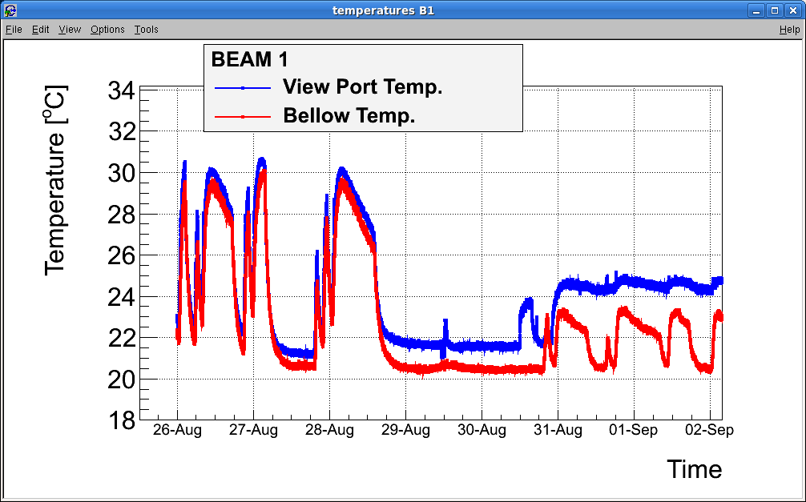
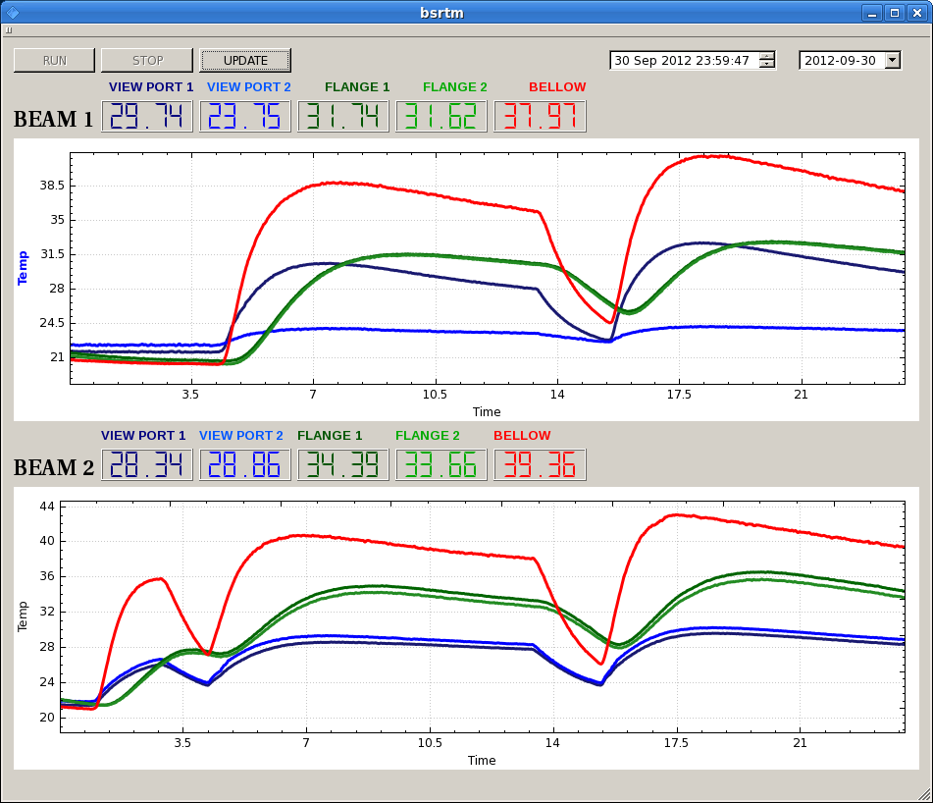
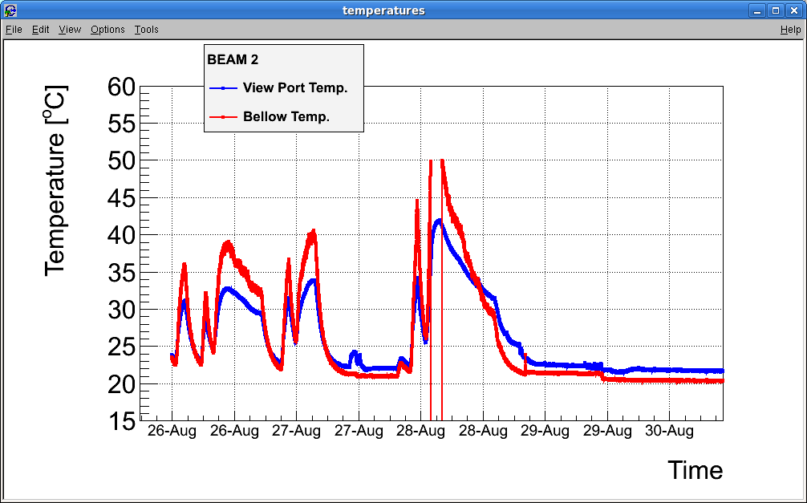
Temperatures
Before TS#3 (‘bellow’ probe B1 not at same location as B2)
After TS#3
‘bellow’ probe B1 displaced to be = B2
Added 2 probes on flange
BEAM 1
1380 b
Mirror OUT
1380 b
LAMP ON
1380 b
Bellow
View Port
Flange
Mirror IN
BEAM 2
Mirror Falling
1380 b
1380 b
Bellow
1380 b
Flange
View Port
B1 heating ~= B2 heating
Bellow heats more and faster than flange (== radiation more than conduction?)

Slide 16
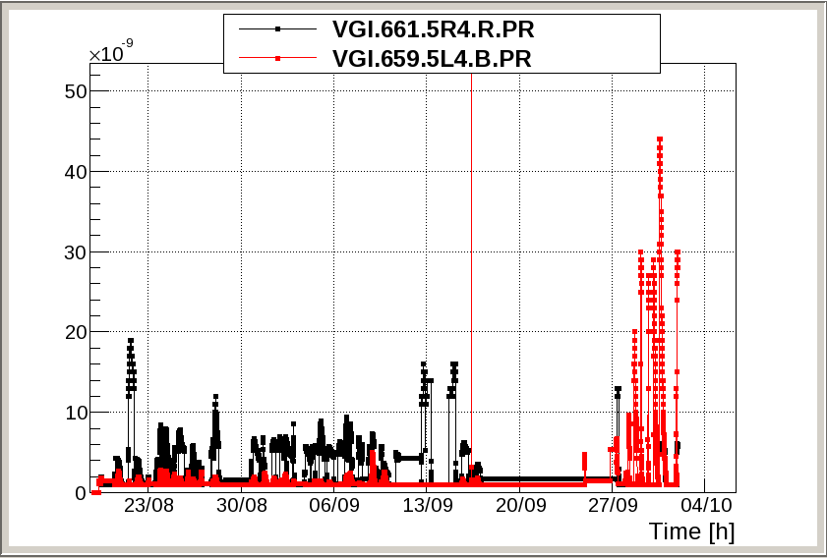
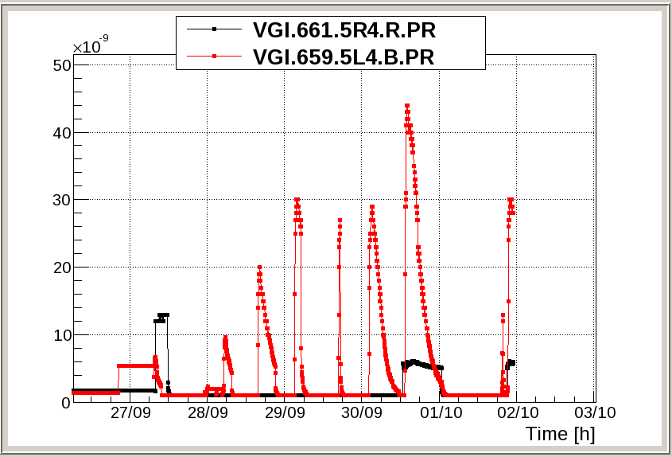
Vacuum
5.L4 → BSRT B2 , baked out during TS#3 ….

Slide 17
Summary of Observations after TS#3
B1 ok, need to verify if survives to thermal cycles
New optics base on lenses seems better for overall resolution and accuracy, to be confirmed
B2 image ‘distortion’ to be understood
edge effect?
Bad surface polishing?
Silicon not suitable for imaging?
Optics after extraction mirror misalignment?
No clear evidence of less heating w.r.t before TS#3 for both B1 and B2
No clear evidence of B1 (metallic coating) heating more than B2
Both B1 and B2 AGM operational despite bad B2 imaging. Calibration checks on-going, need to verify calibration stability over time

Slide 18
Plans - Proposals
ASAP:
access 3 hours → re-check alignment B2 with calibration laser → exclude (or not) any source of uncertainty other than the extraction mirror itself
Test imaging system based on pure silicon mirror in the lab (on-going)
Before MD3 (if possible)
B2 Bumps (450 GeV and/or 4 TeV) + move mirror out with bump >= 4mm IN → assess it’s only an edge effect or not
MD3
B1: Precise Calibration w.r.t WS
B2: points above if not possible before
If enough time: B1&B2, characterize heating with high intensity beams at 450 GeV
Wait between injections to cope with thermal inertia and establish whether there is a threshold effect or not
TS#4 (xstmas)
depending on possible new observations/understanding, e.g. will B1 mirror survive thermal cycles?
Open B2 and replace mirror with copy of B1 (glass + metallic coating)
If new B1 optics full validated
Replace also B2 optics with focusing lenses based system
LS1: depending on end of the run experience + improved RF and thermo-mechanical simulations
Redesign mechanics to minimize RF coupling
Active cooling
…

Slide 19
SPARE

Slide 21
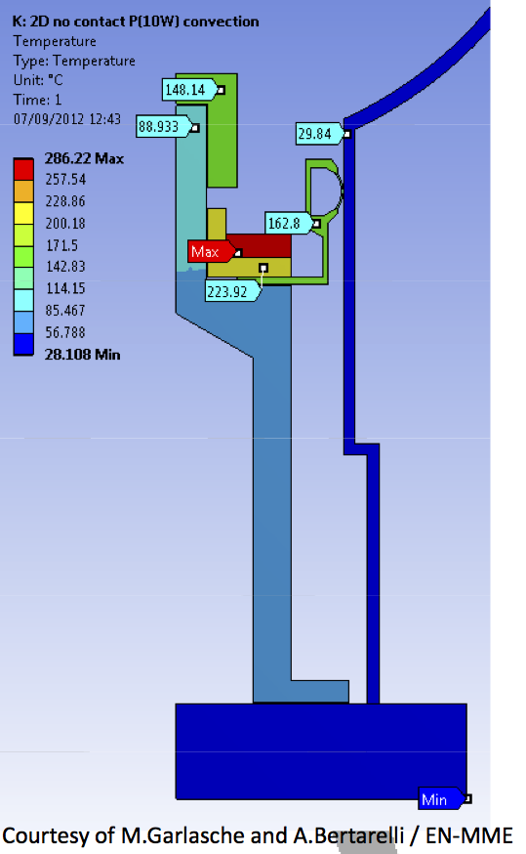

Slide 22
