Slide 1
Recent observations of instabilities Fill 3102&3108 End of Fill test 3089 T. Pieloni for the BB team

Slide 2
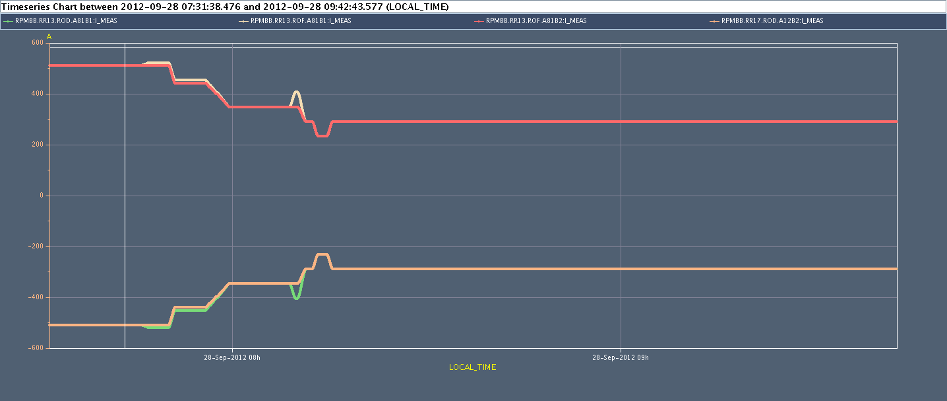
Octupole trims with new polarity during Squeeze and Adjust
Squeeze
Adjust

Slide 3
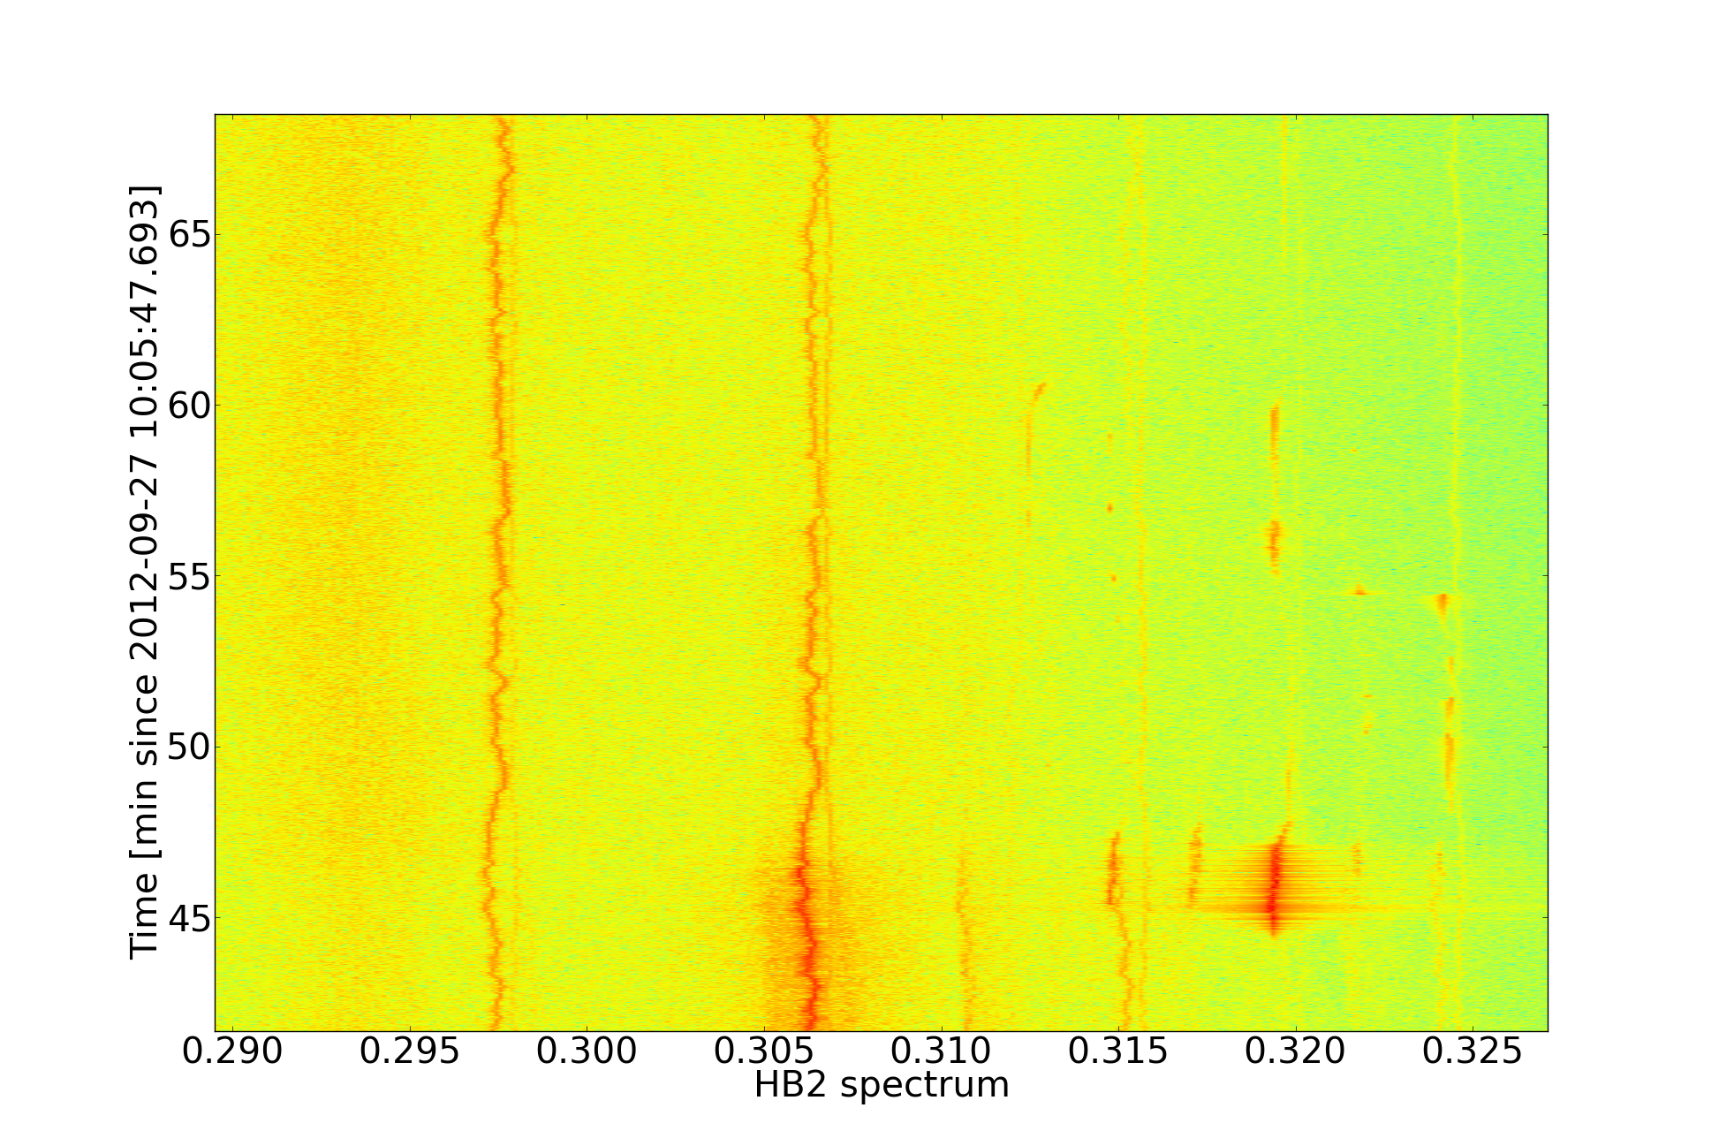
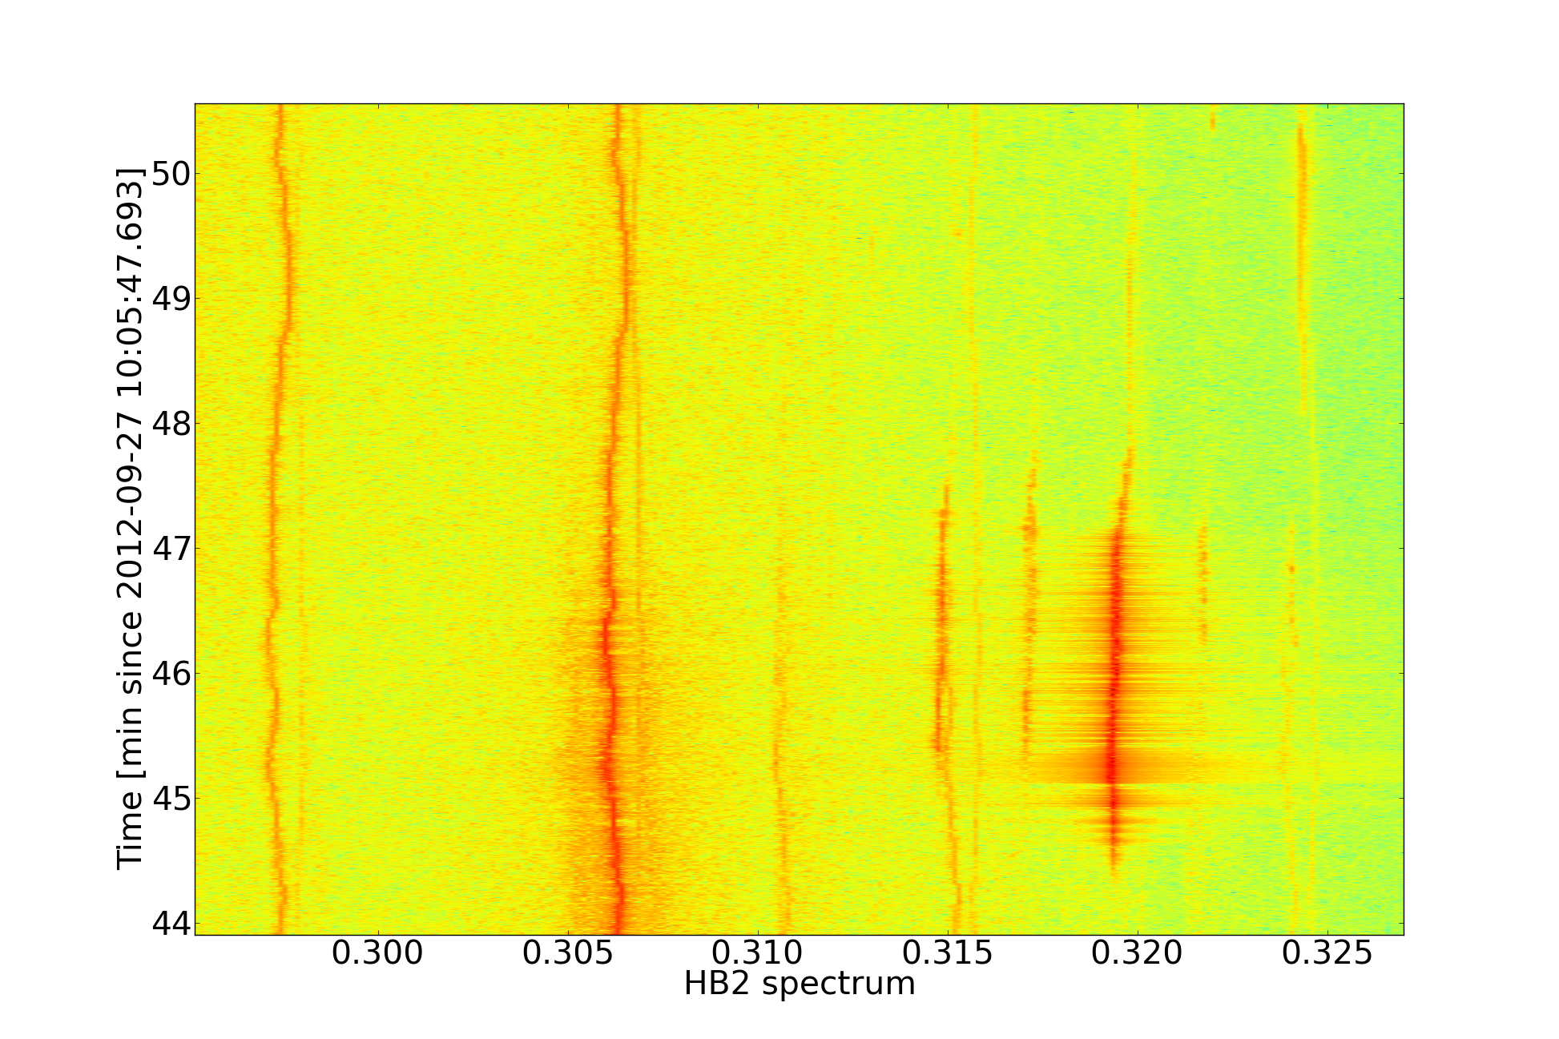
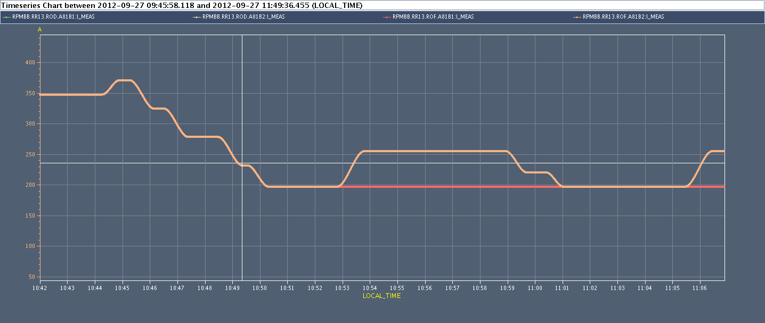
Fill 3102
Time =0 is Adjust mode
Horizontal B2
Instability
IP8 special bunches (separated 4s) of B2 get unstable while octupole current reduced when
Collision beam process finished
Octupole current =240A to 200A Damper gain = operational settings

Slide 4
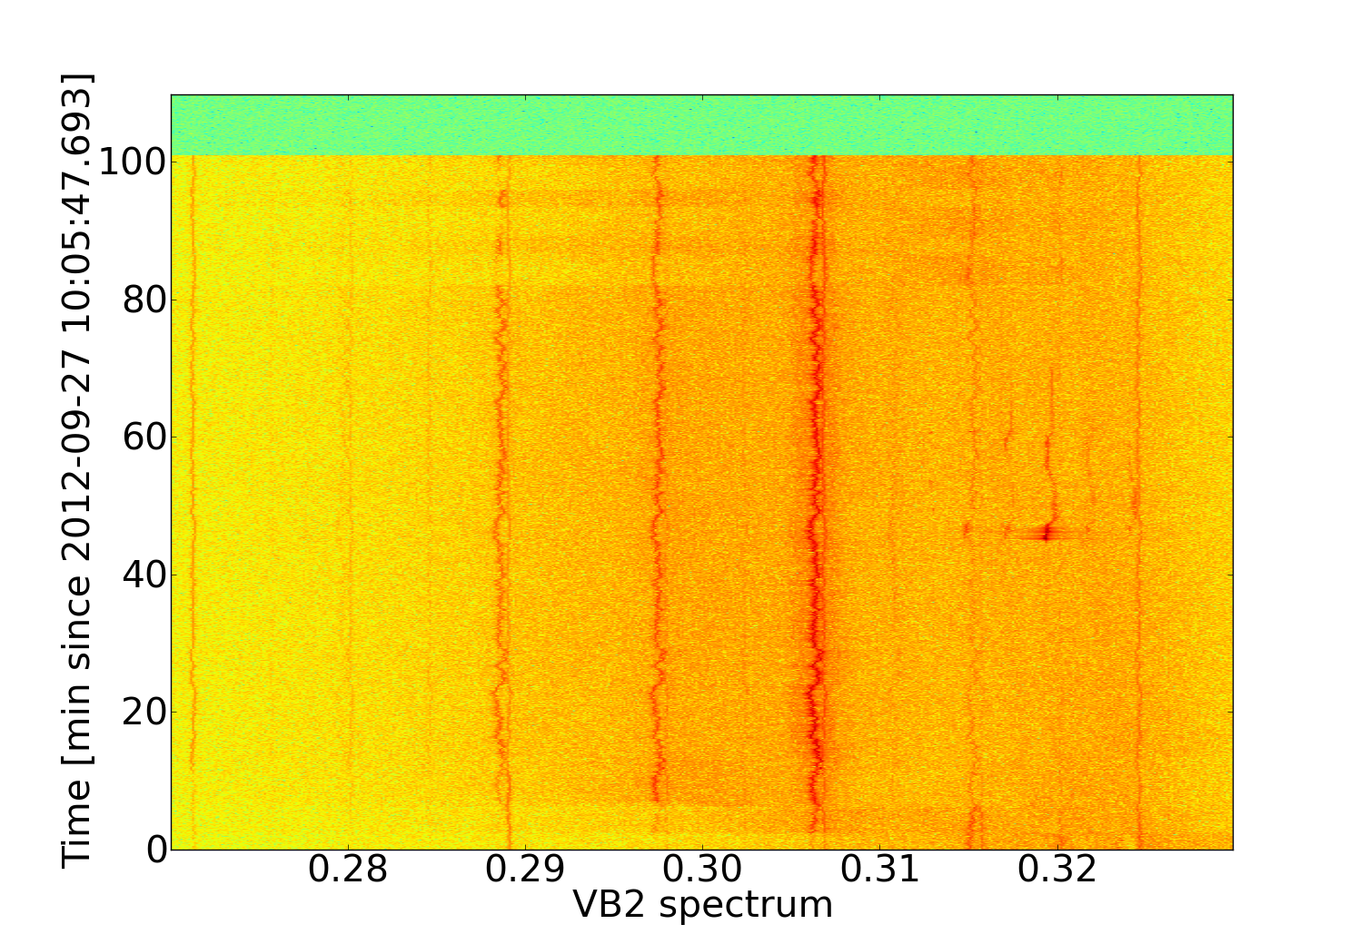
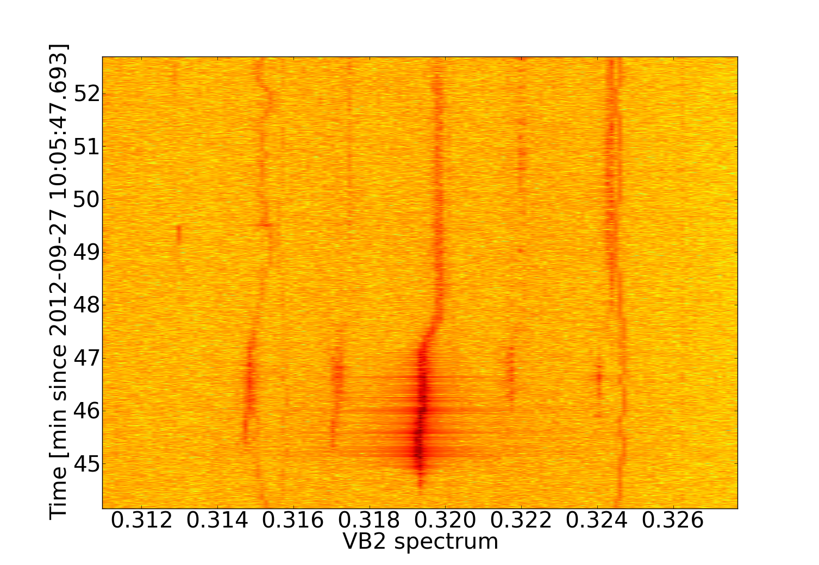
Fill 3102
Time =0 is Adjust mode
Vertical B2
Triming back the octupoles at higher current mitigates the problem
Octupole current = around 200A

Slide 5
Fill 3102
Time=0 is Adjust mode
Instability
In Adjust beam process usual signature of instability cured by fast collapse of IP1 and IP5
Octupole current = B1 from 510A to 520A Damper gain = operational settings

Slide 6
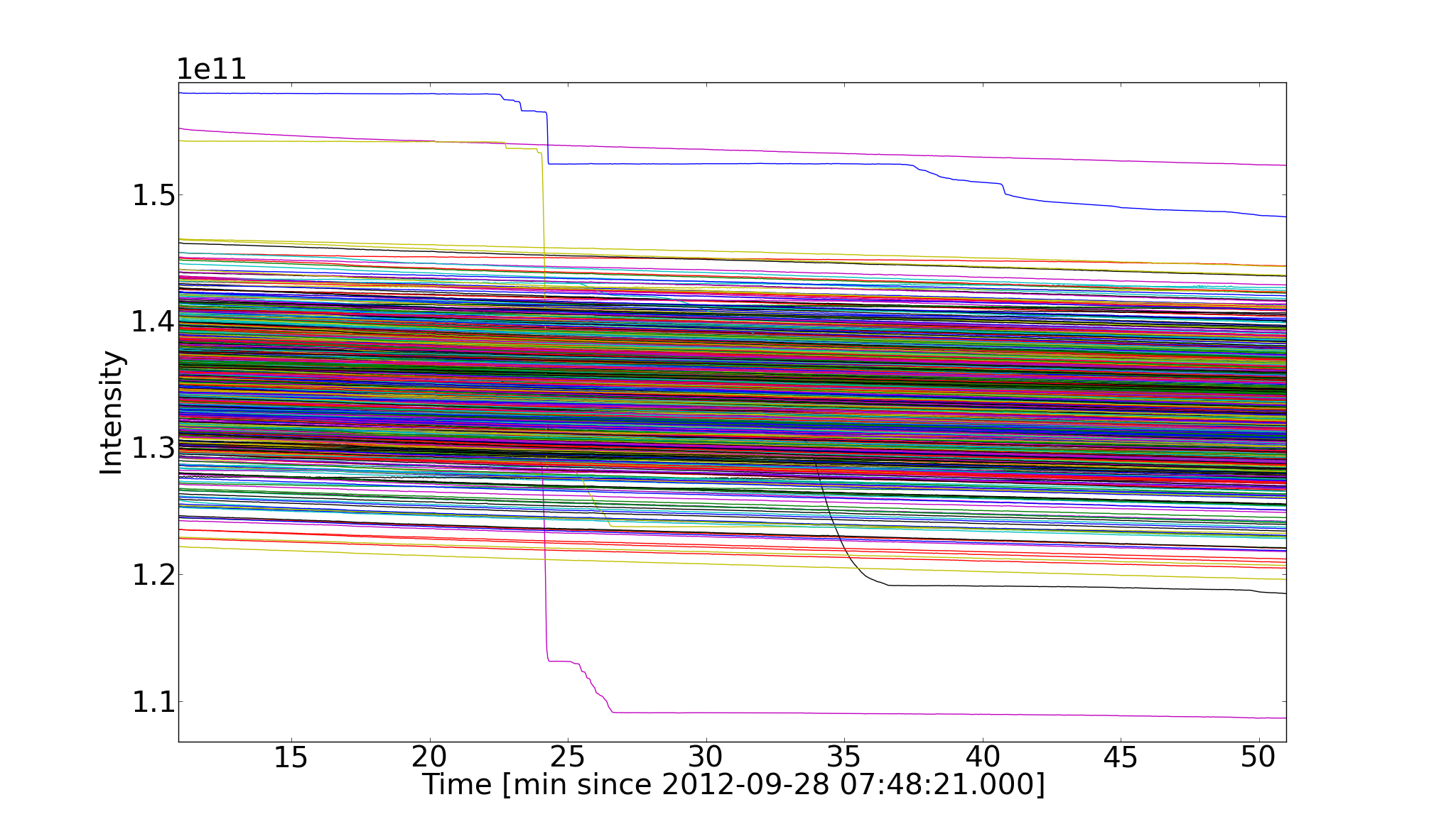
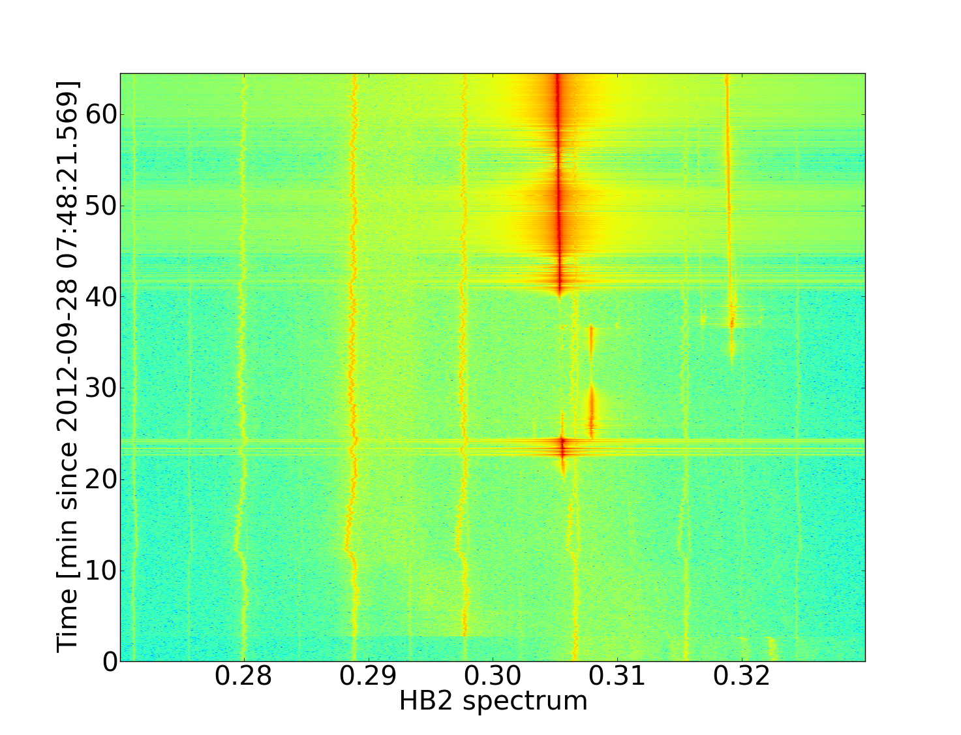
Fill 3108
Time=0 is Adjust mode
Special 6 bunches not colliding of B2 get unstable while octupole current reduced (time 8:12:21)
Octupole current = 290A to 230A Damper gain = operational settings

Slide 7
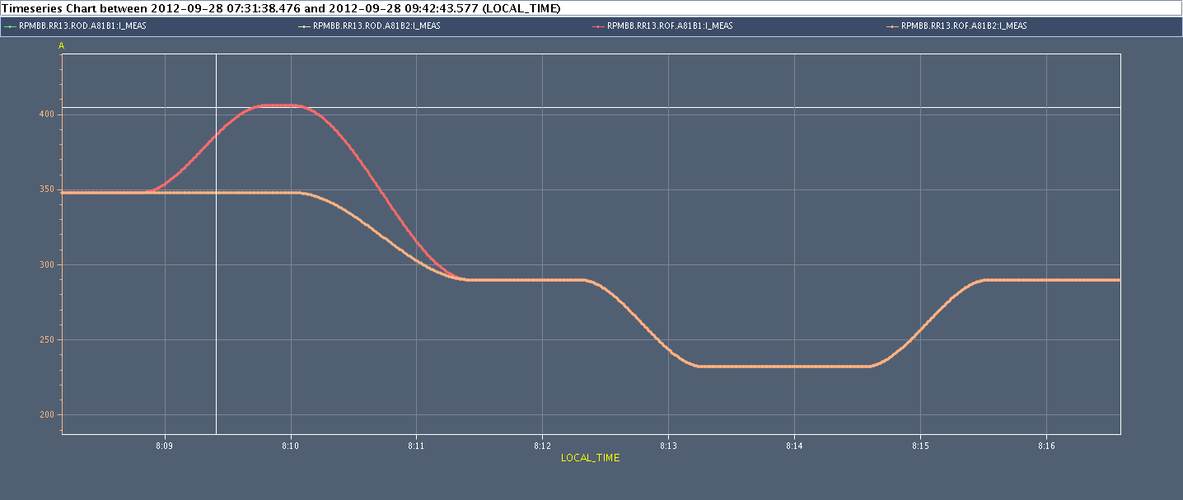
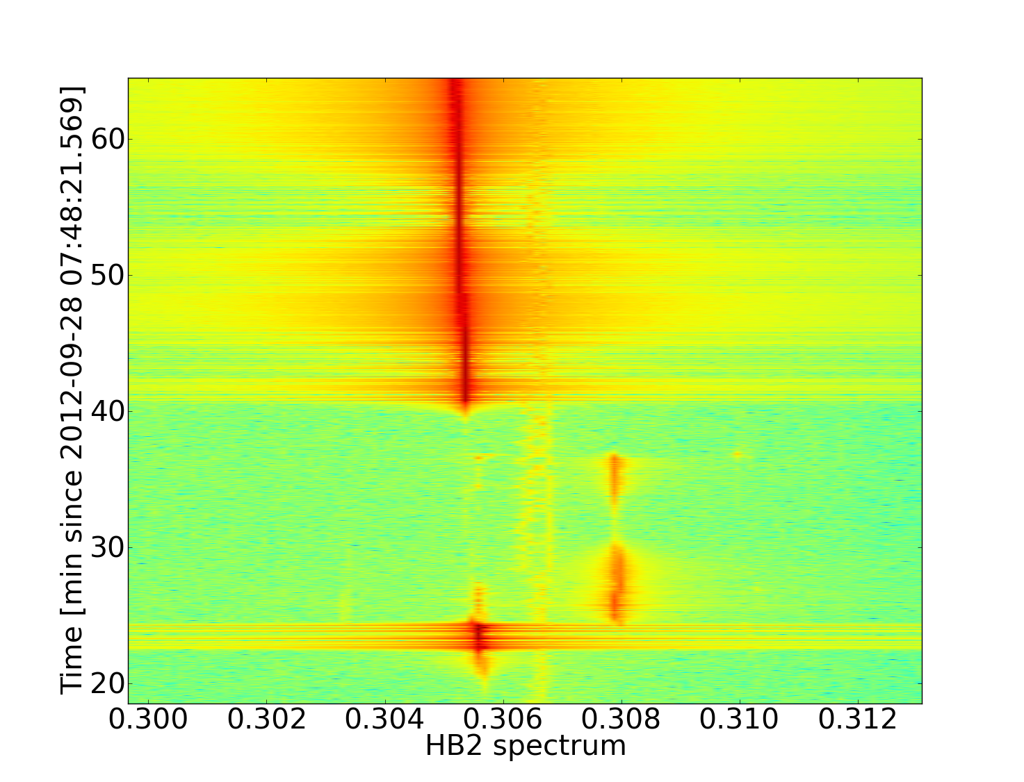
Fill 3108
Octupoles reduced in collision from 510 A to 240 A to improve lifetime.
Instability occurs when reducing from 290-320 A
Instability
Time=0 is Adjust mode

Slide 8
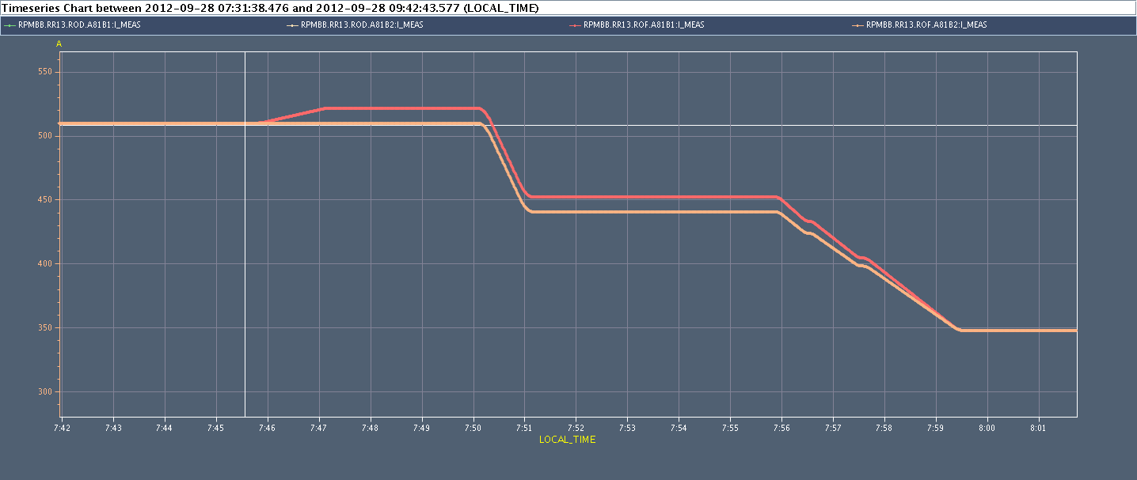
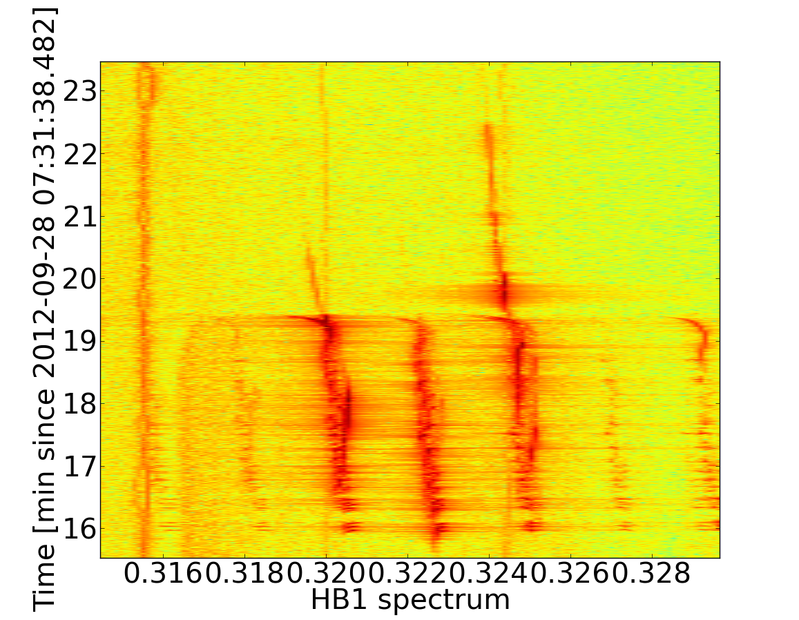
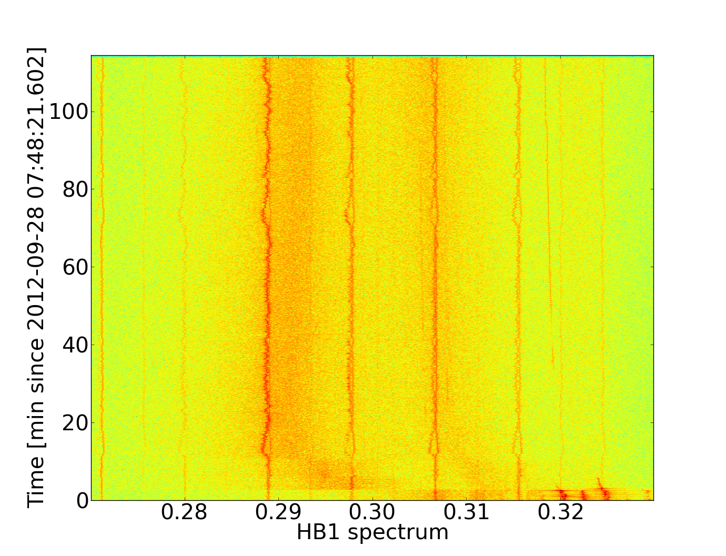
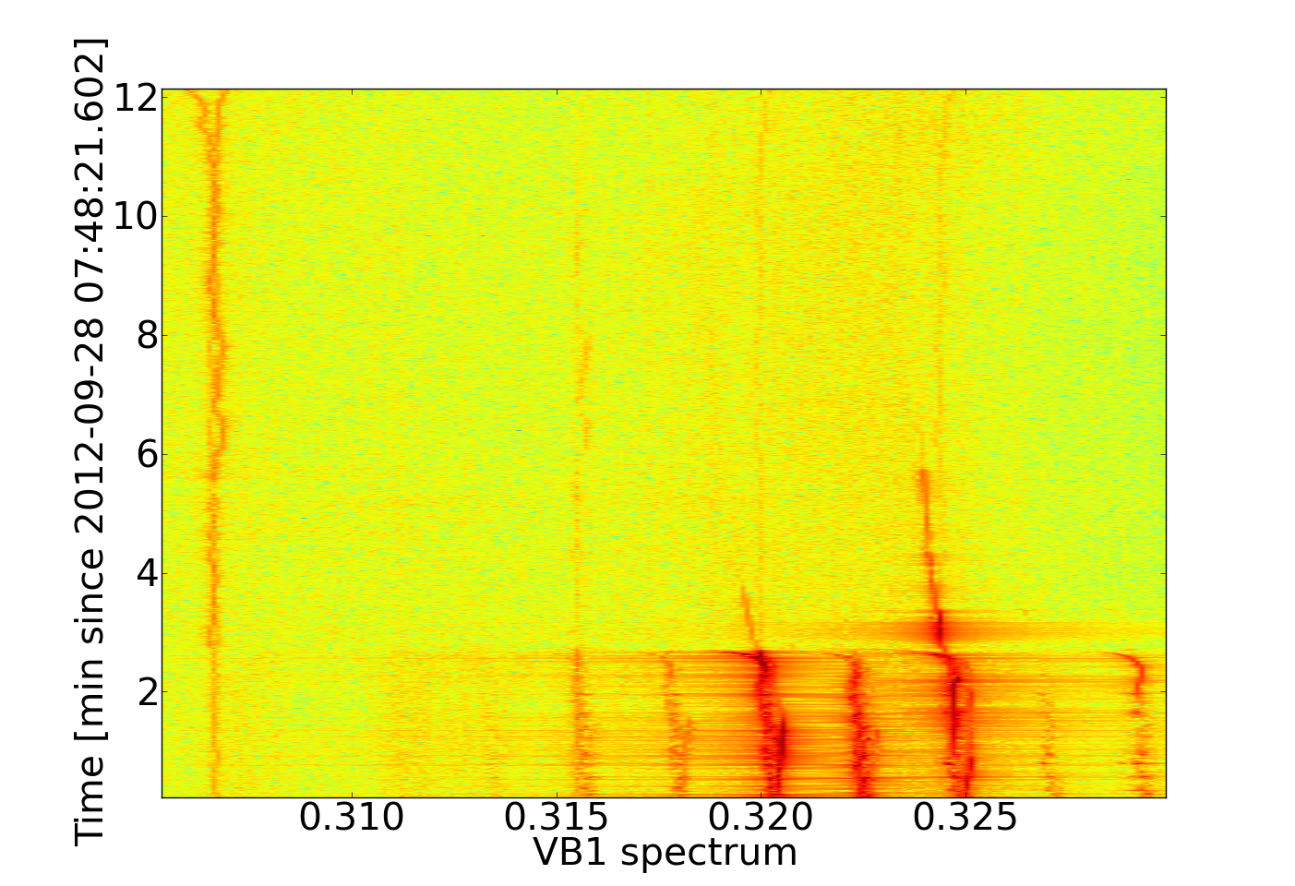
Fill 3108
Time=0 is Squeeze mode
Instability
Again in Adjust usual signature of instability in V plane B1 cured by fast collapse of IP1 and IP5
Octupole current = from 510 to 520 B1
Damper gain = operational settings
Time=0 means Adjust mode
Time=0 means Adjust mode

Slide 9
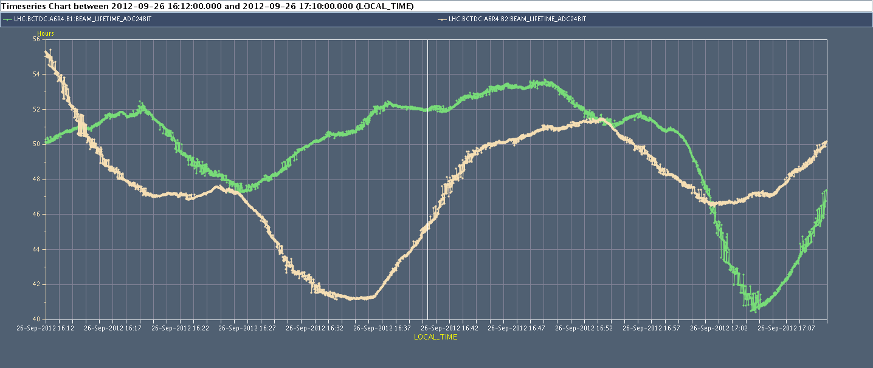
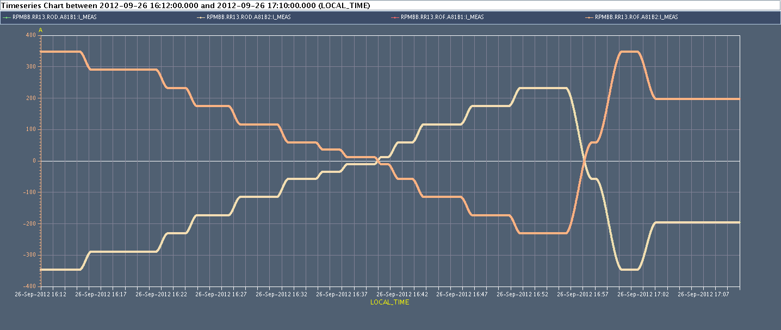
End of fill test on Octupoles 26/09/2012
Going at zero Octupole current NO INSTABILITIES observed
Asymmetry between beams during scan
No chroma corrections

