Slide 1
PS Working Point & Transverse Emittances
Rende Steerenberg
ABP-ICE - Meeting
22 August 2012

Slide 2
Contents:
Low energy
High energy
Summary / Conclusions

Slide 3
Low energy
High energy
Summary / Conclusions

Slide 4
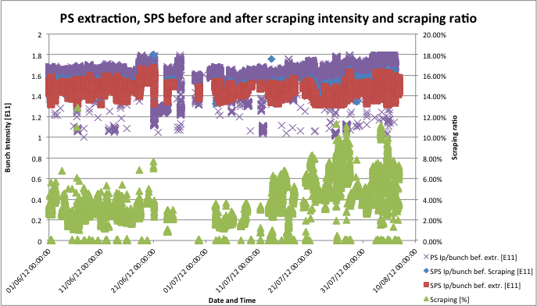
A Word on bunch intensities
Tech. Stop 2
LHC wants more intensity per bunch in small transverse emittances.

Slide 5
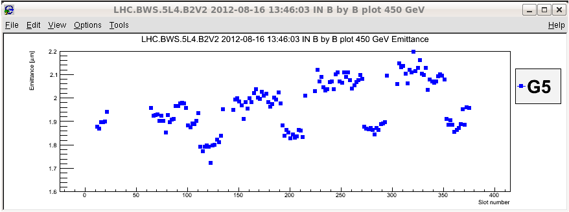
LHC vertical emittances 16 August
Blow up of at least vertical emittances between 1st and 2nd injection.
4 rings PSB 1st injection
2 rings PSB 2nd injection
PS Batch 1
PS Batch 2
PS Batch 3
PS Batch 3

Slide 6
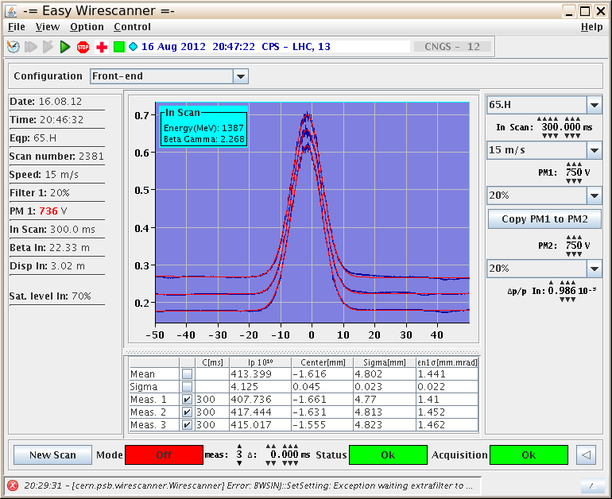
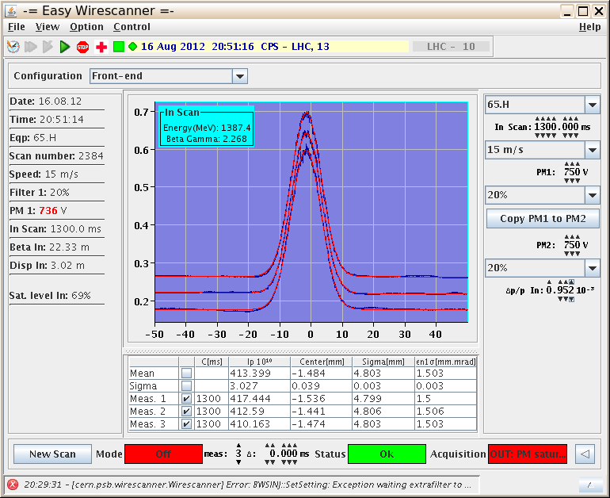
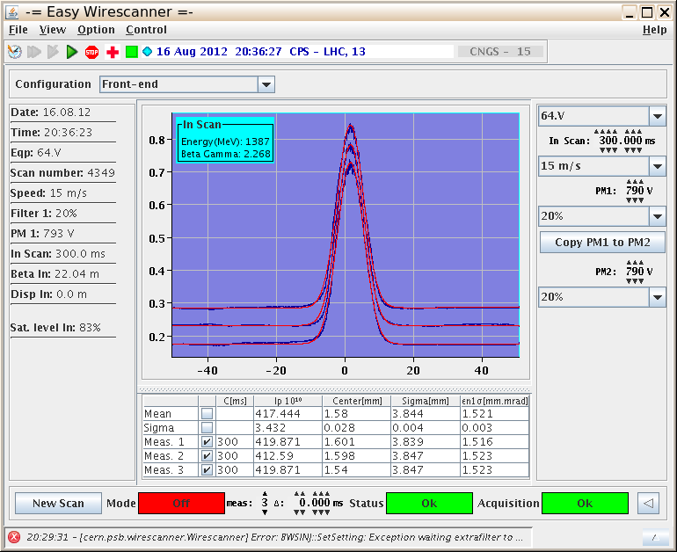
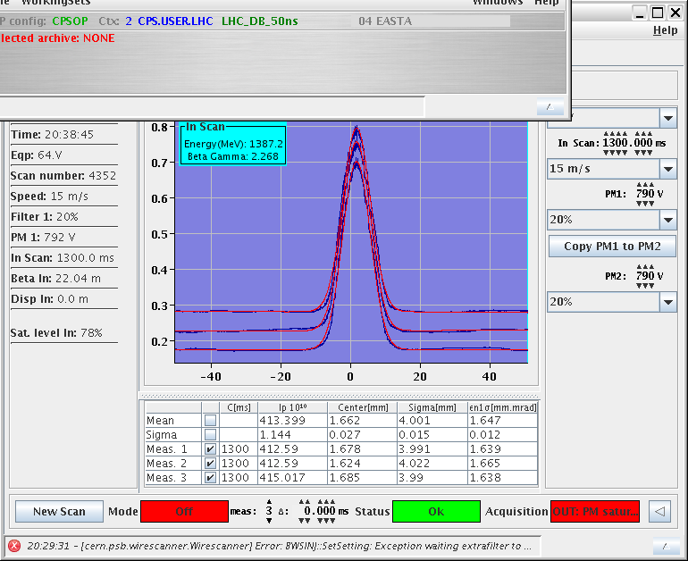
Transverse blow up during PS flat bottom
C170
1st inj.
C300
1st meas.
C1300
2nd meas.
C1370
2nd inj.
~4% blow up
~8% blow up
Not observed before, what was changed ?

Slide 7
PSB injection matching improvement
Saturday 4th August morning:
Changed settings of 2 quadrupoles in the BI line (BI.QNO30 and BI.QNO40; common quadrupoles for all 4 rings) and injection working point for rings 2 and 3.
Average transverse emittance decrease of ~ 10%.
 | ε*_hor. [mm mrad] BEFORE | ε*_hor. [mm mrad] AFTER | ε*_vert. [mm mrad] BEFORE | ε*_vert. [mm mrad] AFTER
Ring 1 | 1.53 | 1.29 | 1.22 | 1.21
Ring 2 | 1.21 | 1.13 | 1.27 | 1.22
Ring 3 | 1.60 | 1.22 | 1.33 | 1.29
Ring 4 | 1.60 | 1.28 | 1.27 | 1.24
~ 17%
~ 2%
Measurements for ~108E10 p/ring.
The result is more dense bunches injected into the PS.

Slide 8
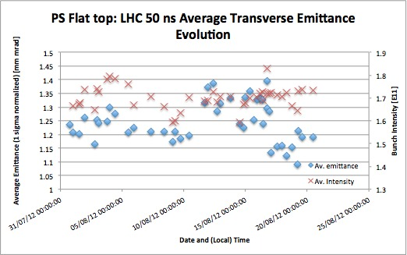
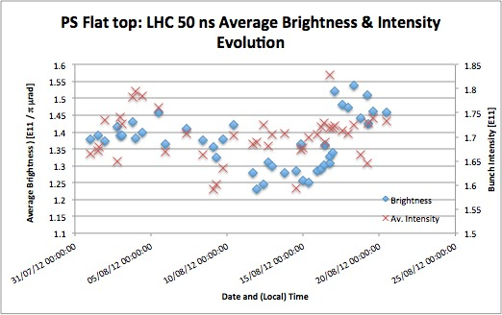
PS low energy working point change
The hypothesis was that due to space charge the tune foot print had increased and shifted down touching the integer resonance and causing blow up.
Tunes were changes:
 | BEFORE | AFTER
Horizontal tune | 6.2104 | 6.2356
Vertical tune | 6.2297 | 6.2440

Slide 9
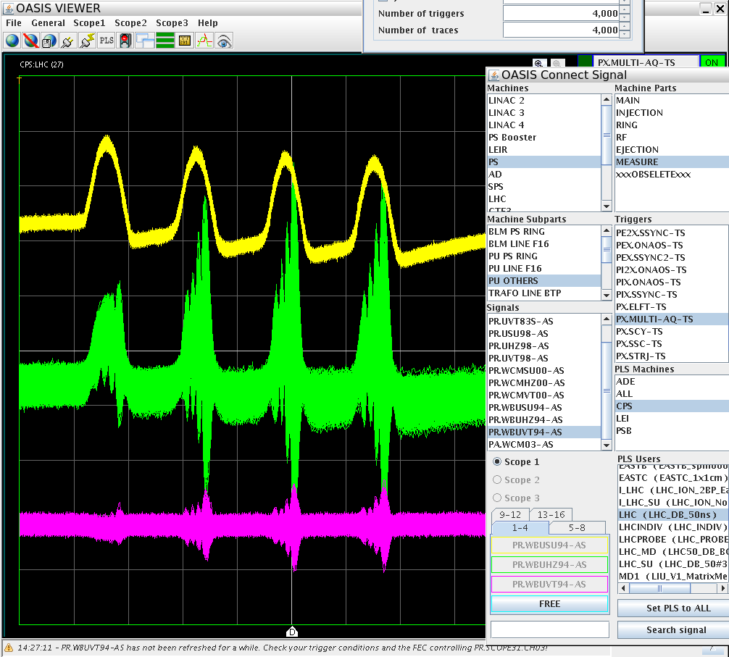
Transverse instability & Skew Quads
Yesterday afternoon the intensity was slightly increased and part of the beam was sometimes lost on the PS flat bottom → instability
Creating coupling with skew quads stabilized the beam. (E. Metral)
Interesting to investigate in more detail this instability
Visible in both planes ?
Higher order head-tail mode ?
TMCI like ?

Slide 10
Contents:
Low energy
High energy
Summary / Conclusions

Slide 11
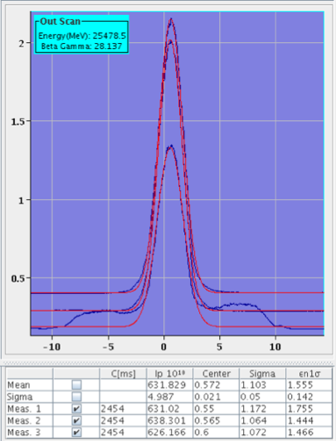
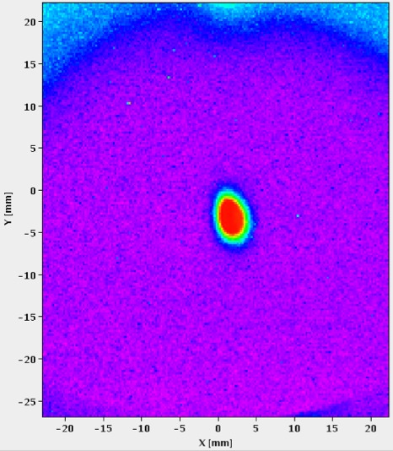
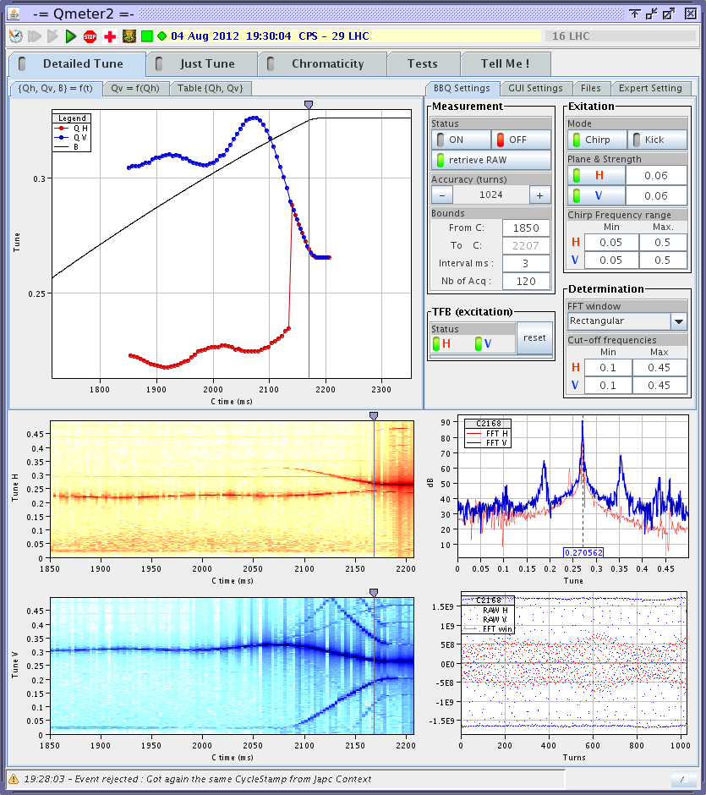
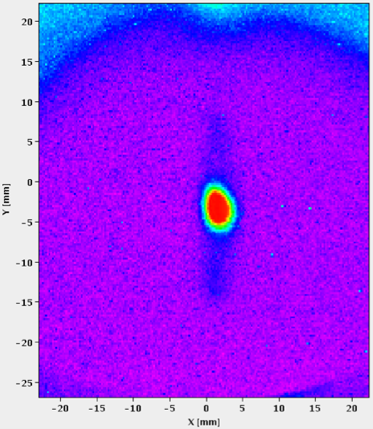
PS HE “instability” & working point
Following the PSB emittance decrease on Saturday 4 August and gradual intensity increase since TS2 the periodic vertical transverse emittance measurements showed sometimes “shoulders”.
Never observed in systematic measurements before Saturday (PSB change)
3rd order resonance issue in the vertical plane ?

Slide 12
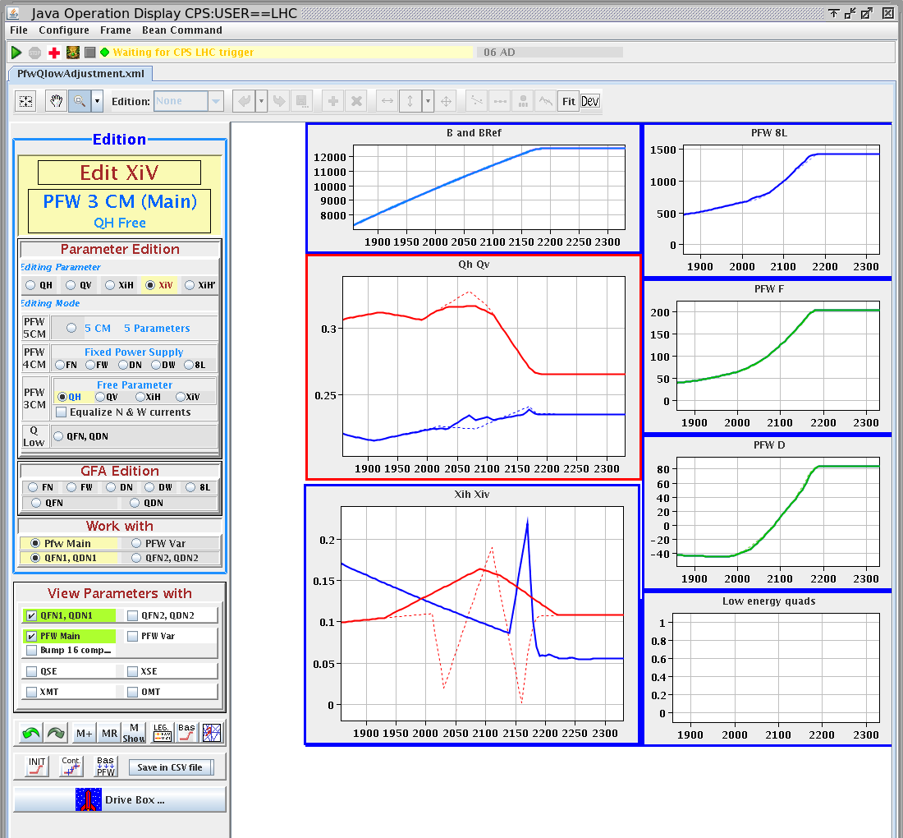
PS working point adjustment
The vertical tune was reduced.
The vertical chromaticity was also slightly increased to ensure it to be positive:
Until Saturday 4 August, the working point had not been changed since 2009.
Further “cleaning” is considered

Slide 13
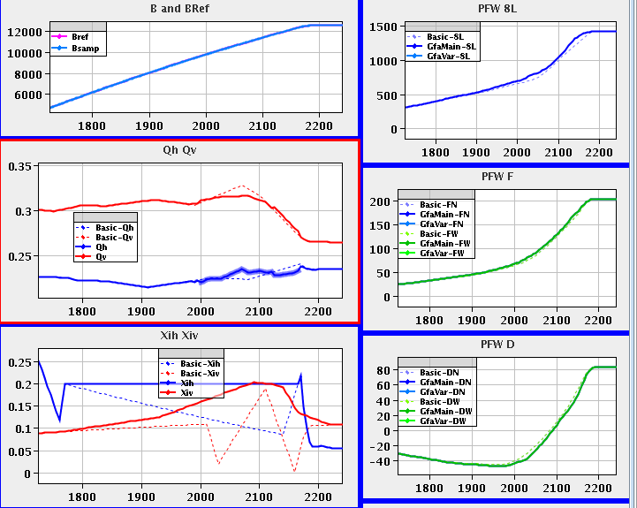
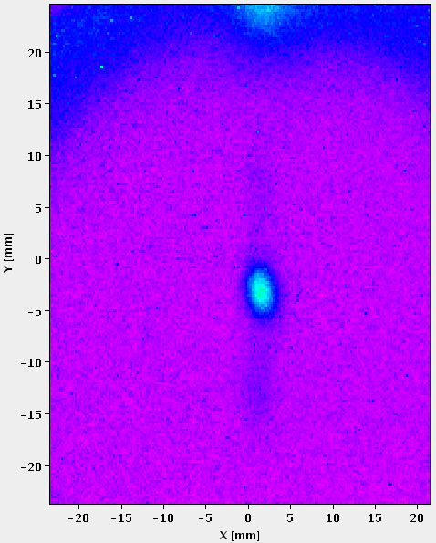
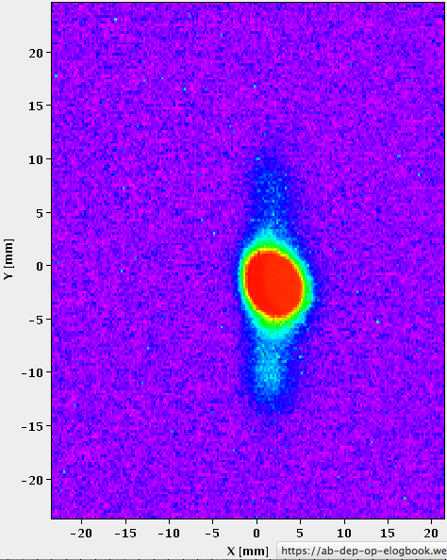
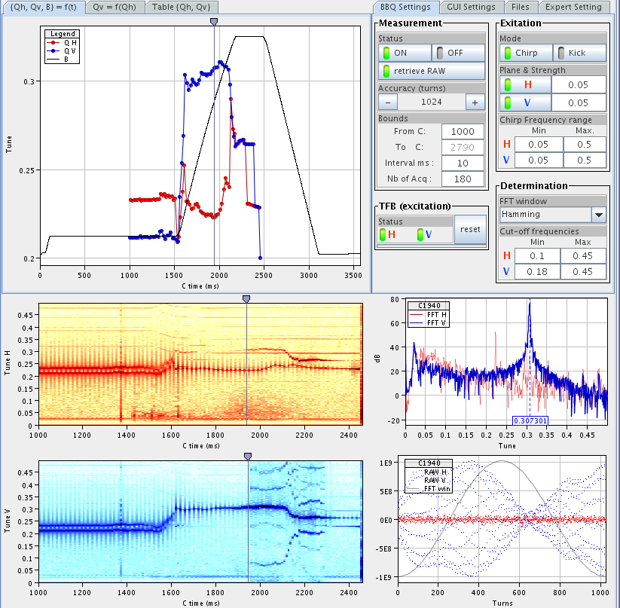
PS “instability” & working point
Similar observation was made last Thursday
Further reducing the tune did not reduce the frequency.
Putting the vertical tune at 6.333 did not change the frequency.
Increasing the chromaticity solved the problem
Should have confirmed Landau damping with octupoles

Slide 14
Low energy
High energy
Summary / Conclusions

Slide 15
Summary / Conclusions
The LHC 50 ns beam transverse blow up:
result of more dense beam send by the PSB.
Space charge made beam cross integer resonance.
Careful adjustment of tune required.
Low energy instability damped thanks to coupling using skew quads (and tunes close to each other).
The high energy instability solved by increasing the chromaticity
More Landau damping
Would be nice to confirm with octupoles
Corrections resulted in record peak luminosities in the LHC of well above 7E33.

Slide 16
SPARE SLIDES

