Slide 1
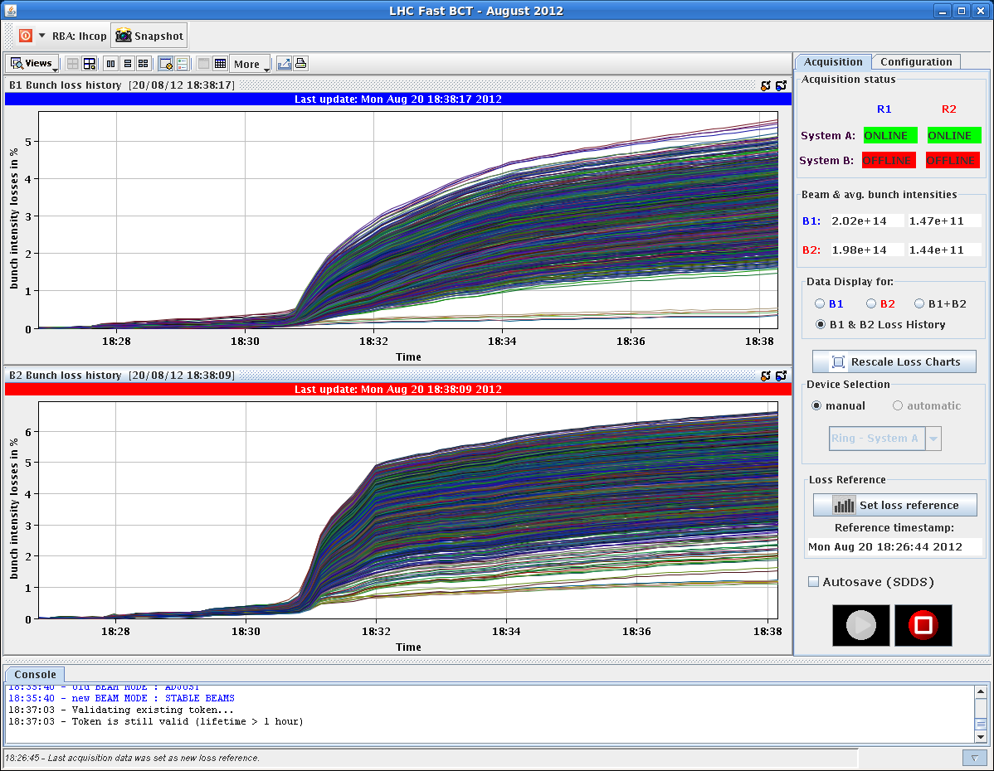
Fill 2991

Slide 2
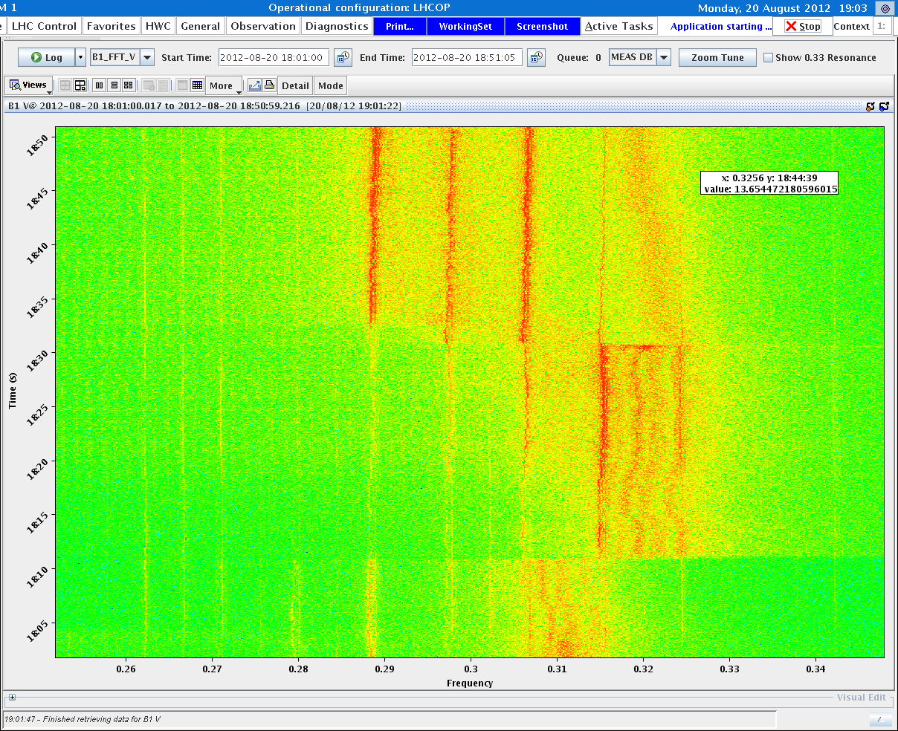
B1V Fill 2991 (start of adjust at 18:26 on 20/08)
2 visible tune
Lines in collision
Excitation in B1V
Synchrotron
side bands visible
due to
high chromaticity?

Slide 3
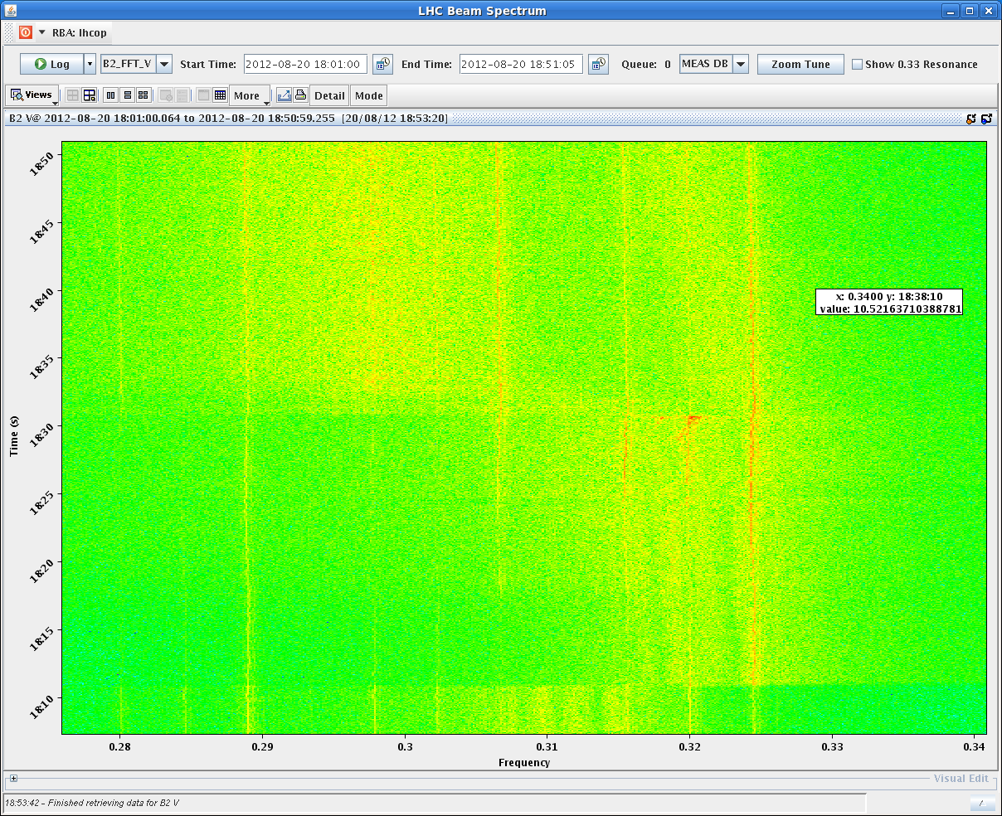
B2V Fill 2991 (start of adjust at 18:26 on 20/08)

Slide 4
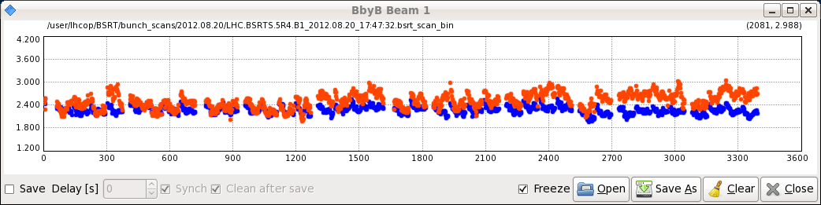
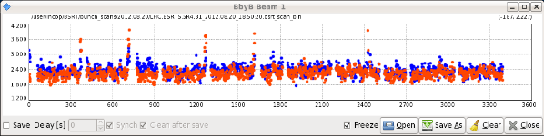
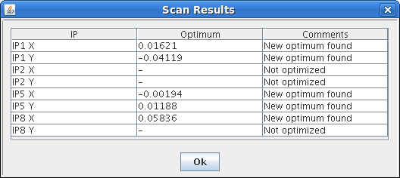
B1H and B1V before adjust
B1H and B1V in stable beams
Also saw on ADT that the end
of the batches was affected
Verena and Lasse noticed
that IP1 was quite far from head on
(1 sigma in X and 3 sigma in V)

Slide 5
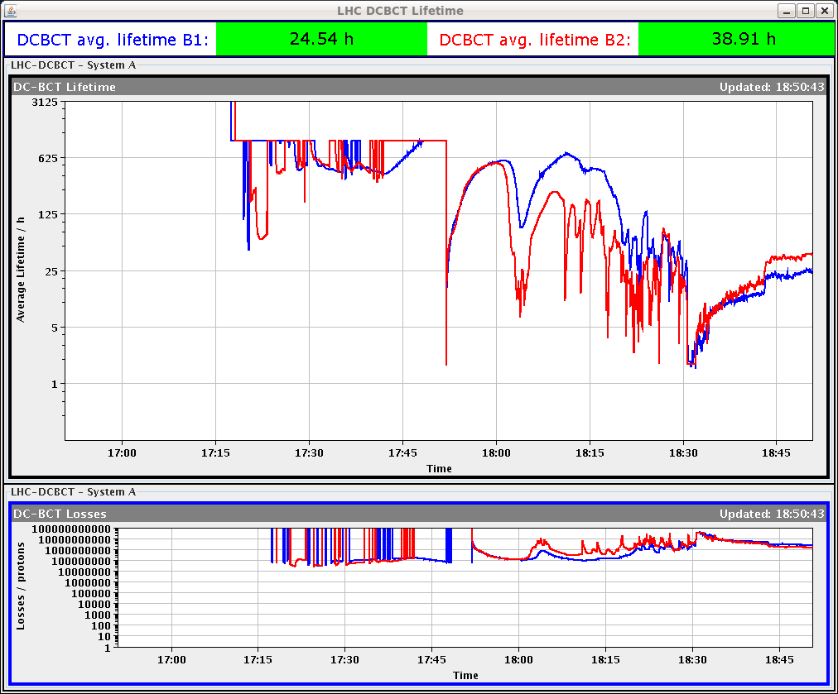
Q’h-3
Q’v-5

Slide 6
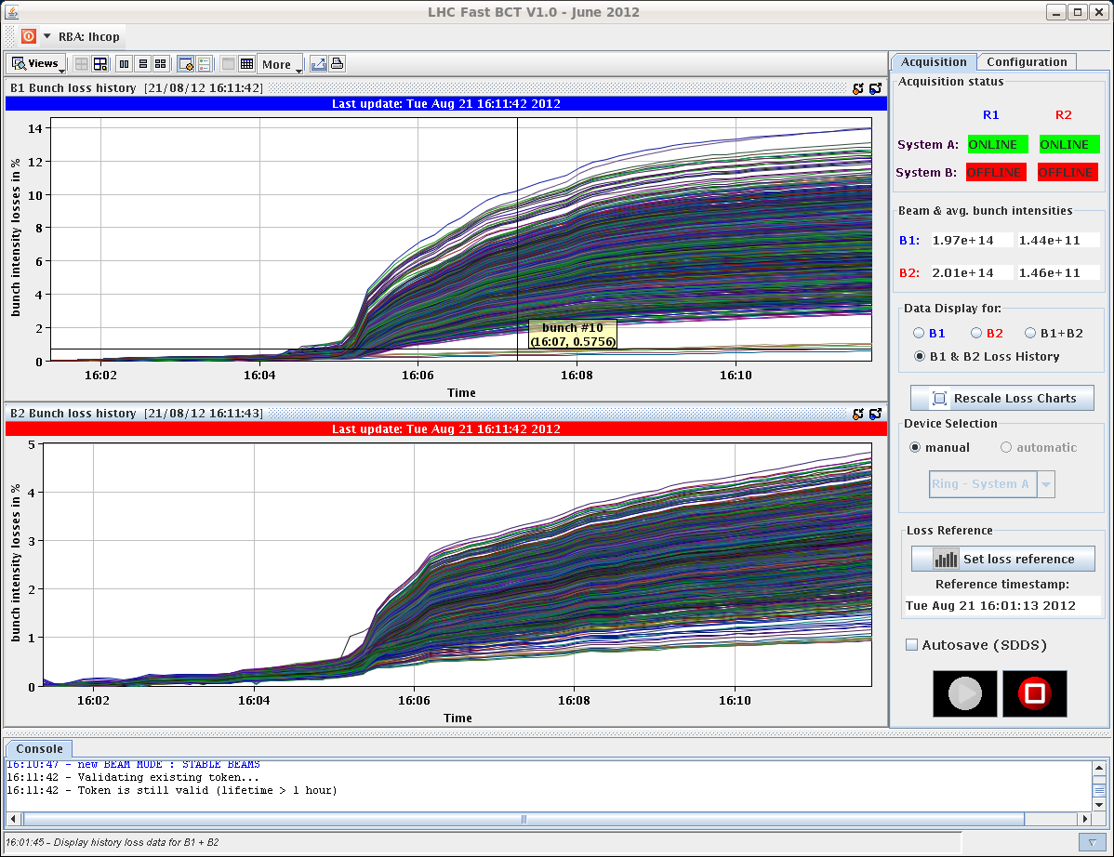
Fill 2992

Slide 7
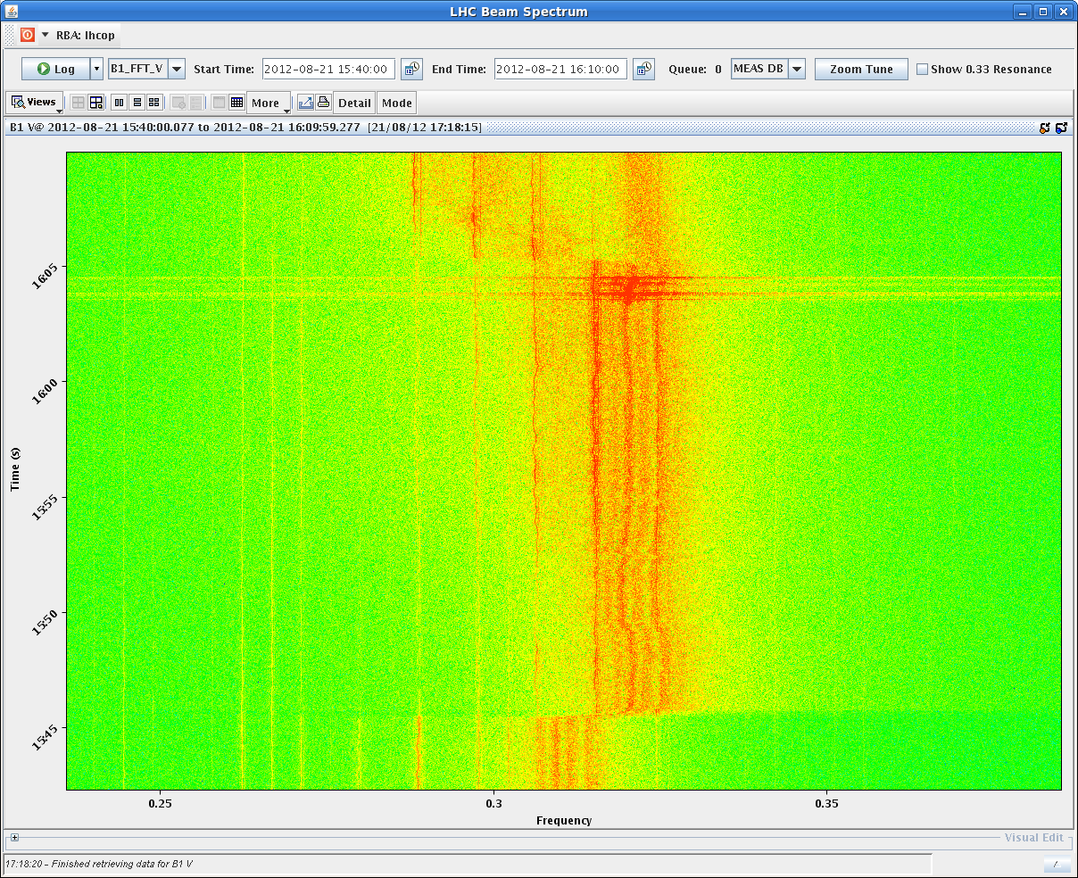
B1V Fill 2992 (start of adjust at 16:01 on 21/08)
2 visible tune
Lines in collision
Excitation in B1V
Synchrotron
side bands visible
due to
high chromaticity?

Slide 8
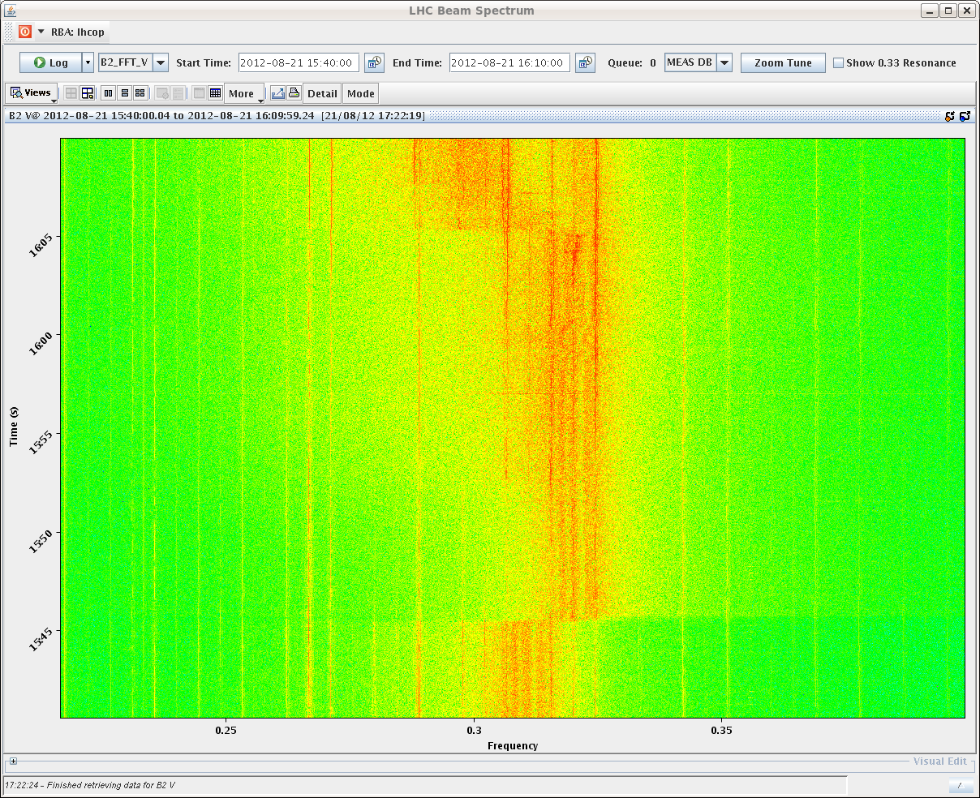
B2V Fill 2992 (start of adjust at 16:01 on 21/08)

Slide 9
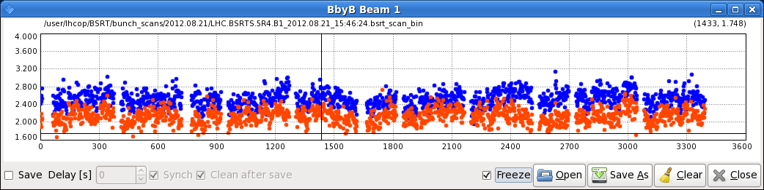
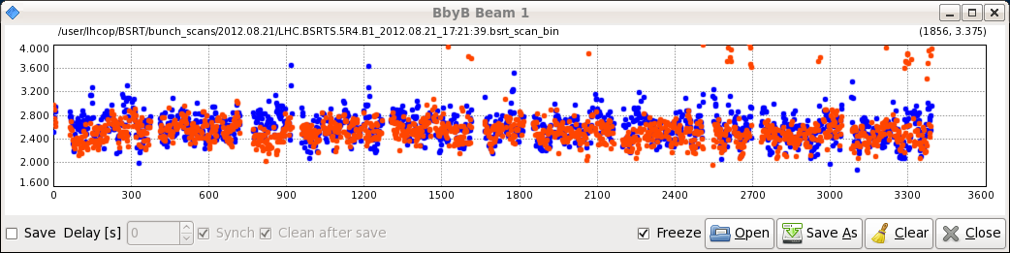
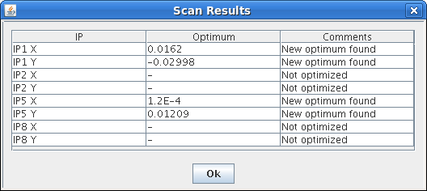
B1H and B1V before adjust
B1H and B1V in stable beams
Also saw on ADT that the end
of the batches was affected
Verena and Lasse noticed
that IP1 was quite far from head on
(1 sigma in H and 2 sigma in V)

