Slide 1
EVOLUTION OF THE PSB TRANSVERSE EMITTANCES VS INTENSITY FOR LHC BEAMS
Elias Métral (with Bettina Mikulec, Klaus Hanke, Giovanni Rumolo)

Slide 2
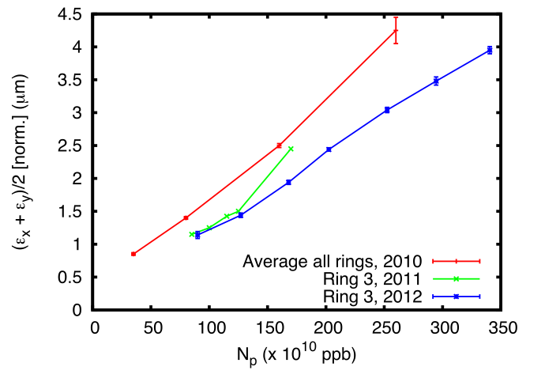
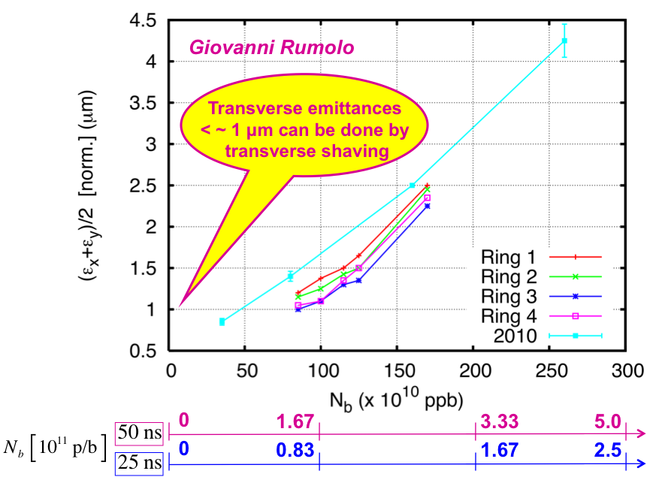
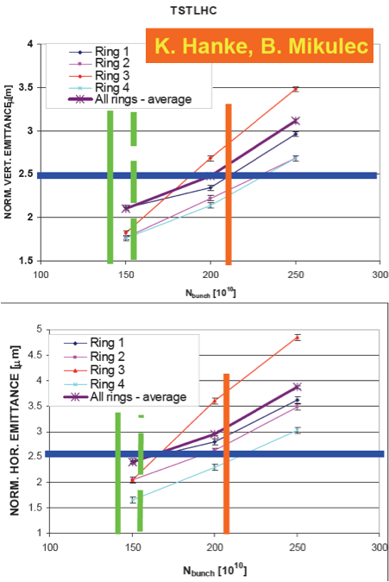
2007
2010
& 2011
2012
Bettina Mikulec
(CMAC, 2012)

Slide 3
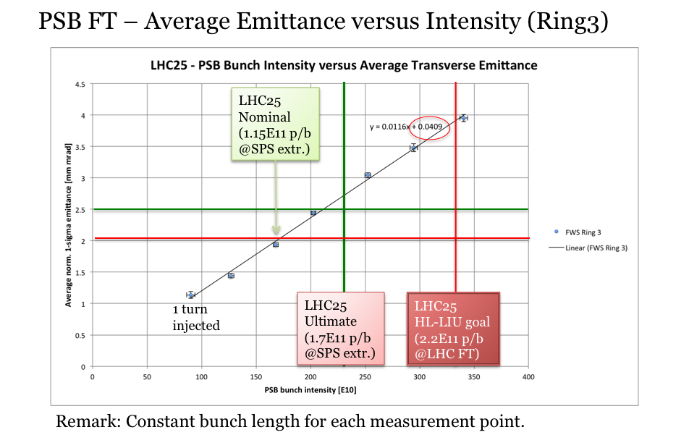
Bettina Mikulec (CMAC, 2012)

Slide 4
Next steps
One should try and understand what happened for each year (changes of working points, re-alignment, optics changes, etc.) which could explain the differences
Can we go continue to increase the beam brightness? Where is the limit as it keeps going down year after year (certainly also due to careful adjustments weeks after weeks from the operators)?
It is also linked to the longitudinal parameters: can we have some margin there?
Longer bunches at PS injection would help for space charge, but it would be detrimental for the longitudinal plane. Still no margin? Satellites were a concern in the past but they do not seem to be an issue anymore in the LHC. Does this change the picture?
Others?

