Slide 1
Status of the single-bunch feedback system for the SPS/LHC
M. Pivi
for
C. Rivetta, J. Cesaratto, J. Fox, O. Turgut, S. Uemuda, W. Hofle, U. Wehrle, K. Li, H. Bartosik, G. Rumolo, M. Furman, S. De Santis, R. Secondo, J.-L. Vay
LARP collaboration: SLAC, CERN, LBNL
27 June 2012 - ICE Meeting, CERN

Slide 2
Single-bunch Feedback system concept
TMCI and electron cloud cause intra-bunch motion in the SPS.
LARP / CERN design of a feedback: measure the position of slices in a bunch and control each slice individually by applying electric fields
Need for high bandwidth to sufficiently sample the bunch

Slide 3
Feedback system ongoing work
Driving the beam during Machine Development MD studies
Code development to include a single-bunch feedback system
Under development:
  High bandwidth kicker design
  Analog equalizer for the pick-up system
Design Report

Slide 4
Machine Development’s goals
MDs goals: Install hardware in the SPS tunnel/ Faraday cage and drive the beam (i.e. excite the beam and measure its response)
Evaluate a method to time properly the kicker signal with the bunch.
Actually installed in the SPS beam line (Linnecar):
  Kicker: exponentially tapered pickup and flipped around, with 200MHz response transfer function

Slide 5
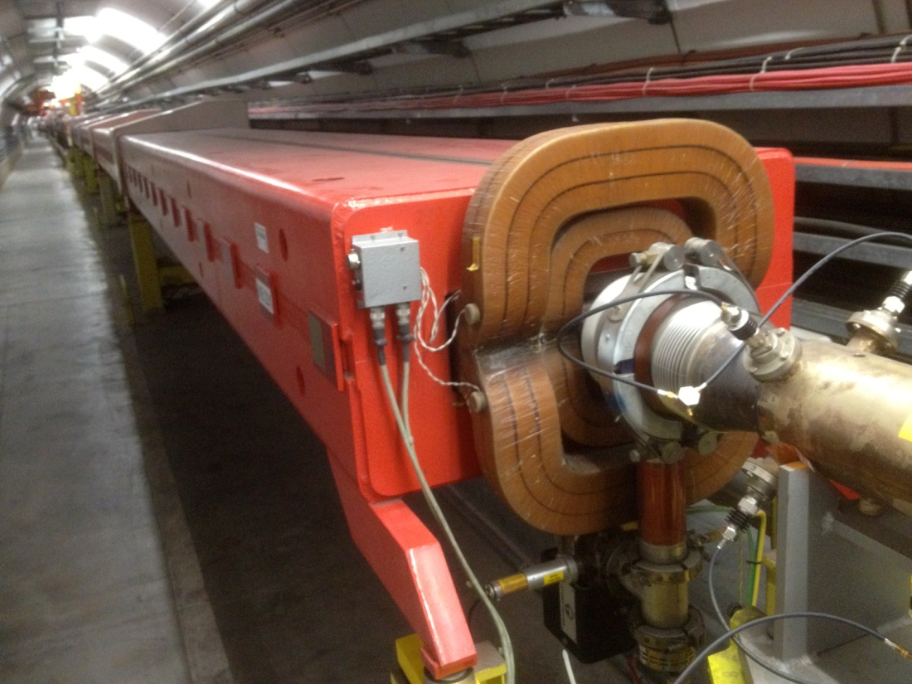
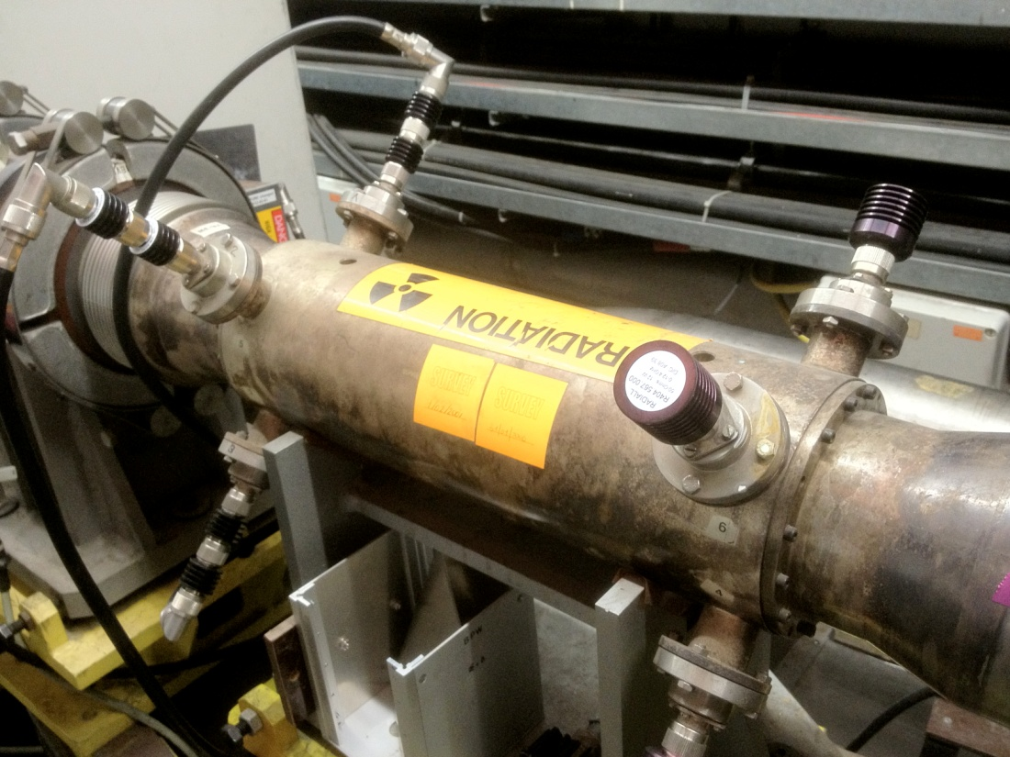
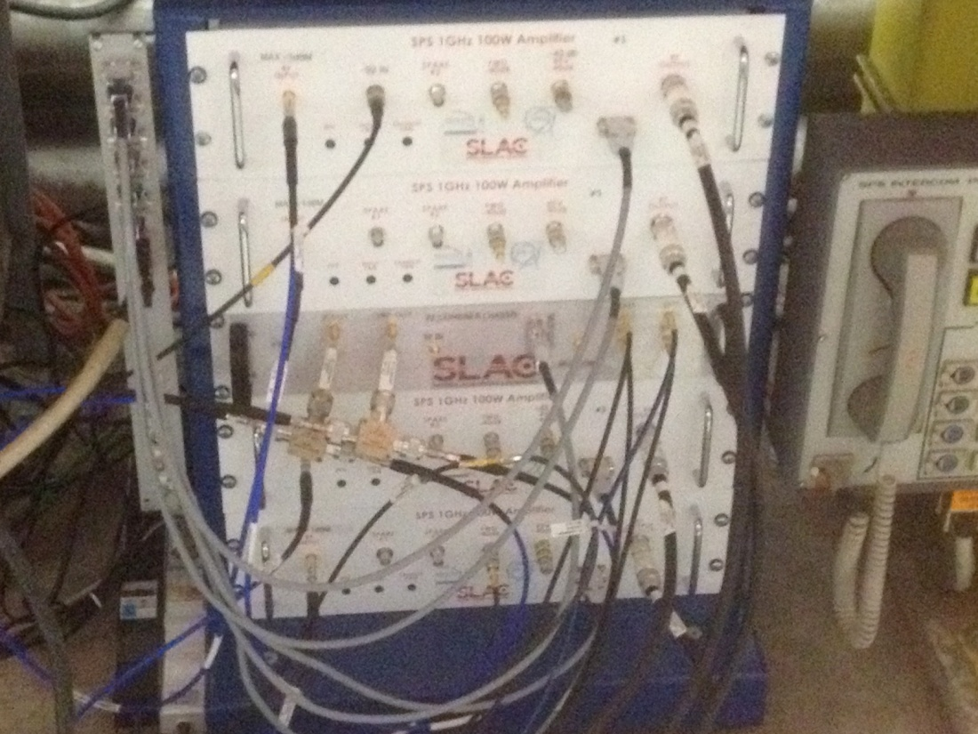
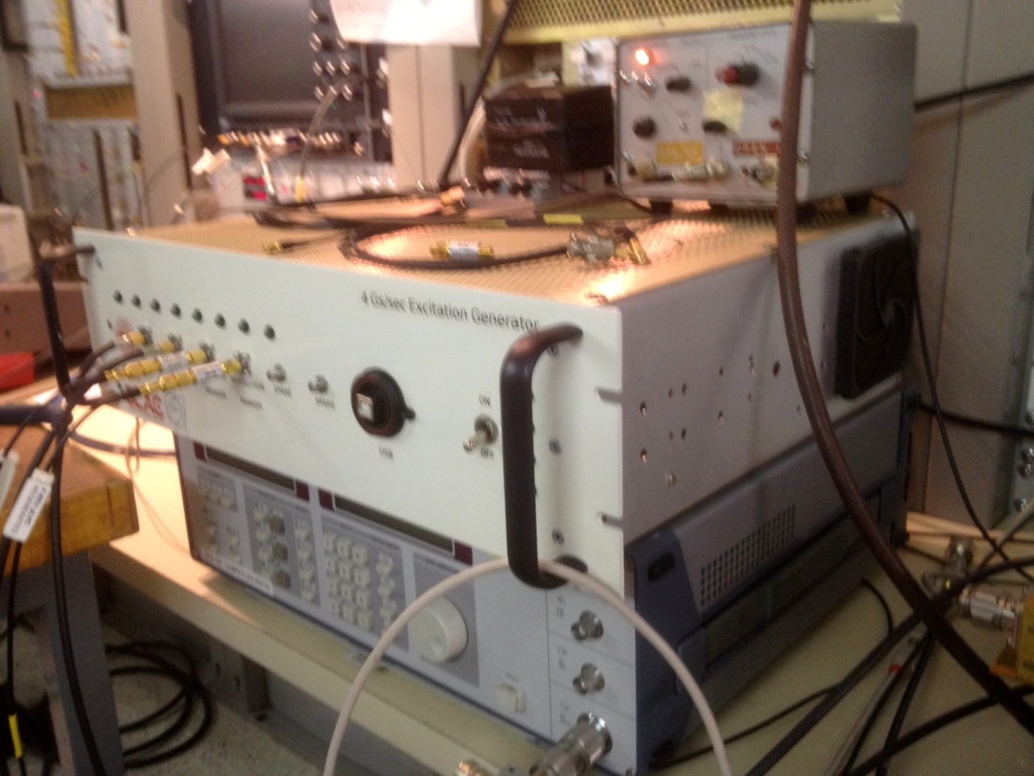
200 MHz kicker in SPS
Hardware installed in the SPS
Beam excitation system in Faraday cage

Slide 6
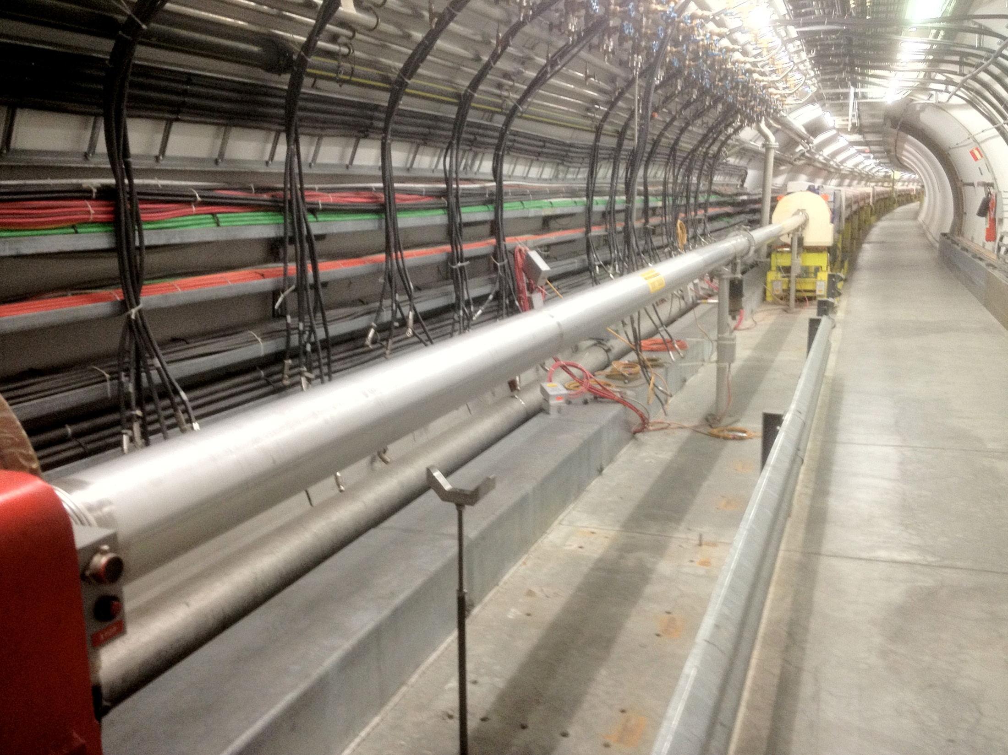
Potential SPS location for the single-bunch feedback system installation

Slide 7
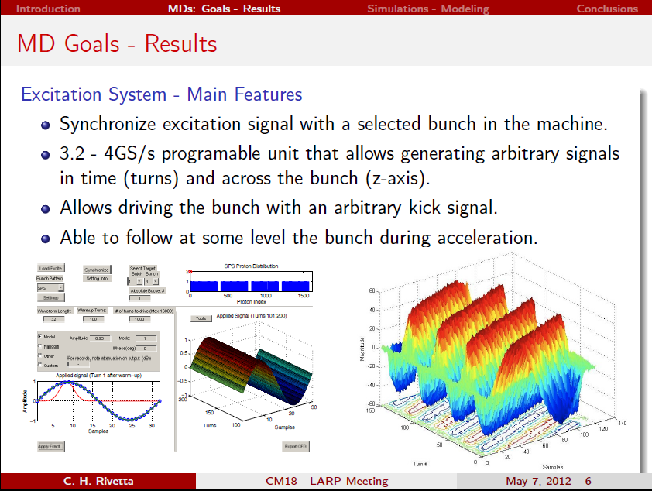
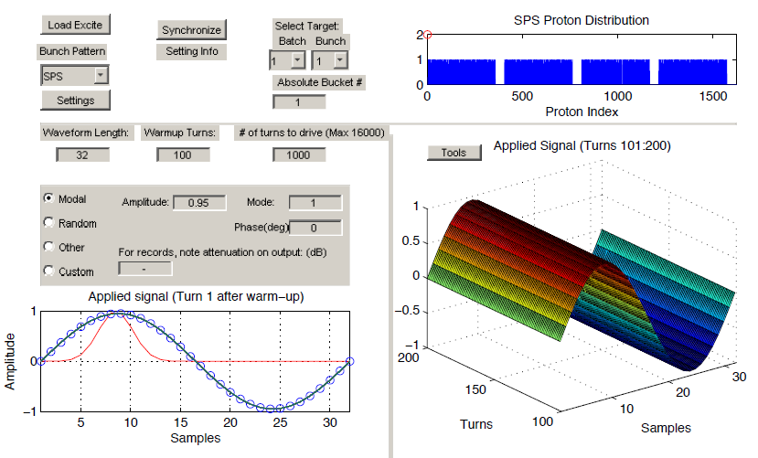
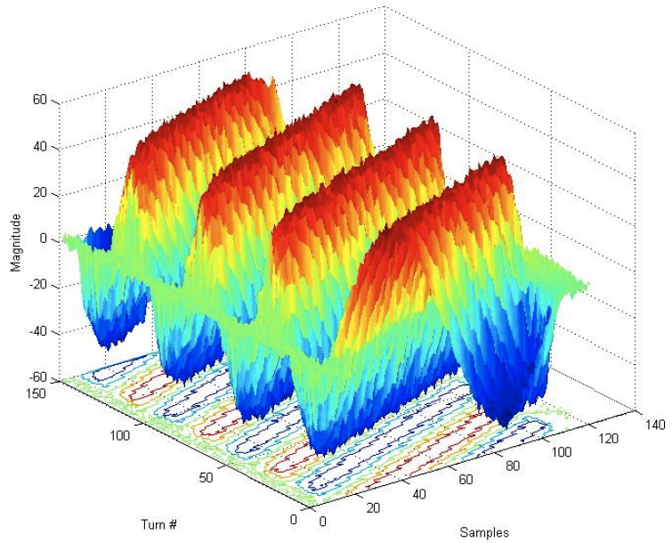

Slide 8
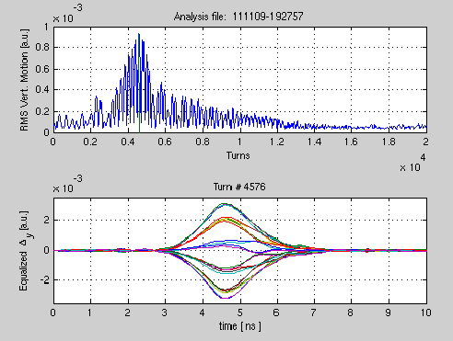
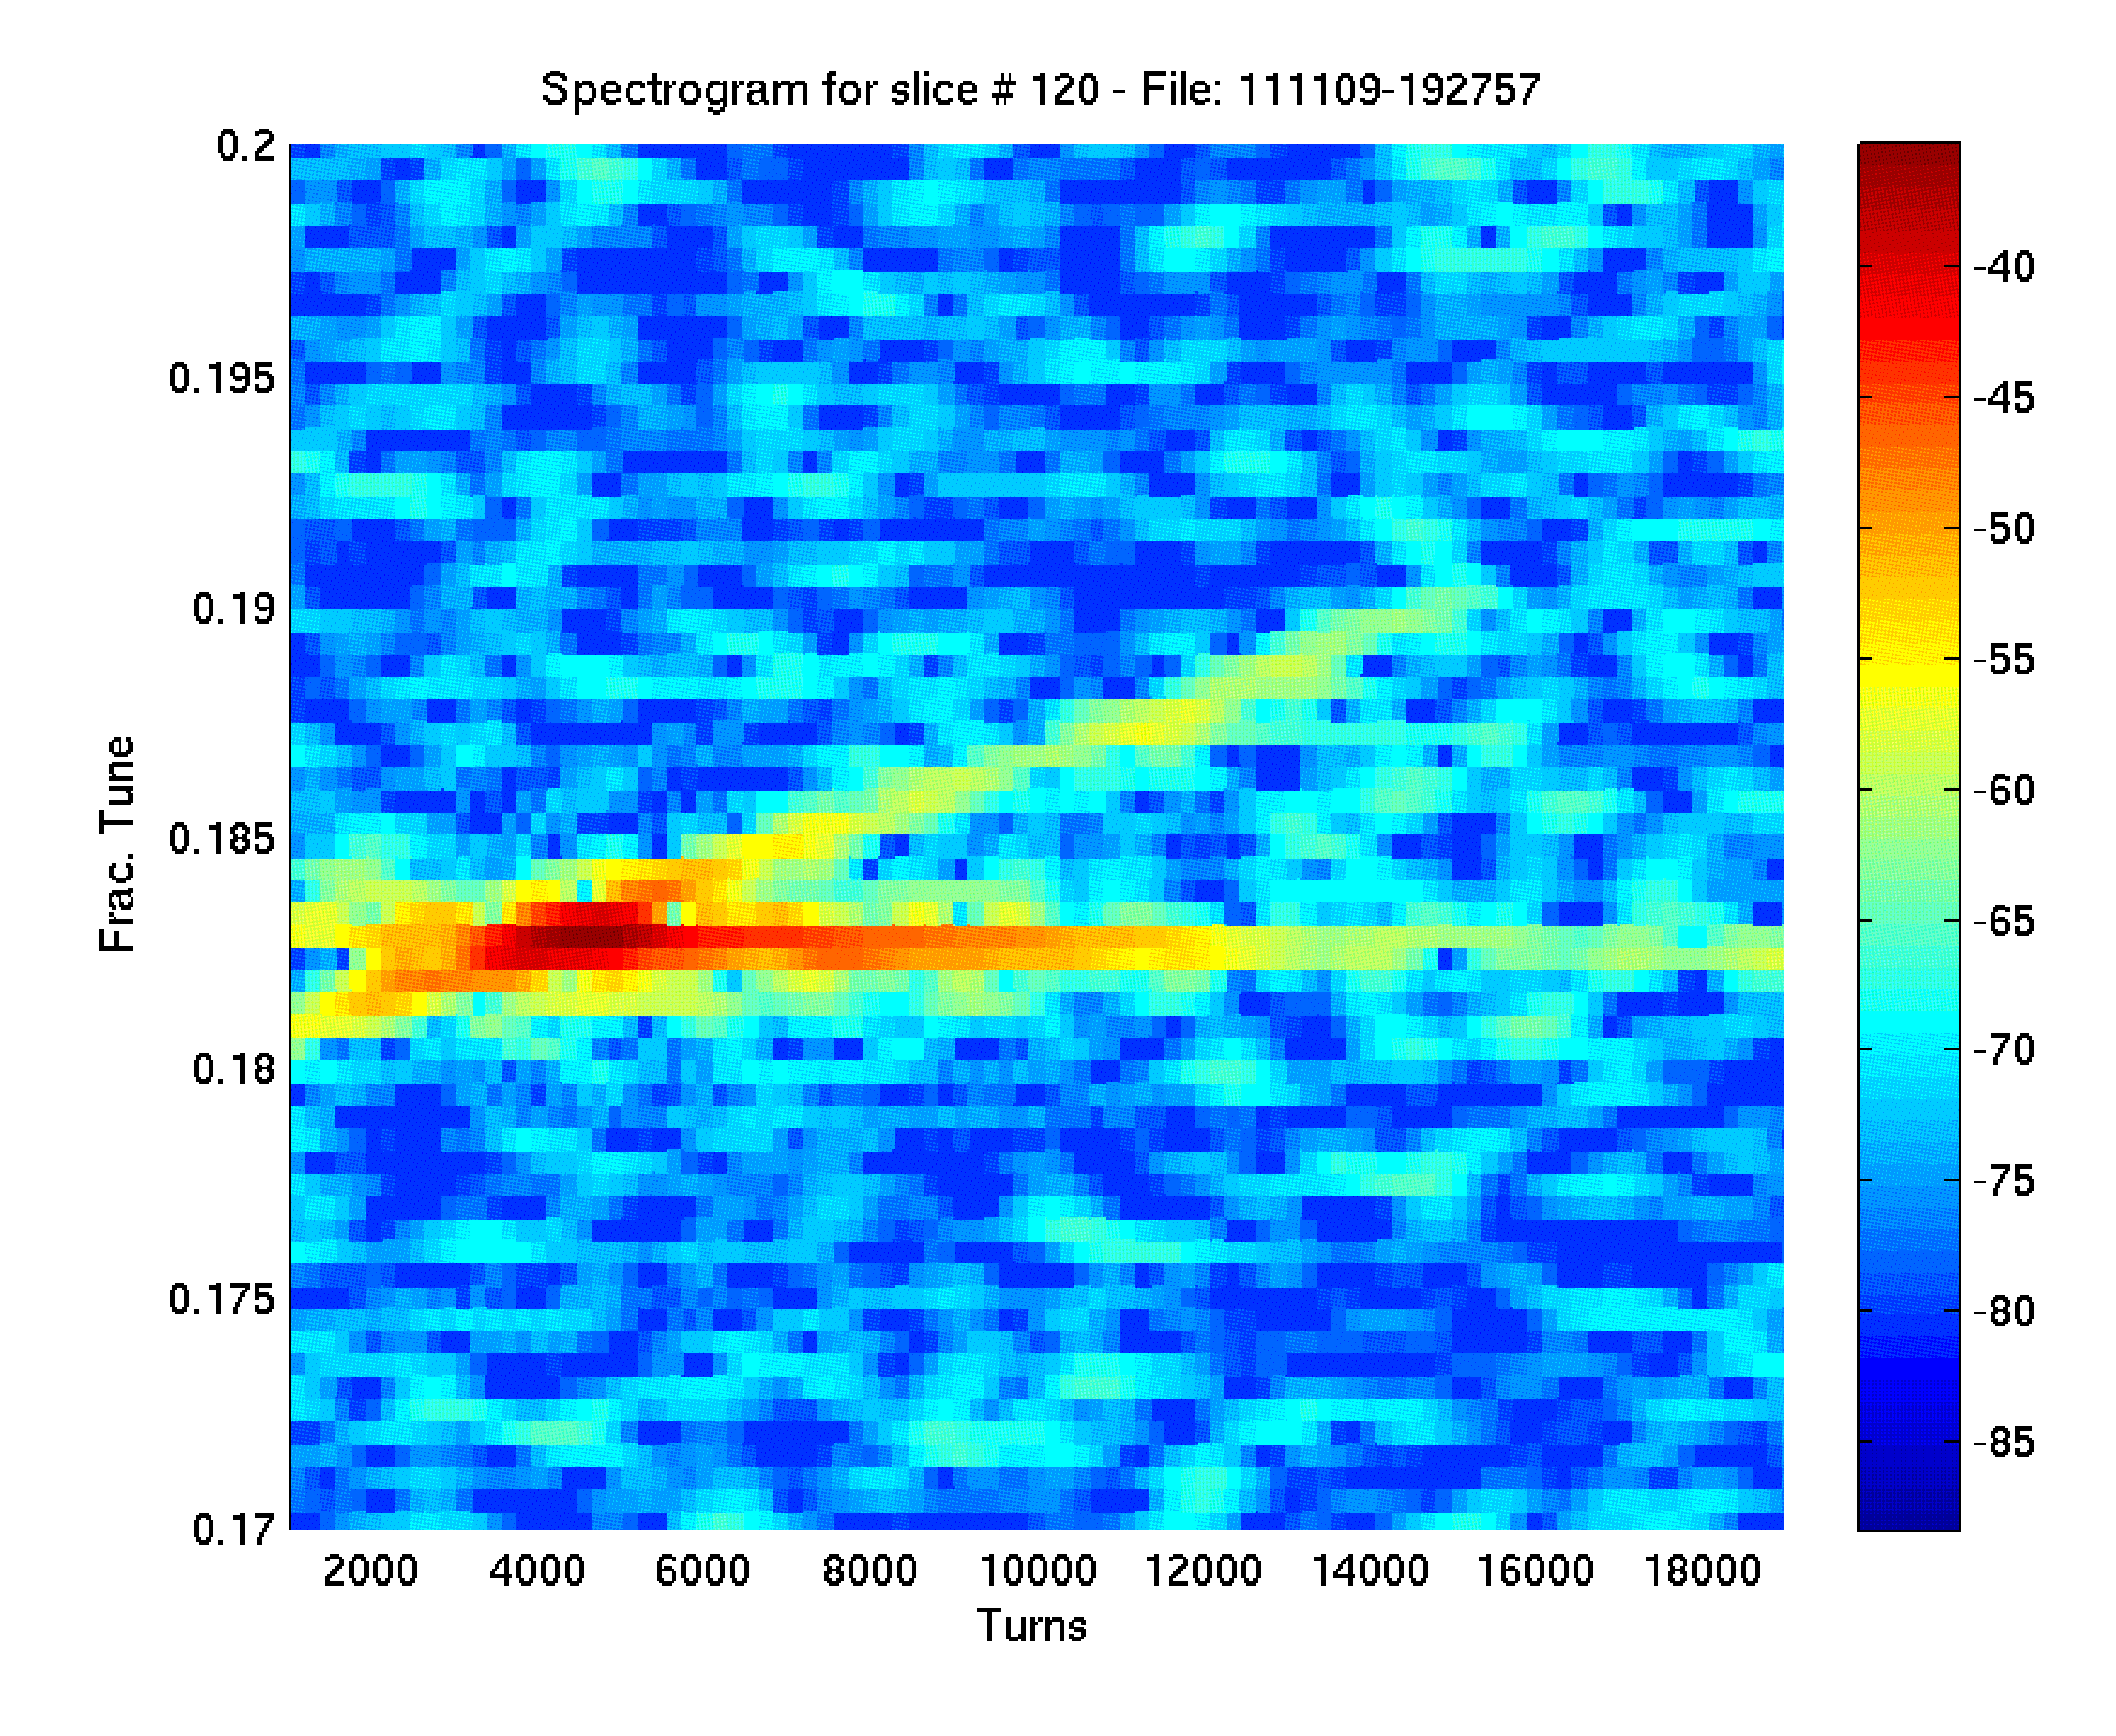
MD April results: excited bunch multimode motion. 1 / 2
Precisely timed the kick with a Single Bunch in the machine
Swept a 200MHz sine wave excitation signal from a tune of 0.18 through 0.19 The signal is swept from turn 2000-14000.
RMS vertical motion
Qx=0.183, Qs~0.005
delta signal from pick-up shows modal composition at turn 4576
Power spectrum (of 1 bunch slice): excitation of mode 0 at turn
4000 and weekly of mode 1 at
Turn 11000.

Slide 9
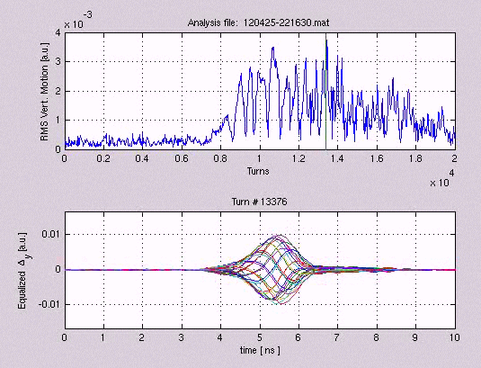
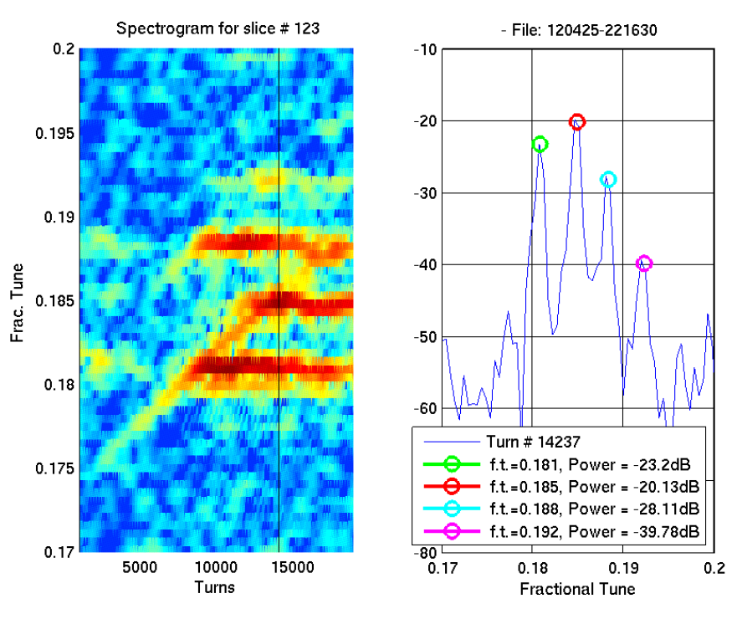
MD April results: excited bunch multimode motion. 2 / 2
Lower bunch chromaticity, swept the excitation signal from a tune of 0.175 through 0.188. The signal is swept here from turn 2000-17000.
Qx=0.181, Qs~0.004
RMS vertical motion
Delta signal from pick-up shows modal composition at turn 13376
Power spectrum (of 1 bunch slice): excitation of modes 0, 1, 2, 3
from turn 9000 to 13000.
No -1 mode observed.

Slide 10
animations
C. Rivetta, J. Cesaratto, M. Pivi

Slide 11
MD April
All machine data taken to date has been with a single bunch.
Look forward to measurements exciting a particular bunch in a multi-bunch fill.

Slide 12
Past work
Experimental observations
  Limitation in intensity (TMCI)
  Limitations in filling patterns (ECI)
  Diagnostic tools: BPM, headtail monitors, emittance monitors, mode analysis
  Stabilisation on a bunch-by-bunch level by transverse damper
High bandwidth feedback (some examples)
  Y. Chin et al.: Intra-bunch feedback system in Jparc (Jp), 50 MHz
  J. Thomson: simplified and idealised feedback model
  → minimum bandwidth of 300 MHz
  K. Ohmi: high bandwidth feedback simulations
  → 700 MHz
  M. Pivi: implementation of a realistic feedback system into CMAD
Kevin Li, CERN

Slide 13
Simulation Code Development
Realistic single-bunch feedback system have been implemented in Head-Tail, C-MAD, Warp simulation codes.
At SLAC:
  First implemented C-MAD (by Pivi, Rivetta):
    Developed and tested feedback system in C-MAD, then the routine has been copied into Head-Tail
  Head-Tail developed (by Pivi, Li) to include single-bunch feedback system

Slide 14
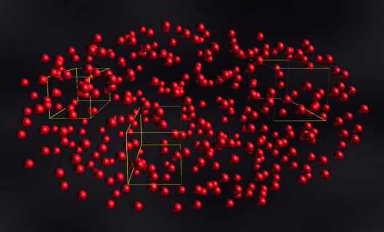
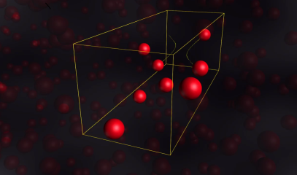
Plans for code utilization
The feedback system is simulated with:
Head-Tail which comes with different options for the SPS: electron cloud, TMCI and advanced impedances model for the SPS.
C-MAD parallel code (M. Pivi et al.): electron cloud instability, Intra-Beam Scattering IBS, and allows to upload the full SPS lattice from MAD for more realistic simulations.

Slide 15
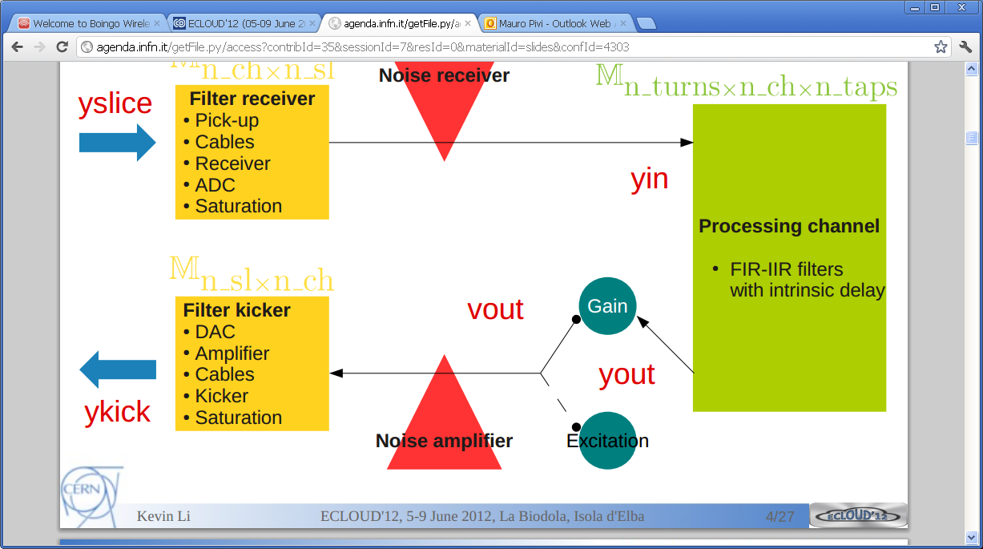
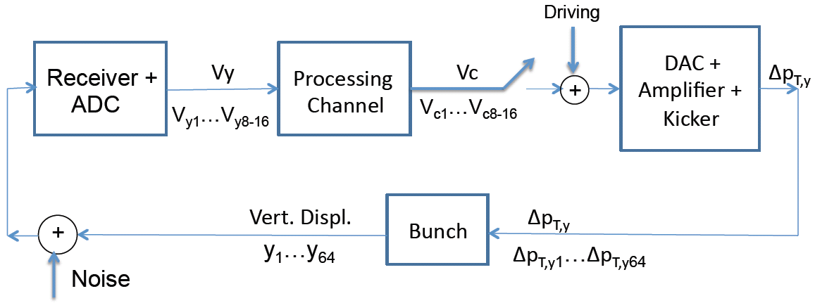
Feedback system design
C. Rivetta

Slide 16
Code development: Feedback Design
Intra-bunch feedback includes:
Main Blocks
  Processing Channel: FIR-IIR filters (diagonal by now)
  Filter receiver – (Pick-up, cable, receiver, ADC)
  Filter kicker – (DAC, Amplifier, Cables, Kicker)
  Includes saturation at the receiver and amplifier
  The system has finite dynamic range and realistic input noise floor
Bunch sampling frequency is an adjustable parameter
Noise-Signal-Perturbation injection:
  Receiver
  Amplifier
Measurement of absolute vertical displacement and dipole motion
7 input files characterize the feedback system
Frequency bandwidth: example 200MHz / 1000Mhz

Slide 17
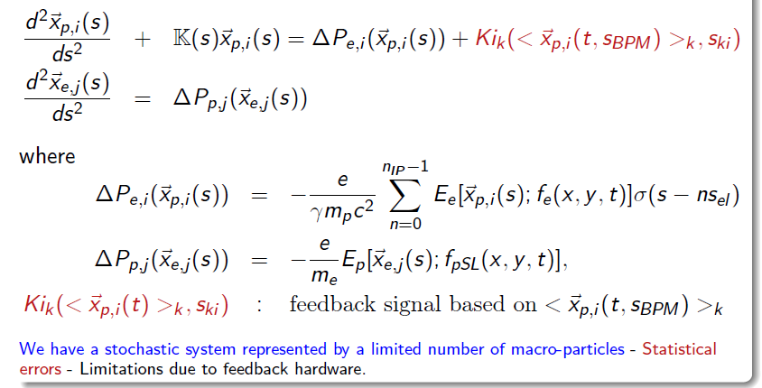
Multi-particle simulation codes
The multi-particle simulation codes solves:

Slide 18
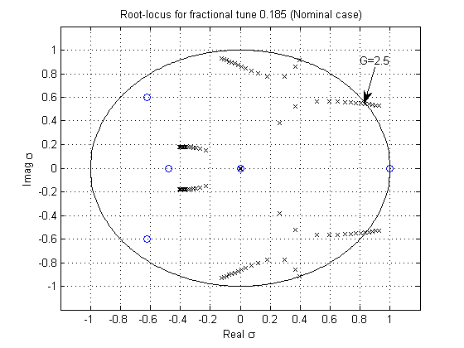
Feedback system reduced model – Root-locus (note: no electron clouds)
The beam is stable within the boundary.
Exceeding the ideal feedback gain may induce the beam unstable.
Eigenvalues for increased gain of the feedback system.

Slide 19
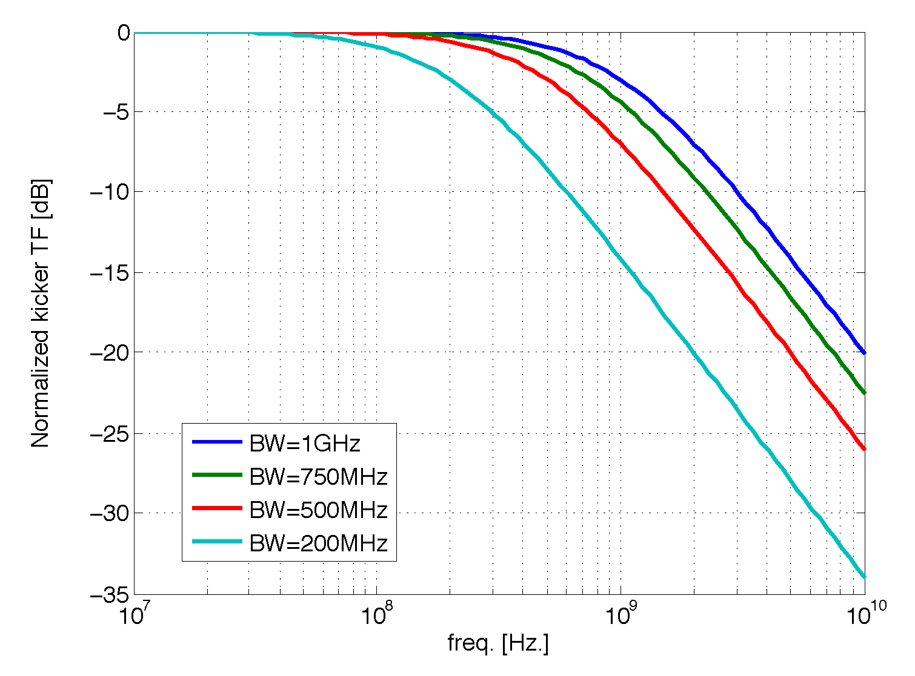
Kicker frequency response
C. Rivetta
Different kicker bandwidths implemented in simulations. Kicker actually in SPS has BW=200MHz.

Slide 20
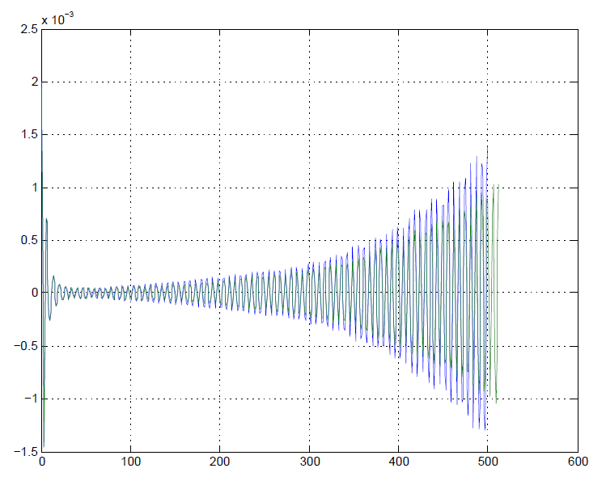
Codes comparison
Codes comparison: feedback in “closed loop”, no cloud, bunch has initial displacement.
BW=200MHz, Head-Tail gain = 8.4e-3 (C-MAD G = 0.75)
Vertical position (m)
turns
Good agreement

Slide 21
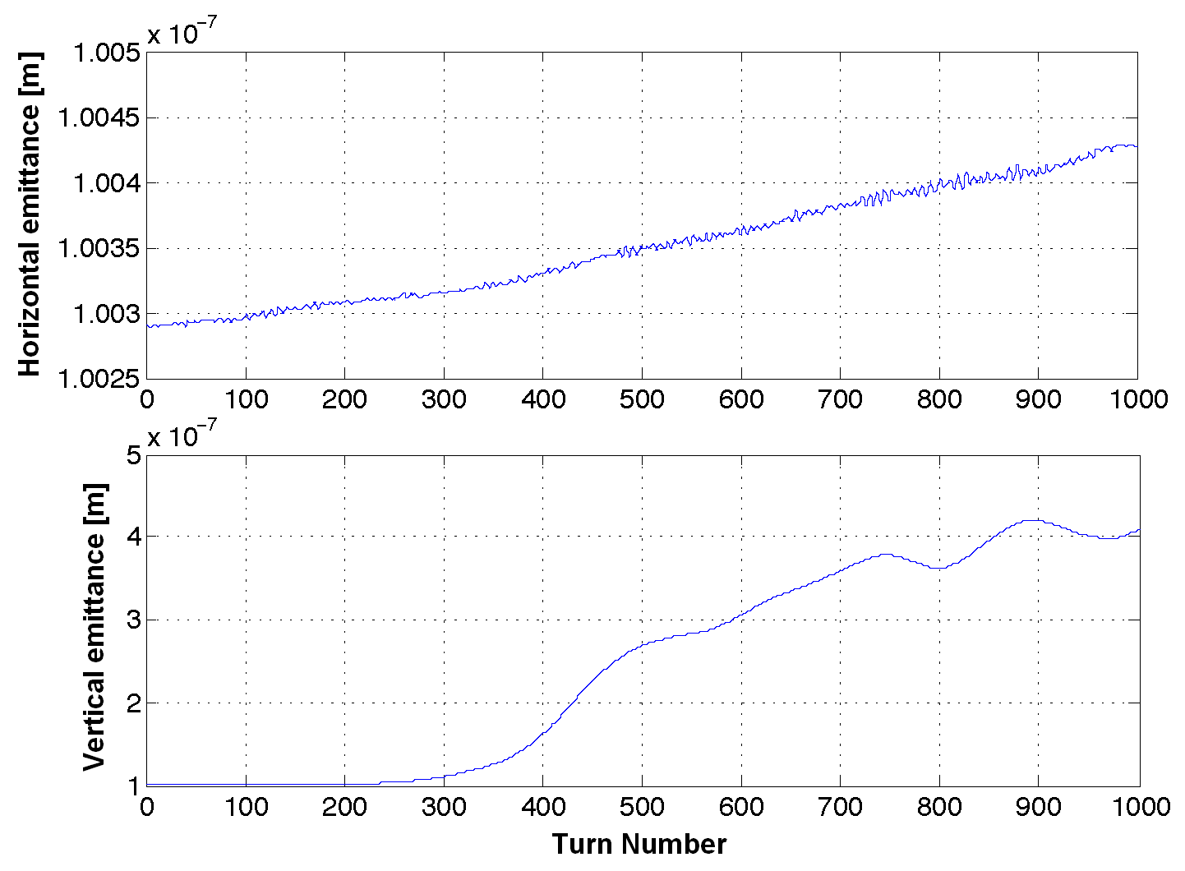
SPS: Feedback OFF
E-cloud density: 5e11e/m³, beam current 1.1e11 ppb.
SPS – single-bunch feedback OFF
Increase in vertical beam emittance a factor 4

Slide 22
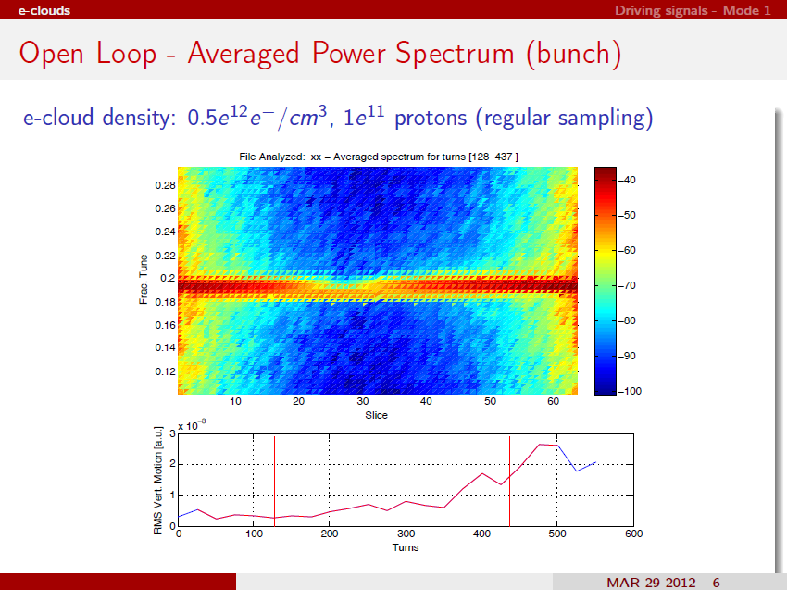
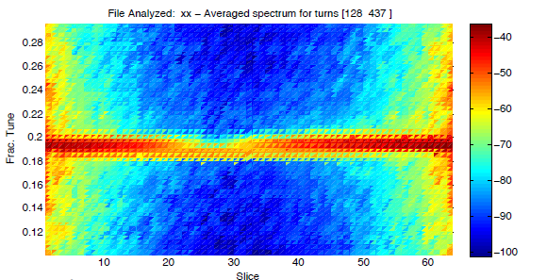
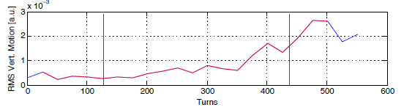

Slide 23
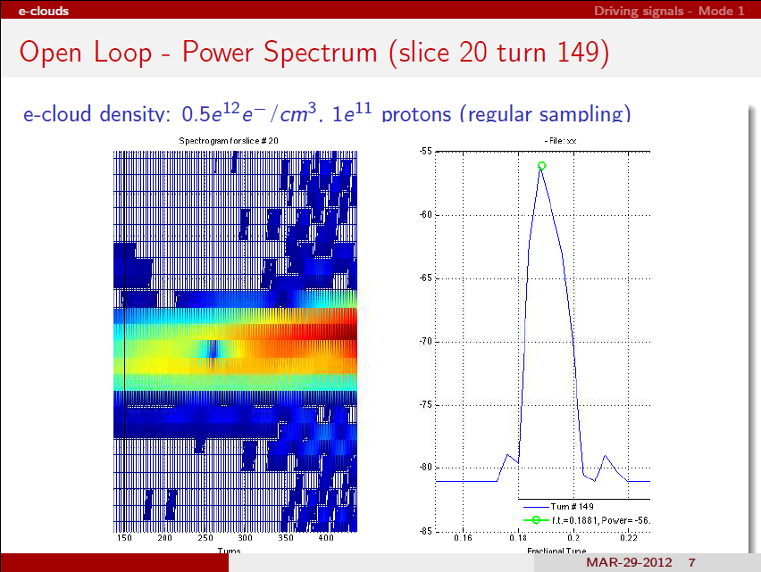
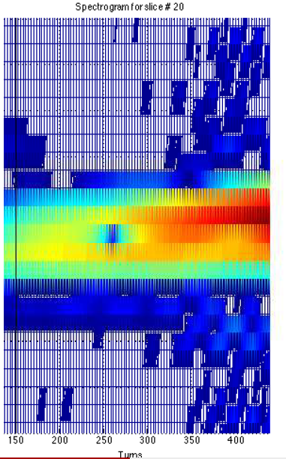
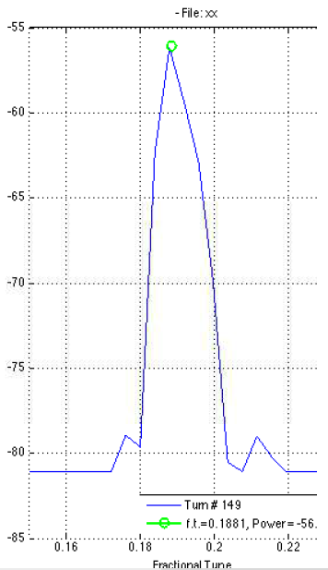

Slide 24

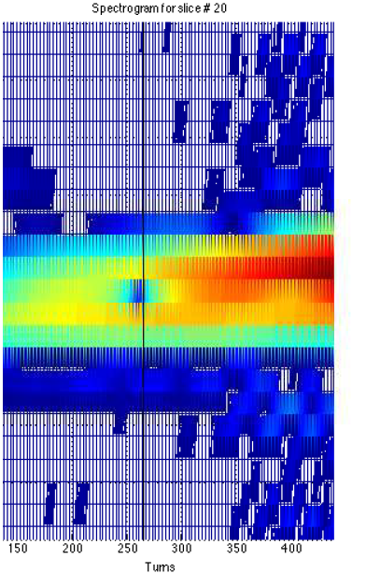
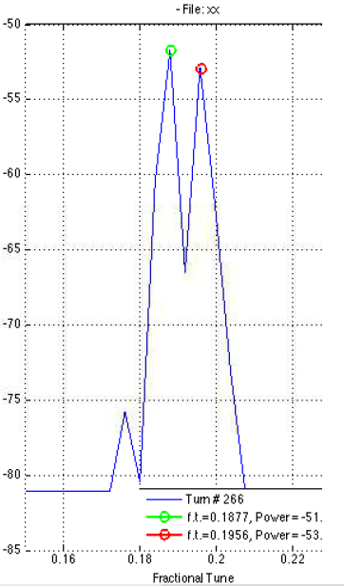

Slide 25

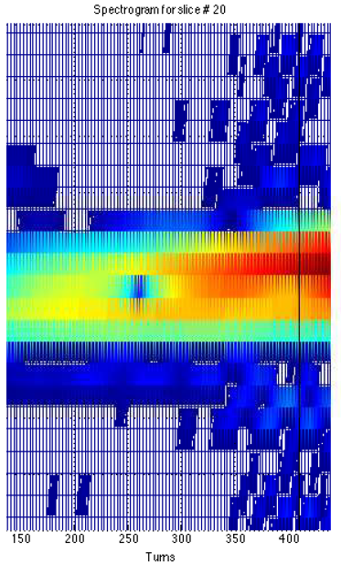
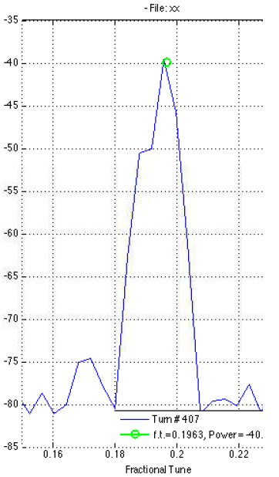

Slide 26
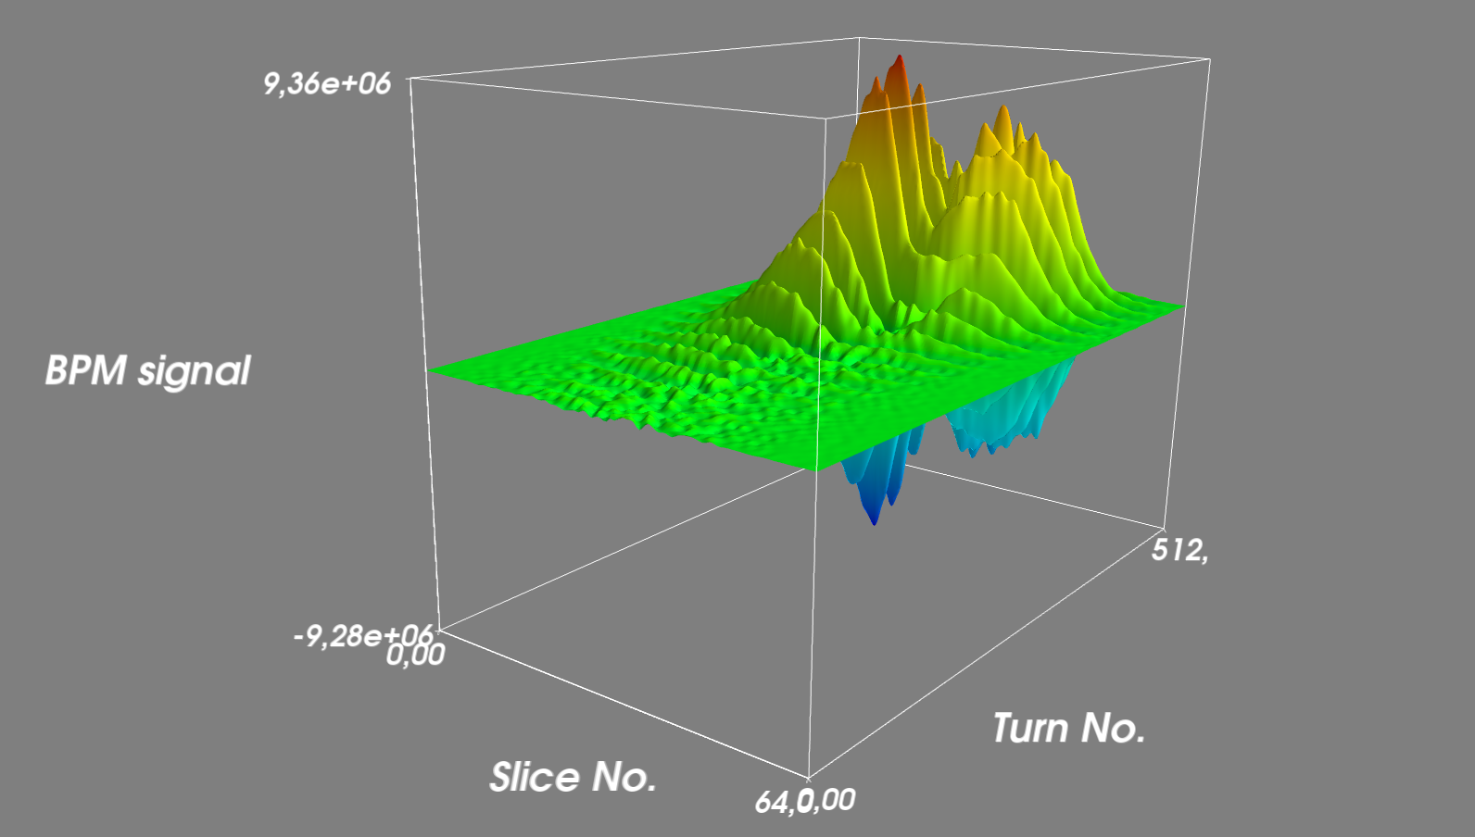
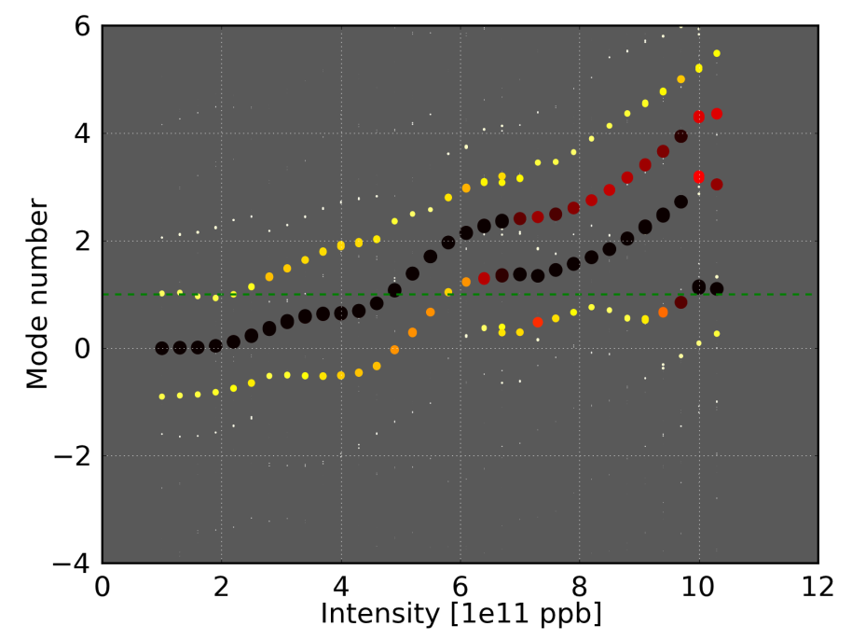
Spectral mode analysis: Feedback OFF
Evolution of vertical position of bunch slices during 512 turns, e-cloud density 6e11 e/m³
Bunch oscillation modes as a function of cloud density

Slide 27
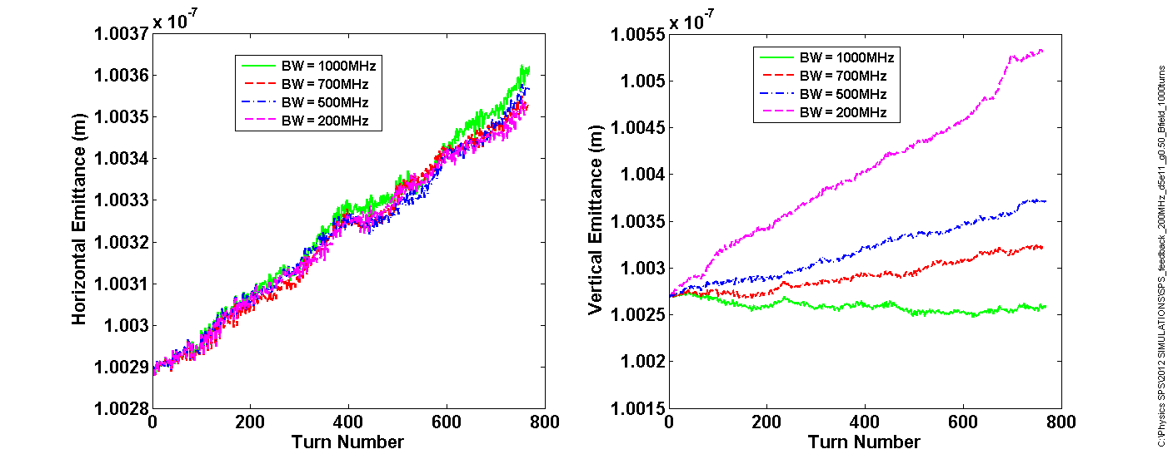
SPS: Feedback ON Preliminary Tests
SPS – feedback in Closed Loop” (ON)
E-cloud density: 0.5e12e/m³, 1.1e11 ppb, feedback fixed gain 0.5, BW=200-1000MHz

Slide 28
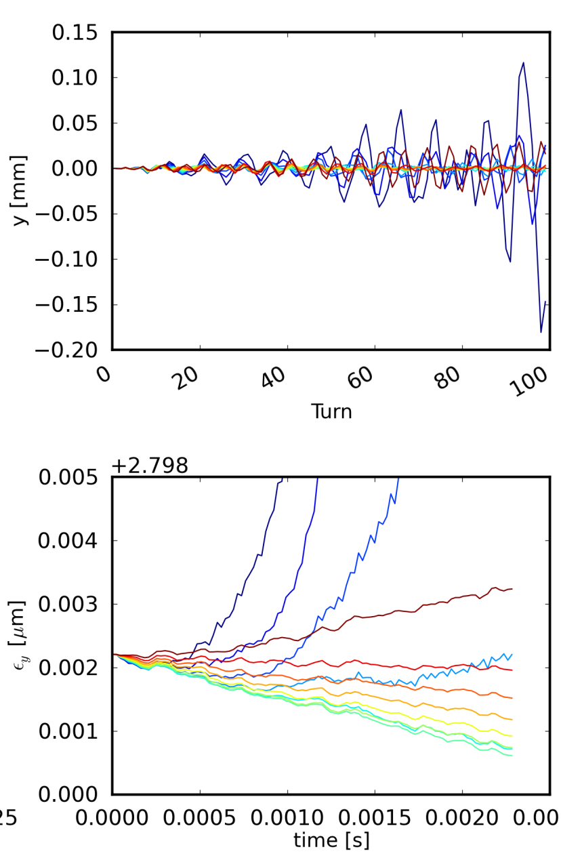
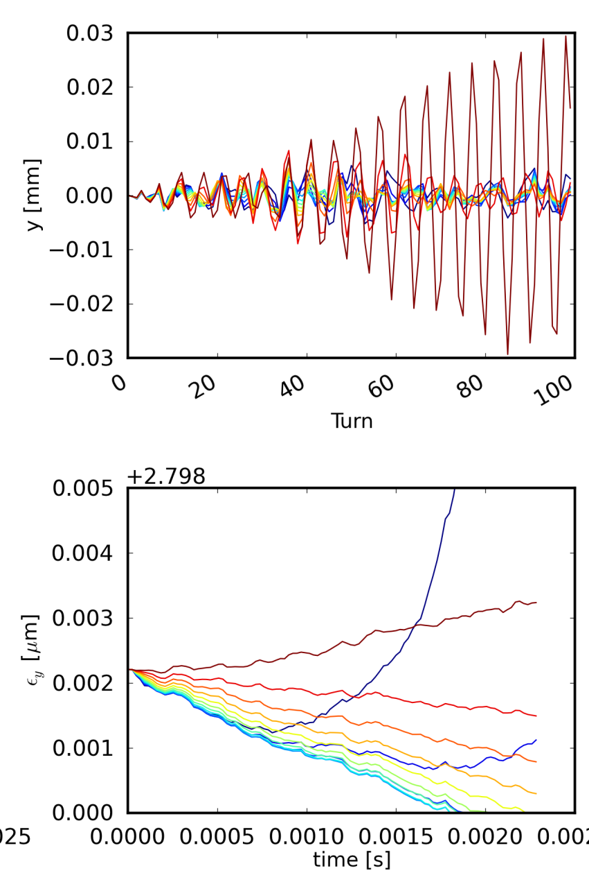

Initial tests
500 MHz
Perturbation:
Electron cloud
1000 MHz
Kevin Li, C. Rivetta, M. Pivi

Slide 29
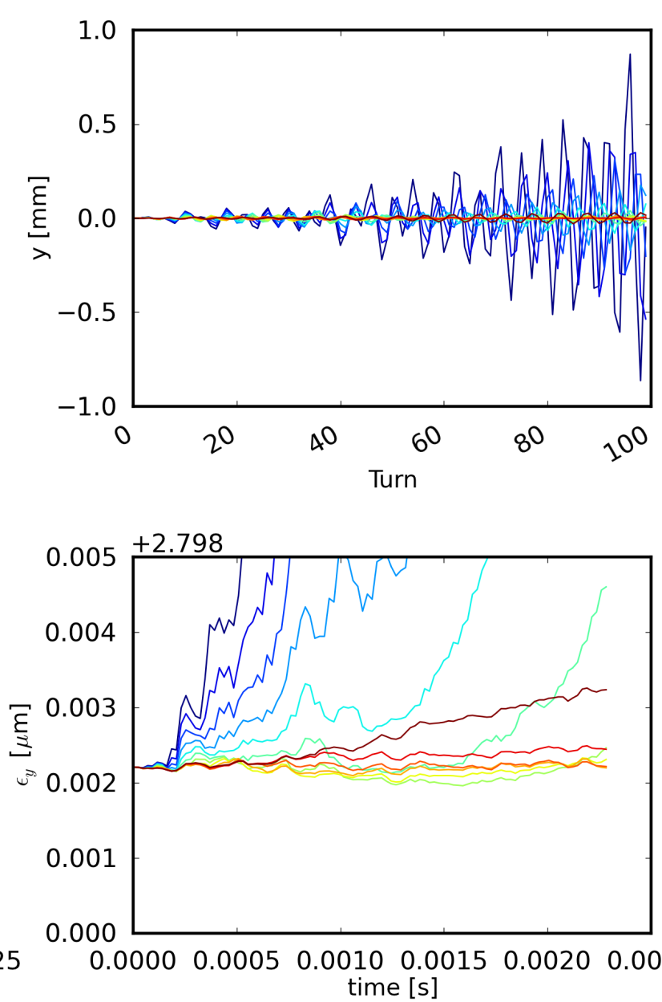
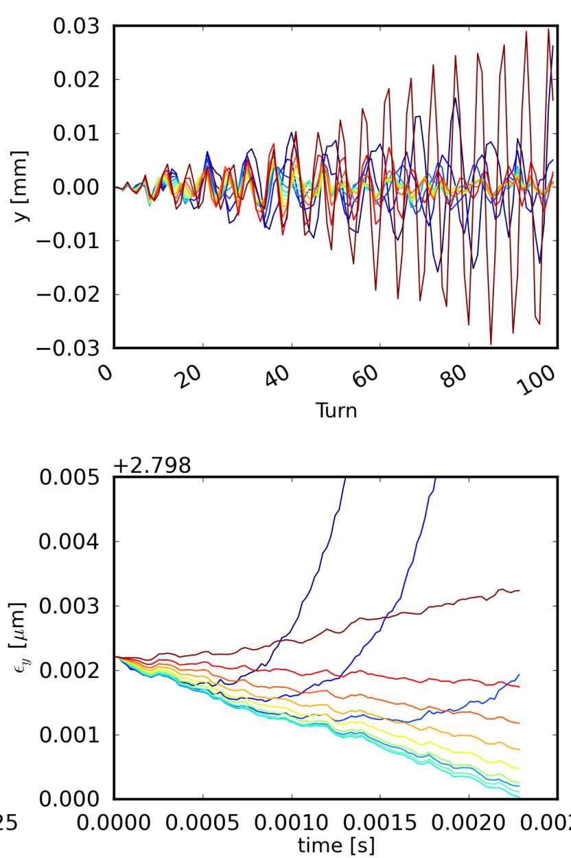
Initial tests
200 MHz
Perturbation:
Electron cloud
700 MHz
Kevin Li, C. Rivetta, M. Pivi

Slide 30
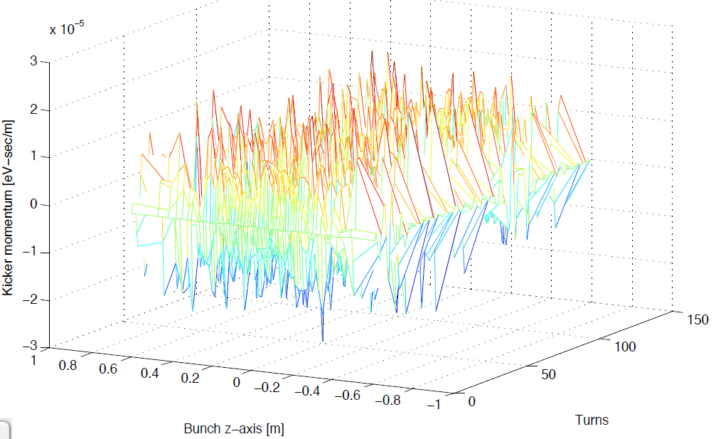
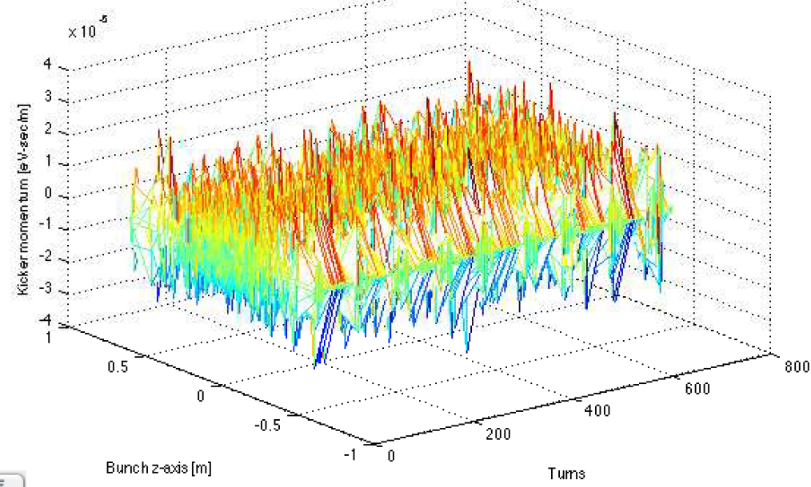
Feedback power required
Kick applied to individual bunch slices by the feedback system
Feedback ON: no electron cloud
Feedback ON: ecloud density 5e11/m3
 10⁻⁵
 10⁻⁵
Same scale: Low feedback power is required to stabilize the beam in the presence of electron cloud
M. Pivi, C. Rivetta, Kevin Li

Slide 31
Report in preparation
The LARP working group will provide CERN with the design report and suggested kicker(s) implementations
CERN will build the feedback system
  resources needed at CERN (with W. Hofle, LIU)

Slide 32
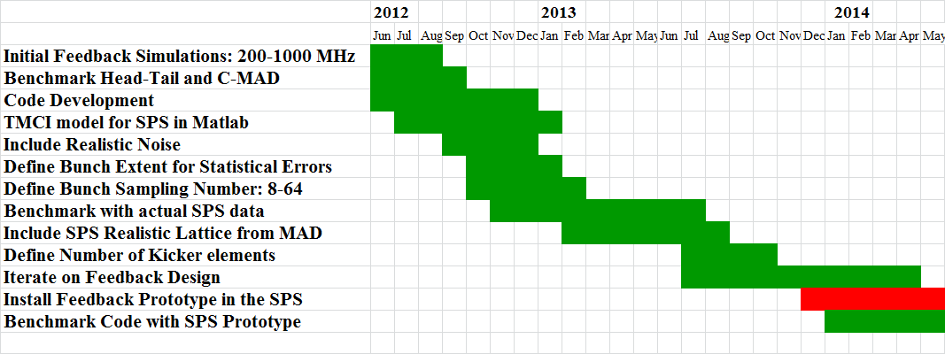
Simulation plan
Mauro Pivi, CERN/SLAC

Slide 33
Simulation plan (continue)
Use Head-Tail: simulate a Damper-like feedback with χ0 for TMCI and electron cloud (see Alexey Burov presentation 13/06/12)
Space charge effect with electron cloud: investigate the observed (Landau) damping effect introduced by space charge

Slide 34
Feedback System Team*
*LARP collaboration: SLAC, LBNL, CERN
Beam excitation and MD tests: Rivetta, Fox, Cesaratto, Hofle, Uemuda, Turgut, Pivi, Wehrle
Simulations: Rivetta, Pivi, Li, Secondo, Vay
  Head-Tail development: Pivi, Li
Kicker design: De Santis, Cesaratto
Feedback design: all

Slide 35
Summary
Beam excitation and measurements in the SPS show intra-bunch motion with modes excited
Development of codes (recently Head-Tail) to include single-bunch feedback system
  very promising initial results from simulations:
  A bandwidth of 500 MHz and low power levels are required to stabilize the beam with electron cloud interactions
Design Report for SPS prototype

Slide 36
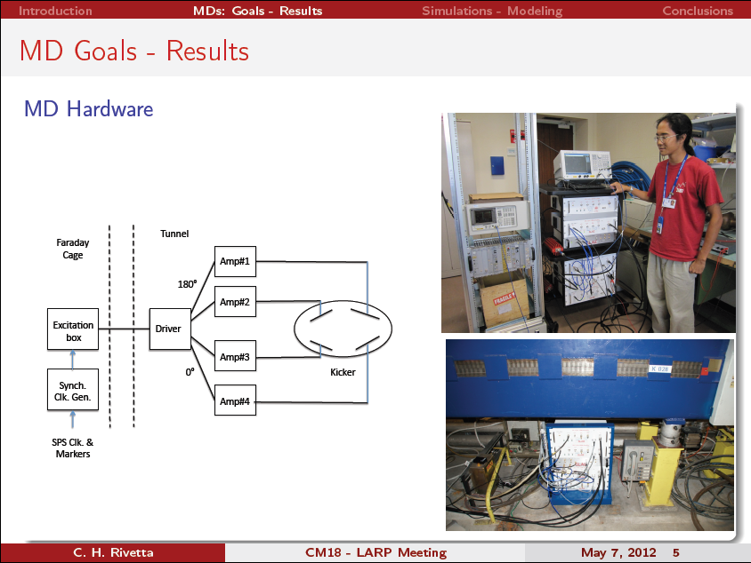

Slide 37
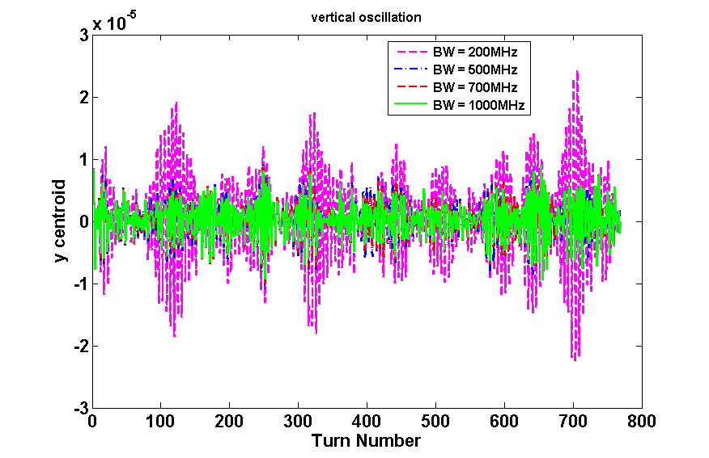
SPS: Feedback ON Preliminary Tests
SPS – feedback in Closed Loop” (ON)
E-cloud density: 0.5e12e/m³, 1.1e11 ppb, feedback fixed gain 0.5, BW=200-1000MHz

Slide 38
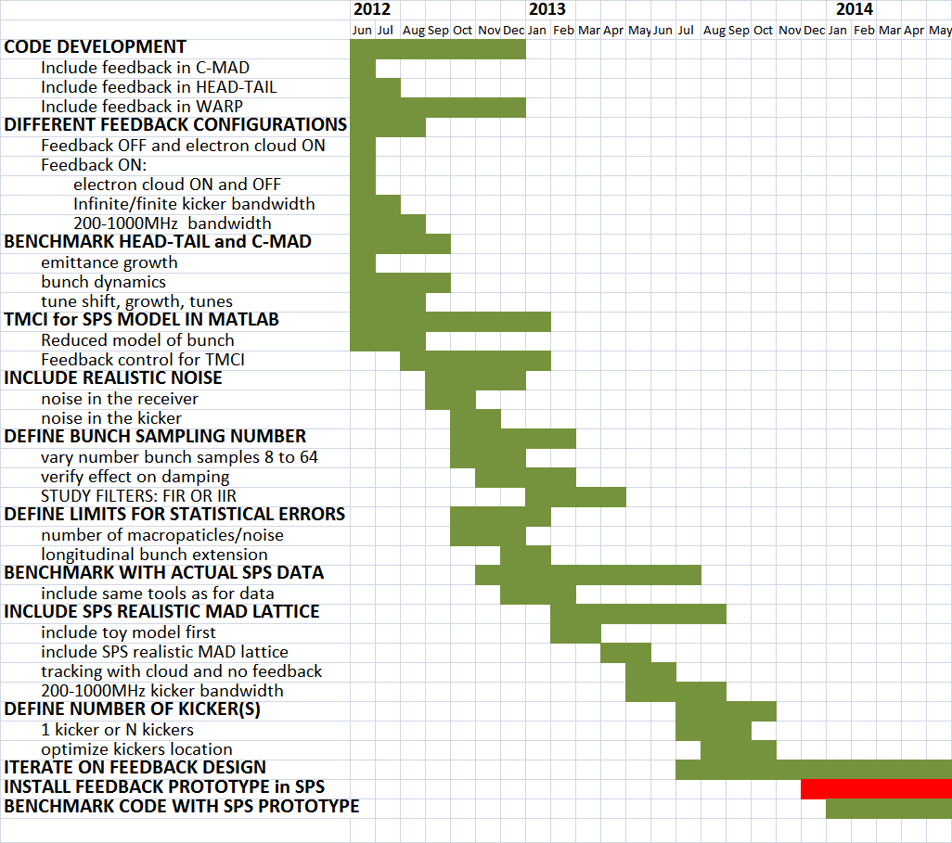
Simulation plan
Mauro Pivi, CERN/SLAC

Slide 39
Simulation plan and feedback design
In particular, important steps are:
  Optimize bunch sampling: vary from 8 to 64 (so far, used ideally 64). Smaller the number of samples, less expensive the feedback.
  Include noise in the receiver/kicker
  Include SPS realistic MAD lattice
  Iterate on feedback design

Slide 40
Kicker available in SPS
Kicker: exponentially tapered pickup and flipped around, with 200MHz response transfer function.
  Tapered for frequency response, smooth the zeroes, but keep 50 Ohms along entire length!
See paper by Linnecar

