Slide 1
PS (electron cloud?!) instability at flat top
Mauro Pivi
Gianni Iadarola, Giovanni Rumolo, Simone Gilardoni, Hannes Bartosik, Sandra Aumon
27/06/2012
ICE meeting, CERN

Slide 2
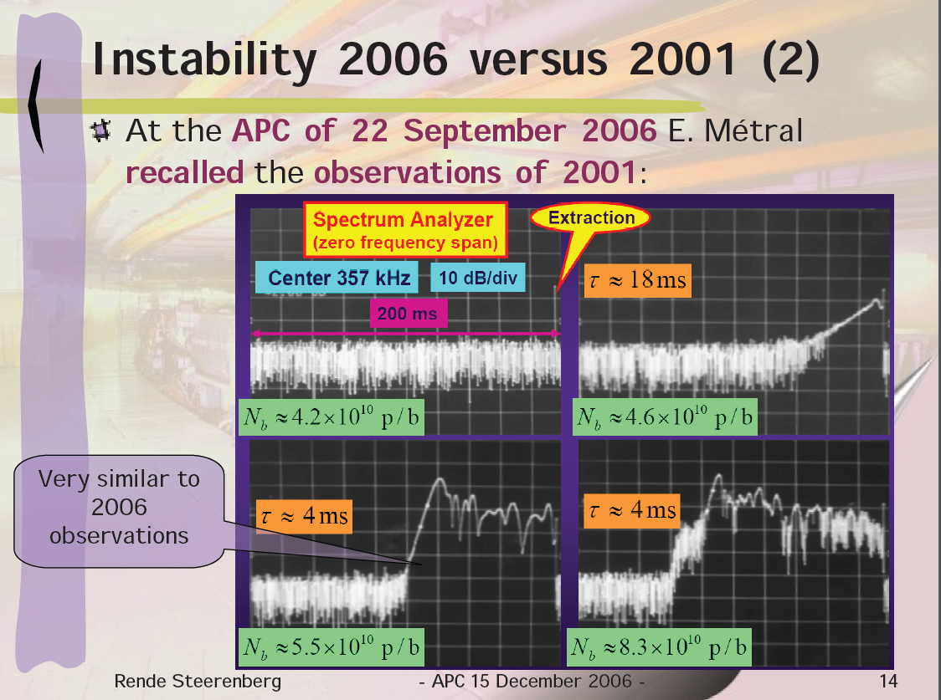
Previous Work
[1] R. Cappi, M. Giovannozzi, E. Metral, G. Metral, G. Rumolo, and F. Zimmermann, PRST AB Volume 5, 094401 (2002)
[2] Rende Steerenberg et al. APC – Meeting December (2006)
https://ab-div.web.cern.ch/ab-div/Meetings/APC/2006/apc061215/RS-APC-15-12-2006.pdf

Slide 3

LHC beam, 25 ns bunch spacing
LHC beam, 25 ns bunch spacing, 1.15 e11 ppb
Removed last part of compression before extraction from PS:
  40 MHz cavity maxed up at 100kV (adiabatic compression)
  80 MHz cavity turned OFF
  11-14ns long bunch
Added 35ms to obtain long flat top

Slide 4
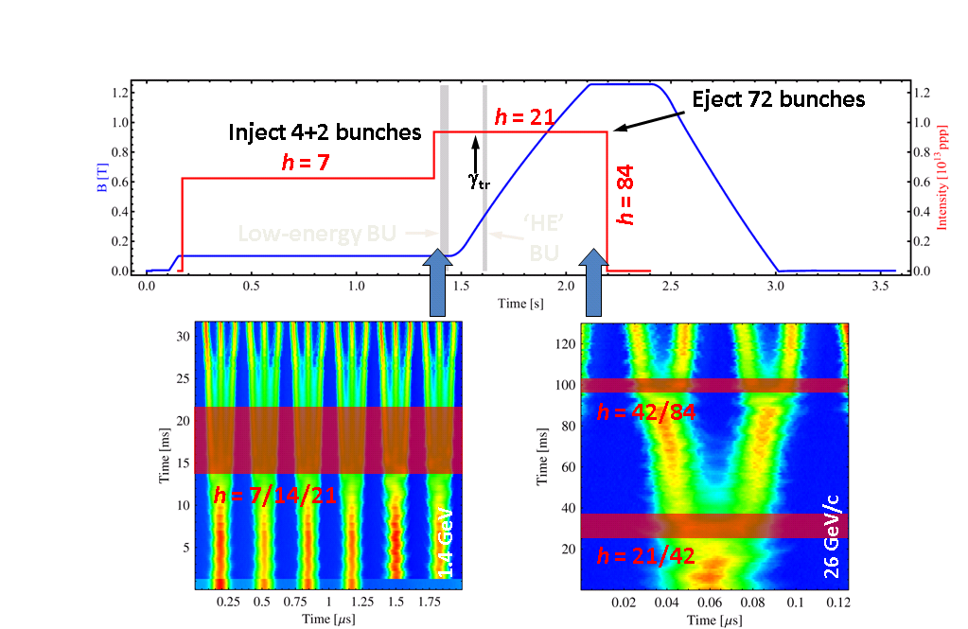
Nominal RF cycle
http://op-webtools.web.cern.ch/op-webtools/dokuwiki/doku.php?id=cps:lhc25:lhc25

Slide 5
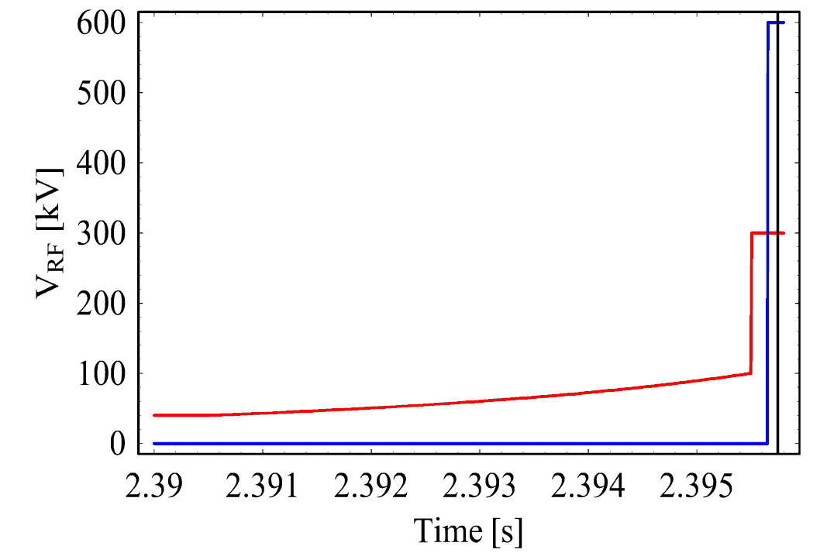
Nominal RF cycle
What happens before the extraction of LHC beam from the PS?
80 MHz (h= 168)
4 ns
4σ = 14 ns
11 ns
40 MHz (h= 84)
Extraction
Bunch splittings
Adiabatic shortening
Bunch rotation
…and lots of other things: Extraction bump, synchronization, etc.
Heiko Damerau

Slide 6
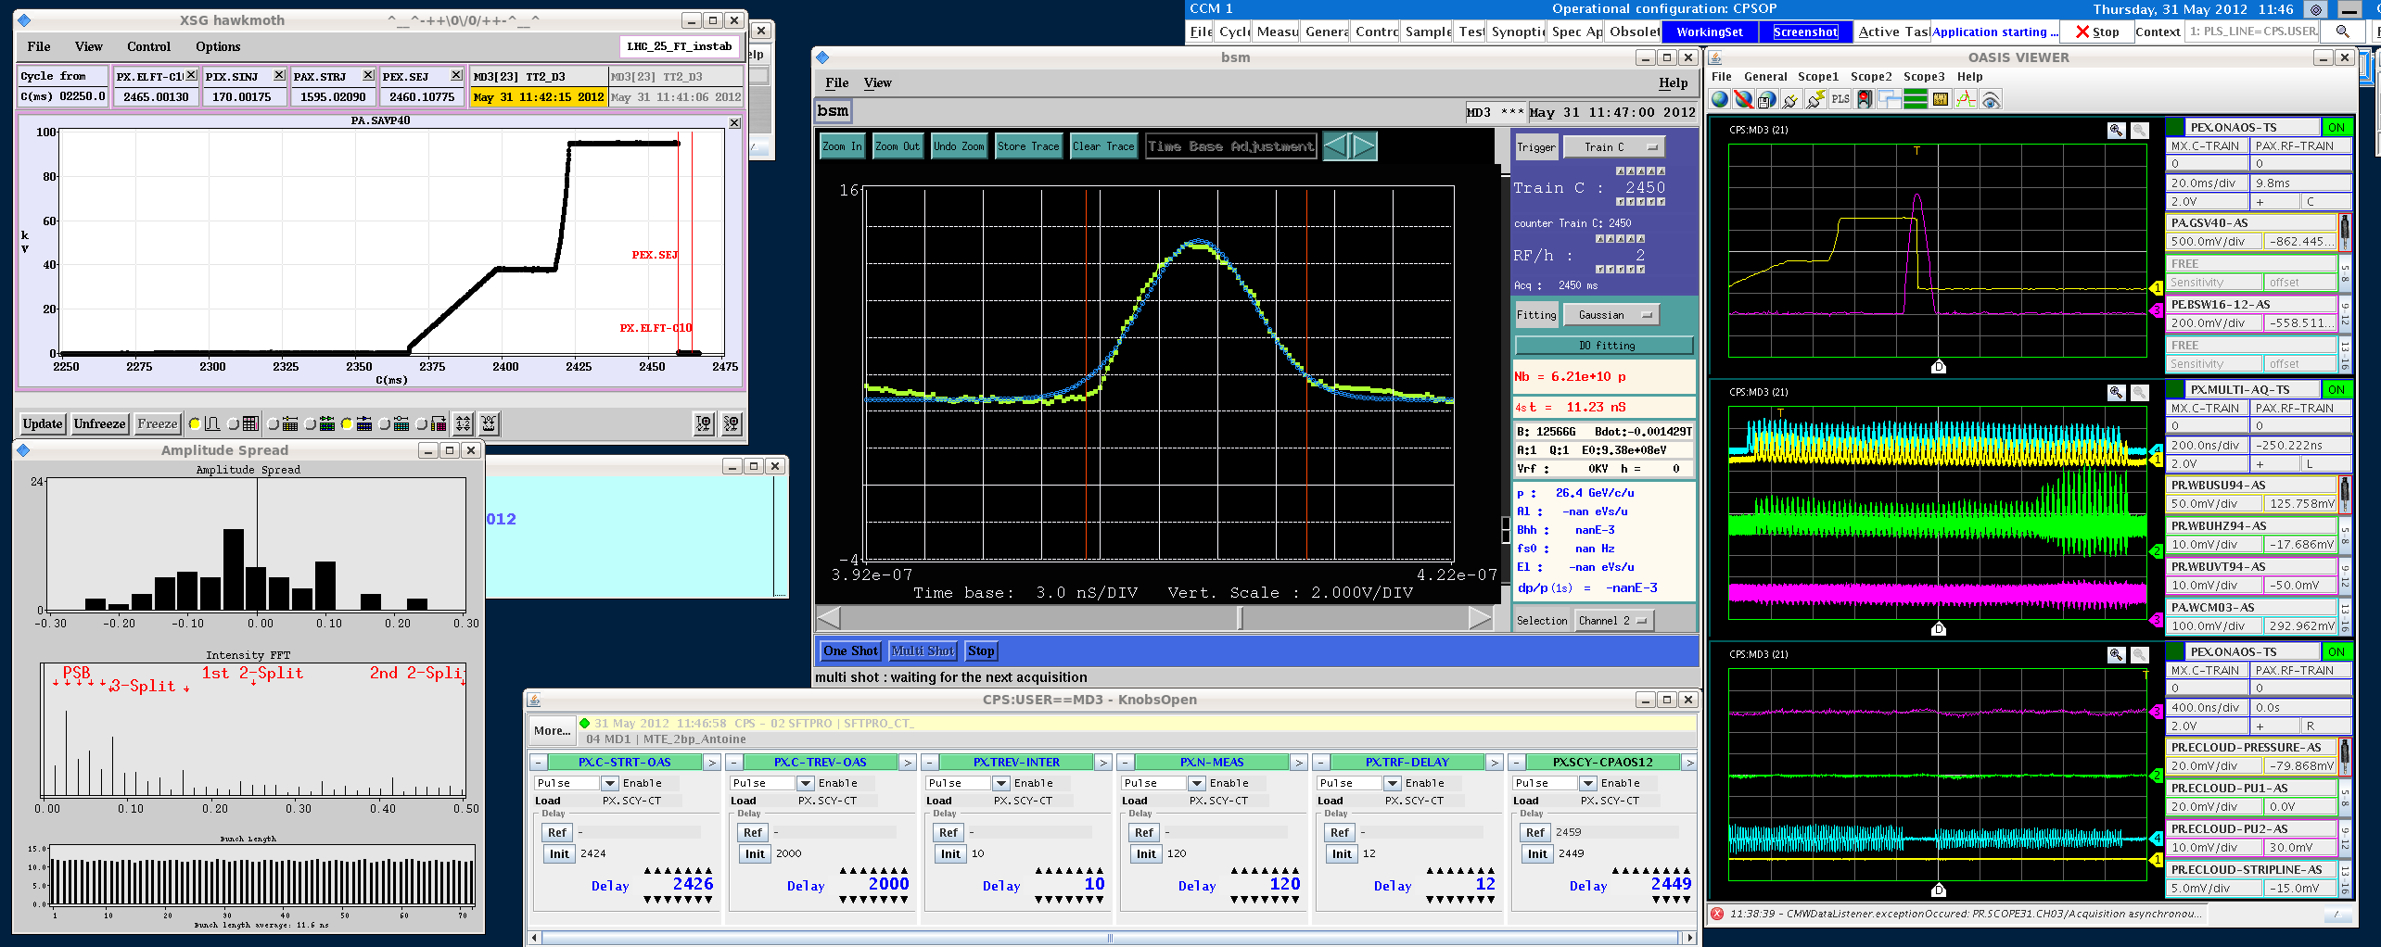
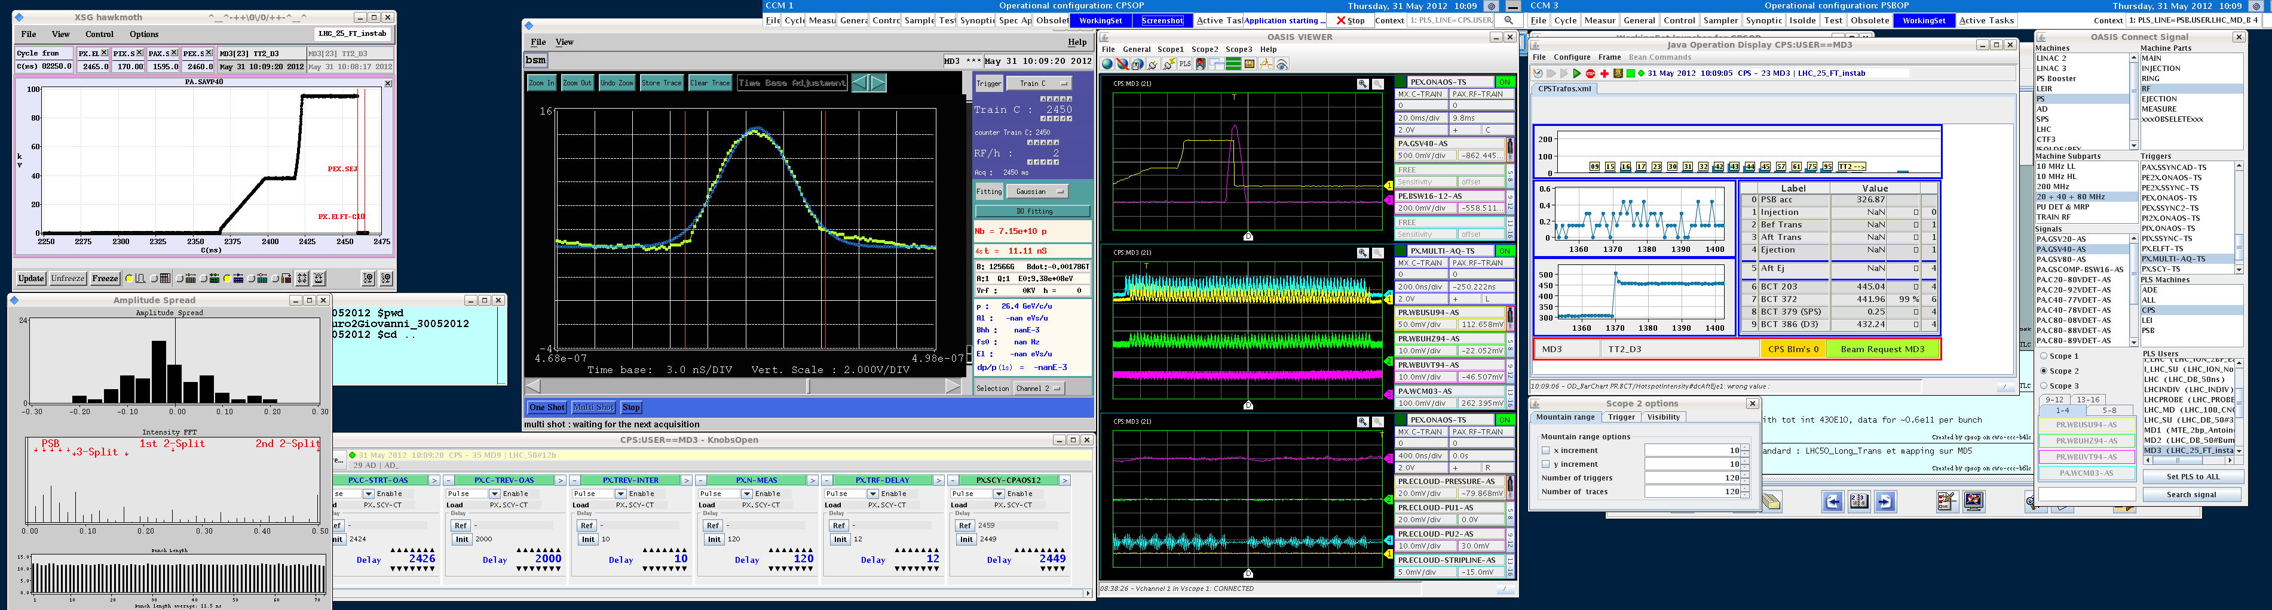
RF cycle – 40 MHz cavity ramp and added flat top
-- RF 40 MHz cavity
-- extraction bump
RF cavity 40 MHz: measured RF Voltage ramp

Slide 7
Measured beam at 4 different times on flat top
2419 ms
2426 ms
2436 ms
2446 ms
LHC 25 ns
RF ramp END at 2419 ms
RF ramp to 100kV
RF cavity 40 MHz: measured RF Voltage ramp

Slide 8
Instability measurements at longer flat top – Preview
 | 2419 ms | 2426 ms | 2436 ms | 2446 ms
1.15 x 10¹¹ ppb | UNSTABLE | UNSTABLE | UNSTABLE | UNSTABLE
0.6 x 10¹¹ ppb | slightly unstable | UNSTABLE | UNSTABLE | UNSTABLE

Slide 9
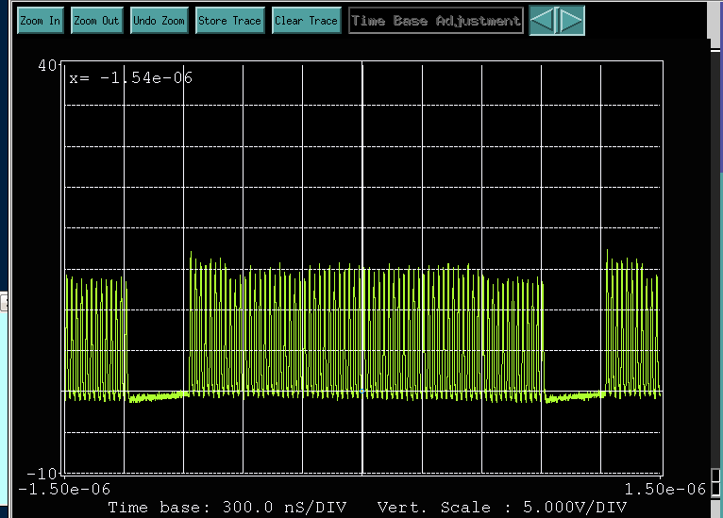
Beam fill

Slide 10
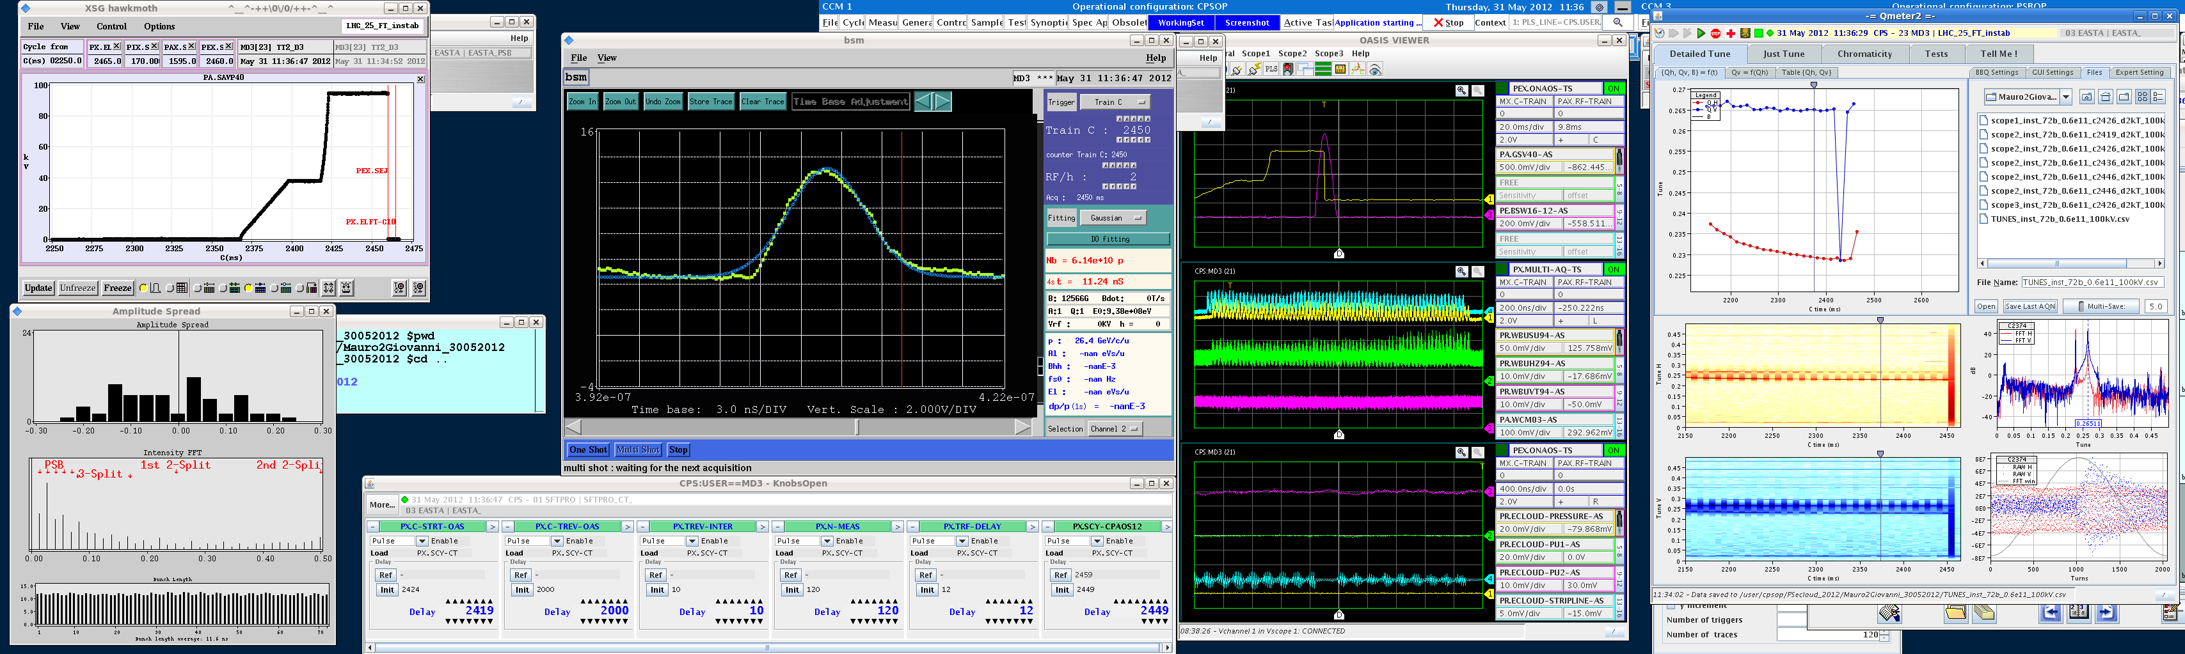
Measurement at end of RF ramp – low bam intensity
Beam pick-up signals
-- Wall current monitor
-- Sum
-- Horizontal
-- Vertical
- 0.6e11 ppb
- 2419 ms, RF ramp End
Horizontal plane slightly unstable near end of train
This measurement taken at this time
2419 ms
Electron cloud signals:
-- e- cloud pickup 1
-- e- cloud pickup 1
-- e- cloud strip-line
-- pressure
RF ramp

Slide 11
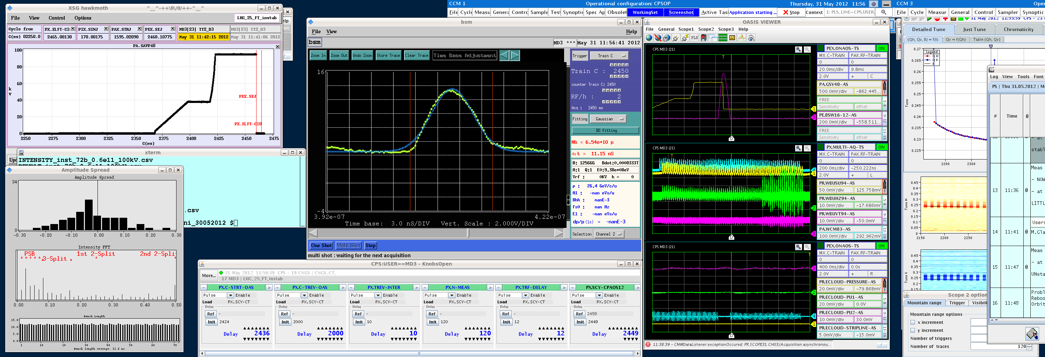
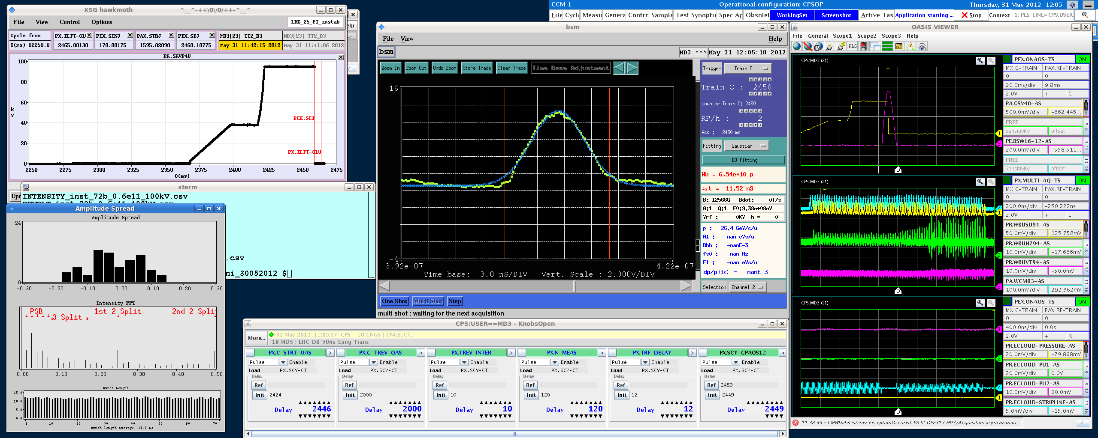
Measurement along flat top – Low beam intensity
Legend Beam Pick-up Signals:
-- Horizontal
-- Vertical
-- Sum
-- Wall current monitor
Bunch intensity = 0.6e11 ppb
bunch length = 11.5 ns
2419 ms
2426 ms
2436 ms
2446 ms
RF ramp
Legend Electron cloud pick-ups
-- e- cloud pickup 1
-- e- cloud pickup 1
-- e- cloud strip-line
-- pressure
Note: electron cloud is under the radar …

Slide 12
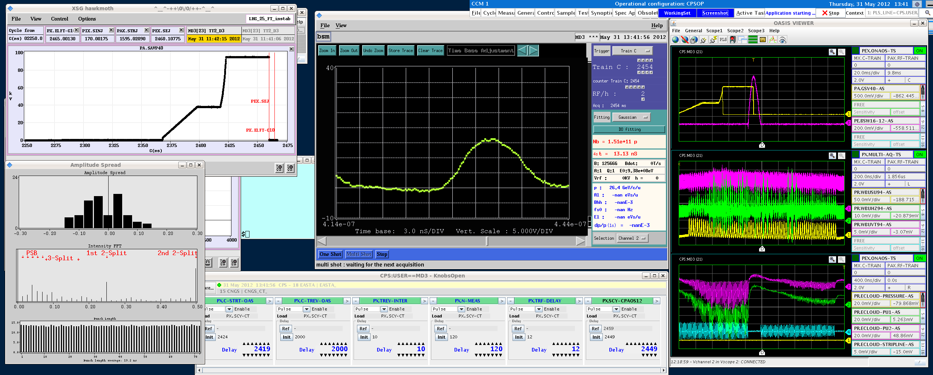
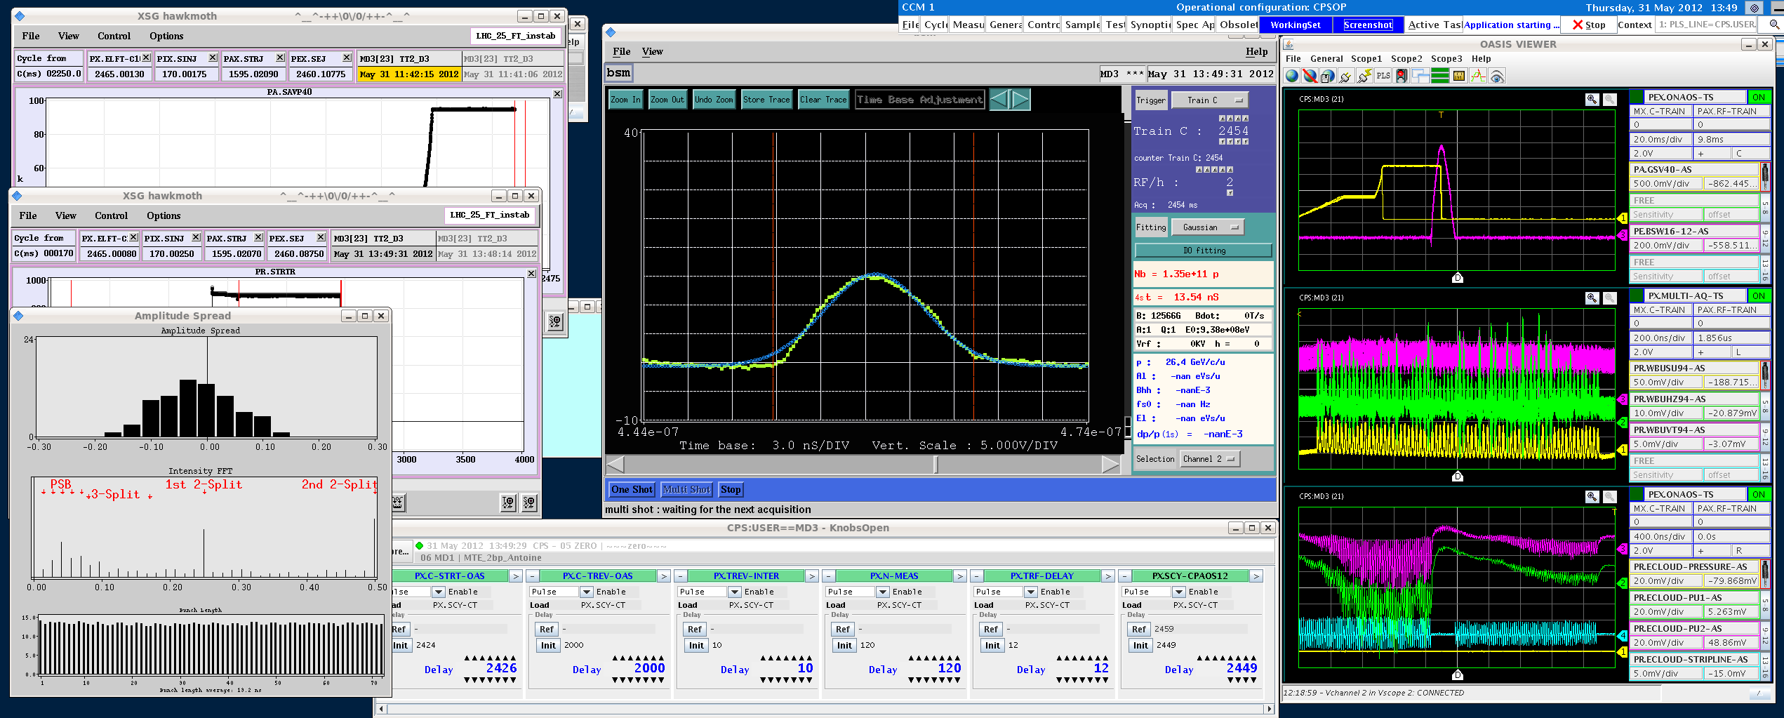
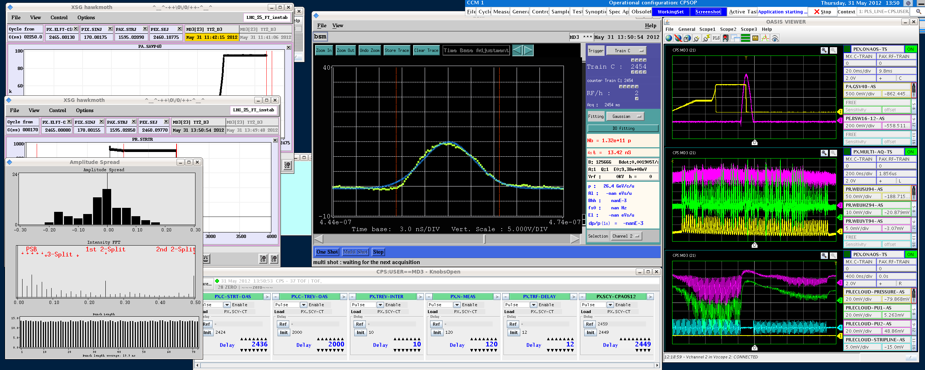

Measurement along flat top – Nominal beam intensity
-- Sum
-- Horizontal
-- Vertical
-- Wall current monitor
Bunch intensity = 1.15e11 ppb
bunch length = 13.5 ns
2419 ms
2426 ms
2436 ms
2446 ms
RF ramp
-- e- cloud pickup 1
-- e- cloud pickup 1
-- e- cloud strip-line
-- pressure
electron cloud signal

Slide 13
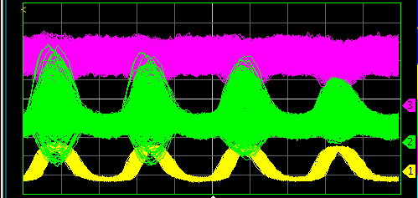
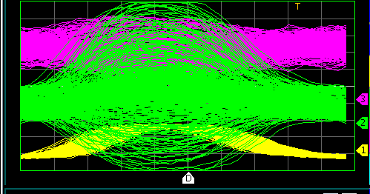
Measurement along flat top – nominal beam intensity: Closer look
Bunch intensity = 1.15e11 ppb
bunch length = 13.5 ns
at 2419 ms
2419 ms
Pick-up Signals:
-- Horizontal
-- Vertical
-- Sum
- Wall current monitor
This measurement taken at:
RF ramp

Slide 14
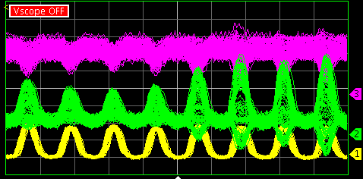
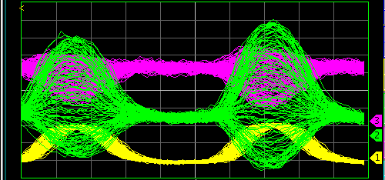
Measurement along flat top – nominal beam intensity: Closer look
Bunch intensity = 1.15e11 ppb
bunch length = 13.5 ns
at 2446 ms
2446 ms
Pick-up Signals:
-- Horizontal
-- Vertical
-- Sum
- Wall current monitor
This measurement taken at:
RF ramp

Slide 15
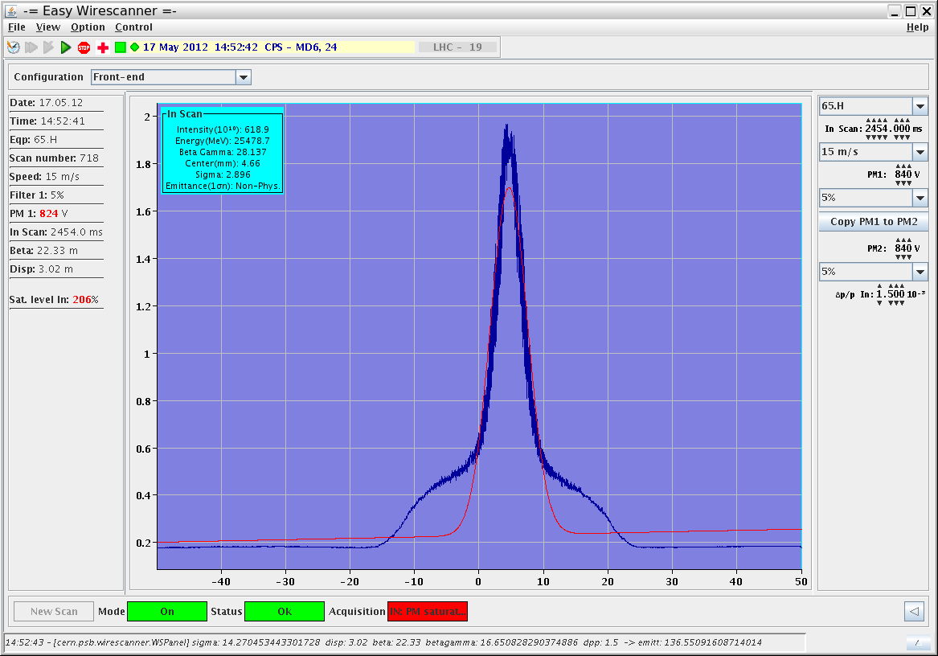
Transverse beam profile
Bunch intensity = 1.15e11 ppb
LHC beam, 25 ns bunch spacing
Horizontal (mm)
Beam profile in the presence of instability at flat top

Slide 16
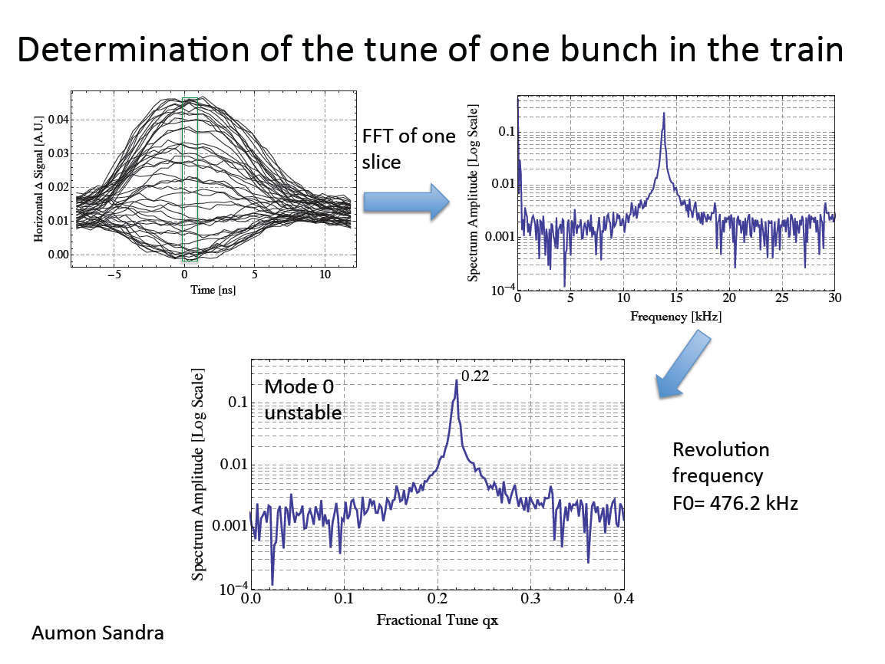

Slide 17
Instability measurements at longer flat top – Summary so far
 | 2419 ms | 2426 ms | 2436 ms | 2446 ms
1.6e11
1.15e11 | UNSTABLE | UNSTABLE | UNSTABLE | UNSTABLE
0.8e11
0.6e11 | slightly unstable | UNSTABLE | UNSTABLE | UNSTABLE

Slide 18
Following MD
In a subsequent MD, the beam was more stable:
at 2421 ms -> stable (on 10 cycles )
at 2426 ms -> threshold (11 stable/6 unstable)
at 2431 ms -> unstable (1 stable 9 un-stable)
As observed in 2006, the beam is not always stable/un-stable

Slide 19
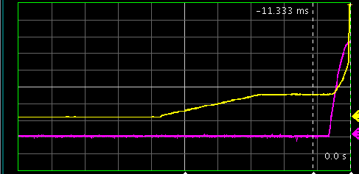
Re-established nominal RF cycle - measuring just before extraction
2455 ms
Bunch intensity = 1.15e11 ppb
bunch length = 13.5 ns
-- RF 40 MHz cavity
-- extraction bump
RF cavity 40 MHz: measured RF Voltage ramp

Slide 20
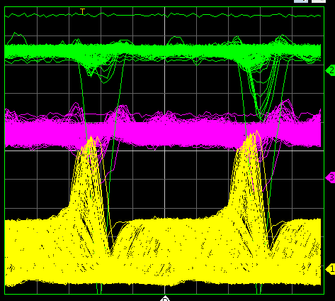
Re-established nominal RF cycle - measuring just before extraction
Bunch intensity = 1.15e11 ppb
bunch length = 13.5 ns
Beam Pick-up Signals:
-- Horizontal
-- Vertical
-- Sum
- Wall current monitor
just before extraction, 500 turns acquisition

Slide 21
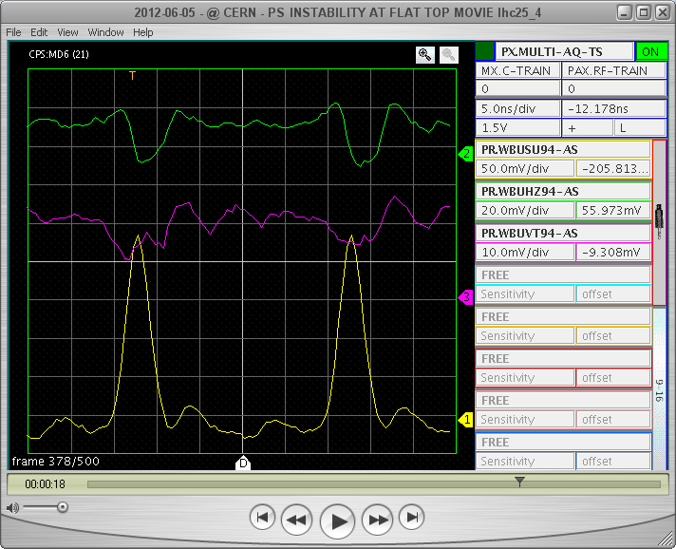
Re-established nominal RF cycle - measuring just before extraction
Bunch intensity = 1.15e11 ppb
bunch length = 13.5 ns
Horizontal displacement due to extraction bump?
Beam Pick-up Signals:
-- Horizontal
-- Vertical
-- Sum
- Wall current monitor
just before extraction: bunch undergoes compression

Slide 22
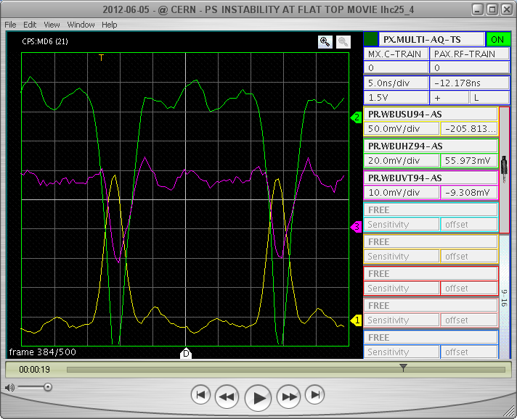
Re-established nominal RF cycle - measuring just before extraction
Bunch intensity = 1.15e11 ppb
bunch length = 13.5 ns
Only displacement?
and why also in vertical?
Beam Pick-up Signals:
-- Horizontal
-- Vertical
-- Sum
- Wall current monitor
just before extraction: bunch undergoes compression

Slide 23

Re-established nominal RF cycle - measuring just before extraction
Bunch intensity = 1.15e11 ppb
bunch length = 13.5 ns
Pick-up Signals:
-- Horizontal
-- Vertical
-- Sum
- Wall current monitor
Beam extracted

Slide 24
Future Plan
With a long flat top:
Next MD on Friday: Check with 50 ns bunch spacing and increase bunch population up to 2e11 ppb
Scan chromaticity and intensity
Measure tune shift as a function of bunch position in the train (positive tune shift → electron cloud sign)
Nominal RF cycle
More measurements to verify if there is an instability at all before extraction
Need tools to analyse data

Slide 25
Medium- and Long-Term Plan
Estimate SEY in PS test chamber by PyEcloud
Use the WARP (Berkeley LBNL) code in coupled-bunch mode and Head-Tail to:
  Understand if it is an Electron cloud driven instability
  Disentangle between coupled- or single-bunch instability
If the PS suffers of an electron cloud instability, plan for countermeasures:
  Feedback system
  Coating of the PS

Slide 26
Summary
Measured transverse instability at flat top, LHC nominal beam and 25 ns bunch spacing
Goal is to:
  Understand if it is an Electron cloud instability
  Estimate SEY in PS test chamber by using PyEcloud
  disentangle between coupled- or single-bunch instability also by using WARP (LBNL) code
With the nominal RF cycle more work is needed to understand if there is effectively an instability

Slide 27
Data in directory: G:\Departments\BE\Projects\PSUpgrade\MDs\PSecloud_2012
http://elogbook.cern.ch/eLogbook/eLogbook.jsp?shiftId=1044558

