Slide 1

MD Report June 19 – 25
Machine coordinators: Barbara Holzer, Mike Lamont
MD Coordinators: Ralph Assmann, Giulia Papotti, Frank Zimmermann
Fast overview → more detailed
discussion in LMC this Wed.
High beta optics → in LPC by Joerg

Slide 2
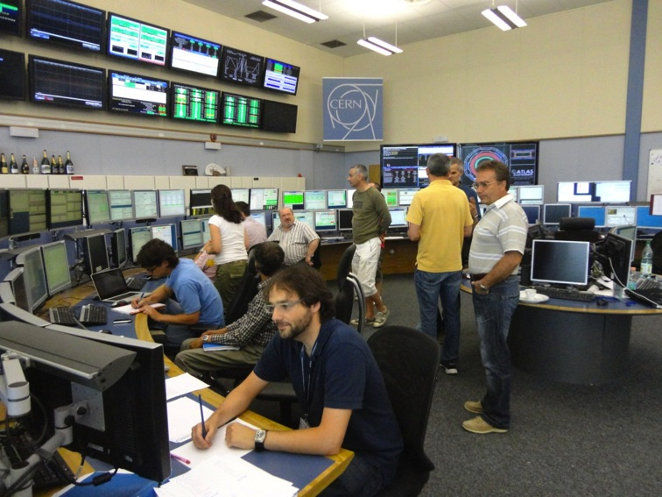
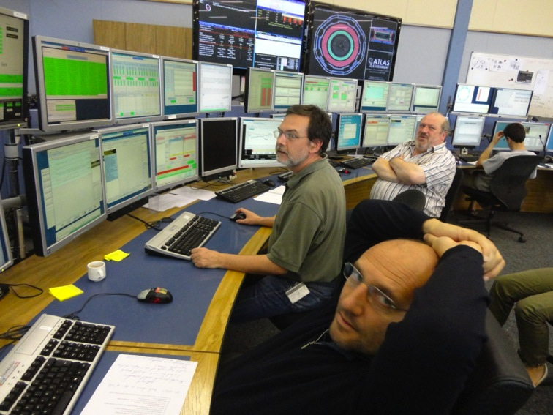
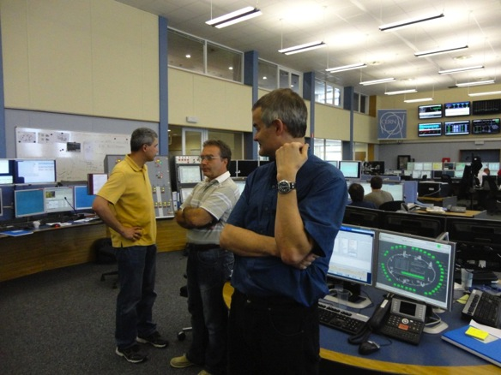
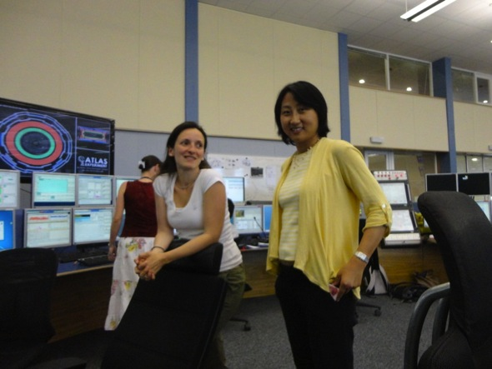
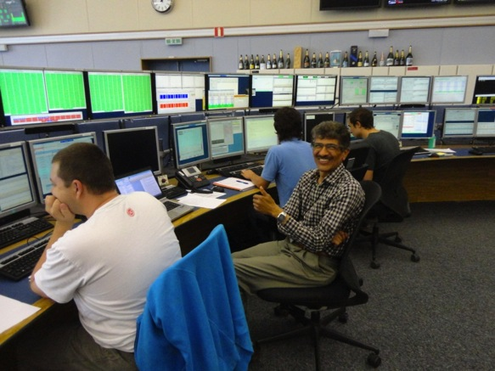
Start of 2012 LHC MD block #2

Slide 3
Highlights I
Excellent availability for MD’s + excellent preparation by all the MD teams → very productive period on 14 topics
Highlight achievements:
  Dependence of chromaticity on octupole strength measured
  Important data on beam stability for different chromaticity, different octupole strengths, different transverse damper gains, different collimation settings
  → with a single (50 ns) beam, with ~ 1.5E11 p/b, beam seems to be deeply inside the stable area in terms of octupoles' current, chromaticity and ADT gain
  → can run with very low octupoles for positive chromaticity
  → LHC impedance not higher than expected…
  Measurement of collimator-induced impedance → tune shift seems as expected.
  Established feasibility of nominal collimation settings for 7 TeV.

Slide 4
Highlights II
Highlight achievements continued:
  Fast losses at collimators with ADT blow-up and asymmetric collimator settings recorded at 450 GeV and 4 TeV.
  Injected and stored bunches of 3e11 p and emittance of 2 μm with Q20 optics.
  Setup of RF cavity phase modulation for 25 ns → RF limit on total beam intensity removed: can go beyond nominal
  Measurement of long-range beam-beam effects for 50ns and two different bunch charges (1.7e11 and 1.1e11) → losses at ~half crossing angle.
  Large Piwinski Angle test.
  Successful test of luminosity leveling with beta*
  Re-commissioned 90m optics (in physics time)
  Established high beta optics with beta* of 500 m (corrected)
  and 1 km in IR1 and IR5.

Slide 5
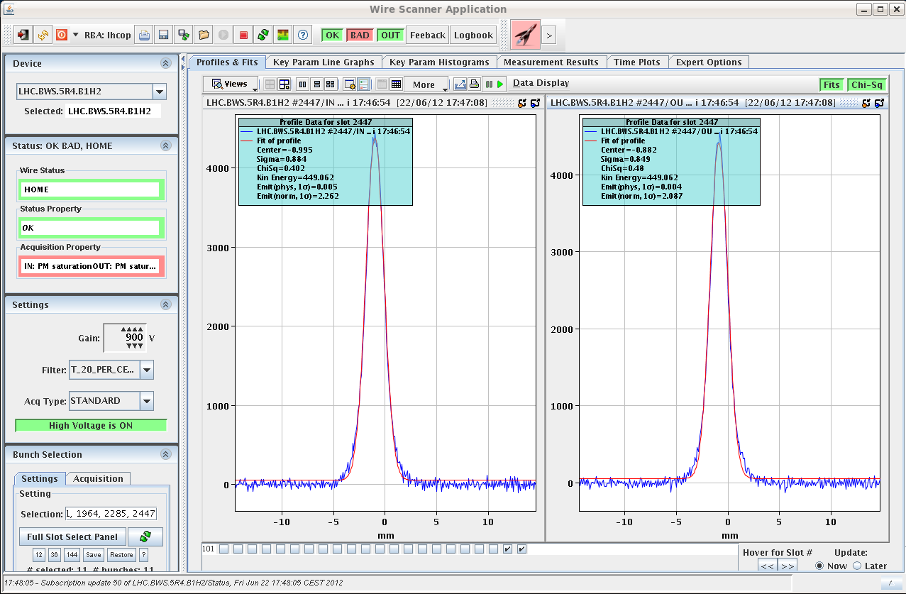
Q20: Emittances of 3e+11 bunch in the LHC
C. Bracco, V. Kain, L. Norderhaug Drosdal, et al
ε~2 μm (both planes)

Slide 6
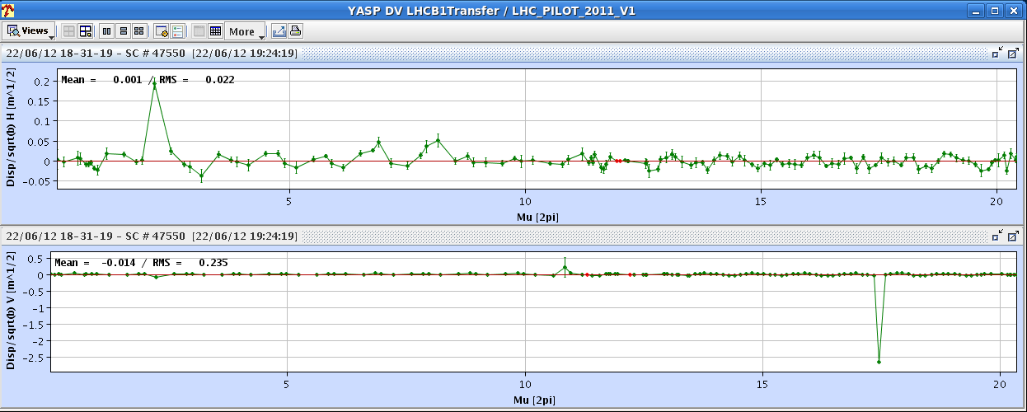
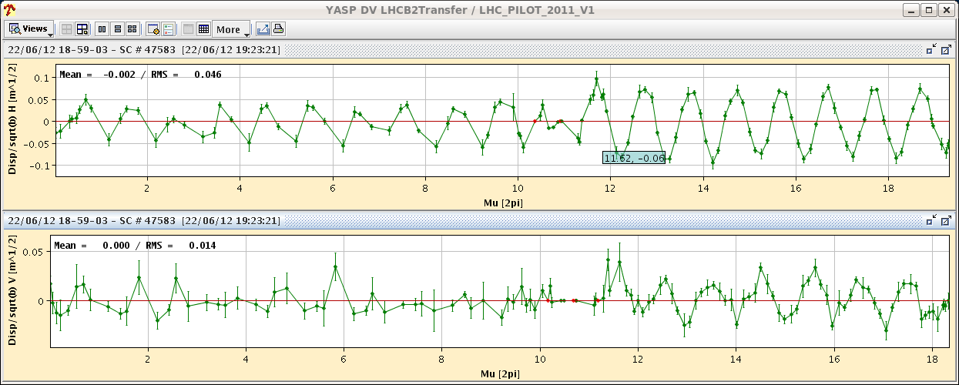
Dispersion into LHC with Q20 Optics
C. Bracco, V. Kain, L. Norderhaug Drosdal, et al
more time will be needed during the next MD to investigate the B2 dispersion mismatch

Slide 7
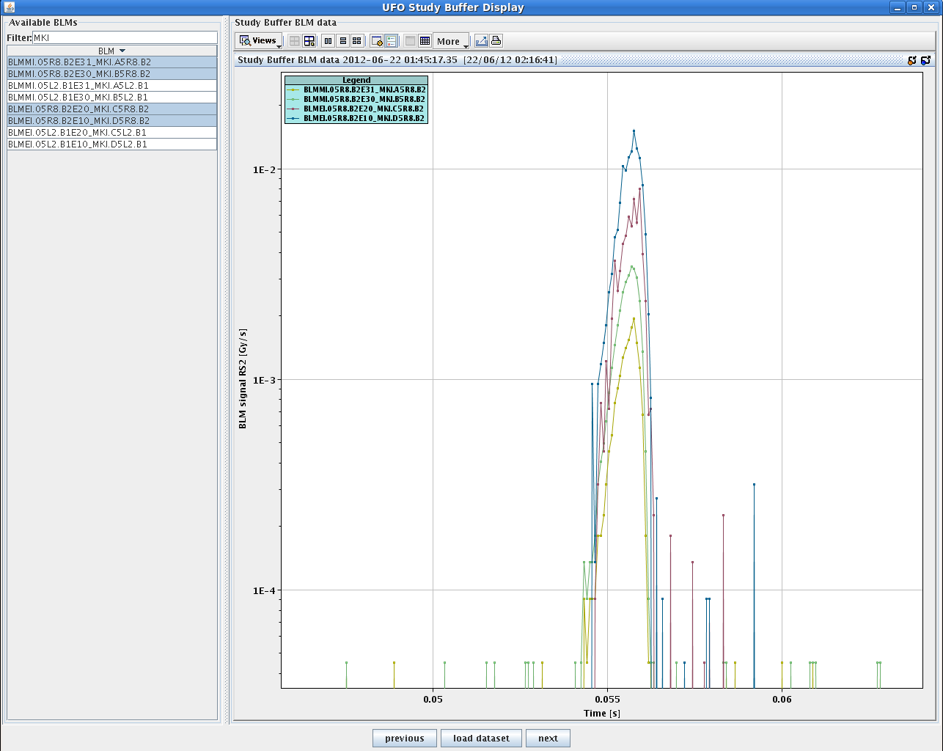
MKI UFO studies
  T. Baer, M. Barnes,
  R. Giachino, G. Roy
Important delays due to unrelated technical problems.
1236 bunches circulating for B1 and B2 with two different emittances of ~3, ~1.5 μrad (blow up by screens).
pulsed MKIs in gap alternating for B1 & B2 to produce UFOs
at 1:40 h switched off MKI
e-cloud solenoids →
10 min later flashover at
MKI.C5R8 with vacuum
interlock
MKIs pulsed 48 times;
several UFO events observed
Conclusion: don’t operate
MKIs without e-cloud
solenoids

Slide 8
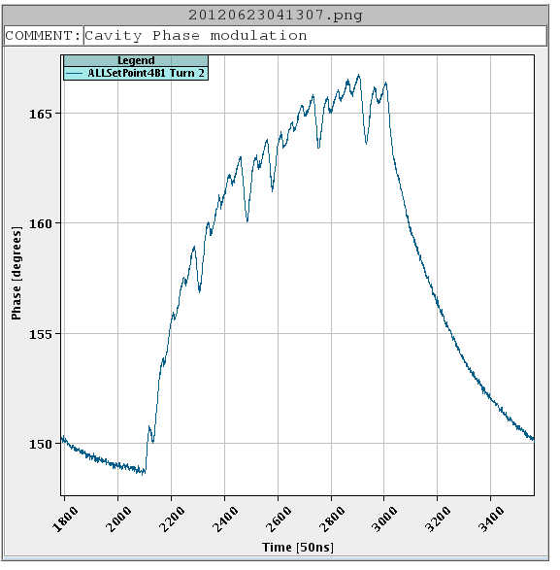
RF Cavity Phase Modulation for 25ns
16 degree phase modulation applied
modulate the set point during the turn resulting in a constant klystron drive and a klystron power independent of beam current
P. Baudrenghien et al
Modulation of the cavity phase with ring half full

Slide 9
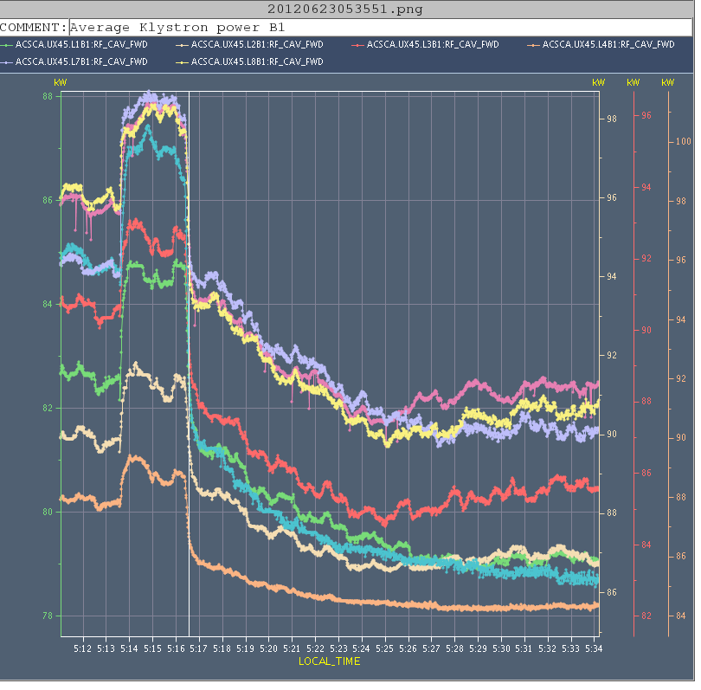
RF Cavity Phase Modulation for 25ns
modulation with 1-T fdbk on: 12b +144 b
next step:
implement the algorithm in the firmware
allowing for a very small amplitude correction at each turn, thereby improving the stability of the algorithm, while achieving a faster overall convergence rate.
P. Baudrenghien et al
Decreasing klystron power as set point is adapted

Slide 10
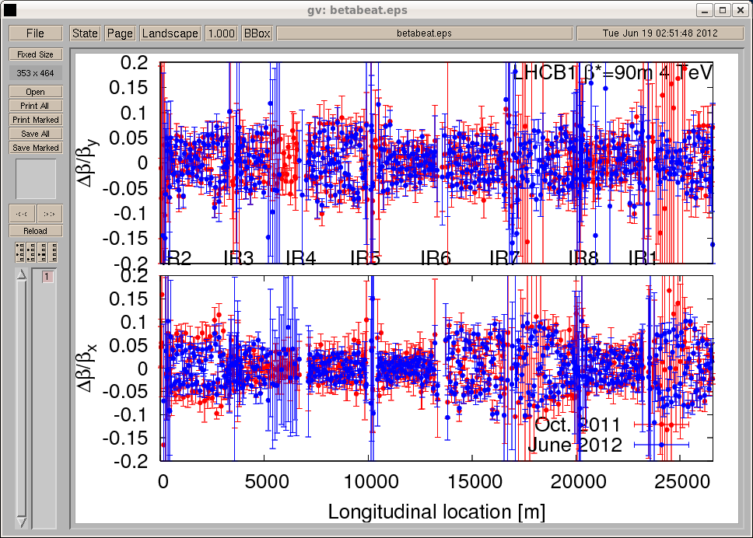
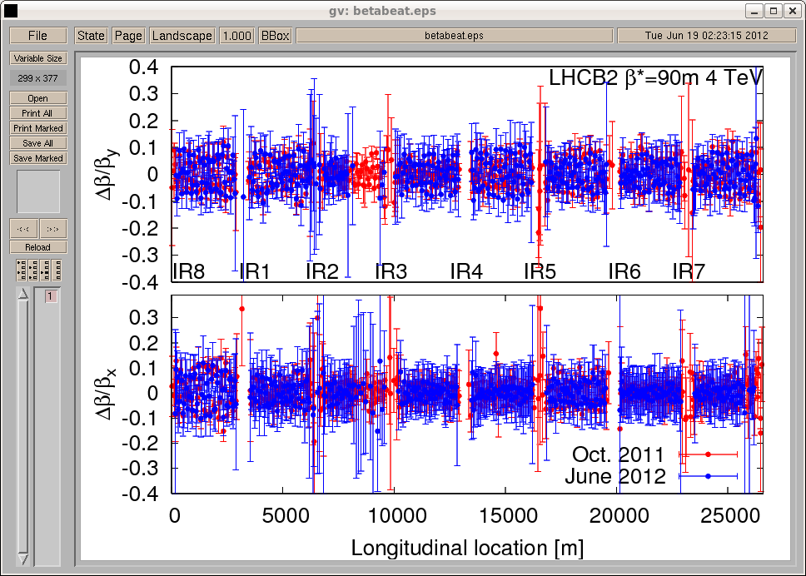
Beta-beat at 90 m
H. Burkhardt, J. Wenninger,
A. Mcpherson, E. Bravin,
D. Jacquet, S. Cavalier,
T. Baer, E. Maclean et al
Within 10% with the 2011 B1 and B2
corrections.
  Plus local triplet coupling correction of 2012.
B1 – scale ±20%
B2 – scale ±40%

Slide 11
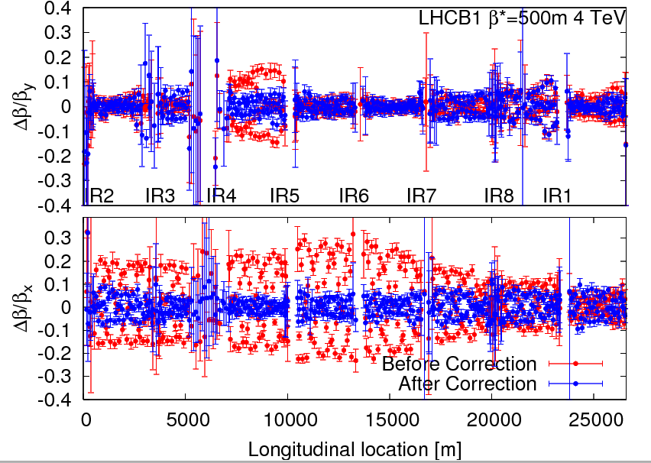
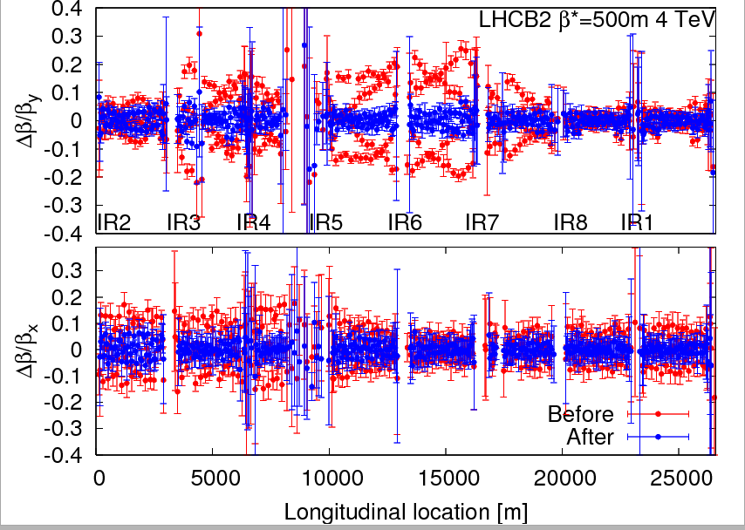
Beta-beat at 500 m
H. Burkhardt, J. Wenninger,
A. Mcpherson, E. Bravin,
D. Jacquet, S. Cavalier,
T. Baer, E. Maclean et al
Within 10% after correction.
B1 – scale ±40%
B2 – scale ±40%

Slide 12
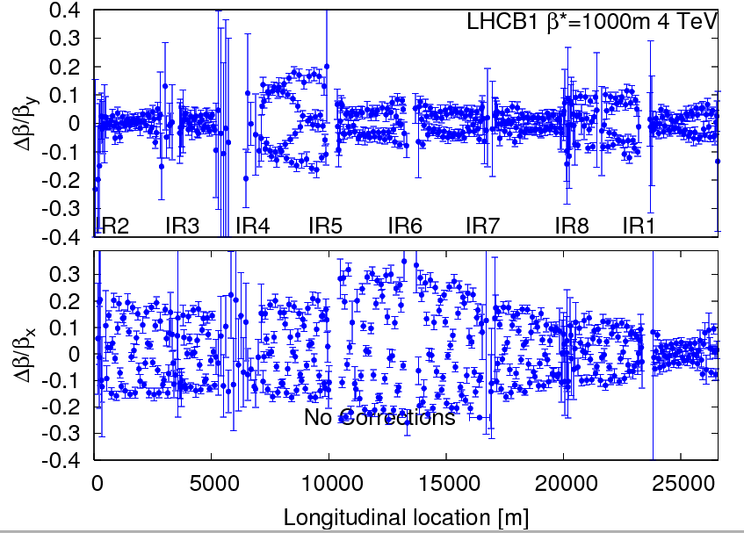
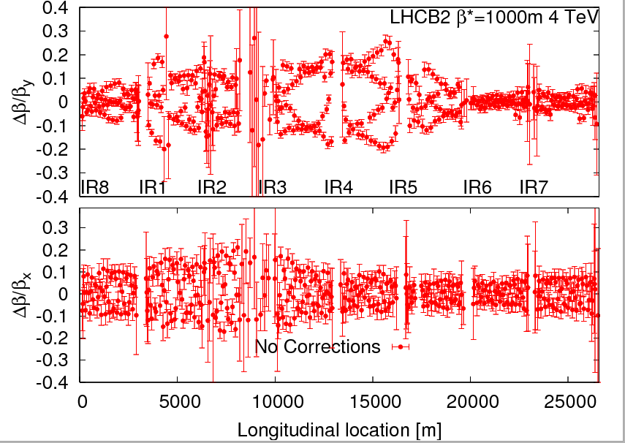
Beta-beat at 1000 m
H. Burkhardt, J. Wenninger,
A. Mcpherson, E. Bravin,
D. Jacquet, S. Cavalier,
T. Baer, E. Maclean et al
Max. beta-beat of 30%, no correction
(yet).
B1 – scale ±40%
B2 – scale ±40%

Slide 13
Data for Transverse Impedance …
After squeeze:
Q'x,y = + 5, ADT as in physics: decreased octupole current down to 0; at 0 the beam became unstable in Vplane (still stable at ~ 20 A in the D octupoles). Increased octupoles to save beam (also Q'x,y +2).
Ioct = 450 A, ADT as in physics: decreased Q'x,y from + 7 to - 10 by steps of 1 unit. The beam was always stable. Then we moved in 1 step to Q'x,y = + 10 and the beam was still stable.
Q'x,y = - 5, ADT as in physics: decreased the octupole current down to ~ 220 A , when the beam became unstable in Vplane. Just after the instability, increased again the octupole current to save beam.
Q'x,y = + 2, ADT as in physics: we decreased the octupole current down to ~60 A, when the beam became unstable in Hplane. Just after the instability, increased again octupole current to save beam.
Q'x,y = + 2, Ioct = 450 A: decreased the ADT gain by steps of 20% and after having reached the limit of the lower value, switched ADT off. The beam was stable. BBQ signal in H increased ~ linearly ~ 3 times above the noise level.
Q'x,y = + 2, ADT switched off: decreased the octupole current by 1 step to ~ 400 A and the beam was unstable in Vplane and finally dumped.
A. Burov, M. Pojer, Y., G. Trad, Y. Le Borgne, T. Pieloni, E. Metral

Slide 14
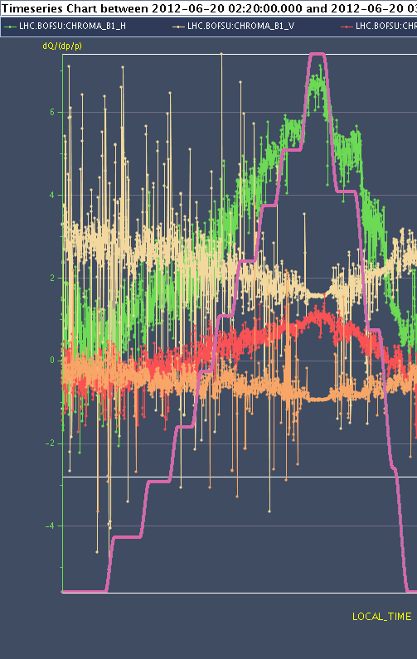
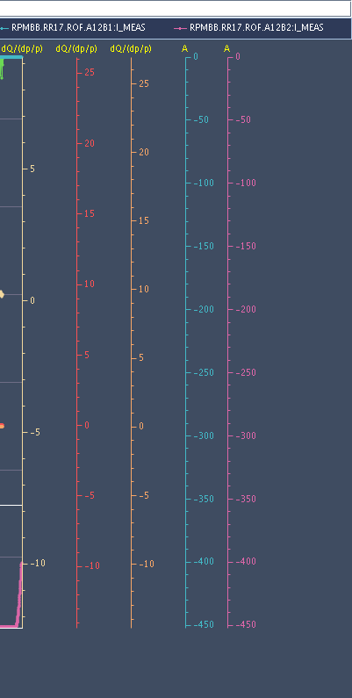
Chromaticity Dependence on Octupoles
Giulia Papotti, Nicolas Mounet, Alexey Burov, et al
B1H chroma
ROF current

Slide 15
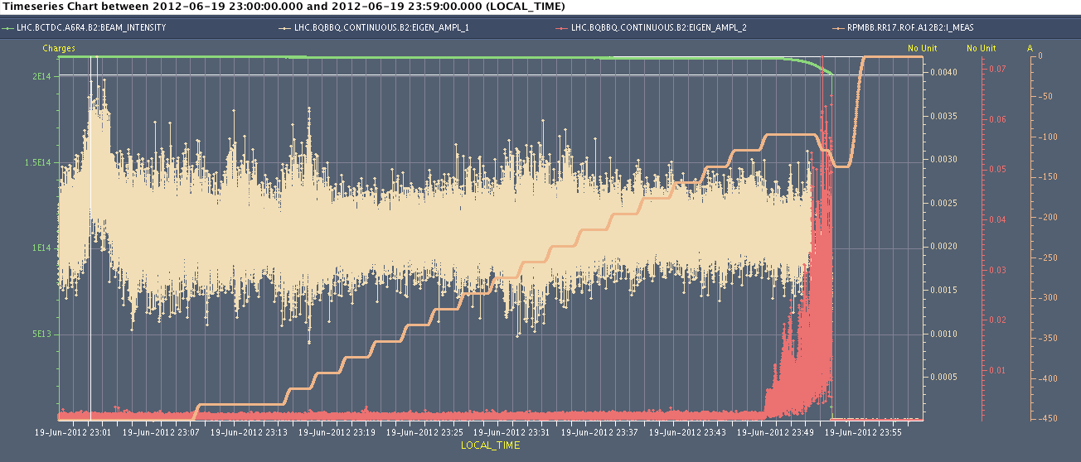
Octupole Instability Threshold 4 TeV
decreasing octupoles' current from ~ 450 A to 97 A (on flat-top before the squeeze) → beam dump due to losses
estimated Q’ + 5 units
Elias Metral, Alexey Burov, Nicholas Mounet, Giulia Papotti
consistent with impedance model

Slide 16
Collimation (Impedance, Nominal Settings)
Squeezed and separated beam, 3 nominal bunches.
Established nominal 7 TeV collimator settings in IR6& IR7:
  Hierarchy worse than nominal settings especially for beam 1
  Beam-based alignment of 7-8 B1 collimators, 80 micron shifts, hierarchy improved.
Impedance: movement prim. and sec. coll. in IR7 with & w/o ADT…
  Vertical signals clean; horizontal signals jumping between two peaks (even w/o ADT)
  Transverse tune shift of all IR7 secondary collimators from 5.1 to 9 sigma: 5e-4
  Tune shift from 3 primary barely visible.
Octupoles: Decreased in large steps, Q’=+2, until both beams lost at ~80 A (instability started at 200-300 A)
  Analysis of ADT signals & synchronous phase shift to be done.

Slide 17
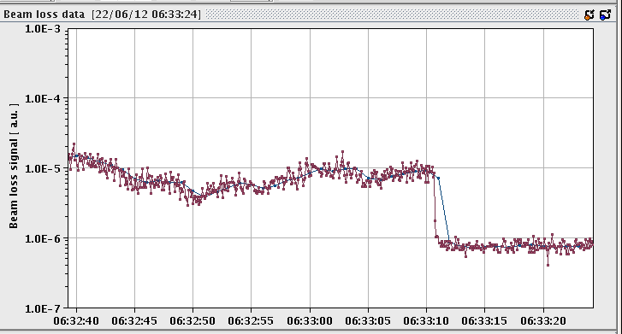
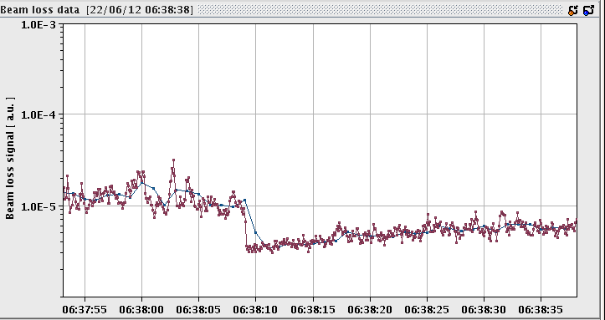
Scraping, Diffusion & Repopulation Study
  F. Burkart, G. Valentino, S. Redaelli et al ++
Halo repopulation at 4 TeV → measurement of diffusion speed
faster repopulation …
w/o collision
with collision
Also: Data on asynchronous dump test for a machine error → leakage to a TCT

Slide 18
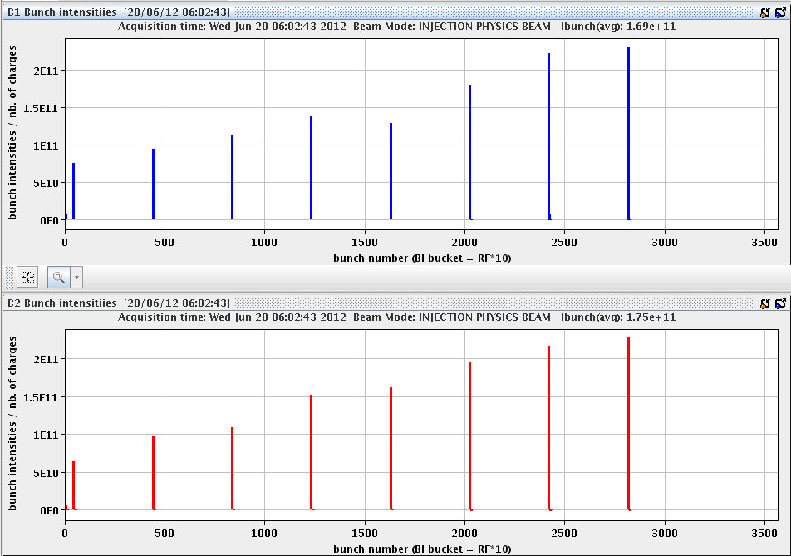
Longitudinal Dynamics Studies
Injected 8 bunches with different intensities but similar bunch lengths (phase loop off, was on for injecting). 2nd fill included ramp.
E. Shaposhnikova,
J. Esteban Muller,
R. Calaga et al
fill 1
synchronous
phase,
synchrotron
frequency,
tune shift, etc.
for different
intensity
and bunch length

Slide 19
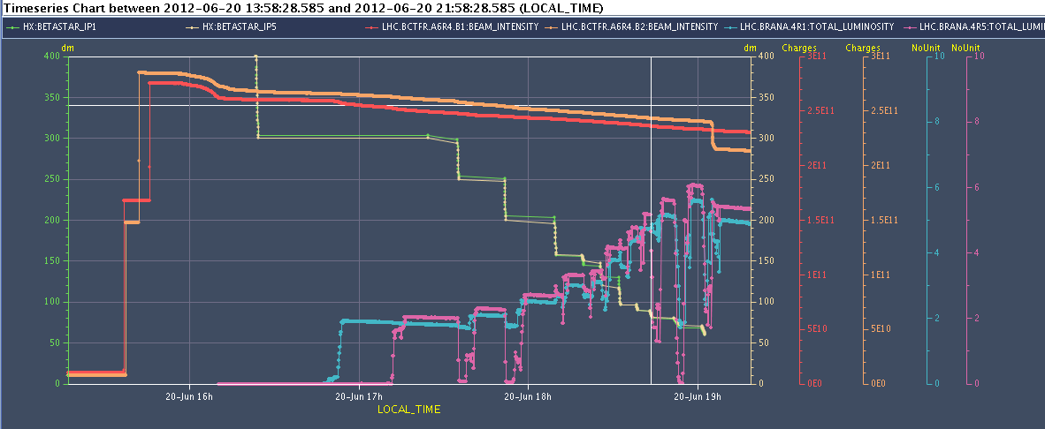
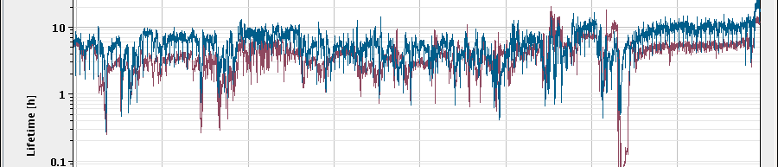
S. Redaelli,
J. Wenninger,
L. Ponce,
M. Pojer, et al
Result beta* Leveling
intensity
beta*
luminosity
10 h
Beam lifetime
1 h

Slide 20
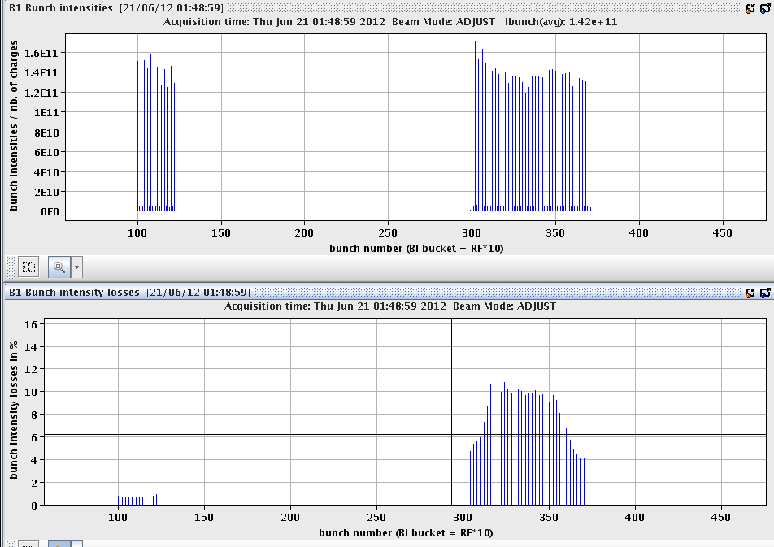
Long-range Beam-Beam Study
W. Herr,
T. Pieloni,
G. Papotti,
R. Assmann,
G. Roy,
R. Giachino
et al
losses along train
show effect of LR
encounters
significant losses appeared due to the reduced distances at the long-range encounters of IP1 at around 50% of the initial angle in IP1. After finding the limit IP1 reduced IP5 crossing angle till same crossing for both IPs was set.
1.6e11 ppb with ε~2micron

Slide 21
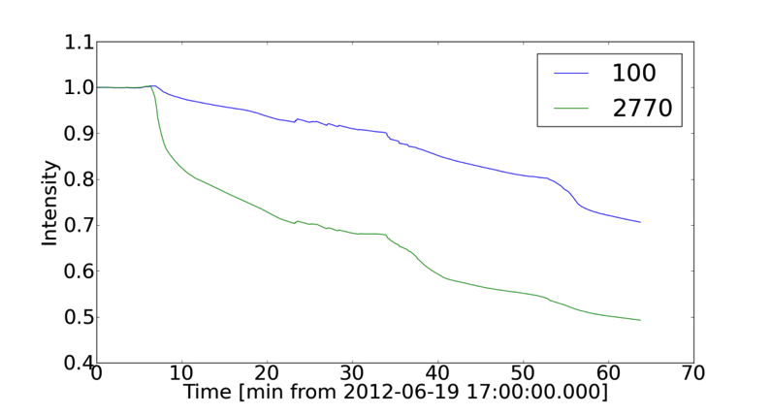
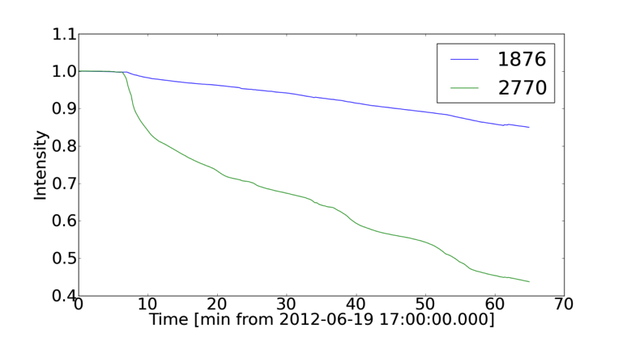
Large Piwinski Angle
bunch with 3 collisions loses much more intensity;
steepest loss at 50% of LHCb spectrometer strength;
best lifetime at 0 strength
largest Piwinski angle ever!
estimated Piwinski angles ~ 1.1, 0.6, 0
100%
0%
100%
0%
50%
50%
qualitatively consistent with expectation
Jose Abelleira, Chandra Bhat, Xavier Buffat, Karel Cornelis, Riccardo De Maria, Rossano Giachino, Mike Lamont, Themis Mastoridis, Alick Mcpherson, Giulia Papotti, Tatiana Pieloni, Ghislain Roy, Belen Salvachua, Daniel Valuch, Frank Zimmermann, + …

Slide 22
Beam Instrumentation Studies
BSRT vs WS calibration: by means of ADT we managed to gradually blow-up bunches and have a wide emittance-range, from ~1.5 to ~ >4.5 um for each beam/plane.
FBCT. System behaves OK, but following must be further studied:
  Proper threshold switching from low-gain back to high gain. Currently too low and result in 'gap' in the measurement at the end of scraping
  Improve cross calibration procedure in expert gui
  Provide AC lookup tables
BPM: tested new BPM interlock logic
Matching monitor: the detector gives enough signal to monitor turn by turn beam size.
BGI: injected 1374 bunche on beam 2, performed bumps and used ADt to blow-up 144 bunches at a time in order to increase all bunches emittance.

Slide 23
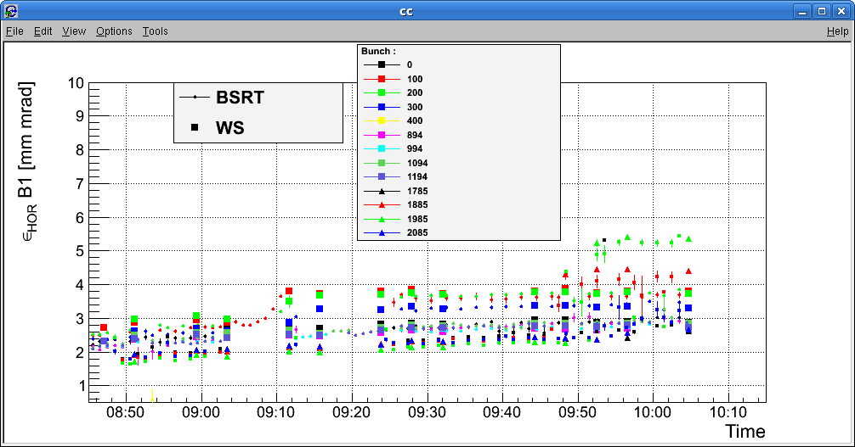
Cross-Calibration BSRT – Wire Scanner
… to be analyzed in detail

Slide 24
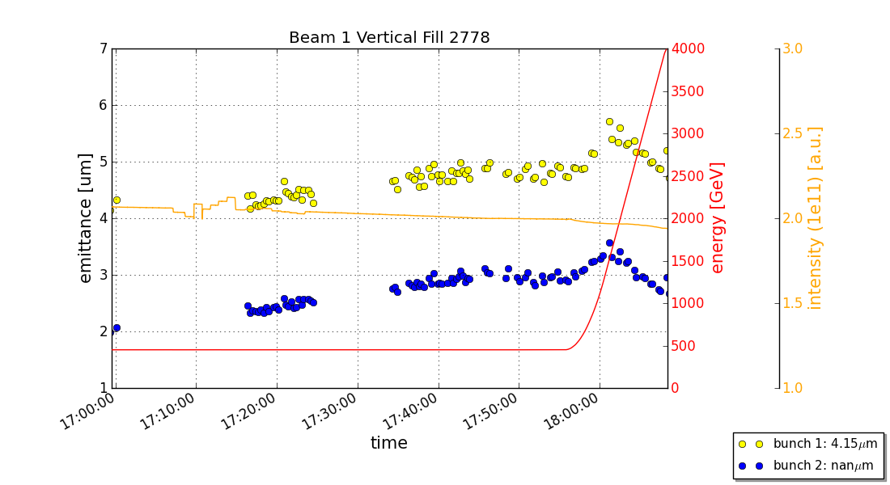
Emittance During Ramp
Wire scanner calibration at injection and flattop with bumps.
Wire scans in ramp with more relaxed collimator settings.
Intensity preserved: emittances are still shrinking towards end.
k-modulation at flattop (point 4 only) and after squeeze (point 4 and triplets of point 1 and point 5).
Luminosity
data taken to
compare with
emittances
from wire
scans.
Details to be
evaluated
offline.

Slide 25
Outlook
The preliminary results give us confidence that better than nominal performance is OK at 6.5 TeV. Also: HiLumi parameters are realistic.
This year: Can push bunch intensities in operation further…
Next is floating MD block beginning of July:
  ATS
  High pile-up (~100) test
  25ns injection test
Beyond: 25ns MD’s after scrubbing run, …

