Slide 1

PyEcloud code and simulations
G. Iadarola, G. Rumolo
ICE meeting 9 April 2012

Slide 2
Outline
  A few basic concepts on e-cloud build-up
  PyEcloud: How do we simulate the e-cloud build-up
      Flow-chart
      MP size management
      Convergence and performances
  Overview of e-cloud studies for CERN accelerators:
      e-cloud studies for the PS and SPS
      e-cloud studies for the LHC
        25ns observation benchmarking for the arcs
        e-cloud build-up in in 800mm common pipe near IP2

Slide 3
Outline
  A few basic concepts on e-cloud build-up
  PyEcloud: How do we simulate the e-cloud build-up
      Flow-chart
      MP size management
      Convergence and performances
  Overview of e-cloud studies for CERN accelerators:
      e-cloud studies for the PS and SPS
      e-cloud studies for the LHC
        25ns observation benchmarking for the arcs
        e-cloud build-up in in 800mm common pipe near IP2

Slide 4
Secondary electron emission
e⁻

Slide 5
Secondary electron emission
e⁻

Slide 6
Secondary electron emission

Slide 7
Secondary electron emission

Slide 8
Secondary electron emission

Slide 9
Secondary electron emission

Slide 10
Secondary electron emission

Slide 11
Secondary electron emission

Slide 12
Secondary electron emission
  The Secondary Electron Yield of the chamber’s surface is basically the ratio between emitted and impacting electrons and is function of the energy of the primary electron.

Slide 13
Secondary electron emission
e⁻ absorber
e⁻ emitter
  The Secondary Electron Yield of the chamber’s surface is basically the ratio between emitted and impacting electrons and is function of the energy of the primary electron.

Slide 14
Seed mechanisms
  In proton accelerators the electron cloud is typically triggered by ionization of residual gas that is present in the beam pipe.
  In the LHC (for E>1TeV) there are many electrons coming from photoelectric emission due to synchrotron radiation

Slide 15
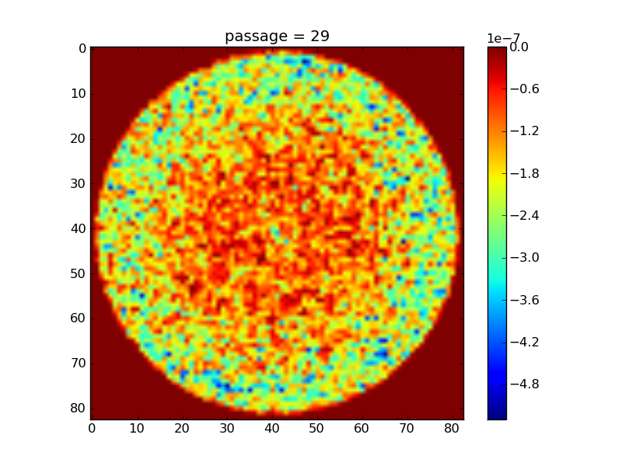
Electron cloud build-up
  Beam pipe transverse cut

Slide 16
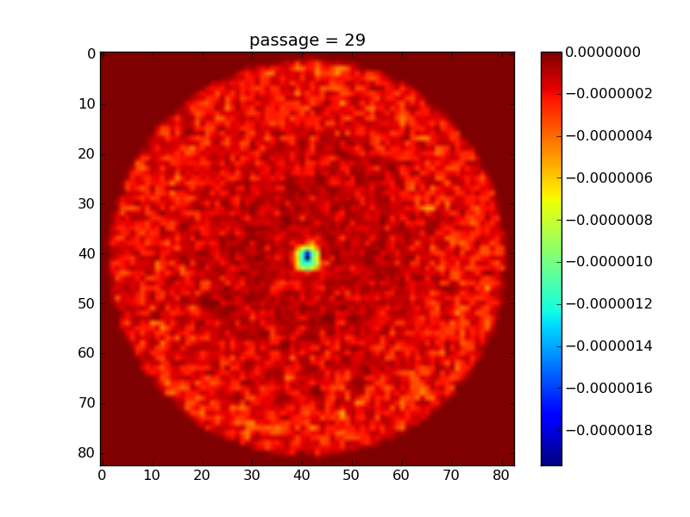
Electron cloud build-up
  Beam pipe transverse cut
  During the bunch passage the electrons are accelerated by the beam “pinched” at the center of the beam pipe

Slide 17
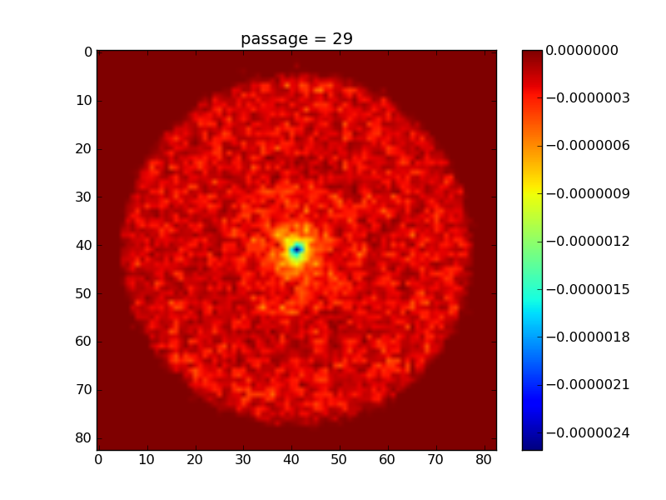
Electron cloud build-up
  Beam pipe transverse cut
  During the bunch passage the electrons are accelerated by the beam “pinched” at the center of the beam pipe

Slide 18
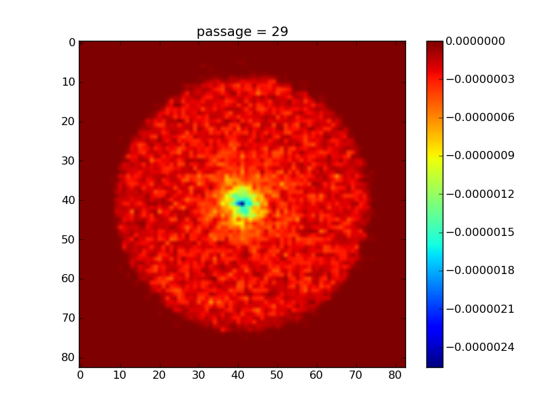
Electron cloud build-up
  Beam pipe transverse cut
  During the bunch passage the electrons are accelerated by the beam “pinched” at the center of the beam pipe

Slide 19
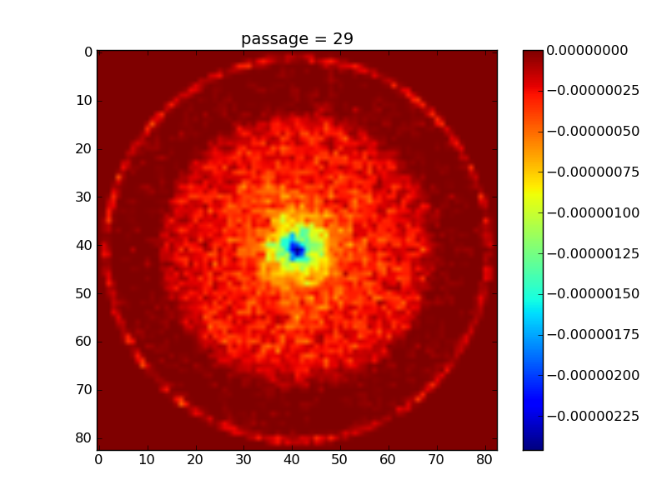
Electron cloud build-up
  Beam pipe transverse cut
  During the bunch passage the electrons are accelerated by the beam “pinched” at the center of the beam pipe

Slide 20
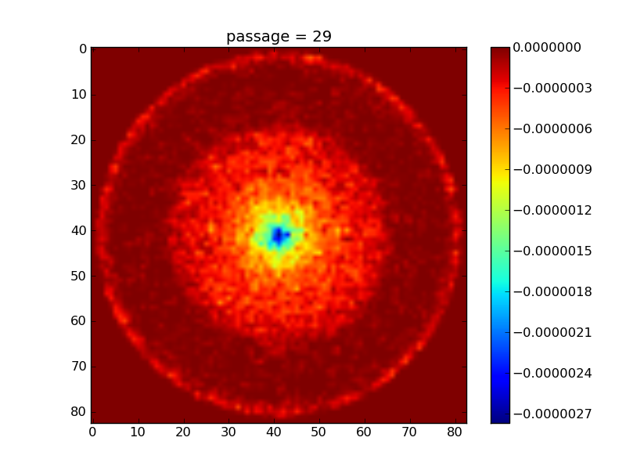
Electron cloud build-up
  Beam pipe transverse cut
  After the bunch passage the electrons hit the chamber’s wall (with E~100eV)
  If the Secondary Electron Yield (SEY) of the surface is large enough, secondary electrons can be generated and growth of the total number of electrons is observed

Slide 21
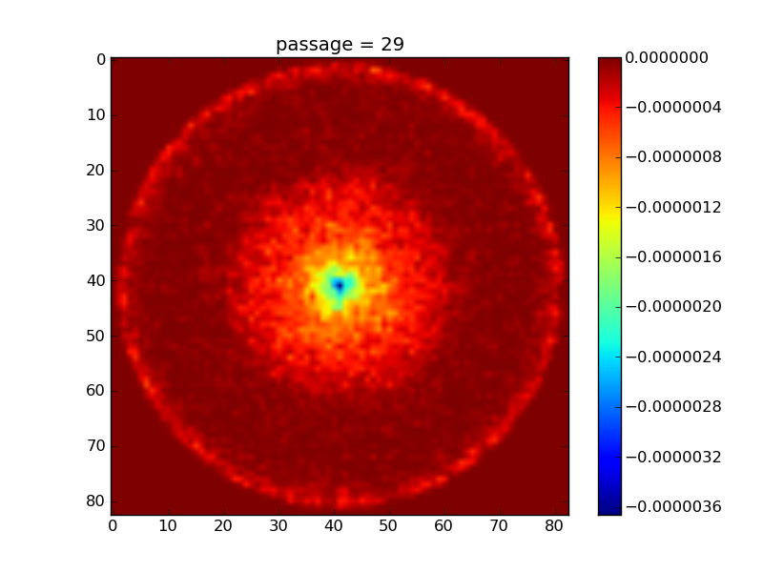
Electron cloud build-up
  Beam pipe transverse cut
  After the bunch passage the electrons hit the chamber’s wall (with E~100eV)
  If the Secondary Electron Yield (SEY) of the surface is large enough, secondary electrons can be generated and growth of the total number of electrons is observed

Slide 22
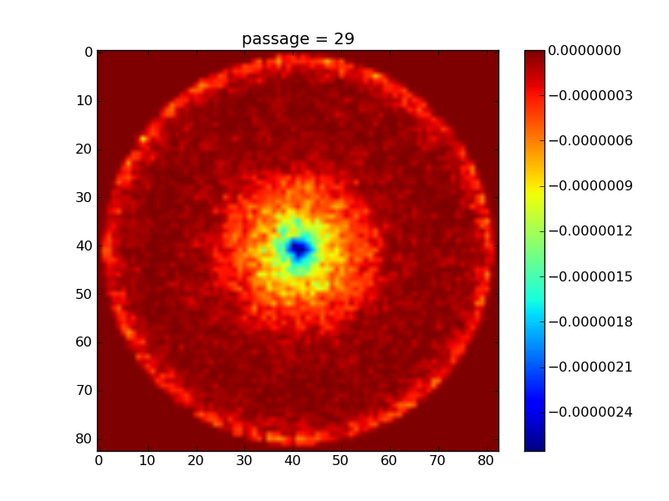
Electron cloud build-up
  Beam pipe transverse cut
  After the bunch passage the electrons hit the chamber’s wall (with E~100eV)
  If the Secondary Electron Yield (SEY) of the surface is large enough, secondary electrons can be generated and growth of the total number of electrons is observed

Slide 23
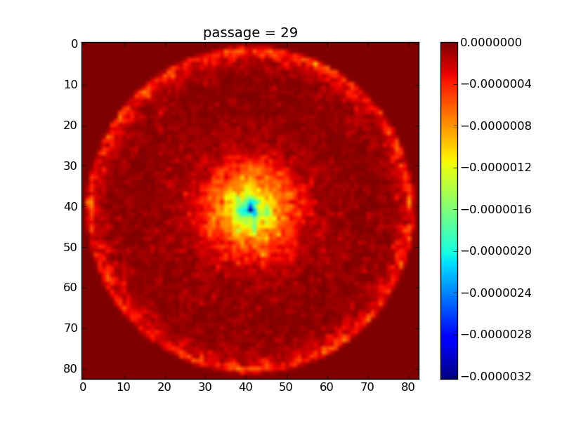
Electron cloud build-up
  Beam pipe transverse cut
  After the bunch passage the electrons hit the chamber’s wall (with E~100eV)
  If the Secondary Electron Yield (SEY) of the surface is large enough, secondary electrons can be generated and growth of the total number of electrons is observed

Slide 24
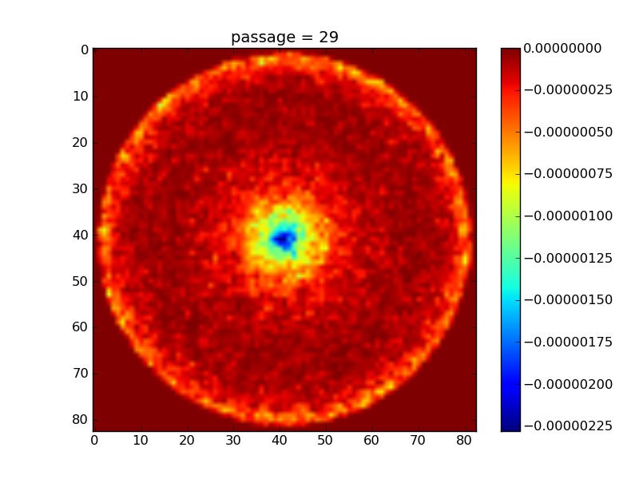
Electron cloud build-up
  Beam pipe transverse cut
  After the bunch passage the electrons hit the chamber’s wall (with E~100eV)
  If the Secondary Electron Yield (SEY) of the surface is large enough, secondary electrons can be generated and growth of the total number of electrons is observed

Slide 25
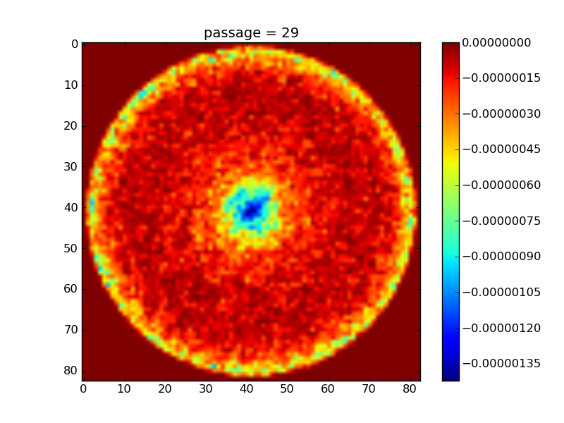
Electron cloud build-up
  Beam pipe transverse cut
  After the bunch passage the electrons hit the chamber’s wall (with E~100eV)
  If the Secondary Electron Yield (SEY) of the surface is large enough, secondary electrons can be generated and growth of the total number of electrons is observed

Slide 26
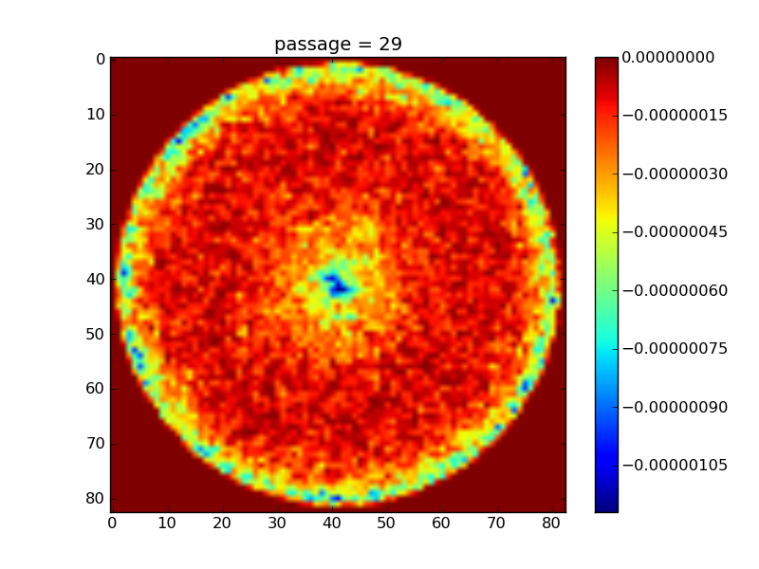
Electron cloud build-up
  Beam pipe transverse cut
  After the bunch passage the electrons hit the chamber’s wall (with E~100eV)
  If the Secondary Electron Yield (SEY) of the surface is large enough, secondary electrons can be generated and growth of the total number of electrons is observed

Slide 27
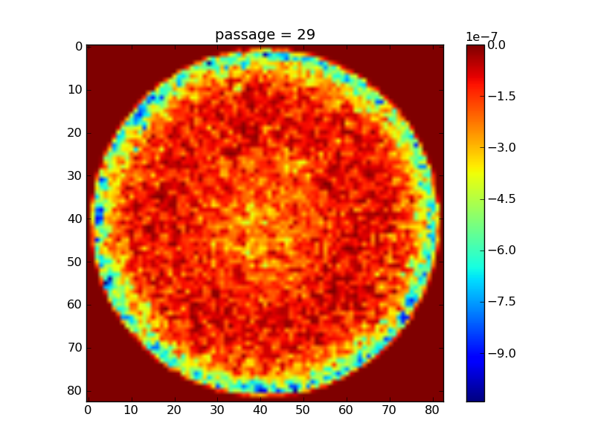
Electron cloud build-up
  Beam pipe transverse cut
  After the bunch passage the electrons hit the chamber’s wall (with E~100eV)
  If the Secondary Electron Yield (SEY) of the surface is large enough, secondary electrons can be generated and growth of the total number of electrons is observed

Slide 28
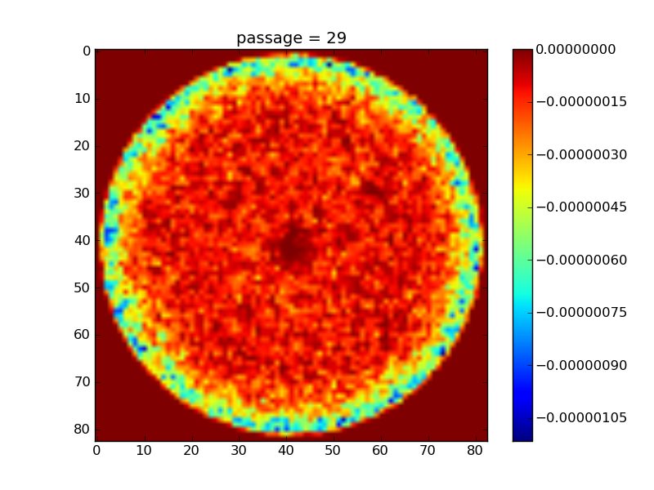
Electron cloud build-up
  Beam pipe transverse cut
  After the bunch passage the electrons hit the chamber’s wall (with E~100eV)
  If the Secondary Electron Yield (SEY) of the surface is large enough, secondary electrons can be generated and growth of the total number of electrons is observed

Slide 29
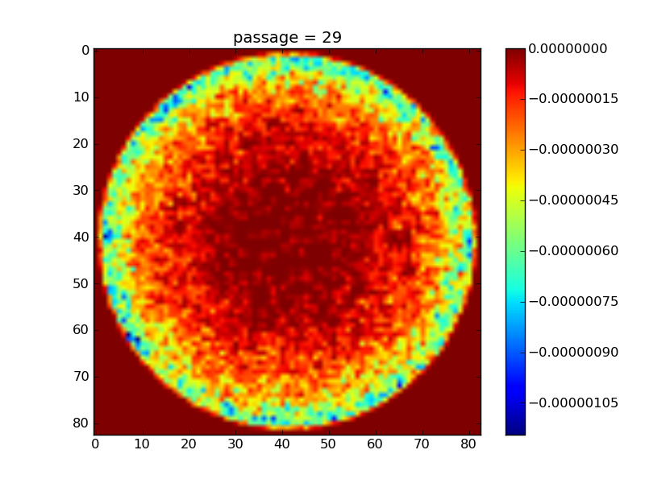
Electron cloud build-up
  Beam pipe transverse cut
  After the bunch passage the electrons hit the chamber’s wall (with E~100eV)
  If the Secondary Electron Yield (SEY) of the surface is large enough, secondary electrons can be generated and growth of the total number of electrons is observed

Slide 30
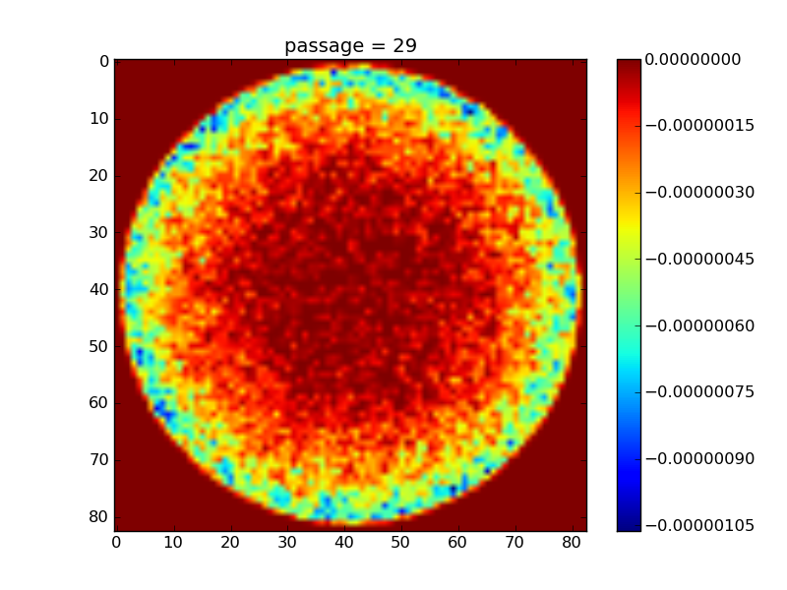
Electron cloud build-up
  Beam pipe transverse cut
  After the bunch passage the electrons hit the chamber’s wall (with E~100eV)
  If the Secondary Electron Yield (SEY) of the surface is large enough, secondary electrons can be generated and growth of the total number of electrons is observed

Slide 31
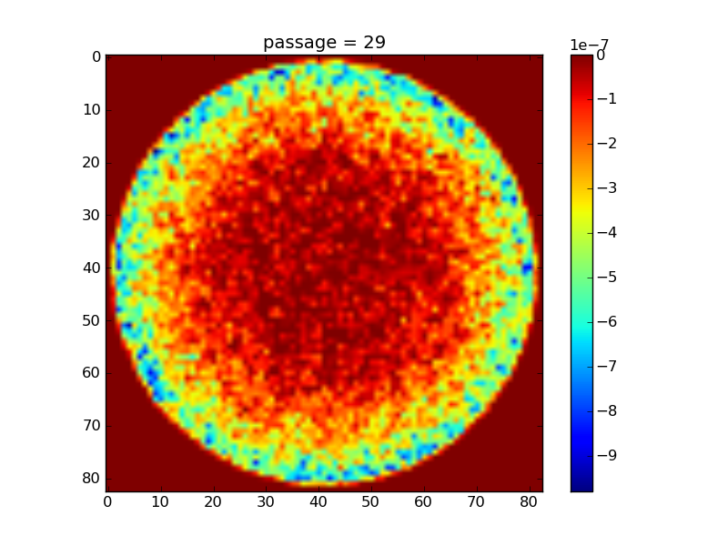
Electron cloud build-up
  Beam pipe transverse cut
  Secondary electrons are emitted with smaller energies (E~1eV) and, if they hit the wall before the following bunch passage, they are absorbed without generation of further secondaries
  Decay of the total number of electrons can be observed in this stage

Slide 32
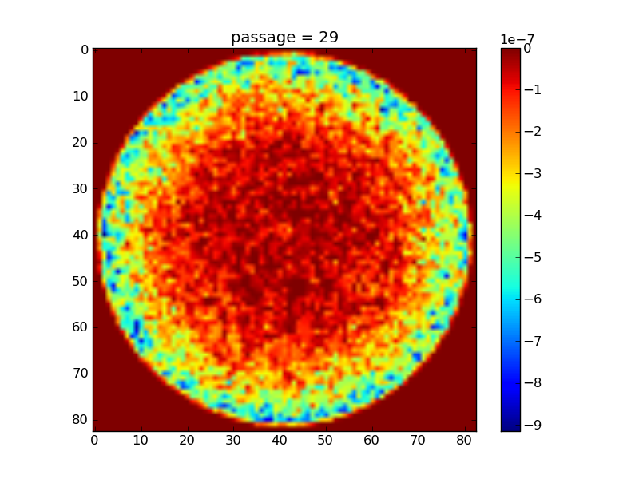
Electron cloud build-up
  Beam pipe transverse cut
  Secondary electrons are emitted with smaller energies (E~1eV) and, if they hit the wall before the following bunch passage, they are absorbed without generation of further secondaries
  Decay of the total number of electrons can be observed in this stage

Slide 33
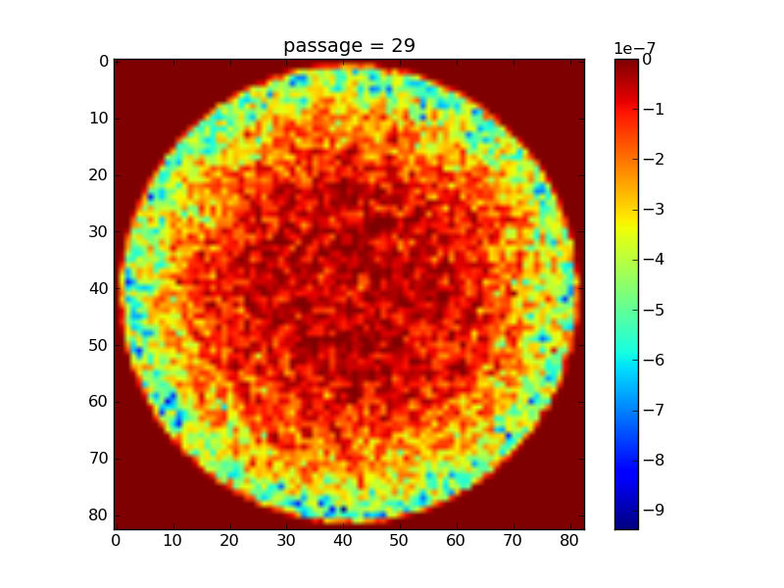
Electron cloud build-up
  Beam pipe transverse cut
  Secondary electrons are emitted with smaller energies (E~1eV) and, if they hit the wall before the following bunch passage, they are absorbed without generation of further secondaries
  Decay of the total number of electrons can be observed in this stage

Slide 34
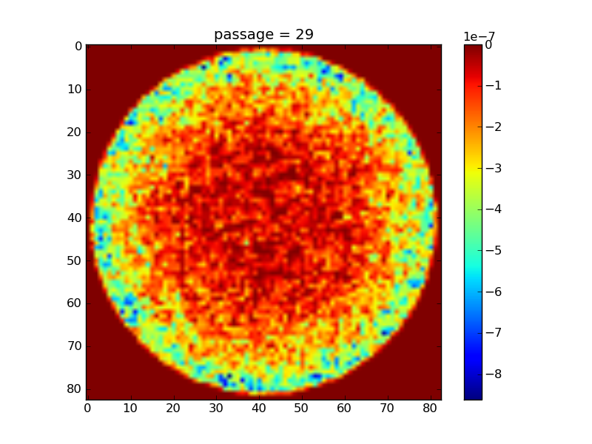
Electron cloud build-up
  Beam pipe transverse cut
  Secondary electrons are emitted with smaller energies (E~1eV) and, if they hit the wall before the following bunch passage, they are absorbed without generation of further secondaries
  Decay of the total number of electrons can be observed in this stage

Slide 35
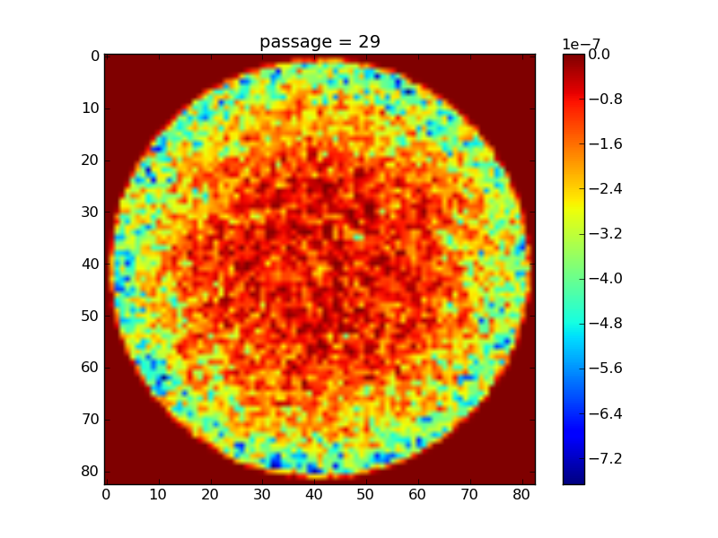
Electron cloud build-up
  Beam pipe transverse cut
  Secondary electrons are emitted with smaller energies (E~1eV) and, if they hit the wall before the following bunch passage, they are absorbed without generation of further secondaries
  Decay of the total number of electrons can be observed in this stage

Slide 36
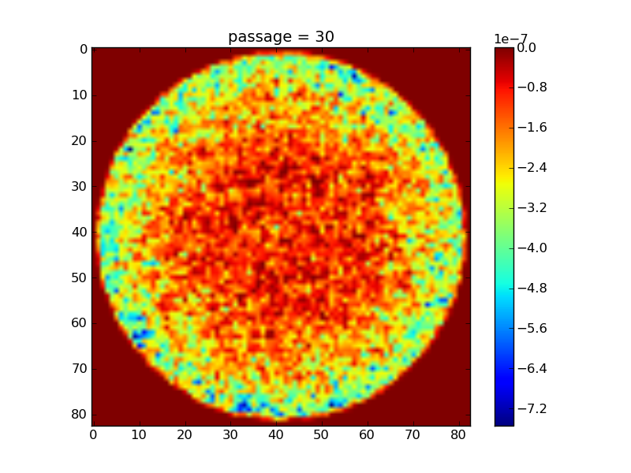
Electron cloud build-up
  Beam pipe transverse cut
  Secondary electrons are emitted with smaller energies (E~1eV) and, if they hit the wall before the following bunch passage, they are absorbed without generation of further secondaries
  Decay of the total number of electrons can be observed in this stage

Slide 37
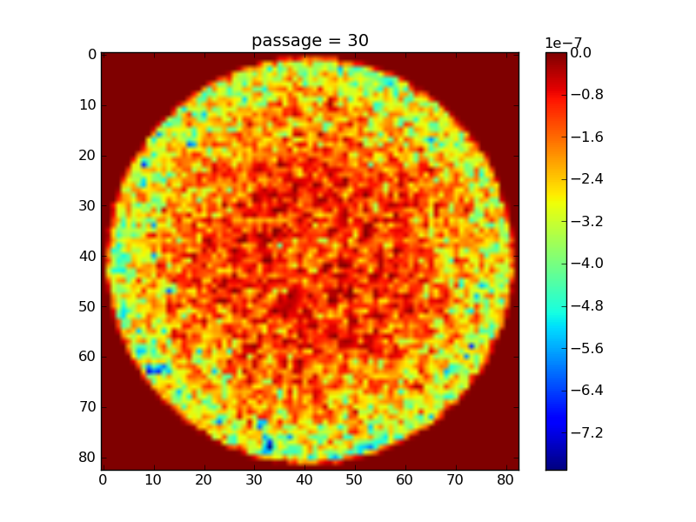
Electron cloud build-up
  Beam pipe transverse cut
  Secondary electrons are emitted with smaller energies (E~1eV) and, if they hit the wall before the following bunch passage, they are absorbed without generation of further secondaries
  Decay of the total number of electrons can be observed in this stage

Slide 38
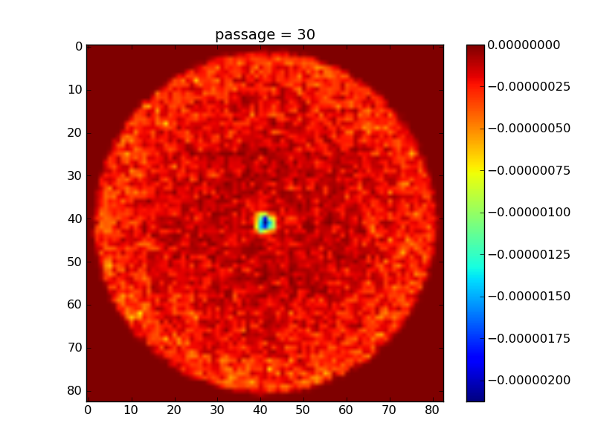
Electron cloud build-up
  Beam pipe transverse cut
  Another bunch passage can interrupt the decay before reaching the initial value
  In these cases avalanche multiplication is observed between bunch passages, and an exponential growth of the number of electrons happens during the bunch train passage

Slide 39
Electron cloud build-up
  Beam pipe transverse cut
  Another bunch passage can interrupt the decay before reaching the initial value
  In these cases avalanche multiplication is observed between bunch passages, and an exponential growth of the number of electrons happens during the bunch train passage

Slide 40
Electron cloud build-up
  Beam pipe transverse cut
bunch spac.
  Electron cloud effect is strongly dependent on bunch spacing!

Slide 41
The electron cloud buildup

Slide 42
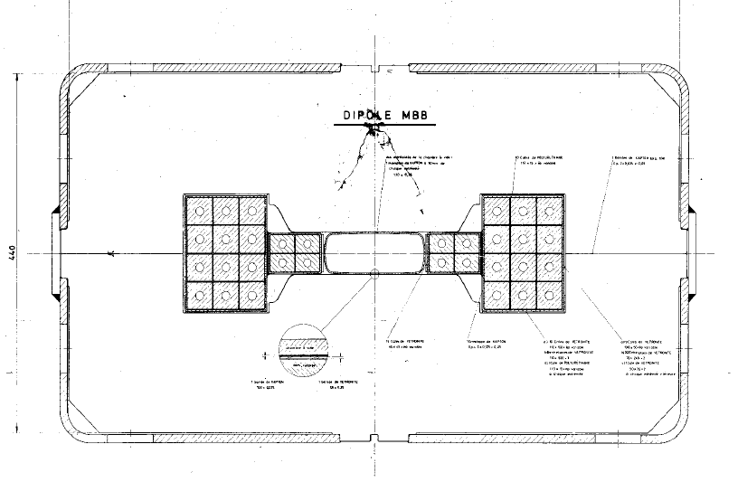
The electron cloud buildup

Slide 43
The electron cloud buildup

Slide 44
The electron cloud buildup

Slide 45
The electron cloud buildup

Slide 46
The electron cloud buildup
  The passage of the first bunches of the train provokes an exponential rise of the number of electron in the chamber (multipacting).

Slide 47
The electron cloud buildup
  The number of e⁻ tends to saturate to a certain value because of the space charge field generated by the electron themselves.

Slide 48
The electron cloud buildup

Slide 49
The electron cloud buildup
  The e-cloud is partially lost in the gaps between batches and a short build-up is observed at the beginning of each batch passage

Slide 50
The electron cloud buildup

Slide 51
The electron cloud buildup

Slide 52
The electron cloud buildup

Slide 53
The electron cloud buildup

Slide 54
The electron cloud buildup

Slide 55
The electron cloud buildup
  After the passage of the train the e-cloud decays

Slide 56
The electron cloud buildup

Slide 57
The electron cloud buildup

Slide 58
The electron cloud buildup
  1st turn
  2nd turn
  The decay can be fast enough that no memory effect is observed between turns

Slide 59
The electron cloud buildup
  1st turn
  2nd turn
  If the decay is slow enough or other memory effects are present a multi-turn regime can be observed
5% uncaptured beam present in the machine

Slide 60
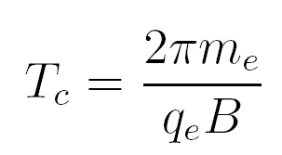
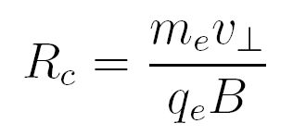
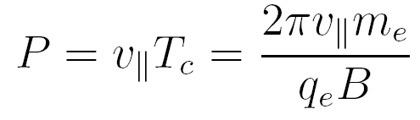
Electron cloud distribution in a bending magnet
  In a strong dipolar magnetic field, electrons perform helicoidal trajectories around the field lines.
B
P
R_{c}

Slide 61
Electron cloud distribution in a bending magnet
  In a strong dipolar magnetic field, electrons perform helicoidal trajectories around the field lines.
B
<1ns
P
<1mm
R_{c}
  e⁻ are confined to move along B field lines

Slide 62
Electron cloud distribution in a bending magnet
e⁻

Slide 63
Electron cloud distribution in a bending magnet
e⁻

Slide 64
Electron cloud distribution in a bending magnet
e⁻

Slide 65
Electron cloud distribution in a bending magnet
e⁻

Slide 66
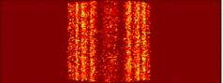
Electron cloud distribution in a bending magnet
  This gives the two stripes distribution that typical for the e-cloud in a bending magnet

Slide 67
Outline
  A few basic concepts on e-cloud build-up
  PyEcloud: How do we simulate the e-cloud build-up
      Flow-chart
      MP size management
      Convergence and performances
  Overview of e-cloud studies for CERN accelerators:
      e-cloud studies for the PS and SPS
      e-cloud studies for the LHC
        25ns observation benchmarking for the arcs
        e-cloud build-up in in 800mm common pipe near IP2

Slide 68
ECLOUD
  Analysis and prediction on the e-cloud buildup strongly relies on numerical simulations that are typically performed with simulation tools developed ad-hoc.
  Most of the work done at CERN in the last years has employed the ECLOUD code (developed at CERN since 1998, mainly by G. Bellodi, O. Bruning, G. Rumolo, D. Schulte, F. Zimmermann).
  At the very beginning our idea was to reorganize ECLOUD in order to make it easier to develop new features, to identify and correct present and future bugs, to access a larger amount of information about our simulations
  However…

Slide 69

PyECLOUD
  We have decided to write a new fully reorganized build-up code, in a newer and more powerful language, considering that the initial effort would be compensated by a significantly increased efficiency in future development and debugging.
  The employed programming language is Python:
  Interpreted language (open source), allowing incremental and interactive development of the code, encouraging an highly modular structure
  Libraries for scientific computation (e.g Numpy, Scipy, Pylab)
  Extensible with C/C++ or FORTRAN compiled modules for computationally intensive parts
Thanks to R. De Maria and K. Li

Slide 70
PyECLOUD
  Writing PyECLOUD has required a detailed analysis of ECLOUD algorithm and implementation, looking also at the related long experience in electron cloud simulations.
  Attention has been devoted to the identification of ECLOUD limitations, in particular in terms of its convergence properties with respect to the electron distribution in bending magnets (how many stripes…)
  As a result, several features have been significantly modified in order to improve the code’s performances in terms:
  Reliability & Accuracy
  Efficiency
  Flexibility
Thanks to C. Bhat, O. Dominguez, H. Maury Cuna, F. Zimmermann

Slide 71

Macroparticles
  The simulation of the dynamics of the entire number of electrons (≈10¹⁰ per meter) is extremely heavy (practically unaffordable)
  Since the dynamics equation of the electron depends only on the q/m ratio of the electron a macroparticle (MP) method can be used:
  The MP size can be seen as the “resolution” our electron gas simulation

Slide 72
Outline
  A few basic concepts on e-cloud build-up
  PyEcloud: How do we simulate the e-cloud build-up
      Flow-chart
      MP size management
      Convergence and performances
  Overview of e-cloud studies for CERN accelerators:
      e-cloud studies for the PS and SPS
      e-cloud studies for the LHC
        25ns observation benchmarking for the arcs
        e-cloud build-up in in 800mm common pipe near IP2

Slide 73
PyEcloud flowchart
t=t+Δt
Generate seed e⁻
Evaluate the electric field of beam at each MP location
Evaluate the e⁻ space charge
electric field
Compute MP motion (t->t+Δt)
Detect impacts and generate secondaries

Slide 74
PyEcloud flowchart
t=t+Δt
Generate seed e⁻
Evaluate the electric field of beam at each MP location
  Evaluate the number of seed e⁻ which are generated during the current time step and generate the corresponding MP:
  Residual gas ionization and photoemission are implemented
  Theoretical/empirical models are used to determine MP space and energy distributions
Evaluate the e⁻ space charge
electric field
Compute MP motion (t->t+Δt)
Detect impacts and generate secondaries

Slide 75
PyEcloud flowchart
t=t+Δt
Generate seed e⁻
Evaluate the electric field of beam at each MP location
  The field map for the relevant chamber geometry and beam shape is pre-computed on a suitable rectangular grid and loaded from file in the initialization stage
  When the field at a certain location is needed a linear (4 points) interpolation algorithm is employed
Evaluate the e⁻ space charge
electric field
Compute MP motion (t->t+Δt)
Detect impacts and generate secondaries

Slide 76
PyEcloud flowchart
t=t+Δt
Generate seed e⁻
Evaluate the electric field of beam at each MP location
  The field map for the relevant chamber geometry and beam shape is pre-computed on a suitable rectangular grid and loaded from file in the initialization stage
  When the field at a certain location is needed a linear (4 points) interpolation algorithm is employed
Evaluate the e⁻ space charge
electric field
Compute MP motion (t->t+Δt)
Detect impacts and generate secondaries

Slide 77
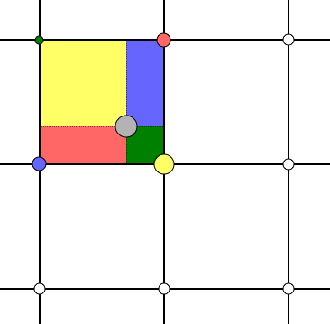
PyEcloud flowchart
t=t+Δt
Generate seed e⁻
Evaluate the electric field of beam at each MP location
  The field map for the relevant chamber geometry and beam shape is pre-computed on a suitable rectangular grid and loaded from file in the initialization stage
  When the field at a certain location is needed a linear (4 points) interpolation algorithm is employed
Evaluate the e⁻ space charge
electric field
Compute MP motion (t->t+Δt)
Detect impacts and generate secondaries

Slide 78
PyEcloud flowchart
t=t+Δt
Generate seed e⁻
Evaluate the electric field of beam at each MP location
  To compute the e⁻ space charge electric field we employ a classical Particle In Cell (PIC) algorithm
Evaluate the e⁻ space charge
electric field
Compute MP motion (t->t+Δt)
Detect impacts and generate secondaries

Slide 79



PyEcloud flowchart
t=t+Δt
Generate seed e⁻
Evaluate the electric field of beam at each MP location
  Poisson equation:
Evaluate the e⁻ space charge
electric field
Compute MP motion (t->t+Δt)
Electrostatic potential
e⁻ charge density
with
on the boundary
  The electric field is given by:
Detect impacts and generate secondaries

Slide 80

PyEcloud flowchart
t=t+Δt
Generate seed e⁻
Evaluate the electric field of beam at each MP location
Evaluate the e⁻ space charge
electric field
  The electron charge density distribution ρ(x,y) is computed on a uniform square grid by distributing the charge of each MP to the nearest 4 nodes:
Compute MP motion (t->t+Δt)
Detect impacts and generate secondaries

Slide 81


PyEcloud flowchart
t=t+Δt
Generate seed e⁻
Evaluate the electric field of beam at each MP location
Evaluate the e⁻ space charge
electric field
Finite differences
method
Compute MP motion (t->t+Δt)
Detect impacts and generate secondaries

Slide 82
PyEcloud flowchart
t=t+Δt
Generate seed e⁻
Evaluate the electric field of beam at each MP location
Evaluate the e⁻ space charge
electric field
Sparse matrix depending only on the geometry (can be computed in the initialization stage and reused for all the space-charge evaluations).
Finite differences
method
Compute MP motion (t->t+Δt)
Detect impacts and generate secondaries

Slide 83



PyEcloud flowchart
t=t+Δt
Generate seed e⁻
Evaluate the electric field of beam at each MP location
  Central difference formulas are used to retrieve the electric field on the nodes:
Evaluate the e⁻ space charge
electric field
Compute MP motion (t->t+Δt)
Detect impacts and generate secondaries

Slide 84
PyEcloud flowchart
t=t+Δt
Generate seed e⁻
Evaluate the electric field of beam at each MP location
  When the field at a certain location is needed a linear (4 points) interpolation algorithm is employed
Evaluate the e⁻ space charge
electric field
Compute MP motion (t->t+Δt)
Detect impacts and generate secondaries

Slide 85
PyEcloud flowchart
t=t+Δt
Generate seed e⁻
Evaluate the electric field of beam at each MP location
Evaluate the e⁻ space charge
electric field
Compute MP motion (t->t+Δt)
Detect impacts and generate secondaries

Slide 86
PyEcloud flowchart
t=t+Δt
Generate seed e⁻
Evaluate the electric field of beam at each MP location
  The dynamics equation is integrated in order to update MP position and momentum:
Evaluate the e⁻ space charge
electric field
Compute MP motion (t->t+Δt)
  When possible, “strong B condition” is exploited in order to speed-up the computation (D. Schulte)
Detect impacts and generate secondaries

Slide 87
PyEcloud flowchart
t=t+Δt
Generate seed e⁻
Evaluate the electric field of beam at each MP location
  When a MP hits the wall theoretical/empirical models are employed to generate charge, energy and angle of the emitted charge
  According to the number of emitted electrons, MPs can be simply rescaled or new MP can be generated.
Evaluate the e⁻ space charge
electric field
Compute MP motion (t->t+Δt)
Detect impacts and generate secondaries

Slide 88
Outline
  A few basic concepts on e-cloud build-up
  PyEcloud: How do we simulate the e-cloud build-up
      Flow-chart
      MP size management
      Convergence and performances
  Overview of e-cloud studies for CERN accelerators:
      e-cloud studies for the PS and SPS
      e-cloud studies for the LHC
        25ns observation benchmarking for the arcs
        e-cloud build-up in in 800mm common pipe near IP2

Slide 89
Macroparticle size management
  In an electron-cloud buildup, due to the multipacting process, the electron number spreads several orders of magnitude:
  It is practically impossible to choose a MP size that is suitable for the entire simulation (allowing a satisfactory description of the phenomenon and a computationally affordable number of MPs)

Slide 90
Macroparticle size management
  We define a target average size of the MPs N_{ref} which is adaptively changed during the simulation and is used for:
  Seed MP generation: the generated MPs have size N_{ref}
  Secondary MP emission: additional true secondary MPs are emitted if the total emitted charge is >1.5N_{ref}
  MP cleaning: at each bunch passage a clean function is called that eliminates all the MPs with charge <10⁻⁴N_{ref}
x

Slide 91
Macroparticle size management
  When the number of MPs becomes larger than a certain threshold (≈10⁵) that means that the computational burden is becoming too high, we change MP target size (N_{ref} ) and perform a regeneration of the MPs system:

Slide 92
Macroparticle size management
  When the number of MPs becomes larger than a certain threshold (≈10⁵) that means that the computational burden is becoming too high, we change MP target size (N_{ref} ) and perform a regeneration of the MPs system:
  Each macroparticle is assigned to a cell of a uniform grid in the 5-D space (x,y,v_{x},v_{y},v_{z}) obtaining an approximation of the phase space distribution

Slide 93
Macroparticle size management
  When the number of MPs becomes larger than a certain threshold (≈10⁵) that means that the computational burden is becoming too high, we change MP target size (N_{ref} ) and perform a regeneration of the MPs system:
  Each macroparticle is assigned to a cell of a uniform grid in the 5-D space (x,y,v_{x},v_{y},v_{z}) obtaining an approximation of the phase space distribution

Slide 94
Macroparticle size management
  When the number of MPs becomes larger than a certain threshold (≈10⁵) that means that the computational burden is becoming too high, we change MP target size (N_{ref} ) and perform a regeneration of the MPs system:
  Each macroparticle is assigned to a cell of a uniform grid in the 5-D space (x,y,v_{x},v_{y},v_{z}) obtaining an approximation of the phase space distribution

Slide 95

Macroparticle size management
  When the number of MPs becomes larger than a certain threshold (≈10⁵) that means that the computational burden is becoming too high, we change MP target size (N_{ref} ) and perform a regeneration of the MPs system:
  Each macroparticle is assigned to a cell of a uniform grid in the 5-D space (x,y,v_{x},v_{y},v_{z}) obtaining an approximation of the phase space distribution
  The new target MP size is chosen so that:
  A new MPs set, having the new reference size, is generated according to the computed distribution.

Slide 96

Macroparticle size management
  When the number of MPs becomes larger than a certain threshold (≈10⁵) that means that the computational burden is becoming too high, we change MP target size (N_{ref} ) and perform a regeneration of the MPs system:
  Each macroparticle is assigned to a cell of a uniform grid in the 5-D space (x,y,v_{x},v_{y},v_{z}) obtaining an approximation of the phase space distribution
  The new target MP size is chosen so that:
  A new MPs set, having the new reference size, is generated according to the computed distribution.
  All moments related to position and velocity (e.g. energy distrib. , charge distrib.) are preserved. The error on total charge and total energy does not go beyond 1-2%

Slide 97
Outline
  A few basic concepts on e-cloud build-up
  PyEcloud: How do we simulate the e-cloud build-up
      Flow-chart
      MP size management
      Convergence and performances
  Overview of e-cloud studies for CERN accelerators:
      e-cloud studies for the PS and SPS
      e-cloud studies for the LHC
        25ns observation benchmarking for the arcs
        e-cloud build-up in in 800mm common pipe near IP2

Slide 98
Convergence study - Number of electrons
ECLOUD
PyECLOUD

Slide 99
Convergence study – Heat load
ECLOUD
PyECLOUD

Slide 100
Convergence study – Electrons ditribution
ECLOUD
PyECLOUD

Slide 101
Processing time
Timestep | ECLOUD | PYECLOUD
0.2 ns | 29 min | 12 min
0.1 ns | 1h 27 min | 13 min
0.05 ns | 1h 45 min | 24 min
0.025ns | 3h 7 min | 40 min
0.012ns | 4h 15 min | 1h 6 min

Slide 102
Outline
  A few basic concepts on e-cloud build-up
  PyEcloud: How do we simulate the e-cloud build-up
      Flow-chart
      MP size management
      Convergence and performances
  Overview of e-cloud studies for CERN accelerators:
      e-cloud studies for the PS and SPS
      e-cloud studies for the LHC
        25ns observation benchmarking for the arcs
        e-cloud build-up in in 800mm common pipe near IP2

Slide 103
E-cloud studies for the PS
  In the PS, the e-cloud appears only in the last stages of the RF gymnastics. A dedicated e-cloud experiment, with a shielded pickup, is available.
Measurements with 50ns beam
Thanks to F. Caspers, S. Gilardoni, E. Mahner, C. Y. Vallgren

Slide 104
E-cloud studies for the PS
  In the PS, the e-cloud appears only in the last stages of the RF gymnastics. A dedicated e-cloud experiment, with a shielded pickup, is available.
Measurements with 50ns beam
Thanks to F. Caspers, S. Gilardoni, E. Mahner, C. Y. Vallgren

Slide 105
E-cloud studies for the PS
  In the PS, the e-cloud appears only in the last stages of the RF gymnastics. A dedicated e-cloud experiment, with a shielded pickup, is available.
Measurements with 50ns beam
Thanks to F. Caspers, S. Gilardoni, E. Mahner, C. Y. Vallgren

Slide 106
E-cloud studies for the PS
  In the PS, the e-cloud appears only in the last stages of the RF gymnastics. A dedicated e-cloud experiment, with a shielded pickup, is available.
Measurements with 25ns beam
Thanks to F. Caspers, S. Gilardoni, E. Mahner, C. Y. Vallgren

Slide 107
E-cloud studies for the PS
  In the PS, the e-cloud appears only in the last stages of the RF gymnastics. A dedicated e-cloud experiment, with a shielded pickup, is available.
Measurements with 25ns beam
Thanks to F. Caspers, S. Gilardoni, E. Mahner, C. Y. Vallgren

Slide 108
E-cloud studies for the PS
  In the PS, the e-cloud appears only in the last stages of the RF gymnastics. A dedicated e-cloud experiment, with a shielded pickup, is available.
Measurements with 25ns beam
Thanks to F. Caspers, S. Gilardoni, E. Mahner, C. Y. Vallgren

Slide 109
E-cloud studies for the PS
  In the PS, the e-cloud appears only in the last stages of the RF gymnastics. A dedicated e-cloud experiment, with a shielded pickup, is available.
Benchmarking of these data with simulations is ongoing:
PyECLOUD simulation
Measurement

Slide 110
E-cloud studies for the SPS
  Clear indications of e-cloud activity along the ring with 25ns beam (basically pressure rise)
  E-cloud mitigation is considered necessary to improve the machine performances (LIU) -> aC coating is the baseline
  Simulation and machine studies are ongoing to identify which parts of the machine need to be coated and to optimize the scrubbing process for the other components
Thanks to:
H. Bartosik, F. Caspers, M. Driss Mensi, B. Goddard, H. Neupert, M. Taborrelli,
E. Shaposhnikova

Slide 111
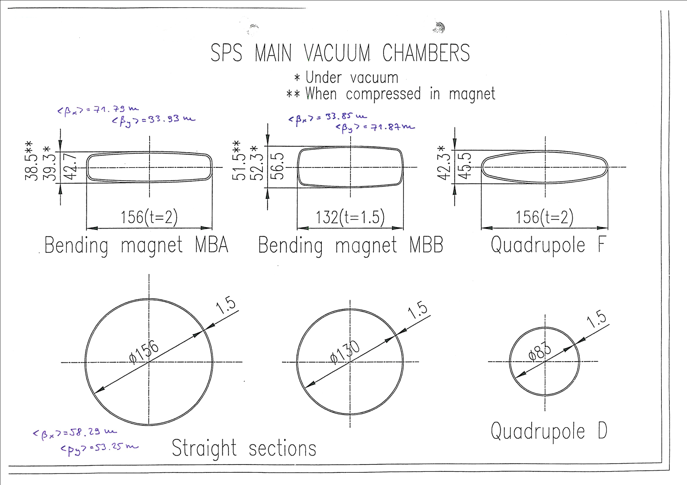
E-cloud studies for the SPS

Slide 112
E-cloud studies for the SPS
  Different e-cloud experiments are available (Strip detectors, shielded pickup, aC coated magnets and straight sections). Much data collected during 2012 Scrubbing Run and MD session. Analysis and simulation benchmarking is ongoing.
Example of shielded pickup measurement

Slide 113
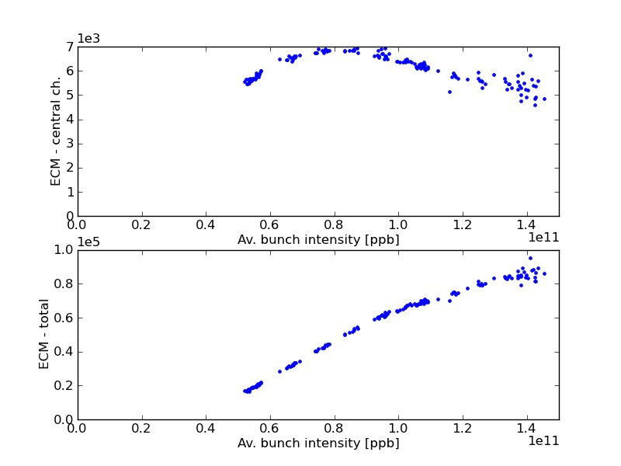
E-cloud studies for the SPS
  Different e-cloud experiments are available (Strip detectors, shielded pickup, aC coated magnets and straight sections). Much data collected during 2012 Scrubbing Run and MD session. Analysis and simulation benchmarking is ongoing.
Strip-detector measurements on MBA profile

Slide 114
Outline
  A few basic concepts on e-cloud build-up
  PyEcloud: How do we simulate the e-cloud build-up
      Flow-chart
      MP size management
      Convergence and performances
  Overview of e-cloud studies for CERN accelerators:
      e-cloud studies for the PS and SPS
      e-cloud studies for the LHC
        25ns observation benchmarking for the arcs
        e-cloud build-up in in 800mm common pipe near IP2

Slide 115
25ns tests in the LHC
Beam 1
Beam 2
Energy
29/06
07/10
14/10
24-25/10
DATE | SHORT DESCRIPTION
29 June | Injections of 9 x 24b trains per beam with different spacings between them
26 August | Two attempts to inject a 48b train with damper on and off: fast instability dumps the beam within 500 turns in both cases (SBI and CBI)
7 October | High chromaticity (Q’_{x,y} ≈15): Injection tests with trains of 72-144-216-288 bunches from the SPS + ramp to 3.5 TeV & 5h store with 60b (12+24+24) per beam
14 October | High chromaticity: injection of up to 1020 bunches per beam in 72b trains (decreasing spacings between trains at each fill: 6.3–3.2–1 μs)
24-25 October | Injection of up to 2100 bunches in Beam 1 and 1020 in Beam 2 (1μs train spacing)
Scrubbing

Slide 116
Simulation approach
  The entire beam with measured bunch intensities and bunch lengths has been simulated:
  From FBCT
  From BQM

Slide 117
Simulation approach
  The entire beam with measured bunch intensities and bunch lengths has been simulated:
  From FBCT
  From BQM

Slide 118
Simulation approach
  The entire beam with measured bunch intensities and bunch lengths has been simulated:
  From FBCT
  From BQM

Slide 119
Heat load
Beam 1
Beam 2
Energy
29/06
07/10
14/10
24-25/10
29/06
07/10
14/10
24-25/10
Thanks to S. Clodet, L. Tavian

Slide 120
Heat load
Beam 1
Beam 2
Energy
29/06
07/10
14/10
24-25/10
29/06
07/10
14/10
24-25/10
Six snapshots from the 25ns MDs to reproduce the measured heat load by simulations!

Slide 121
Heat load
29/06
07/10
14/10
24-25/10
50ns
2011 scrubbing history of LHC arcs
δ_{max} has decreased from the initial 2.1 to 1.52 in the arcs !
25ns threshold @450 GeV
25ns threshold @3.5 TeV

Slide 122
Bunch energy loss
Simulations → δ_{max} fixed to 1.5
(added 2e9p⁺/m uncapt. beam)
Measurements → the energy loss per bunch is obtained from the stable phase shift
ZOOM
Beam 1
Thanks to J. E. Muller, E. Shaposhnikova

Slide 123
Bunch energy loss
Thanks to J. E. Muller, E. Shaposhnikova

Slide 124
Outline
  A few basic concepts on e-cloud build-up
  PyEcloud: How do we simulate the e-cloud build-up
      Flow-chart
      MP size management
      Convergence and performances
  Overview of e-cloud studies for CERN accelerators:
      e-cloud studies for the PS and SPS
      e-cloud studies for the LHC
        25ns observation benchmarking for the arcs
        e-cloud build-up in in 800mm common pipe near IP2

Slide 125
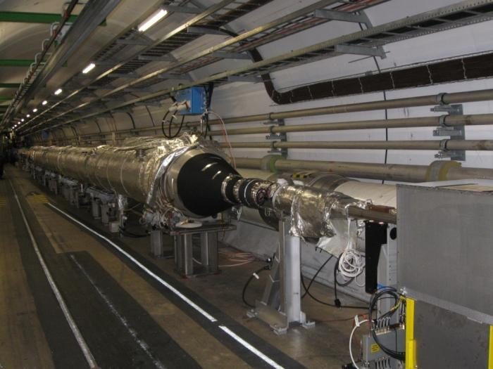
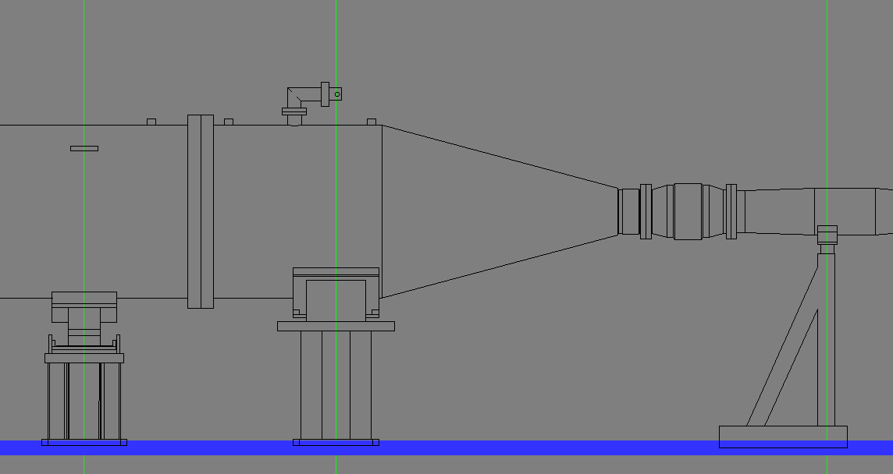
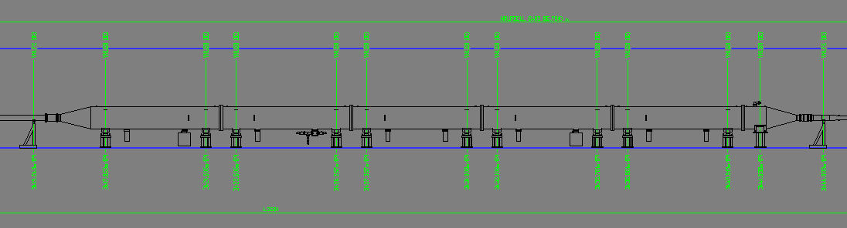
800mm vacuum chamber @ IP2
  Vacuum team has reported pressure rise in 800mm common vacuum chambers on both sides of ALICE, with significant impact on background
Ø 80cm
Ø 20cm
27m

Slide 126
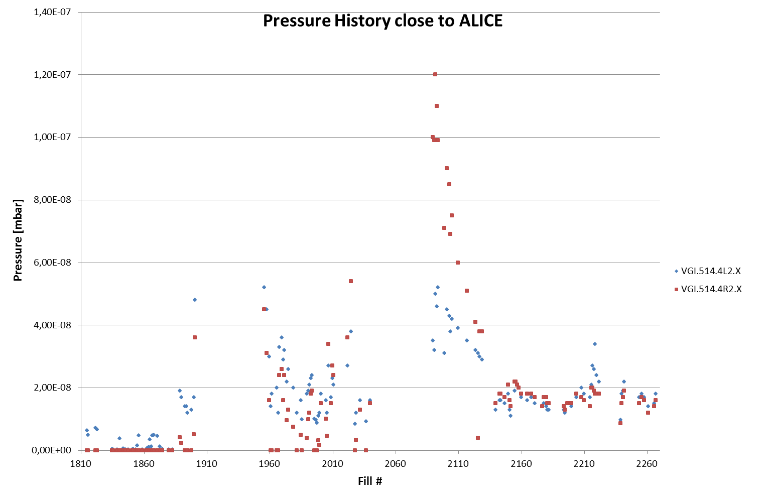
Vacuum observations
  Pressure measurements in the 800mm chambers on both sides of ALICE
  Number of bunches per beam
1236
1092
1380
ALICE polarity flip seems to cause further worsening of vacuum quality followed by a slow conditioning
Thanks to O. Dominguez, V. Baglin

Slide 127
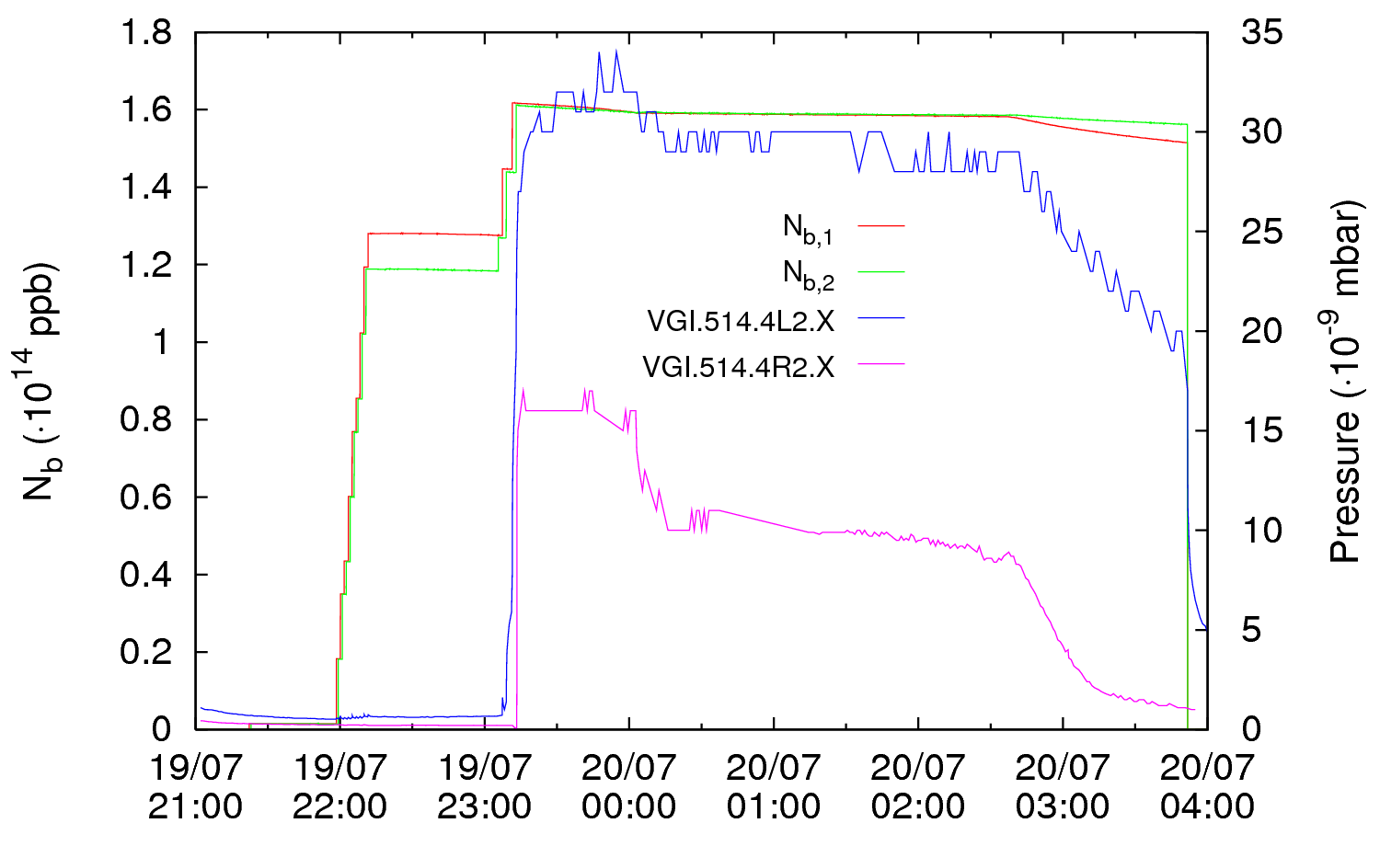
Vacuum observations
Ramp
  Fill 1960 19-20/07/2011
Thanks to O. Dominguez, V. Baglin

Slide 128
800mm chamber – two beams simulations
To check if our model of e-cloud can explain the observed behavior of pressure rise, we have simulated the electron cloud build up in the 800mm chamber before and after the last two injections
  Fill 1960 19-20/07/2011
Simulated conditions

Slide 129
800mm chamber – two beams simulations
Before the last two injections (144 bunches per injection) about 1/4 of each ring is still empty
  1st turn
  2nd turn
  LSS2

Slide 130
800mm chamber – two beams simulations
Before the last two injections (144 bunches per injection) about 1/4 of each ring is still empty
  1st turn
  2nd turn
  LSS2

Slide 131
800mm chamber – two beams simulations
Before the last two injections (144 bunches per injection) about 1/4 of each ring is still empty
  1st turn
  2nd turn
  LSS2

Slide 132
800mm chamber – two beams simulations
Before the last two injections (144 bunches per injection) about 1/4 of each ring is still empty
  1st turn
  2nd turn
  LSS2

Slide 133
800mm chamber – two beams simulations
Before the last two injections (144 bunches per injection) about 1/4 of each ring is still empty
  1st turn
  2nd turn
  LSS2

Slide 134
800mm chamber – two beams simulations
  1st turn
  2nd turn
  LSS2

Slide 135
800mm chamber – two beams simulations
Before the last two injections (144 bunches per injection) about 1/4 of each ring is still empty
  1st turn
  2nd turn
  LSS2

Slide 136
800mm chamber – two beams simulations
Before the last two injections (144 bunches per injection) about 1/4 of each ring is still empty
  1st turn
  2nd turn
  LSS2

Slide 137
800mm chamber – two beams simulations
e-cloud buildup is observed when both beams are passing in the 800mm chamber
  1st turn
  2nd turn
  LSS2

Slide 138
800mm chamber – two beams simulations
e-cloud buildup is observed when both beams are passing in the 800mm chamber
  1st turn
  2nd turn
  LSS2

Slide 139
800mm chamber – two beams simulations
e-cloud buildup is observed when both beams are passing in the 800mm chamber
  1st turn
  2nd turn
  LSS2

Slide 140
800mm chamber – two beams simulations
e-cloud buildup is observed when both beams are passing in the 800mm chamber
  1st turn
  2nd turn
  LSS2

Slide 141
800mm chamber – two beams simulations
e-cloud buildup is observed when both beams are passing in the 800mm chamber
  1st turn
  2nd turn
  LSS2

Slide 142
800mm chamber – two beams simulations
e-cloud buildup is observed when both beams are passing in the 800mm chamber
  1st turn
  2nd turn
  LSS2

Slide 143
800mm chamber – two beams simulations
e-cloud buildup is observed when both beams are passing in the 800mm chamber
  1st turn
  2nd turn
  LSS2

Slide 144
800mm chamber – two beams simulations
A slow decay of the e-cloud is observed when only one 50ns beam is passing in the 800mm chamber
  1st turn
  2nd turn
  LSS2

Slide 145
800mm chamber – two beams simulations
A slow decay of the e-cloud is observed when only one 50ns beam is passing in the 800mm chamber
  1st turn
  2nd turn
  LSS2

Slide 146
800mm chamber – two beams simulations
A slow decay of the e-cloud is observed when only one 50ns beam is passing in the 800mm chamber
  1st turn
  2nd turn
  LSS2

Slide 147
800mm chamber – two beams simulations
A slow decay of the e-cloud is observed when only one 50ns beam is passing in the 800mm chamber
  1st turn
  2nd turn
  LSS2

Slide 148
800mm chamber – two beams simulations
A slow decay of the e-cloud is observed when only one 50ns beam is passing in the 800mm chamber
  1st turn
  2nd turn
  LSS2

Slide 149
800mm chamber – two beams simulations
A slow decay of the e-cloud is observed when only one 50ns beam is passing in the 800mm chamber
  1st turn
  2nd turn
  LSS2

Slide 150
800mm chamber – two beams simulations
A slow decay of the e-cloud is observed when only one 50ns beam is passing in the 800mm chamber
  1st turn
  2nd turn
  LSS2

Slide 151
800mm chamber – two beams simulations
A slow decay of the e-cloud is observed when only one 50ns beam is passing in the 800mm chamber
  1st turn
  2nd turn
  LSS2

Slide 152
800mm chamber – two beams simulations
A slow decay of the e-cloud is observed when only one 50ns beam is passing in the 800mm chamber
  1st turn
  2nd turn
  LSS2

Slide 153
800mm chamber – two beams simulations
A slow decay of the e-cloud is observed when only one 50ns beam is passing in the 800mm chamber
  1st turn
  2nd turn
  LSS2

Slide 154
800mm chamber – two beams simulations
A slow decay of the e-cloud is observed when only one 50ns beam is passing in the 800mm chamber
  1st turn
  2nd turn
  LSS2

Slide 155
800mm chamber – two beams simulations
A slow decay of the e-cloud is observed when only one 50ns beam is passing in the 800mm chamber
  1st turn
  2nd turn
  LSS2

Slide 156
800mm chamber – two beams simulations
A slow decay of the e-cloud is observed when only one 50ns beam is passing in the 800mm chamber
  1st turn
  2nd turn
  LSS2

Slide 157
800mm chamber – two beams simulations
A slow decay of the e-cloud is observed when only one 50ns beam is passing in the 800mm chamber
  1st turn
  2nd turn
  LSS2

Slide 158
800mm chamber – two beams simulations
A slow decay of the e-cloud is observed when only one 50ns beam is passing in the 800mm chamber
  1st turn
  2nd turn
  LSS2

Slide 159
800mm chamber – two beams simulations
No memory effect between following turns is observed
  1st turn
  2nd turn
  LSS2

Slide 160
800mm chamber – two beams simulations
No memory effect between following turns is observed
  1st turn
  2nd turn
  LSS2

Slide 161
800mm chamber – two beams simulations
No memory effect between following turns is observed
  1st turn
  2nd turn
  LSS2

Slide 162
800mm chamber – two beams simulations
No memory effect between following turns is observed
  1st turn
  2nd turn
  LSS2

Slide 163
800mm chamber – two beams simulations
No memory effect between following turns is observed
  1st turn
  2nd turn
  LSS2

Slide 164
800mm chamber – two beams simulations
No memory effect between following turns is observed
  1st turn
  2nd turn
  LSS2

Slide 165
800mm chamber – two beams simulations
No memory effect between following turns is observed
  1st turn
  2nd turn
  LSS2

Slide 166
800mm chamber – two beams simulations
No memory effect between following turns is observed
  1st turn
  2nd turn
  LSS2

Slide 167
800mm chamber – two beams simulations
No memory effect between following turns is observed
  1st turn
  2nd turn
  LSS2

Slide 168
800mm chamber – two beams simulations
No memory effect between following turns is observed
  1st turn
  2nd turn
  LSS2

Slide 169
800mm chamber – two beams simulations
No memory effect between following turns is observed
  1st turn
  2nd turn
  LSS2

Slide 170
800mm chamber – two beams simulations
No memory effect between following turns is observed
  1st turn
  2nd turn
  LSS2

Slide 171
800mm chamber – two beams simulations
No memory effect between following turns is observed
  1st turn
  2nd turn
  LSS2

Slide 172
800mm chamber – two beams simulations
No memory effect between following turns is observed
  1st turn
  2nd turn
  LSS2

Slide 173
800mm chamber – two beams simulations
No memory effect between following turns is observed
  1st turn
  2nd turn
  LSS2

Slide 174
800mm chamber – two beams simulations
No memory effect between following turns is observed
  1st turn
  2nd turn
  LSS2

Slide 175
800mm chamber – two beams simulations
No memory effect between following turns is observed
  1st turn
  2nd turn
  LSS2

Slide 176
800mm chamber – two beams simulations
No memory effect between following turns is observed
  1st turn
  2nd turn
  LSS2

Slide 177
800mm chamber – two beams simulations
No memory effect between following turns is observed
  1st turn
  2nd turn
  LSS2

Slide 178
800mm chamber – two beams simulations
No memory effect between following turns is observed
  1st turn
  2nd turn
  LSS2

Slide 179
800mm chamber – two beams simulations
No memory effect between following turns is observed
  1st turn
  2nd turn
  LSS2

Slide 180
800mm chamber – two beams simulations
No memory effect between following turns is observed
  1st turn
  2nd turn
  LSS2

Slide 181
800mm chamber – two beams simulations
No memory effect between following turns is observed
  1st turn
  2nd turn
  LSS2

Slide 182
800mm chamber – two beams simulations
No memory effect between following turns is observed
  1st turn
  2nd turn
  LSS2

Slide 183
800mm chamber – two beams simulations
No memory effect between following turns is observed
  1st turn
  2nd turn
  LSS2

Slide 184
800mm chamber – two beams simulations
No memory effect between following turns is observed
  1st turn
  2nd turn
  LSS2

Slide 185
800mm chamber – two beams simulations
No memory effect between following turns is observed
  1st turn
  2nd turn
  LSS2

Slide 186
800mm chamber – two beams simulations
No memory effect between following turns is observed
  1st turn
  2nd turn
  LSS2

Slide 187
800mm chamber – two beams simulations
To check if our model of e-cloud can explain the observed behavior of pressure rise, we have simulated the electron cloud build up in the 800mm chamber before and after the last two injections
  Fill 1960 19-20/07/2011
Simulated conditions

Slide 188
800mm chamber – two beams simulations
At the end of injection the two rings look quite completely filled, the largest holes being the two abort gaps
  1st turn
  2nd turn
  LSS2

Slide 189
800mm chamber – two beams simulations
At the end of injection the two rings look quite completely filled, the largest holes being the two abort gaps
  1st turn
  2nd turn
  LSS2

Slide 190
800mm chamber – two beams simulations
At the end of injection the two rings look quite completely filled, the largest holes being the two abort gaps
  1st turn
  2nd turn
  LSS2

Slide 191
800mm chamber – two beams simulations
At the end of injection the two rings look quite completely filled, the largest holes being the two abort gaps
  1st turn
  2nd turn
  LSS2

Slide 192
800mm chamber – two beams simulations
At the end of injection the two rings look quite completely filled, the largest holes being the two abort gaps
  1st turn
  2nd turn
  LSS2

Slide 193
800mm chamber – two beams simulations
At the end of injection the two rings look quite completely filled, the largest holes being the two abort gaps
  1st turn
  2nd turn
  LSS2

Slide 194
800mm chamber – two beams simulations
At the end of injection the two rings look quite completely filled, the largest holes being the two abort gaps
  1st turn
  2nd turn
  LSS2

Slide 195
800mm chamber – two beams simulations
At the end of injection the two rings look quite completely filled, the largest holes being the two abort gaps
  1st turn
  2nd turn
  LSS2

Slide 196
800mm chamber – two beams simulations
At the end of injection the two rings look quite completely filled, the largest holes being the two abort gaps
  1st turn
  2nd turn
  LSS2

Slide 197
800mm chamber – two beams simulations
At the end of injection the two rings look quite completely filled, the largest holes being the two abort gaps
  1st turn
  2nd turn
  LSS2

Slide 198
800mm chamber – two beams simulations
At the end of injection the two rings look quite completely filled, the largest holes being the two abort gaps
  1st turn
  2nd turn
  LSS2

Slide 199
800mm chamber – two beams simulations
At the end of injection the two rings look quite completely filled, the largest holes being the two abort gaps
  1st turn
  2nd turn
  LSS2

Slide 200
800mm chamber – two beams simulations
At the end of injection the two rings look quite completely filled, the largest holes being the two abort gaps
  1st turn
  2nd turn
  LSS2

Slide 201
800mm chamber – two beams simulations
At the end of injection the two rings look quite completely filled, the largest holes being the two abort gaps
  1st turn
  2nd turn
  LSS2

Slide 202
800mm chamber – two beams simulations
At the end of injection the two rings look quite completely filled, the largest holes being the two abort gaps
  1st turn
  2nd turn
  LSS2

Slide 203
800mm chamber – two beams simulations
At the end of injection the two rings look quite completely filled, the largest holes being the two abort gaps
  1st turn
  2nd turn
  LSS2

Slide 204
800mm chamber – two beams simulations
At the end of injection the two rings look quite completely filled, the largest holes being the two abort gaps
  1st turn
  2nd turn
  LSS2

Slide 205
800mm chamber – two beams simulations
At the end of injection the two rings look quite completely filled, the largest holes being the two abort gaps
  1st turn
  2nd turn
  LSS2

Slide 206
800mm chamber – two beams simulations
At the end of injection the two rings look quite completely filled, the largest holes being the two abort gaps
  1st turn
  2nd turn
  LSS2

Slide 207
800mm chamber – two beams simulations
At the end of injection the two rings look quite completely filled, the largest holes being the two abort gaps
  1st turn
  2nd turn
  LSS2

Slide 208
800mm chamber – two beams simulations
At the end of injection the two rings look quite completely filled, the largest holes being the two abort gaps
  1st turn
  2nd turn
  LSS2

Slide 209
800mm chamber – two beams simulations
At the end of injection the two rings look quite completely filled, the largest holes being the two abort gaps
  1st turn
  2nd turn
  LSS2

Slide 210
800mm chamber – two beams simulations
At the end of injection the two rings look quite completely filled, the largest holes being the two abort gaps
  1st turn
  2nd turn
  LSS2

Slide 211
800mm chamber – two beams simulations
At the end of injection the two rings look quite completely filled, the largest holes being the two abort gaps
  1st turn
  2nd turn
  LSS2

Slide 212
800mm chamber – two beams simulations
At the end of injection the two rings look quite completely filled, the largest holes being the two abort gaps
  1st turn
  2nd turn
  LSS2

Slide 213
800mm chamber – two beams simulations
At the end of injection the two rings look quite completely filled, the largest holes being the two abort gaps
  1st turn
  2nd turn
  LSS2

Slide 214
800mm chamber – two beams simulations
At the end of injection the two rings look quite completely filled, the largest holes being the two abort gaps
  1st turn
  2nd turn
  LSS2

Slide 215
800mm chamber – two beams simulations
At the end of injection the two rings look quite completely filled, the largest holes being the two abort gaps
  1st turn
  2nd turn
  LSS2

Slide 216
800mm chamber – two beams simulations
At the end of injection the two rings look quite completely filled, the largest holes being the two abort gaps
  1st turn
  2nd turn
  LSS2

Slide 217
800mm chamber – two beams simulations
At the end of injection the two rings look quite completely filled, the largest holes being the two abort gaps
  1st turn
  2nd turn
  LSS2

Slide 218
800mm chamber – two beams simulations
At the end of injection the two rings look quite completely filled, the largest holes being the two abort gaps
  1st turn
  2nd turn
  LSS2

Slide 219
800mm chamber – two beams simulations
At the end of injection the two rings look quite completely filled, the largest holes being the two abort gaps
  1st turn
  2nd turn
  LSS2

Slide 220
800mm chamber – two beams simulations
At the end of injection the two rings look quite completely filled, the largest holes being the two abort gaps
  1st turn
  2nd turn
  LSS2

Slide 221
800mm chamber – two beams simulations
At the end of injection the two rings look quite completely filled, the largest holes being the two abort gaps
  1st turn
  2nd turn
  LSS2

Slide 222
800mm chamber – two beams simulations
At the end of injection the two rings look quite completely filled, the largest holes being the two abort gaps
  1st turn
  2nd turn
  LSS2

Slide 223
800mm chamber – two beams simulations
At the end of injection the two rings look quite completely filled, the largest holes being the two abort gaps
  1st turn
  2nd turn
  LSS2

Slide 224
800mm chamber – two beams simulations
At the end of injection the two rings look quite completely filled, the largest holes being the two abort gaps
  1st turn
  2nd turn
  LSS2

Slide 225
800mm chamber – two beams simulations
At the end of injection the two rings look quite completely filled, the largest holes being the two abort gaps
  1st turn
  2nd turn
  LSS2

Slide 226
800mm chamber – two beams simulations
At the end of injection the two rings look quite completely filled, the largest holes being the two abort gaps
  1st turn
  2nd turn
  LSS2

Slide 227
800mm chamber – two beams simulations
At the end of injection the two rings look quite completely filled, the largest holes being the two abort gaps
  1st turn
  2nd turn
  LSS2

Slide 228
800mm chamber – two beams simulations
At the end of injection the two rings look quite completely filled, the largest holes being the two abort gaps
  1st turn
  2nd turn
  LSS2

Slide 229
800mm chamber – two beams simulations
At the end of injection the two rings look quite completely filled, the largest holes being the two abort gaps
  1st turn
  2nd turn
  LSS2

Slide 230
800mm chamber – two beams simulations
At the end of injection the two rings look quite completely filled, the largest holes being the two abort gaps
  1st turn
  2nd turn
  LSS2

Slide 231
800mm chamber – two beams simulations
At the end of injection the two rings look quite completely filled, the largest holes being the two abort gaps
  1st turn
  2nd turn
  LSS2

Slide 232
800mm chamber – two beams simulations
At the end of injection the two rings look quite completely filled, the largest holes being the two abort gaps
  1st turn
  2nd turn
  LSS2

Slide 233
800mm chamber – two beams simulations
At the end of injection the two rings look quite completely filled, the largest holes being the two abort gaps
  1st turn
  2nd turn
  LSS2

Slide 234
800mm chamber – two beams simulations
At the end of injection the two rings look quite completely filled, the largest holes being the two abort gaps
  1st turn
  2nd turn
  LSS2

Slide 235
800mm chamber – two beams simulations
At the end of injection the two rings look quite completely filled, the largest holes being the two abort gaps
  1st turn
  2nd turn
  LSS2

Slide 236
800mm chamber – two beams simulations
At the end of injection the two rings look quite completely filled, the largest holes being the two abort gaps
  1st turn
  2nd turn
  LSS2

Slide 237
800mm chamber – two beams simulations
At the end of injection the two rings look quite completely filled, the largest holes being the two abort gaps
  1st turn
  2nd turn
  LSS2

Slide 238
800mm chamber – two beams simulations
At the end of injection the two rings look quite completely filled, the largest holes being the two abort gaps
  1st turn
  2nd turn
  LSS2

Slide 239
800mm chamber – two beams simulations
At the end of injection the two rings look quite completely filled, the largest holes being the two abort gaps
  1st turn
  2nd turn
  LSS2

Slide 240
800mm chamber – two beams simulations
At the end of injection the two rings look quite completely filled, the largest holes being the two abort gaps
  1st turn
  2nd turn
  LSS2

Slide 241
800mm chamber – two beams simulations
At the end of injection the two rings look quite completely filled, the largest holes being the two abort gaps
  1st turn
  2nd turn
  LSS2

Slide 242
800mm chamber – two beams simulations
At the end of injection the two rings look quite completely filled, the largest holes being the two abort gaps
  1st turn
  2nd turn
  LSS2

Slide 243
800mm chamber – two beams simulations
At the end of injection the two rings look quite completely filled, the largest holes being the two abort gaps
  1st turn
  2nd turn
  LSS2

Slide 244
800mm chamber – two beams simulations
At the end of injection the two rings look quite completely filled, the largest holes being the two abort gaps
  1st turn
  2nd turn
  LSS2

Slide 245
800mm chamber – two beams simulations
At the end of injection the two rings look quite completely filled, the largest holes being the two abort gaps
  1st turn
  2nd turn
  LSS2

Slide 246
800mm chamber – two beams simulations
At the end of injection the two rings look quite completely filled, the largest holes being the two abort gaps
  1st turn
  2nd turn
  LSS2

Slide 247
800mm chamber – two beams simulations
At the end of injection the two rings look quite completely filled, the largest holes being the two abort gaps
  1st turn
  2nd turn
  LSS2

Slide 248
800mm chamber – two beams simulations
Memory effect is observed between turns, which can strongly enhance the electron cloud
  1st turn
  2nd turn
  LSS2

Slide 249
Future work / Wish list
  Arbitrary externally assigned magnetic/electric field maps (quadrupole, combined function magnet, clearing electrode)
  Non elliptical boundary condition on chamber’s wall
  Non uniform secondary electron yield (including EC detector simulation)
  Integration with the HEADTAIL code for a self consistent model
  Benchmarking with machine observations and measurements (collected and to be collected)
  Parallelization (GPU?)
PyEcloud
HEADTAIL

Slide 250
Thanks for your attention!

