Slide 1
The SPS 800 MHz RF system
E. Shaposhnikova for BE/RF
LIU-SPS Coordination meeting
4 April 2012
Acknowledgments: T. Argyropoulos, T. Bohl, T. Linnecar, E. Montesinos

Slide 2
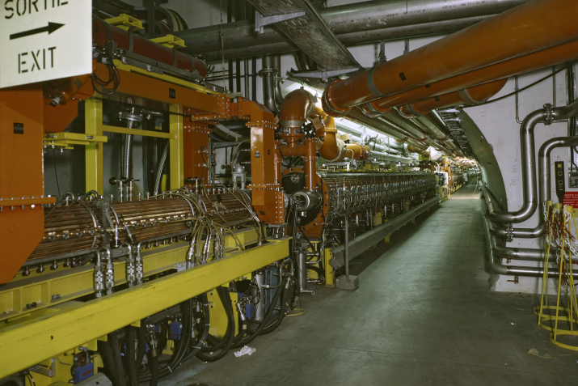
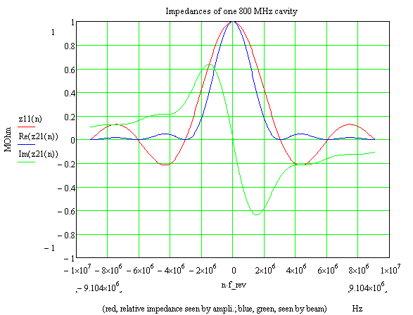
800 MHz RF system in the SPS
2 Travelling Wave cavities installed
3 sections/cavity, 13 cells/section
but only one used (has RF power)
2nd cavity is idle
=> induced voltage in 2 cavities
Power in 1 cavity (E. Montesinos):
  100 kW (in continuous mode)
  (original plant 225 kW/cavity)
Voltage:
now maximum asked 600 kV,
probably just obtained for high intensities
impedance

Slide 3
800 MHz RF system in the SPS
Is required for beam stability above bunch intensity of (2-3)x10¹⁰
It is used for all LHC beams from injection to extraction in bunch shortening mode
Its phase is locked to the 200 MHz voltage, but the relative phase should be programmed during the cycle (according to the stable phase). Absolute phase is calibrated at the start of each run from beam measurements (bunch tilt at injection and beam stability during the cycle)
It is essential but not sufficient for beam stability above nominal intensities and controlled longitudinal emittance blow-up is applied using band limited noise. It should be inside synchrotron frequency distribution which depends on the voltage and phase of the 800 MHz RF system affected by beam loading

Slide 4
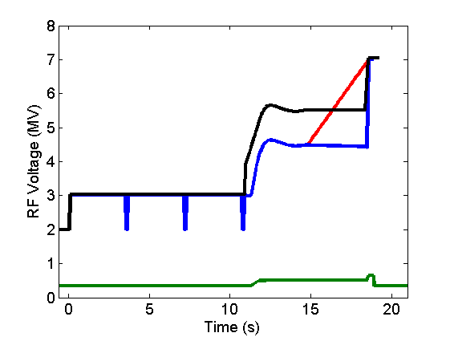
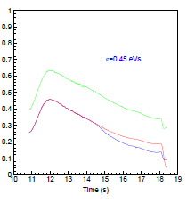
SPS voltage programs in operation and MDs
transfer to LHC
Instability threshold
decreases with energy during the SPS cycle
ultimate 25 ns
200 MHz
Rsh [MOhm]
nominal beams
ultimate 50 ns
800 MHz
+ 800 MHz
200 MHz
Higher voltages (200 MHz and 800 MHz) were used for ultimate beam intensities

Slide 5
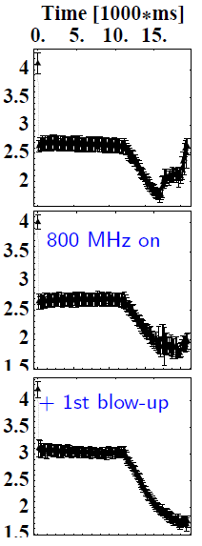
Longitudinal coupled bunch instability
Bunch length [ns] during the cycle (T. Bohl)
Threshold: single batch (25 ns spacing) with 2x10¹⁰/bunch (2006, 3x10¹⁰ before) is unstable at the end of the ramp
Possible source: fundamental or HOMs of
200 & 800 MHz RF systems (not known)
Cures:
- FB, FF, longitudinal damper for 200 MHz
- 800 MHz RF system in bunch shortening mode through the cycle
- controlled longitudinal emittance blow-up (0.35 eVs → 0.42 eVs → 0.63 eVs)

Slide 6
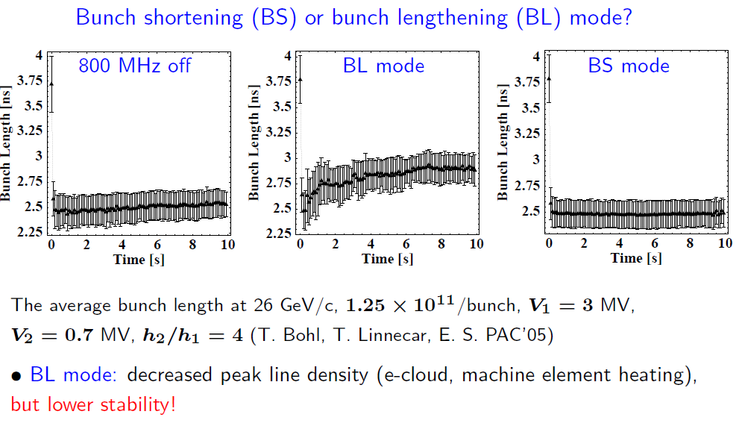
Landau Damping

Slide 7
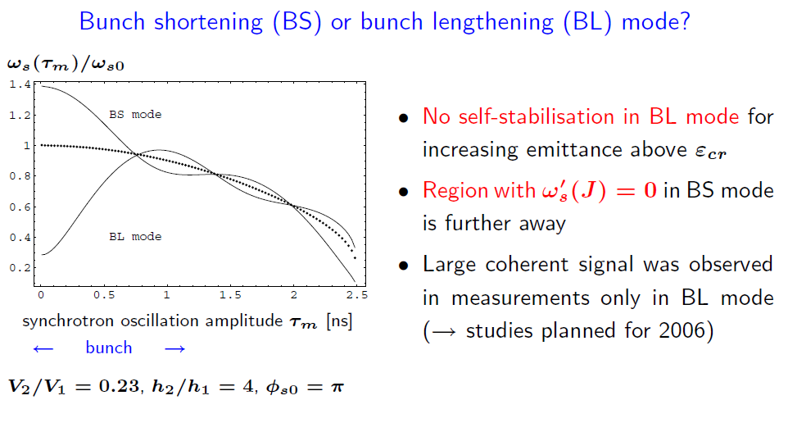
Landau Damping

Slide 8
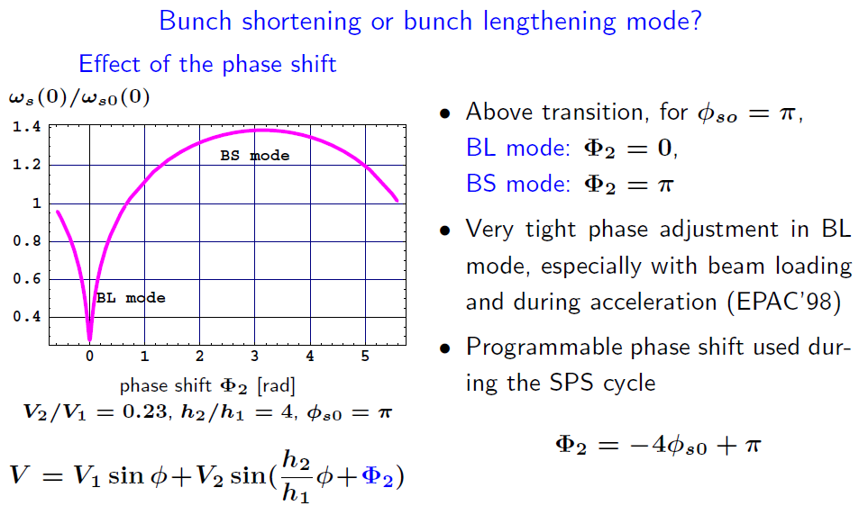
Landau Damping

Slide 9
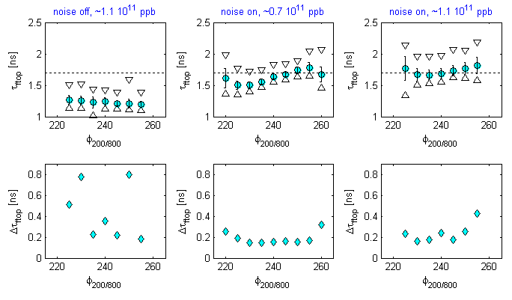
Bunch length and stability at 450 GeV/c as a function of the 800 MHz phase
Bunch length (av., max-min)
at 450 GeV/c
Beam stability
from ∆τ
G. Papotti et al.
Higher 800 MHz voltage was used (in voltage program)
for ultimate beam intensities

Slide 10
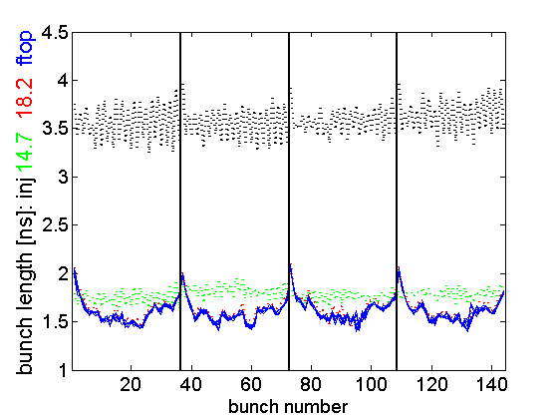
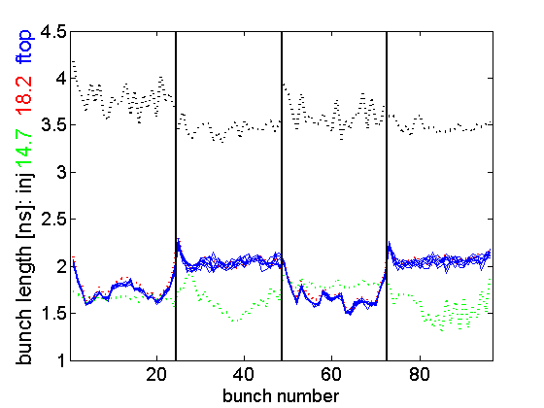
Non-uniform controlled longitudinal emittance blow-up in a double RF system of the SPS
50 ns beam
75 ns beam
ni
Non-uniform emittance blow-up due to beam loading in a double RF system
=> 800 MHz upgrade needed!
Non-uniform emittance blow-up and beam instability for short injected bunches

Slide 11
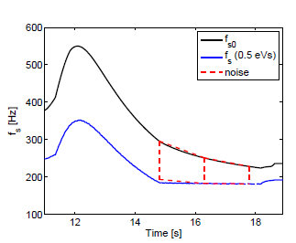
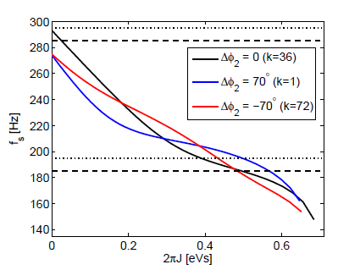
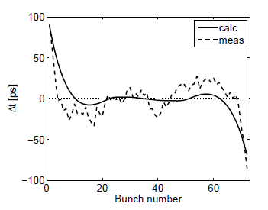


Issues with controlled emittance blow-up by band-limited noise
applied noise
synchrotron frequency
distribution varies along batch
T. Argyropoulos et al., HB2010
measured & calcul.
k-th bunch position ∆φ_{s}

Slide 12
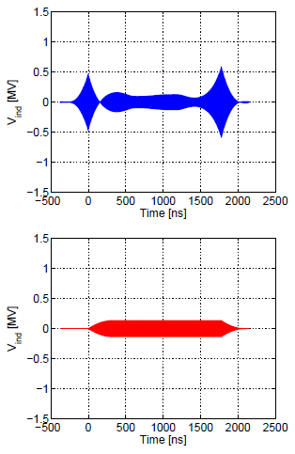
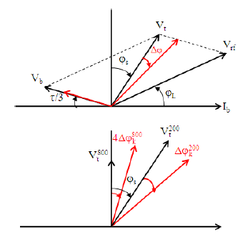
Beam induced voltage during ramp
200 MHz, 4.5 MV + FF&FB
steady
transient
400 MHz, 0.5 MV
Now the reference signal is sampled outside the beam
T. Argyropoulos et al., HB2010

Slide 13
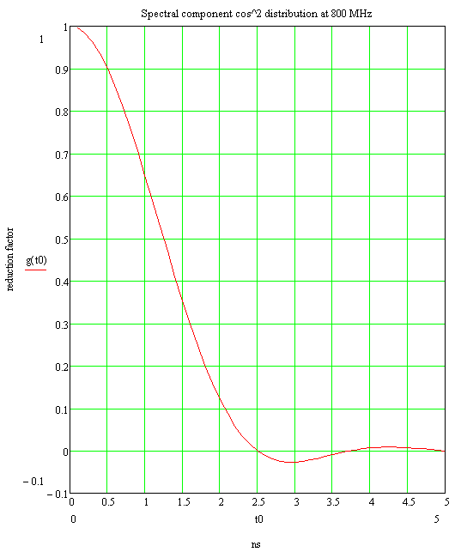
Basic induced voltage and power requirement
T. Linnecar, 2008
Nominal beam 25 ns 1.15*10¹¹
Ib 0.74 A
Peak Irf 1.48 A
g0 ~ 0.33 (Shortest bunch)
Irf800 0.45 A
Max. induced voltage, no RF feedback, Irf800 ~ 0.5 A
Two cavities ~ 2 MΩ 1 MV
Compare 700 kV imposed in operation
Even at 1/10 RF current 100 kV – not insignificant
Single nominal bunch ~ 100 kV
Power requirements:
IRF = 0.75 A 350 kV / cavity 84 kW/ cavity
700 kV / cavity 131 kW / cavity
240 kW + 2.6 dB
IRF = 0.5 A 350 kV / cavity 46 kW / cavity
700 kV / cavity 93 kW / cavity
IRF = 0.1 A 350 kV/ cavity 17 kW / cavity
700 kV /cavity 65 kW / cavity
IRF = 0 A 350 kV /cavity 16 kW / cavity
700 kV / cavity 65 kW / cavity
Effect of phase errors between beam and 800:
IRF = 0.5 A Phase (800) degs. @ 350 kV @ 700 kV
20 61 KW 123 kW
10 54 109
0 46 93
-10 38 78
-20 31 64
(Induced voltage with or against voltage imposed)
We need 700 KV – 350 KV
per cavity. If only one cavity
available then 700 kV per cavity
change of sign
1.5 ns bunch length go ~ 0.35
1.7 ns g0 ~ 0.2
3.0 ns g0 ~ -0.03
4.5 ns g0 ~ 0.01
Note change of sign and fast variation
at shorter bunch lengths. NB distribution only approximately cosine squared.

Slide 14
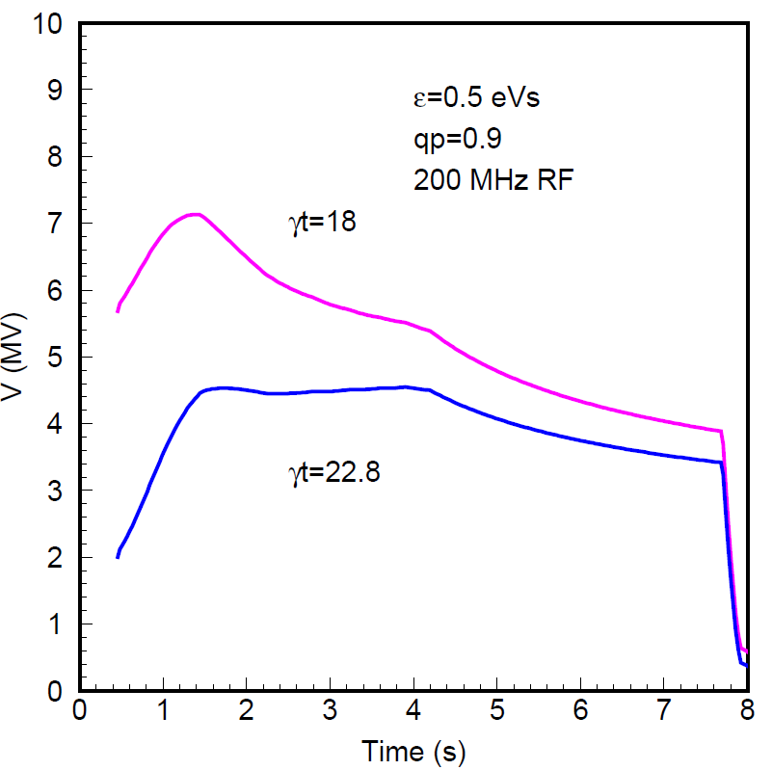
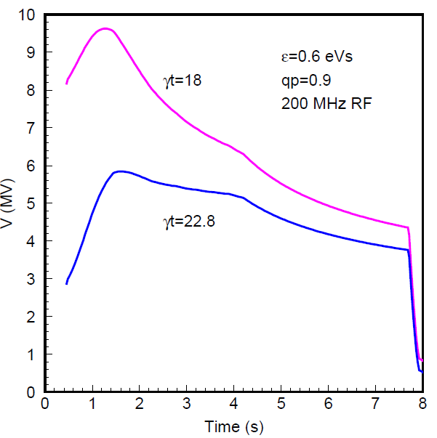
Nominal and ultimate intensities with nominal and Q20 optics
emit=0.5 eVs
emit=0.6 eVs

Slide 15
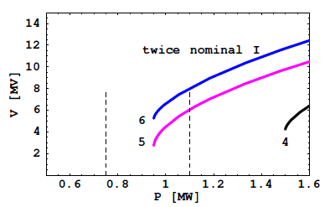
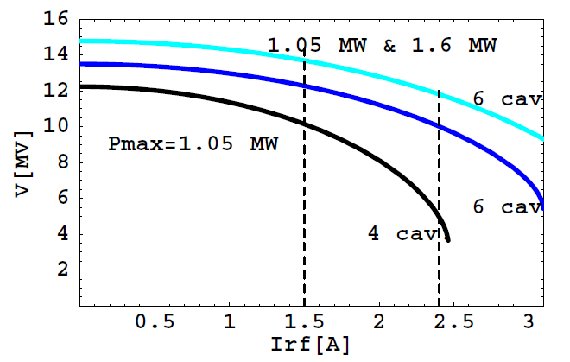
Total 200 MHz voltage on flat top after upgrade
as a function of power/cavity
with 1.6 MW from new power plants
for 2x4-sections cavities
at twice nominal current maximum 200 MHz voltage: 10 MV
=> 1 MV at 800 MHz

Slide 16
800 MHz TW RF system upgrade - summary
Due to induced voltage it is very difficult to control the 800 MHz voltage phase and amplitude which are essential for beam stability directly and via the use of controlled emittance blow-up which needs to be set-up for different beams
More 200 MHz voltage and therefore 800 MHz will be required for higher intensity beam transfer to the LHC. Low γ_{t} optics needs even more 200 MHz and 800 MHz RF voltage.
The 800 MHz voltage used at ~1/10 of the 200 MHz voltage (BSM)
Total voltage of 1.5 MV (700 kV/cavity) should be provided in future
for high intensity beams
Accurate phase control of the 800 MHz, at ~1 deg level also needed
The 800 MHz can be used for other high intensity beams (CNGS)
The first request for 1-turn FB was made in 2003!

Slide 17
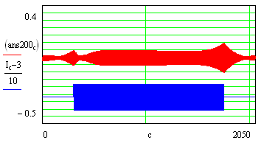
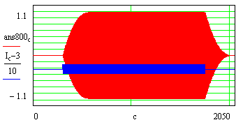
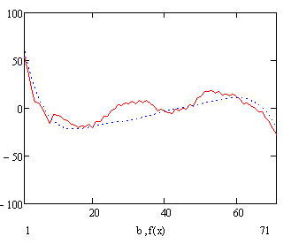
Transient effect along batch, T. Linnecar 2008
200 feedback and feedforward
800 no feedback
These transients move the local zeros of the total RF waveform
i.e. where the bunch sits.
Measured and calculated bunch position along batch.
(Details can be re-produced with delay errors etc.)
Note that the effect is different from batch to batch (gap)
Sharp change at beginning - needs 800 to be included.
These variations :
eat into the transfer margin
make stability and blow-up a function of bunch number

Slide 18
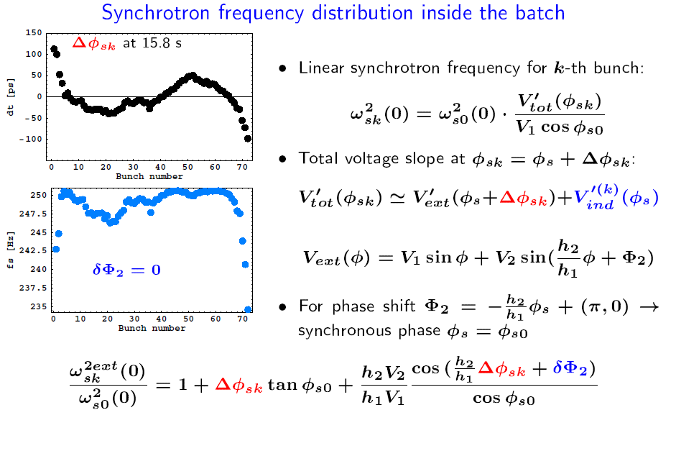
Controlled emittance blow-up in a double RF system

