Slide 1
SPS collective effects
Hannes, Gianni, Giovanni, Benoit, Yannis
Space charge
Electron cloud
TMCI
longitudinal limitations → covered by Elena

Slide 2
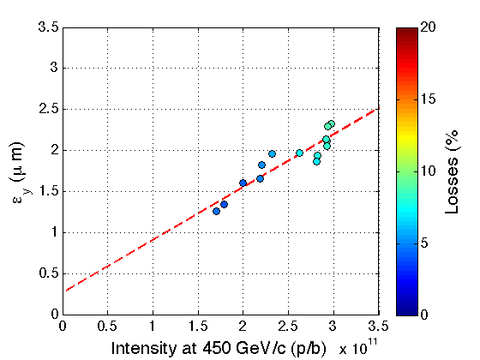
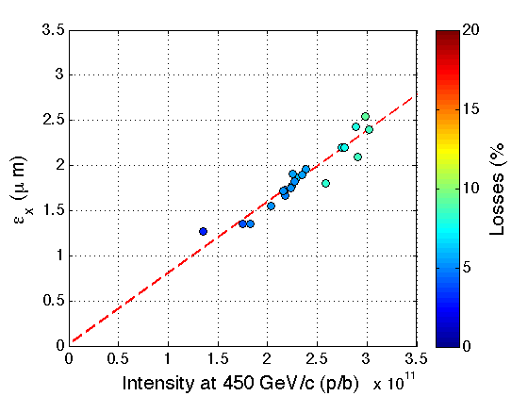
Space charge
Space charge is not a limitation for nominal and ultimate LHC parameters
For LIU :
  25 ns (2.2E11p/b at LHC injection with 2.5 mm.mrad)
  50 ns (3.5E11 p/b at LHC injection with 3 mm.mrad)
Note that the achievable density at SPS extraction is expected to strongly depend on the injected density

Slide 3
Electron cloud
25 ns, nominal intensity
  there is electron cloud in the SPS (pressure rise and instability with low vertical chromaticity)
  With typical chromaticity, acceptable beam quality
25 ns, high intensity (ultimate and LIU)
  baseline: coat large parts of SPS with aC in LS2
  machine studies in 2012 to identify
  (1) current intensity limit without coating
  (2) possible intermediate solutions (coating only MBB chambers)

Slide 4
TMCI
Nominal Q26 optics
  Threshold found at 1.6E11 p/b in Q26 with very low positive chromaticity and optimized settings to minimize damping mechanisms
  Above the threshold, need to increase chromaticity, leading to transverse emittance degradation
→ TMCI is a limitation for LIU in Q26 for both LHC25 and LHC50
New Q20 optics
  Threshold for Q20 not clearly found yet, despite very high intensities sent into the SPS (~5E11 p/b). However, many other effects can prevent the instability from appearing at such high intensities (e.g. space charge in combination with non linearities)
  → TMCI is not a limitation for LIU in Q20

