Slide 1
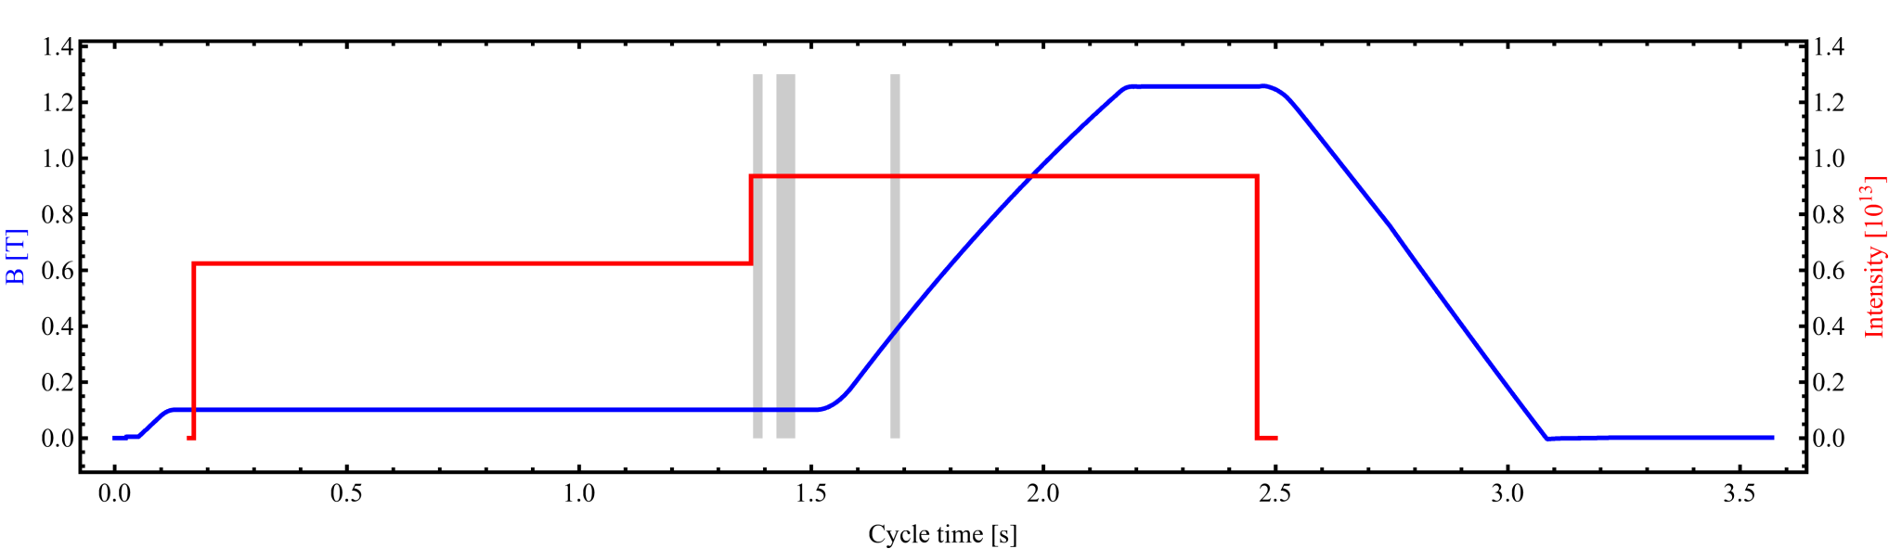
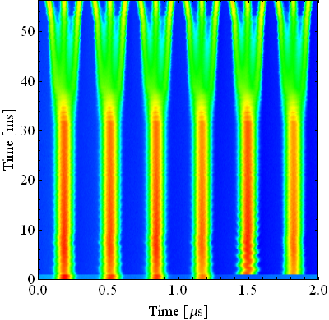
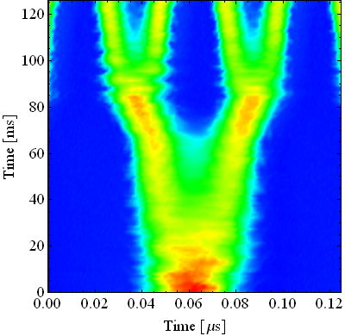
The LHC25ns cycle in the PS
γ_{tr}
Inject 4+2 bunches
Eject 72 bunches
(sketched)
Controlled blow-ups
h = 7
h = 21
Instability
h = 84
Triple splitting after 2nd injection
Split in four at flat top energy
2nd injection
1.4 GeV
26 GeV/c
→ Each bunch from the Booster divided by 12 → 6 × 3 × 2 × 2 = 72

Slide 2
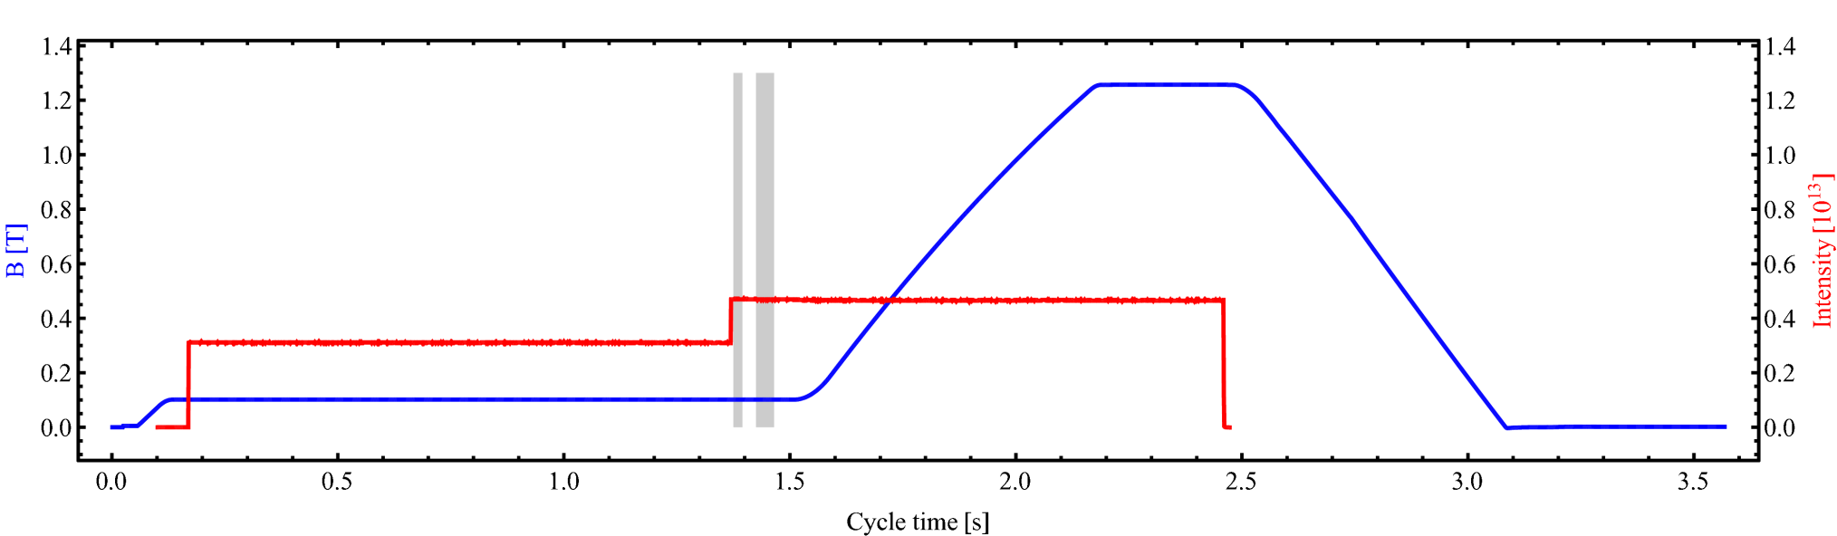
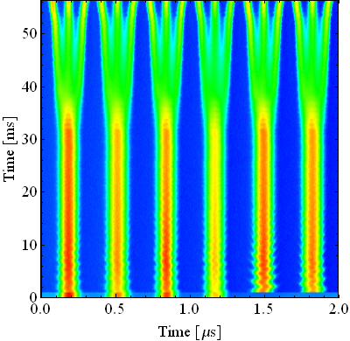
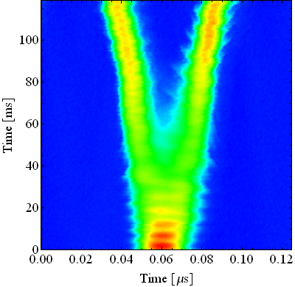
The LHC50ns cycle in the PS
Inject 4+2 bunches
Eject 36 bunches
γ_{tr}
Instability
Controlled blow-ups
h = 21
h = 7
h = 84
Triple splitting after 2nd injection
Split in two at flat top energy
2nd injection
1.4 GeV
26 GeV/c
→ Each bunch from the Booster divided by 6 → 6 × 3 × 2 = 36

Slide 3
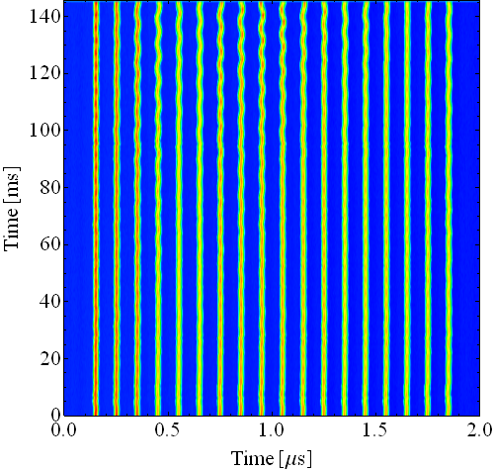
Longitudinal coupled-bunch observations
Without RF manipulations on the flat-top: Slowly (~100 ms) developing dipolar and quadrupolar coupled-bunch instabilities
Ejection
Analyze couple-bunch mode amplitudes and spectrum

Slide 4
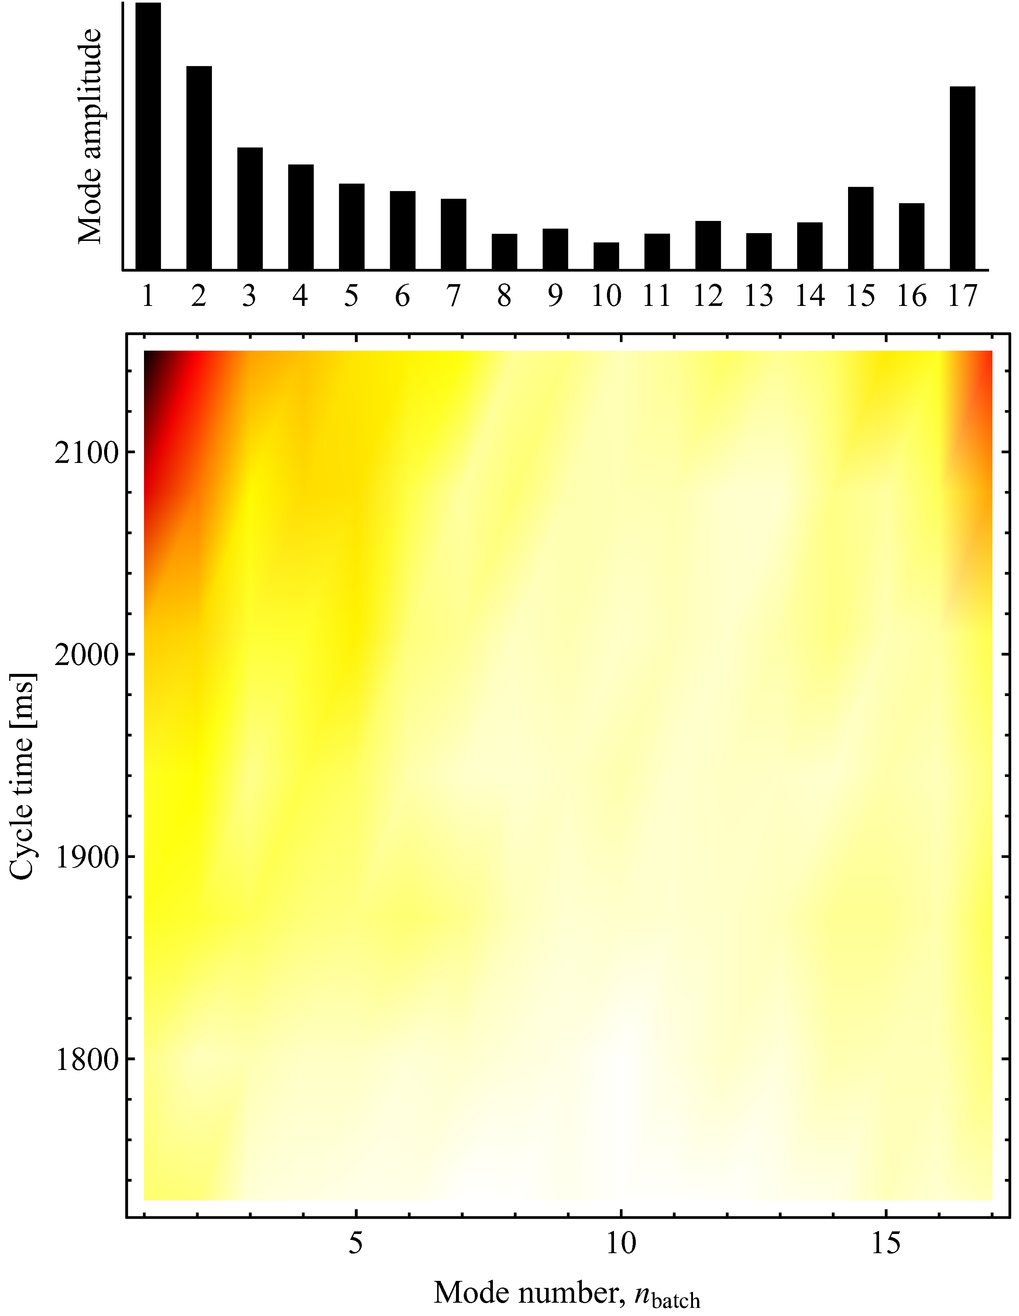
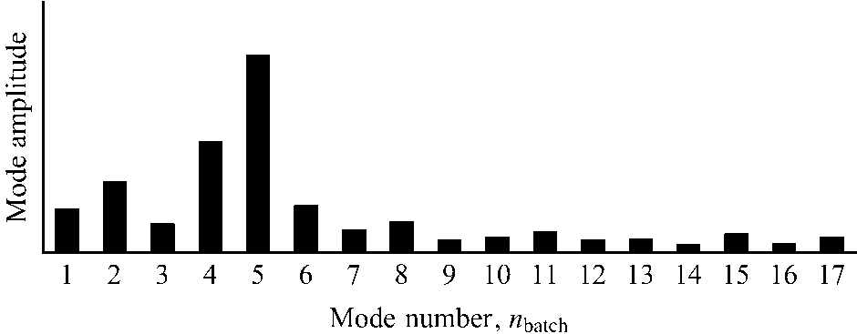
Longitudinal coupled-bunch instabilities
Acceleration
Flat-top
25 ns
γ = 27.2
  During acceleration:
    No resonant excitation of modes
    Main RF cavities are dominant impedance
  Different mode spectrum on the flat-top:
    Driving impedance changes
    Reducing impedance by short-circuiting 9/10 cavities
  Instabilities with 25 ns and 50 ns bunch spacing very similar
Mode spectrum during acceleration
γ = 10.8

Slide 5
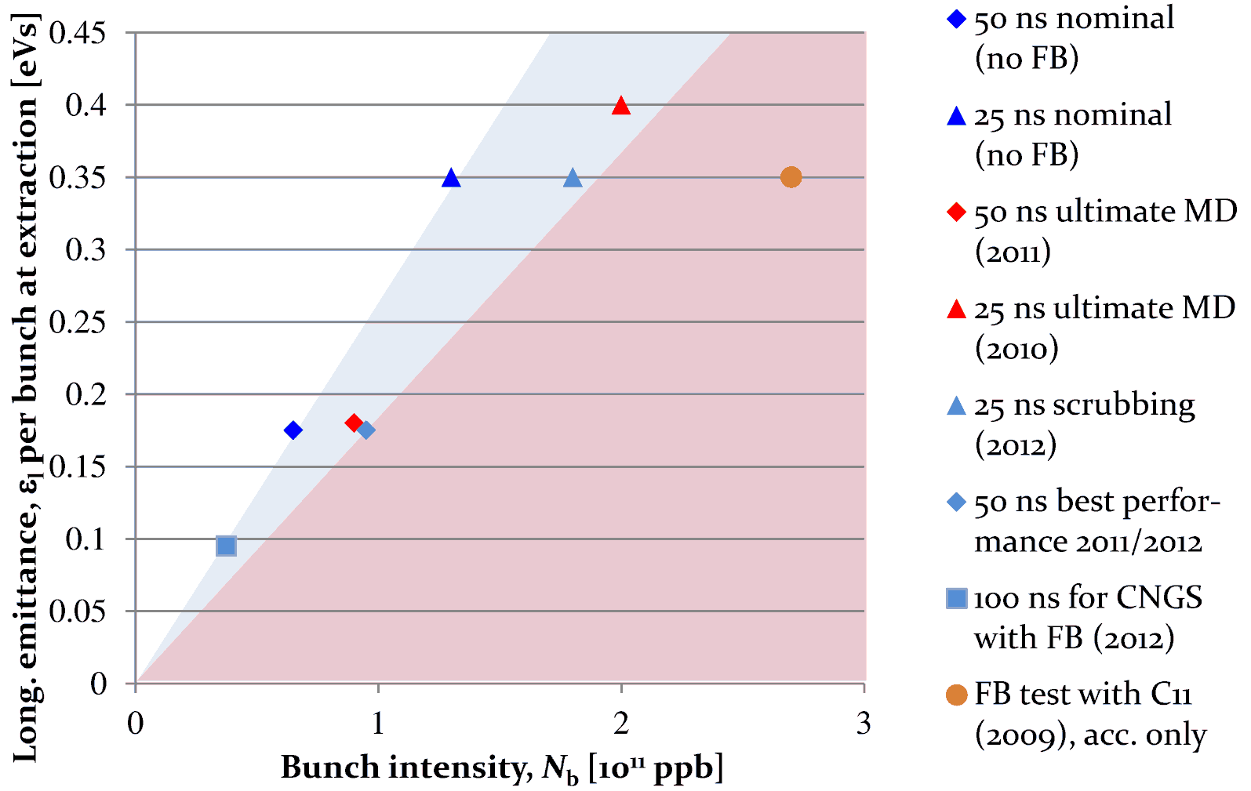
Longitudinal coupled-bunch instabilities
  Coupled-bunch oscillations observed after transition crossing in the PS
  Existing feedback system using RF cavities as longitudinal kickers
Without FB
Requires new FB
Reachable with FB
  Empiric scaling with longitudinal bunch density, N_{b}/ε_{l}
  MDs in 2012
  With present system coupled-bunch limit (25/50 ns) at about 1.9 ⋅ 10¹¹ ppb
ε_{l}/2
  Dedicated wideband kicker (PS-LIU) to be installed during shut-down 2013/14
  Damp all possible modes from f_{rev} to f_{RF}/2

Slide 6
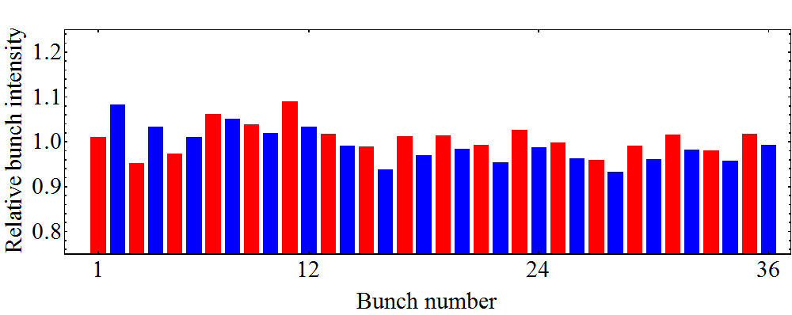
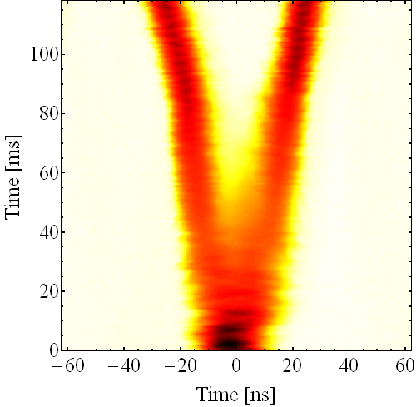
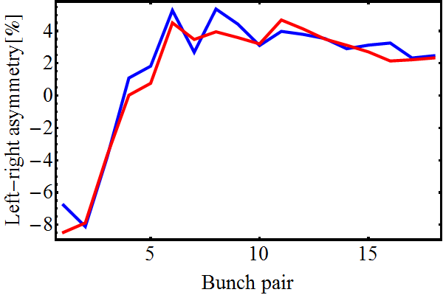
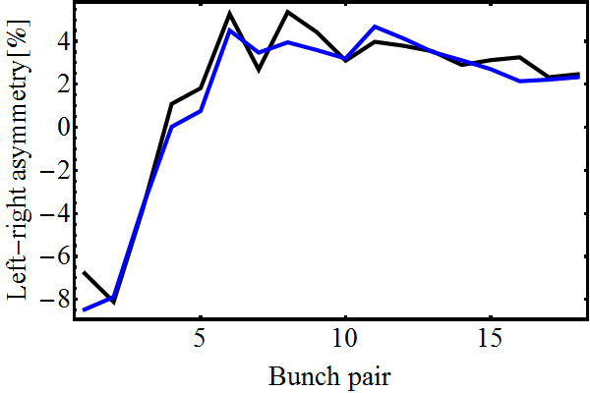
Transient beam-loading during splitting
  Transient beam loading causes small phase errors in RF cavities
  Left-right intensity asymmetry of bunches after splitting along the batch
Left bunch
Right bunch
Left/right asymmetry after splitting
10 cycle average
Bunch profile integral
Gauss fit integral
  Improve and add 1-turn feedbacks against transient beam-loading to reduce bunch-to-bunch intensity and emittance spread
  Maximize gain of direct wide-band feedbacks (10 MHz, 40 MHz, 80 MHz)

