Slide 1

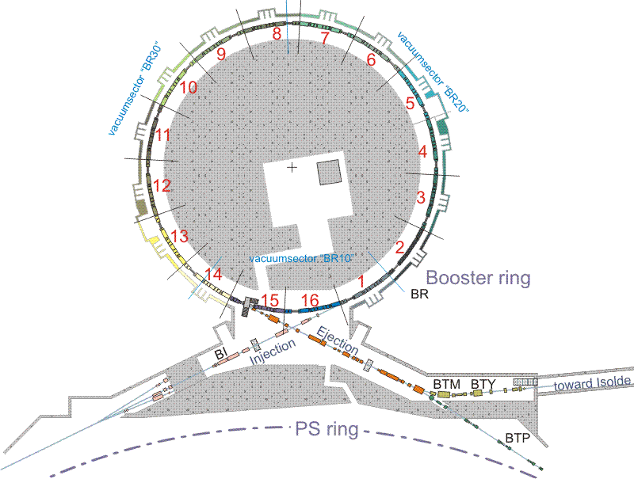

Beam instabilities in the PSB operation with high intensity beams
presented by G. Rumolo
in collaboration with A. Findlay, B. Mikulec, M. Chanel, D. Quatraro
Observations of high-intensity phenomena in the PSB
  Head-tail instabilities along the cycle
  Ring 4 losses before extraction
2010 MDs on Ring 4 losses
  Observation
  Correction

Slide 2
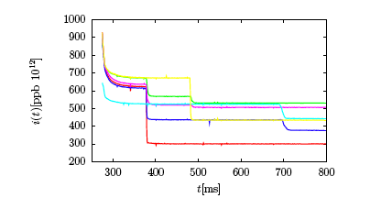
The PSB instabilities….
The beam is transversely stabilized in the PSB by a transverse feedback system
In particular, the feedback is necessary in the horizontal plane for high intensity beams (both h=1 and h=2)
In normal operation, the feedback is off in the vertical plane
What happens if the feedback system is switched off also in H?
Depending on the injected intensity, the beam can become unstable at different points along the cycle!
N.B. Measurements were done on Ring 4, but actually these instabilities were seen to equally occur on all 4 rings
From D. Quatraro’s talk in MSWG, 06/11/2009
Instability @ c=690ms I_{thr} ≈ 400 x 10¹⁰ p (?)
Instability @ c=378ms I_{thr} ≈ 300 x 10¹⁰ p
Instability @ c=478ms I_{thr} ≈ 500 x 10¹⁰ p

Slide 3
Space charge
Measured tune spreads in the PSB
C=297ms is close after injection (50 MeV)
Other c-timings are @160MeV (lower tune spread due to energy, but shorter bunch)
C=656ms → h=2 is on and bunch has been lengthened

Slide 4
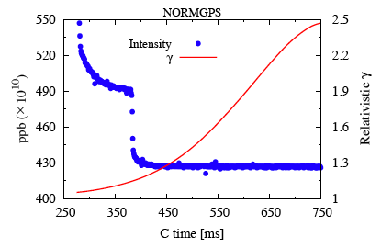
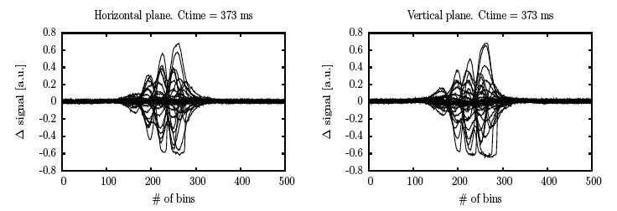
Instability at c=370ms (I)
Taking snapshots of the Δ_{x,y} signal along the bunch while the instability is developing, we can see 3 nodes

Slide 5
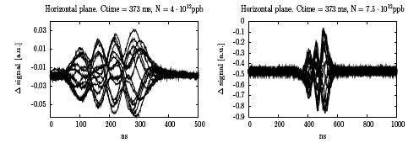
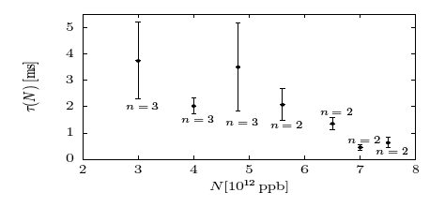
Instability at c=370ms (II)
In fact, the number of nodes has been found to depend on the beam intensity
Lower intensity, 3 nodes
Higher intensity, 2 nodes
Decreasing trend of rise times with the bunch intensity

Slide 6
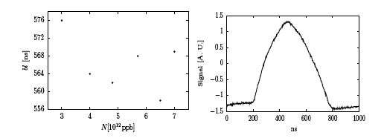
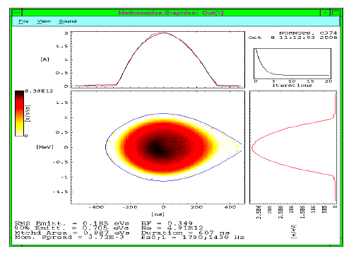
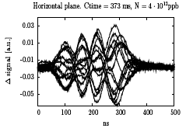
Instability at c=370ms (III)
Puzzling 2009 observations….
The bunch is ~600ns long at c=370ms
Why do we see a Δ signal extending only over ~300ns?
The signal comes from a wideband PU (the same used for the feedback) and goes through a BOSS unit

Slide 7
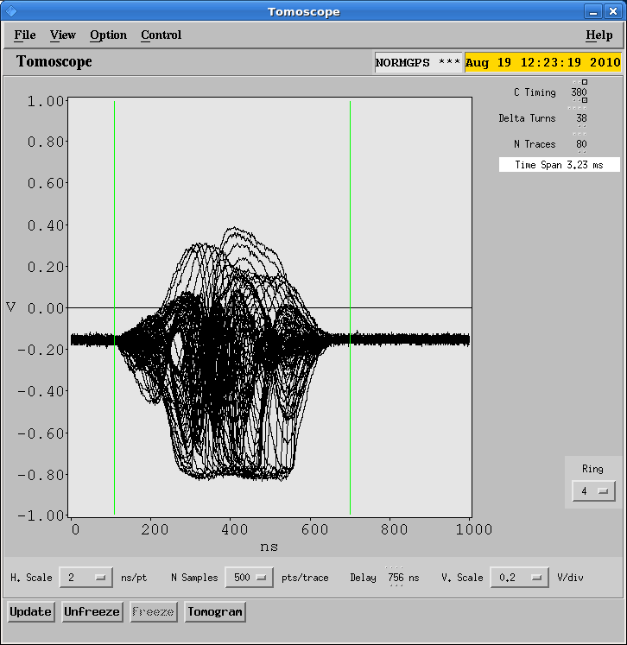
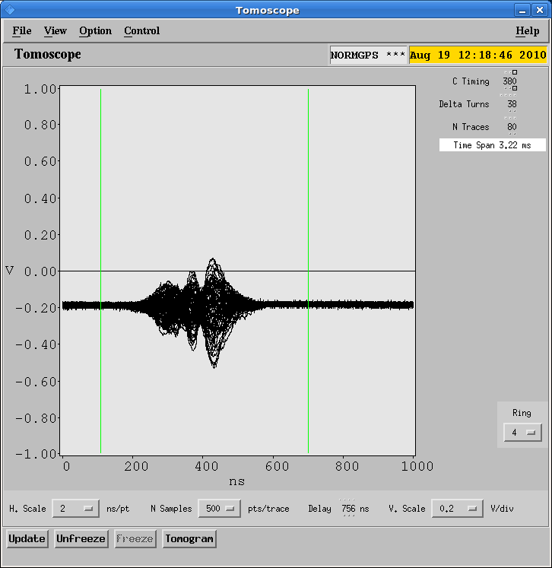
Instability at c=370ms (IV)
2010 measurements (Aug 19th) show that, when we catch the instability at the very beginning of the evolution, we may indeed see only a part of the bunch
Later on, the signal gets saturated and its nodes usually become undistinguishable, but it clearly extends over the whole expected range of the bunch total length
The Δ signal stretches over the bunch core at the beginning, then moves to the whole bunch

Slide 8
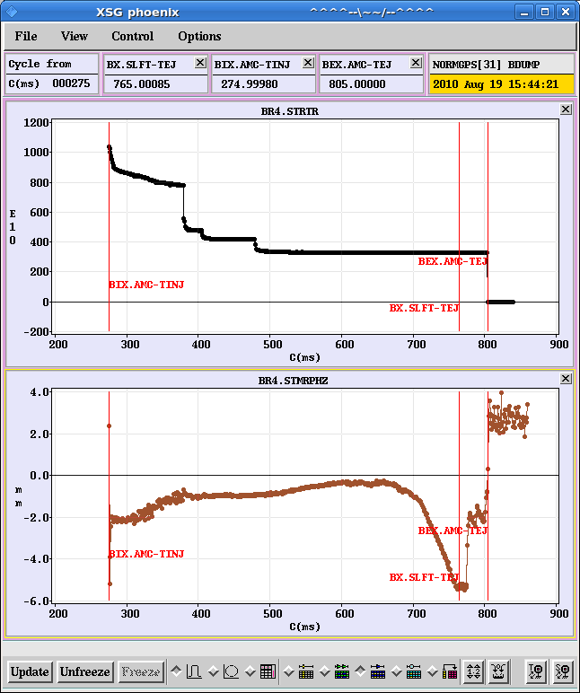
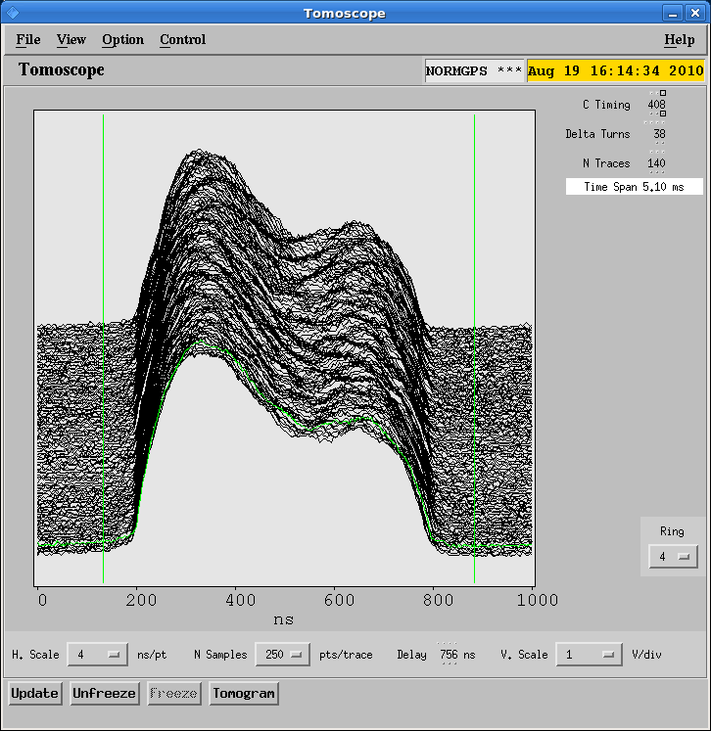
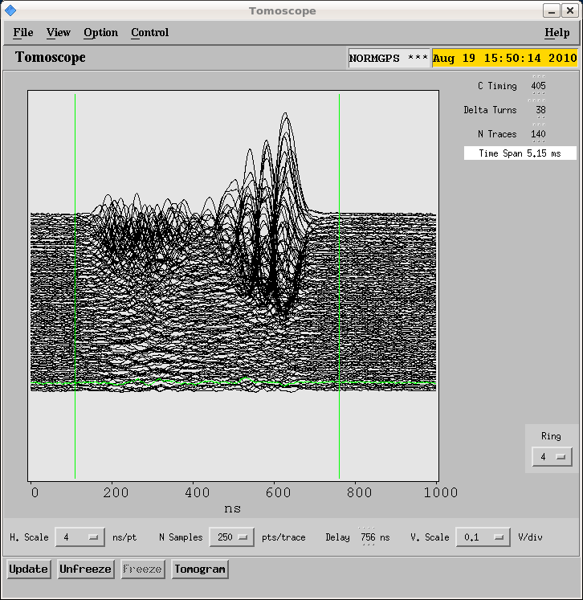
Instability at c=370ms (V)
What else did we learn from the 2010 MDs?
  The radial position of the beam can influence this instability, as the beam tends to become more stable as we move it toward the inside of the machine
  Both this instability and the one close to c=470ms exhibit no strong dependence on the bunch length and shape, and on the synchrotron tune. In fact, by turning on C04+C16 the two instabilities still appear at exactly the same points of the cycle.
  A third instability at around c=407ms appears when we switch on C04+C16

Slide 9
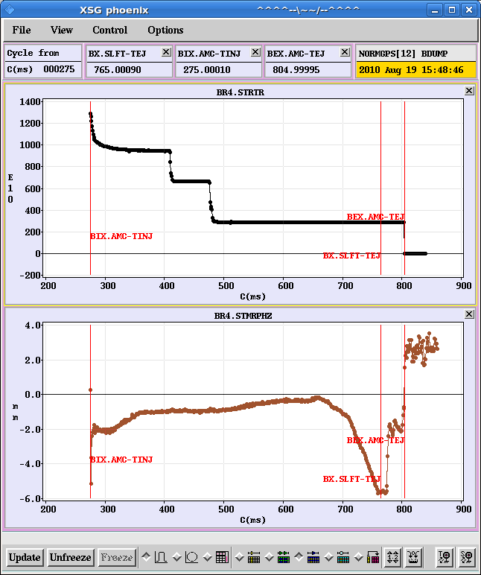
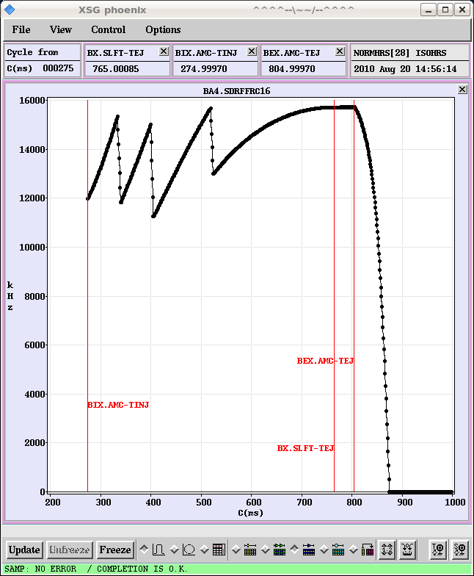
Digression on the instability at c=407ms
We can clearly see the instability at c=407ms when we keep the horizontal damper on up until c=395ms (so that the beam can go through the first instability)
  However, we quickly realized that this instability is strictly related to C16
    If C16 is on and with a voltage applied to the gap, we observe the instability
    If C16 is on with 0 voltage, or it is disabled, or it is “disactuated”, the instability disappears (but we observe substantive beam induced voltage, up to 0.14 kV)
  It is noted that the instability indeed occurs when there is a harmonic change in C16. Re-programming the C16 frequency function may eliminate the problem. Work ongoing (A. Findlay) –maybe this will also have an influence on the other instabilities??

Slide 10
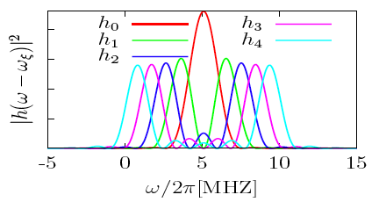
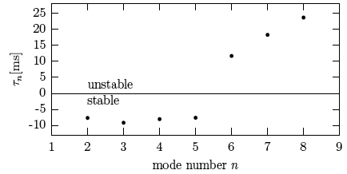
Instability at c=370ms (theory & simulations)
According to Sacherer’s theory, with a chromatic shift of 5 MHz (ξ_{x} ≈-1), the first unstable mode is n=6 and has a rise time of ~12ms for 500 x 10¹⁰ p
This mode would appear due to resistive wall, as this is a low frequency impedance that is first sampled at a high value for bunch mode spectra moving to the negative frequencies.
Sacherer’s theory
1st unstable mode
Resistive wall impedance

Slide 11
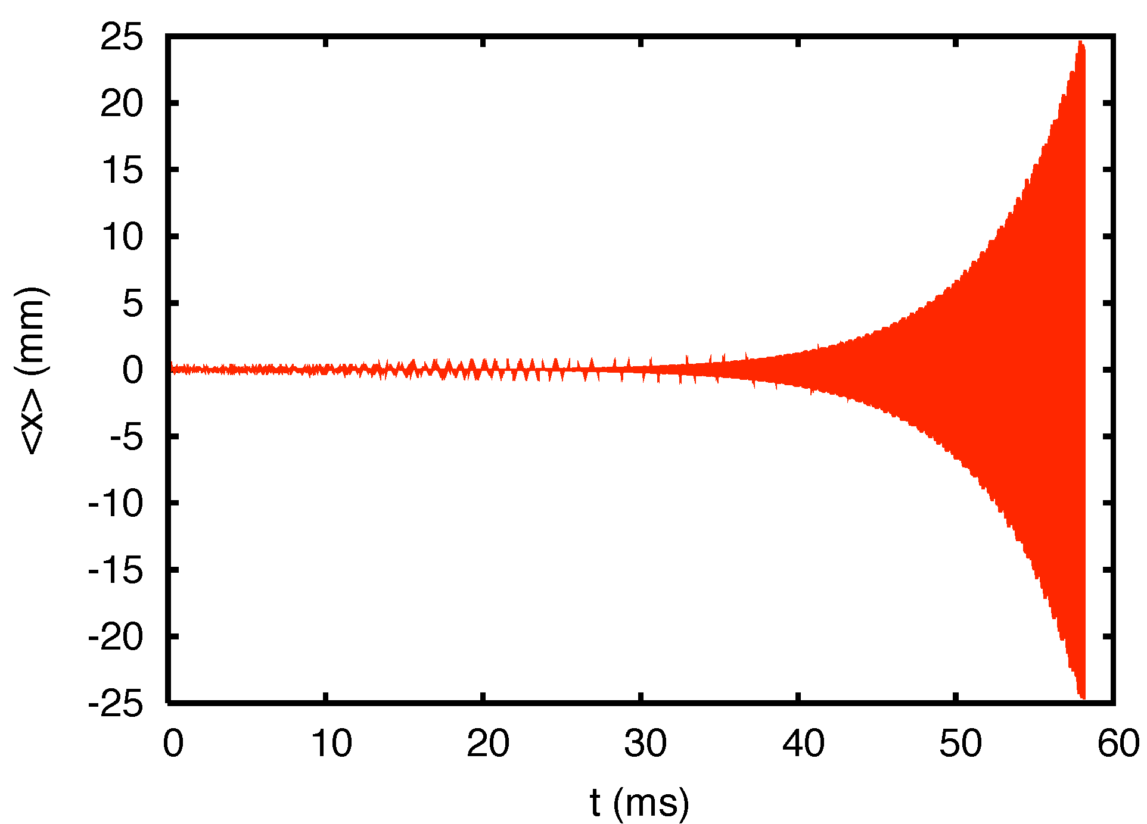
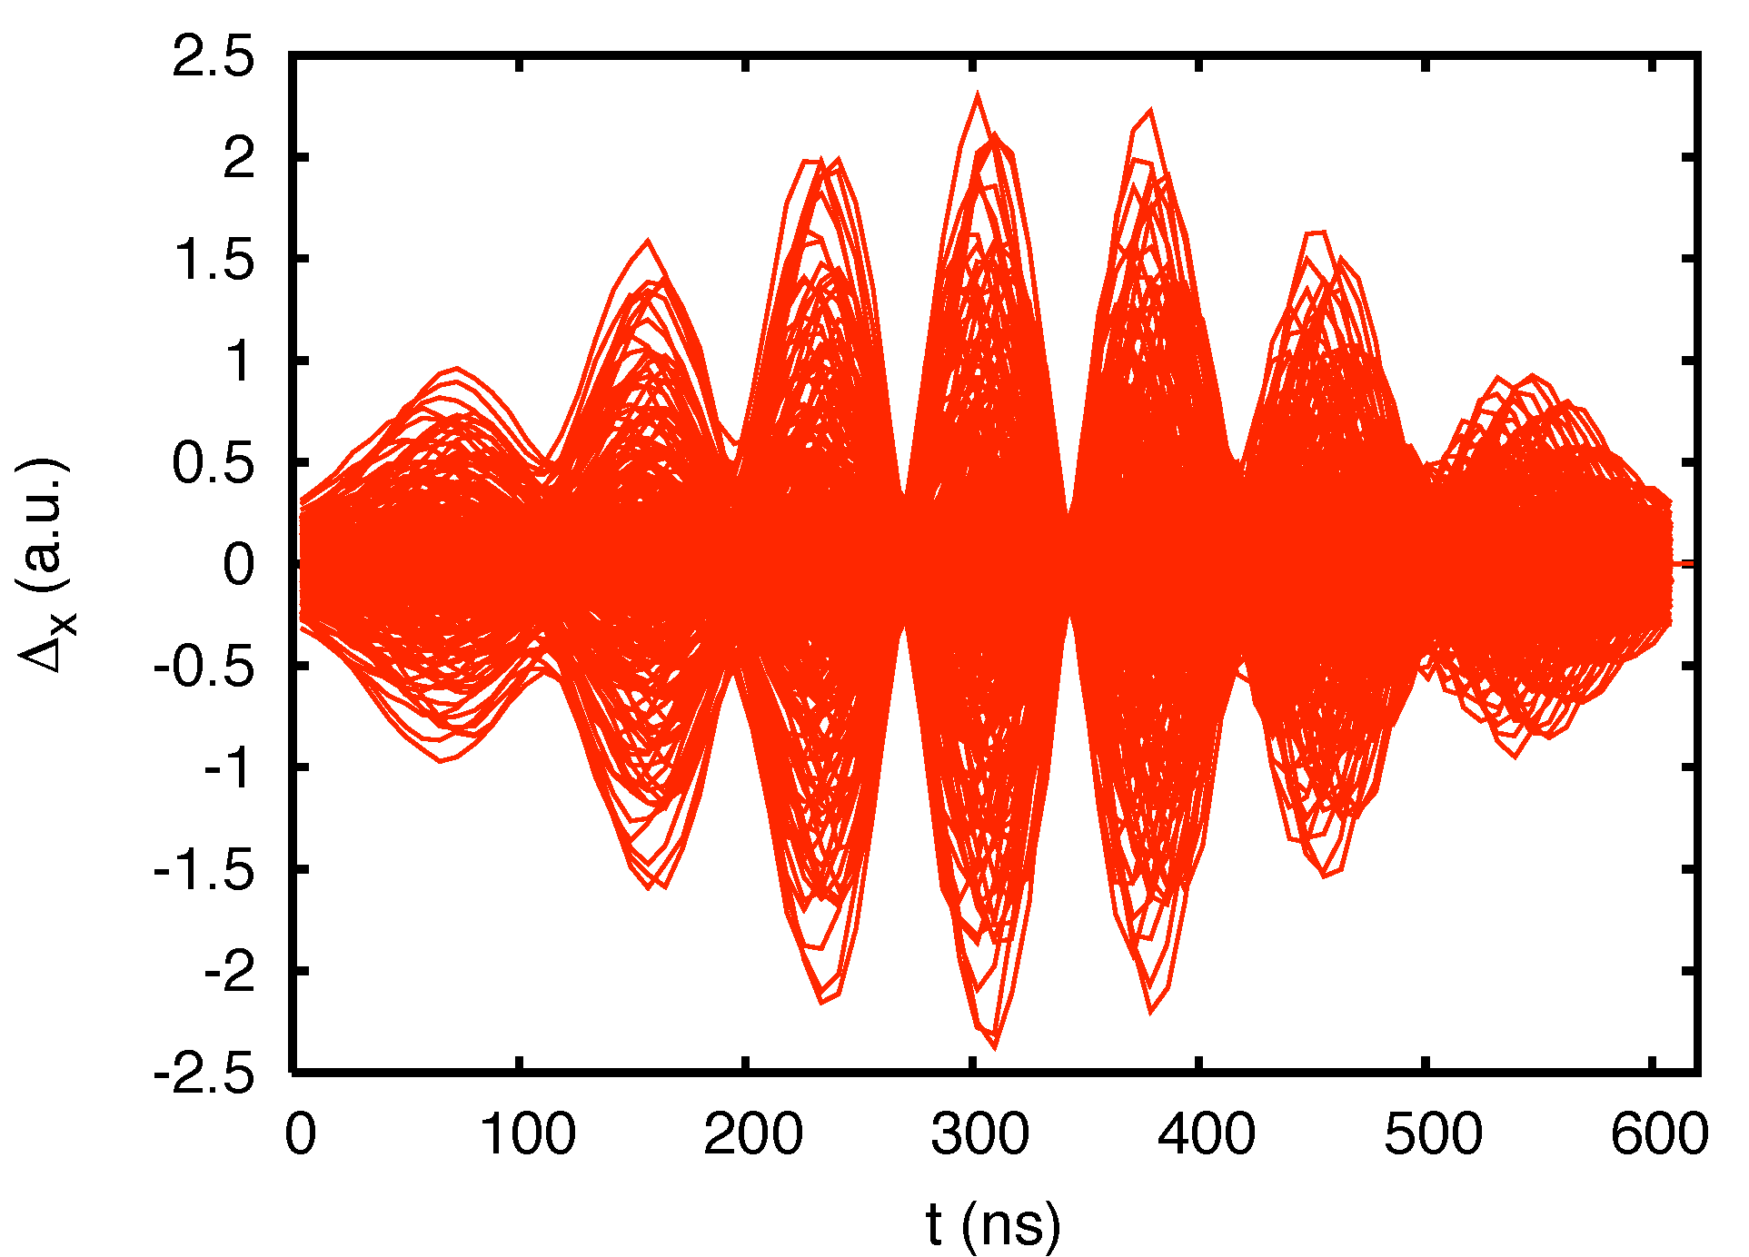
Instability at c=370ms (theory & simulations)
Like theory, macroparticle simulations (not including space charge and using the total wake over several turns) would predict that, with a chromatic shift of 5 MHz (ξ_{x} ≈-1), the first unstable mode is n=6 and has a rise time of ~10ms for 500 x 10¹⁰ p
The simulation has considered classical resistive wall as source of excitation
HEADTAIL simulations with multi-turn
6 nodes
e-folding time ~10ms

Slide 12
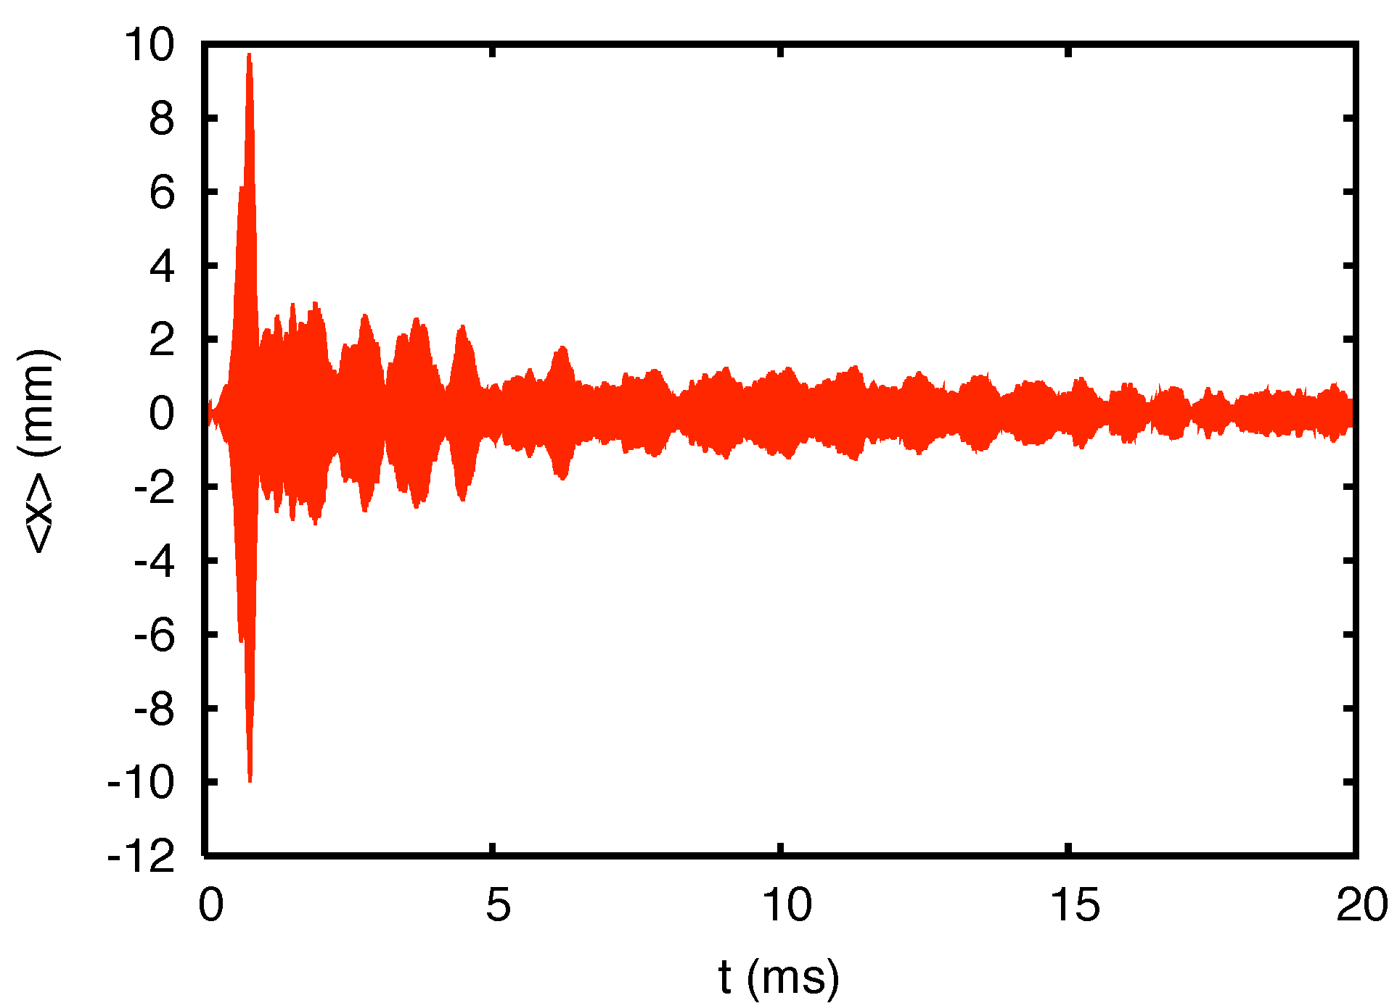
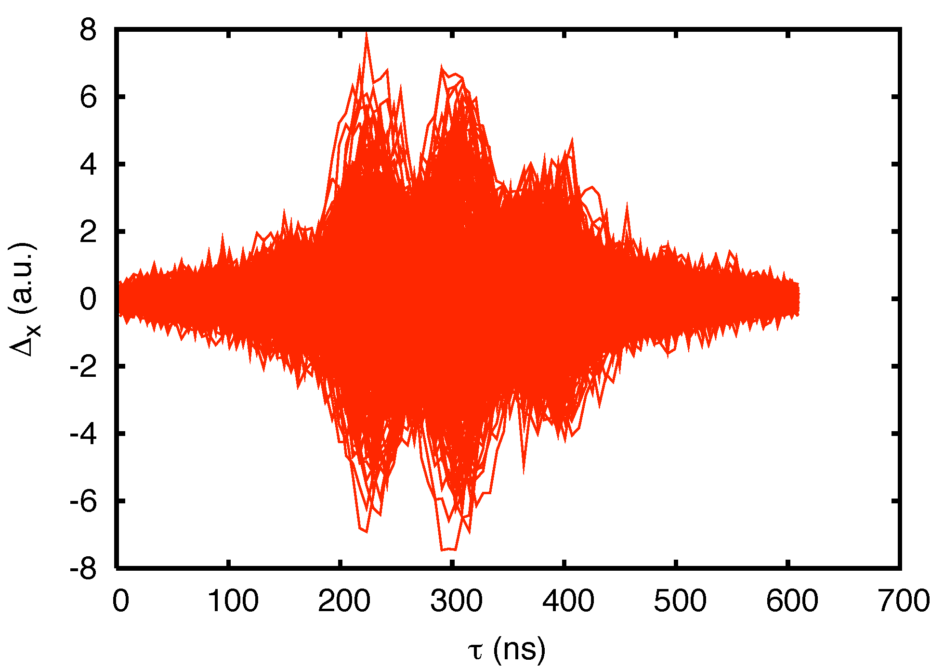
Instability at c=370ms (theory & simulations)
Following Sacherer’s theory, a resonator impedance source would be expected to be able to excite only modes with n above 6
However, HEADTAIL simulations reveal a more complex dynamics, with lower order head-tail modes that can be indeed excited by narrow-band resonators….
Strong instability followed by damping
Resonator impedance
2-3 nodes
The simulations assumed a resonator with parameters: R_{t}=2.5 MΩ/m, f_{r}=1.6 MHz, Q=10
It is interesting to observe that the beam is stable for frequencies around 1.6 MHz (having scanned 1-2 MHz)

Slide 13
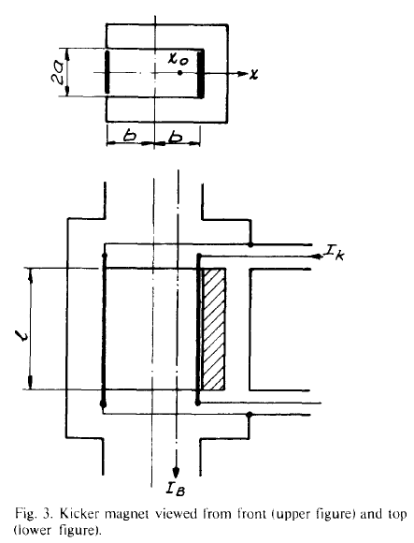
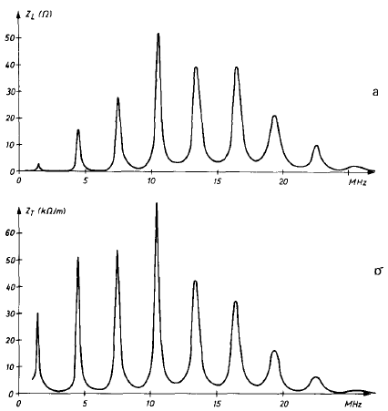
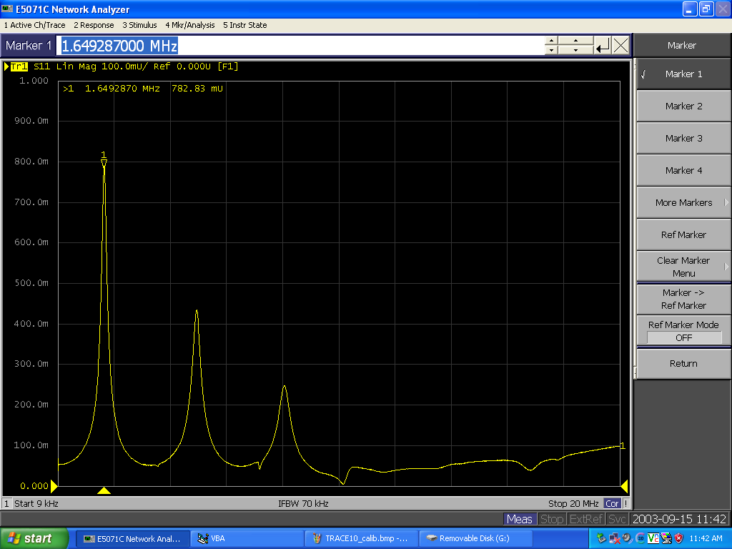
Instability at c=370ms (theory & simulations)
Why did we assume a narrow-band resonator at 1.6 MHz in our simulations?
  A line at this frequency had been singled out on a spectrum analyzer during previous instability measurements at the PSB (M. Chanel, C. Carli)
  This value is also likely to be associated to the lowest resonance due to the unmatched terminations on the PSB ejection kickers
We are currently trying to calculate the wake field of the kicker from CST-PS (C. Zannini)
Longitudinal
Measurements of the signal on the cables of the Ring 4 kicker (C. Carli, M. Chanel, et al, April 2010)
Transverse
Impedance of a C-magnet kicker with both cables on open circuits. Case of one module of the PSB ejection kicker (G. Nassibian, F. Sacherer, 1979). There is also a reference to this impedance as being responsible for horizontal instabilities in the PSB (H. Schönauer)

Slide 14
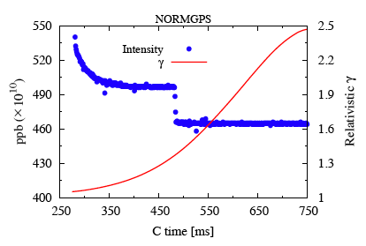
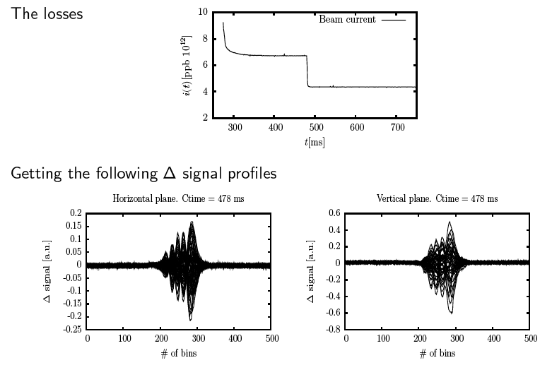
Instability at c=470ms
Also the second instability has the typical head-tail features
The number of nodes is higher (usually 4) and the rise time of this instability is typically longer than for the first one
In 2010 it was also observed like in 2009, and it showed little sensitivity to the mean radial position of the beam
4 nodes

Slide 15
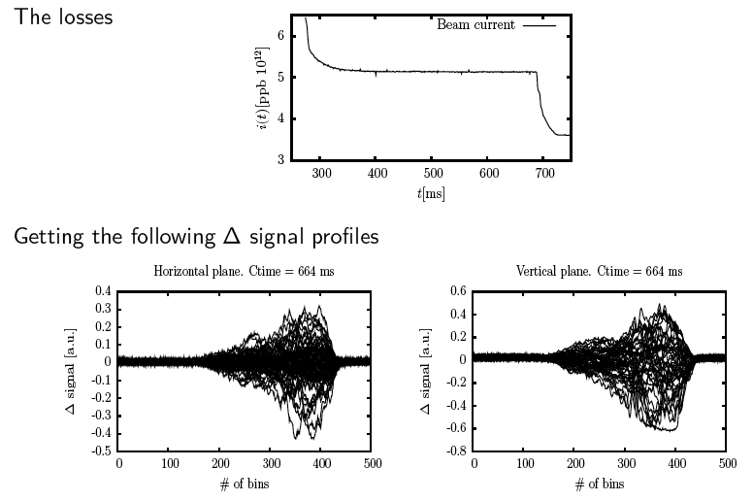
Instability at c=690ms
Hard to recognize a specific head-tail mode from the Δ signal
The rise time of this instability is comparable to that of the first one

Slide 16
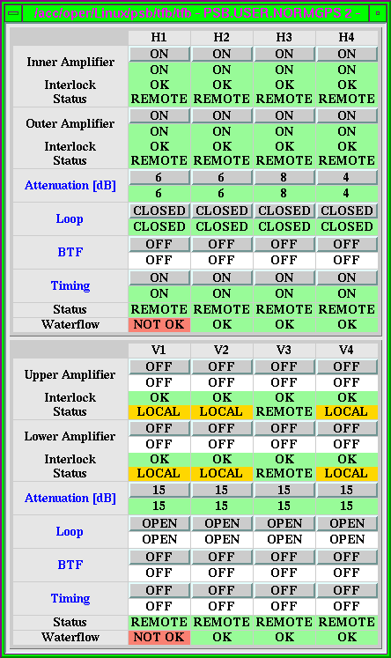
Instability at c=690ms
Losses at around the same time in the cycle were also observed in Ring 4 at the beginning of our MD on July 1st
They could be efficiently suppressed by reducing the gain of the phase loop between the cavities (non-ppm hardware change), and increasing the gain of the TFB.
No trace of this instability was observed in the MD of August 19th
Attenuation reduced on the Ring 4
Once the problem of these losses was solved, the beam could be accelerated up until the last few ms. At this point our old friend, the loss during the last ms, re-appeared (From the PSB e-logbook July 1st Morning)
See next slides….

Slide 17
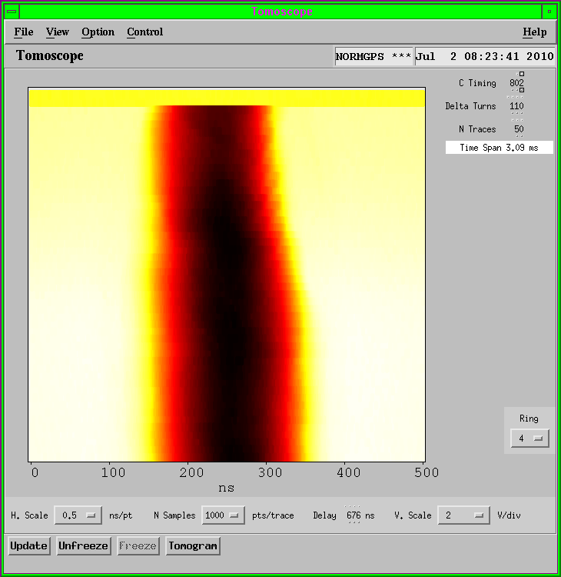
Ring 4 losses before extraction
Even with the feedback system on, Ring 4 has suffered for years from an instability appearing right before extraction for intensities above 800 x 10¹⁰ p
This instability would trigger the BLMs on the ejection line and stop the beam to ISOLDE
Losses take place during the last 2 ms. They are associated to bunch shortening, but particles are also lost from the core

Slide 18
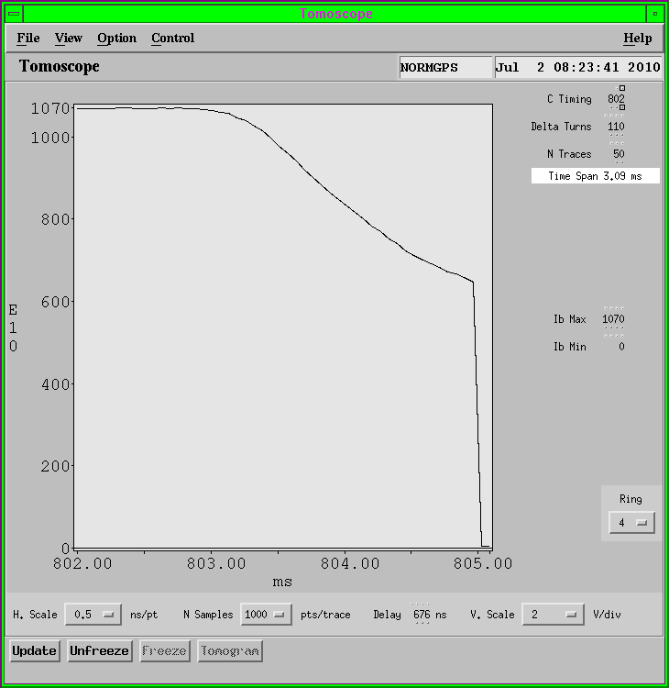
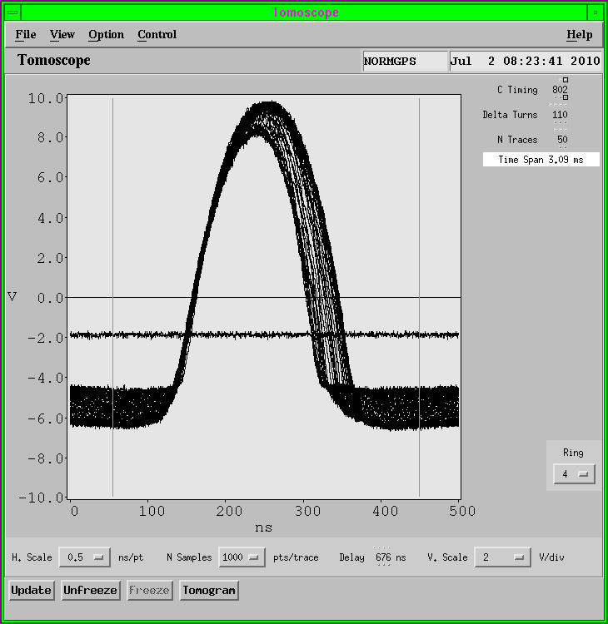
Ring 4 losses before extraction
The maximum intensity in Ring 4 was limited in operation to 800 x 10¹⁰ p
C04 beam-loading, considered a potential responsible, was excluded during a dedicated MD last February, when C04 was short-circuited and the loss was not cured
Almost half of the bunch is lost just before ejection

Slide 19
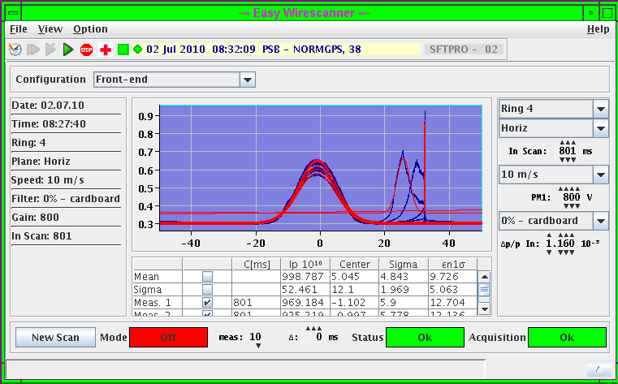
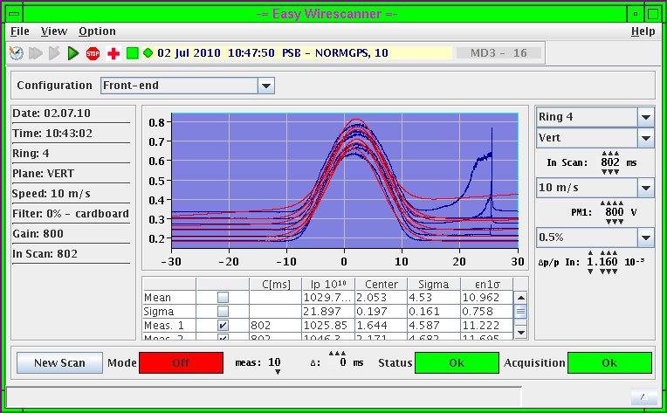
Ring 4 losses before extraction
The Wire Scanner measurements show some bizarre profiles during the instability in both transverse planes
The ‘second’ signal on the right side is measured shortly before extraction and could be a sign of instability or emittance blow up
H profile
V profile
Extraction, the scan takes ~8ms to get to this point. The measurement of the ‘extra-beam’ starts ~2ms before.

Slide 20
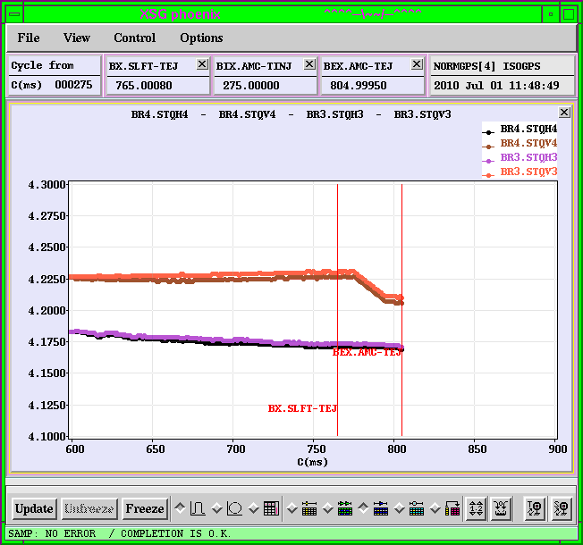
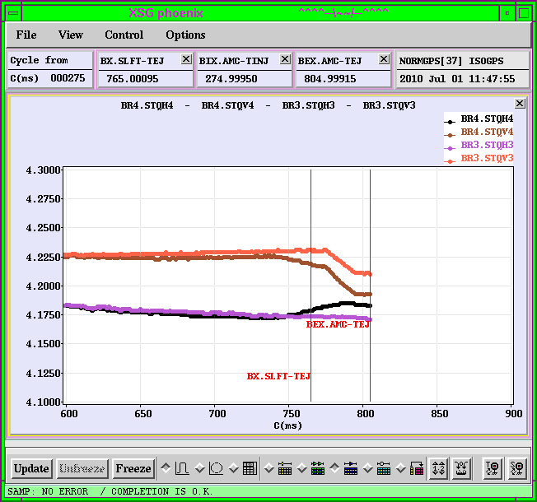
Ring 4 losses before extraction
During the MD session on July 1st, after an adjustment of the beam radial position close to extraction (which removed a transient before the synchro), we attempted to change the working point at extraction in order to possibly cure the unstable motion that causes the beam loss
  If the loss is caused by some resonance crossing enhanced by the space charge with high intensity, we can hope to move farther away from this resonance
  If it is a coherent instability in the horizontal plane, we could suppress it by coupling more to the stable vertical plane (setting the tunes closer together)
The GFA of the Ring 4 Q-strips (BR4.GSQCF) was extended and pulsed close to the end of the cycle. This had the effect of moving the tunes closer together

Slide 21
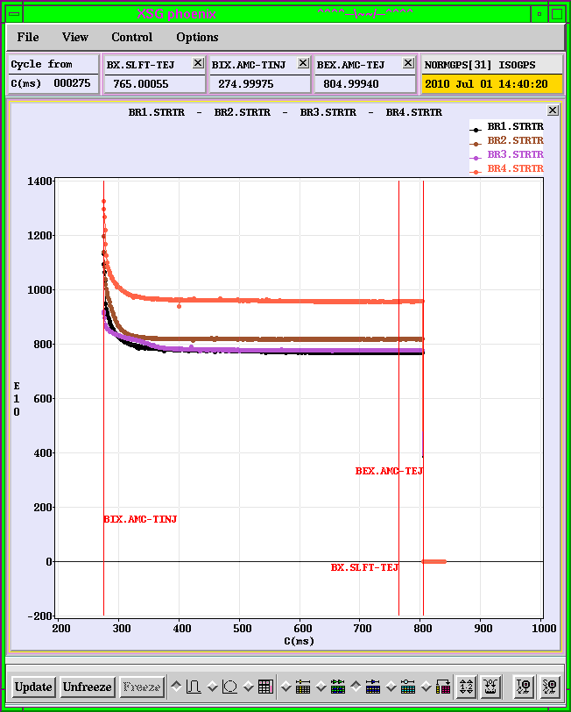
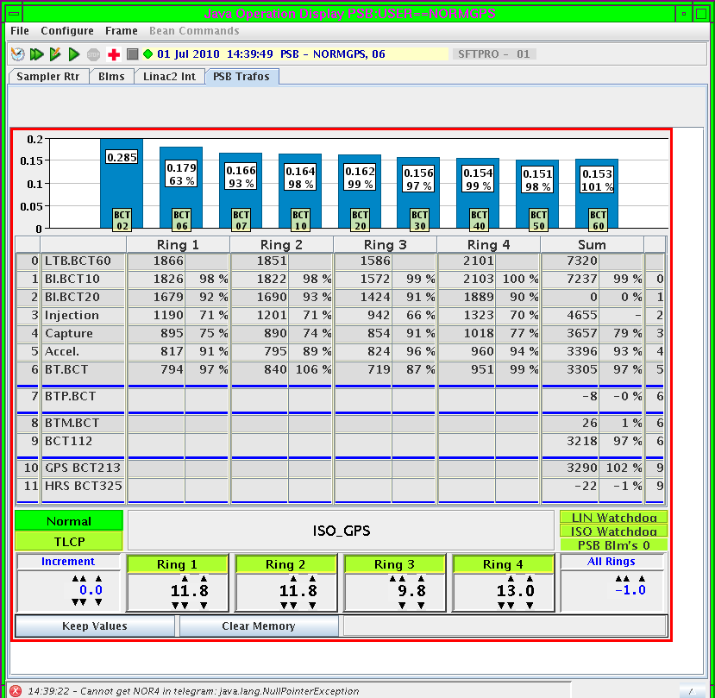
Ring 4 losses before extraction
Et voilà!
  Finally we could accelerate up to almost 1000 x 10¹⁰ p in Ring 4 without the BLMs being triggered

Slide 22
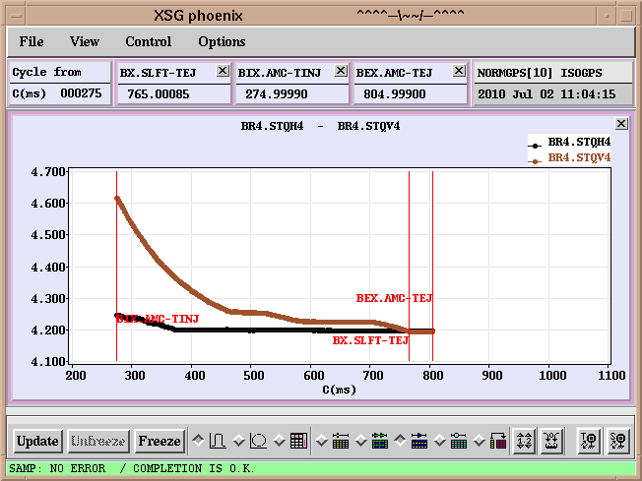
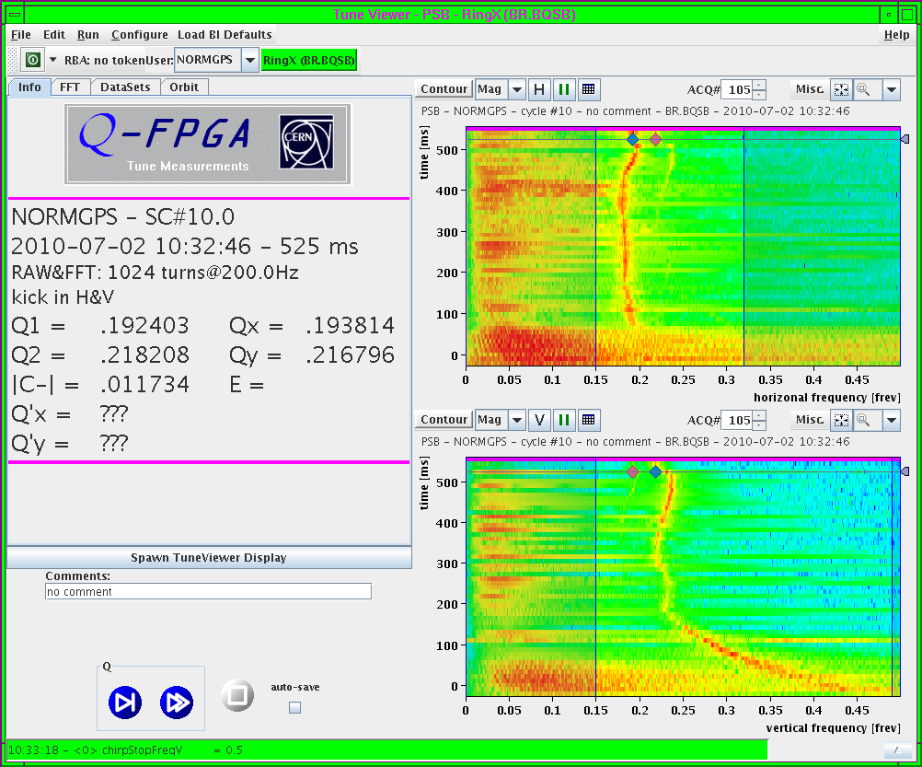
Ring 4 losses before extraction
We decided to adjust the working point at extraction in all 4 rings using the tune editor instead of the Q-strips
We basically programmed the H and V tunes to be equal at extraction (4.200) to enhance the coupling (they were before Q_{x}=4.17 and Q_{y}=4.23)
This could stabilize the beam in Ring 4 and allowed extraction of up to 1100 x 10¹⁰ p !!!
Programmed tunes
Measured tunes

Slide 23
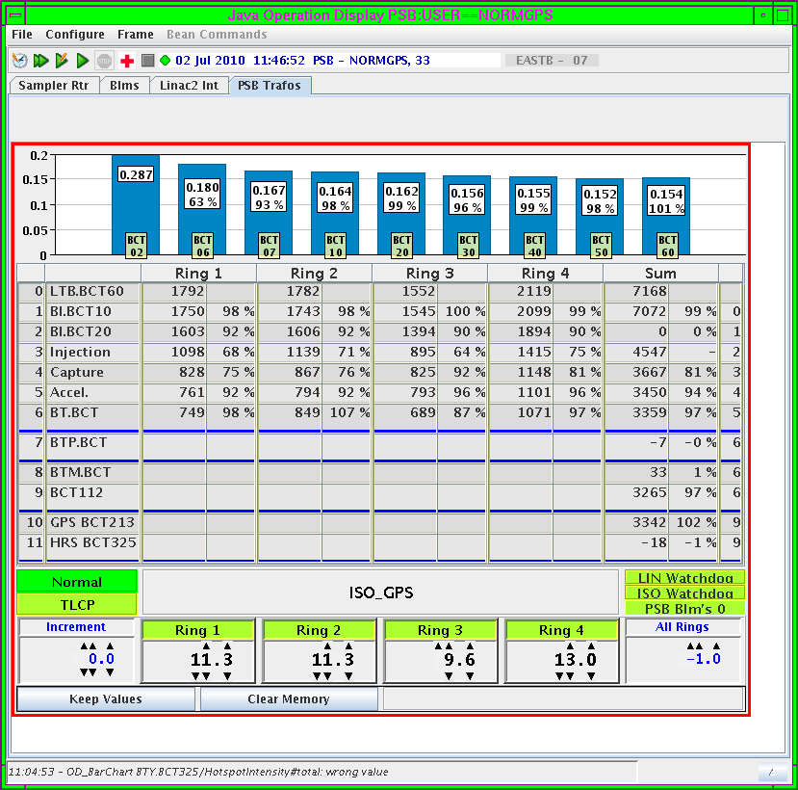
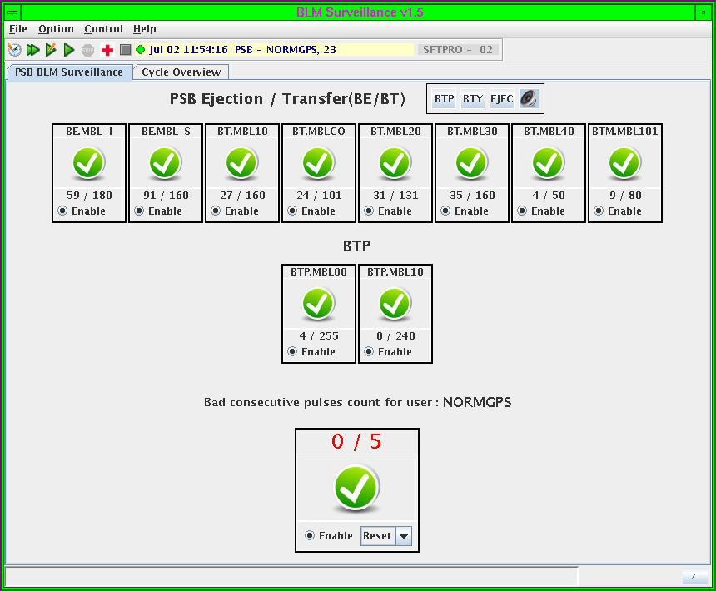
Ring 4 losses before extraction
M. Chanel went then back to the original working points at extraction and enhanced the coupling at extraction by using the skew quadrupole BR4.QSKH0 in Ring 4
This setting proved to cure the losses at extraction, too. However, we are presently running with the modified working point at extraction and BR4.QSKH0 set to its original 0.78A
Consequently, we tend to believe that by bringing the tunes closer together we have actually stabilized the horizontal plane by coupling it to the stable vertical plane.
1.1 x 10¹³ p accelerated and extracted with low losses in the ejection line

Slide 24
Summary & Conclusions
Several coherent instabilities have been observed throughout the years in the PSB, usually starting from the horizontal plane
Up to the highest intensities that can be produced in the 4 Booster rings (i.e. 1000 x 10¹⁰ p/ring) those listed below can be stabilized using the Transverse Feedback System
  An instability at about c=370ms shows a head-tail pattern with 2-3 nodes and little (or no) dependence on the bunch shape and length. Seems to improve when the beam is radially moved inwards.
  An instability at about c=407ms is correlated to C16, and in particular with its harmonic change. A new frequency program is under study
  An instability at about c=470ms exhibits a head-tail pattern with 4 nodes and little (or no) dependence on the bunch shape and length, nor on the MRP
  An instability at about c=690ms, with no distinctive pattern, which was stabilized by adjusting the gain of the phase loop between C02 and C04.
If resistive wall was responsible for these instabilities, we would expect higher order modes to be excited. Other potential impedance candidates
  Peaked impedance at 1.6 MHz from unmatched terminations on the extraction kicker cables
  Cavities (C16 at some specific frequency?)
We would like to identify, and possibly reduce, the source of these instabilities to gain more stability margin with respect to the PSB intensity upgrade with Linac4!
The Ring4 instability shortly before extraction, which has been affecting the performance of Ring 4 in the last years, was suppressed by changing the working point at extraction and enhancing the coupling between the x and y planes.

