Slide 1
Collective effects in the SPS and LHC (longitudinal plane)
T. Argyropoulos, T. Bohl, J. E. Muller,
E. Shaposhnikova + many other colleagues

Slide 2
Main intensity limitation in the SPS: longitudinal instability during the ramp
Very low intensity threshold - 2x10¹⁰/bunch (at the end of the ramp), reduces with energy
Depends on single bunch and total beam intensity
Bunches with smaller longitudinal emittance are more unstable
Small injected bunches are unstable on the 450 GeV flat top (50 ns beam)

Slide 3
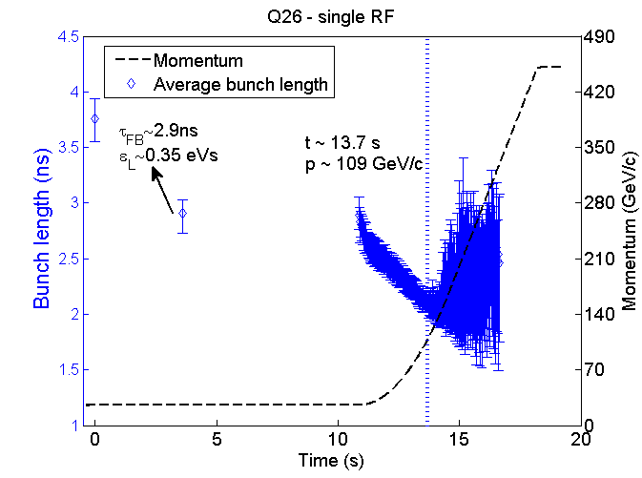
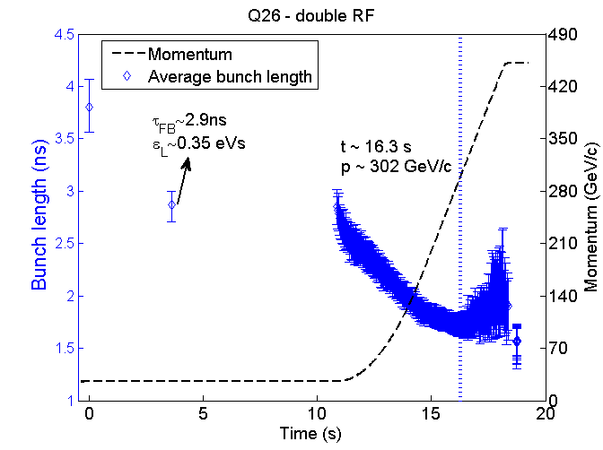
Nominal LHC beam in the SPS (25 ns spacing, 1 batch of 72 bunches)
Cures:
4th harmonic RF system in the bunch-shortening mode with V₄ = V₁/10
Controlled long. emittance blow-up (by band-limited noise), but then transfer to LHC with limited voltage
Lower transition energy (Q20) – under studies
Q26
1 RF
Q26
2RF
Q20
2RF

Slide 4
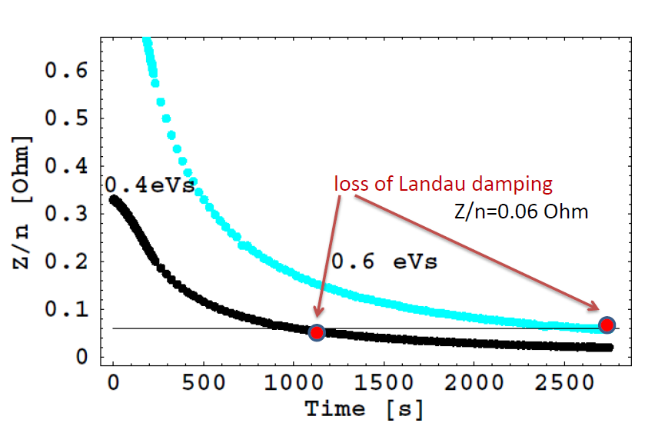
Loss of Landau damping in LHC (longitudinal plane)
Expected loss of Landau damping during the ramp without controlled longitudinal emittance blow-up
Single bunch instability observed during the first ramps and on the flat top in 2010
Un-damped (very slowly damped) injection phase oscillations also observed for multi-bunch 50 ns spaced beam
Threshold during the 2010 cycle and measurements

Slide 5
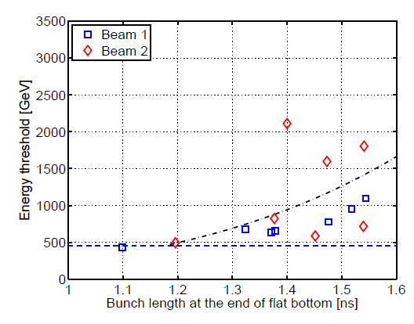
Longitudinal instability during LHC ramp
Dipole mode: loss of Landau damping on the flat bottom for emittances below 0.5 eVs (bunch intensity 1.2x10¹¹), instability during ramp with threshold decreasing with energy and longitudinal emittance
Cure: controlled longitudinal emittance blow-up during ramp to ~2eVs
(4σ bunch length of 1.2 ns) also required for IBS and heating problems

