Slide 1
Some beam-beam effects during the intensity ramp-up 06/04/2012-08/04/2012
T. Pieloni with many inputs from:
G. Arduini, X. Buffat, W. Herr, F. Roncarolo and the OP crews on shift

Slide 2
Fill 2480 and 2481 Intensities 1.6x10¹¹ damped beams for LHCb wrong settings ( head-on collision instead of separated) over night 6/04-07/04 Fill 2482 STABLE BEAMS (1.3x10¹¹ p/b) and 264 bunches with initial luminosity of >0.9x10³³ cm⁻² s⁻¹ morning of 07/04 Fill 2488 and Fill 2489 STABLE BEAMS (1.3x10¹¹ p/b) and 264 bunches leveling tests in IP1 and IP5 on 08/04
Summary of the fills

Slide 3
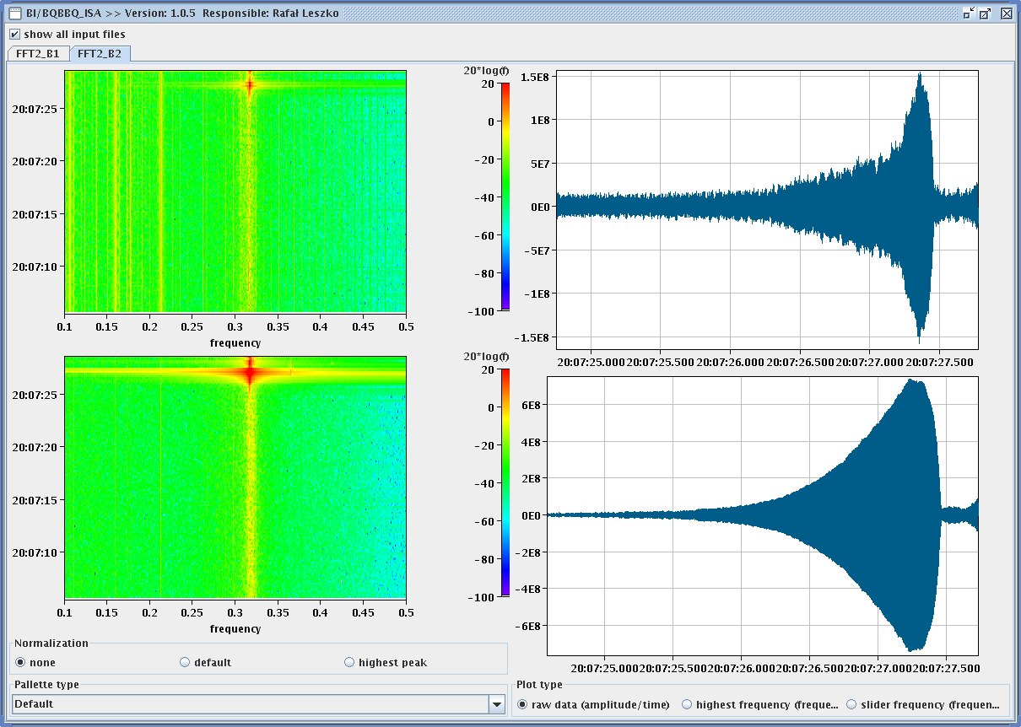
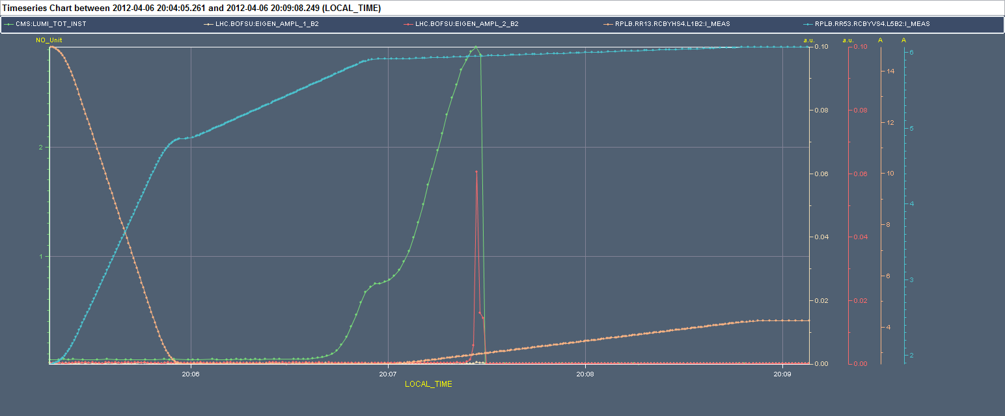
Fill 2480 with 264 bunches (2480)
Instability observed when going in collision (mostly vertical) but still far from head-on
G. Arduini

Slide 4
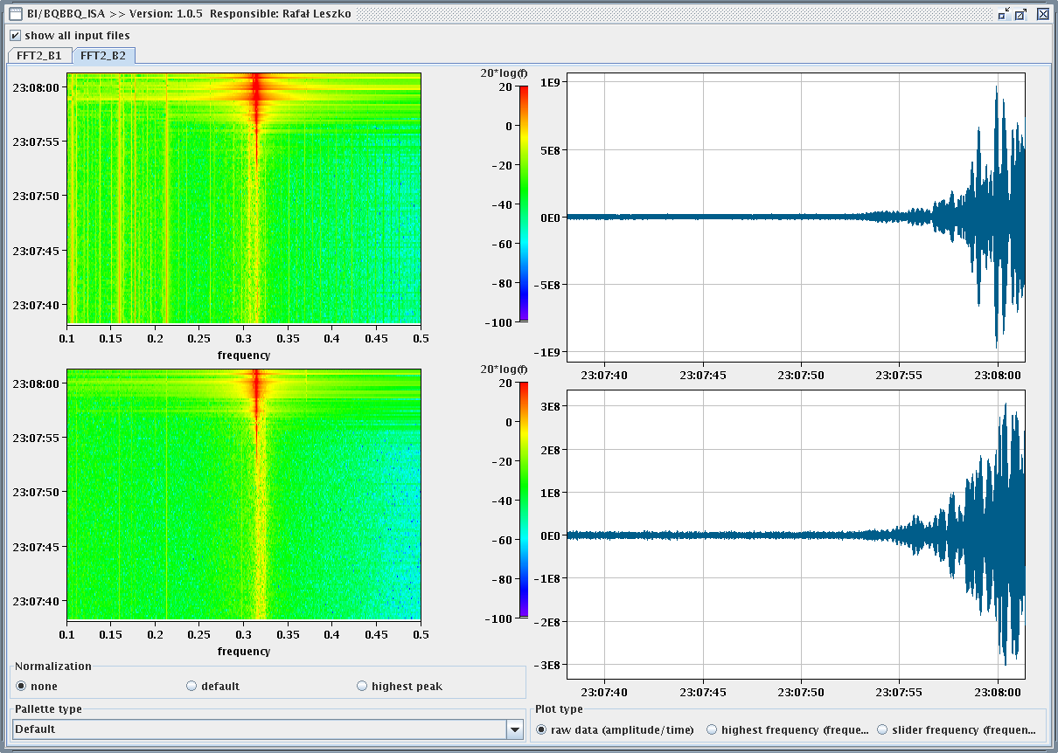
Fill2481with 264 bunches (2481)
Squeeze without tune feedback. Significant reduction of the losses.
Adjust:
Reduction of chromaticity before going in collision (2 to 1 unit)
Increase of the damper gain in the vertical plane
Still instability observed (mostly in the H-plane)
Observed also head-on collisions during the “rotation” of the LHCb crossing plane
G. Arduini

Slide 5
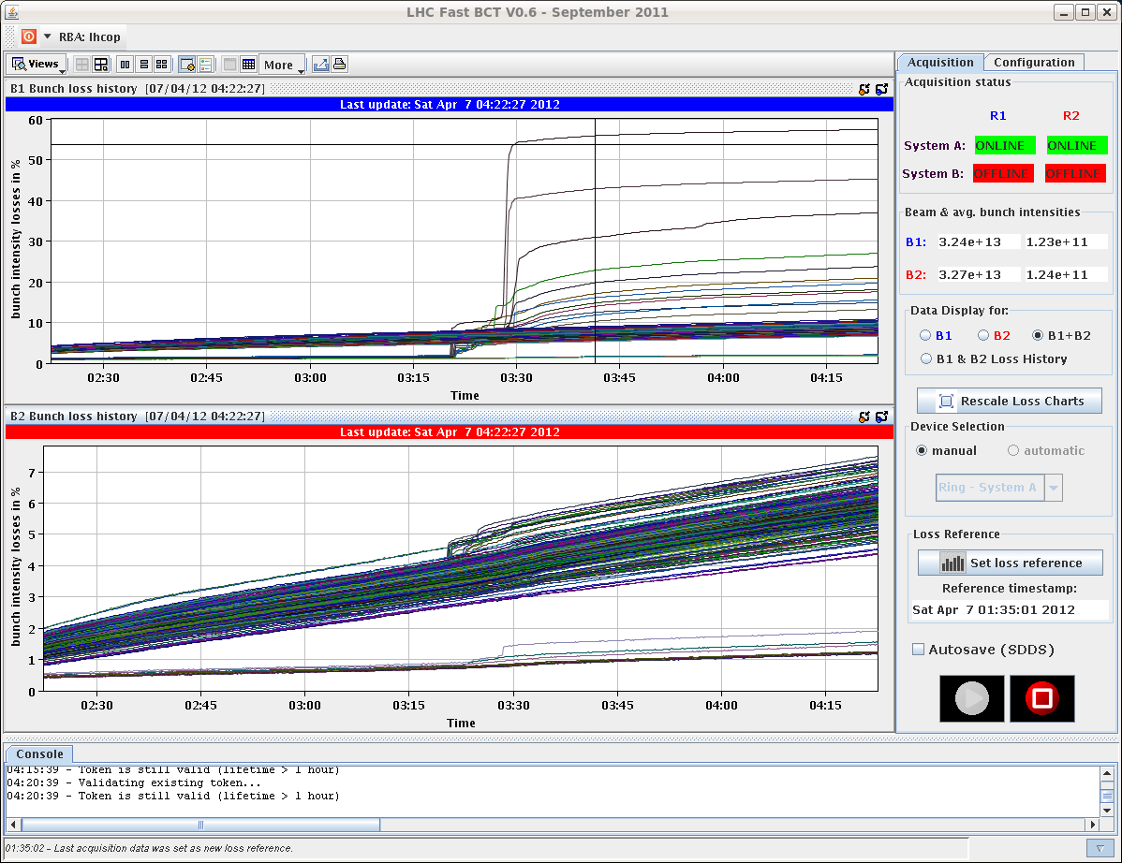
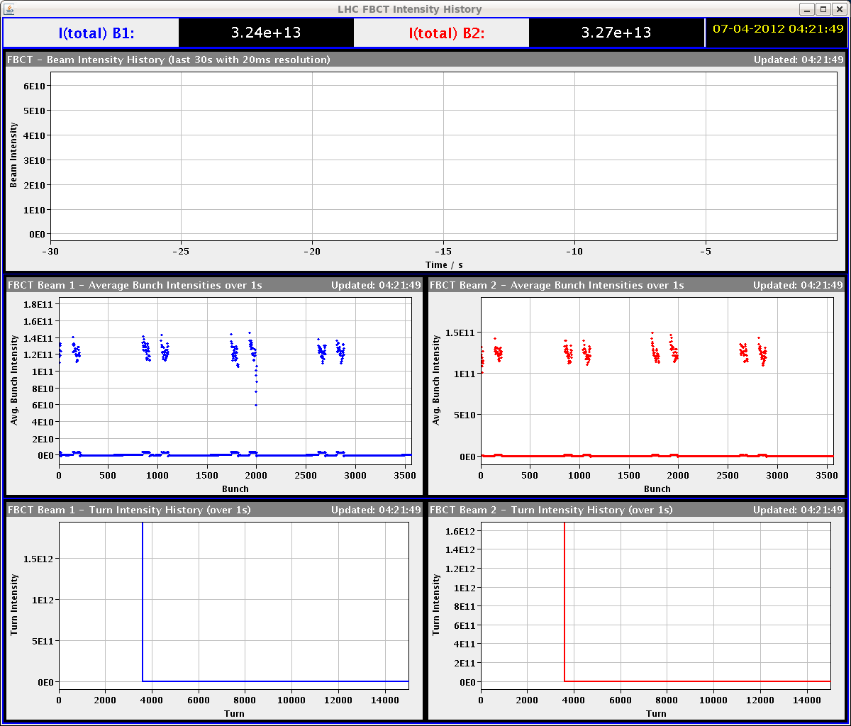
Fills with 264 bunches (2482)
Sudden losses observed in some bunches. Patterns being verified (colliding in IP8)
G. Arduini

Slide 6
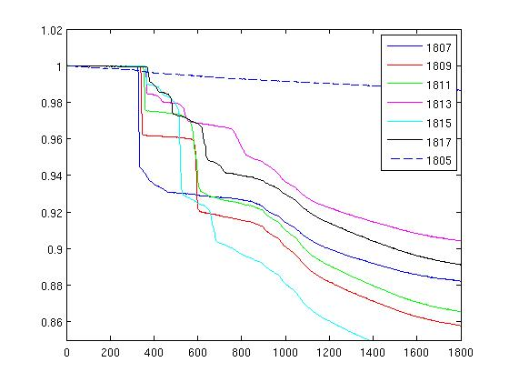
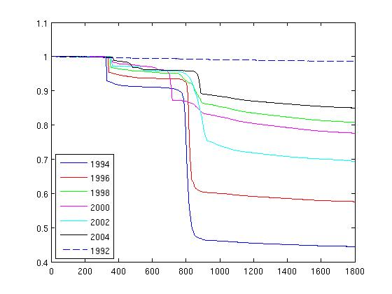
The losses in details B1
Selected bunches start loosing after 2 hour of stable beams during leveling exercise of LHCb

Slide 7
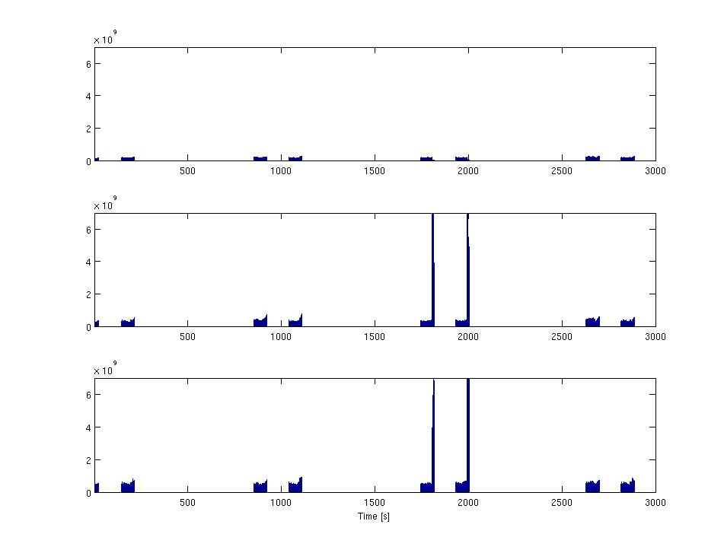
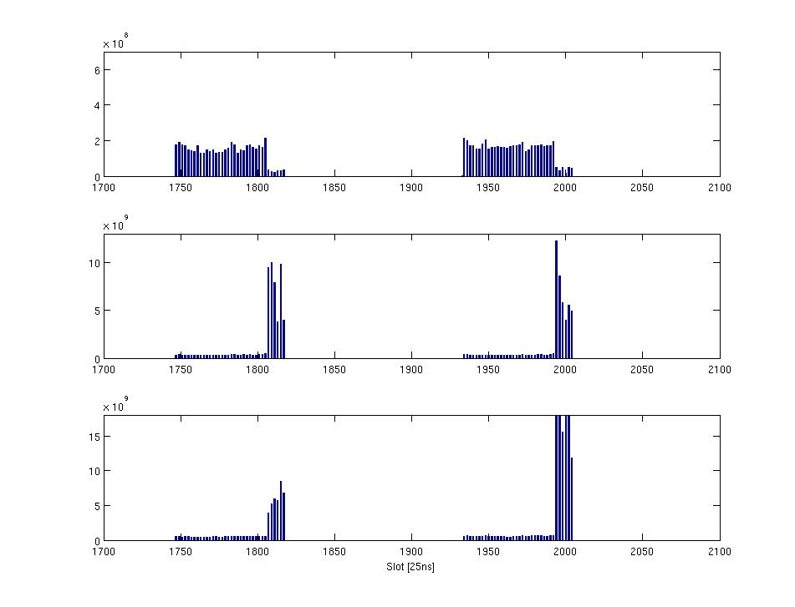
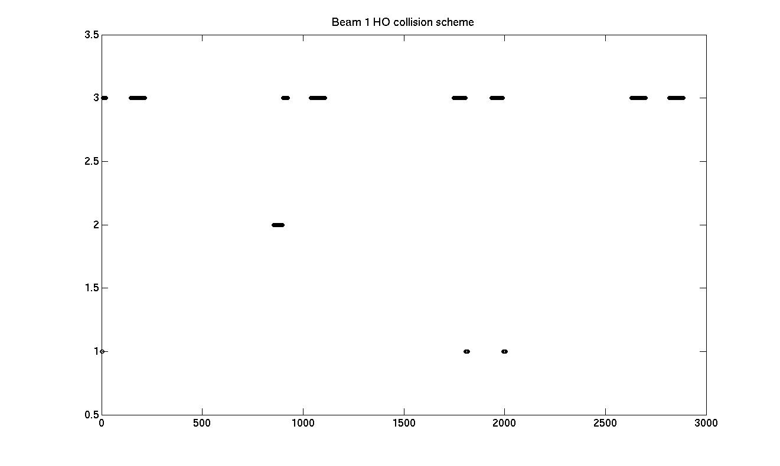
Losses and filling scheme B1
The bunches loosing in B1 collide head-on only in IP8 while those in B2 collide also in IP1 and 5…not clear evidence of causes from filling pattern but indication of LHCb related…. still investigating!

Slide 8
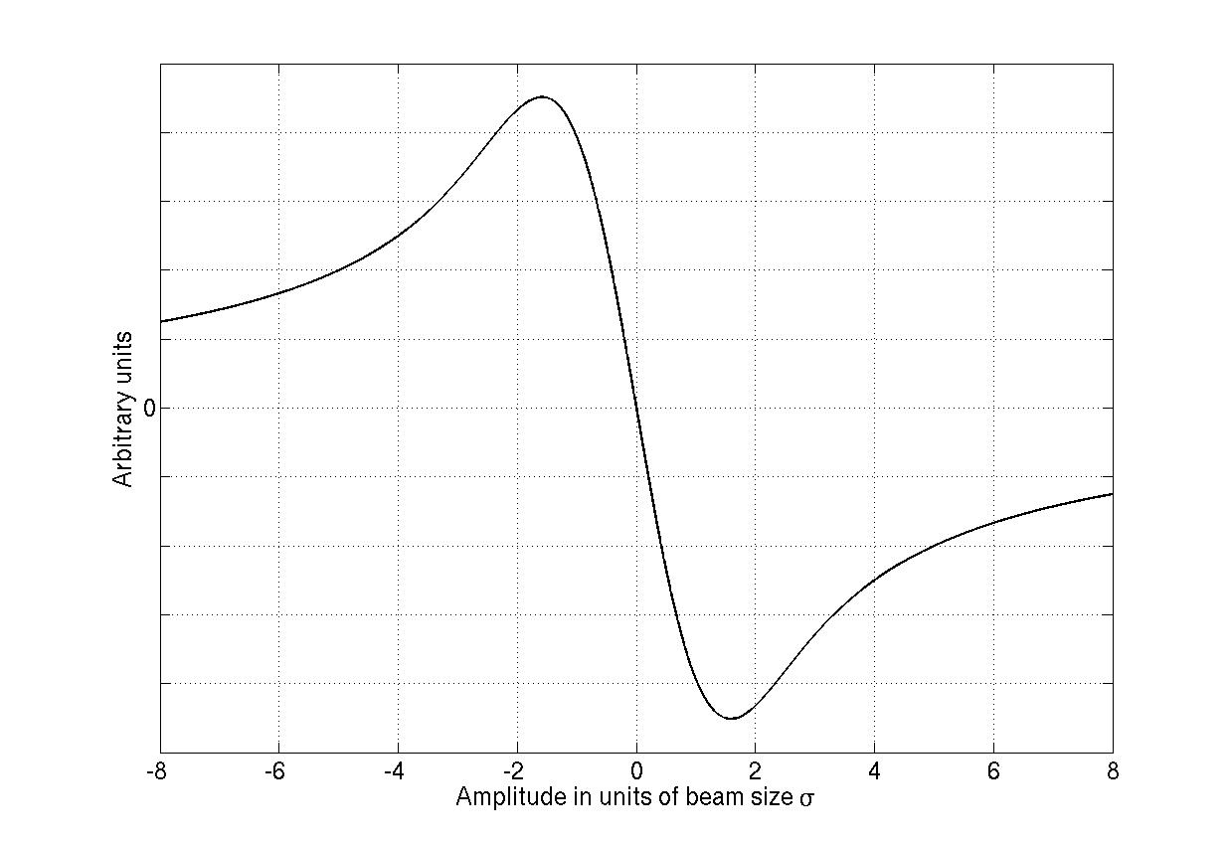
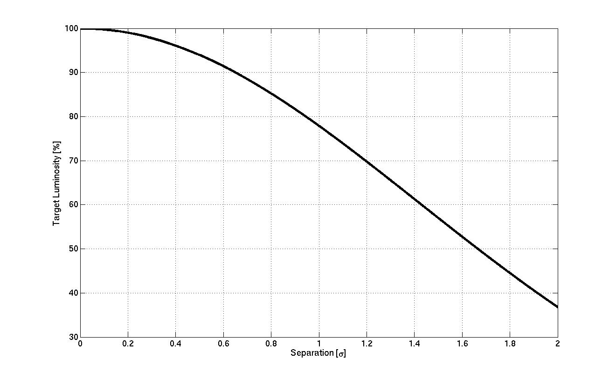
Fills 2488 and 2489: Luminosity leveling with transverse offset
IP1 & IP5 request reduced lumi to 70-80%
95%
75%
Beam-beam Effects
Different dynamics of particles
Orbit effects
Slow emittance growth with offsets
Passive compensation

Slide 9
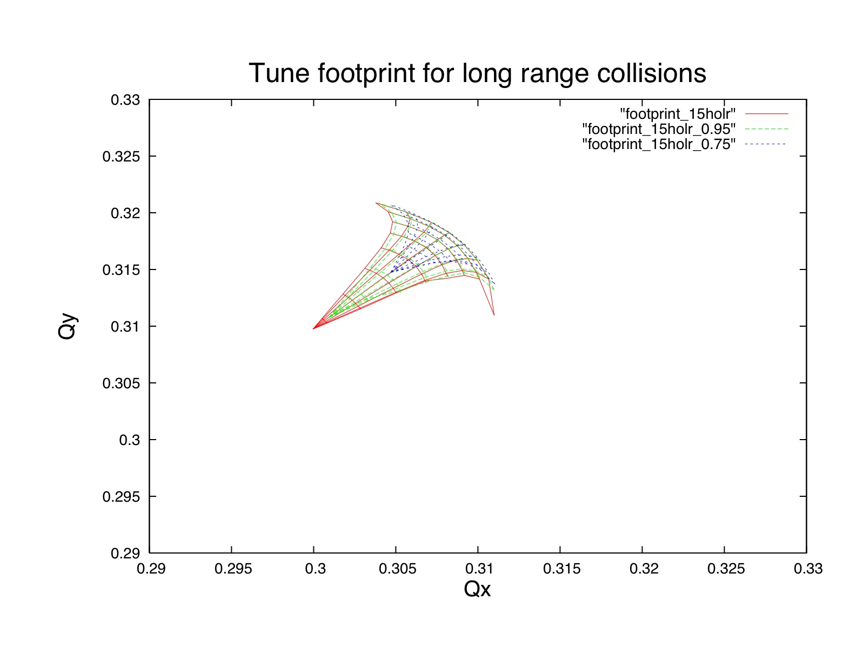
Why 95% and 75%
Different beam-beam dynamics at 0.4 σ and 1.2 σ
Beam-beam force
Depending on the offset the force seen by the other beam is different
Depending on the offset bunches have different tunes

Slide 10
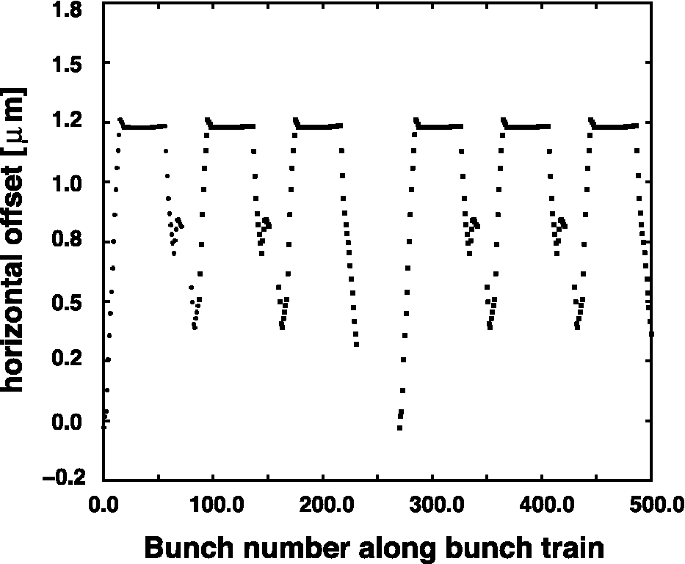
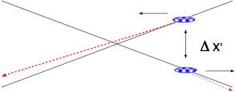
Why 95% and 75%
Orbit effects different due to pacman effects and the many long-range add up giving a non negligible effect
d = 0 - 0.4 units of beam size
Small Offsets from long-range interactions
0.4 σ offset is what the experiments will have from LR for nominal LHC

Slide 11
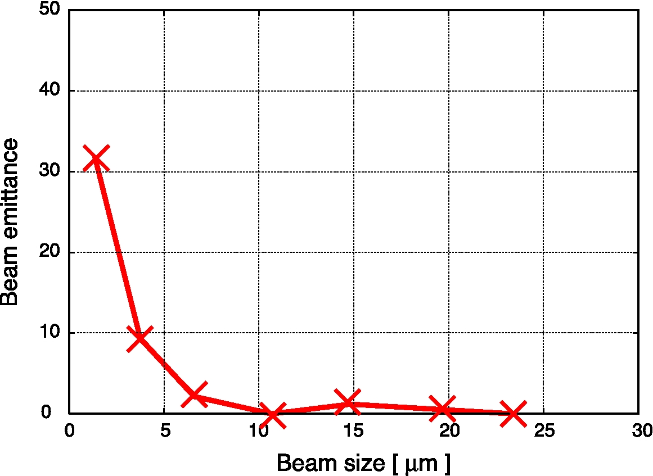
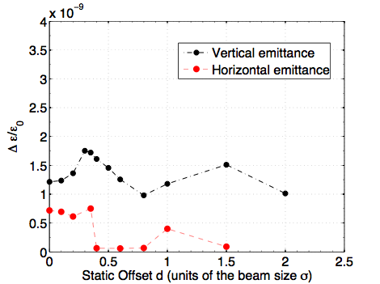
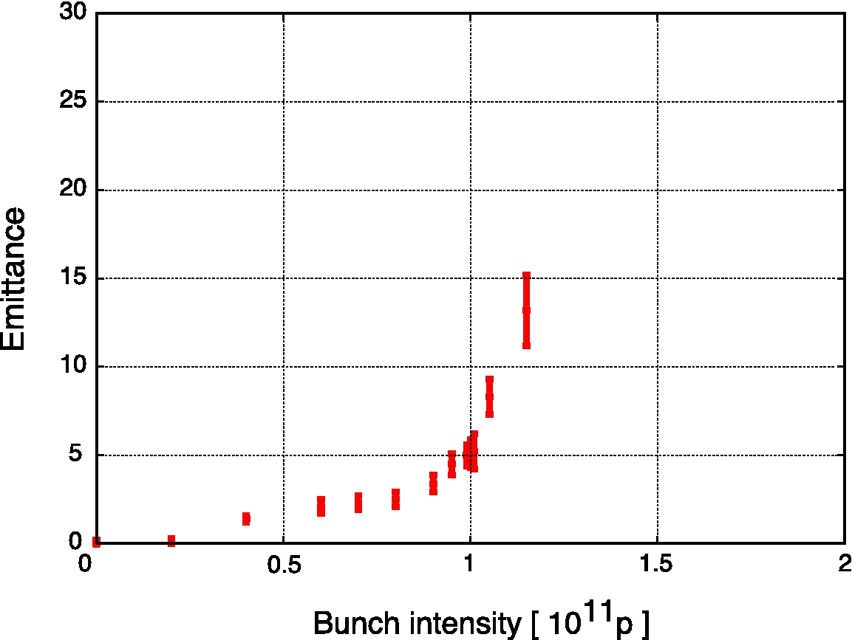
Why 95% and 75%:
Offsets in collision give Slow Emittance growth
Δσ / σ 0
LHC nominal
Maximum
Δσ / σ ₀ (per turn)
And strong tune dependency stay away from 3rd order resonance
Δσ / σ ₀
LHC nominal
Numerical models show a slow emittance growth (8% hour for nominal LHC)
Reduce orbit effects (passive compensation)
Interplay with parameters to not enter threshold values and working point optimization

Slide 12
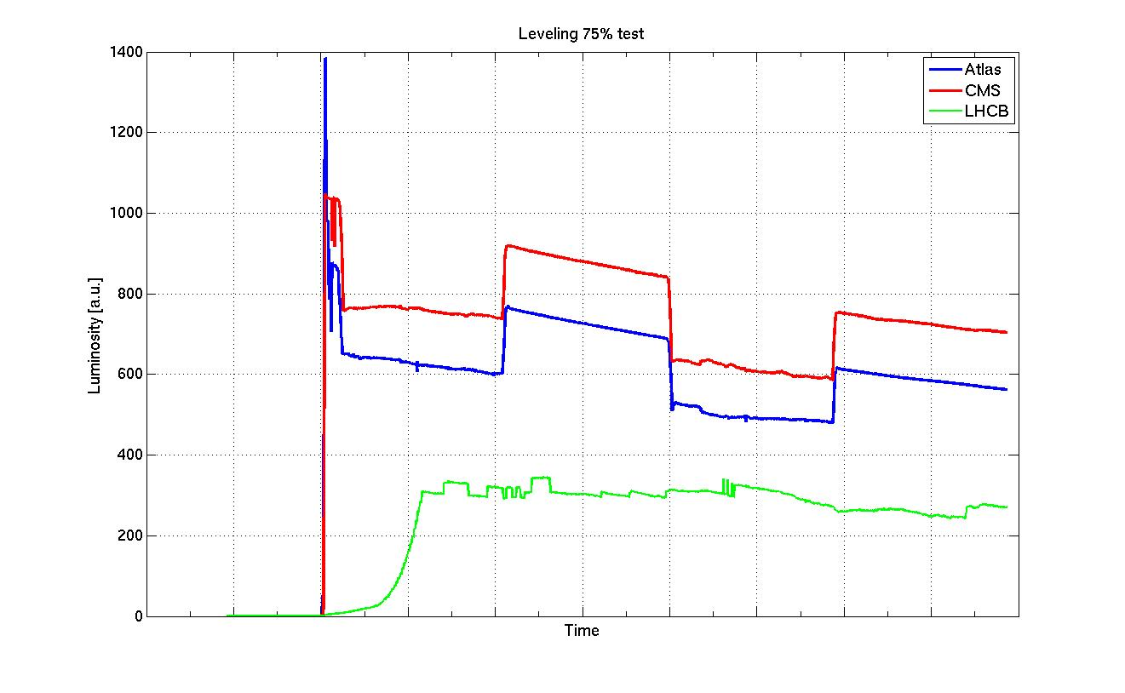
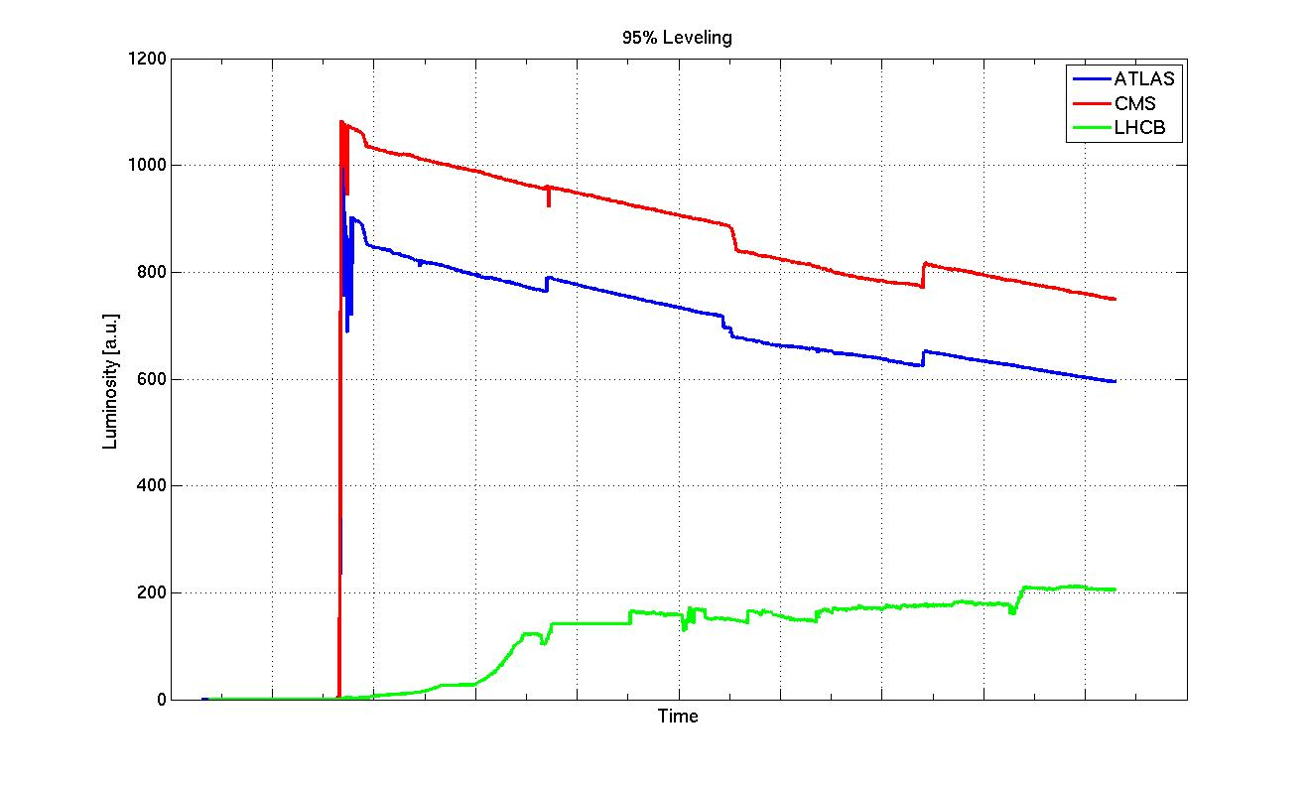
Fill 2488 and 2489
Fill 2488 8th April 00:26-05:10
ADT B1H ½ GAIN
Fill 2489 8th April 06:51-11:36
ADT B1H back full GAIN @9:00

Slide 13
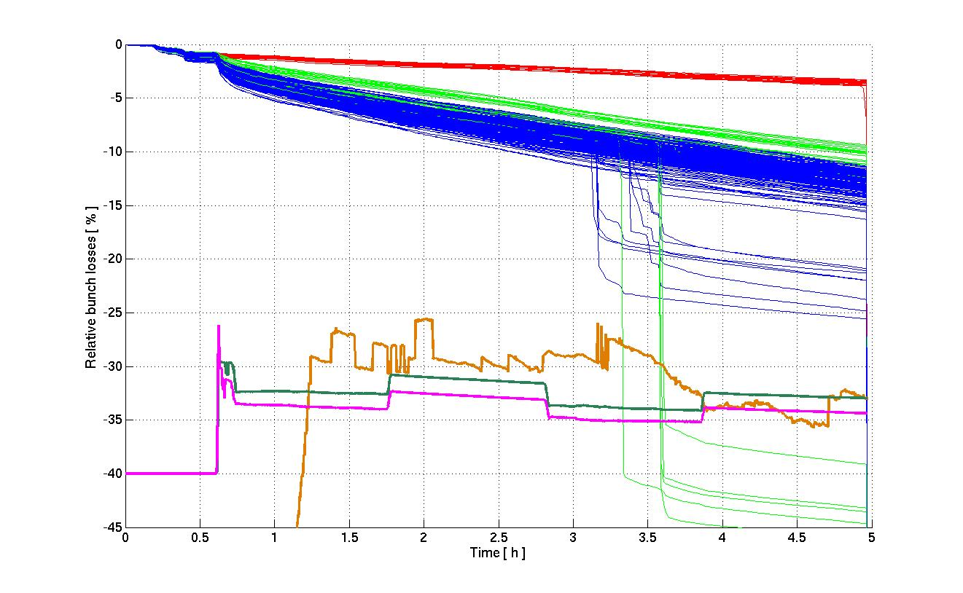
Bunch by Bunch losses Fill 2488 B2
IP8
IP1&5
IP1&5&8
ATLAS
CMS
LHCB
LHCB leveling drives unstable few bunches of Beam 2
Nothing to do with offset in IP1 & IP5

Slide 14
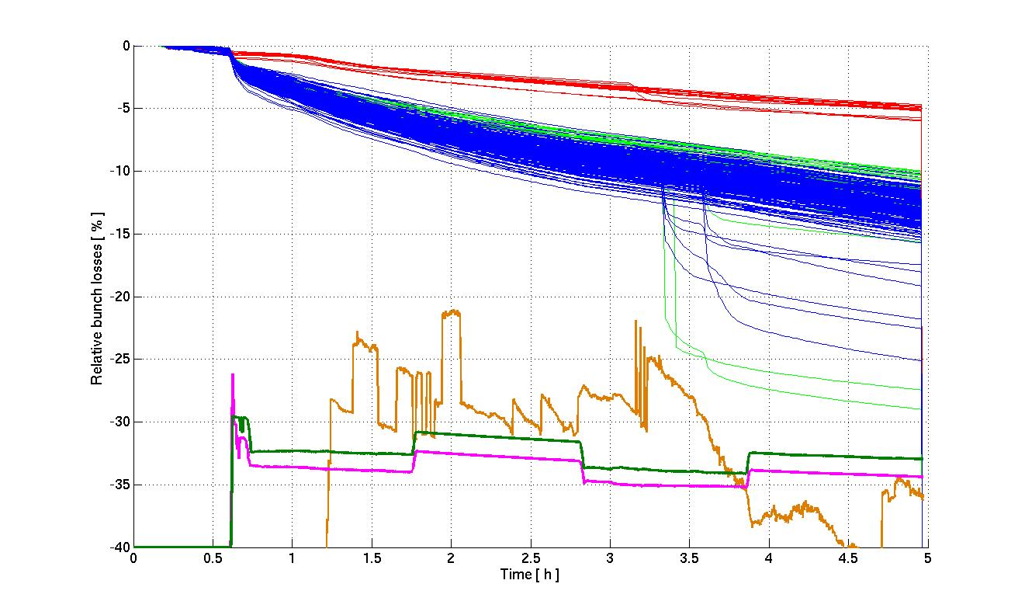
Bunch by Bunch losses Fill 2488 B1
IP8
IP1&5
IP1&5&8
ATLAS
CMS
LHCB
Instability propagates to Beam 1 via coupling in IP1 and IP5

Slide 15
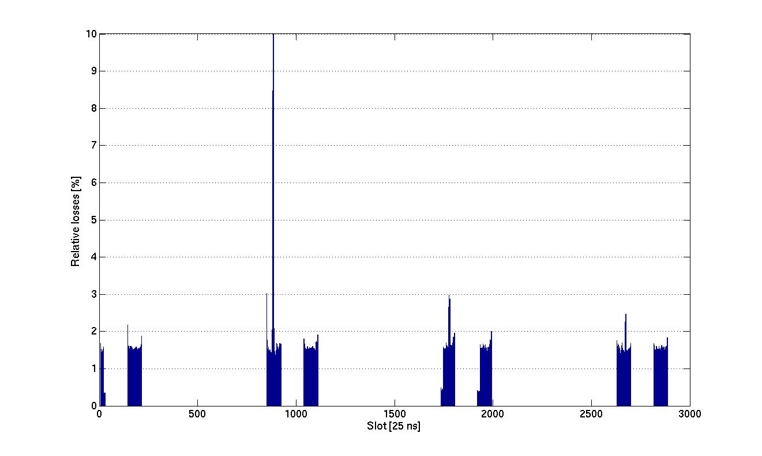
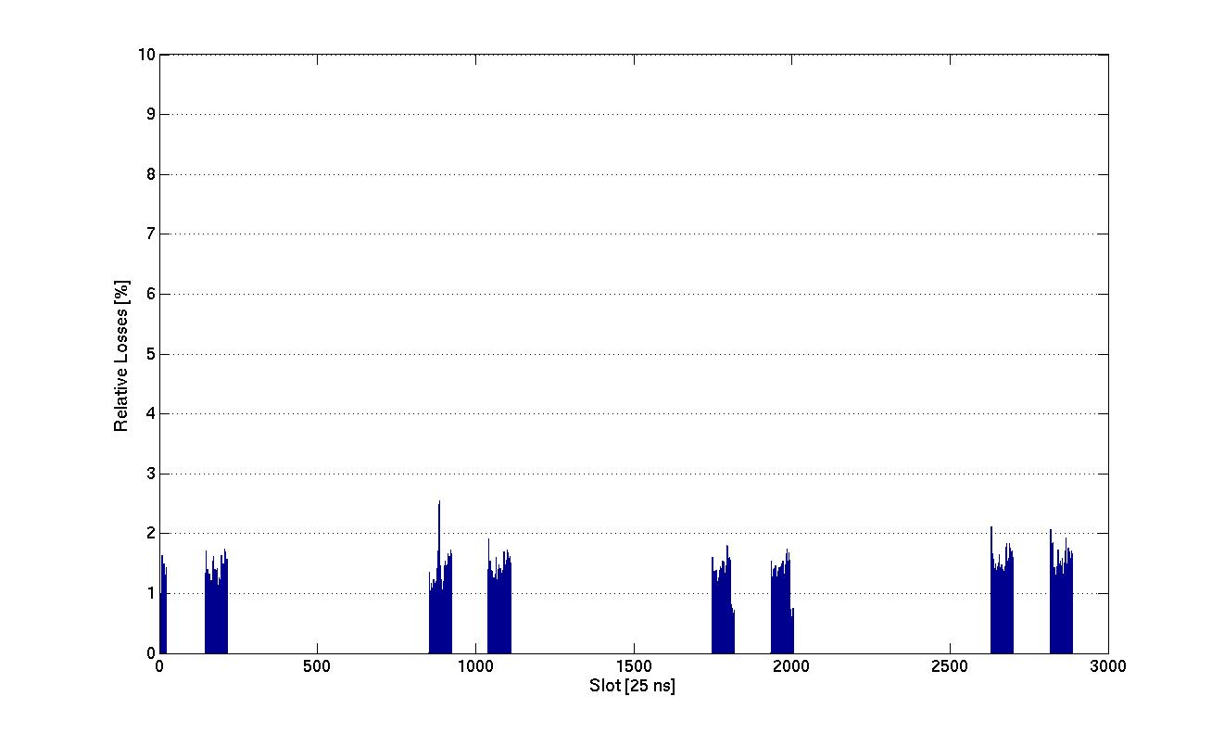
Few bunches of B1 & B2 unstable
Beam 2
During leveling at IP8 few bunches start loosing:
B1: 2 bunches just colliding in IP8
B2: few bunches colliding in IP1-5-8
Instability starts with few bunches of B1 & B2 and then propagates to the other colliding partners at the different IPs
Beam 1

Slide 16
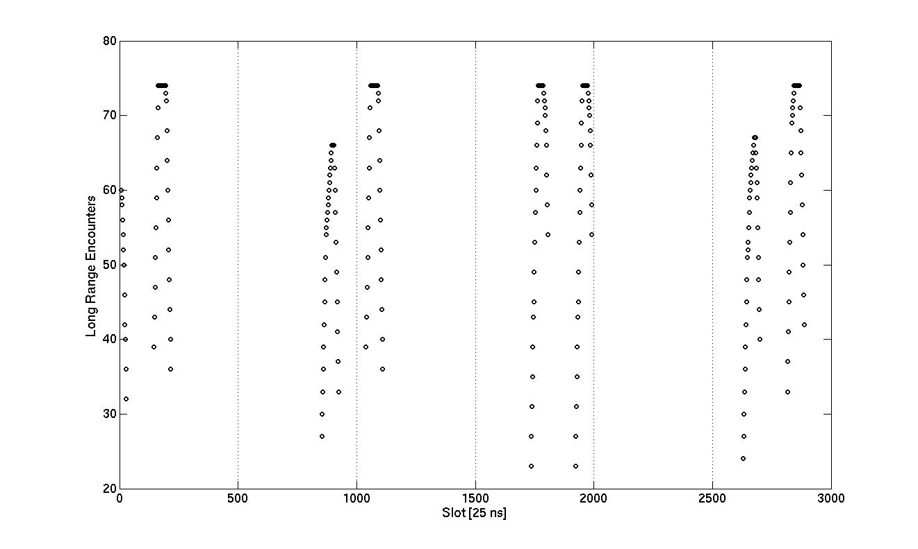
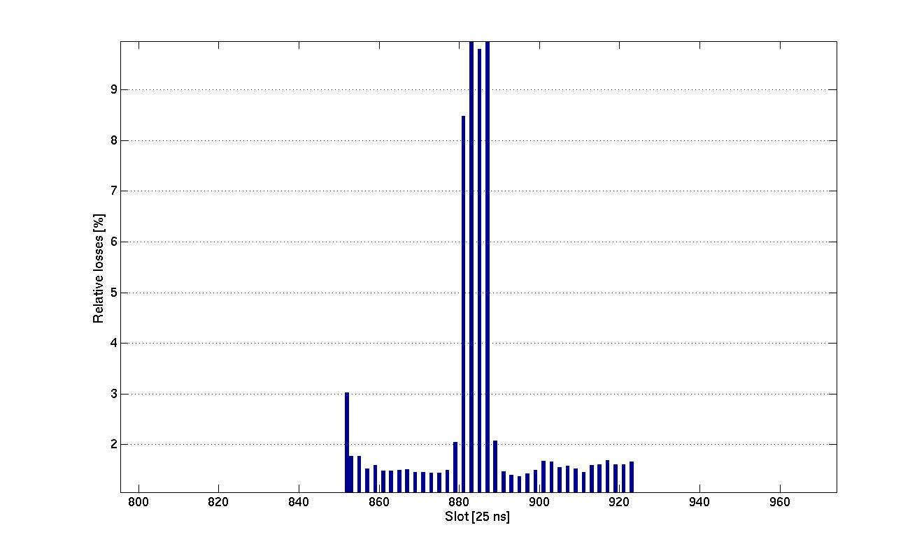
Special bunches?
These 4 bunches of Beam 2
Has full complement of LR collisions in IP8
Any coherent excitation on 1 beam couples to the other beam

Slide 17
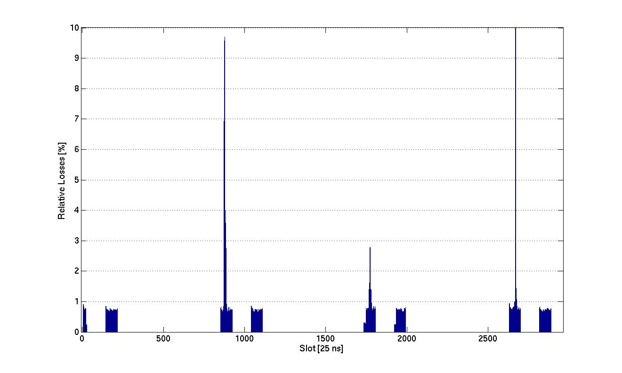
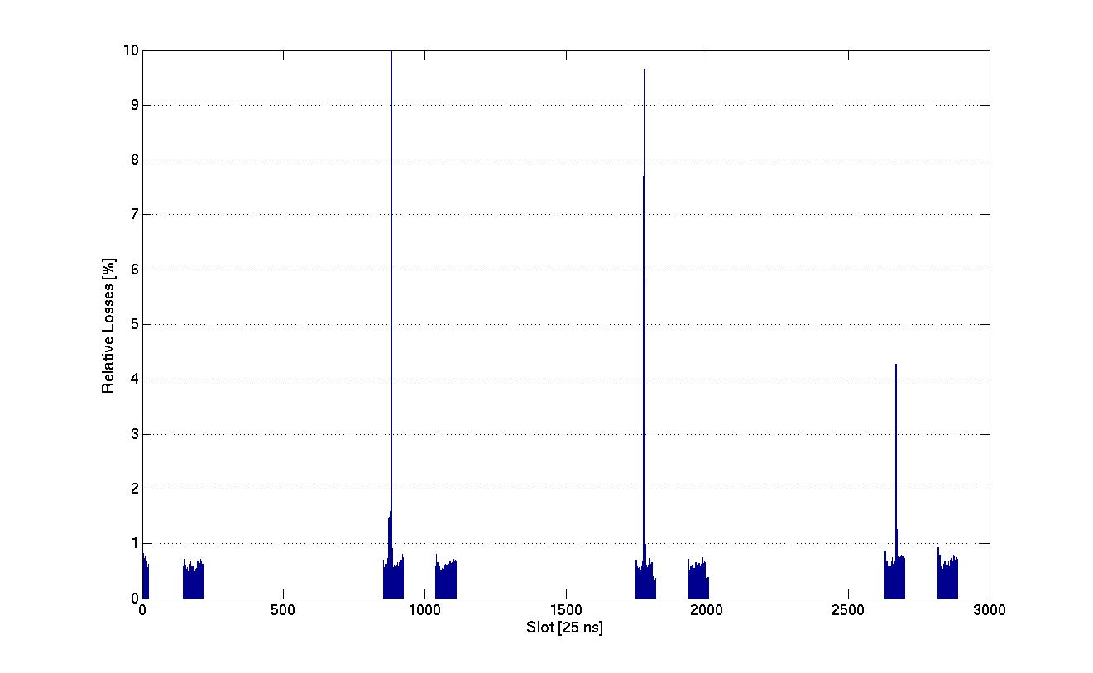
Instability propagates to colliding pairs
Beam 2
Beam-beam couples the effect to many more bunches
Still investigating the source of transverse excitation
Beam 1

Slide 18
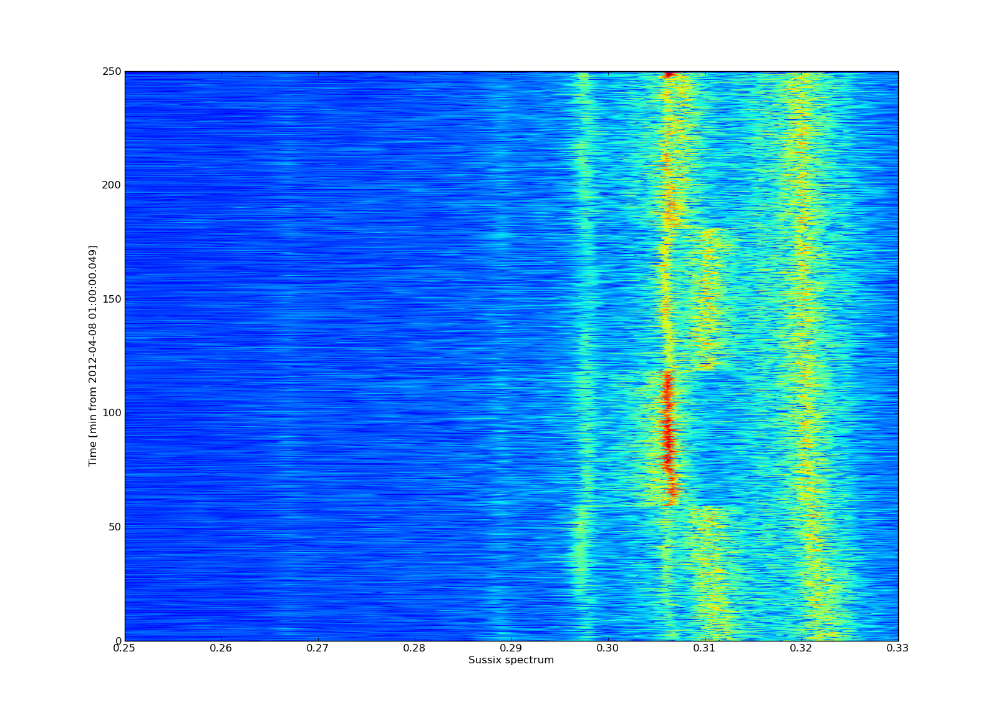
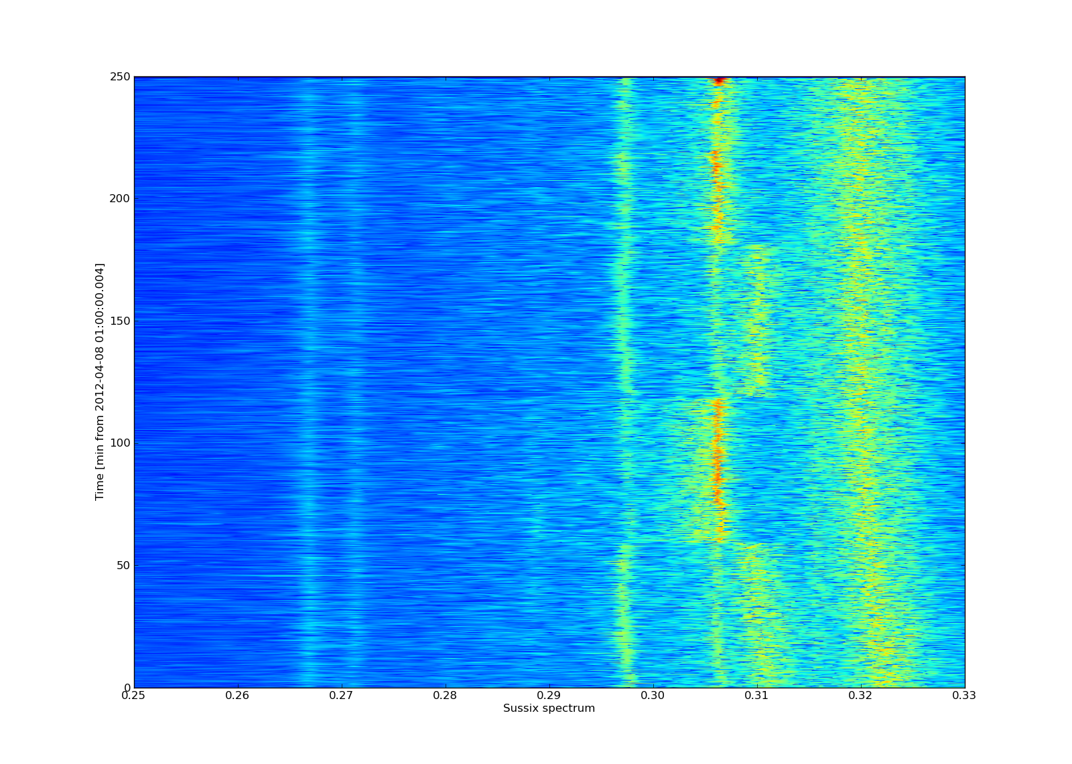
Tunes Fill 2488 B1
B1 V
B2 V
Clear evidence of beam-beam tune shifts during the leveling test
but still analysis needed

Slide 19
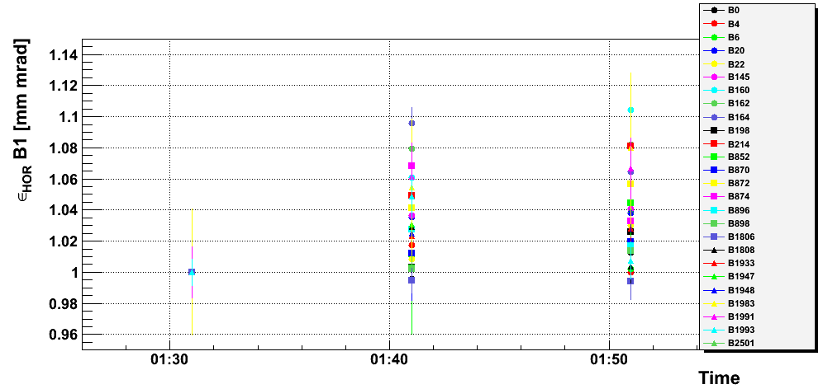
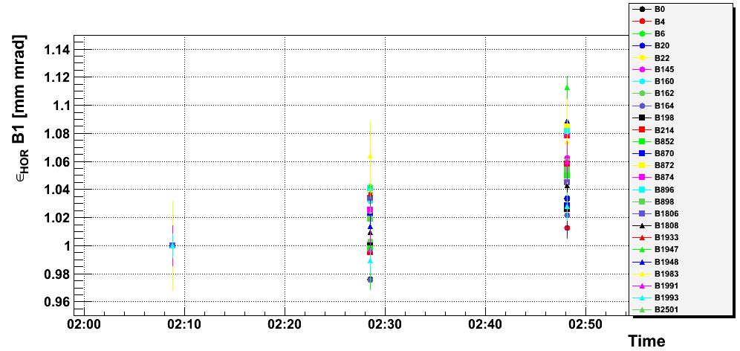
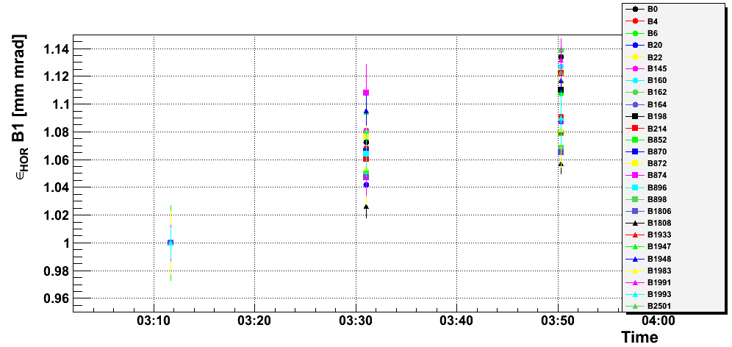
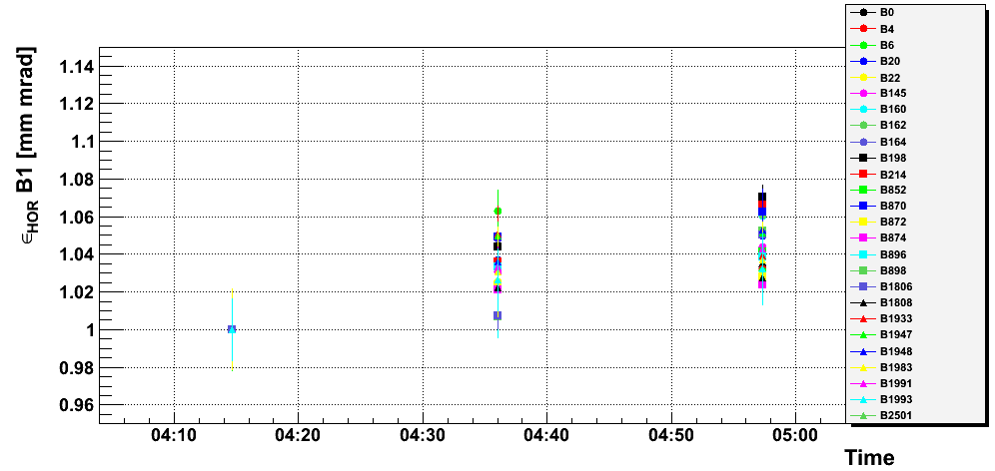
Bunch by bunch Emittances B1 Hor
Fill 2488
100%
75%
No significant/obvious effects due to offset at IPs
Detailed analysis still on-going to relate to bunch collision schedule and tunes
75%
100%

Slide 20
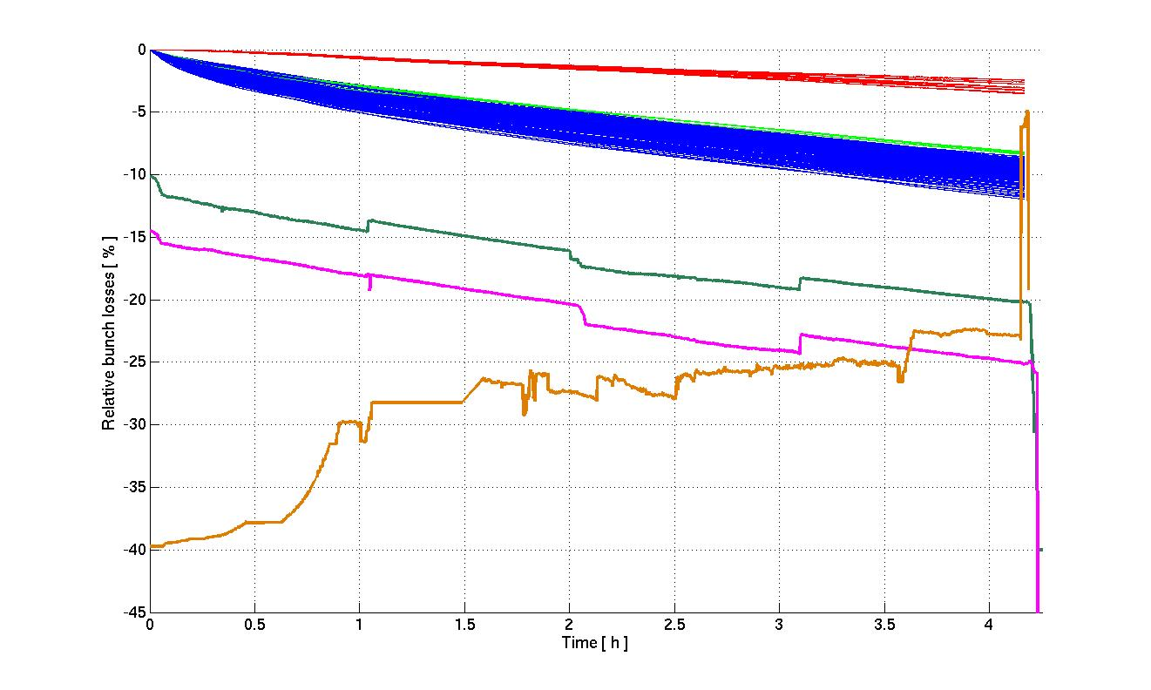
Bunch by Bunch losses Fill 2489 B1
IP8
IP1&5
IP1&5&8
ATLAS
CMS
LHCB
Beam 1 during 95% luminosity test is stable and no visible differences in lifetimes

Slide 21
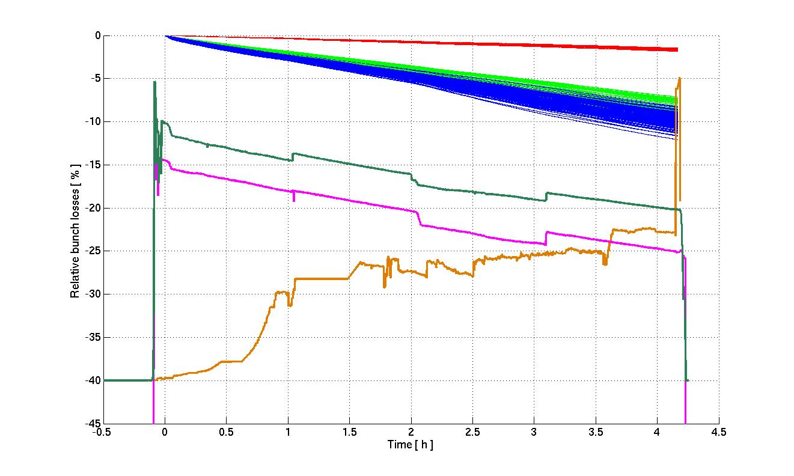
Bunch by Bunch losses Fill 2489 B2
IP8
IP1&5
IP1&5&8
ATLAS
CMS
LHCB
Beam 2 during 95% luminosity test stable and no visible differences in lifetimes

Slide 22
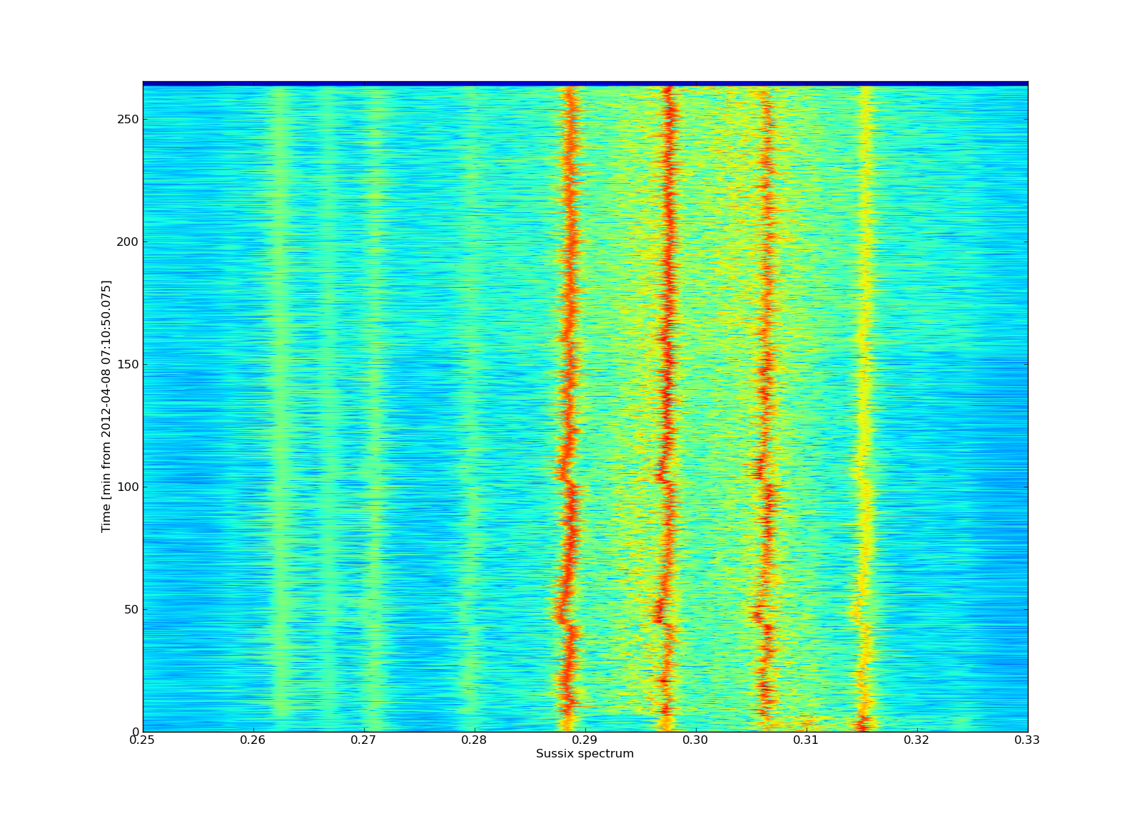
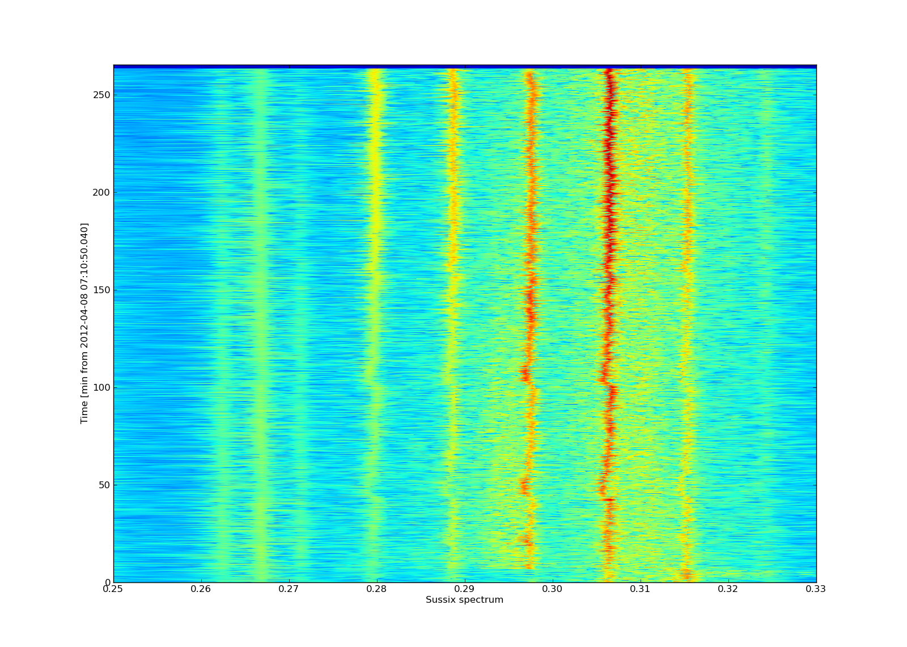
Tunes Fill 2489
B1 H
B2 H
95% leveling almost zero effect on tunes but still data to be analyzed

Slide 23
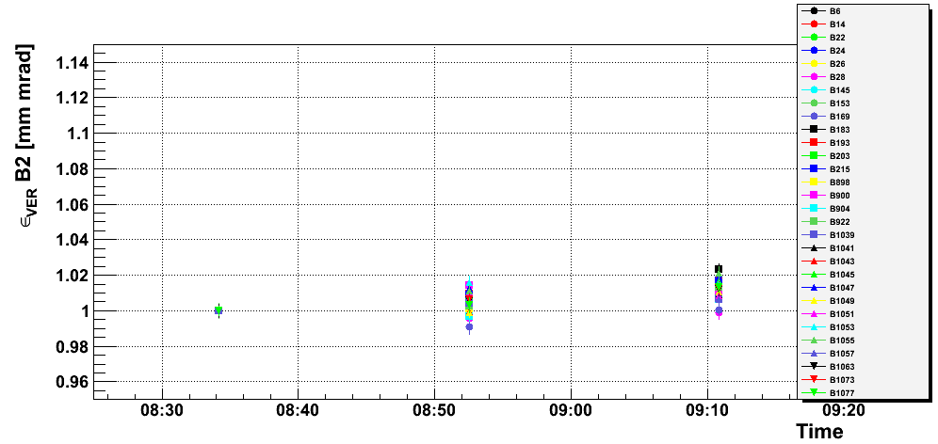
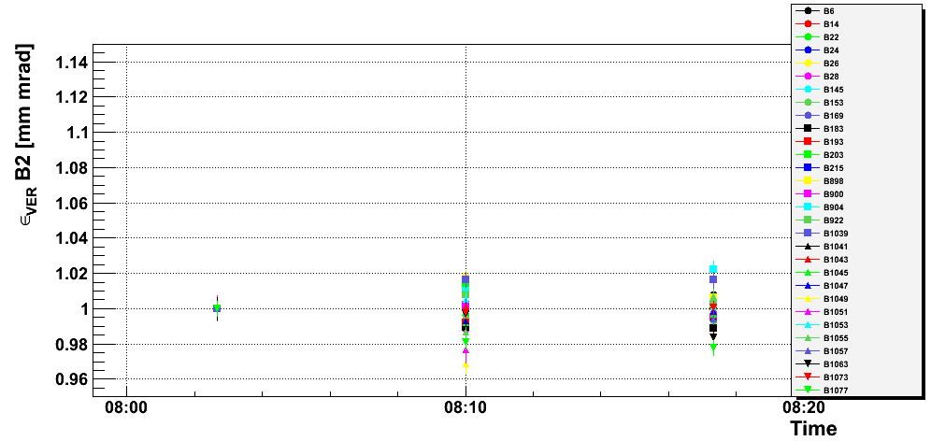
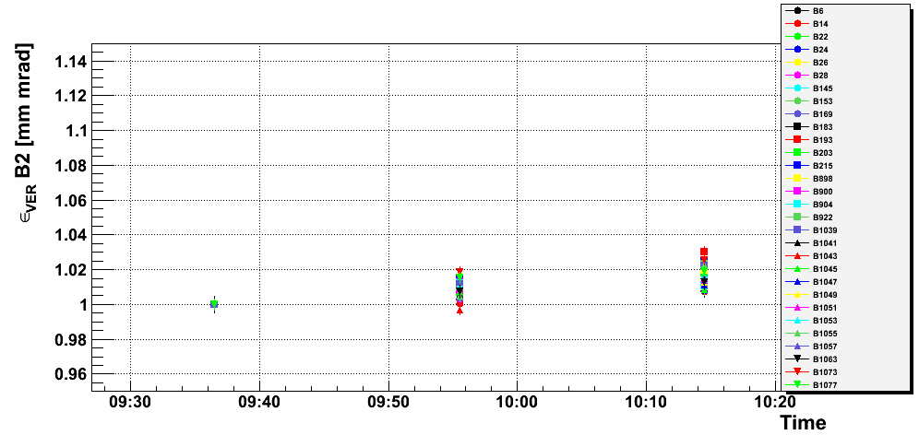
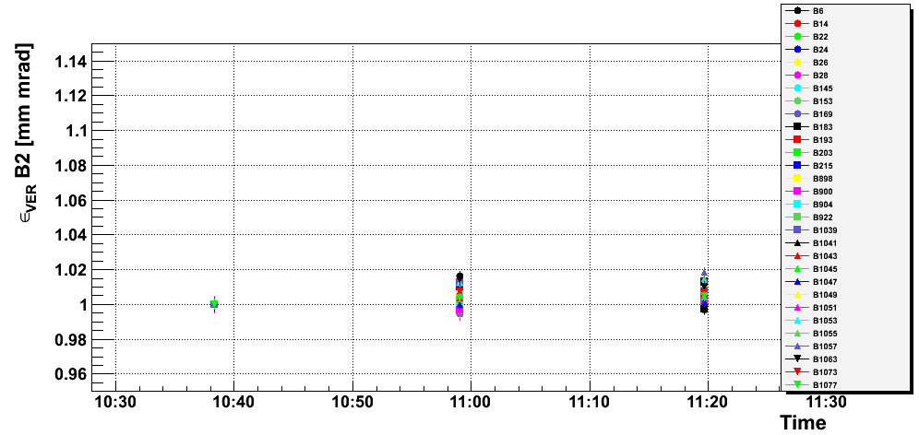
Bunch by bunch Emittances B2 VER
Fill 2489
100%
95%
No significant effect related to leveling
Detailed analysis still on-going to relate to bunch collision schedule
95%
100%

Slide 24
Summary
Intense Easter period….
Some features of sudden losses on selective bunches still to be understood but seems to appear often after hours of stable beams
Successful test with static offsets with 75% and 95% luminosity
No visible problems from beam-beam for the test configuration (emittances, lifetimes)
Any movement of one beam (leveling) is transferred to the colliding bunches
Detailed analysis on-going and some observations still to be understood
detailed analysis on-going
Still many fills to analyze (CMS separated at 2.5 σ Fill 2505 and Fill2509)

