Slide 1
Overview of HOM Damping in PEP-II
Mauro Pivi, SLAC while at CERN
ICE Meeting, CERN
April 18, 2012

Slide 2
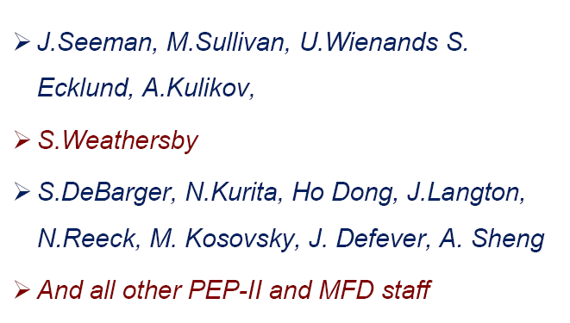
On behalf of
S. NovoKhatski

Slide 3
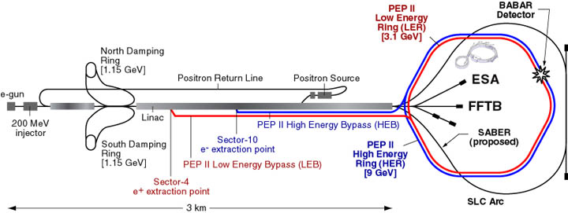
Linac and PEP-II

Slide 4
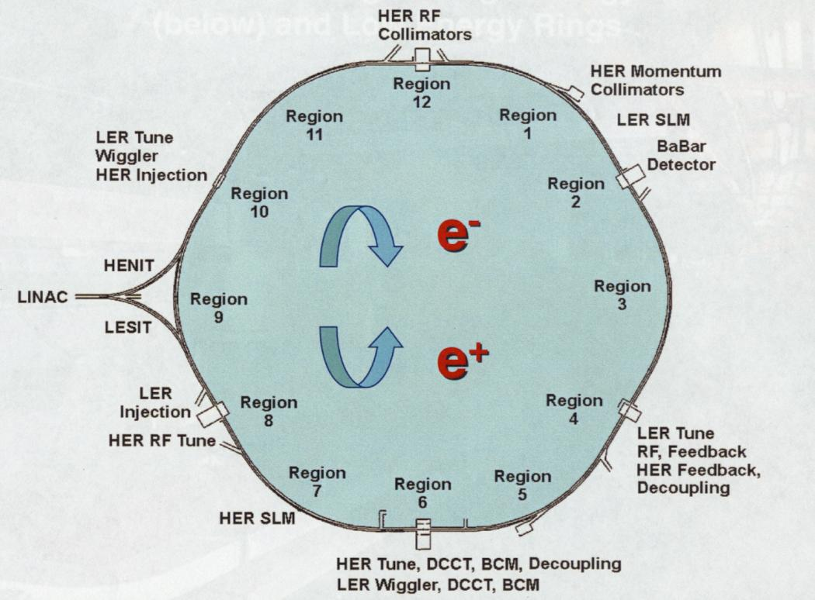
Layout of the PEP-II Ring
9 GeV
3.1 GeV

Slide 5
Luminosity and electromagnetic fields
PEP-II: high current beams of very short bunches to achieve very high luminosity
These beams carry high intensity electromagnetic fields.
Electric field at the beam pipe wall
Fields near a sharp metal corner may exceed the breakdown threshold
HOM power scales as:

Slide 6
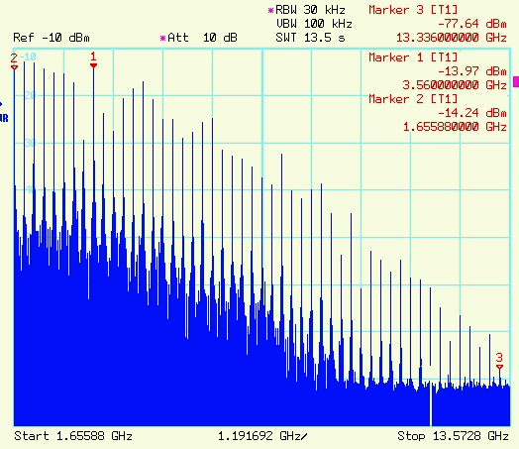
Bunch field spectrum
Field spectrum goes to higher frequency with shorter bunches exponentially
Beam spectrum (12 mm bunch)
Bunch spacing resonances
Bunch spacing

Slide 7
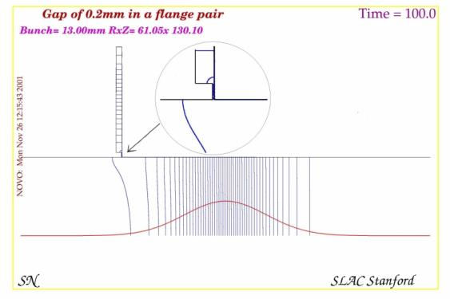
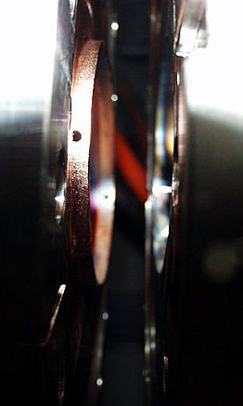
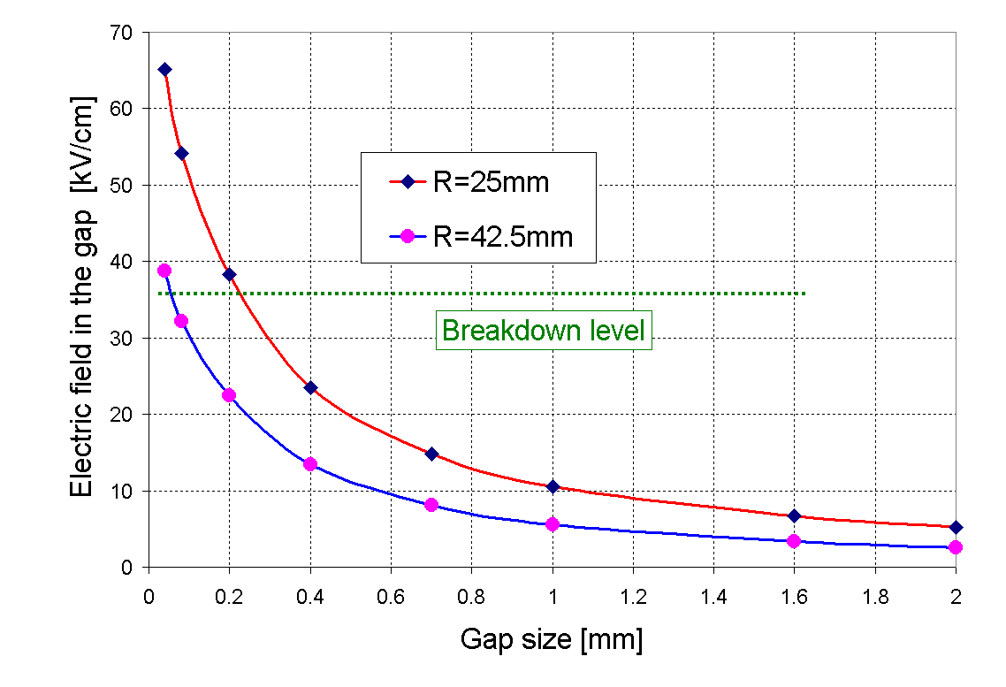
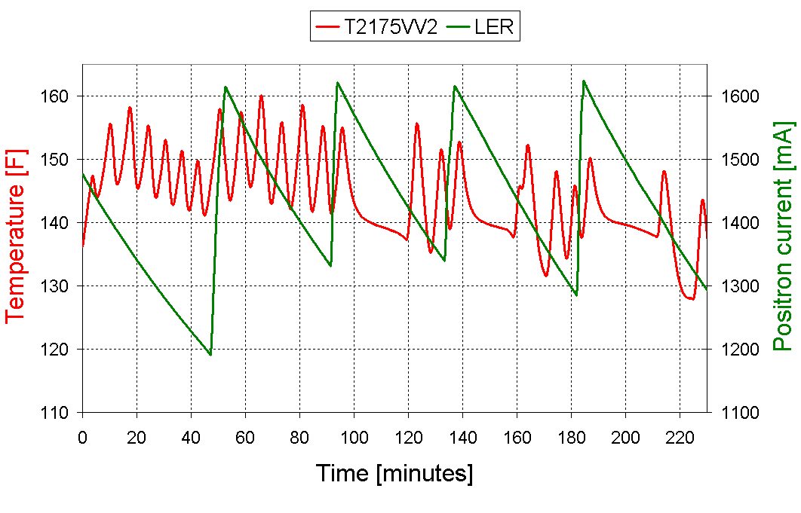
Small Gap, Breakdowns and Temperature Oscillations
Very small gaps are the source of high intensity wake fields causing electric breakdowns
Breakdowns

Slide 8
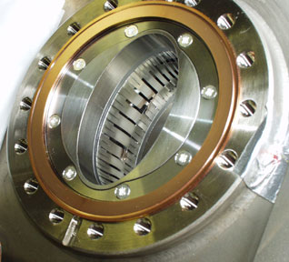
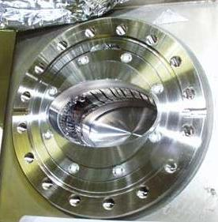
Wake field Evidence from PEP-II
Shielded fingers of some vacuum valves were destroyed by breakdowns of intensive HOMs excited in the valve cavity.

Slide 9
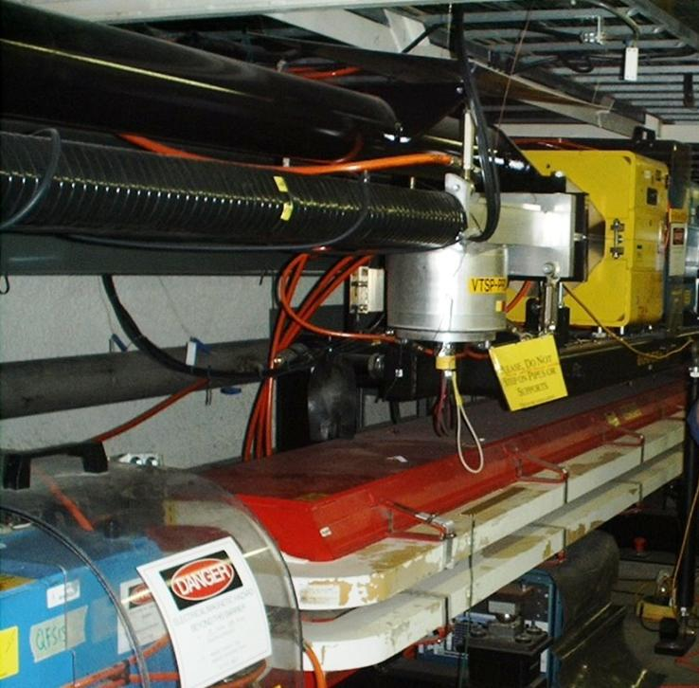
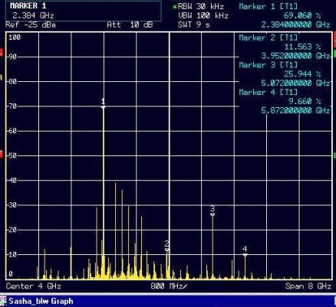
HOM leaking from TSP heater connector
Wake fields can leave the vacuum chamber through heating wires of Titanium Sublimation Pumps (TSP)
antenna
HOM spectrum from
Spectrum analyzer

Slide 10
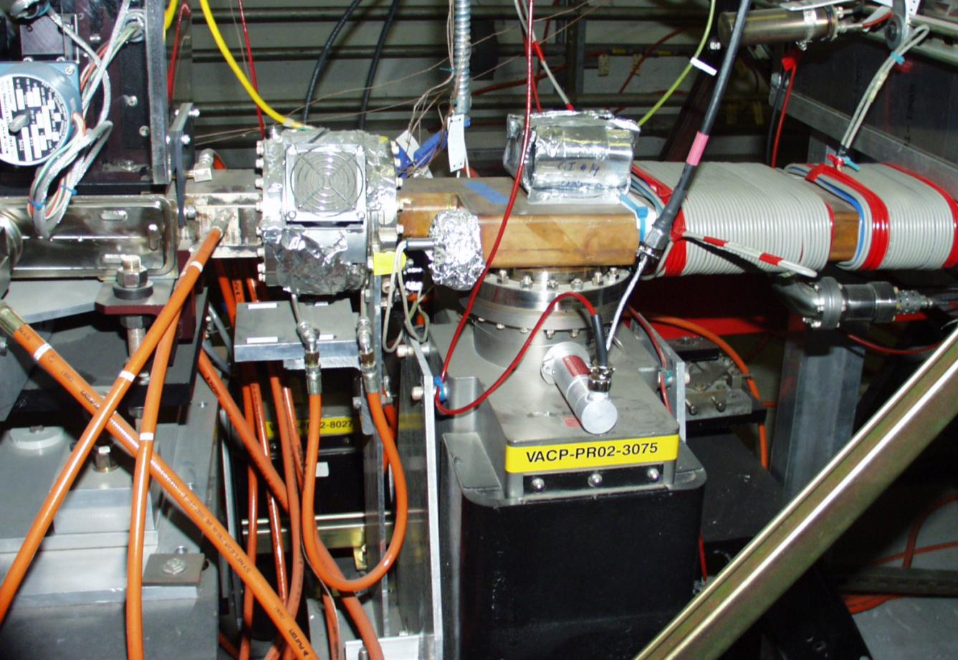
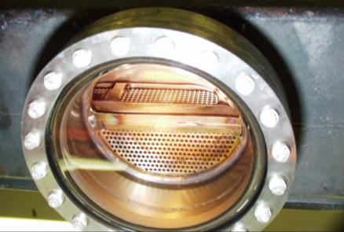
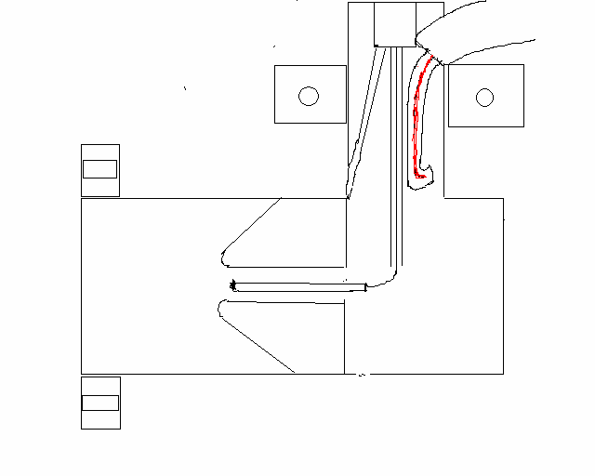
HOMs go through RF screens
RF spectrum
antenna
RF screens

Slide 11
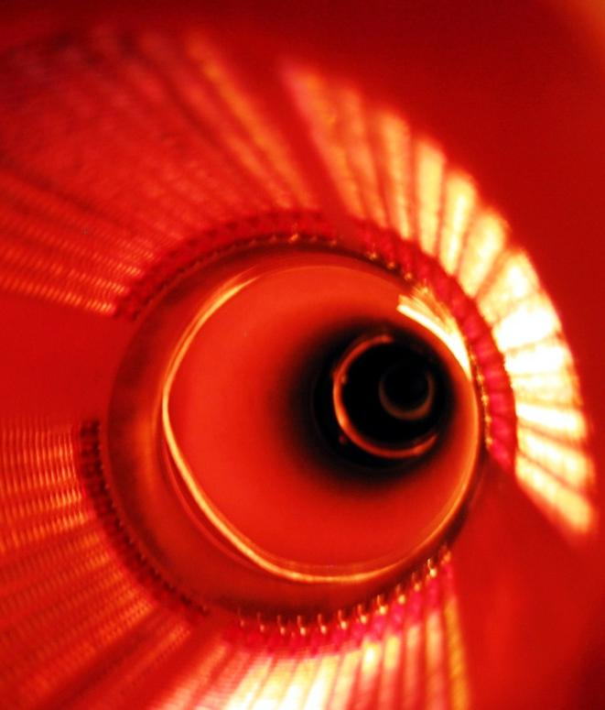
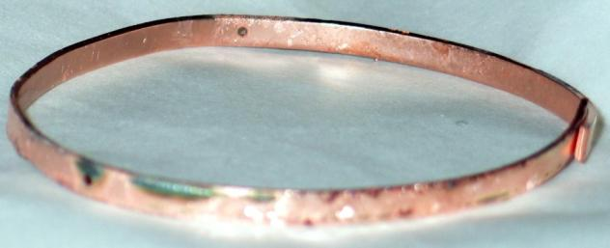
A gap ring may be a reason for the beam instability
Breakdowns traces

Slide 12
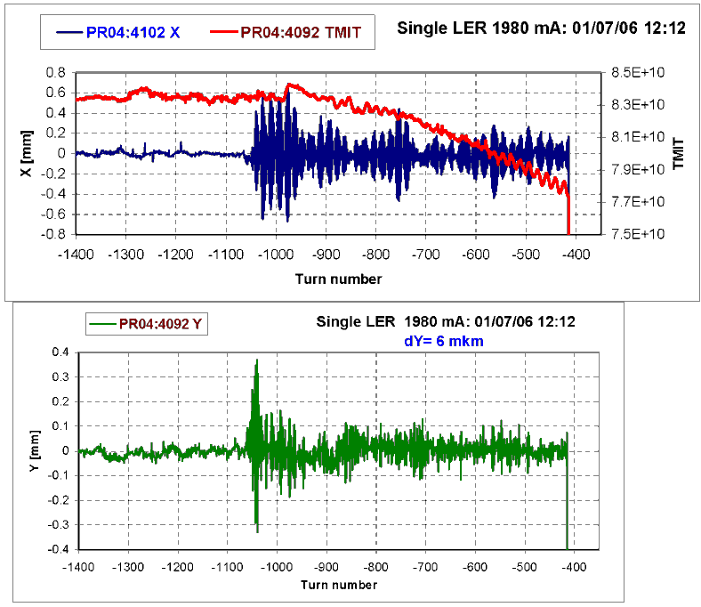
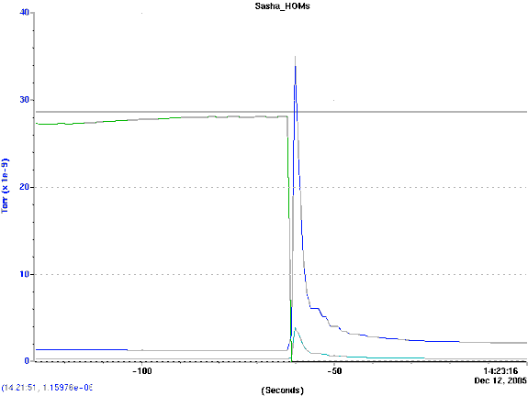
Fast Instability and vacuum spikes
LER
vacuum
abort

Slide 13
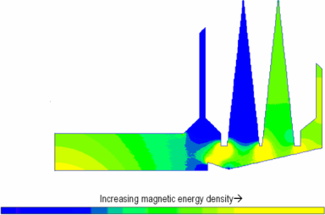
Simulated magnetic energy density (MAFIA)
Temperature ©
Wake fields transfer energy to resonance HOMs excited in the closed volumes of shielded bellows.

Slide 14
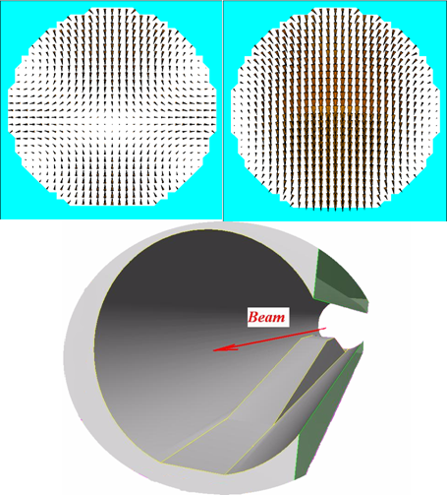
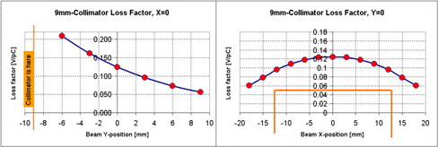
Main HOM Source are Collimators
MAC Review

Slide 15
What we can do
There is only one way:
extract HOM power from the beam pipe by specially designed water-cooled RF absorbers, before HOM reach sensitive components

Slide 16
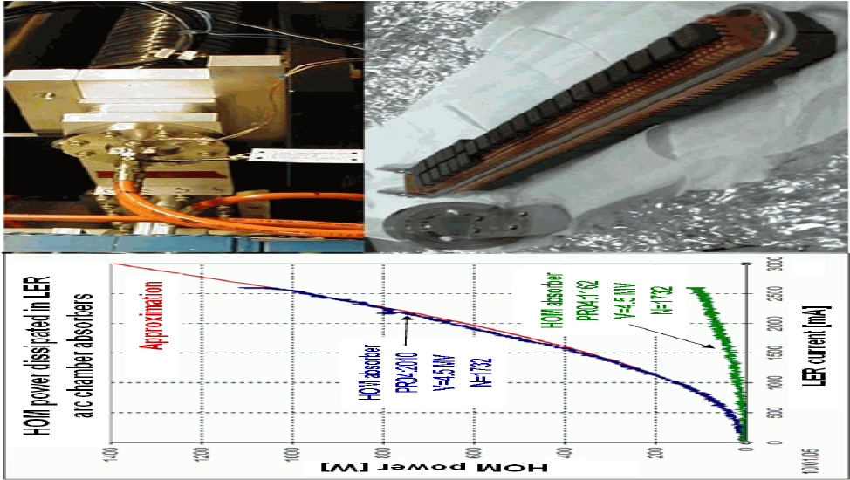
HOM absorber in PEP-II arc antechamber
S. Weathersby, SLAC

Slide 17
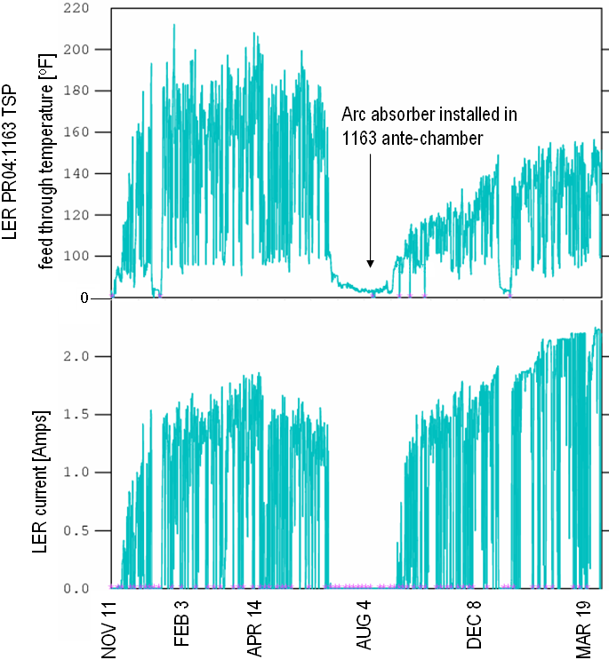
HOM damping following absorber installation
Temperature reduction at TSP feed-through downstream location

Slide 18
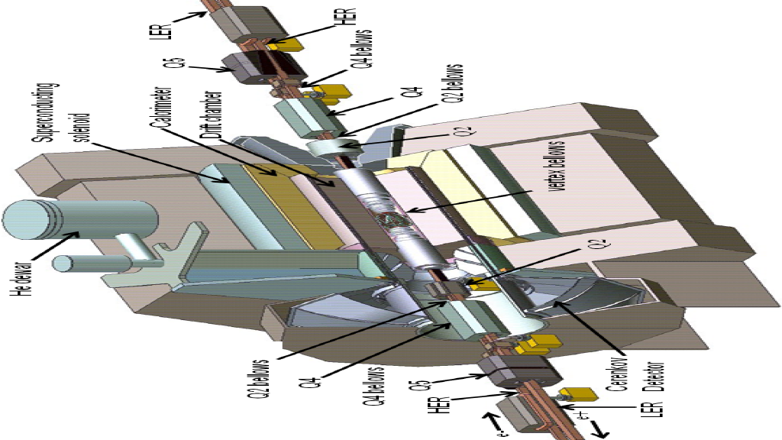
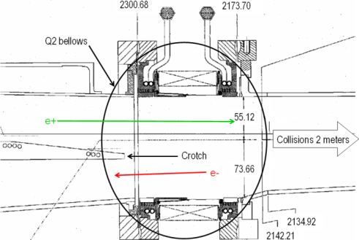
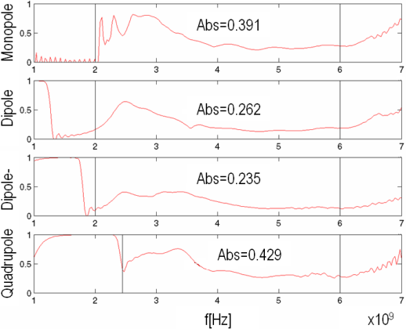
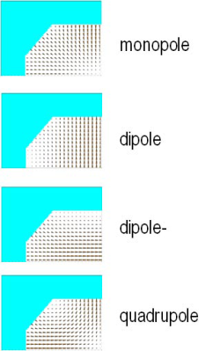
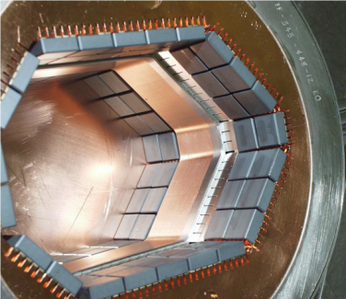
Bellows in the Interaction Region area: Q2
HOM 10 kW deposited in Q2 bellow area
Existing Q2 bellow with tiles fully exposed to beam
Absorption spectra analysis. High monopole value
S. Weathersby, SLAC

Slide 19
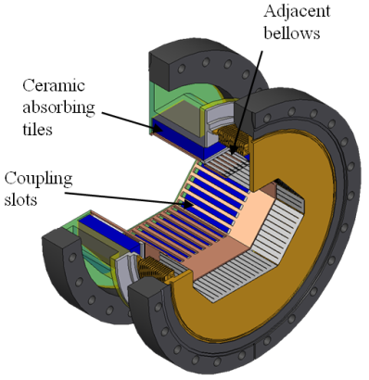
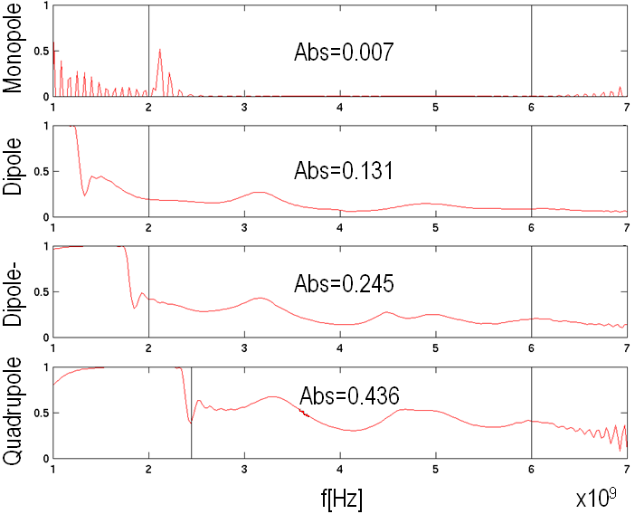
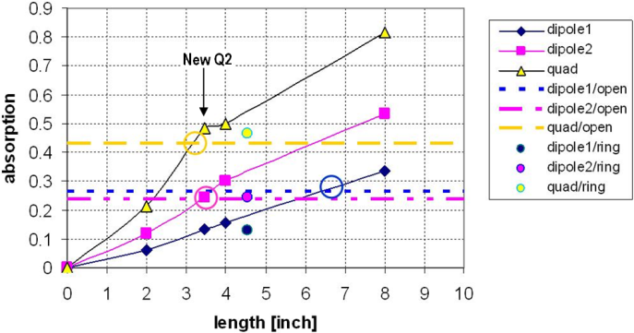
Bellows in the Interaction Region area: Q2
New Q2 bellow, coupling slots and ceralloy tiles behind
Spectral mode analysis for new bellow. Reduced monopole.
Absorption vs slot length for dipole and quadrupole modes
S. Weathersby, SLAC

Slide 20
Old Q2 bellow
New Q2 bellow

Slide 21
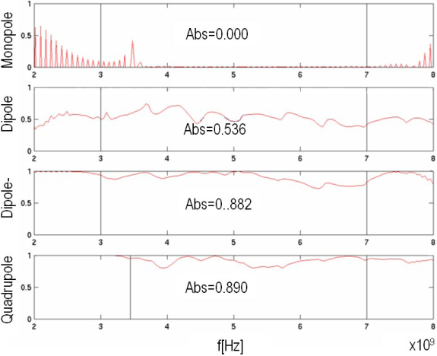
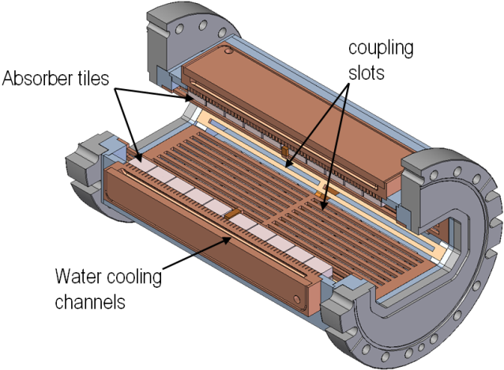
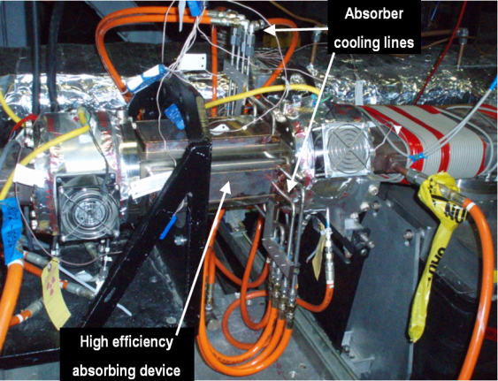
New optimized high efficiency absorbing device
54%
88%
89%
Long coupling slots, and tiles brazed to copper with cooling line, dimensions in inches
J.Seeman, S. Novokhatski, S. Weathersby, N. Kurita and N. Reeck

Slide 22
Developed high efficiency HOMs absorbers for different cross sections and installed 25 in the rings

Slide 23
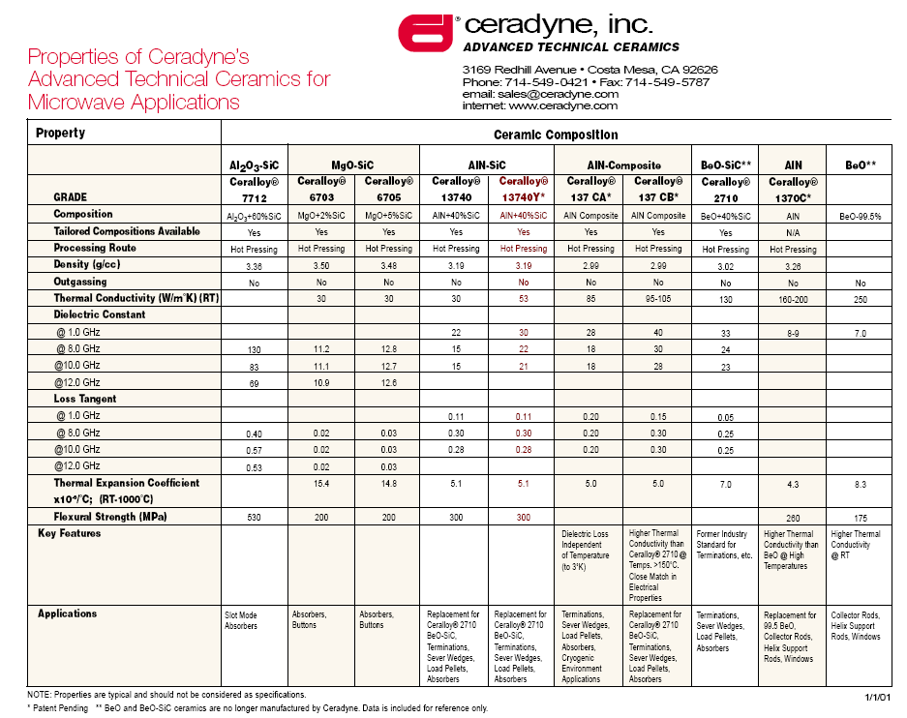
Properties of ceramic tiles

Slide 24
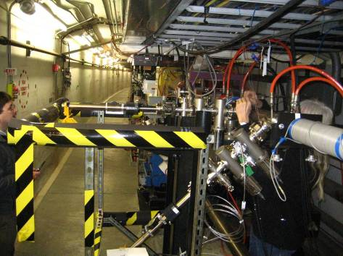
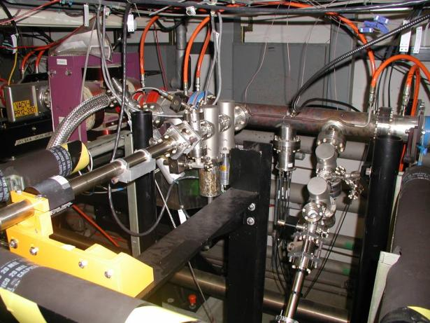
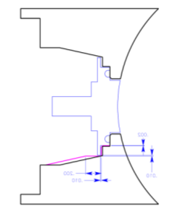
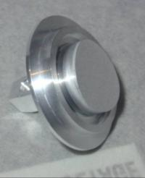
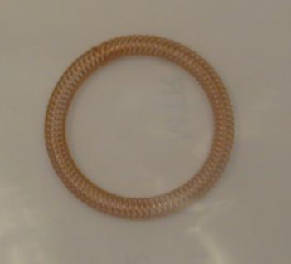
Collective Effects test set-up (nº 1) in PEP-II: controlling HOM
Samples moved by manipulators to face the interior of the vacuum chamber
Must avoid beam HOM into the 2 manipulators: assure perfect contact of the samples to the chamber wall, together with the use of RF seal springs
Cu-Be Ag coated RF seal
PEP-II LER side
sample surface exposed to SR and to electron cloud

Slide 25
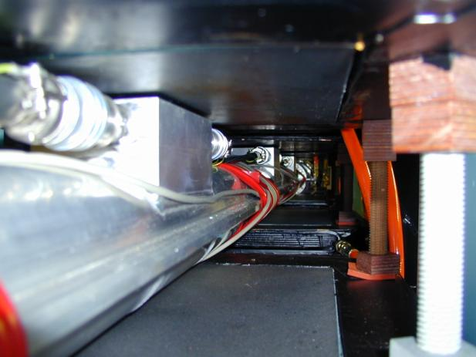
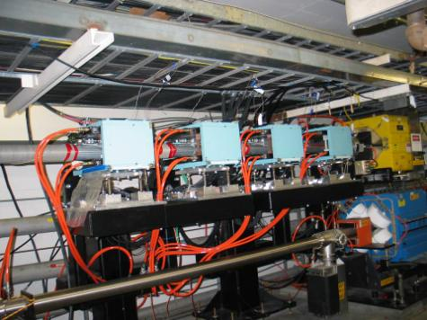
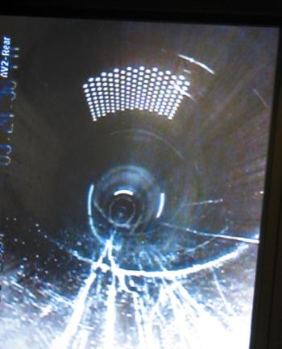
Collective Effects test set-up (nº 3) in PEP-II: controlling HOM
Chicane installed in PEP-II
Chicane inner view
Chamber inner view
Holes in the wall to measure electron cloud current
Need to avoid propagation of HOM through holes: holes size designed to damp beam RF
OUTCOME: No HOM issues in electron cloud set-ups. Smooth operations of PEP-II + new break-through findings from tests.

Slide 26
Summary
As bunch currents increase, became clear that wake field effects have been underestimated during machine design
Important understanding of HOMs in accelerators achieved
Collimators identified as source of HOMs heating
Developed devices to selectively couple dipole and quadrupole modes and discourage monopole mode coupling
PEP-II collider ended at nearly twice the design current and 4X the design luminosity.
- Beam current = 3 A and L = 1.2  10³⁴ cm⁻² s⁻¹
HOM have been a limitation to further increase current
26

Slide 27
Main High Order Modes (HOM) Effects
Heating of vacuum elements
Temperature and vacuum rise
Deformations and vacuum leaks
Decreasing pumping speed
Breakdowns and multipacting
Vacuum leaks
Melting thin shielded fingers
Longitudinal instabilities
Electromagnetic waves outside vacuum chamber
Interaction with high sensitive electronics

Slide 28
Examples from PEP-II
A very small gap in a vacuum chamber is the source of high intensity wake fields, which cause electric breakdowns

Slide 29
HOMs with transverse components
Wake fields, which have transverse components may penetrate through small slits of shielded fingers to vacuum valves volumes and excite high voltage resonance fields, which may destroy the fingers

Slide 30
Wake fields outside
Wake fields can go outside the vacuum chamber through heating wires of Titanium Sublimation Pumps (TSP).

Slide 31
Wake fields
Other possibilities for wakes to go outside is to escaped from the vacuum pumps through RF screens

Slide 32
Temperature raise
Propagating in the vacuum chamber wake fields may transfer energy to resonance High Order Modes (HOMs) excited in the closed volumes of shielded bellows.
Main effect is the temperature rise

Slide 33
