Slide 1
Can we make a wire-measurement, without using matching boxes ?
Olav Berrig
Wednesday 28/3 2012
Thanks to V. Vaccaro, H.Day, JL.Nougaret, and especially to F.Caspers

Slide 2
Inspiration from INFN/TC-94/023 14 Nov 1994 V.Vaccaro:

Slide 3
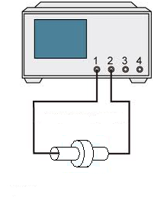
Modern measurements use matching boxes, which intends to match the 50 Ω of the Network Analyzer to the characteristic impedance of the vacuum chamber:
Suco boxes with matching resistors. These will prevent the reflected waves from the mismatch between the 50 Ohm of VNA and the vacuum chamber.

Slide 4
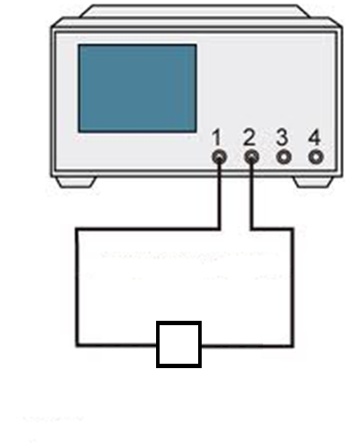
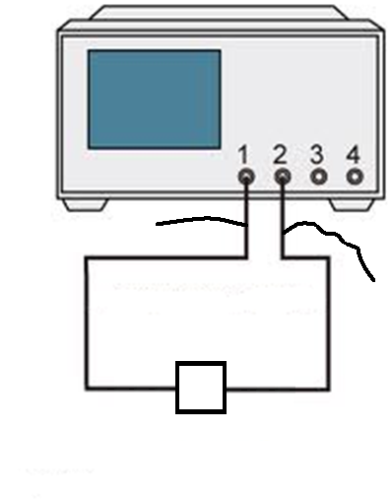
The matching boxes are difficult to calculate and difficult to make. Idea: Use the Network Analyzer to calibrate away the mismatch
TEST NORMAL
TEST with MISMATCH
Wires to create mismatch
Calibration by Network Analyzer

Slide 5
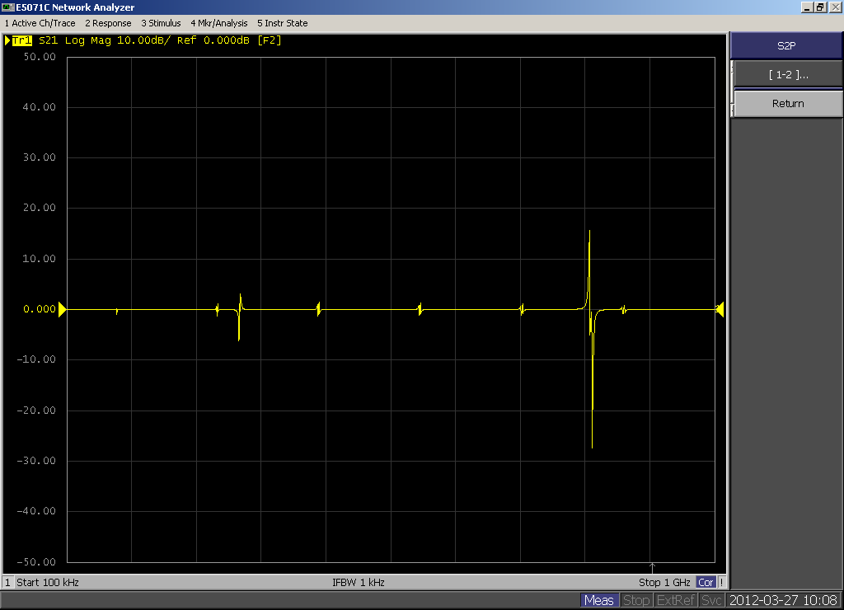
Big Success
S21
Frequency [Hz]
My calibration was not too successful. It should have been a straight line.
The calibration is a special 2-port calibration - idea of F.Caspers – where each of the wires are compensated.
This mistake probably explains the differences in the freq. responses

Slide 6
Conclusion
The method seems to be working. However, the 2-port matching should be repeated.
The method should be tried on a real vacuum chamber.

Slide 7
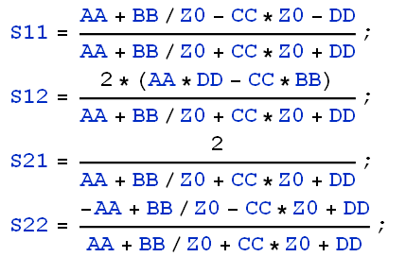
How are scattering parameters: S11, S12, S21 and S22 related to the ABCD matrix formalism (see VMTSA (JLN) )?

Slide 8
Does a frequency response measurement give all information? YES !!!

