Slide 1
Low Energy Ion Ring LEIR
Motivation for LEIR
LEIR after complete installation
LEIR Layout
LEIR Cycles
LEIR Lattice
Injection with stacking all three phase spaces
Accumulation
Dynamic Vacuum
A few Words on Impedances and Instabilities
LEIR Run 2011
Ideas and plans for the future

Slide 2
Motivation for LEIR
Pre-LHC era:
  Ion chain with new Linac3 for SPS fixed target ion operation (via Booster)
  Not suitable for LHC: large emittances and low brightness (brightness limited already at ECR ion source)
Proposals to increase brightness for LHC
  Laser ions source to increase brightness
    Studied in the 1990ies
  Accumulation in synchrotron with electron cooling
    Electron Cooling fast at low energy and for “heavy” (high charge state) ions
    Studied experimentally between 1994 and 1997 with LEAR
    Insufficient life-time of initially envisaged Pb⁵³⁺ due to recombination with electrons from cooler … choice of Pb⁵⁴⁺, which has low recombination rates
    Chosen as viable solution, which can be ready on time for LHC
    (expected around 2006)
    Construction of LEIR reusing most of the LEAR hardware
    LEIR transforms several long low density pulses from Linac3 into dense short bunches useful for LHC

Slide 3
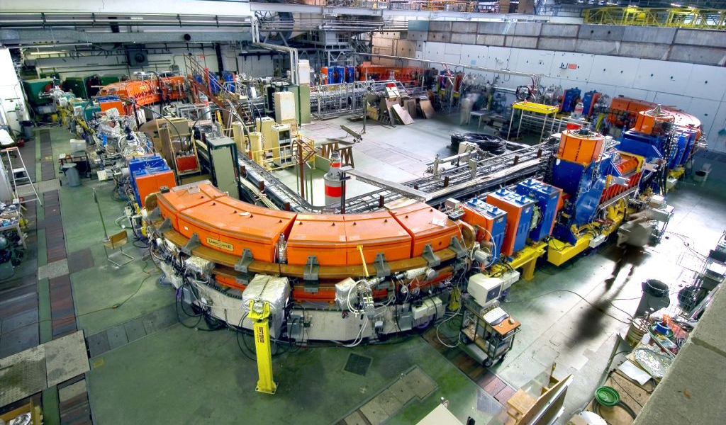
LEIR after complete installation
Transfer tunnel
Injection
(inclined septum)
Electron Cooler
(new, from BINP)

Slide 4
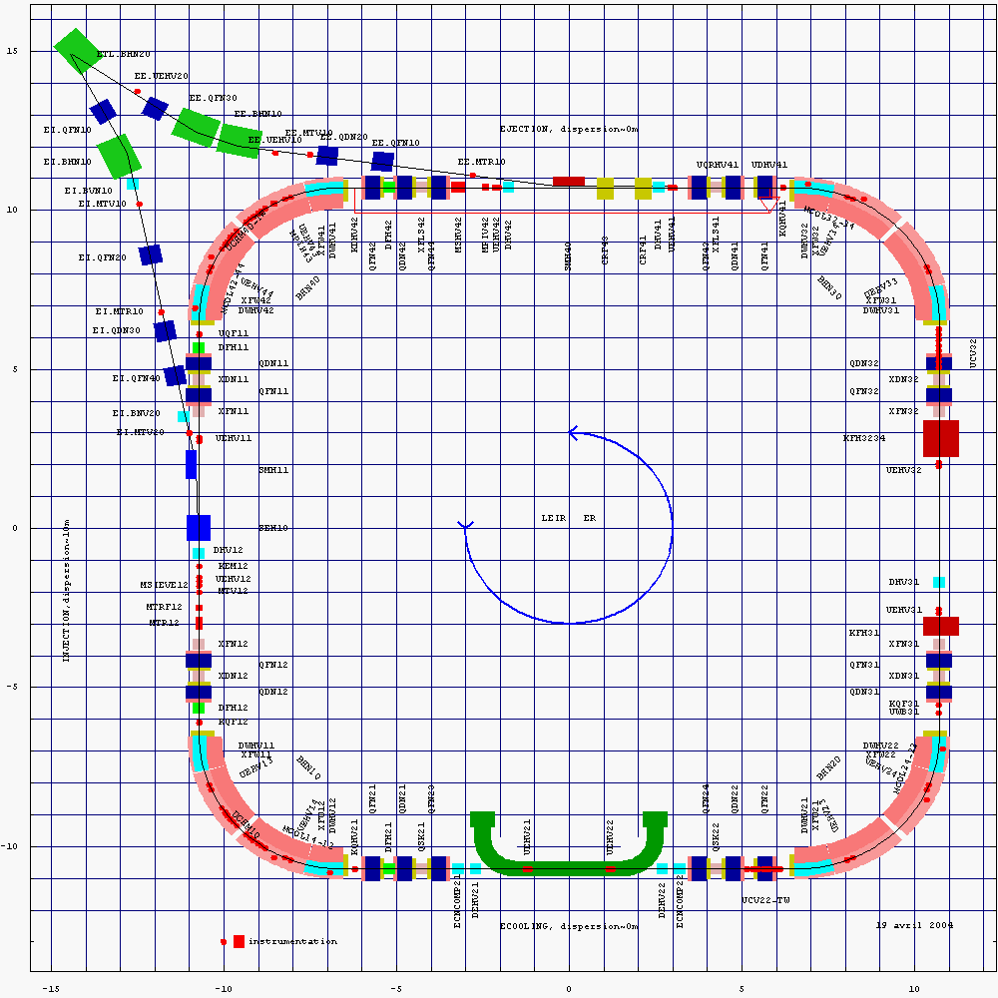
LEIR layout (1/2)
Quadrupole triplets in cooling section
-> lattice o.k. for cooling & injection
Main hardware installed :
Section 10 :
Injection (D ~10 m !)
Section 20:
Electron cooling (D ~0 m)
Section 30 :
Ejection kicker
Section 40 (D ~ 0 m) :
  RF (small “Finemet” cavities, allows to install RF in extraction section)
  Extraction septum (small dispersion -> small beamsize)
Beam diagnostics, damper, bumper, … installed wherever possible
Ejection
Quadrupole triplet
D=0
RF
Injection
Ejection
kicker
D≠10m
D≠0
Quadrupole doublet
D=0
dipole
E-Cooling
LEIR layout – ~two fold symmetry
-> Opposite sections have identical properties

Slide 5
LEIR Layout (2/2)
Ejection
PS ring
ITE loop
LEIR ring
Bi-directional ETL line
Linac 3
Injection
Overview of Linac 3, LEIR transfer lines, LEIR and PS
Part of the line is used for injection and extraction :
-> laminated, pulsed magnets,
-> Complicated behavior for Power Converter.

Slide 6
LEIR Cycles
Bunching, acceleration
Extraction
Nominal LEIR cycle lasting 3.6 s :
Bring machine in a state suitable for beam,
Accumulation alternating :
  Multiturn injection with horizontal, vertical and longitudinal stacking : 70 turns (~200 μs) with >50% efficiency,
  Fast (~200 to 400 ms) electron cooling
  with a new state-of-the-art cooler constructed by a BINP team.
  Sufficient (~9 108 Pb54+ for 4 LHC bunches) after 4 or 5 injections/coolings.
Bunching (h=2) and acceleration
during ~1s
Extraction
Injections
momentum (or field)
Electron cooler on
0 time (s) 3.6
Sketch of a nominal LEIR cycle
“Early LHC ion beam”:
* Every LEIR cycle provides only 2.25 10⁸ Pb
ions for one LHC bunch
* One (or two) injection -> a shorter 2.4 s cycle
and one bunch (h=1) in LEIR,
“Long plateaus”:
* Special mode for tests of accumulation,
scrubbing …

Slide 7
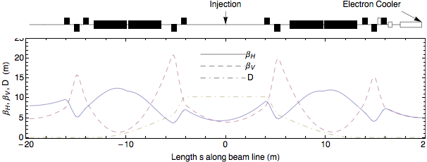
LEIR lattice
Many constraints (reasonable working point, sufficient
acceptances, small β_{H} and large dispersion for injection,
β_{H} ≈ β_{V} ≈ 5 m and small dispersion for electron cooler)
Only few parameters (quadrupole locations and gradients)
to adjust
Strong effect from focusing properties of bendings
Somewhat irregular lattice (not at all a FODO structure!)
as many small machines
C-shaped magnet and not insulated vacuum chamber
=> ramp induces net current along the chamber and quad. components

Slide 8
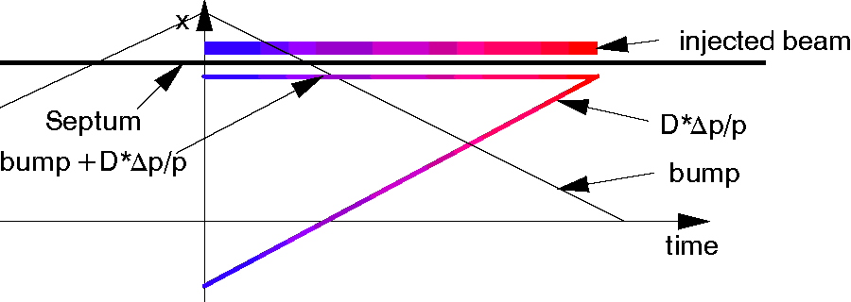
LEIR Multiturn Injection (with 6D Stacking)
1st turn of incoming beam
After 3 turns
End of injection (70 turns)
After collapse
of the bump
Principle (stacking in three phase spaces):
bumper moves orbit inwards,
energy ramping moves orbit outwards,
constant betatron amplitude for incoming beam.
Result
long pulses pulses and good efficiency,
Large momentum spread, relatively small emittances (fast electron cooling).
Extension of stacking in momentum and horizontal phase space (proposed by D.Möhl and S.Maury)
Stack “parked” with negative momentum offset

Slide 9
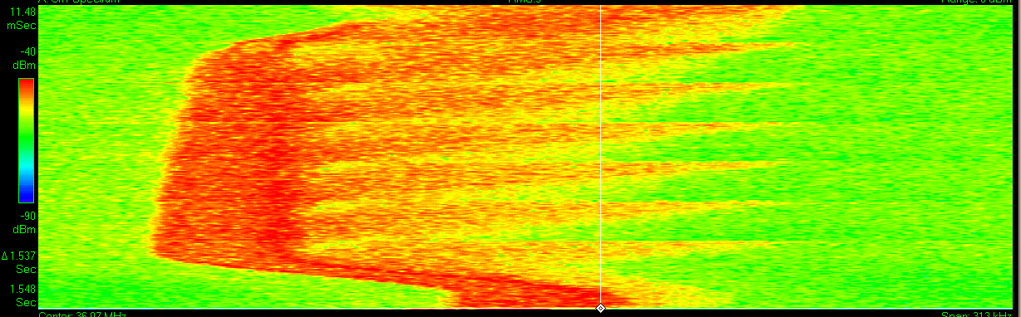
Accumulation
Accumulated
stack
Injected beam
(7 injections)
Time
Momentum (observation frequency)
Time evolution of Schottky spectra (unbunched beam)
Evolution of longitudinal distribution
Stack parked at low energies
  If too low: some slow losses looking as life-time problem
  If too high: fast loss at next injection
  Gun voltage depends on electron current AND ion beam current (space of beams affects electron energy)
  Better performance (higher Linac3 current, injection efficiency) requires lower voltage of electron cooler gun

Slide 10
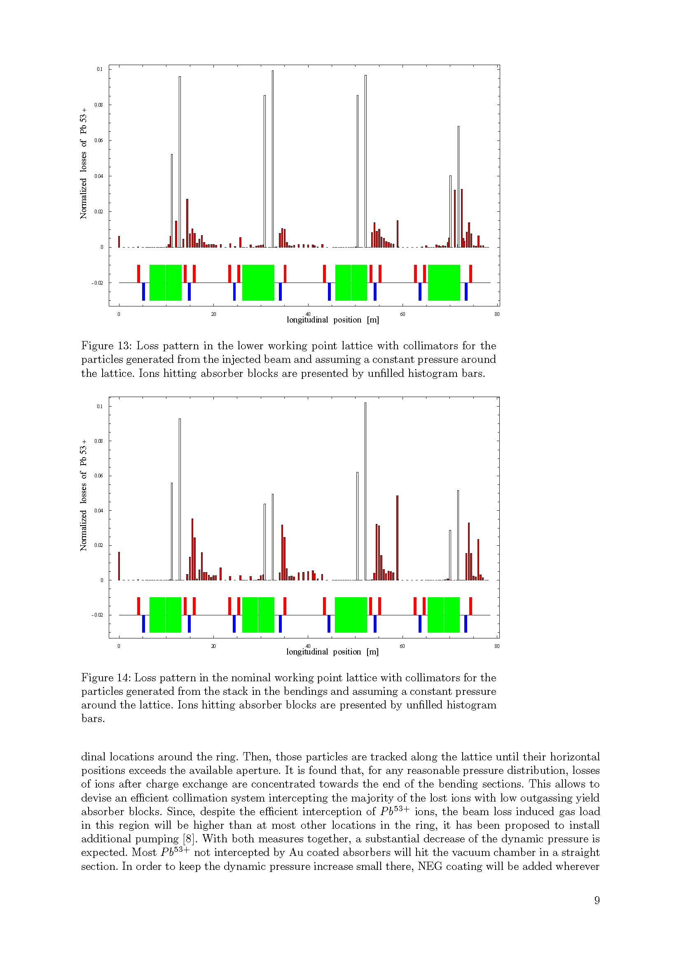
LEIR – Dynamic Vacuum & life-time
Avalanche-like pressure rise :
ions lost due to rest gas electron capture (or loss)
(Pb⁵⁴⁺-> Pb⁵³⁺),
every lost ion desorbs many rest gas molecules,
Limitation in proof of principle experiment in 1997 !!
LEIR upgrades based on measurements at Linac 3 (AT/VAC & Linac 3 team)
Problem during tests in ’97
successfully cured
… some worries this year about observed life-times reductions …probably caused by inappropriate cooler gun voltages
Intercepted by absorbers :
Reduced outgassing with Au coating,
Efficient scrubbing due to small surface
Simulation by
J. Pasternak
NEG coatings in straight sections
to improve vacuum there
Injection Cooler
Loss pattern of Pb⁵³⁺ ions around the LEIR ring
with collimators and homogeneous gas density

Slide 11
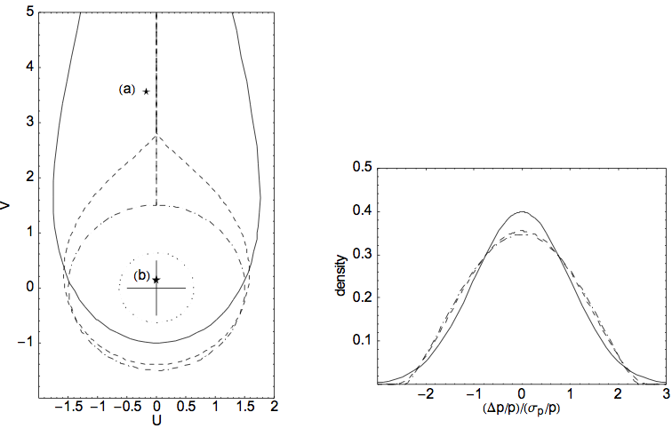
A few words on Impedances and Instabilities
Very large direct space charge impedance typical for low energy
  Note: will be even larger for ELENA
Many transition between different vacuum chambers … not built to minimize impedances
Cures implemented against transverse instabilities:
  Large band (100 MHz, i.e. about 300 harmonics) transverse damper
    technical issue with
    (erratic) signal delay
    solved last autumn
  Modulation of the electron
  cooler gun voltage to shake
  the beam and increase the
  momentum spread – not
  required during last run
Longitudinal impedance
  Increase of the real part of
  the longitudinal impedance
  due to magnetic alloy cavities
Most critical n = 1:
Z_{n}/n = (400 + 8000 i) Ohm
(a) σ_{p}/p = 0.2 10⁻³ and
(b) σ_{p}/p = 1.0 10⁻³

Slide 12
LEIR run 2011
Excellent injection efficiency of >50 %
  very complicated multiturn injection with stacking on all three phase spaces over 70 turns!
  Aim: highest possible injected intensity, not high efficiency (higher efficiencies possible with shorter Linac3 pulses and lower intensity)
  Probably related to matching/properties of Linac3 beam (no matching and emittance measurement in line, injected beam observed only on TVs, which are damaged by beam)
Operation with nominal performance
  Accumulation of seven Linac3 shots (lower intensities than than expected from Linac)
  Very important to adjust the electron cooler gun voltage correctly
  Unfortunately lower intensity during LHC run with <20 uA from Linac3
Voluntary reduction of intensity for EARLY cycles to generate LHC pilots
  Only one injection and other measures
Outstanding problem (identified in autumn 2010) with transverse damper solved (thanks to Alan and Fredi)
Electron cooler current increased
  Motivation: faster cooling to cure small losses at injection every 200 ms (maximum possible for hardware)
  Gain not so clear – should be studied more carefully this year

Slide 13
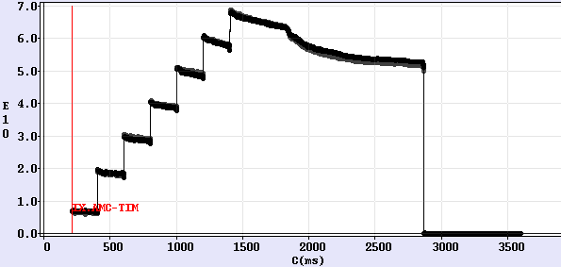
LEIR run 2011 – performance
Loss (at capture and
start of ramp)
Linac3 beam current around 20 uA (nominal 50 uA)
=> Accumulation of 7 pulses instead of 4 or 5 (and good injection efficiency)
=> Cooling fast enough for an injection every 200 ms
Significantly more than required 5 10¹⁰ charges accumulated to obtain required intensity at ejection due to loss (not understood)
* Hypothesis: Space charge limit lower than expected for a machine with irregular (not at all FODO) lattice? … or working point too close to resonances?
Nominal beam not available any more during LHC run!

Slide 14
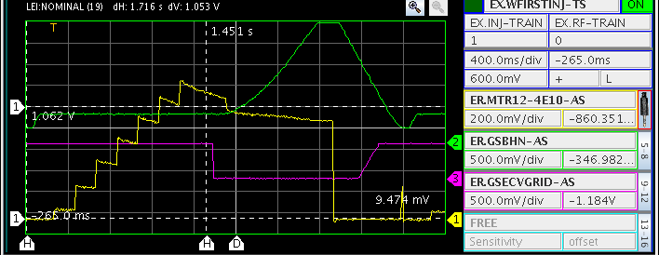
LEIR run 2011 – performance
Note after accumulation:
  Electron cooler switched off (purple trace – grid voltage) as quickly as possible
  Followed by capture and acceleration (green trace – reference fucntion for main power supply)
First injection sometimes (at beginning of run) with lower efficiency due to advanced injection timing to allow two injections for EARLY

Slide 15
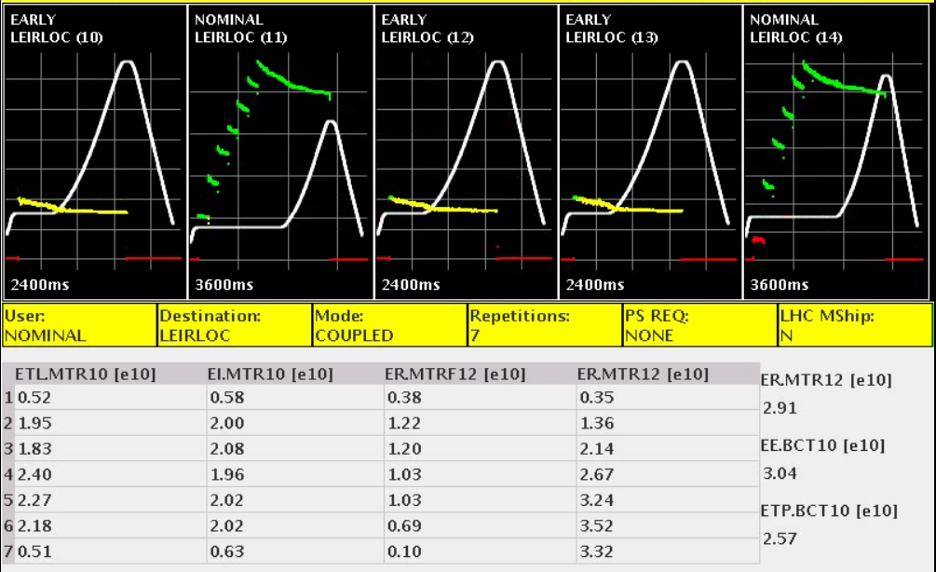
2011 Performance – NOMINAL and EARLY
NOMINAL and EARLY with required intensities
(New) Vistar and reliable fast BCT acquisitions finally available

Slide 16
Ideas and Plans for the future
Run 2012:
  Pb⁵⁴⁺ for SPS fixed target and LHC
  LHC p-Pb run: LEIR beam as in 2011
  Start-up with beam already beginning of July (with some tests before)
Other lighter ions for SPS fixed target:
  Ar and Xe after LS1
Lighter ions for LHC
  Ar beams may be used after LS2
Within LIU investigations on increased LHC luminosity for ion operation
  Proposal to double intensities available from LEIR
  …. somewhat speculative since present limitations are not really understood
Radio-protection issues with operation with lighter ions
  Possible higher charge over mass ratios imply higher energies (per nucleon)
Preparation for other ion species:
  First tests on magnetic cycle generation (by S. Pasinelli with CO and PO) done
Proposal by JINR (I. Meskov) for recombination tests with lower Pb charge states
  Our interest: re-learn setting up LEIR for slightly different beam rigidities AND better understanding of recombination)

Slide 17
Ideas and Plans for the future
Understanding of the loss at the beginning of the ramp:
  Limitations due to direct space charge (limit with irregular lattice lower than expected)?
  How small are emittances after cooling (very small if one trusts the BIPMs) … should we make them larger (e.g. change angle of ion beam during last few 10s of ms before end of cooling)
  Impact of Bdot … should we accelerate faster/slower to decrease time spent with bunched beams at low energy/to reduce dynamic effects?
  Instabilities … probably not an issue with present intensities
Instrumentation:
  SEMs with electronics to see the injected beam (matching and emittance measurements of the injected beam)
  Scrapers for emittance measurements (Status: controls not operational, Wish: proper control and application to measure emittance)
  Operational BIPM measurements (at present a specialist tool)
Higher electron currents for cooling to decrease cooling times
  Compensate reduced cooling rates for light ions
  Very speculative: increased injection repetition and stacking rate for Pb⁵⁴⁺
Impedance model and understanding of instability limits
Better understanding of electron cooling

Slide 18
Ideas and Plans for the future – biomedical facility
Experiments with LEIR
  First discussed at the “Physics for Health in Europe Workshop” at CERN in February 2010
    Provide beams for experiments in support of treatment centers
    Radiobiology, investigations with different ion species (up to O … or even higher atomic numbers)
    Fragmentation studies, dosimetry
  LEIR well suited for such an installation
    Not (yet?) used all the time
    Additional Linac3 source preferable to provide beams during LHC ion “coasts”
    Could provide beams outside periods for setting up for and operation of LHC with ions
    No other machines (PS) required … minimum impact on other CERN programs
    Energy reach of LEIR appropriate for such experiments
  Studies on requirements started recently
    New ejection channel and a (short vertical?) beam line
    Slow ejection to be (re-)implemented
    Infrastructure (Radiobiology lab …)
    Limitations from radio-protection (higher energy with higher Z/A for light ions)
Heavier Ions with higher energies mentioned for investigations on radiation effects during space travel

Slide 19
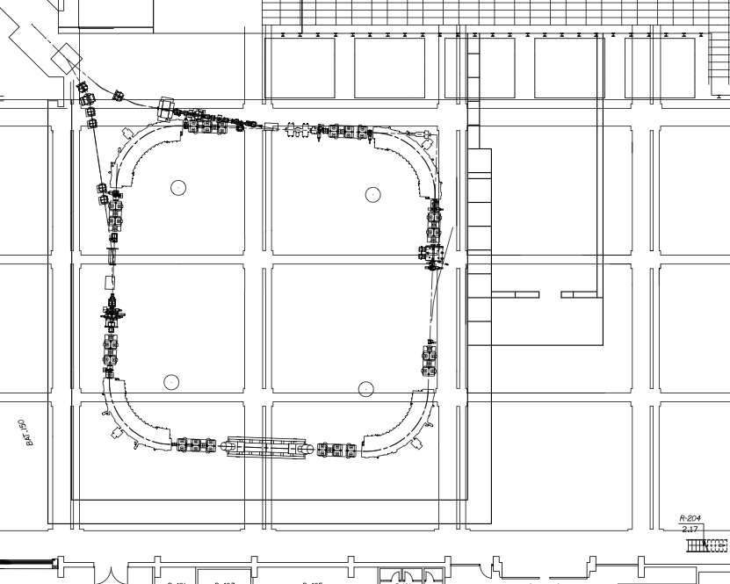
Ideas and Plans for the future – biomedical facility
Transfer lines
- from Linac3
- towards the PS
PS shielding wall
Ejection line
for PS transfer
New transfer line
to experiment
Injection
line
New ejection
channel
Space for lab
LEIR
shielding
wall

