Slide 1
Update of the heating of ALFA detector in 2011
F. Caspers, P. Fassnacht, A. Grudiev,
S. Jakobsen, E. Métral, B. Salvant

Slide 2
Courtesy Sune Jakobsen et al
Beam intensity
Temperatures in 7R1
Temperatures in 7L1
Beam energy
Detector temperature cannot increase by more than 40 degrees
Temperature increased by max 18 degrees in 2011
interesting to note that the temperature increase started already at injection

Slide 3
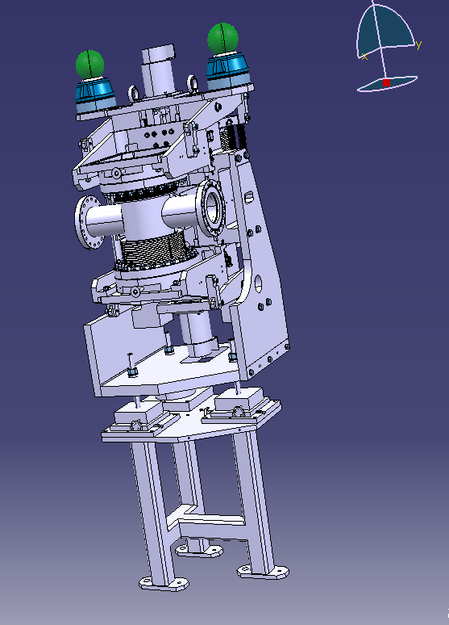
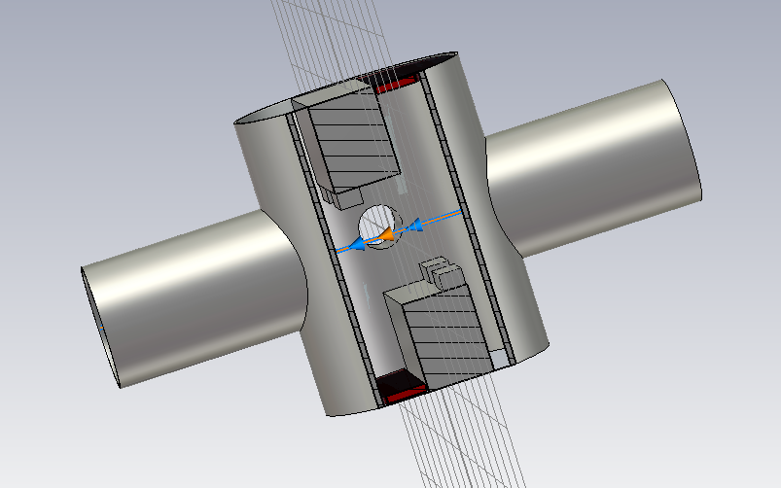
ALFA
SMARTEAM references for the relevant CATIA drawings:
ST0243713_01
ST0040591_02
CST model

Slide 4
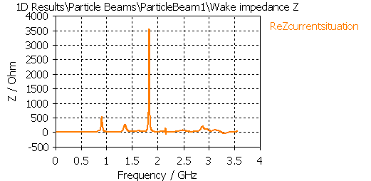
CST simulations for ALFA
3D model imported from Catia
Time domain
Ferrite 4s60 model
40 m wake (100 m for the model with no ferrite)

Slide 5
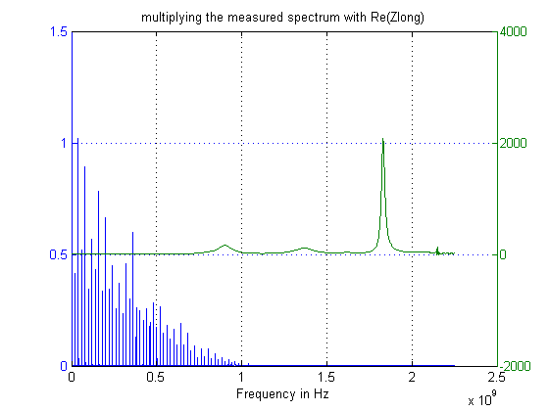
Power spectrum and impedance
Top energy
Measured power spectrum from Philippe and Themis
Impedance simulated by CST in Ohm

Slide 6
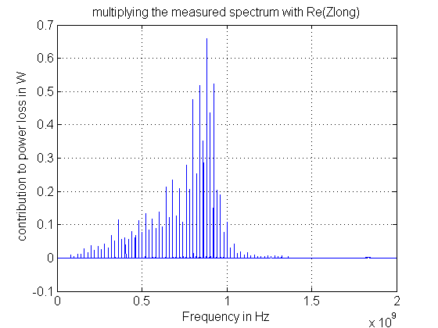
Power loss calculations
Top energy
Total loss → 15W

Slide 7
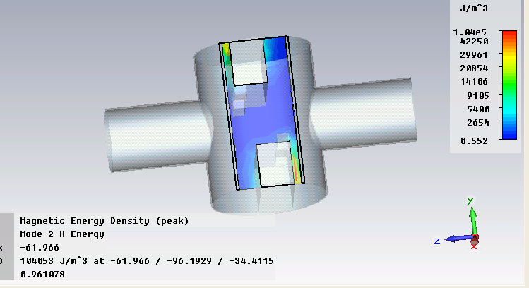
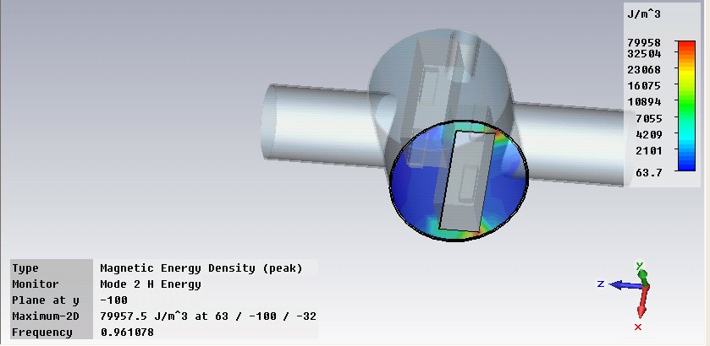
CST eigenmode
f ~ 0.96 GHz
R ~ 23kOhm
Q ~ 700
Ferrite on the wrong side?

Slide 8
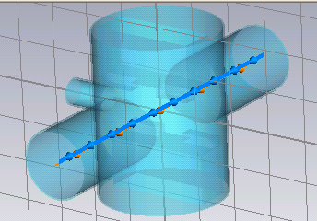
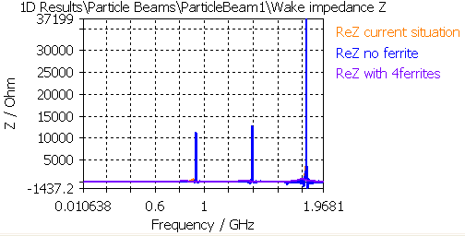
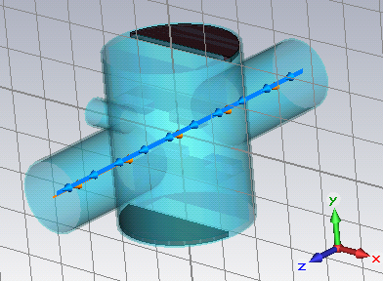
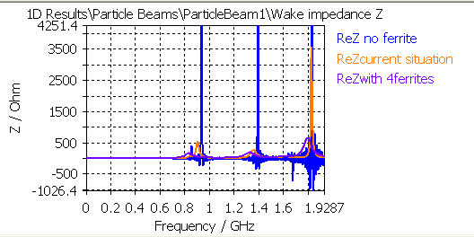
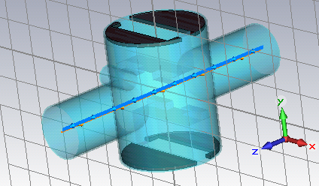
CST simulations for ALFA
No ferrite
2 ferrites (current situation)
4 ferrites

Slide 9
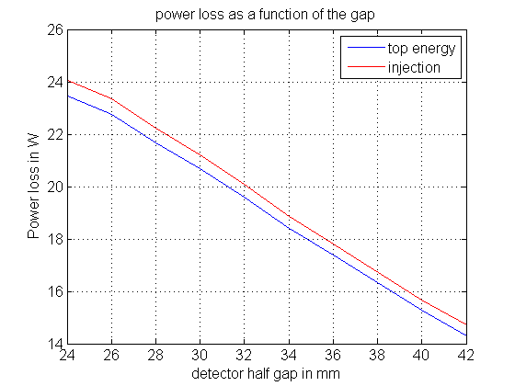
Power loss at top energy and injection Vs detector gap
Slightly worse at injection
smaller loss for bigger gaps

Slide 10
Outlook
Do we need to worry for 2012?
  Do we take the detector out?
  Cooling (as TOTEM)?
  Change location of ferrites?
What to do to understand more?
  Measurements with wire on a bench
  Simulations with HFSS

Slide 11
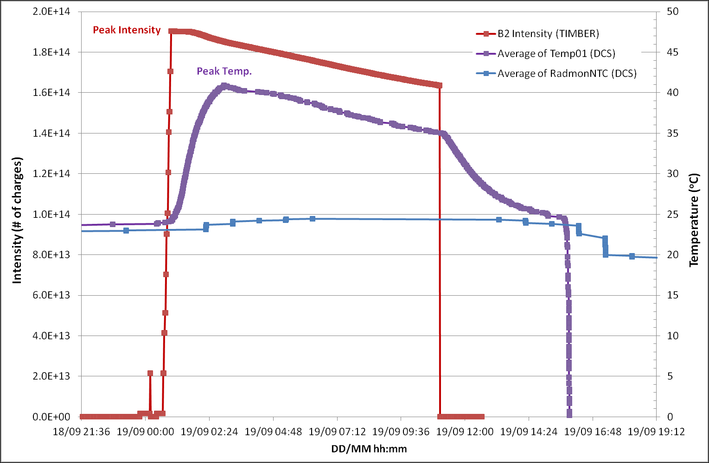
TOTEM installed cooling, but when it is off:

