Slide 1
Small step towards understanding bench measurements’ curves
Jean-Luc Nougaret with a lot of help from Fritz Caspers

Slide 2
Outline
We propose a simple modeling approach which can reproduce the measurement curves of two different kinds of measurements performed recently:
  Transmission measurements on the VMTSA
  Resonant measurements on the MKDV
Notes:
Impedance bench measurements are very intricate and difficult to understand. In this presentation, I present a simple model that help explain these measurements. The very same modeling approach is used to reproduce transmission measurements on the VMTSA and resonant measurements on the MKDV.

Slide 3
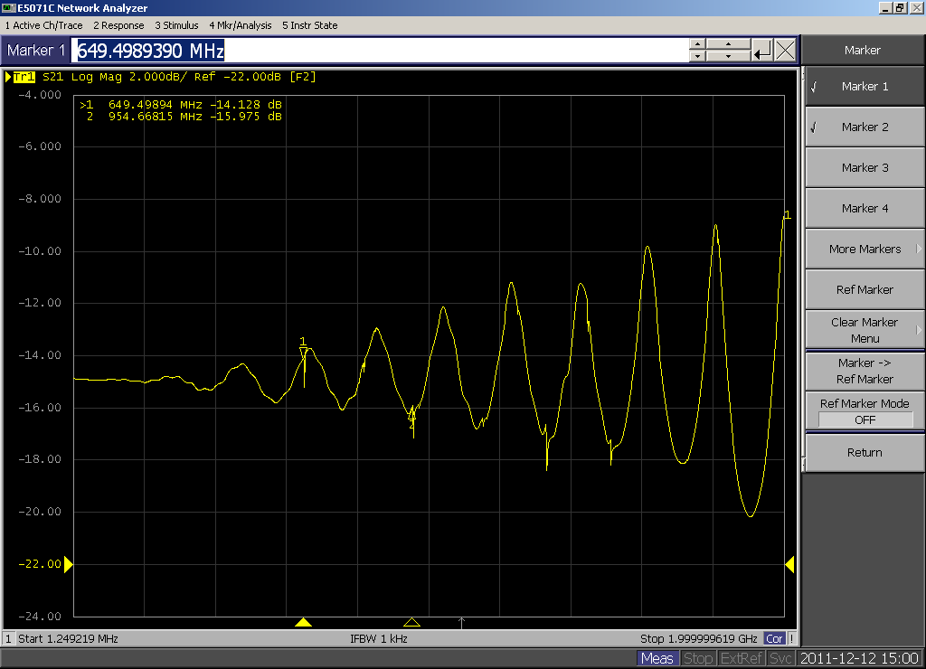
Example of transmission curve
Notes:
This is a typical transmission curve we obtained recently for the VMTSA. We were wondering where these undulations come from.

Slide 4
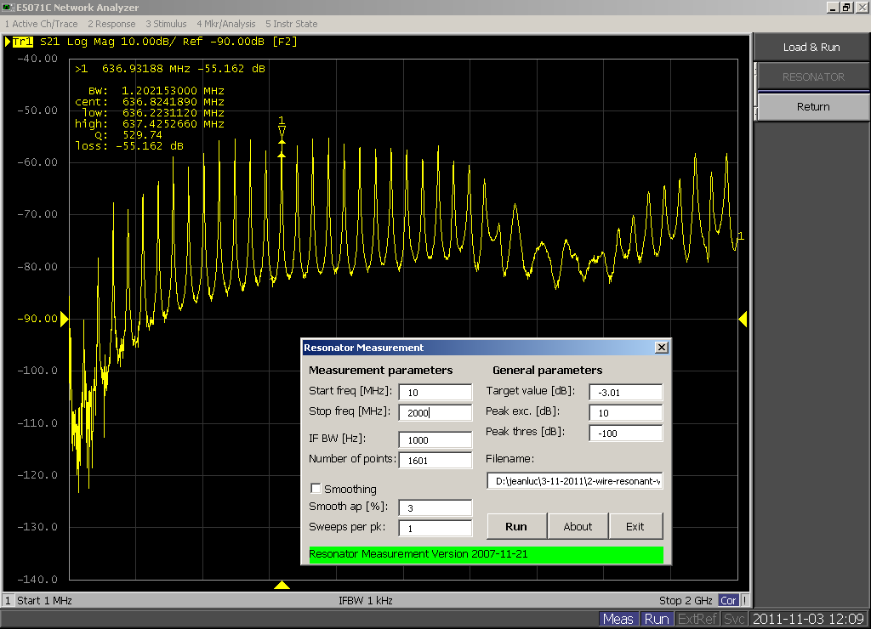
Example of resonant measurement
Notes:
In addition to the transmission wire method, the resonant method provides these kind of curves. For me it was not clear why we observe such curves.

Slide 5
ABCD matrix formalism reminder
Scattering and ABCD matrices
ABCD matrices can be cascaded
One can convert ABCD into scattering matrix
I₁
I₂
I₃
+
-
+
-
V₁
V₂
V₃
Notes:
The simple model we propose relies on the ABCD matrix formalism. In bench measurements we are usually interested in measuring the scattering parameter s21. But we first propose to build the model using ABCD matrices. Because such matrices can be cascaded, we can assemble the model bit by bit. In the end, we come back to the scattering parameter s21 by relying on standard conversion formula between ABCD and the scattering matrix.

Slide 6
Representation of a transmission line
Notes:
At the heart of the model, we consider that the device under test can be viewed as a transmission line. The ABCD matrix of a transmission line is given here.

Slide 7
Transmission measurement setup
, γ
Notes:
Here is the model for transmission measurements using matching resistors. The DUT is viewed as a transmission line which is embedded in between imperfect matching resistors. We also have parasite capacity due to the small hole in the SUCOBOX. We first compute the compound ABCD matrix then convert to the s21 scattering parameter.

Slide 8
Transmission comparison
VMTSA
= 0.76m!
Notes:
The s21 scattering parameter can then be simulated. The DUT length is not very clear and we corrected the value to improve the match. But at least qualitatively, the simulation and measurement are in agreement.

Slide 9
Resonant measurement setup
, γ
Notes:
Here is the model for resonant measurements using weak coupling capacitors. The DUT is viewed as a transmission line which is embedded in between coupling capacitors. We also have parasite capacity due to the connectors. We first compute the compound ABCD matrix then convert to the s21 scattering parameter.

Slide 10
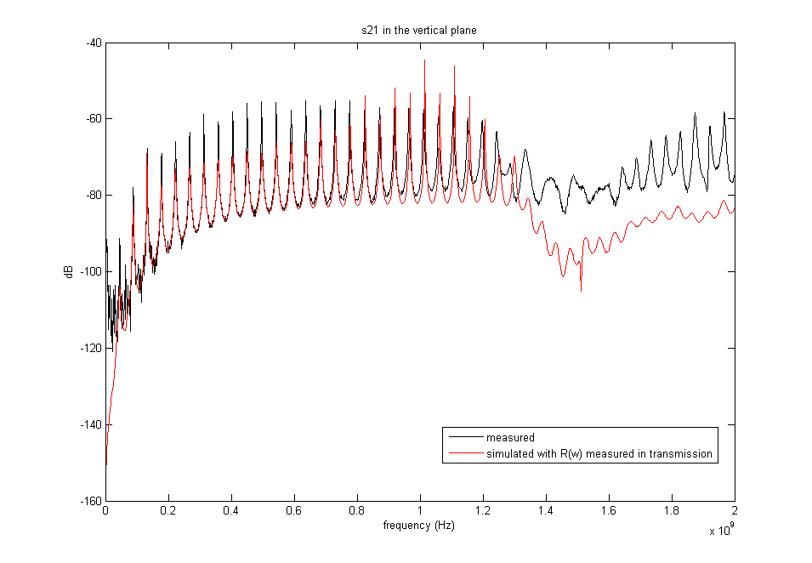
Resonance comparison
0.02pF
0.02pF
MKDV
1pF
1pF
Notes:
Again, we can simulate the s21 scattering parameter. Fritz carried-out a manual optimization of the circuit’s parameters so that the simulation and measurement are in good agreement.

Slide 11
Conclusion
The simple ABCD model of a transmission line with frequency-dependant losses and surrounding components can reproduce these two kinds of curves (transmission, resonance) for two cases.
This is only a small and first step towards understanding bench measurements.
Still some work to do to reproduce the latest VMTSA curves…
Notes:
Bench measurements are very intricate. To the new comer it is very hard to make sense out of the curves we observe. The simple model we present here helps reproduce some of the curves.

