Slide 1
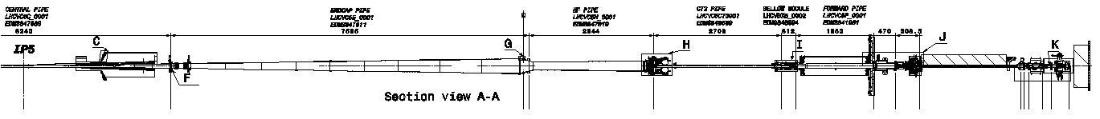
STEP 1 – Inject Neon to 1.2 bara
Neon
Neon
Mechanical considerations when pressurising to 0.2 bar differential (1.2 bara) with Neon.
1. Chambers – even in worst case of 0.5 bar differential (burst disc pressure), these chambers are used every day in a 1 bar differential (vacuum) environment. Neon injections are a well known practice for the vacuum group.

Slide 2
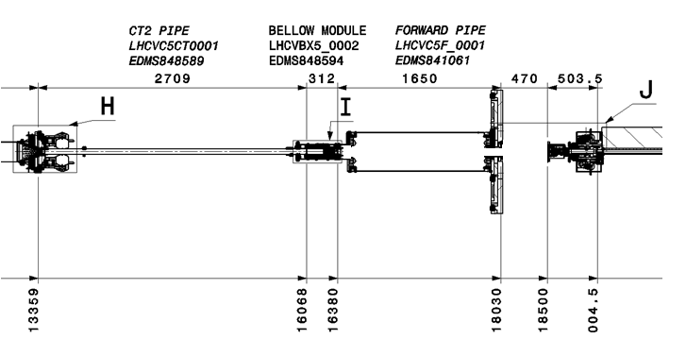
STEP 2 – Remove chambers from 16.5 m to 18.5 m
Longitudinal restraints
Neon
Neon
CT2 protection & temp support
Temp. vertical supports
Mechanical considerations when removing “forward chambers”
1. Load conditions have now changed, therefore both bellows modules at 16.5 m and 18.5 m need to be supported vertically and longitudinally before removal of “forward chambers” in order to protect RF fingers and bellow integrity

Slide 3
STEP 3 – Cap 16.5 m module
Longitudinal restraints
Neon
Neon
CT2 protection & temp support
Temp. vertical supports
Mechanical considerations when capping the 16.5 m module
1. Neon pressure is > 1 bara (baseline is 1.2 bara) in the 16.5 m module during the intervention. In the worst case, the pressure could be 0.5 bar differential acting on a 160 mm diameter leading to a longitudinal force of 1000 N (400 N at 1.2 bara). The “CT2 protection and temp. support” will react this force longitudinally. The 312 mm long module at 16.5 m also requires a longitudinal restraint to maintain integrity of its bellows and RF fingers.

Slide 4
STEP 4 – Cap 18.5 m module
Longitudinal restraints
Neon
Neon
CT2 protection & temp support
Temp. vertical supports
Mechanical considerations when capping the 18.5 m module
1. Neon pressure is > 1 bara (baseline is 1.2 bara) in the 18.5m module during the intervention. In the worst case, the pressure could be 0.5 bar differential acting on a 100 mm diameter leading to a longitudinal force of 400 N (160 N at 1.2 bara). This force will be tied back to the Fixed Iron Nose to maintain integrity of the bellows during the intervention.

