Slide 1
X-rays in A4L2-A4R2
and A4L8 - A4R8
V. Baglin (19/11/11)
CERN TE-VSC, Geneva
1. Positions of defaults
2. Typical default
3. Summary

Slide 2
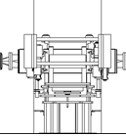
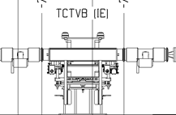
Positions of defaults in LSS2-LSS8
TCDD
VGPB.120.4L2.X
LSS2L :
TCTVB
TCDD
VAB
BPMSX
D1L2
D1L2
VPIA.A151.4L2.X
LSS2R :
D1R2
BPMSX
VAB
VCTCQ
TCTVB
TCLIA
VGPB.120.4R2.X
TCLIA
D1R2
VPIA.A170.4R2.X
TCLIA
VGPB.120.4L8.X
LSS8L :
TCLIA
TCTVB
VCTCF
VAB
BPMSX
D1L8
D1L8
VPIA.A173.4L8.X
LSS8R :
D1R8
BPMSX
VAB
TCDDM
TCTVB
VGPB.120.4R8.X
D1R8
VPIA.A147.4R8.X

Slide 3
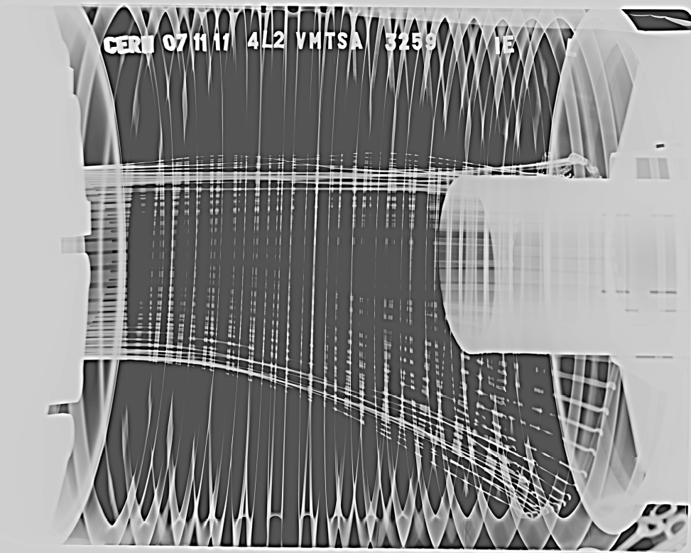
Typical default, DCUM 3259.3524
Left side
Side view (xray from corridor to QRL)
b) Metallic noise due to loose spring when hitting vacuum chamber
c) RF fingers falling due to broken spring
d) aperture reduced ?
Non Conform
b
d
Spring was broken between May and November 2011
c

Slide 4
Summary
6 vacuum modules in LSS2 and LSS8 have falling fingers due to broken springs
There are no significant reduction of aperture
LSS2 :
-During X-ray campaign of the 10th and 12th of May, all the RF fingers were in correct position and the springs were not broken
LSS8 was not imaged before last week
Other modules from D1L2 to D2L2, D1R2 to ID800,R2 , D1L8 to D2L8 and D1R8 to D2R8 which have been imaged are conform
The 6 non-conform modules will be repaired at next X-mas break during the opening of the sectors for the ZDC upgrade and dedicated opening for sectors in LSS8

Slide 5
Bonus slides

Slide 6
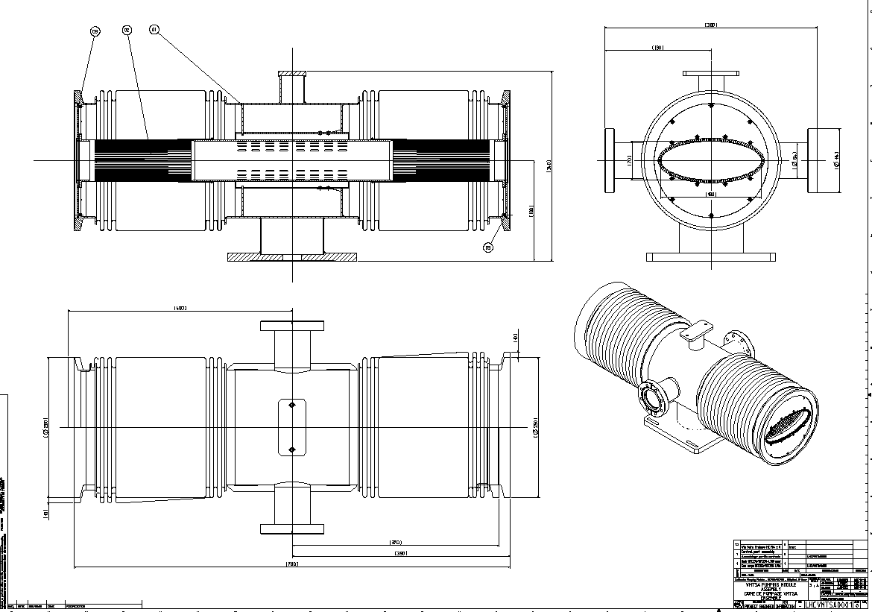
VMTSA son of VAMTF.A4L2.X
Horizontal ellipse 180/70
Left side
Right side
LHCVMTSA0001

Slide 7
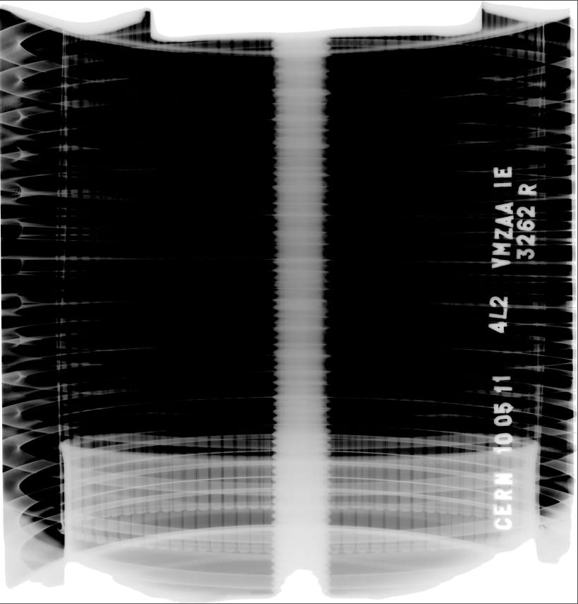
X-rays the 10-5-2011, DCUM 3259
b
Right side
Top view (xray from top to bottom)
b) No metallic noise due to loose spring
Conform

Slide 8
X-rays the 12-5-2011, DCUM 3404.58
a
b
Left side
Top view (xray from top to bottom)
a)Slight deformation of
RF finger.
b)No metallic noise due to loose spring
Use as IS
(to be replaced when possible)

Slide 9
X-rays the 12-5-2011, DCUM 3404.58
b
Right side
Top view (xray from top to bottom)
a) RF fingers bent towards exterior
b) No metallic noise due to loose spring – spring in place
Use as IS
(to be replaced when possible)
b

