Slide 1
A brief summary of the proposal for the new PS dedicated tune pick-up
C. Boccard, M. Gasior, A. Nosych
BE-BI-QP

Slide 2
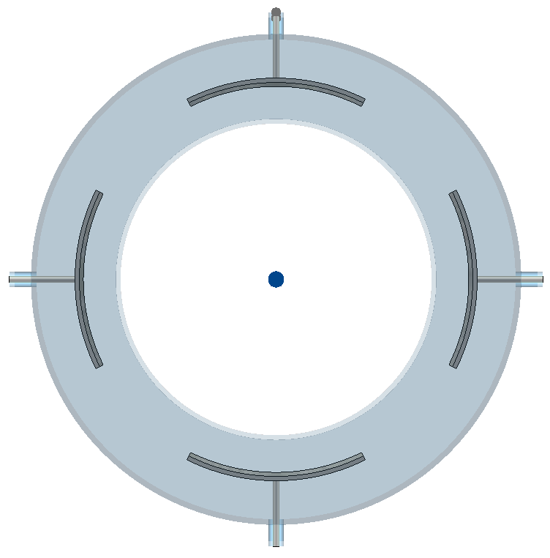
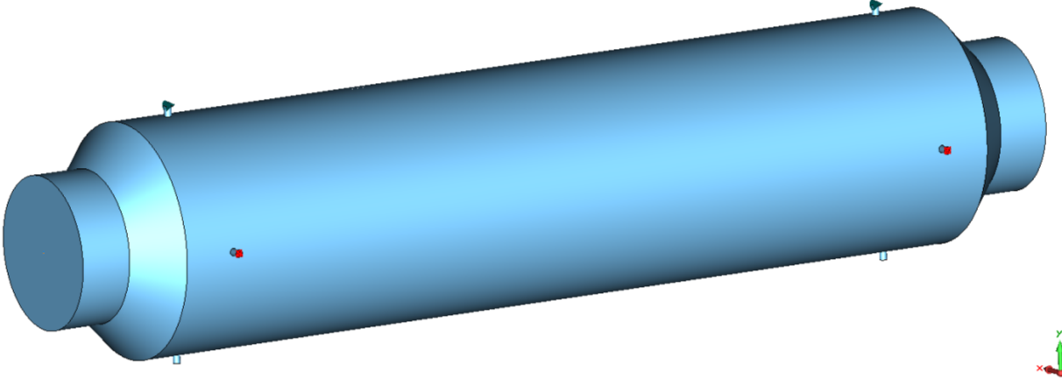
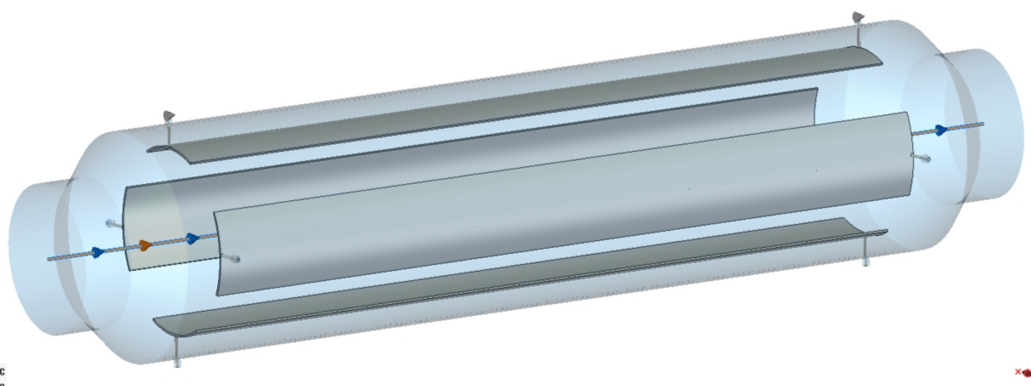
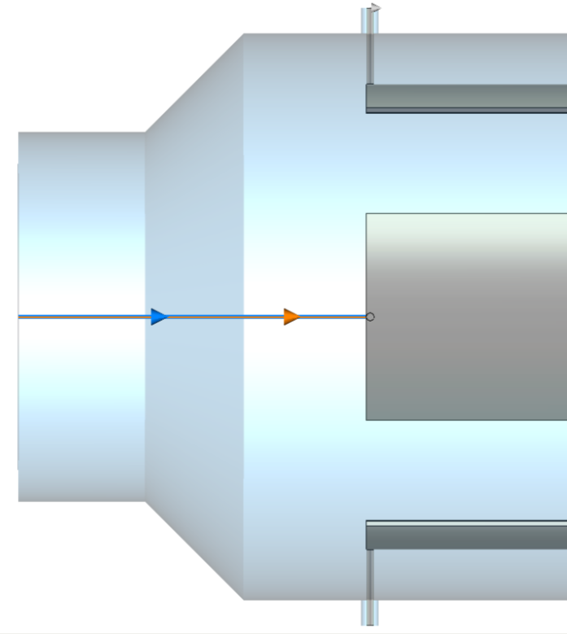
Available slot length: 1050 mm
Tapered.
Ellipse-circle transition angle/length: 45º/39 mm Electrode length: 775 mm
2 mm thick
20
79.8
52.6^{O}
17
73
45^{O}
39
D = 224
775 mm
D = 146
50
50
872 mm

Slide 3
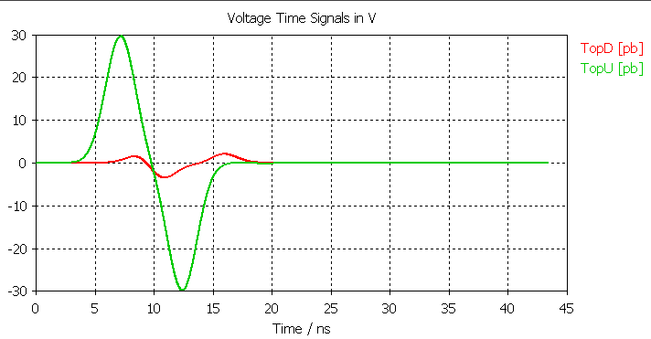
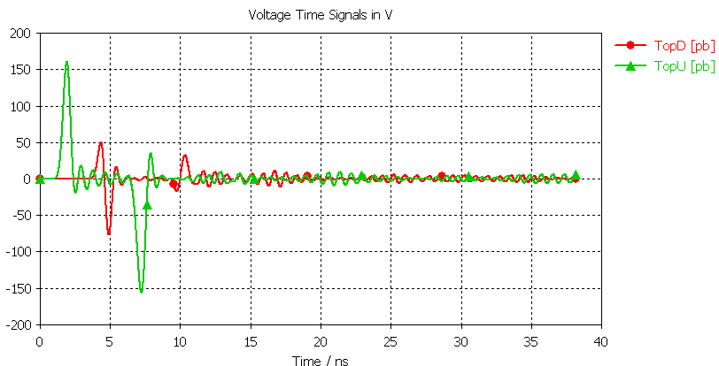
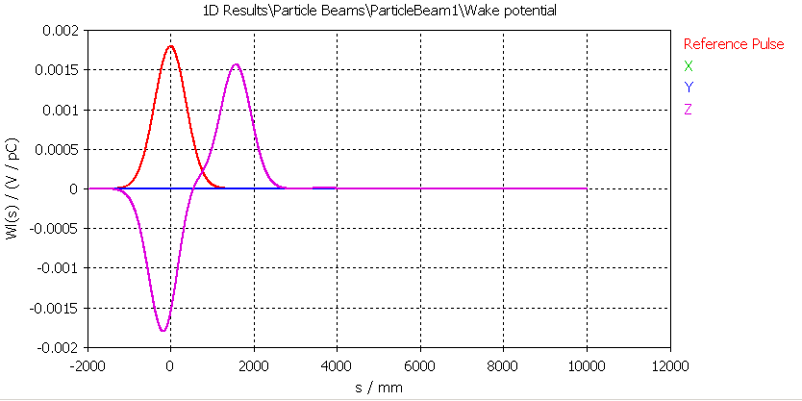
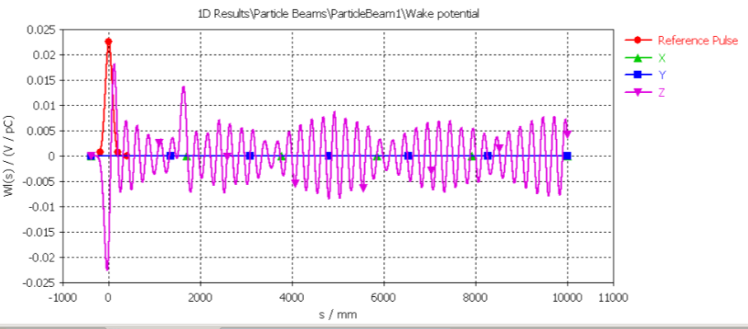
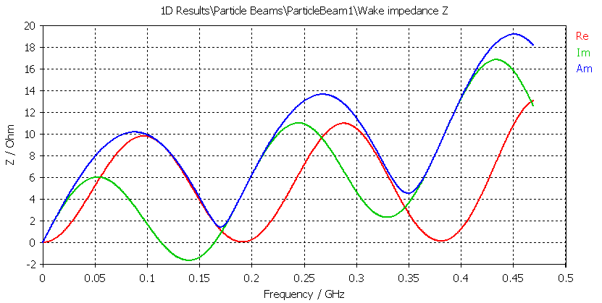
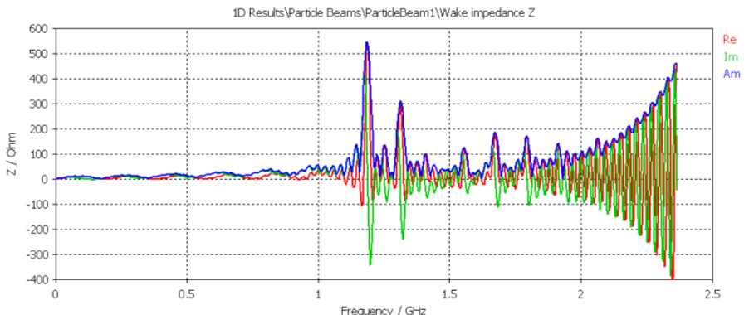
5 ns bunch (≈ shortest in the machine)
1 ns bunch (exaggerated to magnify impedance issues)

Slide 4
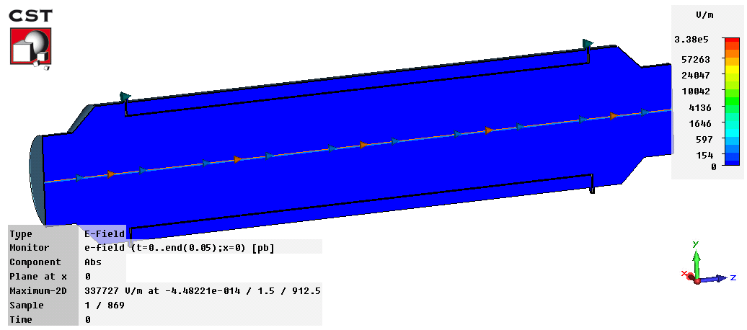
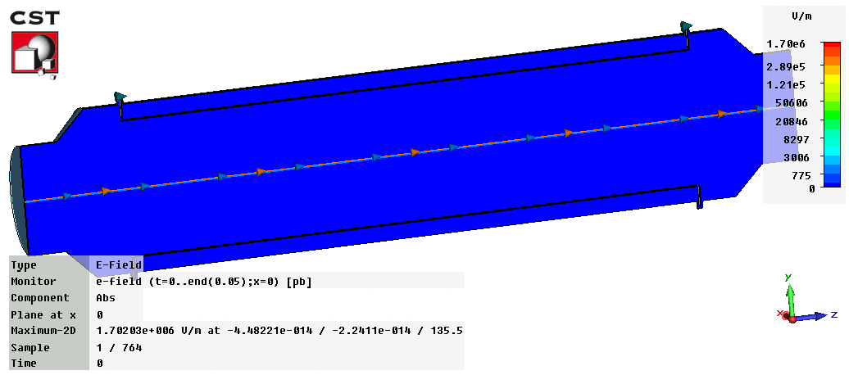
5 ns bunch (≈ shortest in the machine)
1 ns bunch (exaggerated to magnify impedance issues)

Slide 5
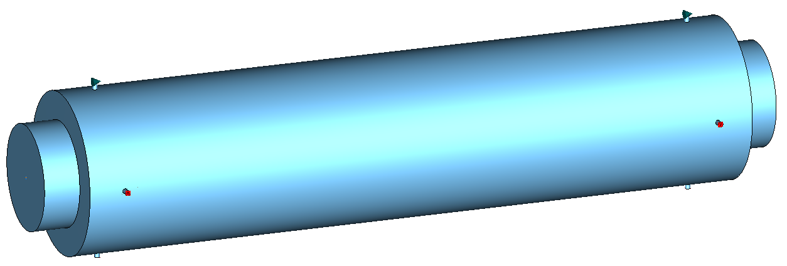
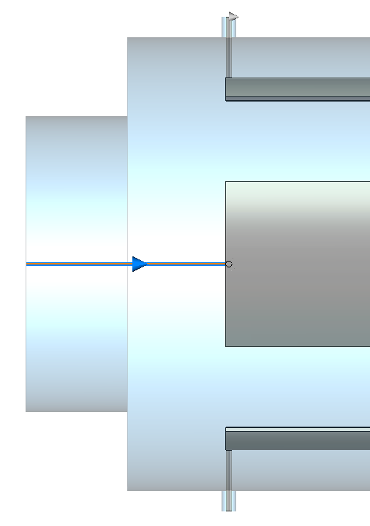
Available slot length: 1050 mm
Electrode length: 853 mm
853 mm
950 mm

Slide 6
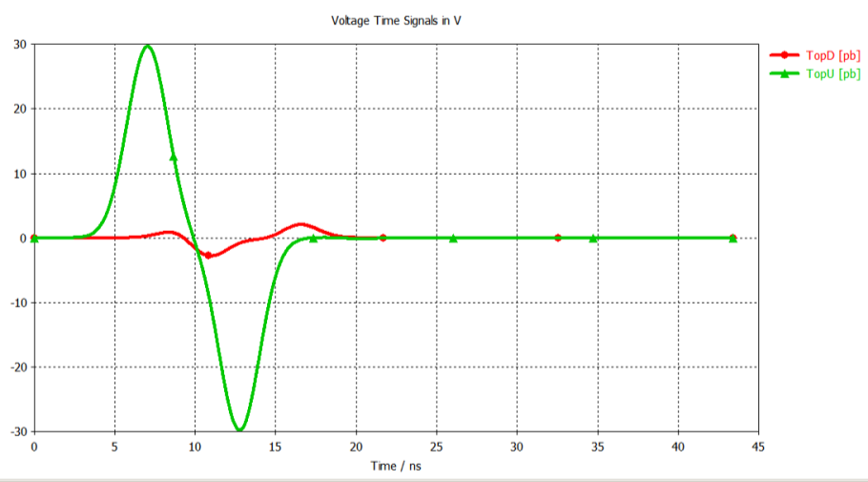
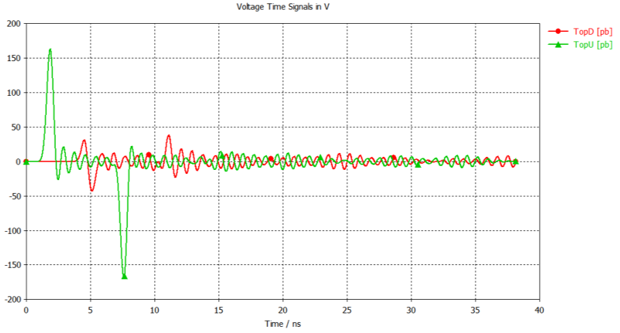
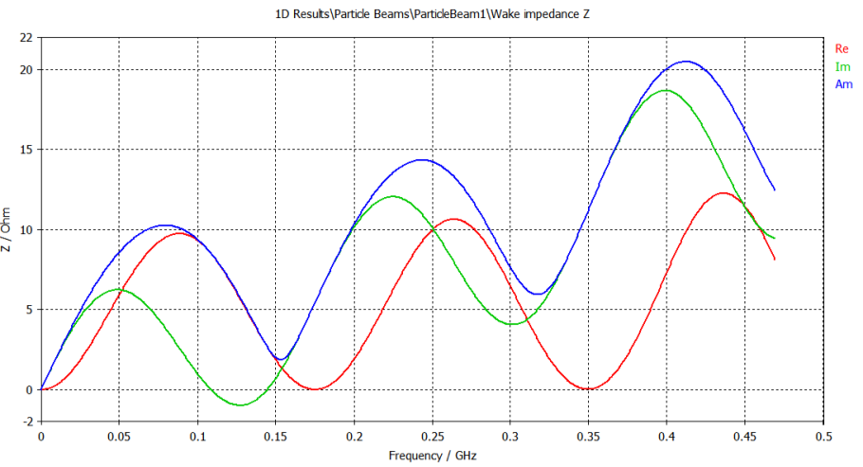
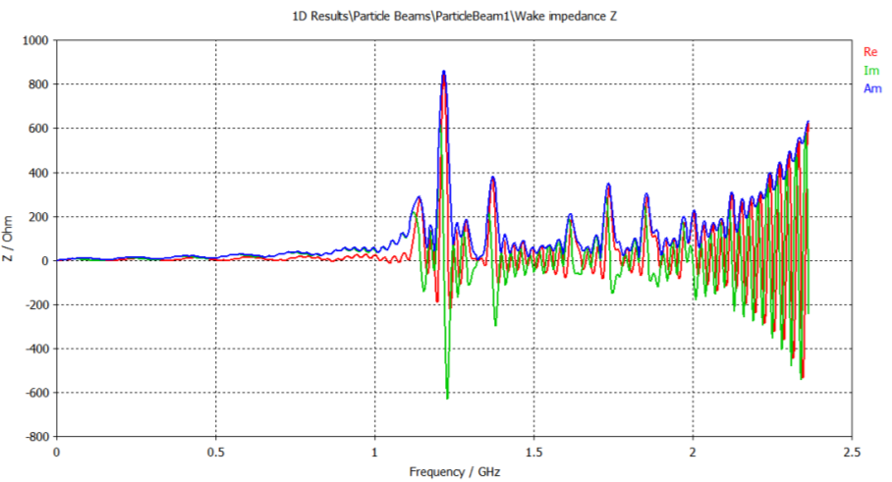
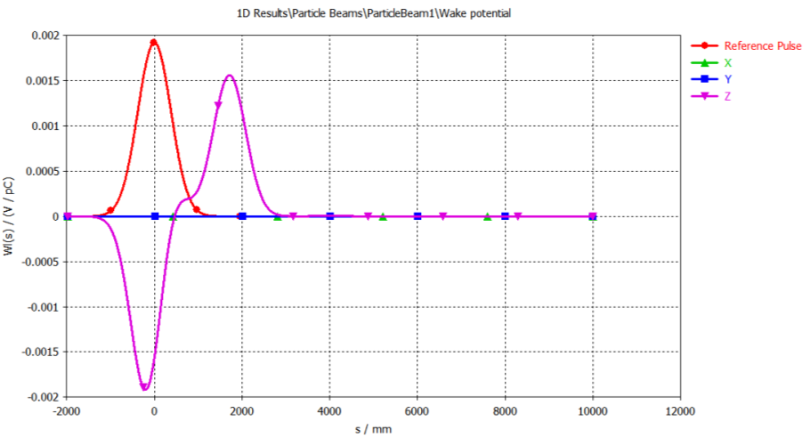
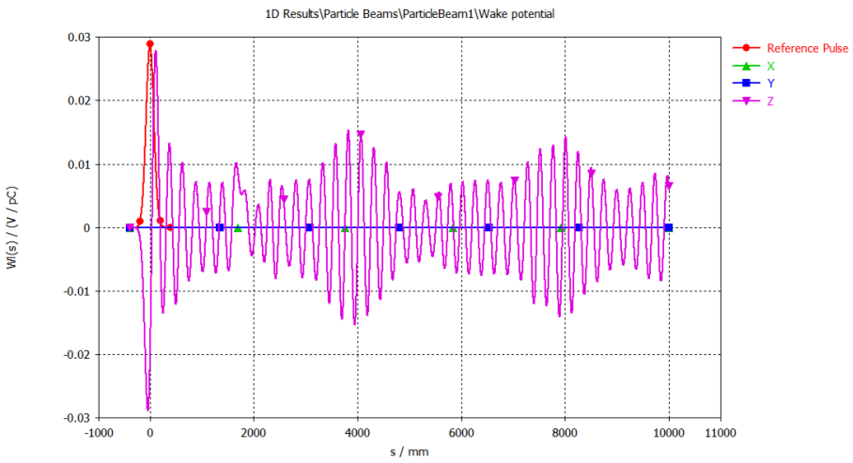
5 ns bunch (≈ shortest in the machine)
1 ns bunch (exaggerated to magnify impedance issues)

Slide 7
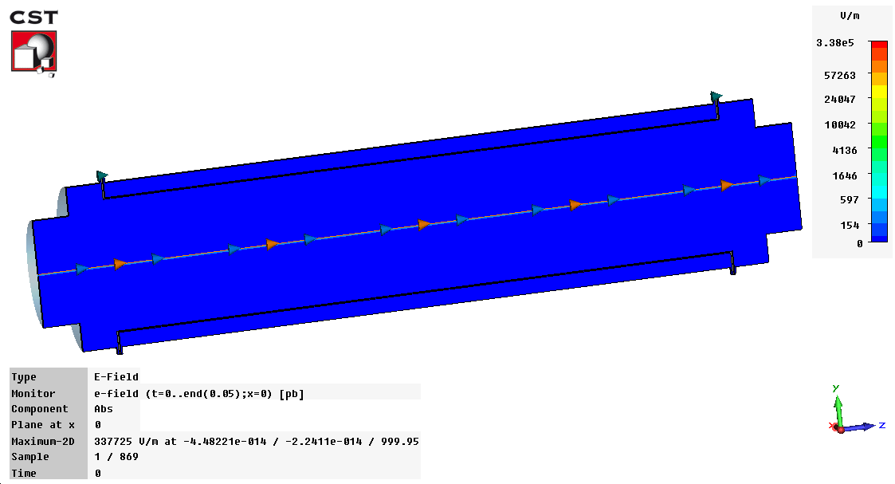
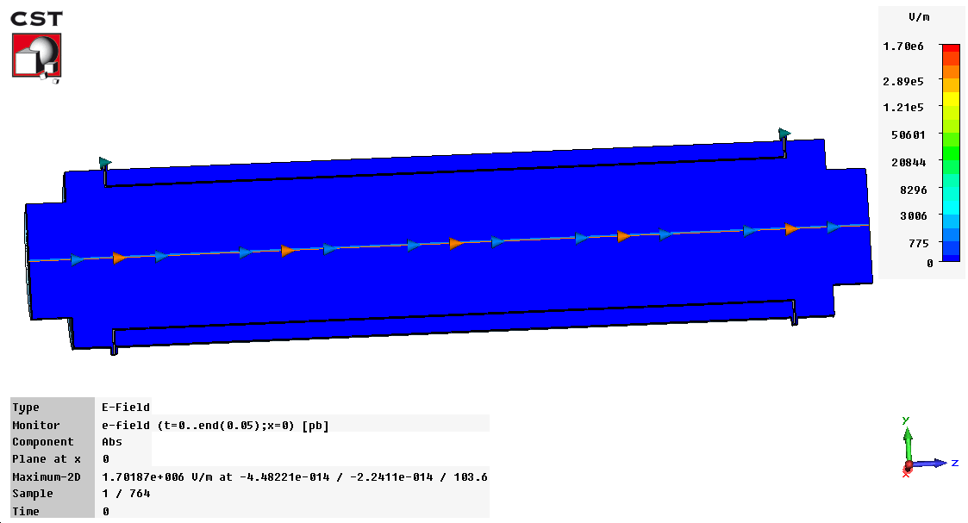
5 ns bunch (≈ shortest in the machine)
1 ns bunch (exaggerated to magnify impedance issues)

Slide 8
Tapered version
(exaggerated 1 ns bunch)
Barrel version

