Slide 1

Elena Wildner, CERN, For WP4
1

Slide 2
Outline
Introduction
Milestones
EUROnu Publications
Outreach
Achievements
Baseline Parameter Lists
Costing/Safety
Future Plans
2
2

Slide 3
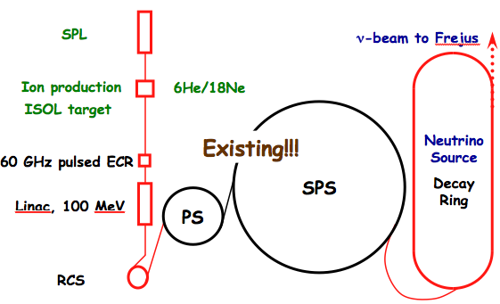
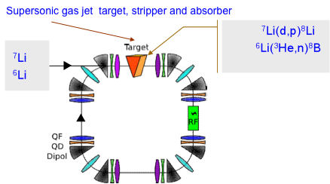
EUROnu Beta Beams
  EURISOL Scenario (low-Q, 6He and 18Ne)
    A preliminary scenario available
    Production of 18Ne not possible
    Collective effects not studied
  EUROnu proposal (high-Q, 8Li and 8B)
    Proposal for ion production (C. Rubbia)
    High production rates
    Higher neutrino-energy with same relativistic ion gamma
    Same acceleration scheme as EURISOL
3

Slide 4
EUROnu Beta Beams
  EURISOL Scenario (low-Q, 6He and 18Ne)
    A preliminary scenario available
    Production of 18Ne not possible
    Collective effects not studied
  EUROnu proposal (high-Q, 8Li and 8B)
    Proposal for ion production (C. Rubbia)
    High production rates
    Higher neutrino-energy with same relativistic ion gamma
    Same acceleration scheme as EURISOL
4

Slide 5
EUROnu Mid Term “news”
    We can now produce enough18Ne !
      Low-Q option feasible now, if experimentally confirmed (planned)
    Ample amounts of antineutrino emitters
      (6He and 8Li ) can be produced (experimented)
    EUROnu proposal for production 8Li/8B very difficult
      Indirect kinematics gas jet target not (yet) a possible option
    Modifications in 8Li/8B production scenario
      Direct kinematics case (simulations)
    Not same acceleration scheme as EURISOL FP6
      Not fully stripped ions at ECR exit: new RFQ-design (losses?)
      SPS RF
      Adaptation of decay Ring Design
    5-10 times more useful neutrinos needed for high-Q isotopes
      Important work on collective effects
      Radiation (may not scale, but certainly > 3 times)
      Cocktail approach (WP6)
5

Slide 6
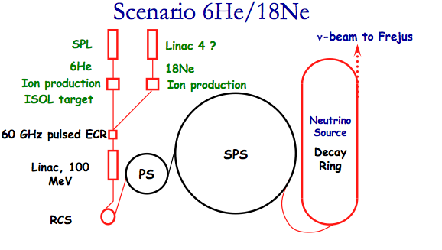
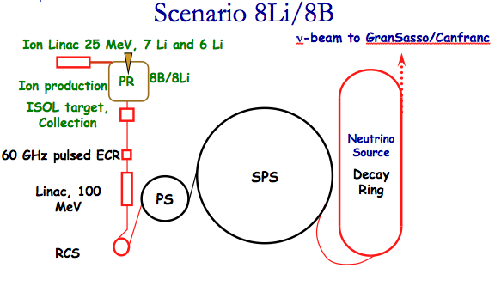
The EUROnu scenarii
Bρ ~ 500 Tm, B = ~6 T, C = ~6900 m, L_{ss}= ~2500 m
γ = 100, all ions
NEW !
BASELINE
6

Slide 7
22 Reports on EUROnu web
Beta Beams for Neutrino Production, E. Wildner for WP4
8B Experiment Setup Planning, V. Kravchouk
Beta Beam baseline parameters, WP4 Team
Status of cross section measurements for 8Li and 8B production, E. Vardaci
Beta Beam Production Ring, Status, E. Benedetto
Short pulse electron-cyclotron resonance source of multicharged ions, V. Zorin et al.
Study of a decay ring for the Beta-Beams with lithium and boron, A. Chancé.
Preliminary FLUKA Studies of the Power Deposited in the Arcs of the Beta Beam DR, E. Bouquerel
Possible changes in the decay ring to enlarge the (anti)neutrino flux, A. Chancé and J. Payet.
Collective Effect Studies of the Beta Beam Decay Ring, C. Hansen and G. Rumolo.
Simulations of Bunch Merging in a Beta Beam Decay, D. C. Heinrich, C. Hansen and A. Chance.
Baseline ion production dedicated to beta-beams Ion Production, T. Stora.
Ionization cooling in a low-energy ion ring with internal target for beta-beams, E. Benedetto.
Beta Beams,E. Wildner.
Beta Beams for Neutrino Production, E. Wildner.
Radioactive Ions Production Ring for Beta-Beams E. Benedetto et. al.
Limitations in the Use of Barrier Buckets in a Beta Beam Decay Ring, C. Hansen.
Beta Beams for Neutrino Production, E. Wildner.
Investigation of intrabeam scattering for Beta beam decay ring. G. Lund.
Development and lattice design of an ion-production ring for a beta-beam facility, . Schaumann
Monte Carlo Simulation of a ion production ring for a beta beam, J. Wehner.
Open midplane designs based on sector coils in superconducting dipole magnets, J. Bruer.
7

Slide 8
Publications ECR Source
Measurement of the sixty GHz ECR Ion Source using megawatt magnets – SEISM magnetic field map
  XIXth International Workshop on ECR Ion Sources (ECRIS 2010), France (2010)
SEISM : a 60GHz cusp electron cyclotron resonance ion source
Review of Scientific Instruments - The 13th International Conference on Ion Sources (ICIS'09), USA (2009)
Short-Pulse ECR Source of multiply cherged ions
Technical Physics, 2010, Volume 55, Number 12
Micropulse generation in ECR breakdown stimulated by Gyrotron radiation at 37.5 GHz, International workshop on ECR ion sources 2010, August
ECR breakdown of heavy gases in open mirror trap
To be published in Fusion Science and Technology in January - February 2011
LNCMI AERES Poster (March 2010)
8

Slide 9

Milestones
WP
Month
4.1 | Baseline Beta-Beam scenario | 4 | 12 | Documentation reviewed
6He and 18Ne, new DR design, new RFQs, parameters have not changed significantly
4.2 | Design of collection device | 4 | 15 | Drawings qualified by external expert
Collection device is designed and assembled, test on collected yields ongoing
4.3 | Lattice frozen for production ring | 4 | 18 | Optics qualified by external expert
Basic lattice exists, 6D simulations tool in place, cooling simulations will tune the lattice
4.4 | New decay ring optics for ⁸Li and ⁸B | 4 | 21 | Optics qualified by external expert
Deacy ring optics done also for B and Li. Needs adjustments to lower eta (collective effects) new verision exists. We have in addition a new decay ring design giving some extra 10% in neutrino flux (stronger magnets).
4.5 | Interim report on reaction channels, collimation and magnet protection | 4 | 24 | Report reviewd
For 8Li reaction channels are studied, report on EUROnu site. Magnet protection partly studied (report on web) collimation still not studied.

Slide 10
Milestones (contd & Deliverables)
6.4 | Physics performance of all facilities with update of fluxes | 6,5,4 | 24 | Report reviewed
Results from the barrier bucket study, (B and Li) with very high intensities in the decay ring that we (WP4) have not yet confirmed by calculations (ongoing). For He and Ne we stay with the original basic parameters. New: cocktail approach!
6.3 | Scenarios for the B and Li Beta Beams | 6,4 | 24 | Report reviewed
Scenarios developed with WP6: RF studies and and collective effects, need to check all machines
D8 | Collection device construction | 4 | 15 | Prototype
Device constructed.
D12 | Report on the experimental validation of the collection device for Li-8 | 4 | 15 | Prototype
Report imminent
D13 | Bunching performance evaluation | 4 | 7 | Report
Beam extraction for 2011

Slide 11
New associated Partners
  GSI, Darmstadt (O. Boine-Frankenheim, C. Dimopoulou)
    Cooling and Internal Gas Targets for production ring
  Technical University of Aachen, Aachen (A.Stahl)
    Production Ring lattice. Target simulations for production and cooling
  Weizmann Institue of Science, Revohot (M. Hass)
    Isotope production (essentially 6He and 8Li )
11

Slide 12
Outreach
  Nufact 2009 and 2010
  European Strategy For Future Neutrino Physics, (2009)
  Neutrino schools, Fermilab (2009) and JPARC (2010)
  IPAC 2010, Kyoto
  Epiphany Conference 2009, Krakow
  NOW2010
  Neutrino2010
  Seminar, Uppsala (2009)
  Seminar, GSI (2010)
  Seminar, INFN (2010)
  Seminar, LNCMI (2011)
12

Slide 13
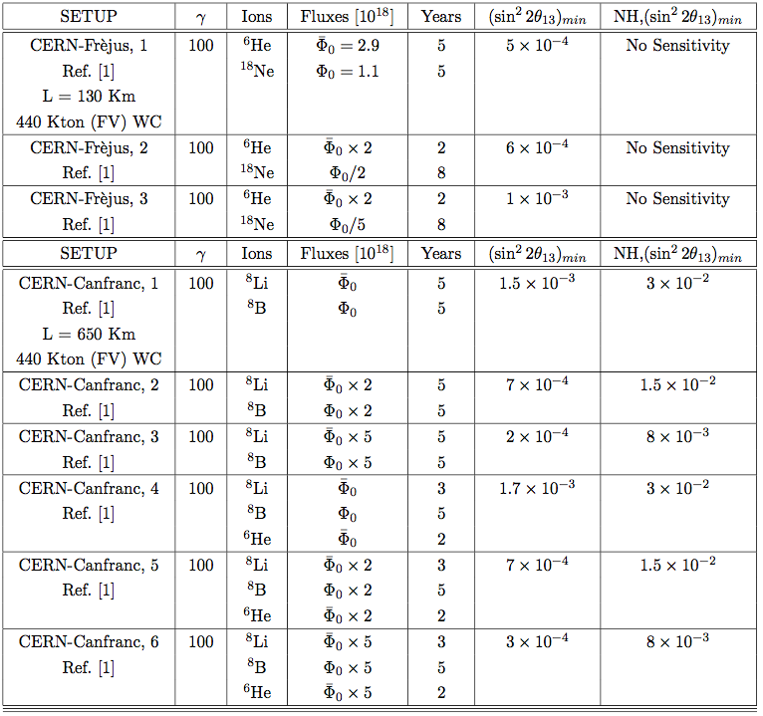
Ion Cocktails 1 (From WP6)
Collective effects important
Less collective effects
Less collective effects
We can get 8Li “easily”, but not 8B

Slide 14
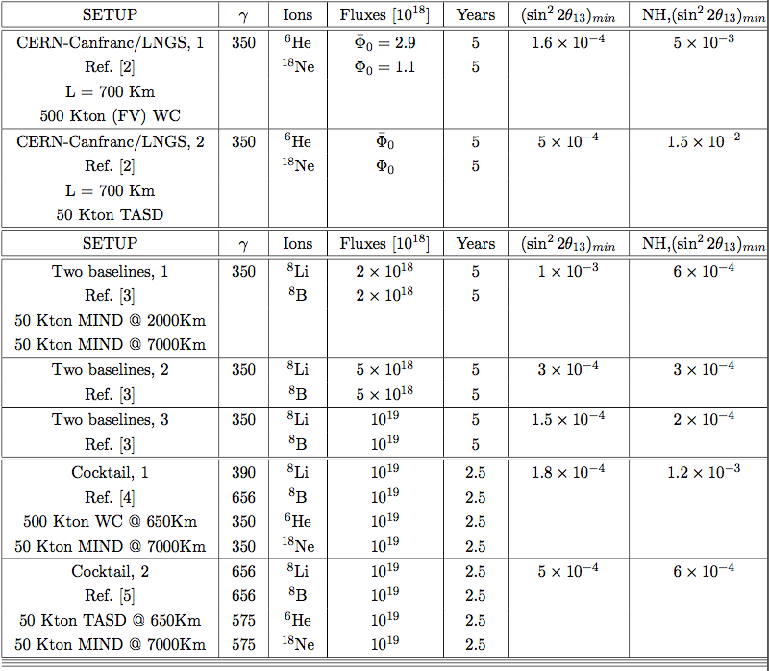
Ion Cocktails 2 (From WP6)
Interesting, Greenfield

Slide 15
Greenfield Beta-Beams
CERN-Canfranc setup : γ = 350 for ⁶He with L = 730 km
θrest=160° θlab=1.2°
θlab=1.2°=2.9 mrad
θrest=90° θlab=0.2°
Distribution of lab frame angle
Lab frame: relativistic aberration (no relativistic beaming)
Greenfield scenario
Michel Martini

Slide 16
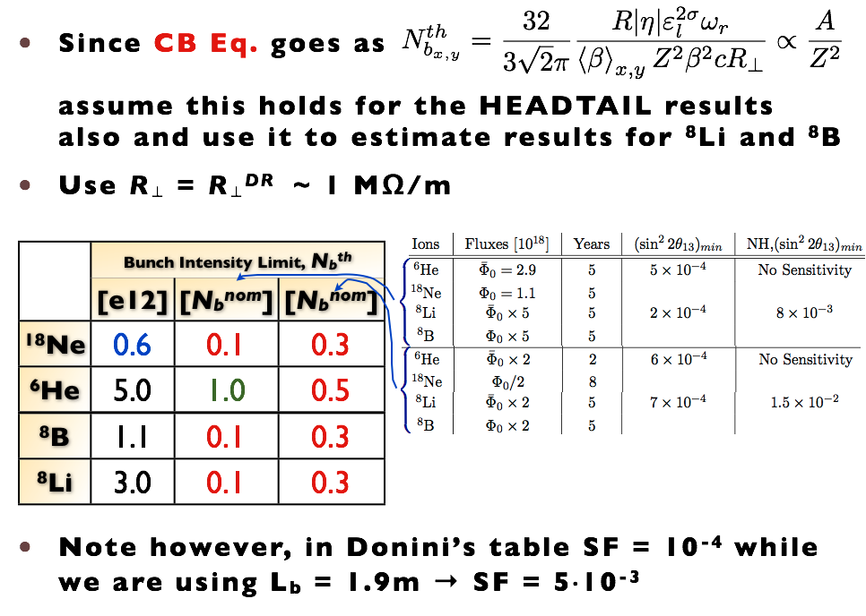
Collective Effects limits EURISOL
16

Slide 17
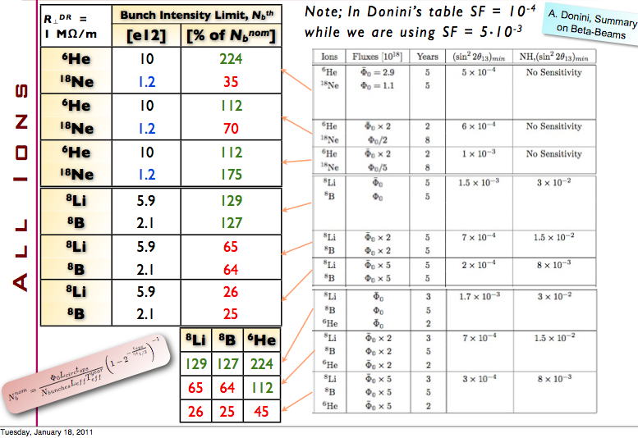
Collective Effects Limits
Recent Encouraging results
17

Slide 18
Collective Effects Limitats
Recent Encouraging results
Two beams, LHC style double bore Magnets !?
Larger Apertures
2011-01-09
18
EUROnu, RAL, Summary Beta Beams, Elena Wildner

Slide 19
Options for production
Courtesy T. Stora, P Valko
Type | Accelerator | Beam | I_{beam} _{mA} | E_{beam} _{MeV} | P_{beam} _{kW} | Target | Isotope | Flux _{S}⁻¹ | Ok?
ISOL & n-converter | SPL | p | 0.1 | 2 10³ | 200 | W/BeO | 6He | 5 10¹³
ISOL & n-converter | Saraf/GANIL | d | 15 | 40 | 600 | C/BeO | 6He | 5 10¹³
ISOL | Linac 4 | p | 6 | 160 | 700 | 19F Molten NaF loop | 18Ne | 1 10¹³
ISOL | Cyclo/Linac | p | 10 | 70 | 700 | 19F Molten NaF loop | 18Ne | 2 10¹³
ISOL | LinacX1 | 3He | > 170 | 21 | 3600 | MgO 80 cm disk | 18Ne | 2 10¹³
P-Ring | LinacX2 | 7Li | 0.160 | 25 | 4 | d | 8Li | ?1 10¹⁴
P-Ring | LinacX2 | 6Li | 0.160 | 25 | 4 | 3He | 8B | ?1 10¹⁴
Possible
Needs experiment
 | Experimentally OK
 | On paper may be OK
 | Not OK yet
Challenging

Slide 20
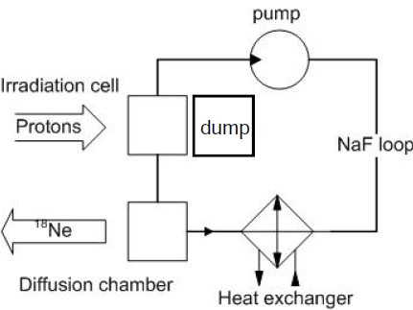
Experiments ¹⁸Ne for Beta Beams
Measure production and release from a sodium target at ISOLDE
  Proposal sent to INTC
Manpower for experimental setup and measurements
  2 years of scientific associateship agreed by CERN
Experiments at small decay ring at ISOLDE
  LOI sent to INTC
EUROnu week in Strasbourg - IPHC P. Valko - CERN

Slide 21
The PR, Simulations and experiments
Gas Jet target proposed in FP7: too high density
Vacuum problems
NEW: Try Direct Production (D. Neuffer)
Basic lattice and 6D tracking ok, tuning for beta function at target
Charge exchange injection to be designed
Direct kinematics could give good production efficiencies
Simulations done so far can be scaled, tune for cooling
RF feasable (10 MHz, 300 kV), capacitive loaded cavities (ACOL)
Experiment/simulations at ERIT, FFAG solution (larger aperture)
Using existing CERN AD and LEIR is an option (under study)
21

Slide 22
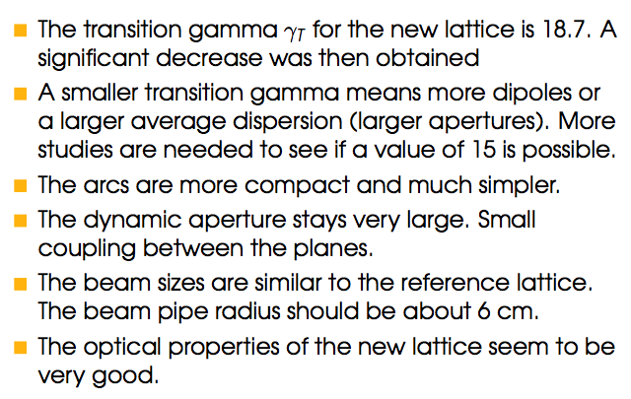
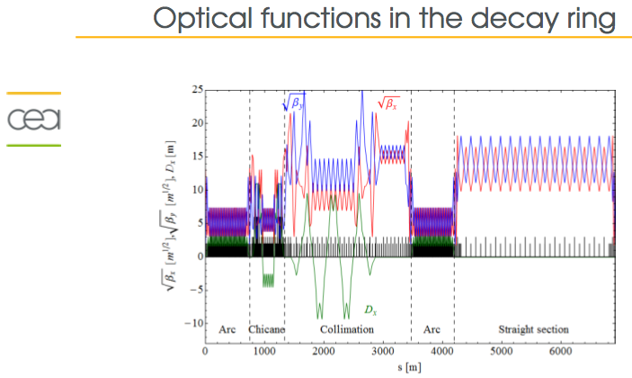
Decay Ring Studies
Lattices for low-Q and high-Q options (2009)
Optimization (stronger magnets) to gain 10 % intensities done
However, as shown, collective effects are a problem
New lattice with lower phase slip factor has been designed
22

Slide 23
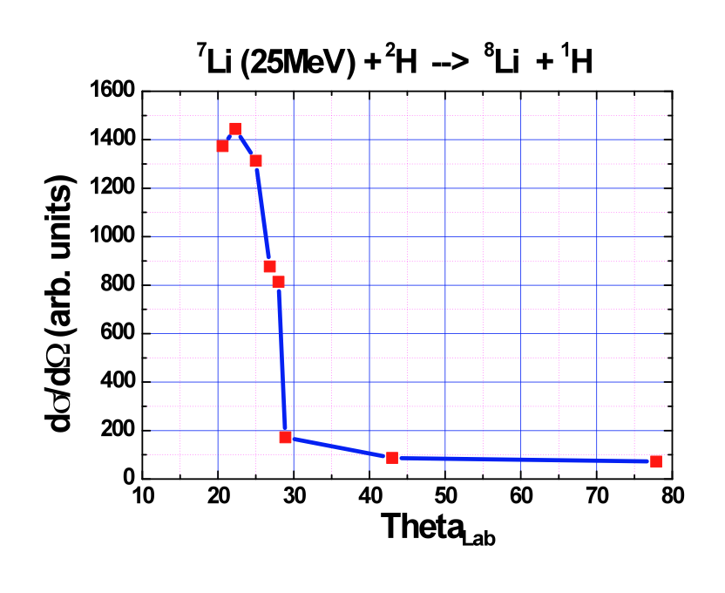
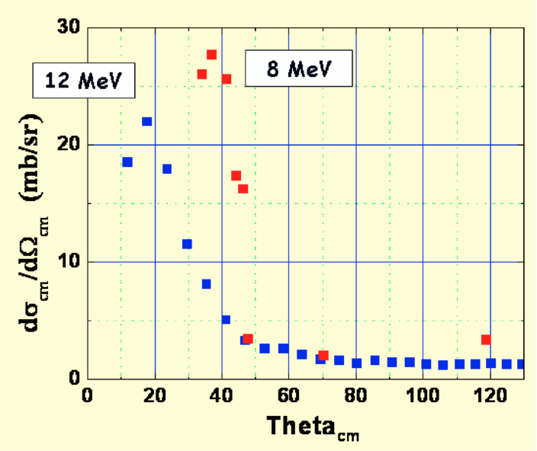
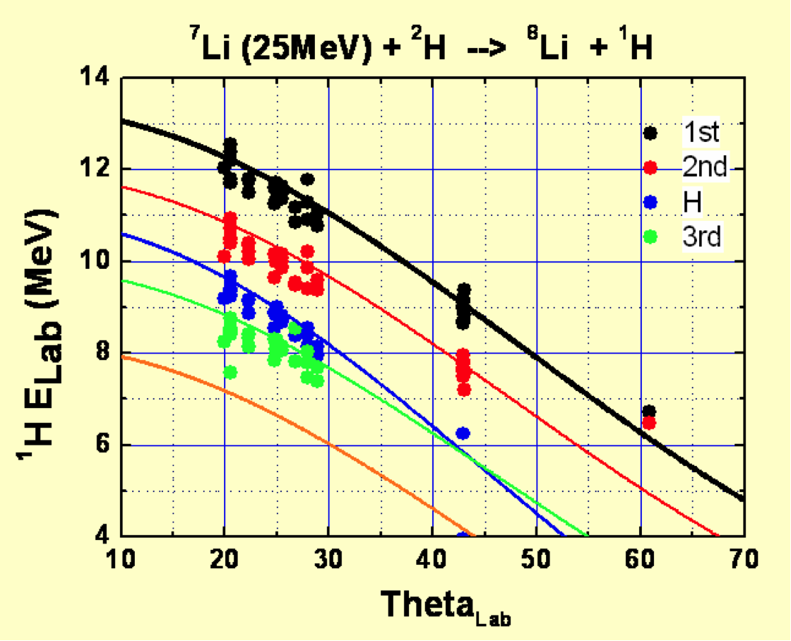
8Li X-sections and distributions
Comparison between the experimental peak energy at different lab angles and the values (curves) expected from two-body kinematics and different excited states of ⁸Li.
Cross sections still needs some mode work
23
E.Vardaci

Slide 24
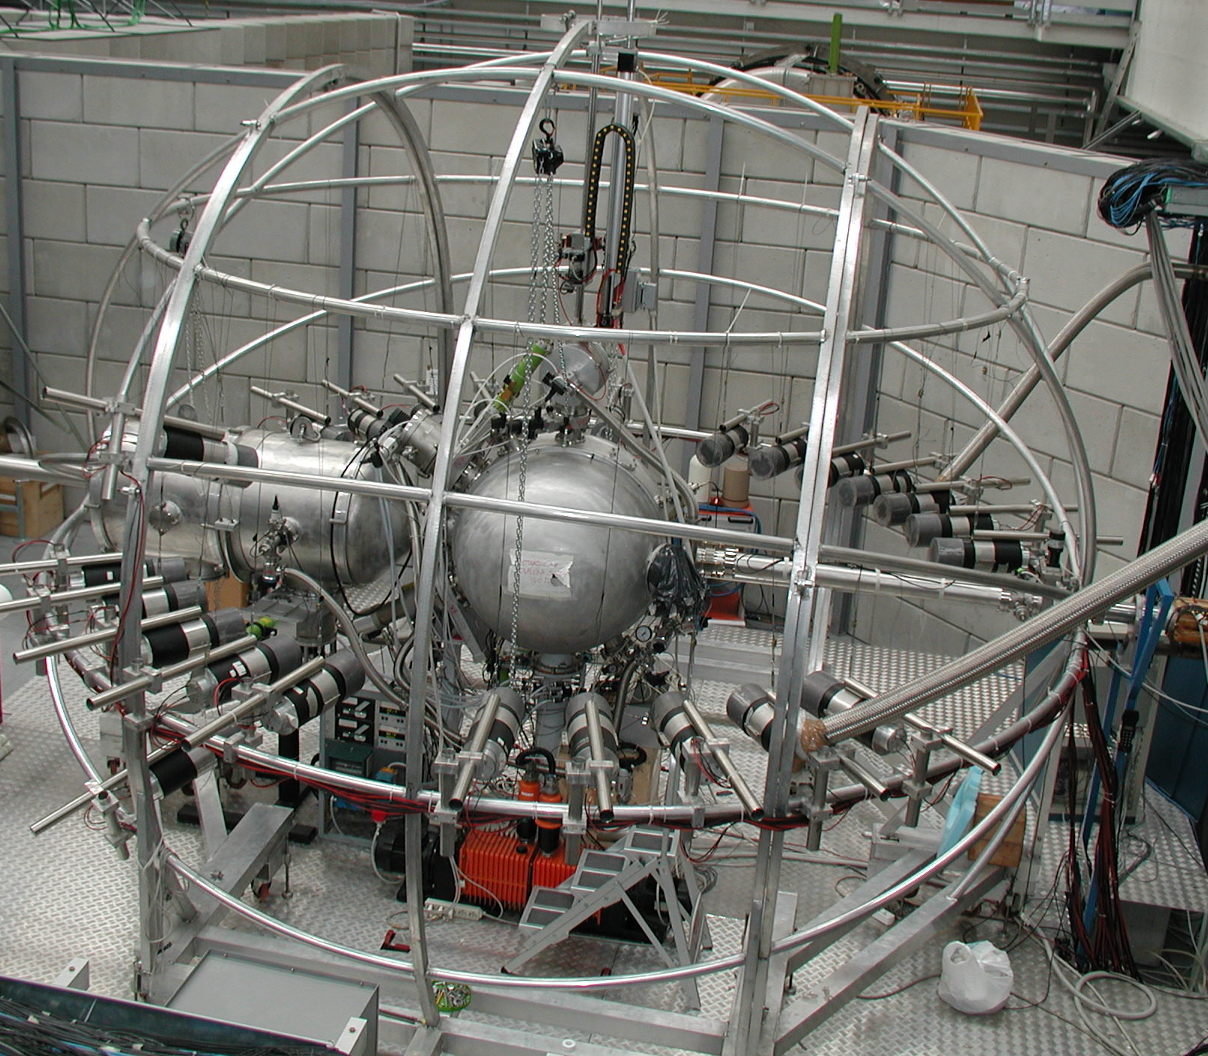
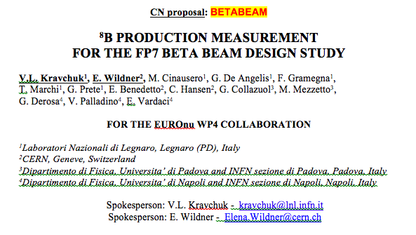
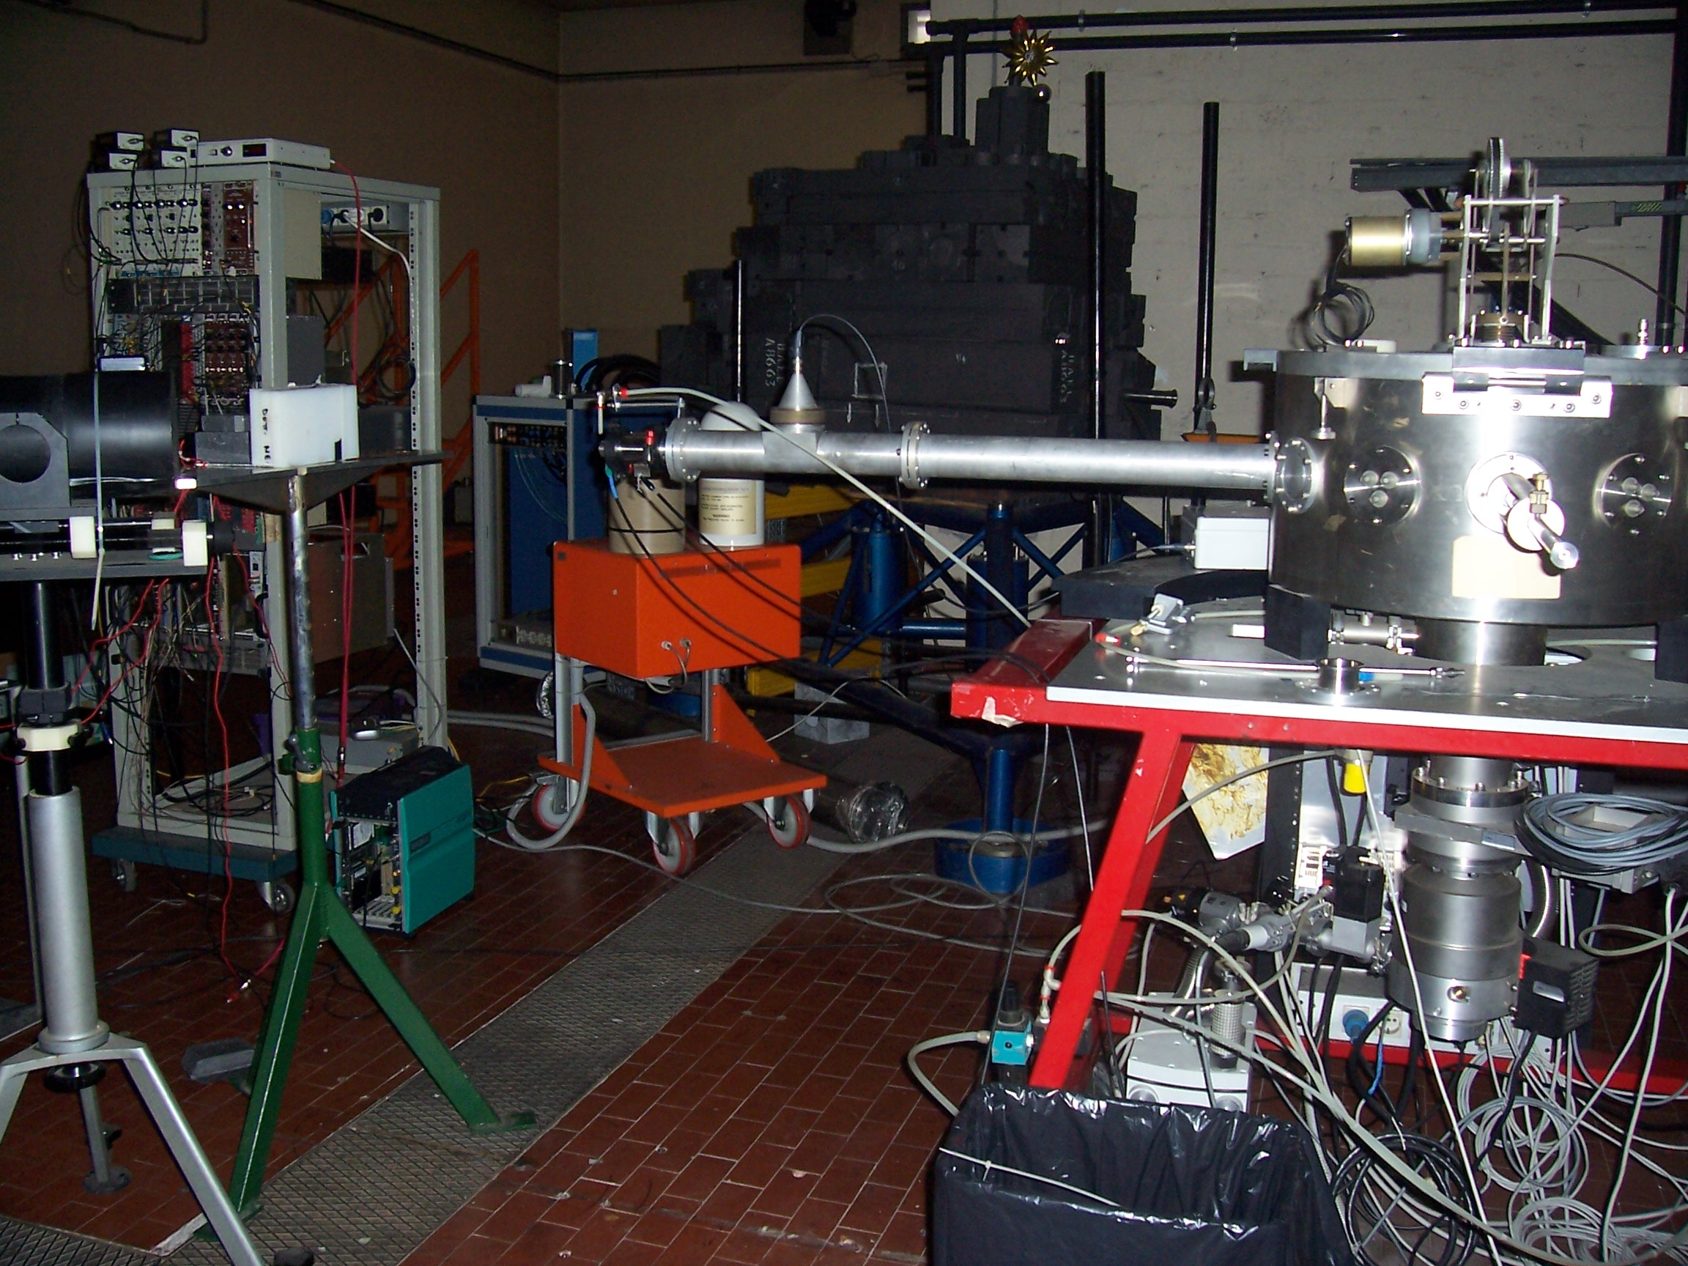
X-sections, Energies and Angles, Li and B
2011
3He, expensive, difficult to find
24
E.Vardaci

Slide 25
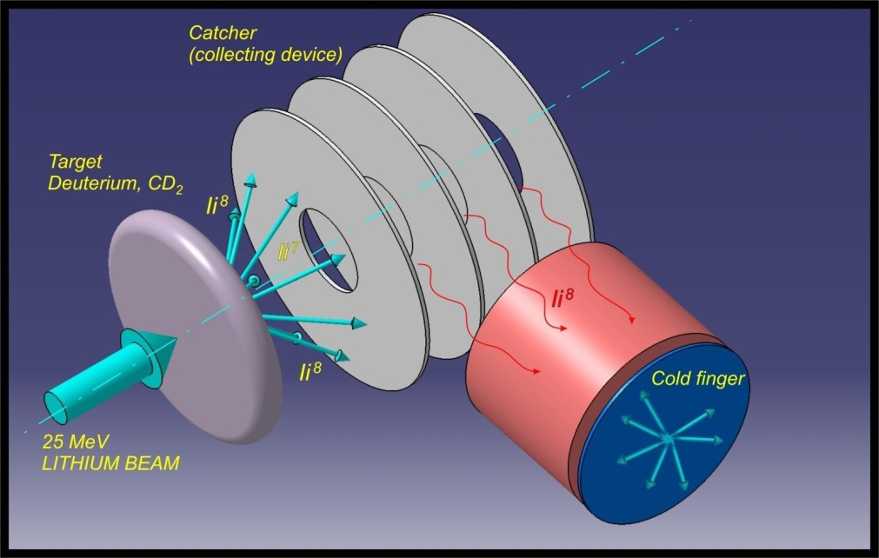
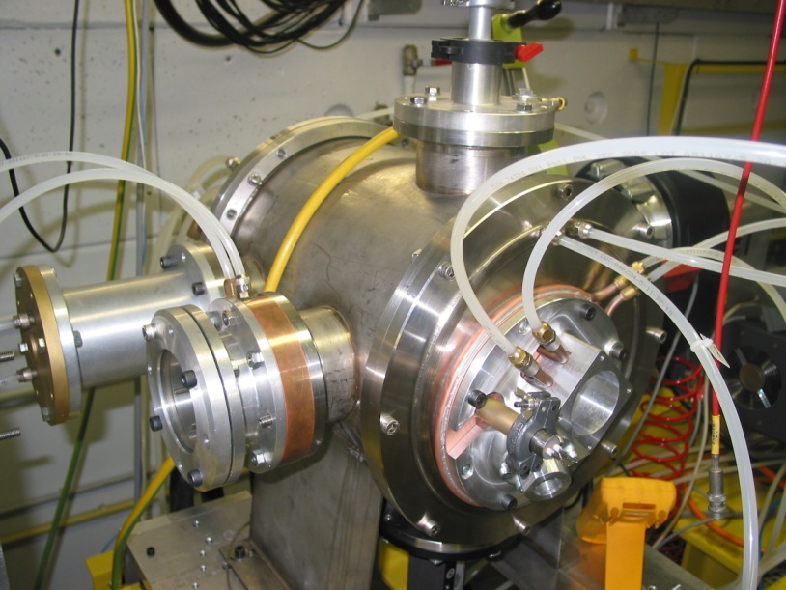
Collection device
Device constructed
Oven, Target, collection, measurement equipment on line
Commissioning problems solved
Measurements/Analysis ongoing for 8Li
Direct kinematics should be discussed

Slide 26
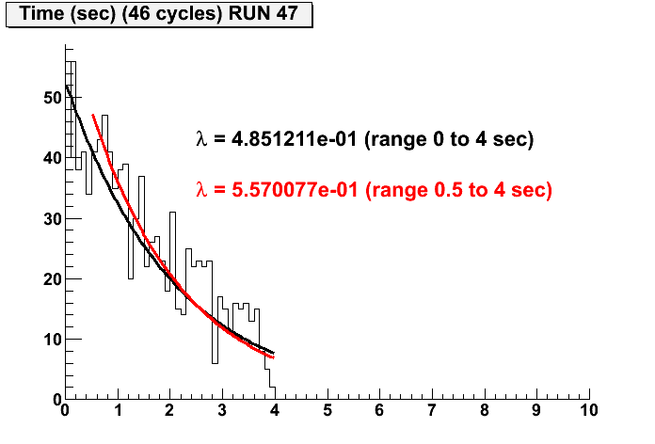
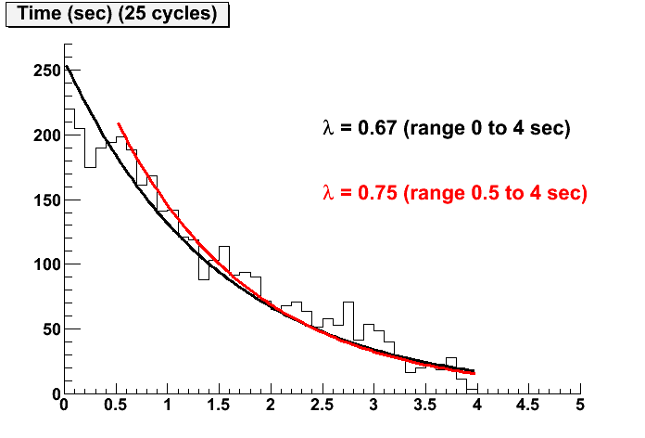
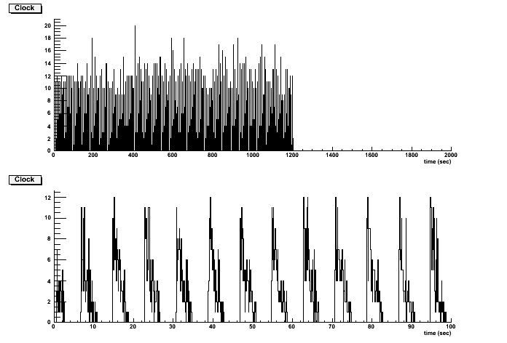
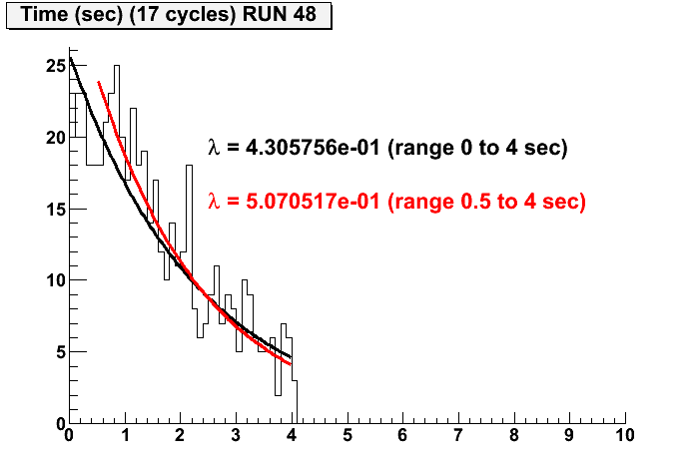
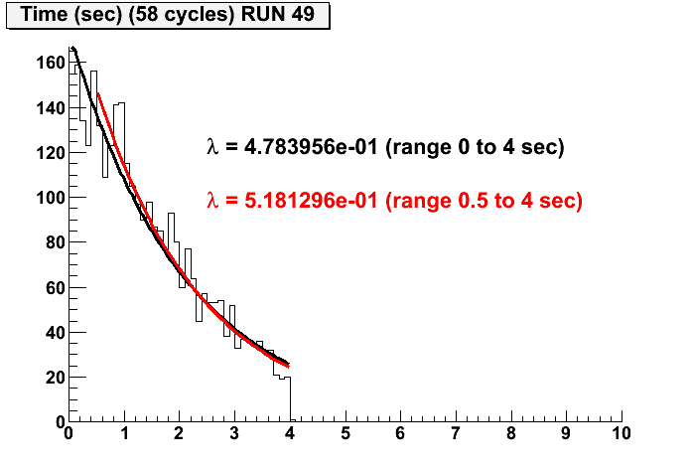
Test Results 8Li being analyzed
On-line beam tests

Slide 27
Duty factor and RF Cavities
10¹⁴ ions, ~0.5% duty (supression) factor for background suppression !!!
....
20 bunches, 5.2 ns long, distance 23*4 nanosseconds
filling 1/11 of the Decay Ring, repeated every 23
microseconds
Work on HW feasibility will start 2011,
Cockroft institute/Lancaster Univ.
27
27

Slide 28
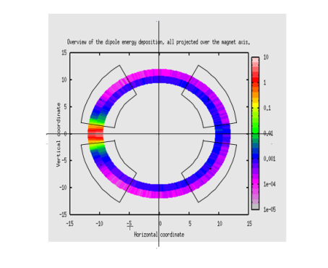
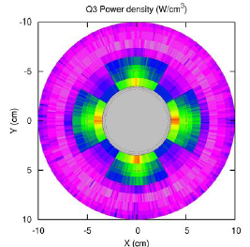
Radiation issues
Open midplane magnet for Decay Ring exists (2009)
Internal absorbers between short dipoles
  Result not entirely satisfactory (2008)
  Magnets at quench limit
Thick liners in the magnets an alternative
  Modelled in FLUKA
  Not conclusive
Work on collimation system to be continued (hibernating...)
SPS is still to be looked at
Other machines ok for baseline (for CERN recommendations)
Have to be checked for 8B and 8Li with high intensities
28

Slide 29
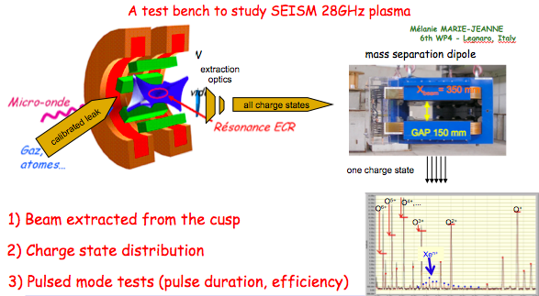
60 GHz Source Challenges
29
29

Slide 30
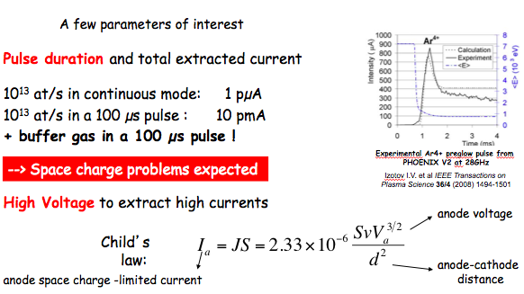
ECR 60 GHz Source

Slide 31




ECR 60 GHz Source
28 GHz-10 kW gyrotron at LPSC is available for first SEISM Euro-nu experiment
finalize the internal structure of the source (HV insulation, vacuum, HF port, gas inlet)
60 GHz gyrotron will be finished at IAP: Installation is funding dependent
Magnet time availability not evident for 60 GHz
Information on experiment should be available by now (see later talk)
ECR efficiency : needs experimental verification of gyrotron data
We have to be confident that experimental program can fly (funding ?)
The SEISM Collaboration

Slide 32
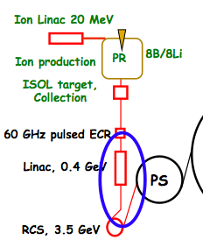
New RFQs
+1 charge states from ECR
Z/A small
RFQ not optimized
May give losses

Slide 33
Costing and Safety
WBS presented at Costing meeting at CERN
Safety only generally looked at
No major changes from this (improvements, details)
Difficult to cost when project only half way.
  PS is going to be upgraded for example
  Baseline needs technical refinements
WP4 did get no help or input for costing
  Tried to get it going
Lack of guidelines, manpower and expertise
33

Slide 34
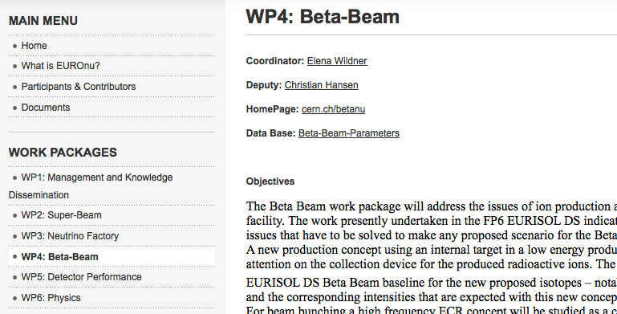
Parameter list
34

Slide 35
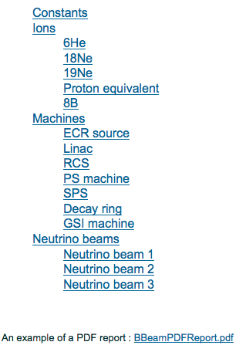
Parameter list
As document in the EUROnu web (date of report)
35

Slide 36
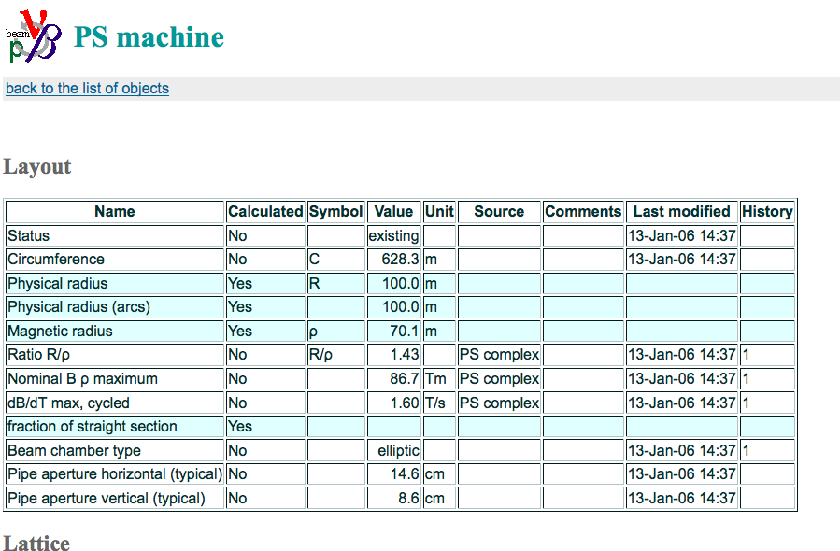
Parameter list
36

Slide 37
Future (2011-
Experiments on 18Ne
Direct kinematics for 8B and 8Li production: targets
Cooling and production simulations for Production Ring (8Li/8B)
Cross-section measurements of 8B
8B collection setup
ECR fields for plasma -> 30 000A (structures supra…), Gyrotron tests, beam extraction, low cost solutions, Proto -> ECR Source
Finalizing collective effects studies, all ions, all machines
CERN complex: RFQ and PS-upgrade
Decay Ring updates for collective effects (phase slip factor/RF)
Decay Ring RF, technical feasibility
Good physics case “green-field” realistic & cheap beta beams
Parameter lists update for all ions
Costing/Safety?

Slide 38
Modifications
Partners continue according to plans
CERN:
  New RFQ
  Very work-intense study on collective effects, FP6 not working
  Results affect machines: we have already indications for DR
  DR redesign is a consequence, work done
  Technical help with impedance (HW specialists available for beta beams?)
  The old machines need to be adapted: we will follow the PS upgrade
  Production ring: inverse to direct kinematics -> collection device ?
  SC-Magnet shielding not complete, radiation for high-Q needs more work
Costing/Safety?
  Partners are ready to work, where are the clear EUROnu guidelines
  CERN: no costing support (Magnets, vacuum, civil engineering, RF….)

