Slide 1
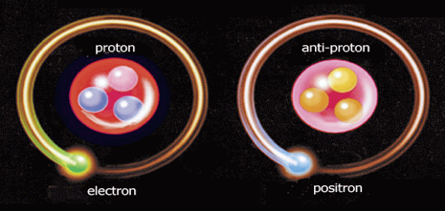
First thoughts on ELENA beam impedances
Olav Berrig
Thanks to P. Belochitskii, A. Burov and W. Herr

Slide 2
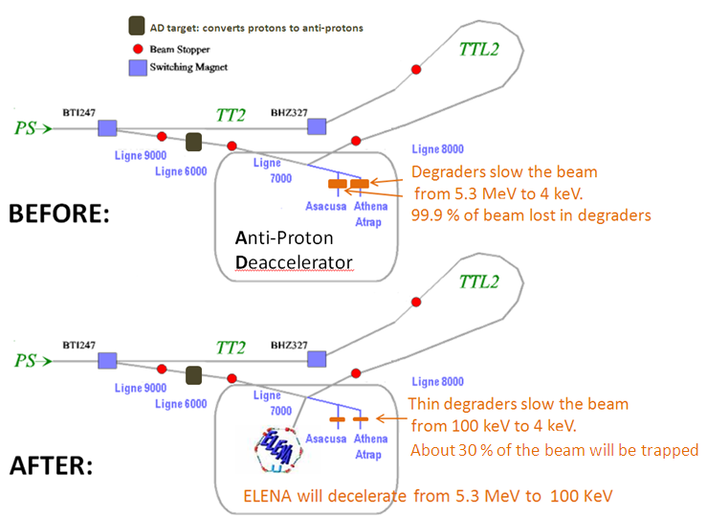
Why do we want ELENA ?

Slide 3
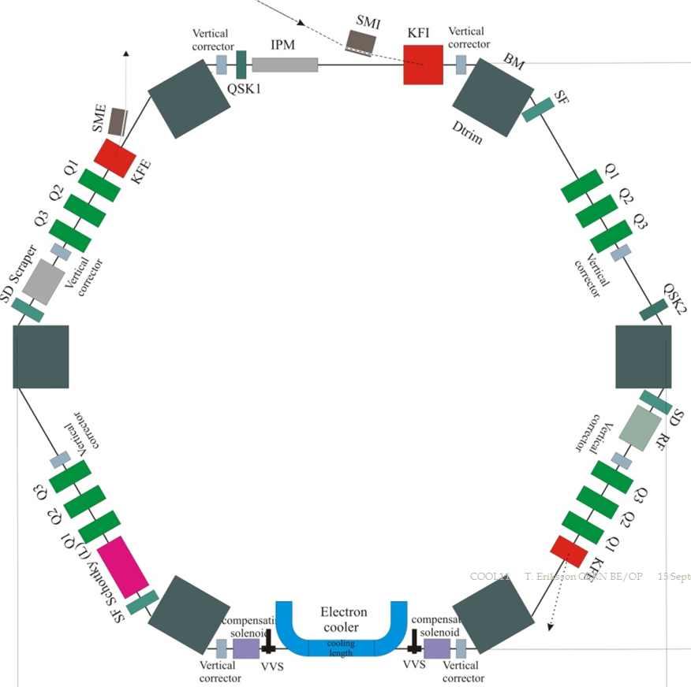
Extra Low ENergy Antiproton ring
Ionization profile monitor:¹⁾
Measures beam profiles. Allows the non-destructive monitoring of beam centres and emittances throughout the cycle
¹⁾ Will the static electric fields affect the circulating antiprotons?
Skew quadrupoles:
Needed to compensate for residual coupling between horizontal and vertical planes.
Electron cooler:
Reduces the transverse emittancies. When the beam is decelerated, the transverse emittancies grows, because they scale with the inverse of gamma-beta i.e. Є~1/(γ.β). Cooling also counteracts “multiple Coulomb scattering” , which heats the beam
Longitudinal Schottky PU:
BTF tune measurements for intensity measurement and cooling control.

Slide 4
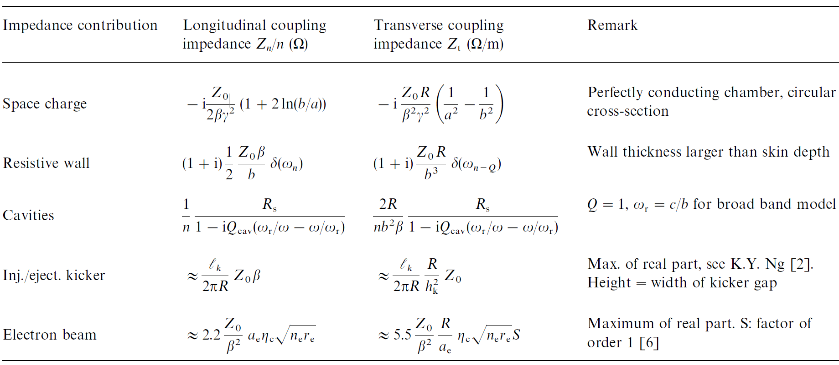
Impedance sources [1]
1)
2)
3)
¹⁾ Space charge impedance is the dominant impedance in low energy machines, because gamma ~ 1. Space charge
leads to large Laslett tune shifts that might cross a resonance. It also separates the coherent and in-coherent tunes
and thereby reduces Landau damping. Space charge impedances are purely imaginary, and are therefore only
affecting the tunes. No energy is exchanged with the beam.
²⁾ Resistive wall instability is the dominant instability in low energy machines
³⁾ The RF cavities are shorted (i.e. a resistor is connected to the input cable) during electron cooling, in order to
absorb energy and reduce the Q_{cav}

Slide 5
The resistive wall instability is the most important [2] The other sources of beam growth are:
Intrabeam scattering (IBS)
Coulumb scattering.
Strict pressure requirement for ELENA of 3*10⁻¹² Torr
NB! In preparation for the heavy ion program of the LHC,
accumulation and cooling tests with lead ion¹⁾ beams have been performed in the LEAR storage ring.The static pressure of the LEAR machine was 5*10⁻¹² torr, but was observed to rise five-fold during the accumulation tests. This increase in the pressure reduced the lifetime of the circulating beam to only 6.5 s, causing the maximum accumulated intensity to be a factor of two less than desired [3]
¹⁾ However, Antiproton beams should be much less sensitive to pressure than ion beams (C.Carli)

Slide 6
Most important question: Do we need a damper ?
Background information:
The low energy choice is limited by 100 keV due to space charge, IBS and gas (=columb) scattering, the reliable operation of the electron cooler, complications of the machine optics due to the solenoidal field of the cooler and – of course – the requirements of the experiments, but the experiments are not the overwhelming determining factor!
The degraders cannot be made thinner than 0.8 um, so we will always have certain losses, so is no need to go lower in energy in order to have thinner degraders.
The reason we care about the energy level is, that, if we needed a lower energy, we would need more electron cooling in order to compensate for reduced adiabatic damping.
The beam intensity. The beam intensity is relatively small 2.5*10⁷, f.ex. compared to the Recycler Ring (RR) in Fermilab, which was an antiproton ring with electron cooler. The RR had a damper installed. The total number of antiprotons in RR was 2.5-5 *10¹².
The electron cooler. The experiments physisist requires small emittances.
The bunch length. The bunch is determined by the experiments to twice the length of the penning trap. So unfortunately we cannot make the bunches longer, which would have reduced space charge and made the Laslett tune shift smaller.
Blowup of beam before extraction. If we experience instabilities at extraction i.e. when the beam is bunched, then – by using the damper to blowup the beam – the instability will be removed.

Slide 7
Other comments
A particularity of the LEAR optics was the very strong focusing: a phase advance of ~250 degree/period yielded an “imaginary transition energy” (decrease of orbit length C with momentum, i.e. negative momentum compaction. This avoids transition and also leads to a large dispersion of the revolution frequencies, beneficial for cooling to small momentum spreads and for control of instabilities.) [4]
Should we copper coat the vacuum chambers, in order to reduce the resistive wall resistance? Can we have both copper coating and NEG coating on top?
Should the vacuum chambers be tapered? (tapering is bad for the vacuum pumps)
Should the kickers have transition pieces (inserts or RF fingers) to reduce the impedance?
Should the bellows have RF-fingers to reduce the impedance?
Will the static electric fields from the “ionization profile monitor” affect the circulation antiprotons?

Slide 8
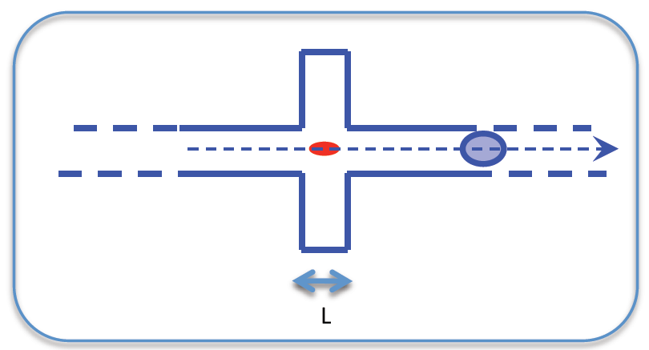
Beam impedance
Test charge
Beam (only one bunch)
Force times length i.e. energy
Energy i.e. Electron Volt
[Volt]
Beam current:
dq/dt = q*c/dz
[5]
1)
longitudinal
¹⁾ In the non-relativistic case, c is replaced by β * c

Slide 9
Current knowledge suggests that, three conditions are necessary (although probably not sufficient) for the stability of intense cold beams [1] :
Operation below transition energy
Active damping to counteract coherent instability
(iii) Careful control of the e-beam neutralization.

Slide 10
Number of anti-protons per bunch: 6.5*10⁶ (at extraction)
Number of bunches: 1 to 4 (depending of experimental physicist requests)
Bunch length: 300 ns = 1.3 m (determined by the length of the trap in the experiment)
Lowest kinetic energy: 0.1 MeV
Lowest momentum: 13.7 MeV/c

Slide 11
References:
[1] Stability of cooled beams. J. Bosser, C. Carli, M. Chanel, N. Madsen, S. Maury, D. MoK hl, G. Tranquille. Nuclear Instruments and Methods in Physics Research A 441 (2000) 1-8. http://betacool.jinr.ru/COOL/COOL'99/001.pdf
[2] A. Burov
[3] Experimental Investigation of Impact-Induced Molecular Desorption by 4.2 MeV/u Pb ions. M. Chanel, J. Hansen, J.-M. Laurent, N. Madsen and E. Mahner. Proceedings of the 2001 Particle Accelerator Conference, Chicago.
http://epaper.kek.jp/p01/PAPERS/WPAH036.PDF
[4] The CERN Low-Energy Antiproton and Ion Rings LEAR and LEIR. M.Chanel, D. Möhl
https://project-ps50.web.cern.ch/project-PS50/Document_draft/LEAR2010_PS50_v1.pdf
[5] General introduction to multi-particle effects. G. Rumolo and E. Métral. USPAS Course on collective effects.
https://impedance.web.cern.ch/impedance/USPAS/Introduction-GR.pdf
See also: Physics of Collective Beam Instabilities in High Energy Accelerators . Alex Chao. Equations (2.69) and (2.71) .
http://www.slac.stanford.edu/~achao/wileybook.html

