Slide 1


TDI with large gaps
V. Baglin (21/10/11)
CERN TE-VSC, Geneva
1.
2.
3.
4.

Slide 2
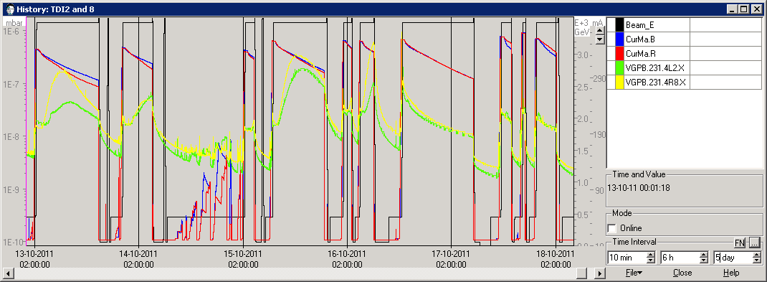
Pressure history
The pressure at TDI exhibit a pressure increase characteristic of heating
Since fill 2219 (16/10, PM), the TDI gap was increased in parking position from 22 mm to 55 mm
As a result, the pressure stays in the few 10⁻⁸ mbar range

Slide 3
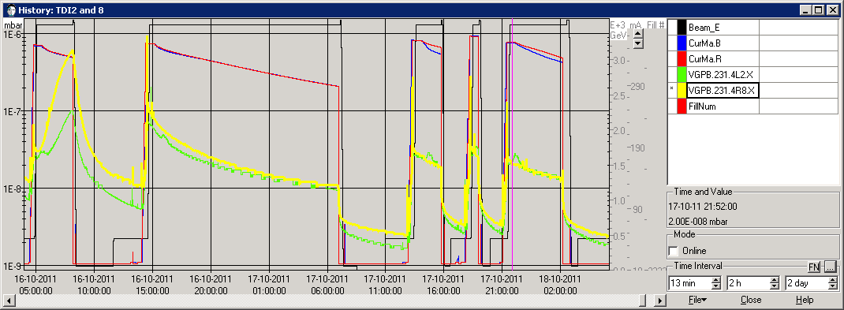
Fills 2218-19-20-21-22
The pressure at TDI exhibit a pressure increase characteristic of heating
Since fill 2219 (16/10, PM), the TDI gap was increased in parking position from 22 mm to 55 mm
As a result, the pressure stays in the few 10⁻⁸ mbar range

Slide 4
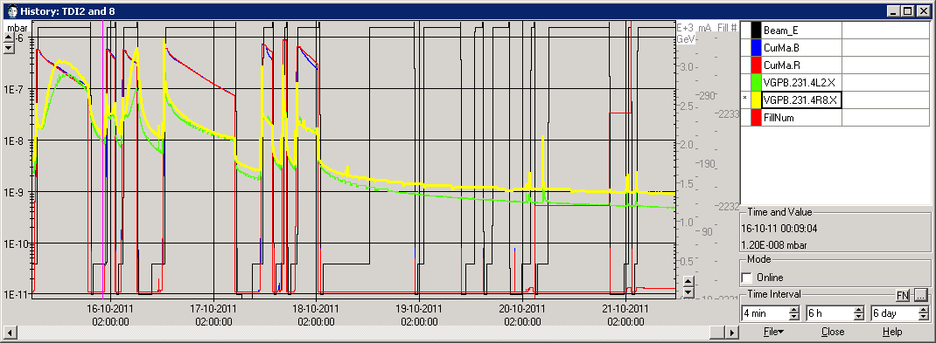
Fills 2218 to 2234
The pressure at TDI exhibit a pressure increase characteristic of heating
Since fill 2219 (16/10, PM), the TDI gap was increased in parking position from 22 mm to 55 mm
As a result, the pressure stays in the few 10⁻⁸ mbar range or bellow for lower values of beam current

Slide 5
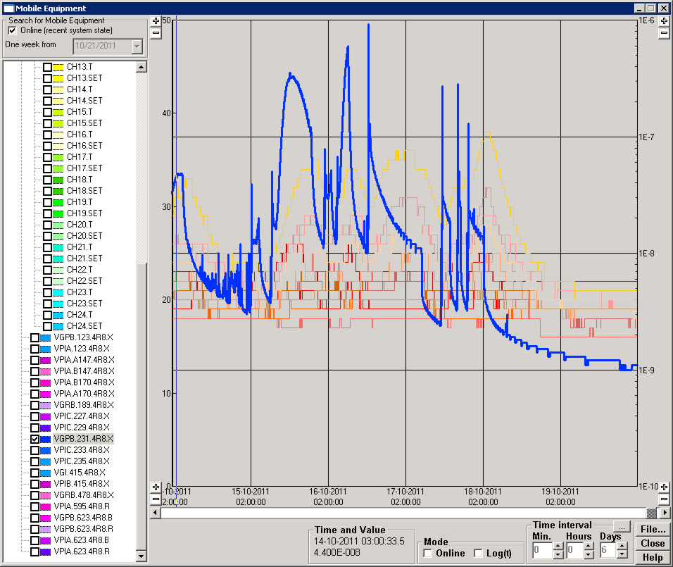
TDI8R – Pressure and Temperature
The pressure at TDI exhibit a pressure increase characteristic of heating
Since fill 2219 (16/10, PM), the TDI gap was increased in parking position from 22 mm to 55 mm
As a result, the pressure stays in the few 10⁻⁸ mbar range but the temperature increase remains
2219

Slide 6
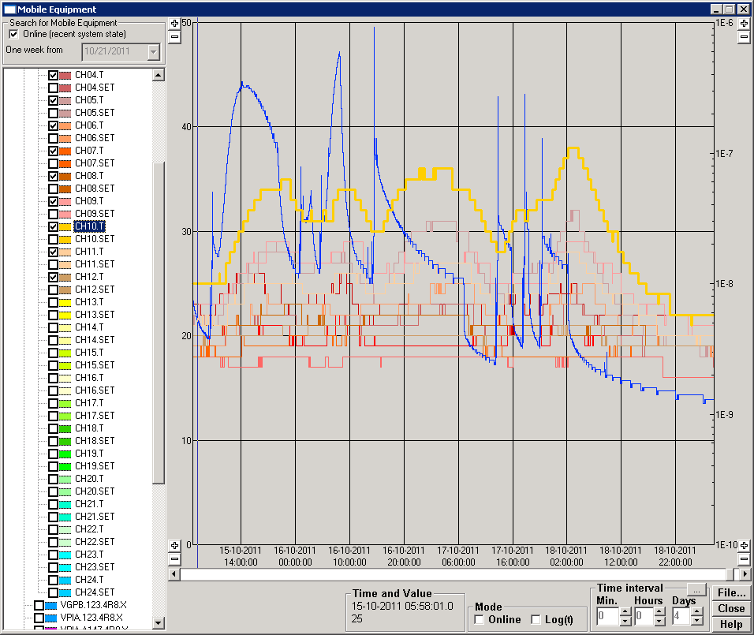
TDI8R – Pressure and Temperature
The pressure at TDI exhibit a pressure increase characteristic of heating
Since fill 2219 (16/10, PM), the TDI gap was increased in parking position from 22 mm to 55 mm
As a result, the pressure stays in the few 10⁻⁸ mbar range but the temperature increase remains
2219
2222

Slide 7
TS4-2011
During the TS 4, wk 35, the TDI.8R and TCTVB.8R were equipped with thermocouples
TC1 and TC2 are located on TCTVB.8R
TC 4 and TC11 are located are located on TDI.8R transitions
TC5,6,9 and 10 are located on TDI.8R extremity
TC 7,8 are located at the centre of TDI.8R
TC3 and TC12 are located at reference vacuum chambers NEG coated.
Pressure is measured at TDI by VGPB.231.4R8.X

