Slide 1
TCTP the CST side
F. Caspers, H. Day, A. Grudiev, E. Metral, B. Salvant
Acknowledgments: R. Assmann, A. Dallocchio, L. Gentini, C. Zannini
Impedance Meeting 17 Oct 2011

Slide 2
Issues to decide
What do we do with the gap above the jaws ?
Should we act on the longitudinal modes generated by the transition region?

Slide 3
Options on the table
Current design (gap opened and ferrite)
No ferrite but gap still opened
RF contacts to close the gap

Slide 4
Open structure (with ferrite)
Open structure (with pec, no ferrite)
Closed structure (simulates ideal RF contacts)
Pros:
No friction
Transverse modes damped
longitudinal modes also damped
Cons:
Low frequency transverse modes
Low frequency impedance
increase
- Small gaps are predicted to generate large intensity effects
- Risk with material model and specifications
Pros:
No friction
model well defined
Cons:
Low frequency transverse modes
large power loss
- Small gaps are predicted to generate large intensity effects
Pros:
No transverse modes
- Solution for phase 1 works
Cons:
Contacts not well defined
solution involves fingers seen directly by the beam
longitudinal modes are not damped

Slide 5
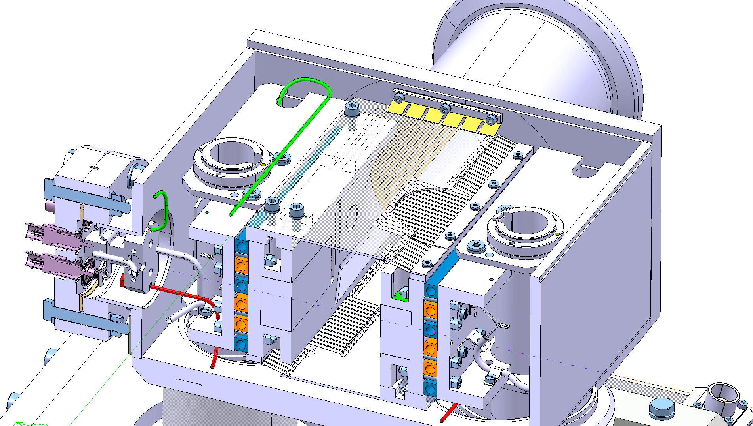
new rf system
Longer RF fingers must be
installed on the axis area.
Longer RF finger

Slide 6
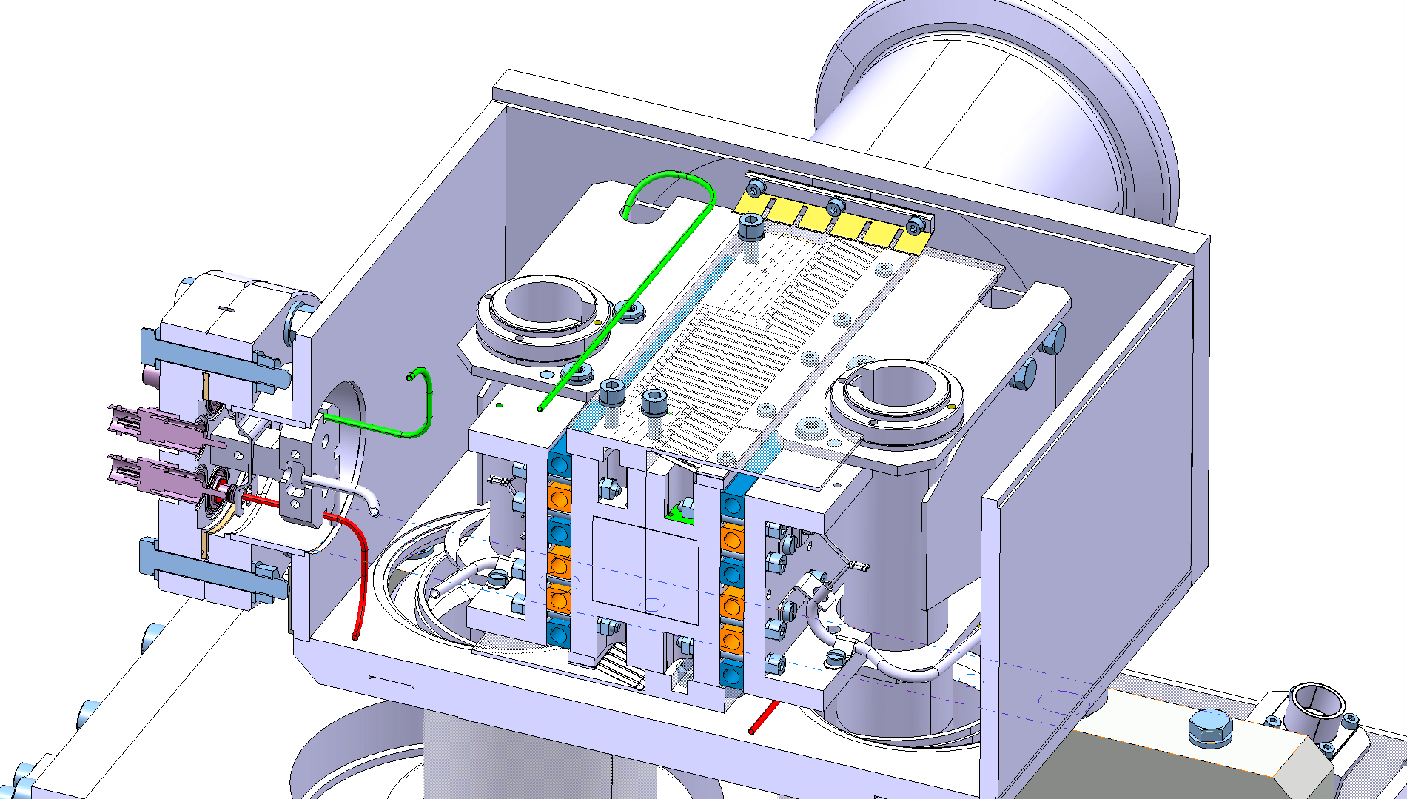
new rf system
Groove on the screen for RF fingers

Slide 7
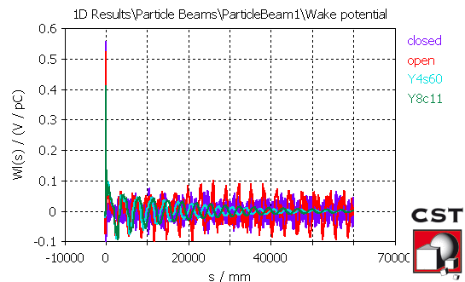
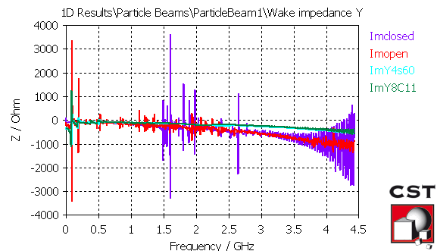
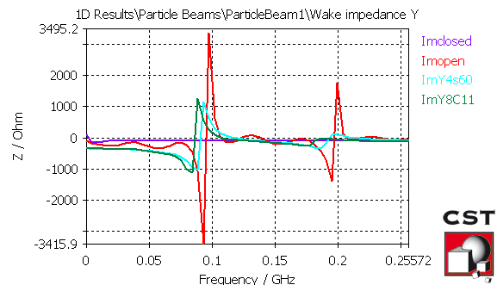
Effect of ferrite (2 mm half gap case)
- Previous simulations were performed with only 10 m of wake (limit for acceptable simulation time)
On the new super PC, we could try 60 m wake, and effect of ferrite is now clear: frequency decreases and all transverse modes are damped. However, low frequency (<100 MHz ) impedance increases (factor 2).
and the longitudinal modes?

Slide 8
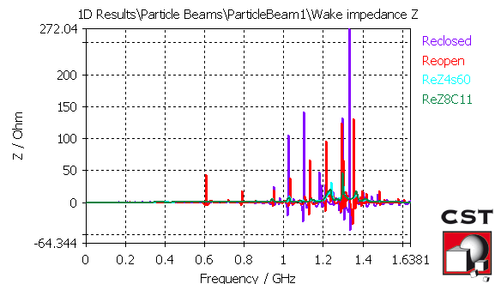
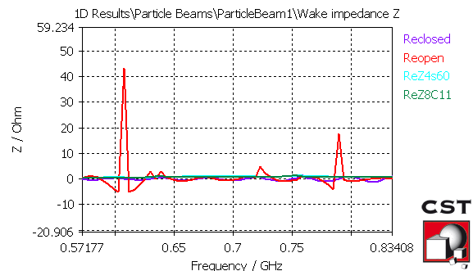
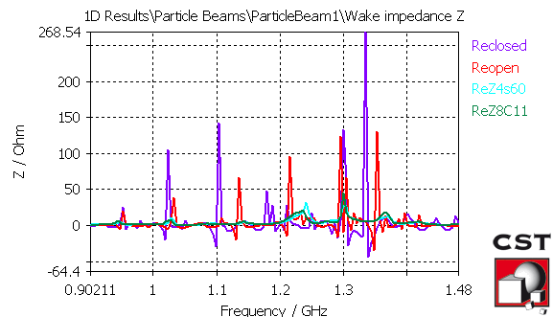
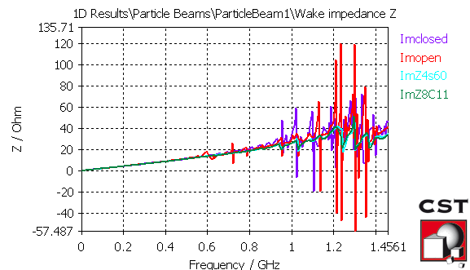
Effect of ferrite on longitudinal modes
Ferrites seem to help significantly in the longitudinal plane too.

Slide 9
Eigenmode simulations (without lossy material, all copper)

Slide 10
Small plate gap 1.5mm (jaw half gap 5 mm)
frequency | Rs (dy=1mm) | Rs (dy=0mm) | Q (copper) | Power loss
95 | 30 | 1 | 752
196 | 18 | 1 | 868
301 | 0 | 3 | 1116
317 | 5 | 0 | 2821
382 | 34 | 7 | 3403
390 | 6 | 3 | 3383
411 | 96 | 96 | 2769 | 34 W
416 | 8 | 6 | 1095
440 | 211 | 189 | 2201 | 70 W
473 | 2 | 0 | 2145
505 | 10 | 29 | 2878
518 | 17 | 20 | 3931
529 | 1 | 1 | 1059
554 | 56 | 55 | 1541
613 | 1 | 4 | 2963
637 | 166 | 165 | 2076 | 32 W
643 | 1 | 0 | 1227
Transverse modes but also large longitudinal modes

Slide 11
With cone
frequency | Rs (dy=1mm) | Rs (dy=0mm) | Q (copper)
117 | 41 | 0 | 1833
132 | 1 | 0 | 2072
236 | 76 | 0 | 2578
261 | 3 | 0 | 2922
334 | 2 | 0 | 6602
359 | 81 | 0 | 3135
391 | 4 | 0 | 3581
405 | 3 | 0 | 5230
482 | 58 | 0 | 3627
504 | 22 | 0 | 4744
Low frequency longitudinal modes are suppressed if the transition RF fingers are replaced by a taper

Slide 12
Closed (half gap 5 mm)
frequency | Rs (dy=1mm) | Rs (dy=0mm) | Q (copper) | Power loss
263 | 1 | 1 | 2941
392 | 2 | 2 | 3564
518 | 5 | 5 | 4036 | 1 W
641 | 11 | 11 | 4405 | 2 W
760 | 31 | 31 | 4684 | 4 W
869 | 10 | 10 | 5060
869 | 144 | 144 | 4903 | 12 W
953 | 410 | 355 | 5450 | 23 W
959 | 754 | 813 | 5063 | 42 W
980 | 274 | 263 | 4985 | 13 W
994 | 81 | 104 | 5246
1020 | 130 | 112 | 5273
1023 | 2267 | 2275 | 5101 | 92 W
1047 | 92 | 82 | 5914
1048 | 38 | 33 | 5164
1074 | 36 | 9 | 6364
1110 | 1711 | 1695 | 5360 | 46 W
Closed structure kills all transverse modes, but large longitudinal modes remain

Slide 13
Small plate gap 1.5mm (half gap 3.6 mm)
frequency | Rs (dy=1mm) | Rs (dy=0mm) | Q (copper) | Power loss
94 | 54 | 0 | 801
194 | 30 | 1 | 904
382 | 32 | 4 | 3813
481 | 383 | 341 | 2243 | 117 W
518 | 24 | 27 | 3942
527 | 36 | 21 | 1319 | 9 W
533 | 65 | 89 | 1563
640 | 33 | 36 | 4210
677 | 28 | 26 | 1483
757 | 128 | 130 | 3242 | 16 W
772 | 58 | 56 | 1677
847 | 20 | 4 | 2299
860 | 307 | 311 | 2226 | 26 W
877 | 28 | 27 | 2349
948 | 921 | 918 | 2997 | 54 W
957 | 51 | 17 | 2577
970 | 17 | 47 | 4974
983 | 63 | 55 | 2117
992 | 68 | 209 | 2321
1023 | 6 | 1 | 3502
Modes shunt impedance is multiplied by a factor ~2 if half gap goes from 5 mm (TCTP) to 3.6 mm (TCSG6)

Slide 14
Stability diagram (7 TeV)
4 TCTP at 5 mm at 635m (larger plate gap, without ferrite)
Rs=45e3*4*635/avbeta; %in Ohm/m
Q=1790;
fres=112e6; % in Hz
clight=299792458;
gamma=7460.52;
betab=sqrt(1-1/gamma^2);
circum=26658.883;
taub=1e-9; %in s
fs=23; % Hz
f0=betab*clight/circum;
tunes=fs/f0;
Nb=1.15e11;
tune=64.31; %in H
%tunes=0.002;
%tunes=0.00374652;
particle='proton';
chroma=0;
alphap=3.225e-4;
M=3564;
mmax=0;
First transverse mode damped by 3 A in octupoles

Slide 15
Conclusions
New design already generates very large intensity effects below 3 mm half gap (due to new taper).
Open plate gap without ferrite seems unacceptable from power loss point of view.
Both other choices present risks from impedance point of view:
RF fingers:
Impedance of fingers seen by the beam?
no damping of longitudinal modes
Contact resistance not known
ferrite:
Decreasing the gap is not an option
Increase of low frequency transverse impedance (before 100 MHz)
Low frequency transverse modes are damped but present
Problem of knowing exactly the ferrite material and its specs
It will be difficult to guarantee that the new design is at least as good as the old one…

Slide 16
What would be left to do?
See Hugo’s talk for eigenmode simulations of ferrite damping
Go higher than 1.1 GHz to check all the other modes
Use real bunch spectrum

Slide 17
Power losses calculations
If we assume the mode frequency overlaps with one of the beam harmonics (conservative approach)
With the parameters of the LHC nominal beam
nominal bunch charge after splitting q = 18.4 nC (1.15 e11 p/b)
bunch spacing = 25 ns (worst case scenario)
smallest nominal RMS bunch length = 7.5 cm
R_{s} is the shunt impedance (linac convention)
σ_{z} is the rms bunch length in m
Remarks: Q is obtained with the formula
with W= total stored energy
(W=1J in eigenmode)
Perturbation method id used to obtain the Q and R for stainless steel.

