Slide 1
Electron cloud related topics in IPAC’11
Electron cloud observation in several machines:
  Cesr-TA
    Studies of mitigation techniques → different coatings tested and effect of conditioning (lepton machine), in-situ SEY measurements, diagnostics and instrumentation
    Studies of instabilities, possibly ascribed to electron cloud
  Petra III (vertical emittance blow-up, in-situ SEY measurements for Al chambers)
  APS (electron machine) → observation of heat load inside a superconducting wiggler, similar to ANKA
  CERN (mitigation in the SPS, observation & scrubbing in the LHC)
Simulations (code development or applications of existing codes for the design of future machines)
  ILC damping rings, SUPER-B Factory, MEIC
  GSI studies for SIS100 (F. Petrov’s new build-up code for ion coasting beams, 3D simulations of bunch passage through a pre-existing cloud)
  Feedback system (SLAC, LBNL in the framework of LARP)

Slide 2
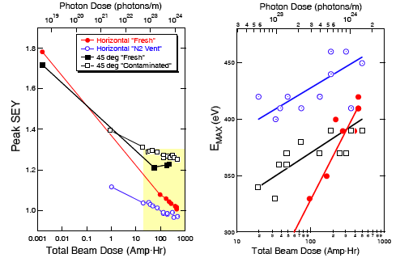
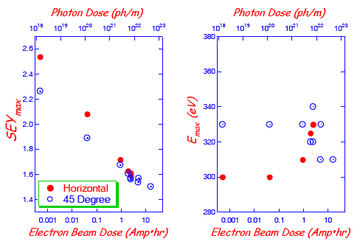
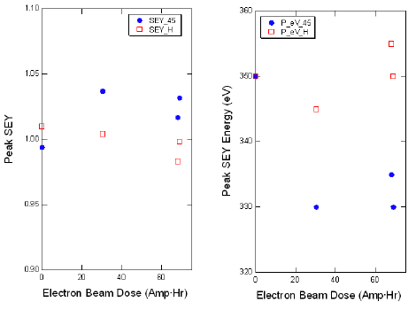
Electron cloud related topics in IPAC’11
(SEY measurements, conditioning)
In Cesr-TA, the SEY has been measured in-situ for different samples
Two samples for SEY measurements installed in the machine, one under direct SR, another one under reflected SR (angle 45º)
TiN
Al sample
a-C

Slide 3
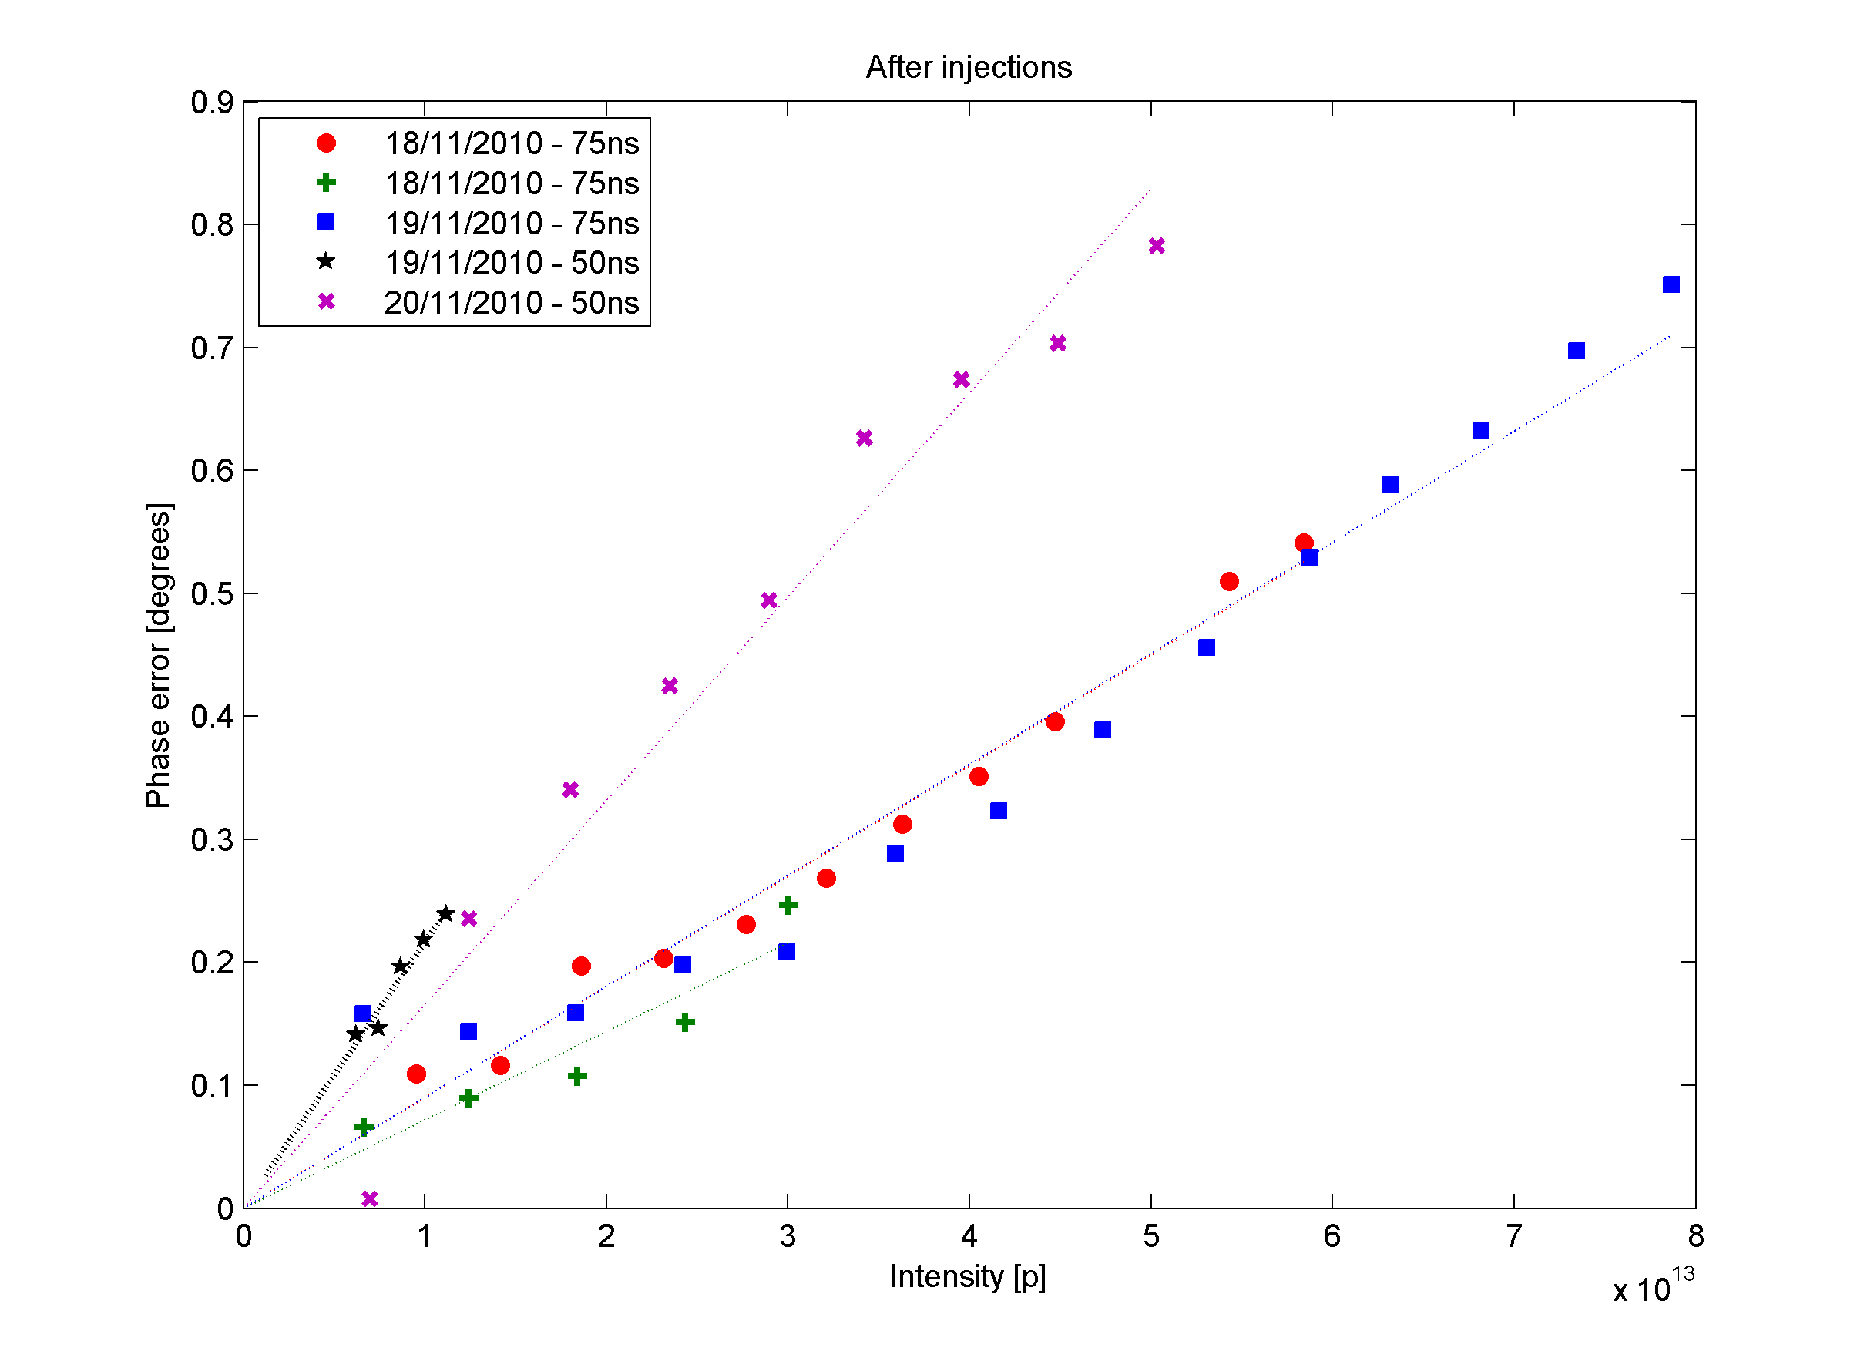
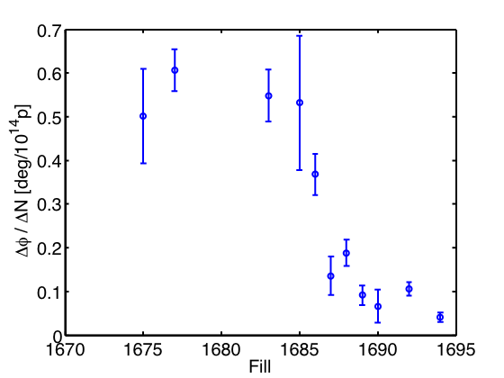
Electron cloud related topics in IPAC’11
(stable phase measurements in the LHC)
In the LHC we measure beam energy loss through the shift of the stable RF phase
Its dependence on the bunch spacing and observed improvement during scrubbing, suggests that it is caused by electron cloud
50 ns
50 ns
75 ns
Machine scrubbing

Slide 4



Electron cloud related topics in IPAC’11
(stable phase theoretical calculation)
The shift of the stable RF phase can be
  Calculated from the total energy gain of the electron cloud after the bunch passage
  Calculated from the total beam energy loss due to the electron cloud wake function (longitudinal electric field)
Electron cloud energy gain
Beam energy loss

Slide 5
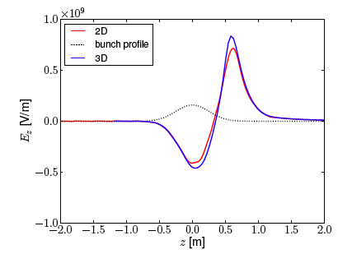
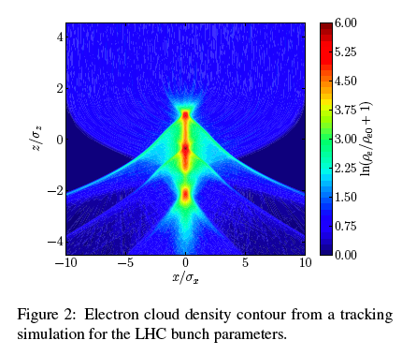
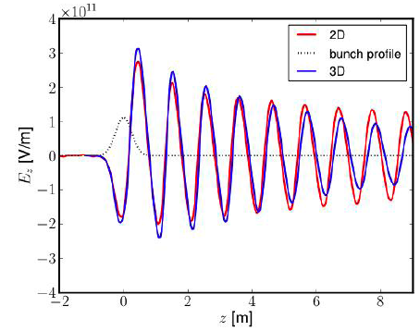
Electron cloud related topics in IPAC’11
(stable phase theoretical calculation)
The electron cloud longitudinal wake function can be calculated via 2D or 3D simulations of the passage of a bunch inside an electron cloud (F. Yaman, TU-Darmstadt)

Slide 6
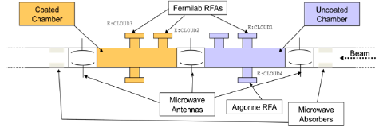
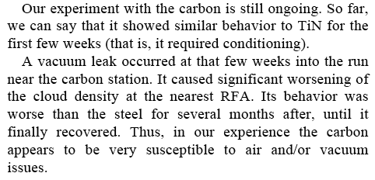
Electron cloud at LFNL (from PAC’11)
From V. Shiltsev’s talk → electron cloud studies at the LNFL Main Injector
Studies have been done with different coatings (R. Zwaska, PAC’11)
In particular, TiN and a-C coated pipes have been installed and the electron cloud has been measured and compared to that in an uncoated chamber
TiN seems fantastic, puzzling results on a-C …
How can you condition a-C if δ_{max} is about 1??
Opposite to CERN observations …

Slide 7
Satellite meeting with German partners for project financing
CERN representatives → G. Arduini, S. Gilardoni, G. Rumolo, F. Zimmermann
German institutes and universities:
  GSI (O. Boine-Frankenheim, G. Franchetti)
  TU-Darmstadt (T. Weiland)
  Rostock University (U. van Rienen, G. Poplau)
Possible subjects on which we can write a common project
  3D electron cloud simulations for longitudinal/transverse wake functions
  Long-term simulations of beam interacting with electron cloud to quantify incoherent effects and study countermeasures
  Materials & impedances
    Kicker impedances
    Measurements of electromagnetic properties of materials
  Space charge and more general low energy studies → further development of the tools from GSI and from the University of Rostock

