Slide 1


Pressure observations
at TDI
till fill 2158
V. Baglin (27/08/11)
CERN TE-VSC, Geneva
1.
2.

Slide 2
Effect of particle loss

Slide 3
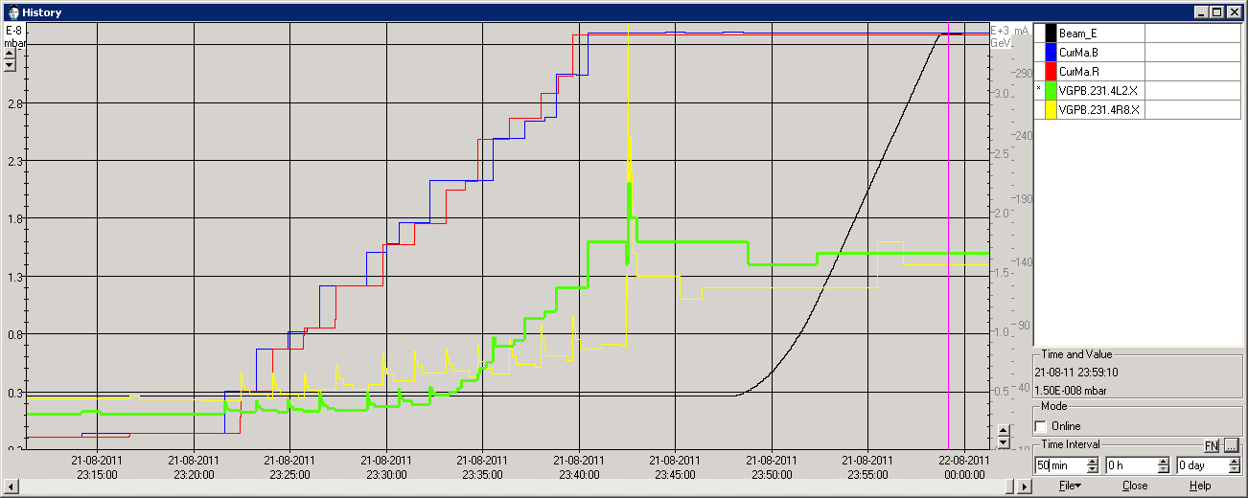
Fill 2040 : Injection
A pressure increase is observed at each injection shot
  DeltaP @ TDI8R = 2 to 2.5 10⁻⁹ mbar
  DeltaP @ TDI2L = 1 to 1.5 10⁻⁹ mbar
Pressure increase slopes are different between TDI2L and TDI8R
At 23h42 pressure increased in both TDI : moving injection collimators out
Final values at 3.5 TeV are the same.

Slide 4
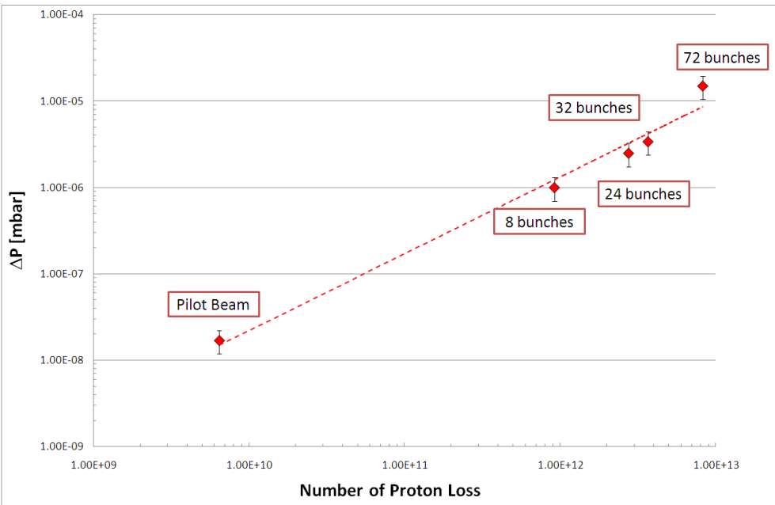
Direct proton losses on TDI
A pressure in the range of a few 10⁻⁸ mbar correspond to a proton loss of some 10¹⁰
Today we have 1.8 10¹⁴ p/beam and a proton burn rate of 6 10⁸ p/s

Slide 5
Effect of heating

Slide 6
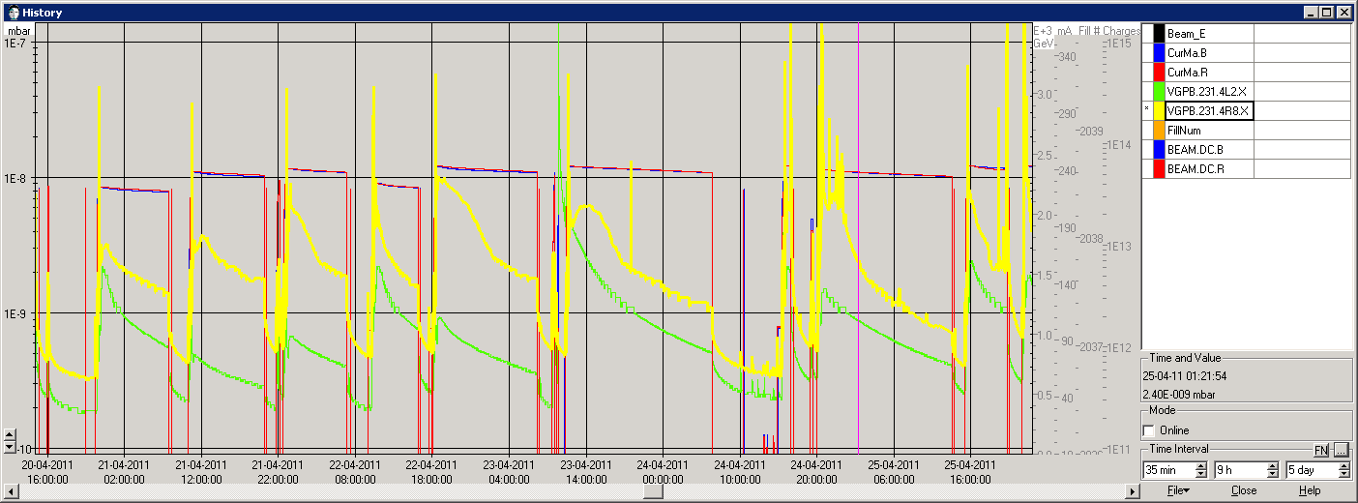
History at TDI
 | mA | TDI2L | TD8R | kb | ppb (x10¹⁰)
1727 |  | ↘ | ↘ | 336 b | 10.8
1728 |  | ↘ | ↘ | 480 b | 10.8
1731 |  | ↘ | ↘ | 480 b | 12.2
1732 |  | ↘ | ↘ | 480 b | 12.1
1735 |  | ↘ | ↘ | 480 b | 11.3
1727
1728
1731
1732
1735

Slide 7
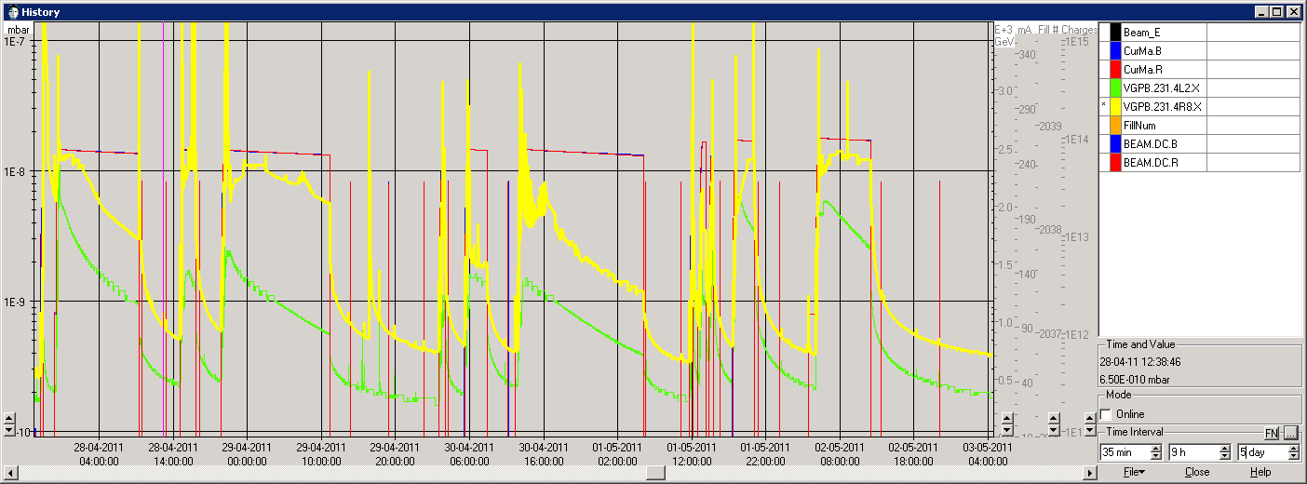
History at TDI
 | mA | TDI2L | TD8R | kb | ppb (x10¹⁰)
1743 |  | ↘ | ↘ | 624 b | 12.0
1744 |  | ↘ | ↘ | 624 b | 11.9
1749 |  | ↘ | ↘ | 624 b | 12.1
1753 |  | ↘ | ↗ | 768 b | 12.1
1755 |  | ↘ | ↗ ? | 768 b | 12.6
1743
1744
1749
1753
1755

Slide 8
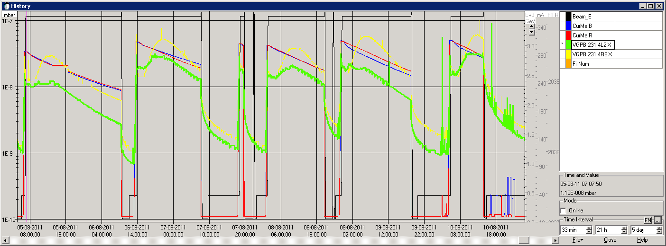
History at TDI
 | mA | TDI2L | TD8R | ppb (x10¹⁰)
2006 | 296 | ↘ | ↗ | 11.9
2007 | 313 | ↗ | ↗ | 12.5
2009 | 306 | ↗ | ↗ | 12.3
2010 | 316 | ↗ ? | ↗ | 12.7
2011 | 316 | ↗ | ↗ | 12.7
2006
2007
2009
2010
2011

Slide 9
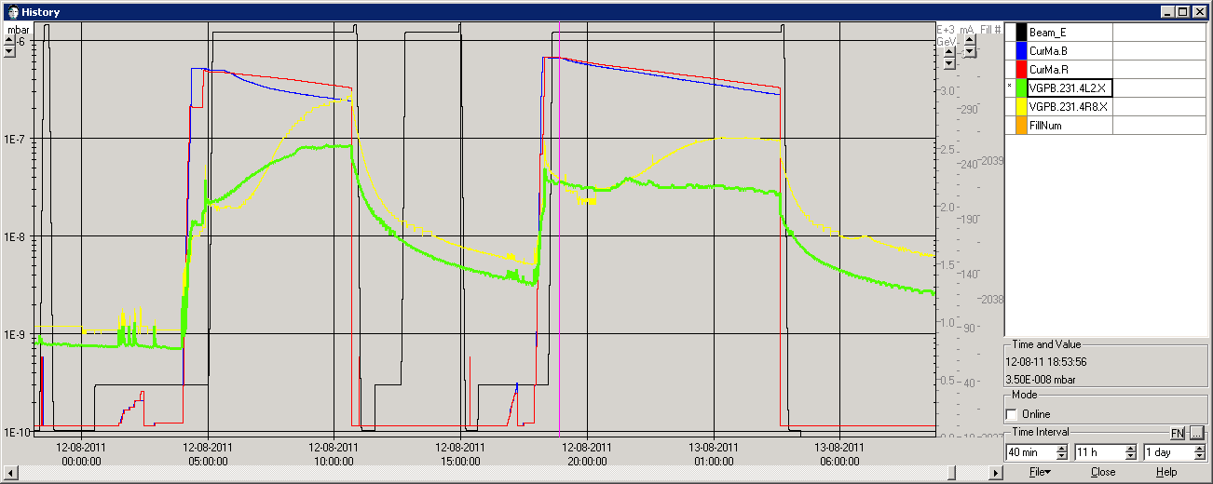
History at TDI
 | mA | TDI2L | TD8R | ppb (x10¹⁰)
2022 | 325 | ↗ | ↗ | 13.0
2025 | 336 | 3 10⁻⁸ | ↗ | 13.5
Long stop | 4 days
2022
2025

Slide 10
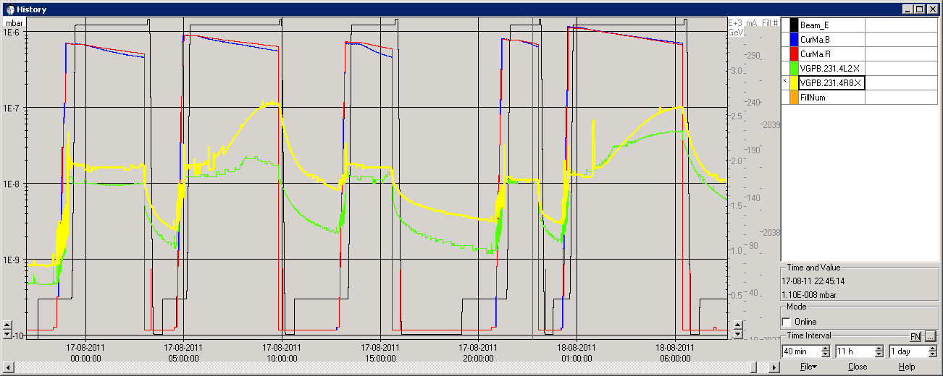
History at TDI
 | mA | TDI2L | TD8R | ppb (x10¹⁰)
2028 | 301 | 1 10⁻⁸ | 1.5 10⁻⁸ | 12.1
2029 | 310 | ↗ ? | ↗ | 12.4
2030 | 303 | 1 10⁻⁸ | 1.5 10⁻⁸ | 12.1
2031 | 305 | 1 10⁻⁸ | 1.0 10⁻⁸ | 12.2
2032 | 318 | ↗ | ↗ | 12.7
2028
2029
2030
2031
2032

Slide 11
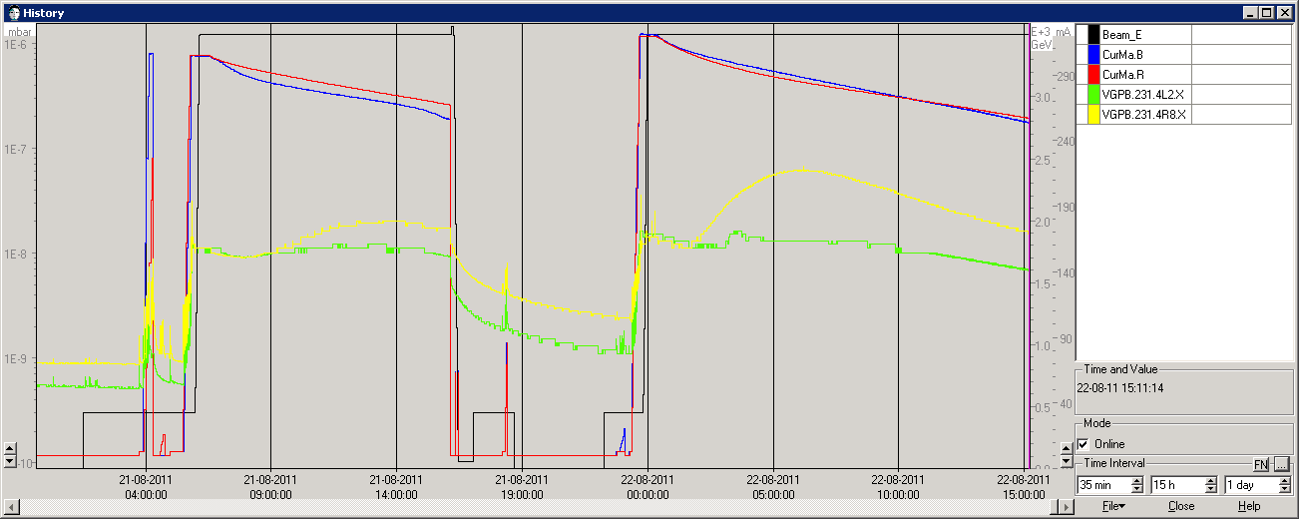
Pressures at TDI - fills 2037-2040
Fill 2039 - 2040: 50ns_13080b+1small_1318_39_1296_144bpi
304-321 mA/beam - 12.2 to 12.8 10¹⁰ pbb
At 3.5 TeV, pressures at both TDI are 1 10⁻⁸ mbar.
Pressure at TDI8R has a slow increase with time. However, there is a delay of a few hours after stable beams
P_{max}@TDI8R = 6 10⁻⁸ mbar at ~ 286 mA/beam
P_{max}@TDI2L = 1 10⁻⁸ mbar
2037
2040

Slide 12
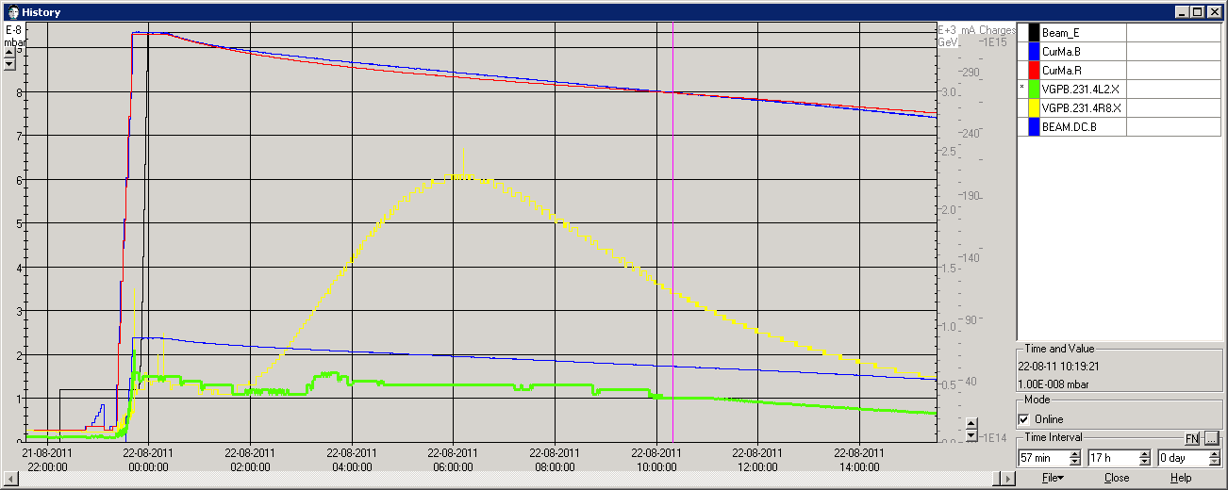
Fill 2040 : TDI8R
There are no linear relation between total beam current and total pressure
The pressure decreases faster than the beam current
proton burn rate ~ 6 10⁸ p/s

Slide 13
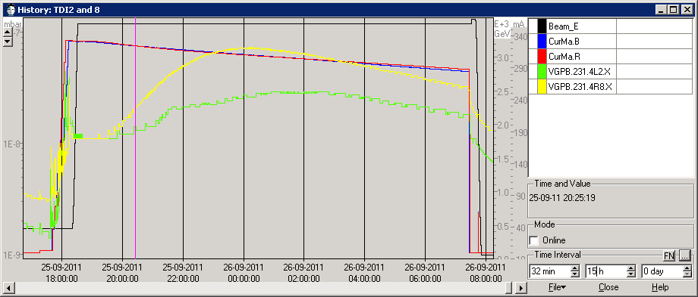
Fill 2156 : Equilibrium Pressure
Fill 2156 - 2040: 50ns_13080b+1small_1318_39_1296_144bpi
332-285 mA/beam - 13.3 down to 11.4 10¹⁰ pbb
At 3.5 TeV, pressures at both TDI are 1 10⁻⁸ mbar.
Pressure at TDI2L has a also slow increase with time. However, there is a delay wrt to TDI8R
Both TDI reached a maximum pressure
P_{max}@TDI8R = 7 10⁻⁸ mbar at ~ 311 mA/beam
P_{max}@TDI2L = 3 10⁻⁸ mbar at ~ 307 mA/beam

Slide 14
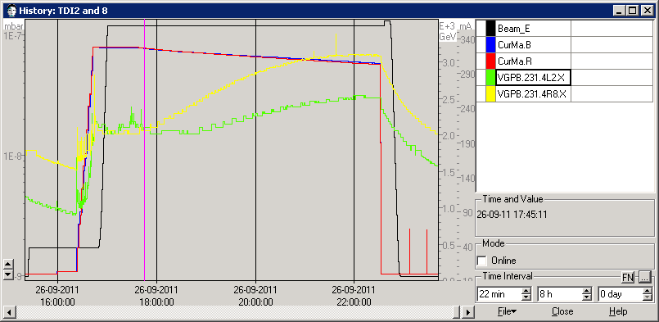
Fill 2158 : confirm previous observation
Fill 2158 - 2040: 50ns_13080b+1small_1318_39_1296_144bpi
328-304 mA/beam - 13.1 down to 12.2 10¹⁰ pbb
At 3.5 TeV, pressures at both TDI are 1.5 10⁻⁸ mbar.
Pressure at TDI2L has a also slow increase with time. However, there is a delay wrt to TDI8R
P_{max}@TDI8R = 6 10⁻⁸ mbar at ~ 312 mA/beam
P_{max}@TDI2L = 3 10⁻⁸ mbar at ~ 303 mA/beam
Beam was dumped to early …

Slide 15
TS4-2011
During the TS 4, wk 35, the TDI.8R and TCTVB.8R were equipped with thermocouples
TC1 and TC2 are located on TCTVB.8R
TC 4 and TC11 are located are located on TDI.8R transitions
TC5,6,9 and 10 are located on TDI.8R extremity
TC 7,8 are located at the centre of TDI.8R
TC3 and TC12 are located at reference vacuum chambers NEG coated.
Pressure is measured at TDI by VGPB.231.4R8.X

Slide 16
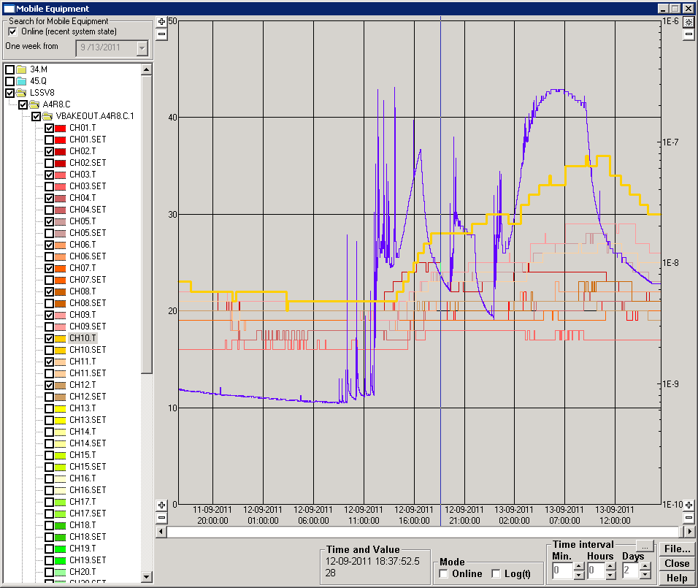
“Nominal” fills
Fill | 2101 | 2102 | 2103
Nb | 1380 | 1380 | 1380
I (mA) | 330 | 334 | 332
Ppb (x1E11) | 1.33 | 1.34 | 1.33
Temperature increased 1h30 and 45 min after machine full for fills 2101 and 2103 respectively.
For fill 2103, pressure started to decrease again after having increased.
TC10 reached 36 deg
TC9 reached 29 deg
TC5 reached 27 deg
2103
TC | deg | Delta | What ?
1 | 21 | 3 | TCTVB
2 | 24 | 4 | TCTVB
4 | 21 | 3 | VCT @TDI
11 | 26 | 8 | VCT@ TDI
5 | 28 | 10 | TDI extremity
10 | 36 | 17 | TDI extremity
6 | 22 | 3 | TDI extremity
9 | 29 | 10 | TDI extremity
7 | 19 | 0 | TDI centre
8 | 22 | 3 | TDI centre
3 | 17 | 1 | Reference
12 | 21 | 2 | Reference
2101
2102
450 GeV

Slide 17
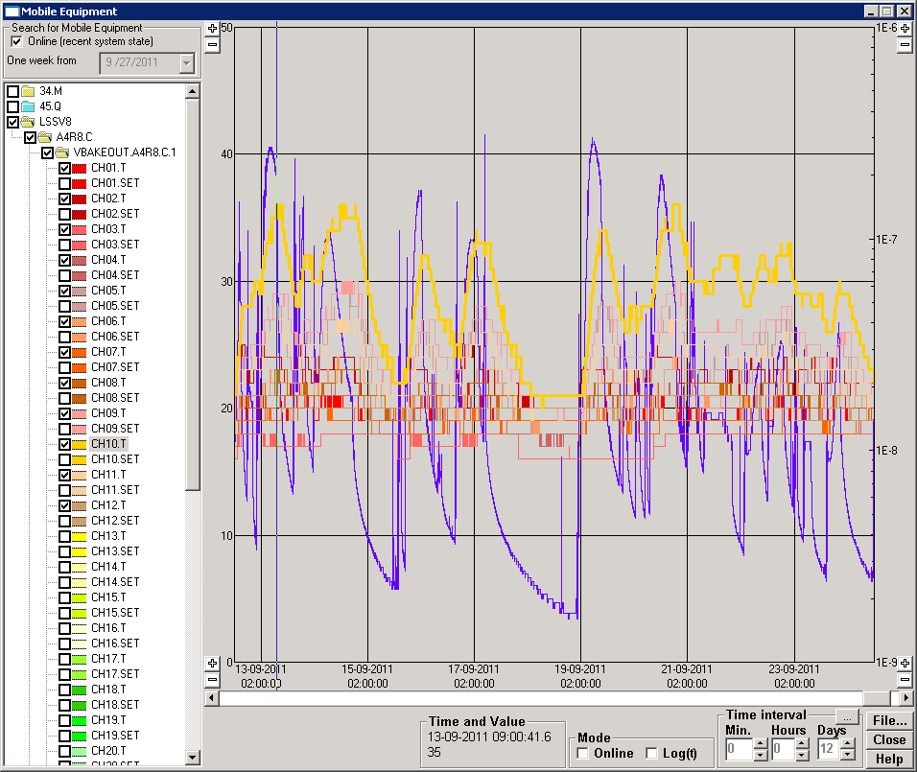
“Nominal” fills : history
2103
2124
2129
2105
2117

Slide 18
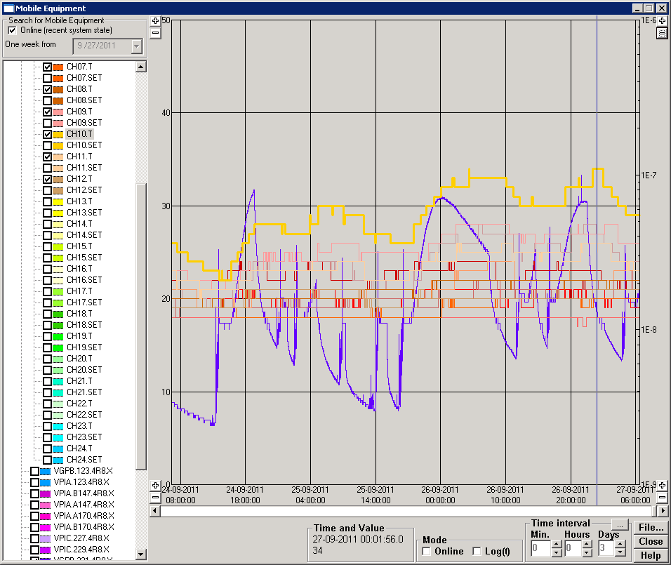
“Nominal” fills
Fill | 2156 | 2158
Nb | 1380 | 1380
I (mA) | 332 | 328
Ppb (x1E11) | 1.33 | 1.31
For fill 2156, pressure started to decrease again after having increased.
TC10 reached 34 deg
TC9 reached 28 deg
TC5 reached 28 deg
TC | deg | Delta | What ?
1 | 21 | 3 | TCTVB
2 | 23 | 3 | TCTVB
4 | 22 | 4 | VCT @TDI
11 | 26 | 8 | VCT@ TDI
5 | 28 | 10 | TDI extremity
10 | 34 | 15 | TDI extremity
6 | 24 | 5 | TDI extremity
9 | 28 | 8 | TDI extremity
7 | 20 | 1 | TDI centre
8 | 22 | 3 | TDI centre
3 | 18 | 2 | Reference
12 | 21 | 2 | Reference
2156
2158

Slide 19
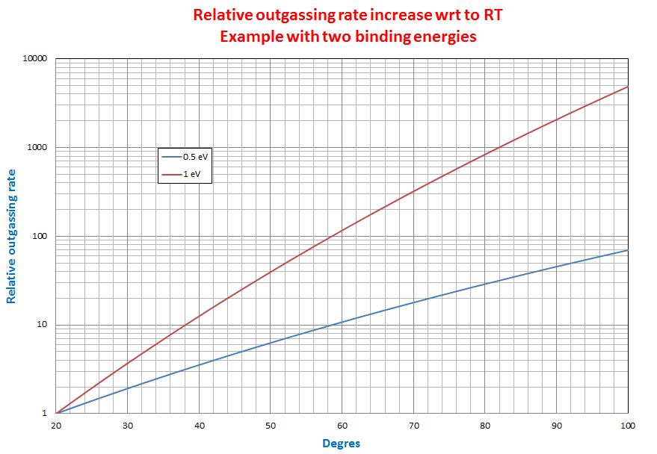
Effect on outgassing rate
A temperature increase of ~ 50 degrees increase the outgassing rate by one order of magnitude

Slide 20
Summary
Both TDIs behave similarly during injection, they are sensitive to particle loss
TDI8R has a systematic slow transient since beginning of May
Most of the time, TDI2L pressure decrease or is constant. However, some transient are occasionally observed since beginning of August and confirmed since then
Following transient, equilibrium pressure are observed at both TDIs for long fills
Transient pressure is correlated with temperature increase of at least 15 deg as measured at TDI8R extremity

