Slide 1
Transverse instability in the AD?
Lajos Bojtar AD-OP

Slide 2
The AD cycle
The coherent oscillations
were observed here at
100 MeV/c

Slide 3
The observations
Signs of horizontal transverse coherent oscillations was observed at the 100 MeV/c flat top.
In vertical plane there is no sign of it.
The oscillations comes and goes several times during the 16 sec. long flat-top.
There is electron cooling at this flat-top while the coherent oscillations happens. If the cooling is disabled, no coherent oscillations were observed.
It was observed at several harmonics of the betatron sidebands, both upper and lower.
The beam is coasting when it happens.

Slide 4
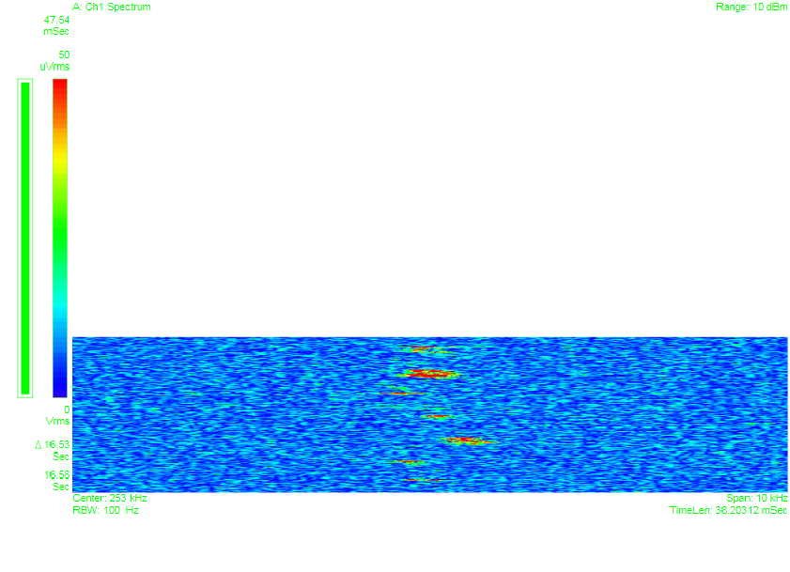
Measured spectra at frev+q
Tgff
time ~ 16 sec
frequency

Slide 5
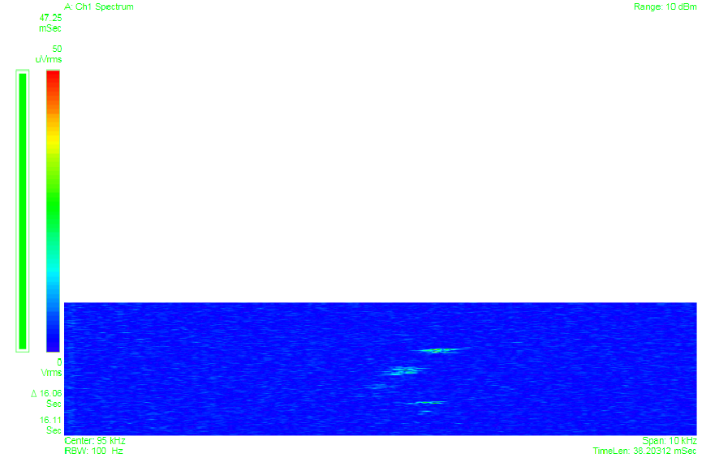
Measured spectra at frev-q

Slide 6
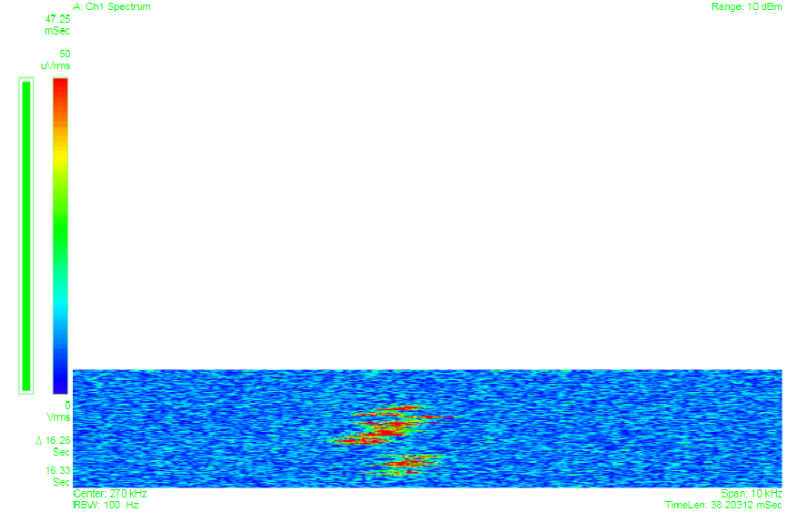
Measured spectra at 2 frev-q

Slide 7
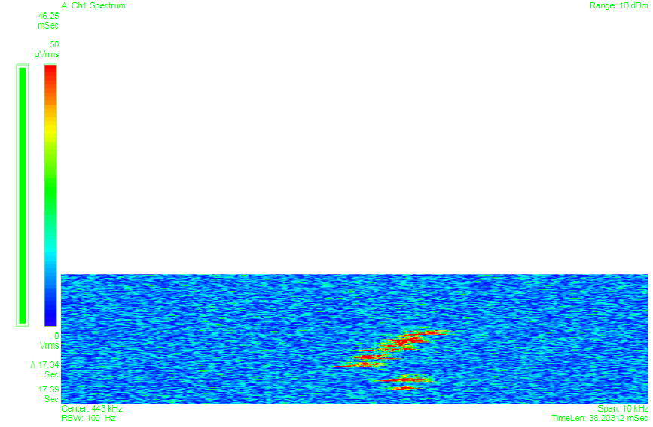
Measured spectra at 3 frev-q

Slide 8
Amplitudes of coherent oscillations at different harmonics
Harmonic | Amplitudes at lower sideband [mm] | Amplitudes at upper sideband [mm]
1 | 0.15 | 0.3
2 | 0.5 | 0.2
3 | 0.6 | 0.15
4 | 0.5 | 0.07
5 | 0.2 | 0
6 | 0 | 0

Slide 9
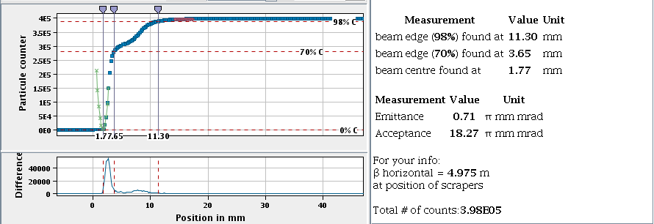
Possible consequence of the coherent oscillations
Transverse profiles has tails, about 30-40 % of the beam is in the tail. Some part of it doesn’t go through the RFQD.

Slide 10
Some relevant parameters
Parameter | value
Intensity | 3.5 E7 pbars.
Momentum (when instability occurs) | 100 MeV/c
AD circumference | 182 m
Revolution frequency | 174155 Hz
dp/p | ~ 3E-4 now, but should be below 1E-4
Initial emittance (H & V) | ~ 15 pi mm mrad
Final emittance (H &V) | ~ 0.7 pi mm mrad
Horizontal tune | 5.45
Vertical tune | 5.42
Horizontal chromaticity | -0.5
Vertical chromaticity | 0

